Slide 1
Honing
Analytic Writing Skills
Fulton T. Armstrong
Course # SIS-730-002
January 27 & 28, 2024
SIS-113
Saturday | Sunday
9:00am-5:00pm | 9:00am-5:00pm

Slide 2
What is ANALYTIC WRITING?
Formats can vary, but …
purpose and tone do not.
causes
context
importance
Informs
Is objective
(or at least transparent)
Explains
“Shows,” doesn’t just “tell”
Almost always institutional
Empowers decisionmaker
IS “ACTIONABLE”
What other kinds of writing are common, and how are they different from analytic writing?

Slide 3
What is ANALYTIC WRITING?
What’s the difference in your response to …
“What’s your analysis of the upcoming election?”
“What’s your opinion of the two candidates?”
“How, specifically, are the presidential campaigns shaping up?”
Analysis presents drivers, trends, outcomes, and implications – in an objective, non-prescriptive way.
(But it gives the recipient the info they need to make a decision.)

Slide 4
What is ANALYTIC WRITING?
The structure; style and tone; vocabulary are different as well.
Standard, few adjectives/adverbs
Neutral, transparent, non-editorializing
Starting with “Bottom line up front” BLUF, facts, etc.
And that is what we’re going to practice.

Slide 5
OBJECTIVES
To help you improve your analytic writing
    Make you more comfortable with the process of writing
    Review basics of all good writing
    Emphasize your value-added as a writer
Not to learn basic grammar, spelling, or other skills you already have, but …
    Emphasize the importance of being concise, clear, unambiguous … and making your reader’s job easy.

Slide 6
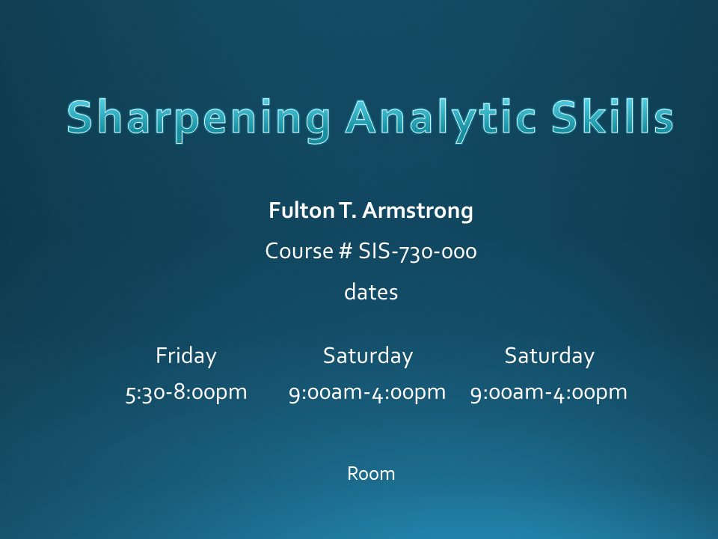
How we will separate the skills in class
WHAT TO SAY
AND HOW TO SAY IT

Slide 7
I …
Have seen hundreds of times the power of information … the power of good argumentation … and the power of good writing.
Have seen copious evidence that, while writing is a skill that we learn different ways and at different paces, it is a learnable skill.
Know that employers (in our areas of interest) judge us more by our writing than by any other skill.
Have seen the interrelation between our thinking and communications skills … that improving one, improves the others.
Know that if you can speak intelligently, you can write intelligently.

Slide 8
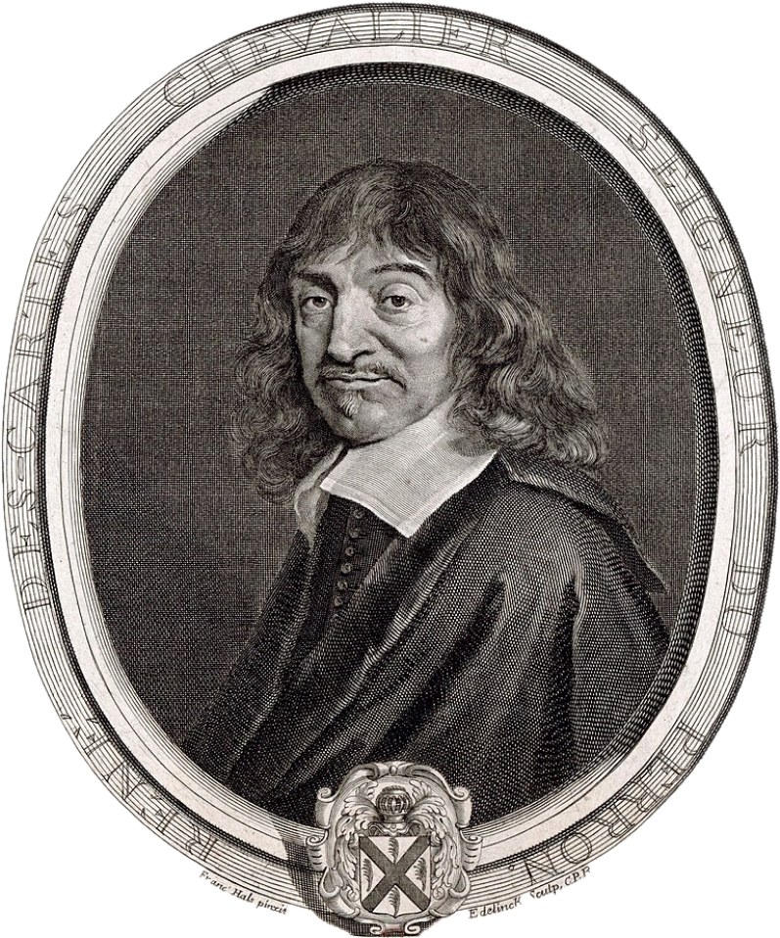
René Descartes
1596-1650
Cogito, ergo sum
I think, therefore I am.
Dubito, ergo cogito, ergo sum
I doubt, therefore I think, therefore I am.
Scribo, ergo cogito, ergo sum
I write, therefore I think, therefore I am.

Slide 9
OUR SCHEDULE
Today | Tomorrow
Introductions, Objectives
Words, phrases, sentences
Snowflakes
Structures
Exercises
Good writing
Editing and self-editing
Thesis sentences
Exercise and peer review
Voice
Big exercises
“FINAL paper”
due Sunday, 4 February

Slide 10
Simple Ground Rules
Respectful, non-judging, non-competing environment
Lean forward in your work
Keep distractions to minimum
Participation is important

Slide 11
Simple Ground Rules
Respectful, non-judging, non-competing environment
Lean forward in your work
Keep distractions to minimum
Participation is important
Particular to being on-line …
Use text (I’ll try to keep up)
Camera
Signal need for breaks, please.
If connections crash, be patient … try again … send an e-mail.

Slide 12
Fulton T. Armstrong
A spontaneous career in information, analysis, policy and politics
Forty years of analytical writing
Linguistics and study in Spain
journalism in Taiwan
U.S. House of Representatives
CIA
          State Department
          National Security Council
          National Intelligence Council
          U.S. Military – Intelligence Advisor
    U.S. Senate
Taught junior analysts
Led intelligence community
Wrote about tradecraft
Teach AU, SU, URJC and others
    American University/CLALS

Slide 13
QUESTION
What’s the hardest part about writing (in general) for you?
What do you find to be hardest about analytic writing?

Slide 14
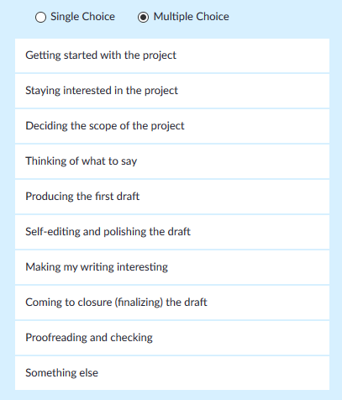
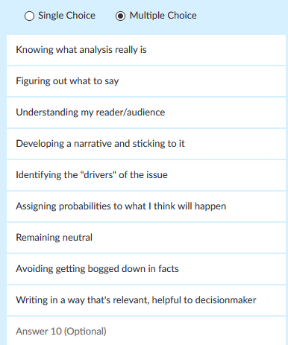
ZOOM POLL #1
Anonymous polls.
What’s the hardest part about writing (in general) for you?
What do you find to be hardest about analytic writing?

Slide 15
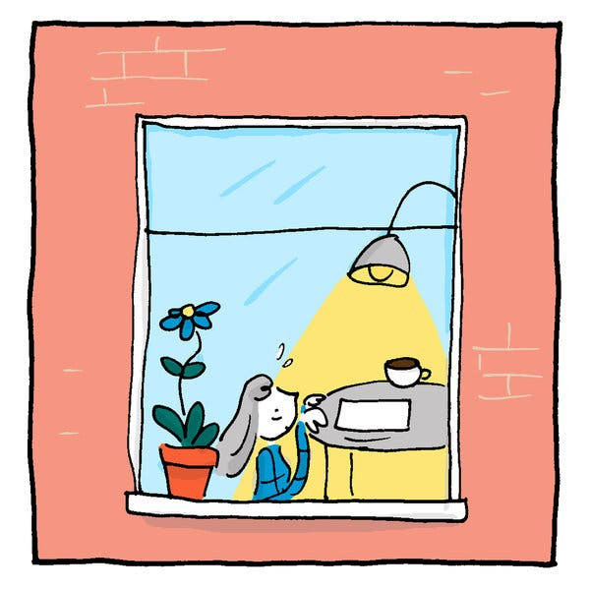
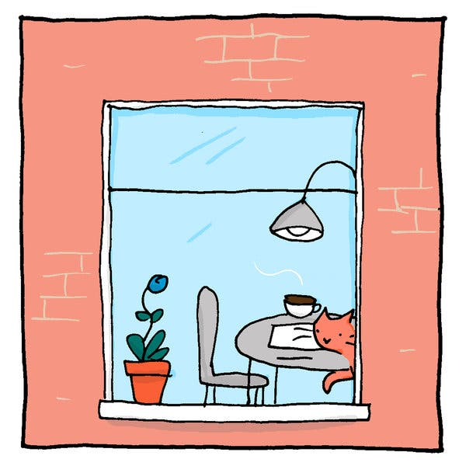
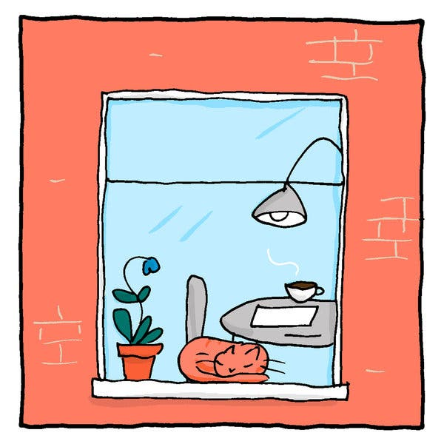
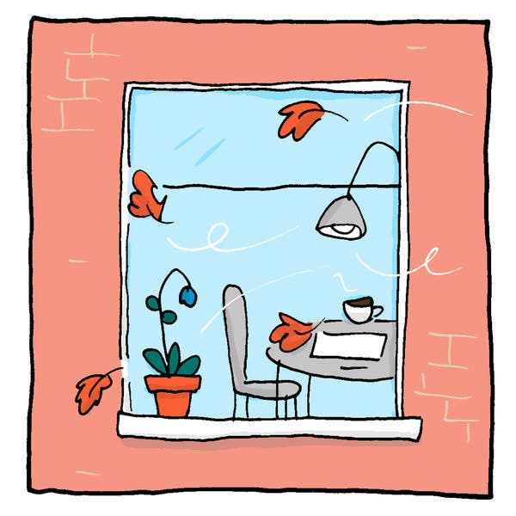
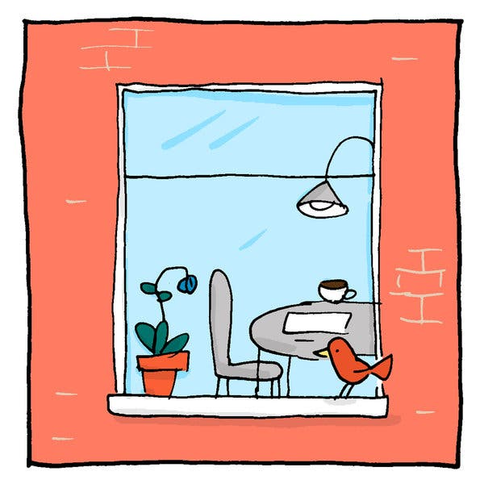
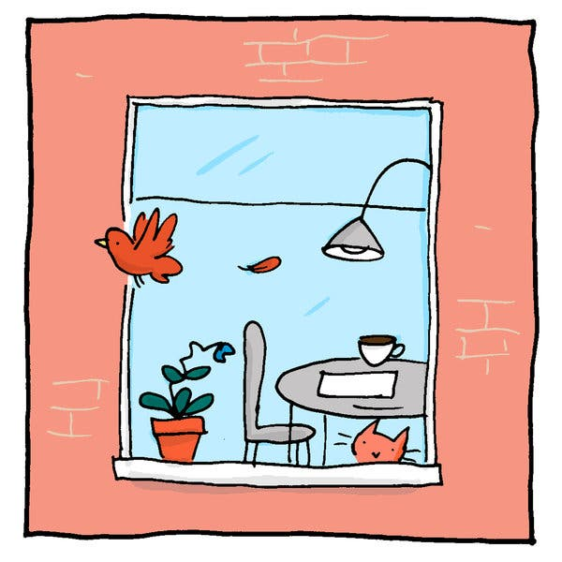
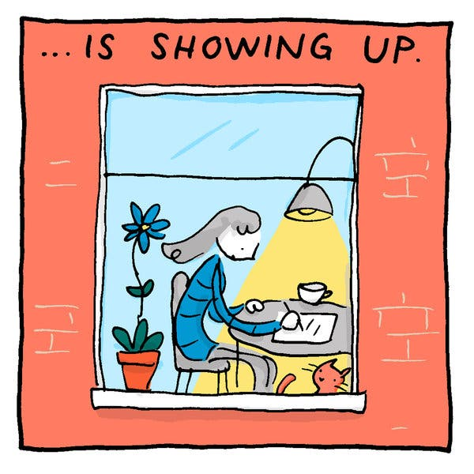
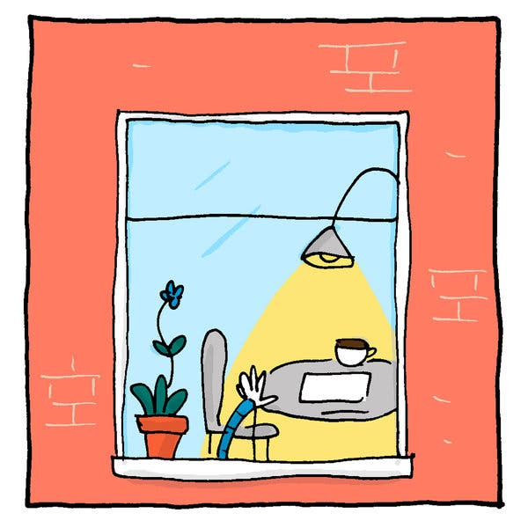
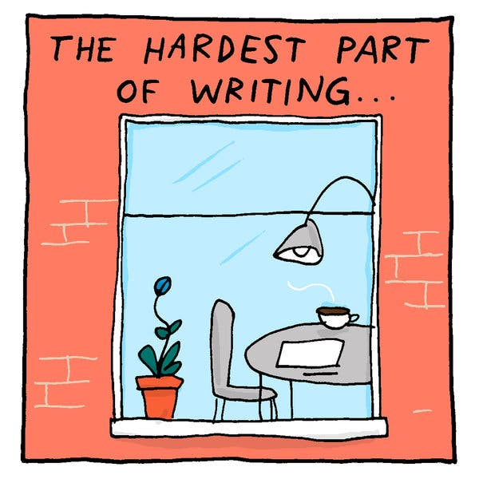
The hardest part of writing, according to cartoonist Grant Snider

Slide 16
  PLEASE INTRODUCE YOURSELF - 15 secs
  Name and program
  Hardest part of analytical writing for you
  Topic that you’d like to write about
Editing myself?
Figuring out what to say?
Figuring out how to say it?
Mechanics (grammar, spelling)?
Writing a particular style?
Getting my professors/boss to see my brilliance?
Separating my facts from my opinions?
Making my writing interesting?
Prioritizing my information?
Sitting down and just doing it?
Receiving feedback?

Slide 17
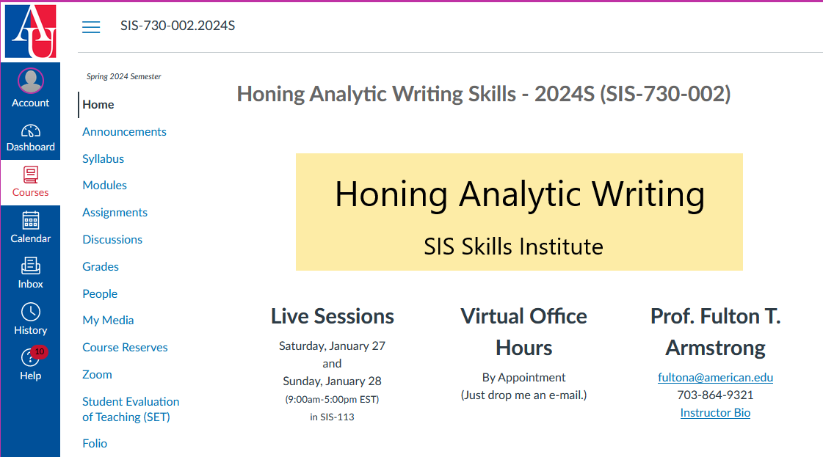
CANVAS

Slide 18



Slide 19

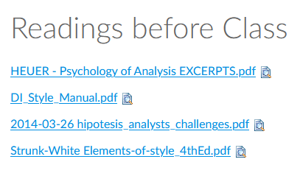
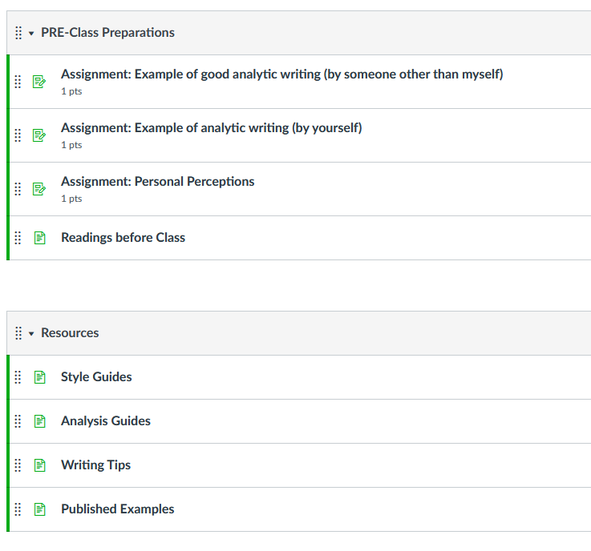
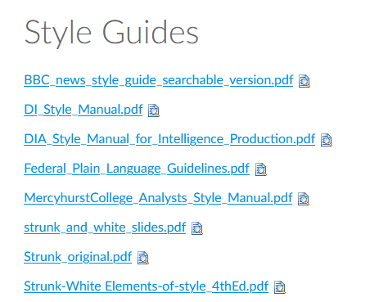
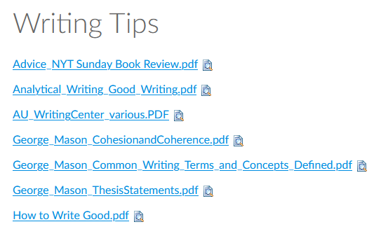
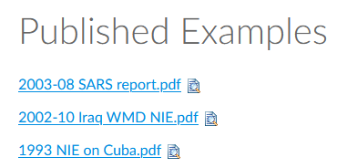
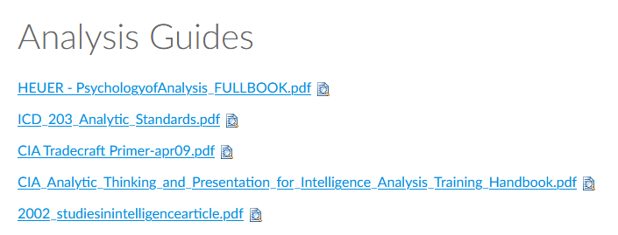

Slide 20
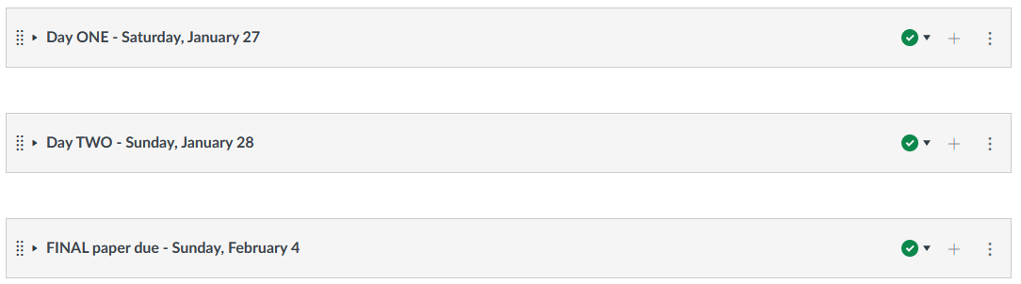

Slide 21

Questions?
Ready to dive in?

Slide 22
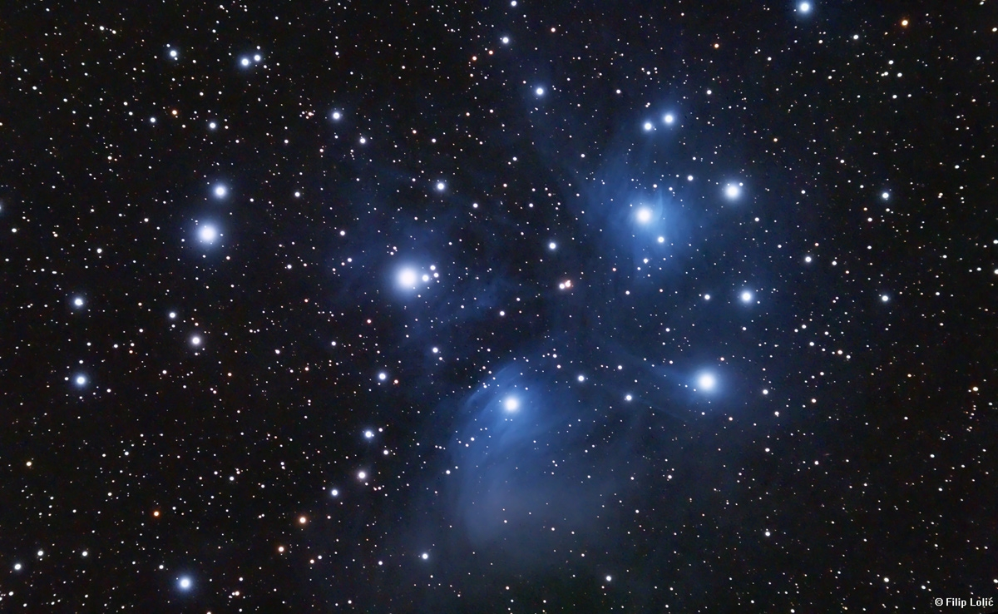
In the beginning was the Word

Slide 23
The power of words
What are we without words?
Have words woken up awareness or consciousness for you?
make us know, remember
make us think, build ideas
make us feel, laugh, cry

Slide 24

The DANGER of using the WRONG
combination of words
“Let’s eat, Grandma”
vs
“Let’s eat Grandma”
Notes:
Eats, shoots, and leaves -- PANDA

Slide 25
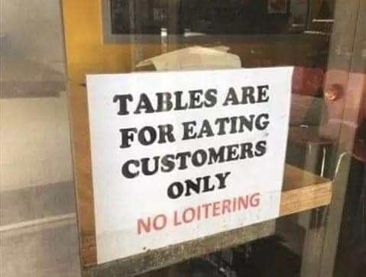

Slide 26
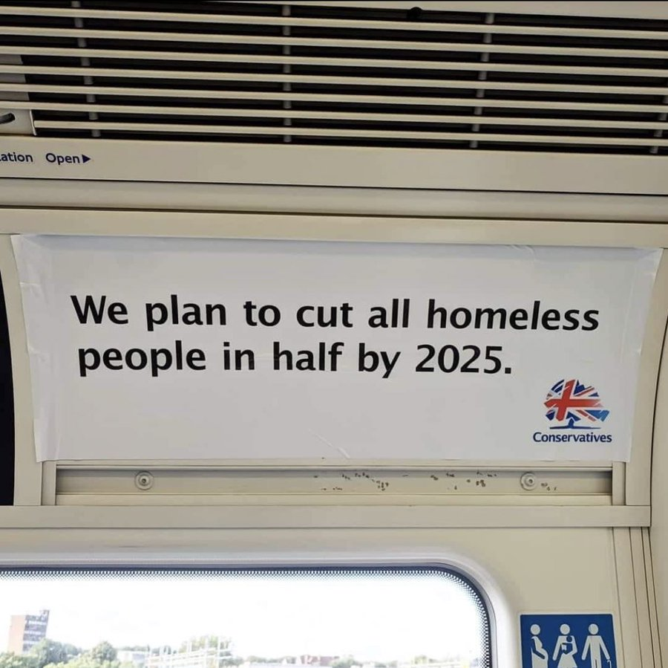
The DANGER of using the WRONG words

Slide 27
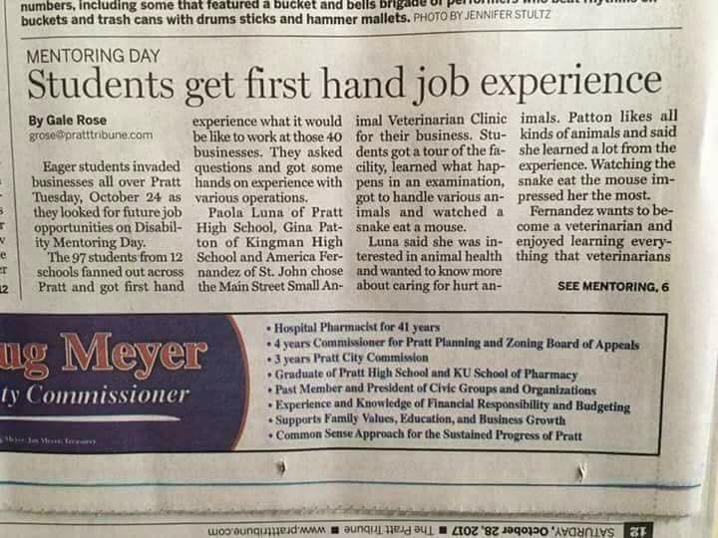
The DANGER of using the WRONG words
The Pratt Tribune 28 Oct 2017

Slide 28
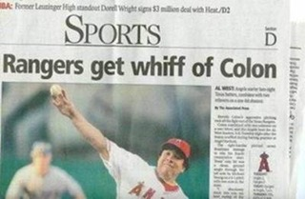
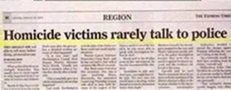
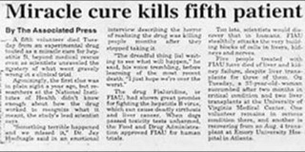


Slide 29
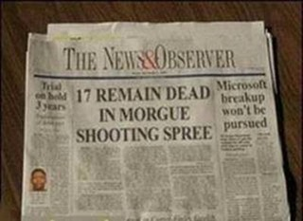
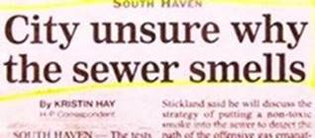
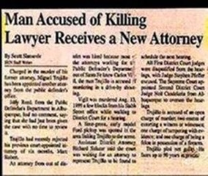
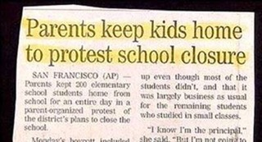
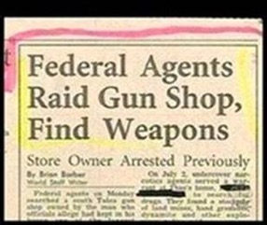

Slide 30
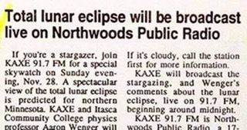
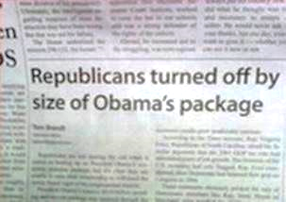
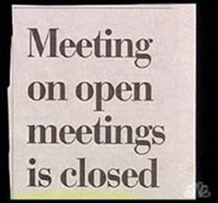
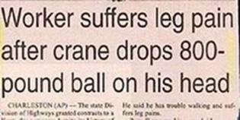

Slide 31

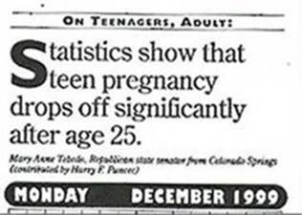
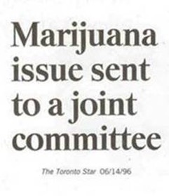
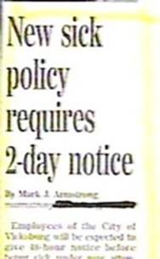
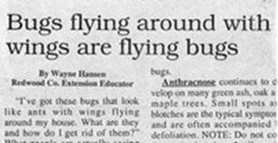

Slide 32
All words are arbitrary and conventional.
But not all words are created equal, of course.
Onomatopoeia
buzz, howl, etc. | squirt
boom | giggle
crash | whiff
splash | honk
She flew to the window.
He/she roared, “No!”
He/she’s a shining star.
She looked at him icily.
It broke his/her heart.
It’s raining cats and dogs.
I’m feeling blue.
Metaphors
Clear roots
etymology

Slide 33
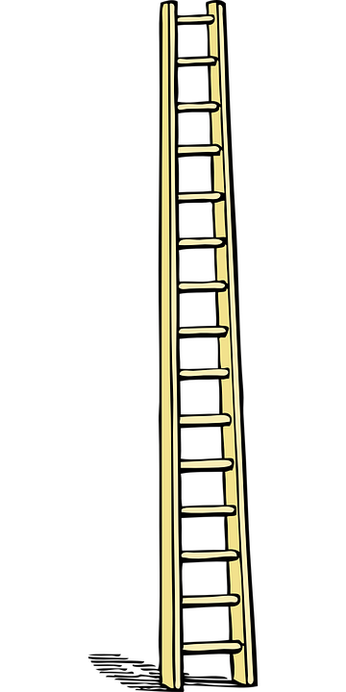
Abstractions
  office necessities
  sustenance
  protection from the elements
Abstract things
  stationery
  food
  wardrobe
On the opposite end:
“Ladder of Abstraction”
Specific-general words
  writing utensil
  fruit
  clothing
Concrete things
  pen
  grapes
  socks
Notes:
“Motivation”

Slide 34
Abstractions
  office necessities
  sustenance
  protection from the elements
Abstract things
  stationery
  food
  wardrobe
On the opposite end:
“Ladder of Abstraction”
Specific-general words
  writing utensil
  fruit
  clothing
Concrete things
  pen
  grapes
  socks
Notes:
“Motivation”

Slide 35
Words
grammar
Phrases
Clauses
logic, reason
Sentences
Paragraphs
Structure
Product

Slide 36
How powerful can a few written words be?
World’s shortest novel:
"For sale: baby shoes, never worn."
Haiku
Summer grasses
All that remains
Of great warriors’ dreams.
Matsuo Basho (17th Century)
I want to see
And to meet you
Stepping on the thin ice.
Mayuzumi Madoka (1962- )

Slide 37
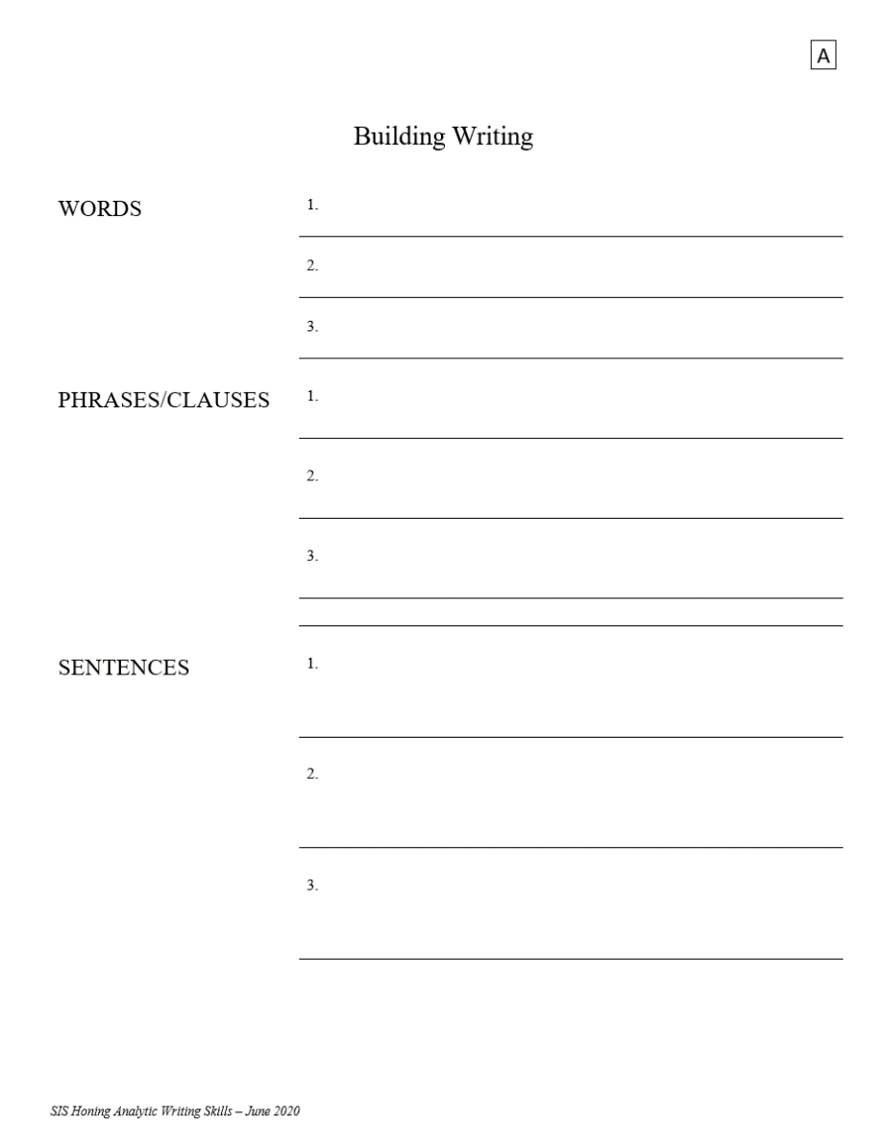
Exercise: Building Writing

Slide 38
Exercise: Building Writing
Tell us your analysis with just …
WORDS
Nouns, Verbs, Adjectives, Adverbs
PHRASES
Combinations of words … separated by ellipses
What do we need to know about:
Social media
Impeachments
Decriminalization of marijuana
Another topic of your interest
SENTENCE
One full
sentence

Slide 39
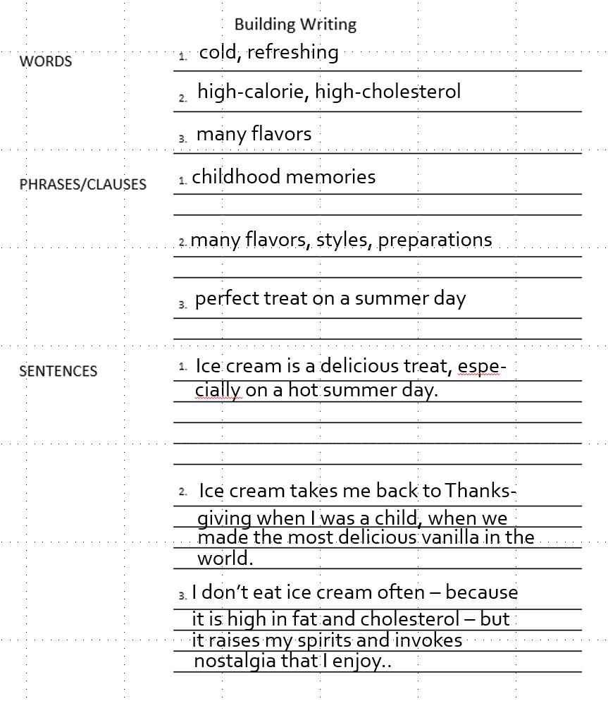
Example:
Ice cream
HAIKU???

Slide 40
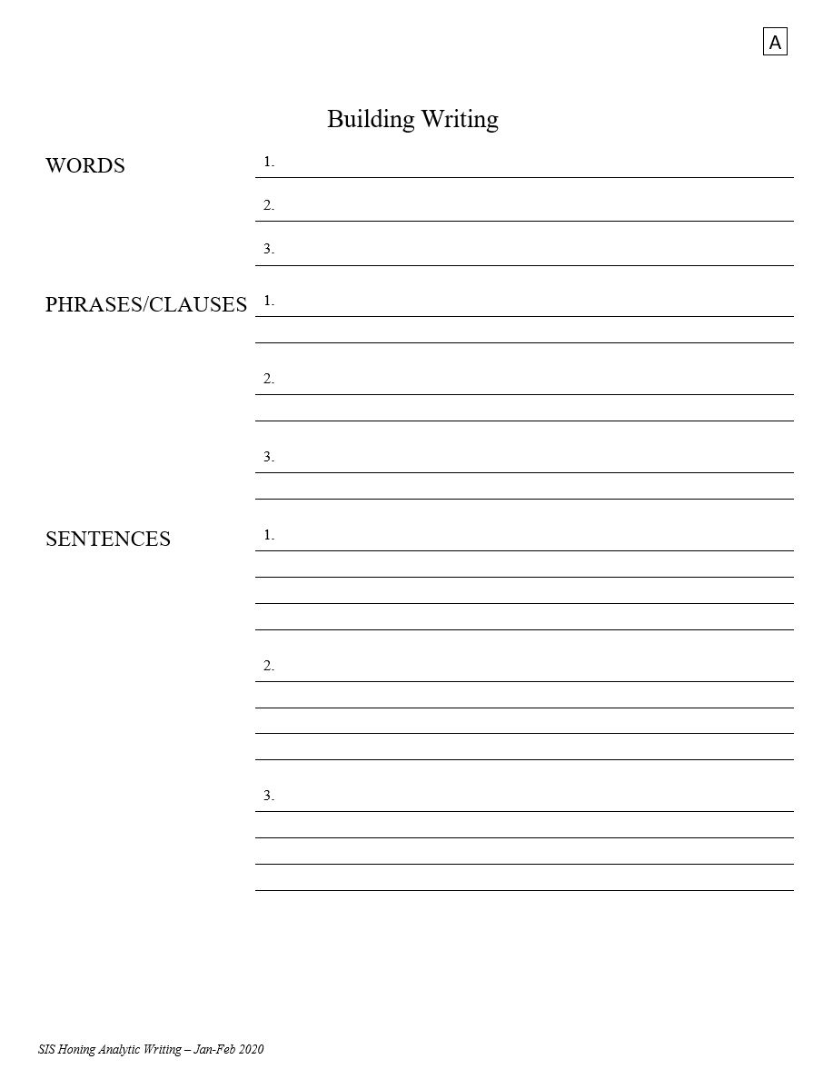

Exercise: Building Writing
What do I need to know about:
Social media
Impeachments
Decriminalization of marijuana
Another topic of your interest
15 minutes

Slide 41
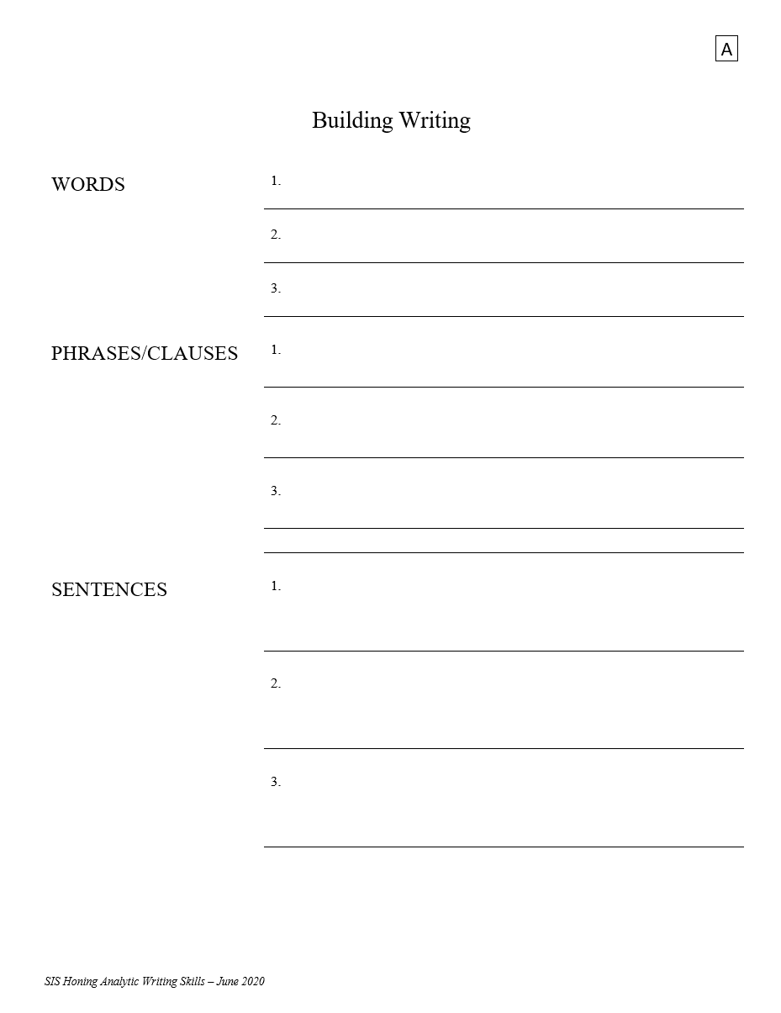
Exercise: Building Writing
What did you come up with?

Slide 42

EXERCISE
The Snowflake
What is a snowflake?

Slide 43
Ukraine
Israel-Palestine
Climate change
Elections
China intentions
Cyberwar
Social media
Technology
etc., etc., etc.
Write an analysis of a topic that interests you …
In 40 words,
    Write a thesis or conclusion.
    Write an argument or explanation.
    Write something about the implications.
EXAMPLE

Slide 44
EXAMPLE
What does collapse of Afghanistan mean?
    The Taliban victory in Kabul has created conditions of repression and instability in Afghanistan. … Restoration of Sharia Law, which international community rejects, has provoked suspension of financial, humanitarian aid, intensifying economic crisis and hunger. … Taliban reaction likely to result in collaboration with terrorists.
BLUF
INFO / ARGU-
MENTATION
PREDICTION / IMPLICATION
41 words!

Slide 45
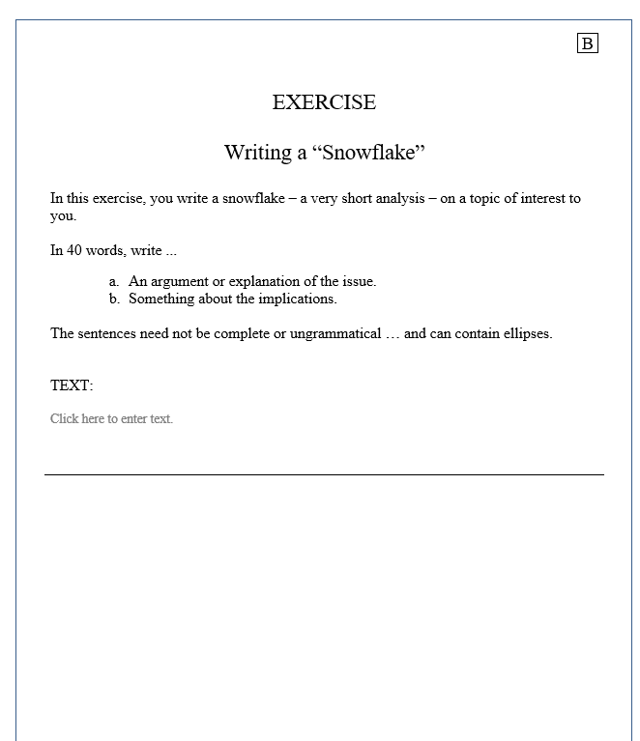
Ukraine
Israel-Palestine
Climate change
Elections
China intentions
Cyberwar
Ukraine
Social media
Technology
etc., etc., etc.
EXERCISE
B
15 minutes
Submit as discussion

Slide 46
The Snowflake
Look at the Discussion space …
    What theses or conclusions do you find effective?
    What arguments or explanations enlightening?
    What implications had an impact on you?
Did each element support one main message?

Slide 47

Why invest time in a 40-word product?
“If you can’t say it in 30 seconds, it’s not ready for prime time.”
Purpose
Structure / Roadmap
Early thesis
It later becomes your “elevator briefing”

Slide 48
Questions or Comments?
TAKE A BREAK
slides

Slide 49
BREAK

Slide 50
Discussion
Why do we write?
Most important means of communication in analytic/policy world
    Oral communication can be great in a jam, but its foundation is written
    To inform … to persuade … to educate … to record
Writing and thinking are integrally linked
    We think by writing, and we write by thinking
    We build and hone our analysis by writing it
Old debate among linguists:
    We can feel without words, but we can’t think without them

Slide 51
What happens when we write?
  Multi-level process similar to any language production
Surface structure | letters; sounds words; sentences; paragraphs
Transformational devices | morphology; phonology; vocabulary
Deep Structure | semantics thought, feeling, knowledge
LANGUAGE
THOUGHT

Slide 52
And it goes both ways.
Surface structure | letters; sounds words; sentences; paragraphs
Transformational devices | morphology; phonology; vocabulary
Deep Structure | semantics thought, feeling, knowledge
LANGUAGE
THOUGHT

Slide 53
CLEARER
LANGUAGE
THOUGHT
LANGUAGE
THOUGHT
CONCEPT: DRAFT AND SELF-EDIT
CLEARER

Slide 54
Why is writing so darned hard?!?!?!?
Everyone has a different answer, but general factors are …
  we don’t know what to say (or fear we don’t)
  skills are complex
  “rules” and styles are confining
  makes us feel vulnerable
  too much work to be “fun”
  and what other reasons?
Like any other skill or art … effort brings results.

Slide 55

One reason it’s difficult often
is that we try to write linearly.
    Dead ends
    No up-and-down flow
    Slow our thought processes
Sometimes we don’t have time
… or energy … or drive to have the full dynamic, but …
    While each writer’s brain operates differently, and while there’s no magic solution, there are always ways to improve.

Slide 56
We can improve our products and our skills
by starting with a good …
BASIC STRUCTURE
of
GOOD ANALYTIC WRITING

Slide 57
BASIC NEEDS
Main STYLE
Satisfy your audience’s need for:
Brevity | Efficient; only detail with purpose
Conciseness | No ambiguity
Objectivity | Free of bias and opinion
Transparency | Honest (including on gaps)

Slide 58
BLUF (Bottom Line Up Front)
BASIC STRUCTURE
One sentence or one paragraph
Main STRUCTURE
Satisfy your audience’s need for:
Clear, meaningful summary | Thesis – BLUF
Factual laydown, validation | What is really needed
Discuss causes and trends | Why and how it’s happening
Scenarios and Implications | Why it’s important, and what else could happen
Perhaps one-quarter of your paper
Perhaps one half
Perhaps one quarter

Slide 59
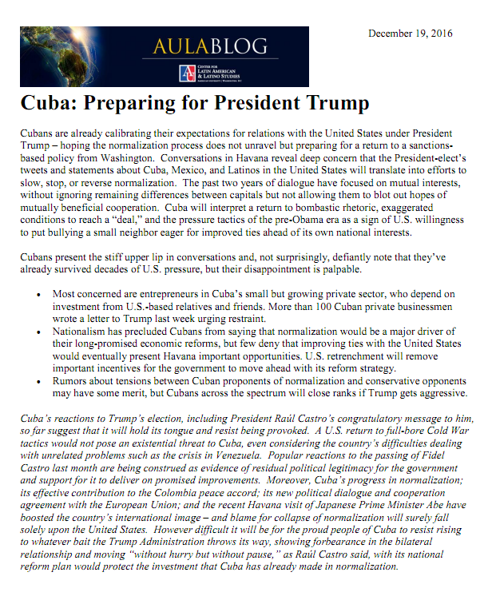
BLUF (Bottom Line Up Front)
Main STRUCTURE
Clear, meaningful summary
Factual laydown, validation
Discuss causes and trends
Scenarios and Implications

Slide 60
Our obsessive concern should be …
What does my reader need most to understand the situation I’m writing about?
Especially if my reader is a decisionmaker, what do they need to know to adopt the best possible decision?
helps politically
promotes interests
achieves strategic benefit
minimizes errors and costs

Slide 61
REVIEW
What is “analytic writing”?
Main PURPOSE
Satisfy your audience’s need for:
Information | What, where, when
Validation/substantiation | How we know. Quality of info.
Feel for the dynamics - Causes - Trends | Why What next, how much momentum
Implications/Scenarios | Why it matters, what will happen

Slide 62
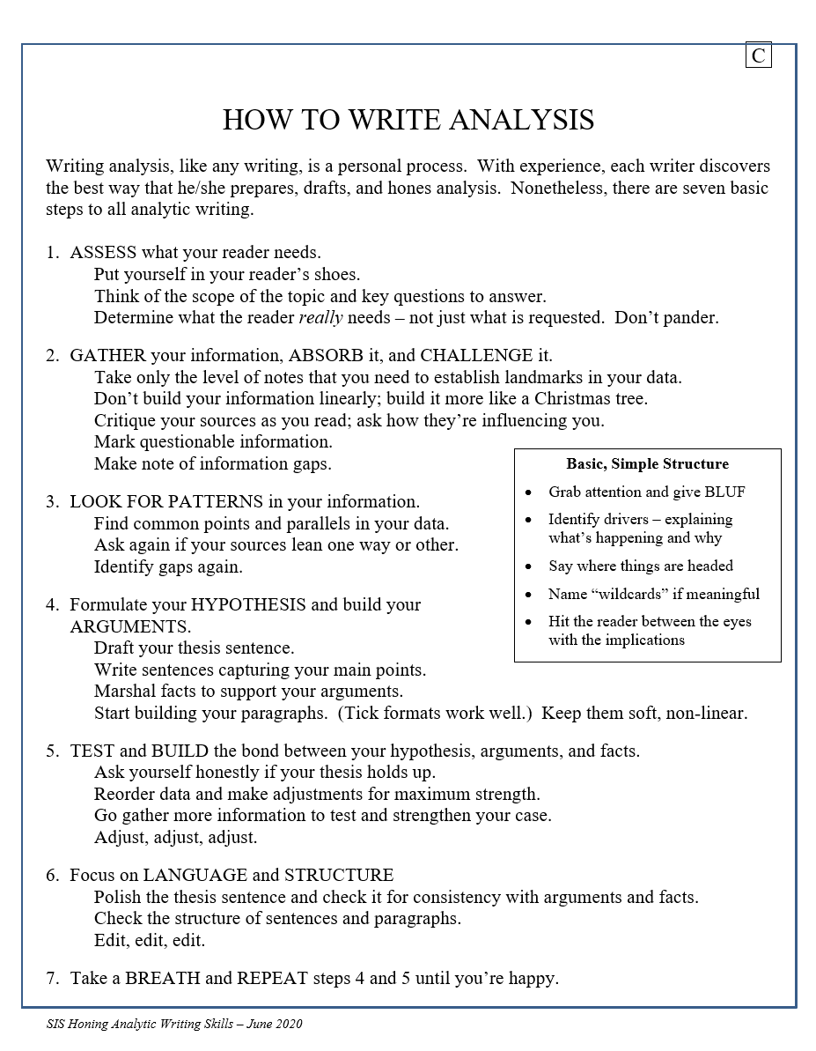
HANDOUT

Slide 63
Structure of a Simple-form Analytic Article Main, Basic Elements to Satisfy Your Audience’s Needs
Reader’s Needs |  | Structural Element
Clear, meaningful summary |  | Thesis – BLUF | One sentence or short paragraph
Enough facts to understand phenomenon |  | Factual snapshot, validation | Perhaps one quarter of paper
Grasp of why and how it’s happening |  | Drivers and trends | Perhaps one half of paper
Idea of what will happen and what else could happen |  | Scenarios, Alternatives, and “Wild Cards” | Perhaps one quarter
Why it’s important |  | Implications

Slide 64
Structure of a Simple-form Analytic Article Main, Basic Elements to Satisfy Your Audience’s Needs
Reader’s Needs |  | Structural Element
Clear, meaningful summary |  | Thesis – BLUF | One sentence or short paragraph
Enough facts to understand phenomenon |  | Factual snapshot, validation | Perhaps one quarter of paper
Grasp of why and how it’s happening |  | Drivers and trends | Perhaps one half of paper
Idea of what will happen and what else could happen |  | Scenarios, Alternatives, and “Wild Cards” | Perhaps one quarter
Why it’s important |  | Implications

Slide 65
Structure of a Simple-form Analytic Article Main, Basic Elements to Satisfy Your Audience’s Needs
Reader’s Needs |  | Structural Element
Clear, meaningful summary |  | Thesis – BLUF | One sentence or short paragraph
Enough facts to understand phenomenon |  | Factual snapshot, validation | Perhaps one quarter of paper
Grasp of why and how it’s happening |  | Drivers and trends | Perhaps one half of paper
Idea of what will happen and what else could happen |  | Scenarios, Alternatives, and “Wild Cards” | Perhaps one quarter
Why it’s important |  | Implications

Slide 66
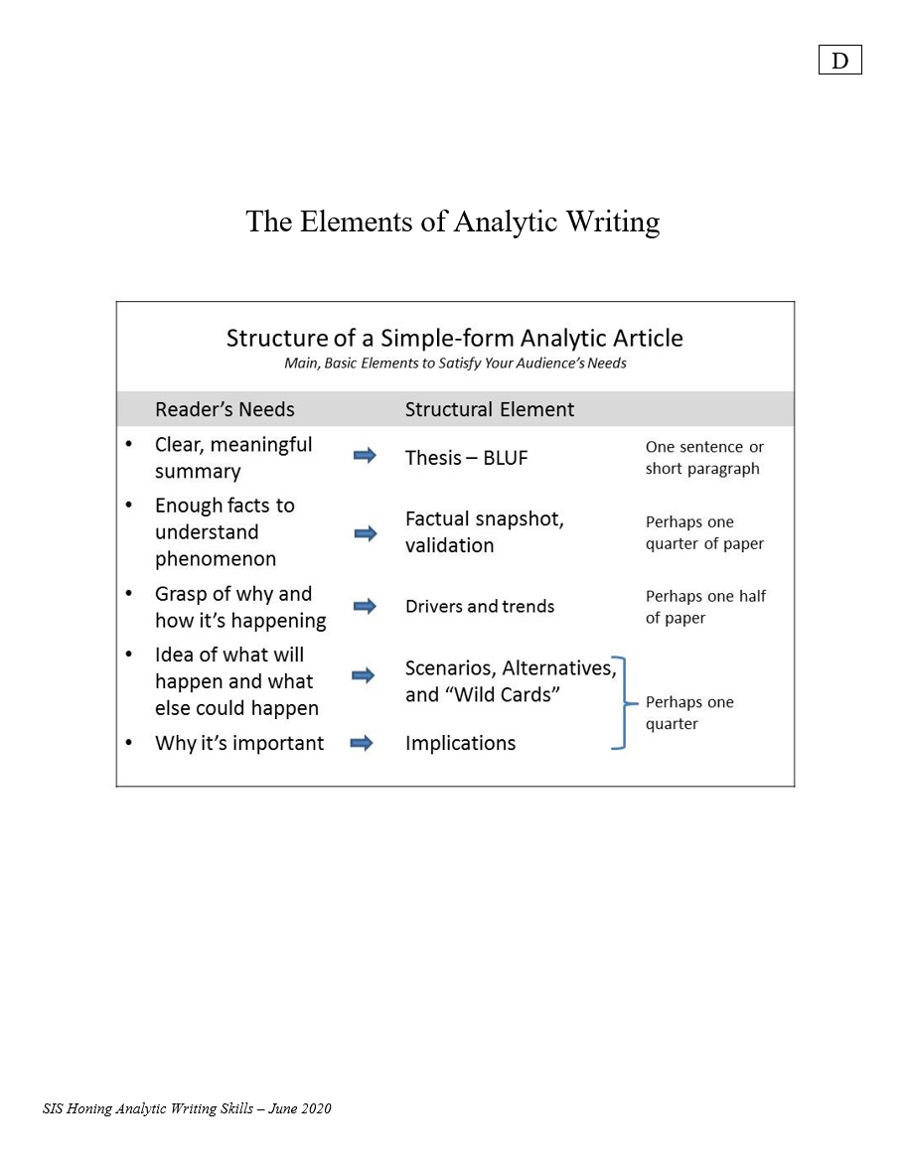

Slide 67
Questions? Comments? Concerns?

Slide 68
EXERCISE
TO ACCELERATE LEARNING:
Analyze examples

Slide 69

EXERCISE
DON’T EDIT … DON’T MAKE PERFECT … ANALYZE FUNCTION OF EACH SECTION
----
Functions:
Summarize?
Inform?
  Background/context
  Developments
  Texture
Present evidence/arguments?
  Drivers
  Trends
Prognosticate?
Identify implications?
What is the author doing?
What is the purpose of each paragraph?
Does the structure work for you?
20 minutes

Slide 70
What is the author doing?
What is the purpose of each paragraph?
Does the structure work for you?
©Alice Callahan
NYT 08 Dec 2023

Slide 71
Does it measure up?
Structure of a Simple-form Analytic Article Main, Basic Elements to Satisfy Your Audience’s Needs
Reader’s Needs |  | Structural Element
Clear, meaningful summary |  | Thesis – BLUF | One sentence or short paragraph
Enough facts to understand phenomenon |  | Factual snapshot, validation | Perhaps one quarter of paper
Grasp of why and how it’s happening |  | Drivers and trends | Perhaps one half of paper
Idea of what will happen and what else could happen |  | Scenarios, Alternatives, and “Wild Cards” | Perhaps one quarter
Why it’s important |  | Implications

Slide 72

What is Analysis
(and how do we do it)?
In the broadest sense …
Analysis is the process of evaluating and transforming raw data into descriptions, explanations, and conclusions that help readers (policymakers) take action.
Before you analyze and before you write:
You MUST consider your audience.
  Their needs
  Their responsibilities
  Their options

Slide 73
Analysis
A basic, time-tested, relevant analytical model:
Identify drivers
Identify trends
Weight drivers and interaction within trends
Identify scenarios
Reexamine drivers and weights
Identify wildcards
Reexamine scenarios
Assess implications
Double-value:
Transparency of analysis empowers policymaker
Drivers are at the heart of good policymaking

Slide 74
In its simplest form … good analysis … the “key judgments”:
Provides an accurate snapshot of what we know and what we think about a current situation
    who, what, when, where, how, why
    what’s driving it – the “drivers”
Identifies the trends
    what’s happening with each key driver
Identifies potential outcomes, with some estimation of probability
Good analysis educates … is transparent … is policy-relevant … is dynamic.

Slide 75

Handout
C

Slide 76

Sounds good, but … how do I write it?

Slide 77


Handout
F
“Building Analysis”

Slide 78

G1
Here’s
an example:

Slide 79
G1
Here’s
an example:

Slide 80
G1
Here’s
an example:

Slide 81
G1
Here’s
an example:

Slide 82
G1
Here’s
an example:

Slide 83

Here’s
an example:

Slide 84
Here’s
an example:

Slide 85
Here’s
an example:

Slide 86
Here’s
an example:

Slide 87


Another example:
See how it works?

Slide 88
See how it works?
Questions?
In this Skills Institute, we won’t develop the analytic worksheet, but knowing the model will help you to write better.
ONCE YOU HAVE A WORKSHEET (OR SIMILAR), YOU CAN FOCUS ON WRITING.

Slide 89
Questions? Comments?

Slide 90


AN EXERCISE
Converting an analytical worksheet into a written report.
Central America migration or Venezuela stability

Slide 91


Supplemented by …

Slide 92



Turn this …
… into this
Short paper with:
Your own title, thesis sentence
Your own organization, emphasis, conclusions, “voice”
Bullets, if you wish
3 paragraphs; 250 words
THINK:
What does my reader need to know about this?
What’s the best way to give it to them?
G1a

Slide 93


Read the directions.
Read the worksheet and CRS report.
Plan your paper.
___ minutes

Slide 94
And … then … write the note.

Slide 95



Posted in Discussion
___ minutes
Submit as discussion

Slide 96

N
Discussion
(in small groups)
How well does the thesis statement work?
How readable and interesting is it?
How well are the facts framed?
How logical is the analysis?
Does it have a clear message?
__ minutes

Slide 97
Discussion
What made a good thesis statement good?
What made the analysis readable and interesting?
Which facts, and what level of facts, were appropriate for the “framing”?
What made the analysis logical … transparent … “actionable”?

Slide 98
DISCUSSION: GOOD WRITING

Slide 99



GOOD ANALYTICAL WRITING
MUST BE
GOOD WRITING FIRST.
DREYER’S ENGLISH
by
Benjamin Dreyer
ADVICE
from
Strunk and White
with a few
additional thoughts
WRITING TOOLS
from
Roy Peter Clark
Elementary rules of usage
Elementary principles of composition
Wisdom from E.B. White

Slide 100
ELEMENTARY RULES OF USAGE
1. Form the possessive singular of nouns with 's
Charles's friend
Burns's poems
the witch's malice
the heel of Achilles
the laws of Moses
the temple of Isis
The United States’ role in world affairs …

Slide 101
ELEMENTARY RULES OF USAGE
2. In a series of three or more terms with a single conjunction, use a comma after each term except the last
red, white, and blue
honest, energetic, but headstrong
He opened the letter, read it, and made a note of its contents.
Notes:
OXFORD COMMA

Slide 102

ELEMENTARY RULES OF USAGE
3. Enclose parenthetic expressions between commas
The best way to see a country, unless you are pressed for time, is to travel on foot.
Marjorie's husband, Colonel Nelson paid us a visit yesterday,
My brother you will be pleased to hear, is now in perfect health,
Non-restrictive relative clauses are, in accordance with this rule, set off by commas.
The audience, which had at first been indifferent, became more and more interested.

Slide 103
Restrictive and Non-Restrictive Relative Clauses
AKA: Defining and Non-Defining Relative Clauses
The car that was on the ramp got ruined.
The car, which was on the ramp, got ruined.
My brother Kevin is a cyclist.
My brother, Kevin, is a cyclist.
The student who worked hardest won the prize.
The student, who worked hardest, won the prize.

Slide 104
ELEMENTARY RULES OF USAGE
Place a comma before and or but introducing an independent clause
The early records of the city have disappeared, and the story of its first years can no longer be reconstructed.
The situation is perilous, but there is still one chance of escape.

Slide 105
ELEMENTARY RULES OF USAGE
5. Do not join independent clauses by a comma
(Use a semicolon.)
Stevenson's romances are entertaining; they are full of exciting adventures.
It is nearly half past five; we cannot reach town before dark.
If the clauses are very short, and are alike in form, a comma is usually permissible:
Man proposes, God disposes.
The gate swung apart, the bridge fell, the portcullis was drawn up.

Slide 106
ELEMENTARY RULES OF USAGE
6. Do not break sentences in two
I met them on a Cunard liner several years ago. Coming home from Liverpool to New York.
He was an interesting talker. A man who had traveled all over the world, and lived in half a dozen countries.

Slide 107
ELEMENTARY RULES OF USAGE
7. A participial phrase at the beginning of a sentence must refer to the grammatical subject.
Walking slowly down the road, he saw a woman accompanied by two children.
He saw a woman, accompanied by two children, walking slowly down the road.
WHO IS DOING THE WALKING?
Being in a dilapidated condition, I was able to buy the house very cheap.
PERHAPS, BUT … ?

Slide 108
ELEMENTARY PRINCIPLES OF COMPOSITION

Slide 109
ELEMENTARY PRINCIPLES OF COMPOSITION
8. As a rule, begin each paragraph with a topic sentence; end it in conformity with the beginning
The topic sentence comes at (or, in rare cases, near) the beginning;
The succeeding sentences explain or establish or develop the statement made in the topic sentence; and
The final sentence either emphasizes the thought of the topic sentence or states some important consequence.

Slide 110
ELEMENTARY PRINCIPLES OF COMPOSITION
8. As a rule, begin each paragraph with a topic sentence; end it in conformity with the beginning
The topic sentence is your roadmap for the rest of the piece.
It tells your reader where you’re taking him/her.
It reflects the structure of your argument and overall message.

Slide 111
ELEMENTARY PRINCIPLES OF COMPOSITION
9. Use the active voice
Avoid passive
My first visit to Boston will always be remembered by me.
I shall always remember my first visit to Boston.

Slide 112
ELEMENTARY PRINCIPLES OF COMPOSITION
9. Use the active voice
Avoid “there is”/”there are”
There were a great number of dead leaves lying on the ground.
Dead leaves covered the ground.

Slide 113
ELEMENTARY PRINCIPLES OF COMPOSITION
9. Use the active voice
Just say what your reader needs to know!
It was not long before he was very sorry that he had said what he had. | He soon repented his words.

Slide 114
ELEMENTARY PRINCIPLES OF COMPOSITION
10. Use definite, specific, concrete language
A period of unfavorable weather set in. | It rained every day for a week.
He showed satisfaction as he took possession of his well-earned reward. | He grinned as he pocketed the coin.

Slide 115
ELEMENTARY PRINCIPLES OF COMPOSITION
11. Put statements in positive form
He was not very often on time. | He usually came late.
He did not think that studying Latin was much use. | He thought the study of Latin useless.
The Taming of the Shrew is rather weak in spots. Shakespeare does not portray Katharine as a very admirable character, nor does Bianca remain long in memory as an important character in Shakespeare's works. | The women in The Taming of the Shrew are unattractive. Katharine is disagreeable, Bianca insignificant.

Slide 116
ELEMENTARY PRINCIPLES OF COMPOSITION
11. Put statements in positive form
not honest | dishonest
not important | trifling
did not remember | forgot
did not pay any attention to | ignored
did not have much confidence in | distrusted

Slide 117
ELEMENTARY PRINCIPLES OF COMPOSITION
12. Omit needless words
the question as to whether | whether (the question whether)
there is no doubt but that | no doubt (doubtless)
used for fuel purposes | used for fuel
he is a man who | he
in a hasty manner | hastily
this is a subject which | this subject
His story is a strange one. | His story is strange.

Slide 118
ELEMENTARY PRINCIPLES OF COMPOSITION
12. Omit needless words
owing to the fact that |  | since because
in spite of the fact that |  | though although
call your attention to the fact that |  | remind you notify you
I was unaware of the fact that |  | I was unaware that I did not know
the fact that he had not succeeded |  | his failure
the fact that I had arrived |  | my arrival

Slide 119

ELEMENTARY PRINCIPLES OF COMPOSITION
13. Avoid a succession of loose sentences
The third concert of the subscription series was given last evening, and a large audience was in attendance. Mr. Edward Appleton was the soloist, and the Boston Symphony Orchestra furnished the instrumental music. The former showed himself to be an artist of the first rank, while the latter proved itself fully deserving of its high reputation. The interest aroused by the series has been very gratifying to the Committee, and it is planned to give a similar series annually hereafter. The fourth concert will be given on Tuesday, May 10, when an equally attractive program will be presented.
Z Z Z Z Z Z Z Z Z Z

Slide 120
ELEMENTARY PRINCIPLES OF COMPOSITION
14. Express co-ordinate ideas in similar form
Formerly, science was taught by the textbook method, while now the laboratory method is employed. | Formerly, science was taught by the textbook method; now it is taught by the laboratory method.
The French, the Italians, Spanish, and Portuguese | The French, the Italians, the Spanish, and the Portuguese
In spring, summer, or in winter | In spring, summer, or winter In spring, in summer, or in winter

Slide 121
ELEMENTARY PRINCIPLES OF COMPOSITION
14. Express co-ordinate ideas in similar form
It was both a long ceremony and very tedious. | The ceremony was both long and tedious.
A time not for words, but action | A time not for words, but for action
Either you must grant his request or incur his ill will. | You must either grant his request or incur his ill will.
My objections are, first, the injustice of the measure; second, that it is unconstitutional. | My objections are, first, that the measure is unjust; second, that it is unconstitutional.

Slide 122
ELEMENTARY PRINCIPLES OF COMPOSITION
15. Keep related words together
Don’t separate grammatical parts if there’s no reason to.
Wordsworth, in the fifth book of The Excursion, gives a minute description of this church. | In the fifth book of The Excursion, Wordsworth gives a minute description of this church.
Cast iron, when treated in a Bessemer converter, is changed into steel. | By treatment in a Bessemer converter, cast iron is changed into steel.

Slide 123
ELEMENTARY PRINCIPLES OF COMPOSITION
15. Keep related words together
The relative pronoun should come, as a rule, immediately after its antecedent.
There was a look in his eye that boded mischief. | In his eye was a look that boded mischief.
He wrote three articles about his adventures in Spain, which were published in Harper's Magazine. | He published in Harper's Magazine three articles about his adventures in Spain.
This is a portrait of Benjamin Harrison, grandson of William Henry Harrison, who became President in 1889. | This is a portrait of Benjamin Harrison, grandson of William Henry Harrison. He became President in 1889.

Slide 124
ELEMENTARY PRINCIPLES OF COMPOSITION
15. Keep related words together
Also important: Modifiers should come, whenever possible, next to the word(s) they modify. If several expressions modify the same word, they should be so arranged that no wrong relation is suggested.
All the members were not present. | Not all the members were present.
He only found two mistakes. | He found only two mistakes.
Major R. E. Joyce will give a lecture on Tuesday evening in Bailey Hall, to which the public is invited, on "My Experiences in Mesopotamia" at eight P.M. | On Tuesday evening at eight P.M., Major R. E. Joyce will give in Bailey Hall a lecture on "My Experiences in Mesopotamia." The public is invited.

Slide 125
ELEMENTARY PRINCIPLES OF COMPOSITION
16. In summaries, keep to one tense
When World War II started, he is working in a widget factory.

Slide 126
ELEMENTARY PRINCIPLES OF COMPOSITION
17. Place the emphatic words of a sentence at the end
Humanity has hardly advanced in fortitude since that time, though it has advanced in many other ways. | Humanity, since that time, has advanced in many other ways, but it has hardly advanced in fortitude.
This steel is principally used for making razors, because of its hardness. | Because of its hardness, this steel is principally used in making razors.

Slide 128
“Rules and Nonrules”
THE BIG THREE NONRULES
1.
Never Begin a Sentence with “And” or “But.” Do so “if it strikes your fancy.”
Francie, of course, became an outsider shunned by all because of her stench. But she had become accustomed to being lonely.
Any difference?
Francie, of course, became an outsider shunned by all because of her stench, but she had become accustomed to being lonely.

Slide 129
“Rules and Nonrules”
THE BIG THREE NONRULES
2.
Never Split an Infinitive.
“To boldly go where no man has gone before.”
- Star Trek

Slide 130
“Rules and Nonrules”
THE BIG THREE NONRULES
3.
Never End a Sentence with a Preposition.
arrant = complete
pedantry [PED-n-tree] = slavish adherence to rules
“This is the kind of arrant pedantry up with which I will not put.”
- Winston Churchill (NOT!)
May be more elegant without …
“What did you do that for?” →→→→ “Why did you do that?”

Slide 131
“Rules and Nonrules”
THE LESSER SEVEN NONRULES
1.
Contractions Aren’t Allowed in Formal Writing.
“Contractions are why God invented the apostrophe, so make good use of both.”
Some are a bit strained …
I’d’ve shouldn’t’ve couldn’t’ve

Slide 132
“Rules and Nonrules”
THE LESSER SEVEN NONRULES
2.
The Passive Voice Is to Be Avoided.
Most important thing: That the actor be clear – avoiding “weasel-like” style
Active: The clown terrified the children.
Passive: The children were terrified by the clown.
Also weasel-like to say: “A car rammed into counter-protestors during a violent white nationalist rally.”

Slide 133
“Rules and Nonrules”
THE LESSER SEVEN NONRULES
3.
Sentence Fragments. They’re Bad.
Acceptable in fiction, but even there, should be sparing.

Slide 134
“Rules and Nonrules”
THE LESSER SEVEN NONRULES
4.
A Person Must be a “Who.”
“The Man That Got Away”
- Ira Gershwin
“He took all the people that the bus could carry.”
Some non-people can be “who,” too.
“An idea the time of which has come” →→→→ “An idea whose time has come”

Slide 135
“Rules and Nonrules”
THE LESSER SEVEN NONRULES
5.
“None” is Singular and, Dammit, Only Singular.”
“None of us are going to the party.”
Fine
“None of the suspects, it seems, is guilty of the crime.”
Perfect
“If you mean to emphasize the feelings, or actions, or inactions, of a group as a group, none of us copy editors are going to stop you from doing that.”

Slide 136
“Rules and Nonrules”
THE LESSER SEVEN NONRULES
6.
“Whether” Must Never Be Accompanied by “Or Not.”
Let me know whether or not you want to go.
If you mean “if,” then don’t say “or not.”
But … “Whether or not you like movie musicals, I’m sure you’ll love Singin’ in the Rain.”
“If you can delete the “or not” from a “whether or not,” and your sentence continues to make sense, then go ahead and delete it. If not, not.”

Slide 137
“Rules and Nonrules”
THE LESSER SEVEN NONRULES
7.
Never Introduce a List with “Like.”
“Great writers of the twentieth century like Edith Wharton, Theodore Drieser, and William Faulkner …”
“Such as” is perfect, but … many like “like” (and it’s OK).

Slide 138
Chapters on
Many Other Aspects of Grammar, Writing, and Composition
Just two tastes:
When does a hyphenated word graduate to a single word?
light bulb → light-bulb → lightbulb
small businessmen? → small-business men? → small-businessmen?

Slide 139
Chapters on
Many Other Aspects of Grammar, Writing, and Composition
Just two tastes:
“The Confusables”
discreet |  | discrete
defuse |  | diffuse
climatic |  | climactic
affect |  | effect
fictional |  | fictitious
jibe | jive | gibe
loath |  | loathe
EXAGGERATED
TALK; EARLY JAZZ
BE IN HARMONY;
AGREE
MOCK,
TAUNT
Notes:
jibe (shift); jive (exaggerated talk); gibe (mock)

Slide 140

H

Slide 141


Slide 142

HANDOUT: “Suggestions and Cautionary Hints”
I

Slide 143

HANDOUT: “How to Write Good”
J

Slide 144
GOOD ANALYTICAL WRITING
MUST BE
GOOD WRITING FIRST.
Questions? Comments?

Slide 145




Slide 146



Slide 147


In careful usage, a crescendo is not a peak of intensity but a gradual increase in force, intensity or loudness. Here, make it something like “peak” or “climax.”

Slide 148



Slide 149



Slide 150



Slide 151



Slide 152



Slide 153



Slide 154



Slide 155



Slide 156



Slide 157



Slide 158



Slide 159



Slide 160
Why do this “quiz”?
See that “even NYT writers” need to check themselves.
Emphasize the need for accuracy, attention.
Consider asking someone else to proofread for you.

Slide 161


EXERCISE: “EDITING”

Slide 162

15 minutes

Slide 163
First…
Where’s the best sentence to serve as thesis sentence?

Slide 164

-delete
-non-agree
-delete

Slide 165

Good lead for last para
NOT
COMMA

Slide 167
How did you do?
Too tedious?
Worth the trouble?

Slide 168
Enough for today?

Slide 169
Do you have the makings of a good paper?
How hard would it be for you to transform
that into good, readable prose?
Please submit two or three paragraphs as an “Assignment”
in Canvas
using the template provided
Deadline: ________
Video and transcript are in today’s module in Canvas and
at https://bmbs.org/writingskills/FATBERG_VIDEO.MP4

Slide 170
QUESTIONS? COMMENTS? CONCERNS?
Have a good evening !
See you at 9:00am sharp tomorrow!

Slide 171
Honing
Analytic Writing Skills
Fulton T. Armstrong
Course # SIS-730-002
January 27 & 28, 2024
SIS-113
Saturday | Sunday
9:00am-5:00pm | 9:00am-5:00pm

