Slide 1

Global Policy Seminar and NSC Simulation
IRP 401 - IRP 402
Week Twelve 14 November 2025
Prof. Fulton T. Armstrong

Slide 2
Week 1 (29 Aug)
Week 2 (5 Sep)
Week 3 (12 Sep)
Week 4 (19 Sep)
Week 5 (26 Sep)
Week 6 (3 Oct)
Week 7 (10 Oct)
Week 8 (17 Oct)
Week 9 (24 Oct)
Week 10 (31 Oct )
Week 11 (7 Nov)
Week 12 (14 Nov)
Week 13 (21 Nov)
Thanksgiving Break
Week 14 (5 Dec)
Fall 2025

Slide 3

TODAY’S AGENDA
9:00
~12:30
1:30 | Professional Skill Development – Negotiating a Salary and Benefits (Samantha)
2:45 | Internship Conversations Mo, Maisie, Katelyn, Erik, Sarina, Skye, Alex
3:45 | Deputies Committee preps
~4:00 | Wrapup
The Six-Party Talks

Slide 4
TODAY’S AGENDA
9:00
~12:30
1:30 | Professional Skill Development – Negotiating a Salary and Benefits (Samantha)
2:45 | Internship Conversations Mo, Maisie, Katelyn, Erik, Sarina, Skye, Alex
3:45 | Deputies Committee preps
~4:00 | Wrapup
The Six-Party Talks

Slide 5


Slide 6
The Six-Party Talks
What are your takeaways from the exercise?

Slide 7






The Six-Party Talks
What are your takeaways from the exercise?
Democratic People’s Republic of Korea (DPRK – North Korea)
Republic of Korea (ROK – South Korea)
People’s Republic of China (PRC – China)
Japan
Russia
United States

Slide 8
The Six-Party Talks
 | Republic of Korea (South Korea) | Democratic People’s Republic of Korea (North Korea) | USA | People’s Republic of China | Japan | Russia
Universe 1 | Priya | Maise | Maeve | Esme | Alex | Richard
Universe 2 | Camille | Syarra | Gabby | Bobby | Kiana | Katelyn
Universe 3 | Skye | Mo | Erik | Sarina | KEI staff | KEI staff

Slide 9


Slide 10
Internship conversations

Slide 11
Internship conversations
INFORMAL DISCUSSION
Launched with 2-3 mins on …
Organization name and business
In-person, virtual, hybrid
Tasks and responsibilities
Communications and team dynamics
Fun things and challenges
Mo
Maisie
Katelyn
Erik
Sarina
Skye
Alex

Slide 12


Slide 13
DISCUSSION and PLANNING

Slide 14
DISCUSSION and PLANNING
Deputies Committee Exercise

Slide 15

NSC DEPUTIES SIMULATION
Friday, 5 December
TWO ROLES
NSC Directors or Senior Directors briefing the issue and proposals.
“The Deputies” receiving the briefing, asking the questions, and making the decisions.

Slide 16
NSC DEPUTIES SIMULATION
“The Deputies” receiving the briefing, asking the questions, and making the decisions.
Who are your decisionmakers?

Slide 17
NSC DEPUTIES
Who attends?
National Security Advisor or Deputy
Deputy Secretary of State +1
Deputy Secretary of Defense +1
Deputy Secretary of Homeland Security +1
Deputy Secretary of Treasury +1
OVP National Security Advisor +1
NSC staff
OMB leadership or staff
Advisors
Joint Chiefs of Staff (JCS)
DNI and/or CIA
And other affected Deputies

Slide 18
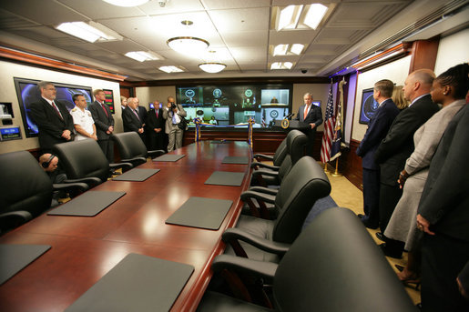
The Situation Room

Slide 19
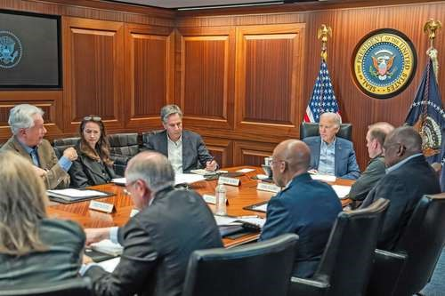
BURNS
HAINES
BLINKEN
SULLIVAN
BIDEN
AUSTIN
BROWN

Slide 20
What will the briefers do?
Serve as NSC Senior Directors or Directors briefing the issue and proposals.
BLUF on issue and proposal
Briefly …
Define the problem and status
Report key analysis (based on research, hearing/event, interviews, discussions)
Present recommendation and pro’s and con’s
Sum up with request for Deputies’ approval for main proposal
4 PowerPoint Slides
8-9 MINUTES (but Deputies can interrupt)

Slide 21
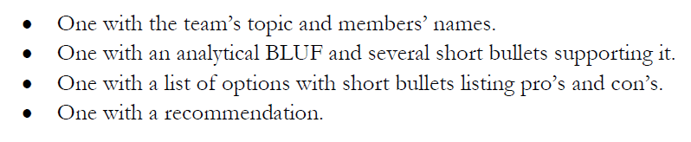
DC BRIEFING
The four PowerPoint slides
DEADLINE to submit in Blackboard: Wednesday (3 Dec) at 9pm.

Slide 22

DC BRIEFING
Scott Morgan’s MODEL
MODEL for our memo
Structure:
BLUF
“Framing”
Drivers/Trends
Options
Recommendation
Problem
Problem
Analysis
Options
Recommendation
Vivid Examples
&
Evidence
Solution
Next Steps
Morgan:
“If I buy your analysis, I’m much more likely to buy your recommendation.”

Slide 23
What will the deputies do?
Serve as decisionmakers.
READ and ABSORB materials provided in advance
LISTEN to the briefing but INTERRUPT if briefing is unclear
ASK questions about analysis and proposal
EXPRESS position on issue and proposal
After pause for all to “vote” …
Approve as is.
Approve with SPECIFIC, DIRECTED conditions.
Remand to Interagency Working Group for re-work.
Disapprove with prejudice.
Q&A and discussion: 8-9 MINUTES
All of you are deputies and will vote, but LEAD deputies will “sit at the table” and discuss their votes.

Slide 24
Who
do you want to be your deputies?
will be your deputies?

Slide 25
PROJECT PLANNING
STAFF | TOPIC | “DEPUTIES”
Maisie | U.S. Declining Birth Rates
Skye
Esme | U.S. Culture Wars
Camille
Erik | Israeli Use of Lavender AI in Targeting
Richard
Alex | Iranian Nationalism
Syarra
Maeve | U.S. Declining Birth Rates
Kiana
Mo | Impact of U.S.-China Tariffs
Bobby
Gabby | U.S.-Israel Relations After Netanyahu
Katelyn
Sarina | Crisis of Legal Immigration Pathways in the U.S.
Priya

Slide 26
PROJECT PLANNING
Maisie | Microplastics | U.S. Declining Birth Rates
Skye | Ending the war in Sudan
Esme | Immigration and Balancing Interests | U.S. Culture Wars
Camille | Microplastics and PFAS
Erik | Ukraine Innovative Use of Drones | Israeli Use of Lavender AI in Targeting
Richard | Enhancing Cybersecurity
Alex | China’s Increasing Military Strength | Iranian Nationalism
Syarra | Russian Influence in Eastern Europe
Maeve | Israeli Use of AI in Military Strikes in Gaza | U.S. Declining Birth Rates
Kiana | Impact of Federal Spending … or inflation
Mo | Aid to Gaza | Impact of U.S.-China Tariffs
Bobby | U.S. Health Care: High Cost of Prescription Drugs
Gabby | U.S. Culture Wars and How Policy Fuels them | U.S.-Israel Relations After Netanyahu
Katelyn | Russia-Ukraine Negotiations
Sarina | Foreign Disinformation Targets U.S. Elections | Crisis of Legal Immigration Pathways in the U.S.
Priya | China’s Advances in Renewable Energy and EVs

Slide 27
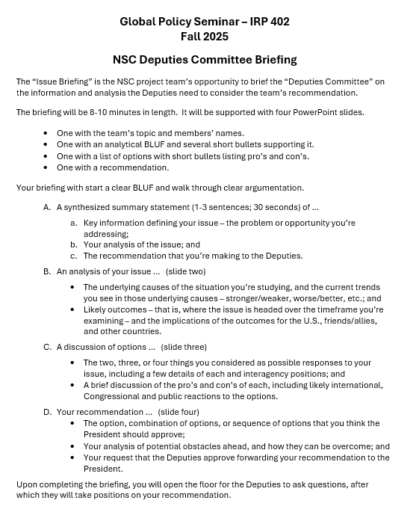
“DEPUTIES COMMITTEE” EXERCISE
GUIDANCE ON BRIEFING
All set?
All good on slides?

Slide 28
Any questions?

Slide 29
DISCUSSION
The Deputies Paper
Due: Friday, 21 November One week from today.

Slide 30
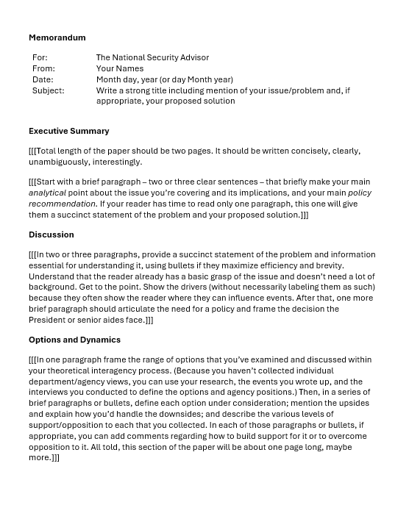
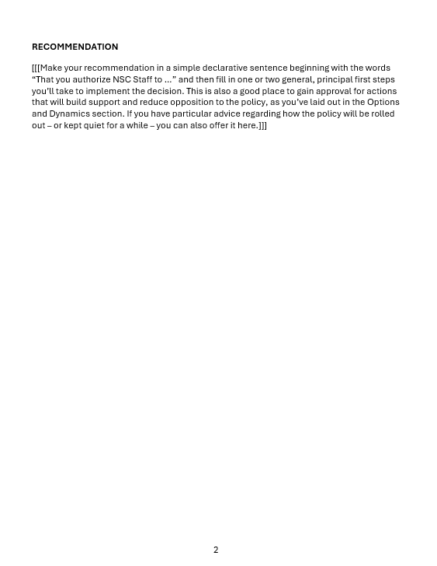
“The DEPUTIES Memo”

Slide 31
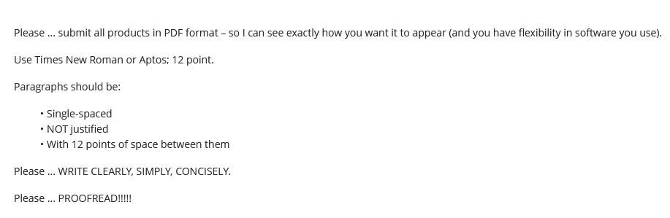
Guidance on Format

Slide 32
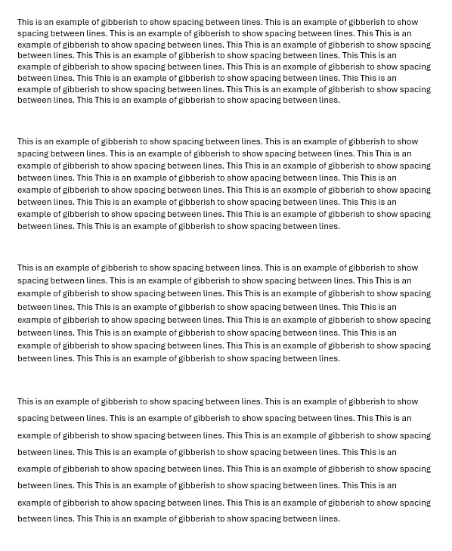
Single space (1.0)
Multiple (1.08)
Multiple (1.16)
1.5 lines (1.5)

Slide 33
REVIEW
What do good memos have in common?
JOB ONE:
MAKE IT EASY FOR YOUR READER TO GET WHAT THEY NEED TO KNOW.
Brevity | They don’t waste readers’ time.
Conciseness | They’re not sloppy, long-winded.
Clarity, precision | They don’t make reader sort through ambiguity.
Relevance | They don’t burden reader with clutter.
Objectivity | They don’t get bogged down in values, norms.
Readability | They’re not obtuse, ornate, distracting.

Slide 34
REVIEW
JOB ONE:
MAKE IT EASY FOR YOUR READER TO GET WHAT THEY NEED TO KNOW.
Digestible declarative sentences
Good, practical grammar
Unambiguous but “normal” vocabulary
Clear logic
Transparent drafter
Zero, minimal, or clearly labeled editorializing

Slide 35
REVIEW
What are the differences between academic writing and memo-writing?
“Washington Memo”
Purpose(s)
“Action”; empower reader by educating.
Scope
Background
Relevance
Only what reader needs to know to decide.
Only what’s relevant.
Examples to show point, not encyclopedia.
Style
Language
Length
Voice
Concise, direct, active.
“As brief as possible” (usually two pages).
Objective, not ornate.
Structure

Slide 36
REVIEW
Standard Info Memo
Standard Decision Memo
Subject: | Clear, crisp
Subject: | Clear, crisp
Thesis: | BLUF, analytical
Thesis: | BLUF, analytical
Framing: | What, when, who, where
Framing: | What, when, who, where
Dynamics: | Why, how
Dynamics: | Why, how
OPTIONS: | Stated, assessed; interagency views
Outcomes: | Likely, less likely (and why)
Outcomes: | Likely, less likely (and why)
Implications: | Why matter?
Implications: | Why matter?
RECOMMENDATION

Slide 37
REVIEW
Standard Info Memo
Standard Decision Memo
Subject: | Clear, crisp
Subject: | Clear, crisp
Thesis: | BLUF, analytical
Thesis: | BLUF, analytical
Framing: | What, when, who, where
STANDARD BRIEFING, TOO!
Framing: | What, when, who, where
Dynamics: | Why, how
Dynamics: | Why, how
OPTIONS | Stated, assessed; interagency views
Outcomes: | Likely, less likely (and why)
Outcomes: | Likely, less likely (and why)
Implications: | Why matter?
Implications: | Why matter?
RECOMMENDATION

Slide 38
REVIEW
The ways Washington memos are prepared, researched, drafted, and edited are different from academic, too.
Obsessively ask ourselves ...
What does the reader need to know (based on my understanding of my issue and their world)?
Does every word, phrase, sentence, and paragraph make it easy for my reader to grab and run?
If necessary, can I summarize my conclusions/ recommendations in 30 seconds or less?

Slide 39
REVIEW
Why is it important to be able to write a good “Washington Memo”?
Good writing is the single most important skill in this business because it shows …
you can think
you can communicate
you know what’s relevant
you are ready to operate
Other skills are important, but writing is central to almost all of them.

Slide 40
“The DEPUTIES Memo” -- STEP BY STEP
STEP BY STEP

Slide 41
IMPORTANT to note if you’re writing for anyone else.
For: | The National Security Advisor
From: | Your Names
Date: | Month day, year (or day Month year)
Subject: | Write a strong title including mention of your issue/problem and, if appropriate, your proposed solution

Slide 42
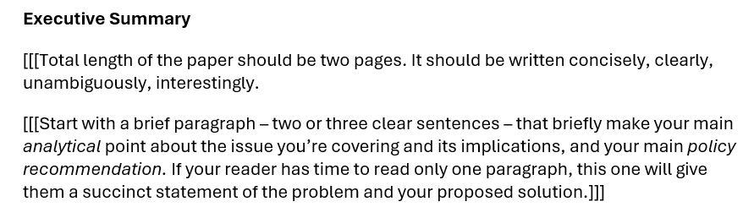

Slide 43
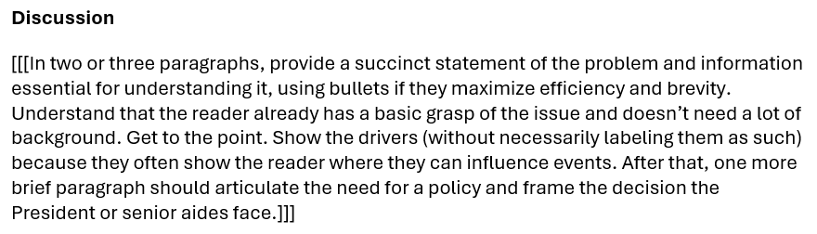

Slide 44
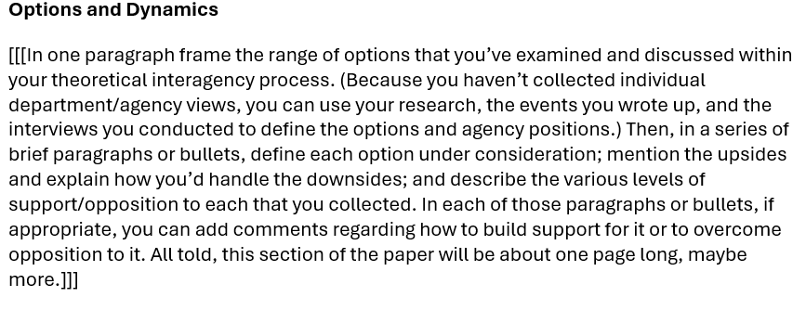

Slide 45
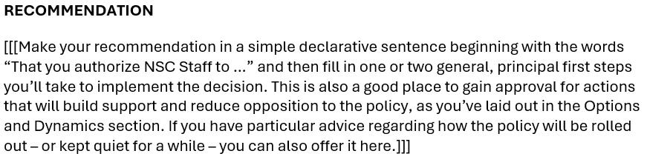

Slide 46
The memo must be good.
Friday, 14 Nov → | Choose your Deputies.
Friday evening, 21 Nov → | Memo post as assignment in BB.
Saturday/Sunday, 22-23 Nov → | I will send memo to Deputies – for them to review, digest, and prepare questions.
Wednesday evening, 3 Dec → | Slides posted as assignment in BB.
Friday, 5 Dec → | Deputies exercise.
Questions?

Slide 47


NEXT WEEK
Cuba
The Environment

Slide 48
The memo must be good.
Friday, 14 Nov → | Choose your Deputies.
Friday evening , 21 Nov → | Memo post as assignment in BB.
Saturday/Sunday, 22-23 Nov → | I will send memo to Deputies – for them to review, digest, and prepare questions.
Wednesday evening, 3 Dec → | Slides posted as assignment in BB.
Friday, 5 Dec → | Deputies exercise.
Questions?

Slide 49
Global Policy Seminar and NSC Simulation
IRP 401 - IRP 402
Week Twelve 14 November 2025
Prof. Fulton T. Armstrong

