Slide 1

Global Policy Seminar and NSC Simulation
IRP 401 - IRP 402
Week Twelve
10 Apr 2026
Prof. Fulton T. Armstrong

Slide 2
Week 1 (16 Jan)
Week 2 (23 Jan)
Week 3 (30 Jan)
Week 4 (6 Feb)
Week 5 (13 Feb)
Week 6 (20 Feb)
Week 7 (27 Feb)
Week 8 (6 Mar)
Spring Break
Week 9 (20 Mar)
Week 10 (27 Mar)
Week 11 (3 Apr)
Week 12 (10 Apr)
Week 13 (17 Apri)
Week 14 (24 Apr)
Spring 2026

Slide 3
TODAY’S AGENDA
9:00 | Skills Presentation – Briefing and PowerPoint
9:45 | Class Discussion Quiz on China and Taiwan Sessions and Readings Conclusions from Recent Speakers, Readings, Discussions Deputies Committee Prep
11:00 | Ambassador Mark BELLAMY - Former U.S. Ambassador to Kenya Intro by Bijan
12:30 | Lunch
1:40 | Ubers to Residence of Ambassador of Madagascar
2:00 | Ambassador Lantosoa RAKOTOMALALA - Amb, Republic of Madagascar Intro by Miles
~3:10 | Wrapup and Walk/Bus

Slide 4
TODAY’S AGENDA
9:00 | Skills Presentation – Briefing and PowerPoint
9:45 | Class Discussion Quiz on China and Taiwan Sessions and Readings Conclusions from Recent Speakers, Readings, Discussions Deputies Committee Prep
11:00 | Ambassador Mark BELLAMY - Former U.S. Ambassador to Kenya Intro by Bijan
12:30 | Lunch
1:40 | Ubers to Residence of Ambassador of Madagascar
2:00 | Ambassador Lantosoa RAKOTOMALALA - Amb, Republic of Madagascar Intro by Miles
~3:10 | Wrapup and Walk/Bus

Slide 5
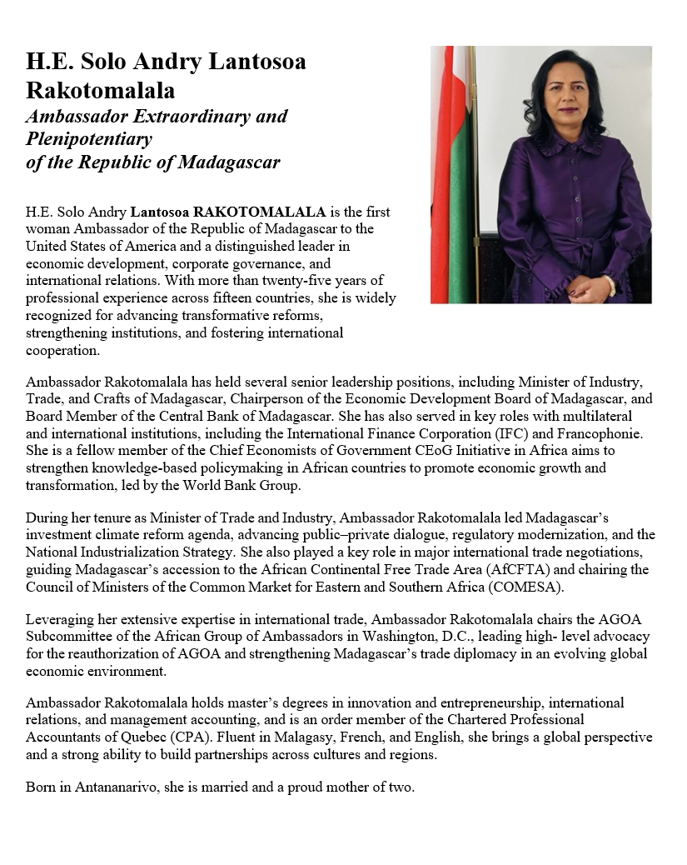
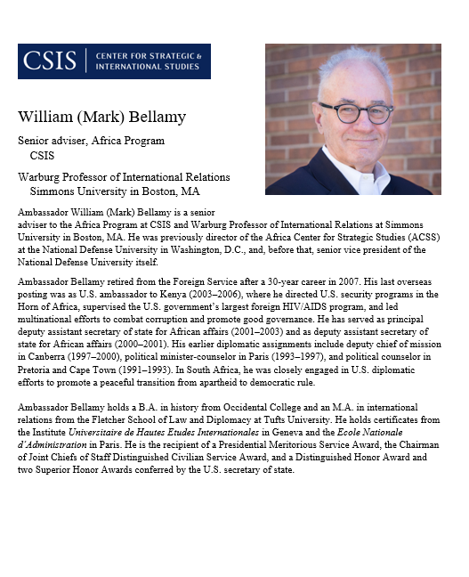
GUEST SPEAKERS
Amb. Lantosoa Rakotomalala
  -Introduced by Miles
Amb. Mark Bellamy
  -Introduced by Bijan

Slide 6
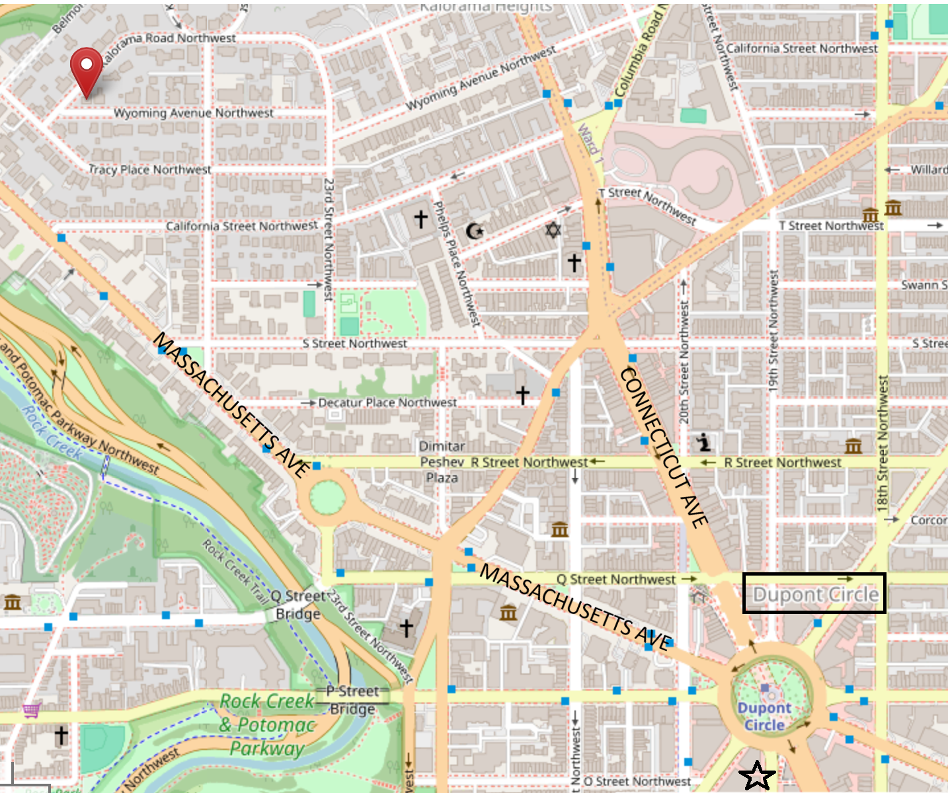




Slide 8


Slide 9
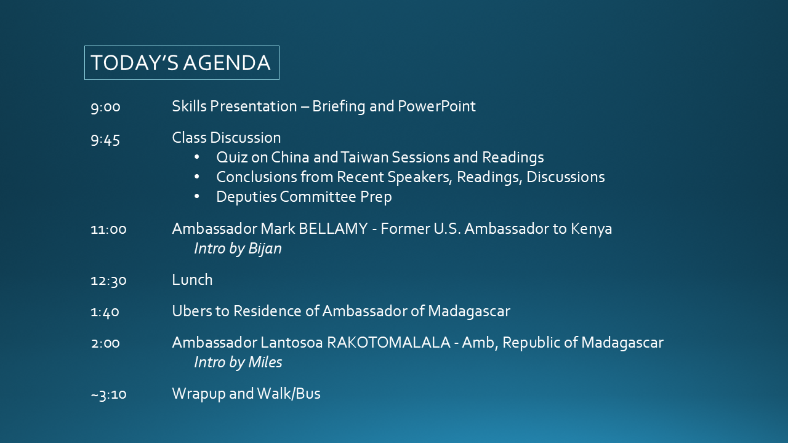

Slide 14
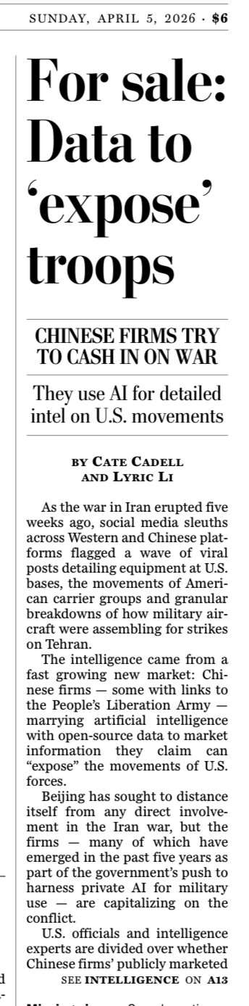
Three (of many) news stories
Washington Post

Slide 15
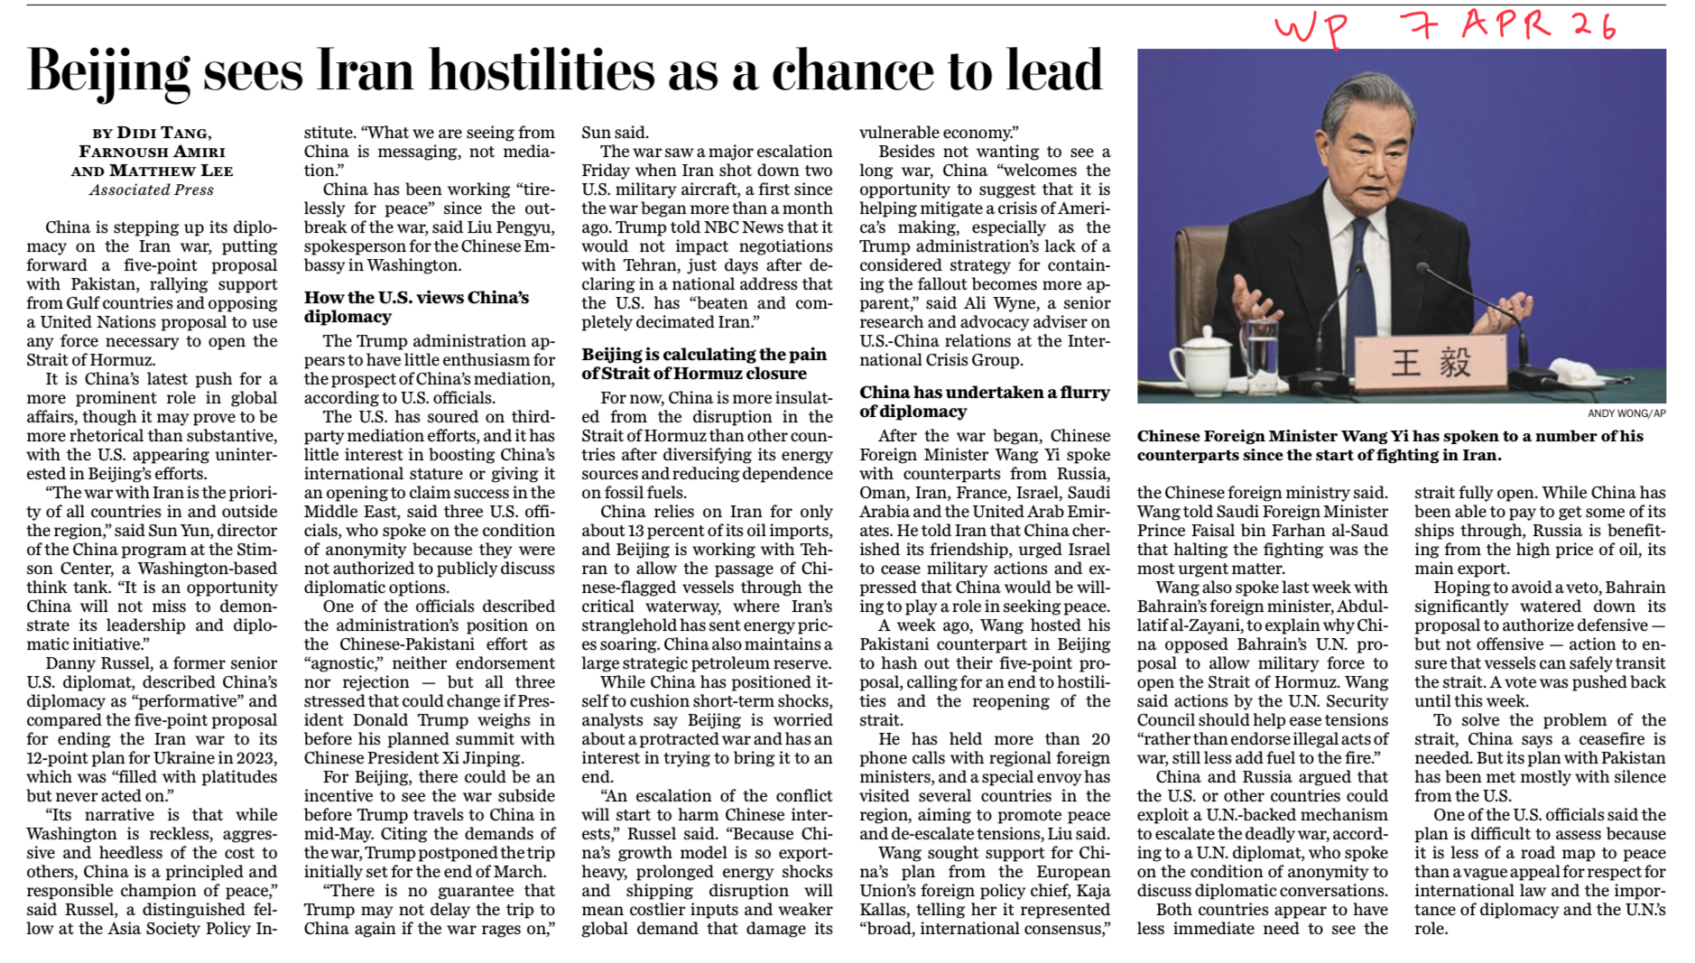

Slide 16
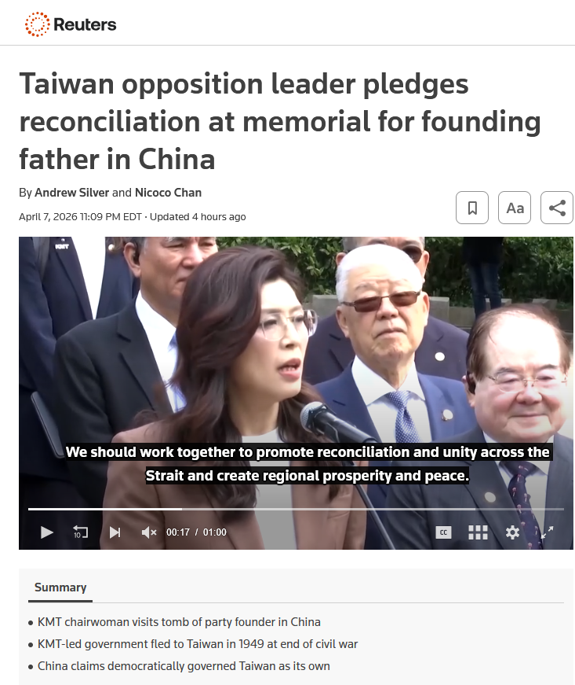

Slide 17
China, Taiwan, U.S-China, and U.S.-China-Taiwan
What’s your analysis of each?
What’s driving each?
What options does U.S. have for dealing with each?

Slide 19
DISCUSSION and PLANNING
Deputies Committee Exercise

Slide 20

NSC DEPUTIES SIMULATION
Friday, 24 April
TWO ROLES
NSC Directors or Senior Directors briefing the issue and proposals.
“The Deputies” receiving the briefing, asking the questions, and making the decisions.

Slide 21
NSC DEPUTIES SIMULATION
“The Deputies” receiving the briefing, asking the questions, and making the decisions.
Who are your decisionmakers?

Slide 22
Who attends?
National Security Advisor or Deputy
Deputy Secretary of State +1
Deputy Secretary of Defense +1
Deputy Secretary of Homeland Security +1
Deputy Secretary of Treasury +1
OVP National Security Advisor +1
NSC staff
OMB leadership or staff
Advisors
Joint Chiefs of Staff (JCS)
DNI and/or CIA
And other affected Deputies
NSC DEPUTIES

Slide 23
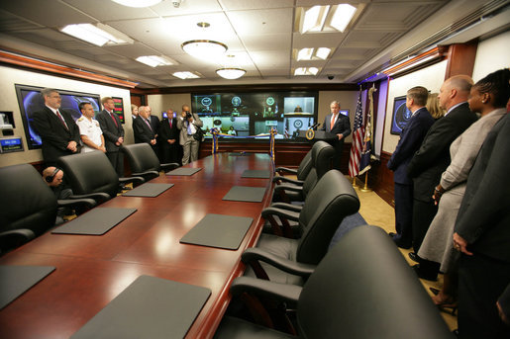
The Situation Room

Slide 24
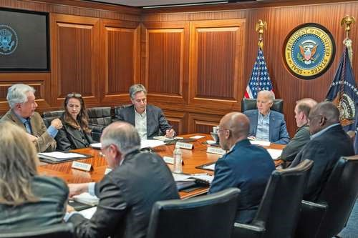
BURNS
HAINES
BLINKEN
SULLIVAN
BIDEN
AUSTIN
BROWN

Slide 25
What will the briefers do?
Serve as NSC Senior Directors or Directors briefing the issue and proposals.
BLUF on issue and proposal
Briefly …
    Define the problem and status
    Report key analysis (based on research, hearing/event, interviews, discussions)
    Present recommendation and pro’s and con’s
    Sum up with request for Deputies’ approval for main proposal
4 PowerPoint Slides
8-9 MINUTES
(but Deputies can interrupt)

Slide 26
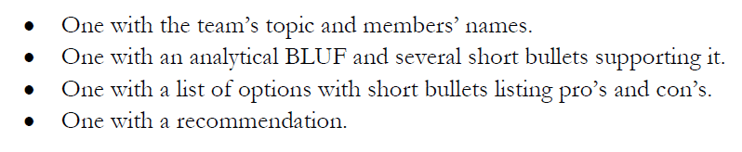
DC BRIEFING
The four PowerPoint slides
DEADLINE to submit in Blackboard: Wednesday (22 April) at 9pm.

Slide 27
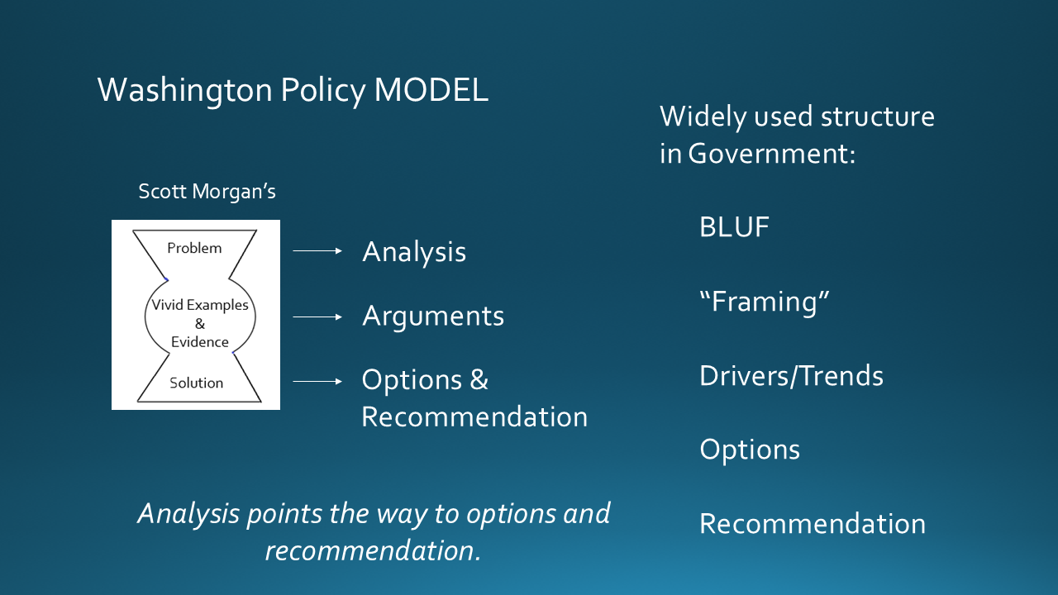
DC BRIEFING

Slide 28

DC BRIEFING
Scott Morgan’s MODEL
MODEL for our memo
Structure:
BLUF
“Framing”
Drivers/Trends
Options
Recommendation
Problem
Problem
Analysis
Options
Recommendation
Vivid Examples
&
Evidence
Solution
Next Steps
Morgan:
“If I buy your analysis, I’m much more likely to buy your recommendation.”

Slide 29
What will the deputies do?
Serve as decisionmakers.
READ and ABSORB materials provided in advance
LISTEN to the briefing but INTERRUPT if briefing is unclear
ASK questions about analysis and proposal
EXPRESS position on issue and proposal
After pause for all to “vote” …
    Approve as is.
    Approve with SPECIFIC, DIRECTED conditions.
    Remand to Interagency Working Group for re-work.
    Disapprove with prejudice.
Q&A and discussion: 8-9 MINUTES
All of you are deputies and will vote, but LEAD deputies will “sit at the table” and discuss their votes.

Slide 30
Who
do you want to be your deputies?
will be your deputies?

Slide 31
DEPUTIES COMMITTEE
STAFF | TOPIC | DEPUTIES
Emmett | Danger of one-dimensional energy sector
John
Miles | Climate change and refugees/sovereignty
Kennedy
Eli | Iran-US relations
Michael
Diego | Globalization and environmental impact
Molisa
Kaiwen | China’s Influence in Africa
Yvette
Bijan | Humanitarian Crisis in Gaza
Megha
Filippo | North Korea illegal ops to support goals
David

Slide 32
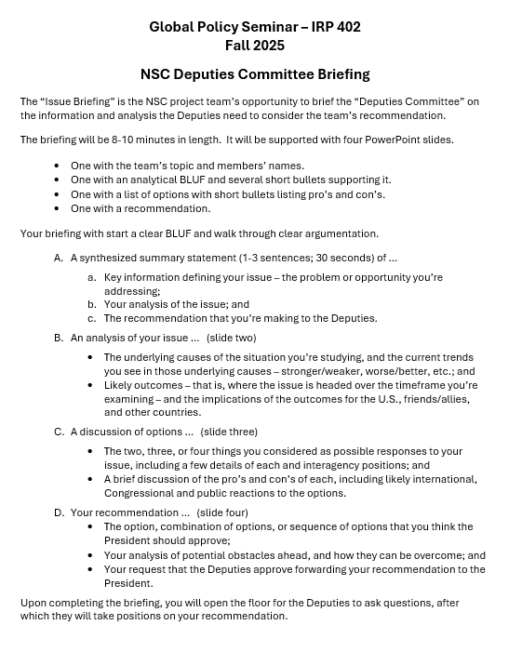
“DEPUTIES COMMITTEE” EXERCISE
GUIDANCE ON BRIEFING
All set?
All good on slides?

Slide 33
Any questions?

Slide 34
DISCUSSION
The Deputies Paper
Due: Friday, 17 April
One week from today.

Slide 35
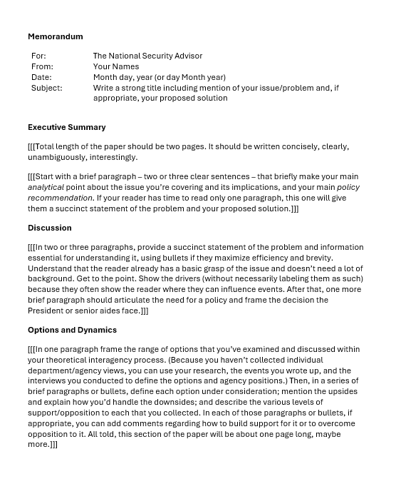
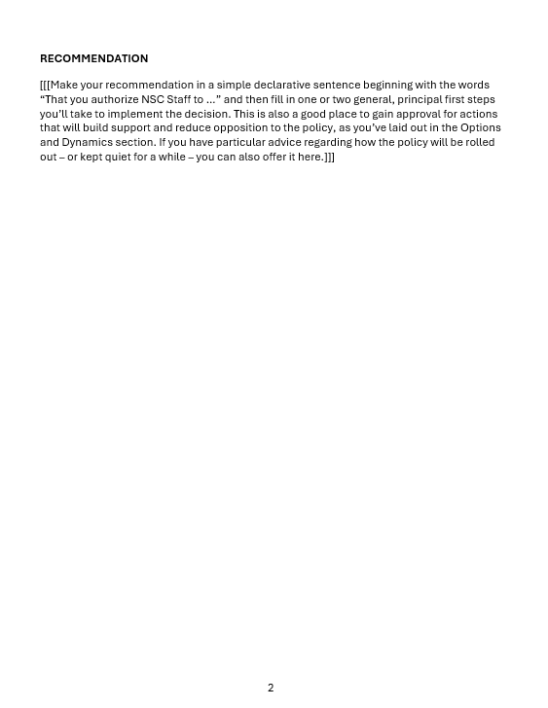
“The DEPUTIES Memo”

Slide 36
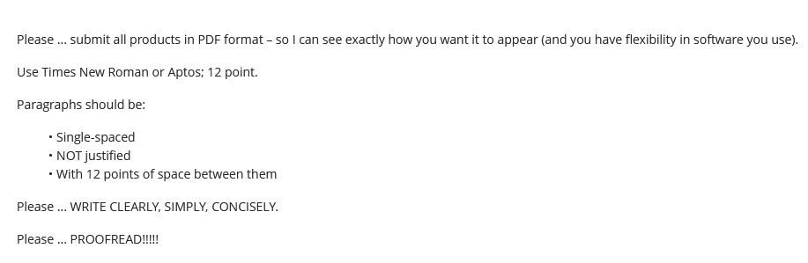
Guidance on Format

Slide 37
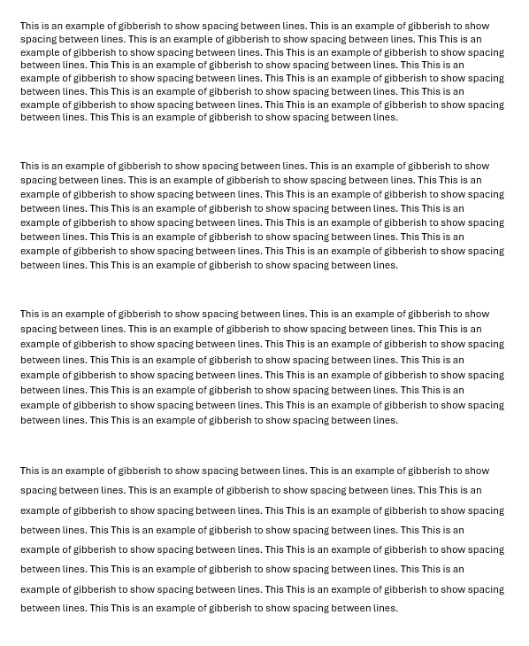
Single space (1.0)
Multiple (1.08)
Multiple (1.16)
1.5 lines (1.5)

Slide 38
REVIEW
What do good memos have in common?
JOB ONE:
MAKE IT EASY FOR YOUR READER TO GET WHAT THEY NEED TO KNOW.
Brevity | They don’t waste readers’ time.
Conciseness | They’re not sloppy, long-winded.
Clarity, precision | They don’t make reader sort through ambiguity.
Relevance | They don’t burden reader with clutter.
Objectivity | They don’t get bogged down in values, norms.
Readability | They’re not obtuse, ornate, distracting.

Slide 39
REVIEW
JOB ONE:
MAKE IT EASY FOR YOUR READER TO GET WHAT THEY NEED TO KNOW.
Digestible declarative sentences
Good, practical grammar
Unambiguous but “normal” vocabulary
Clear logic
Transparent drafter
Zero, minimal, or clearly labeled editorializing

Slide 40
REVIEW
What are the differences between academic writing and memo-writing?
“Washington Memo”
Purpose(s)
“Action”; empower reader by educating.
Scope
Background
Relevance
Only what reader needs to know to decide.
Only what’s relevant.
Examples to show point, not encyclopedia.
Style
Language
Length
Voice
Concise, direct, active.
“As brief as possible” (usually two pages).
Objective, not ornate.
Structure

Slide 41
REVIEW
Standard Info Memo
Standard Decision Memo
Subject: | Clear, crisp
Subject: | Clear, crisp
Thesis: | BLUF, analytical
Thesis: | BLUF, analytical
Framing: | What, when, who, where
Framing: | What, when, who, where
Dynamics: | Why, how
Dynamics: | Why, how
OPTIONS: | Stated, assessed; interagency views
Outcomes: | Likely, less likely (and why)
Outcomes: | Likely, less likely (and why)
Implications: | Why matter?
Implications: | Why matter?
RECOMMENDATION

Slide 42
REVIEW
Standard Info Memo
Standard Decision Memo
Subject: | Clear, crisp
Subject: | Clear, crisp
Thesis: | BLUF, analytical
Thesis: | BLUF, analytical
Framing: | What, when, who, where
STANDARD BRIEFING, TOO!
Framing: | What, when, who, where
Dynamics: | Why, how
Dynamics: | Why, how
OPTIONS | Stated, assessed; interagency views
Outcomes: | Likely, less likely (and why)
Outcomes: | Likely, less likely (and why)
Implications: | Why matter?
Implications: | Why matter?
RECOMMENDATION

Slide 43
REVIEW
The ways Washington memos are prepared, researched, drafted, and edited are different from academic, too.
Obsessively ask ourselves ...
  What does the reader need to know (based on my understanding of my issue and their world)?
  Does every word, phrase, sentence, and paragraph make it easy for my reader to grab and run?
  If necessary, can I summarize my conclusions/ recommendations in 30 seconds or less?

Slide 44
REVIEW
Why is it important to be able to write a good “Washington Memo”?
Good writing is the single most important skill in this business
because it shows …
you can think
you can communicate
you know what’s relevant
you are ready to operate
Other skills are important, but writing is central to almost all of them.

Slide 45
“The DEPUTIES Memo” -- STEP BY STEP
STEP BY STEP

Slide 46
IMPORTANT to note if you’re writing for anyone else.
For: | The National Security Advisor
From: | Your Names
Date: | Month day, year (or day Month year)
Subject: | Write a strong title including mention of your issue/problem and, if appropriate, your proposed solution

Slide 47
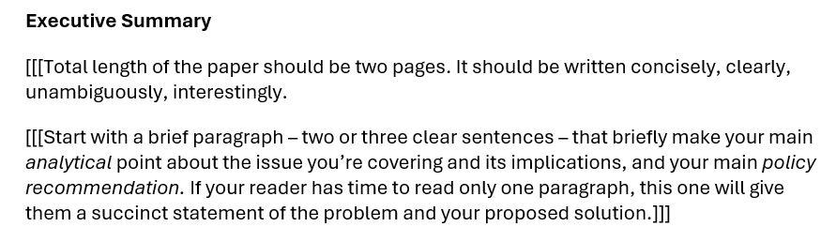

Slide 48
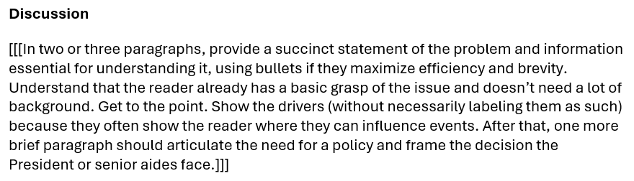

Slide 49
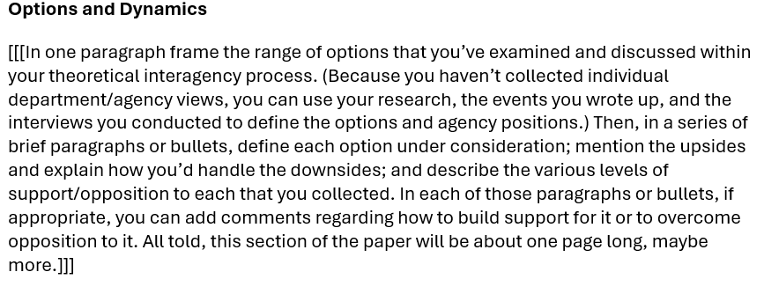

Slide 50
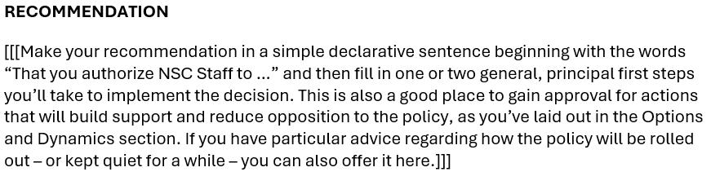

Slide 51
The memo must be good.
Friday, 10 Apr → | Choose your Deputies.
Friday evening, 17 Apr → | Memo post as assignment in BB.
Saturday/Sunday, 18-19 Apr → | I will send memo to Deputies – for them to review, digest, and prepare questions.
Wednesday evening, 22 Apr → | Slides posted as assignment in BB.
Friday, 24 Apr→ | Deputies exercise.
Questions?

Slide 52
Any Questions or Comments about the Deputies Memo, Briefings, or Slides?

Slide 53
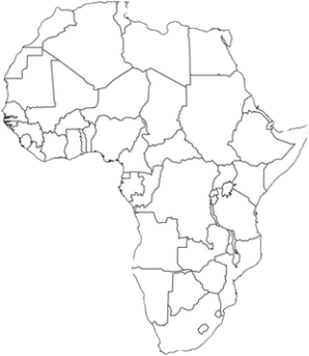
Population | 1.2 billion
Number of countries | 54
Special distinction (among many) | “Cradle of humankind”
Amount of world’s arable land | One sixth
Rank in size among continents | Second
Highest point | Kilimanjaro, Tanzania
Number of languages spoken | 1,500 (Arabic biggest)
Religions | Islam and Christianity (~40 % each)
Average economic growth rate | Above 7 %
Rank among world’s hot deserts | Biggest
Rank among world’s rivers | Longest (The Nile)
Biggest producer of … | Diamonds, gold, platinum, cocoa beans
AFRICA
AT A GLANCE

Slide 54
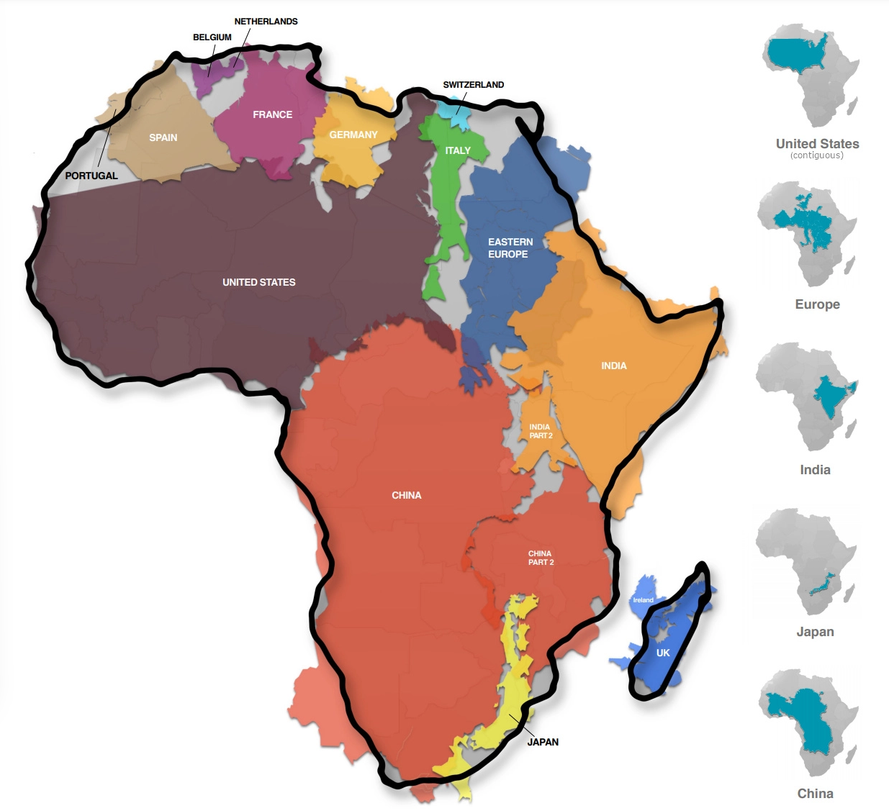

Slide 55
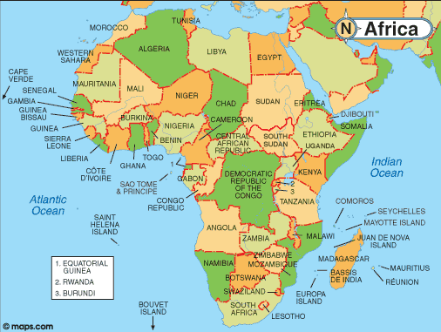
“THE HORN”
THE SAHEL
“SUB-SAHARAN AFRICA”

Slide 57
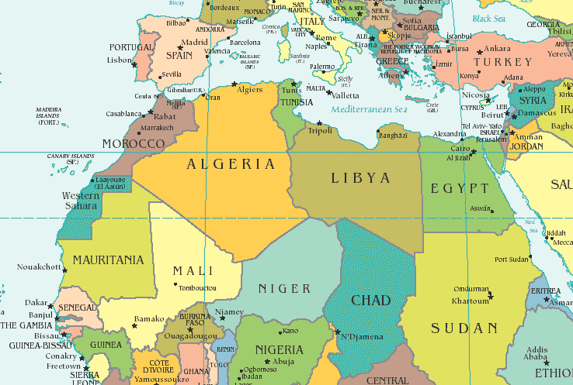
NORTH

Slide 58
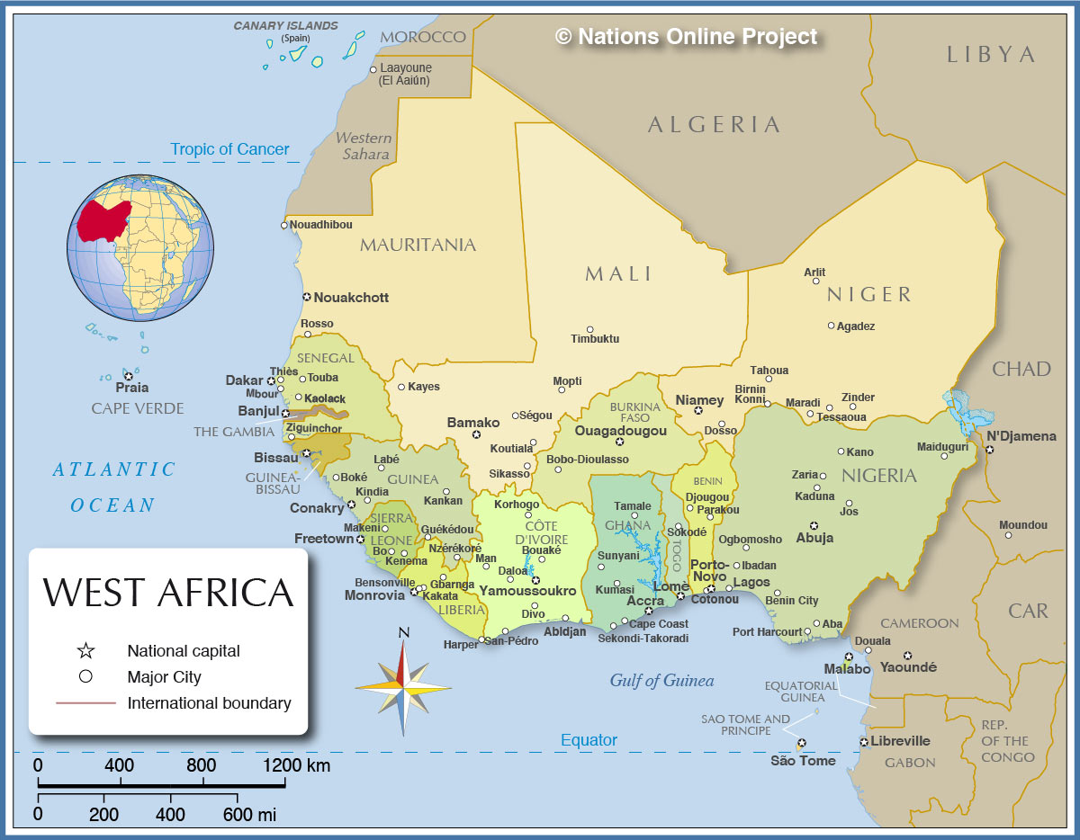
WEST

Slide 59
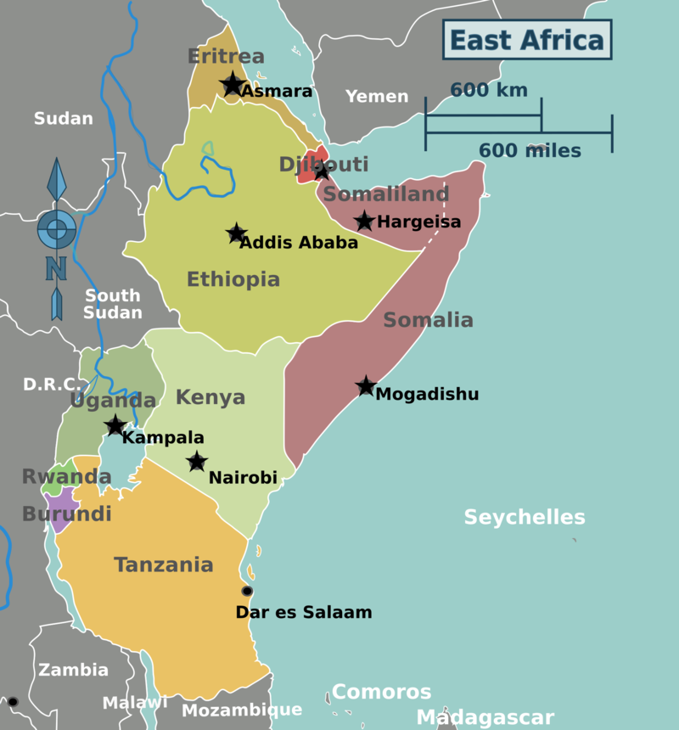
EAST

Slide 60
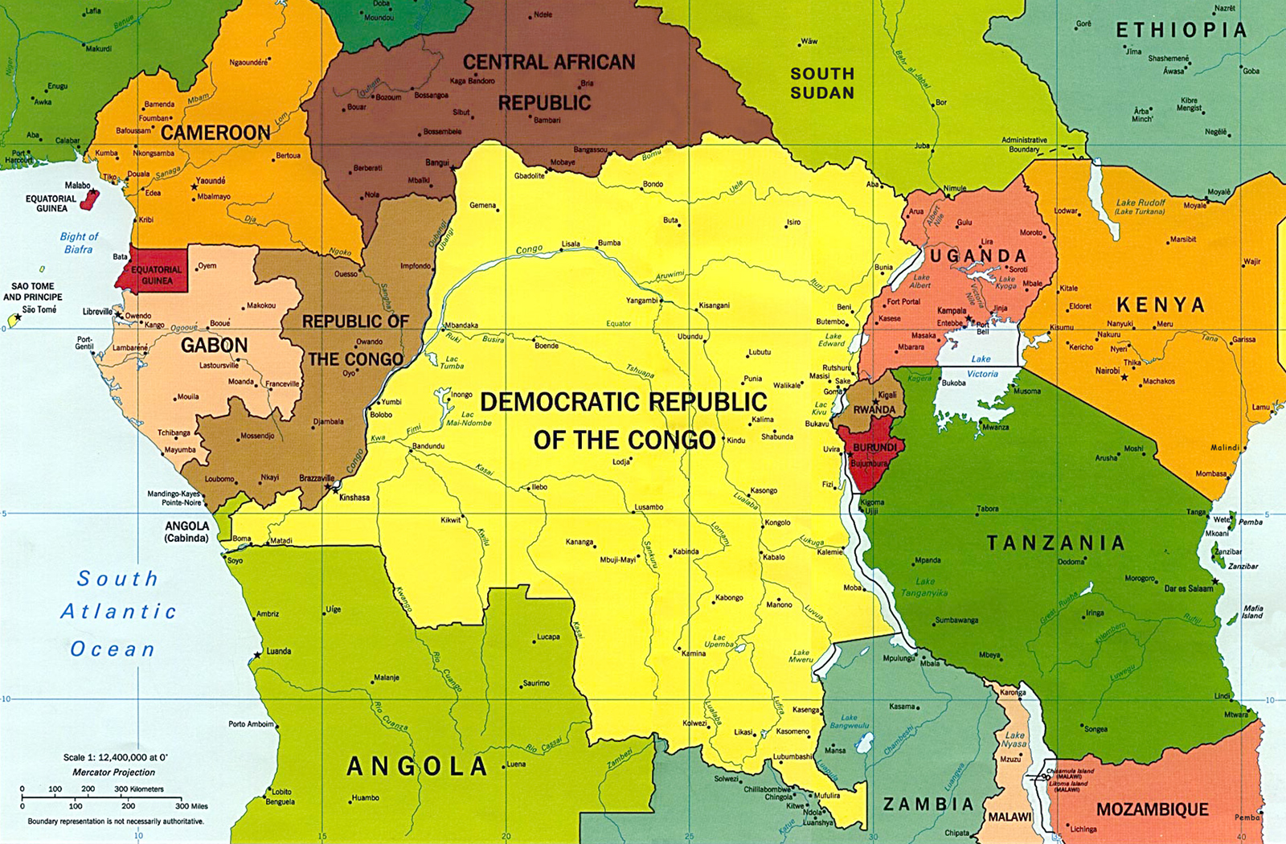
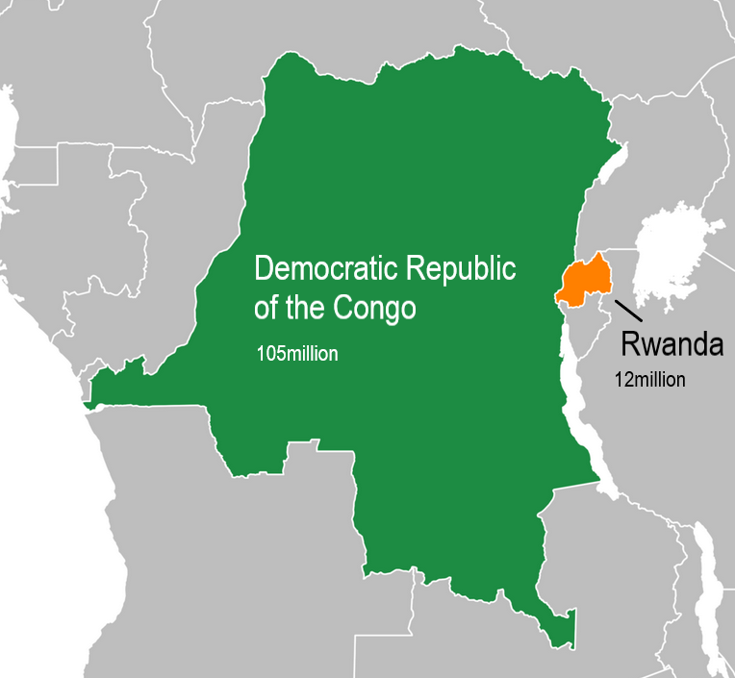
CENTRAL

Slide 61
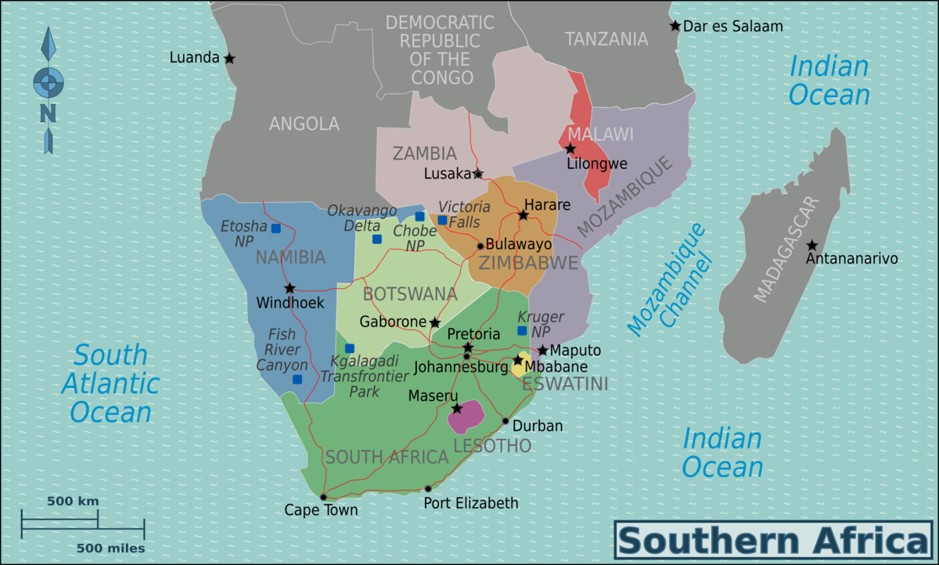
SOUTHERN

Slide 62

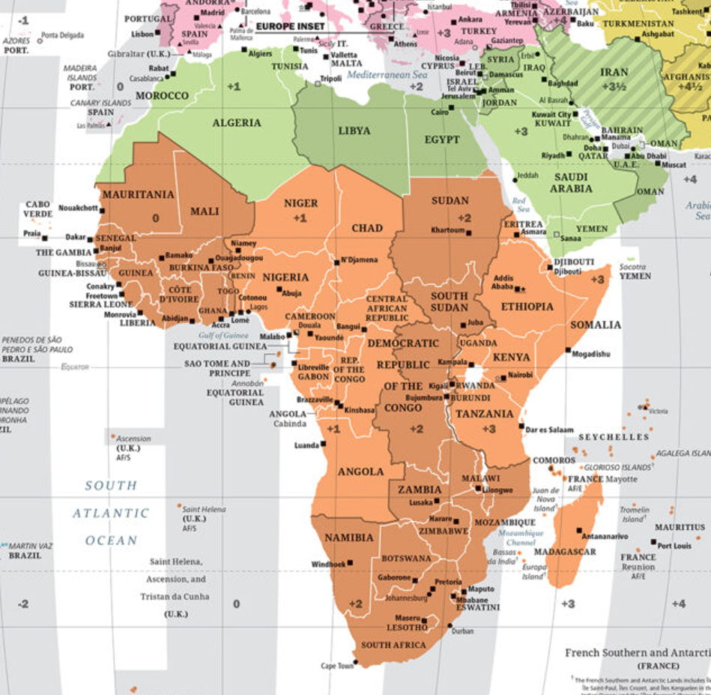
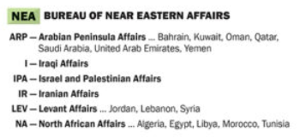
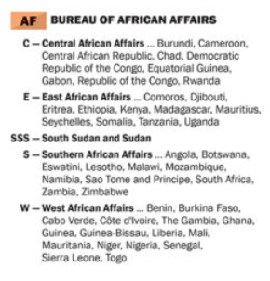

Slide 63
DISCUSSION
U.S. Policy Terms
PEPFAR – President’s Emergency Plan for AIDS Relief
AGOA – Africa Growth and Opportunity Act
DFC – International Development Finance Corporation
MCC – Millennium Challenge Corporation
PA – Prosper Africa – Trump I program to boost trade
GFA – Global Fragility Act – Biden program to reduce conflict

Slide 64
DISCUSSION
The Readings
What are the U.S. interests in Africa?
What are China’s main interests in Africa? What do they mean for the United States?
What internal and external threats do countries of Africa face?
What has been U.S. policy toward Africa in recent years?

Slide 65
GUEST SPEAKER
Ambassador Mark Bellamy
Senior adviser, Africa Program
CSIS
Former Warburg Professor of Int’l Relations
Simmons University in Boston, MA
  -Introduced by Rider

Slide 66
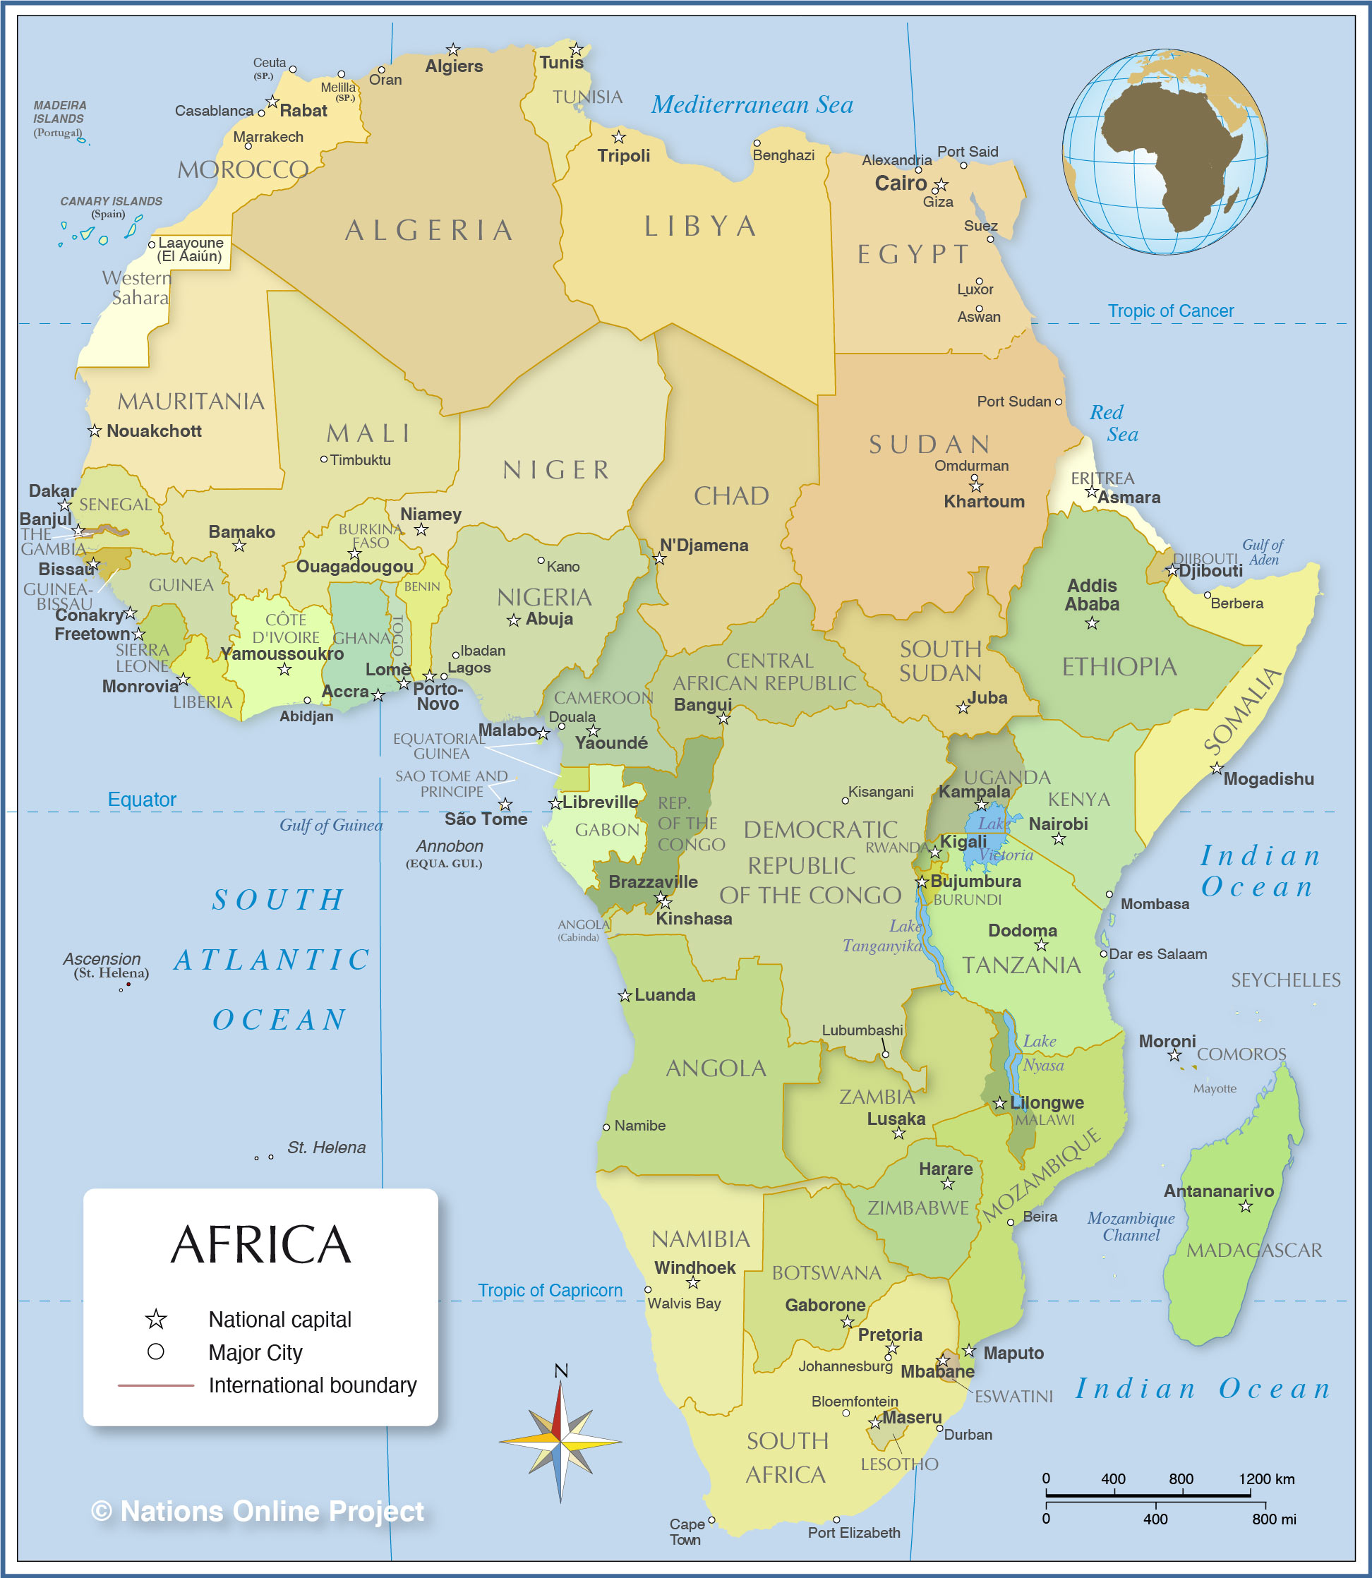

Slide 67
INTERNSHIP CONVERSATIONS
Informal Discussion
Launched with 2-3 mins on …
  Organization name, business, structure
  Your role – team, function, purpose
  Typical duties and responsibilities
  Most challenging aspect; most rewarding aspect
  Your takeaway: what you’ve learned about yourself and future interests
John
Bijan
Filippo

Slide 68

at 1:40

Slide 69
at 1:40

Slide 71

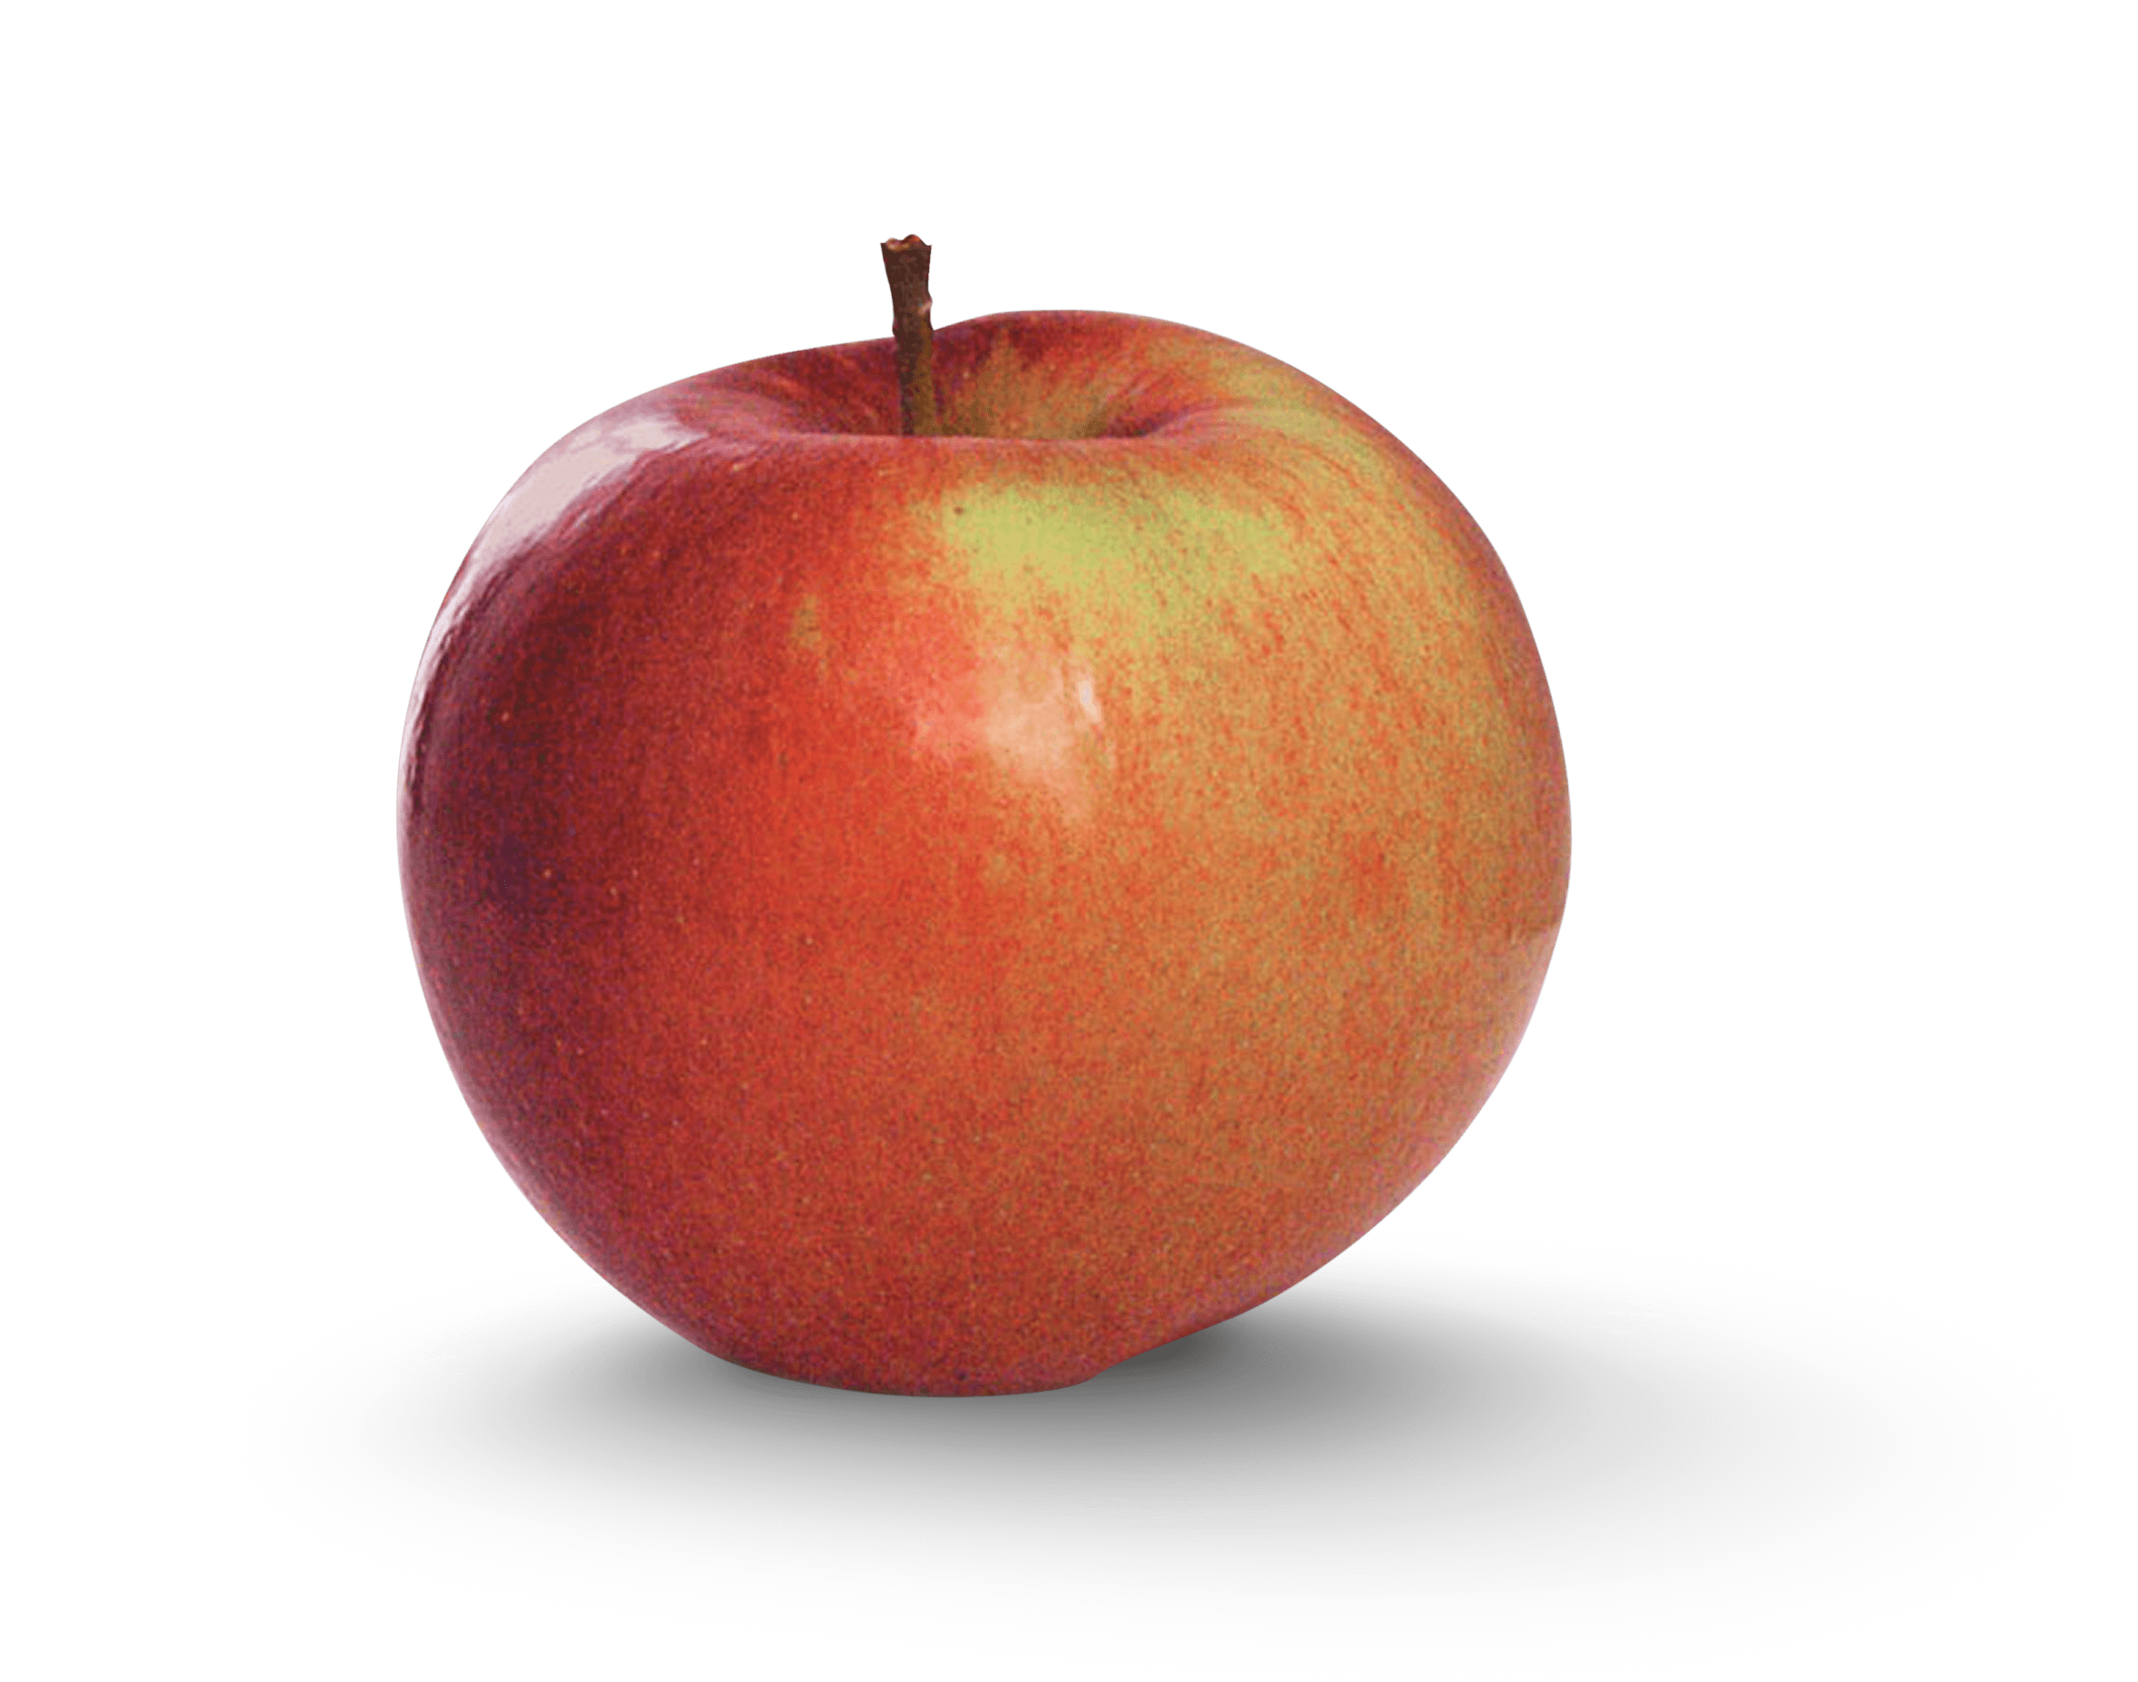
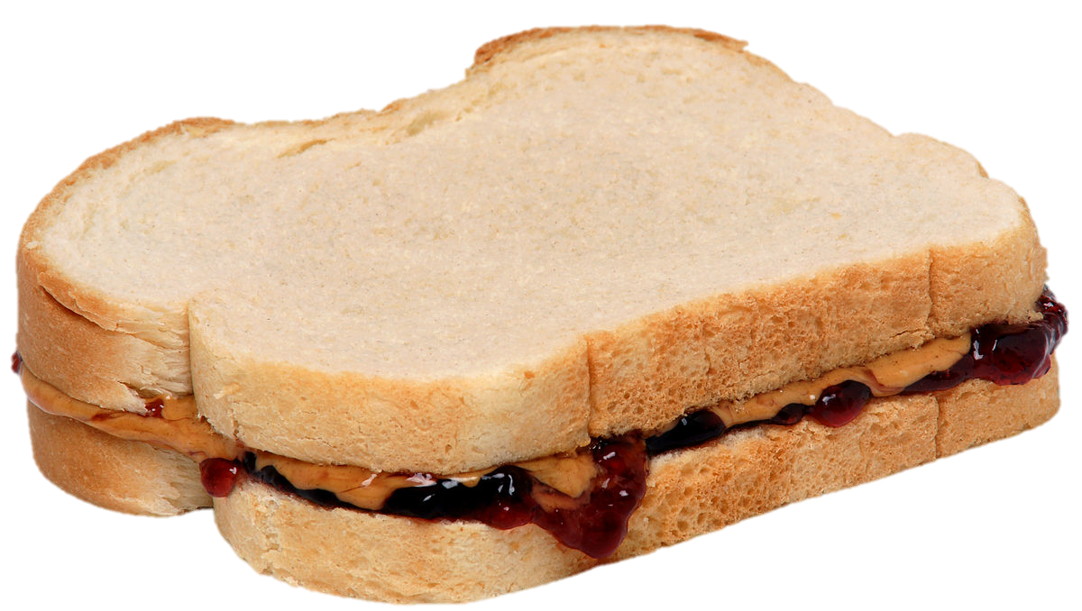
LUNCH

Slide 72
PROJECT UPDATES

Slide 73
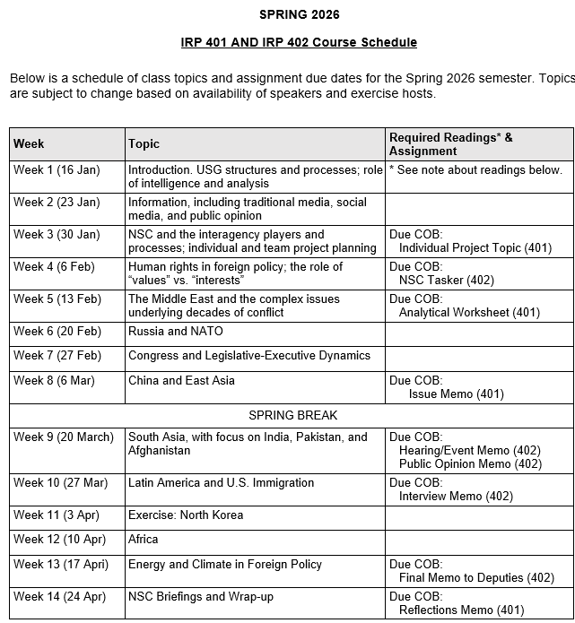
✓
✓
✓
✓
401
✓
✓
✓
✓
✓
✓
✓
✓
402
✓
✓
✓
✓
✓
✓
✓
✓
✓
✓
✓
✓
✓
✓
✓
✓
✓
✓
✓
✓
✓
✓
✓
✓

Slide 74
PROJECT PLANNING
Emmett | Countering “CRINK” Alignment | Danger of one-dimensional energy sector
John | Innovation and Environmental Capacity
Miles | Capitalism and Environment Protection | Climate change and refugees/sovereignty
Kennedy | Taiwan Prosperity and U.S. Interests
Eli | Prediction Markets | Iran-US relations
Michael | Foreign Manipulation of U.S. Elections
Diego | Russian Invasion of Ukraine | Globalization and environmental impact
Molisa | U.S.-China Competition in Critical Technologies
Kaiwen | U.S.-China Economic and Trade Competition | China’s Influence in Africa
Yvette | Rwanda-DRC Conflict and Resolution
Bijan | Housing Shortage and its Implications | Humanitarian Crisis in Gaza
Megha | Restrictive U.S. Immigration and Visa Policies
Filippo | Transatlantic Relations | North Korea illegal ops to support goals
David | ???? | ??????

Slide 75
DISCUSSION
Comfortable?
  Topics
  How partnership will work
The purposes
  Substance, process, skills
The elements
401
  Analysis
  “Memo #2”
402
  Proposal
  Hearing/event
  Public opinion
  Interviews
  DC memo
  Briefing

Slide 76
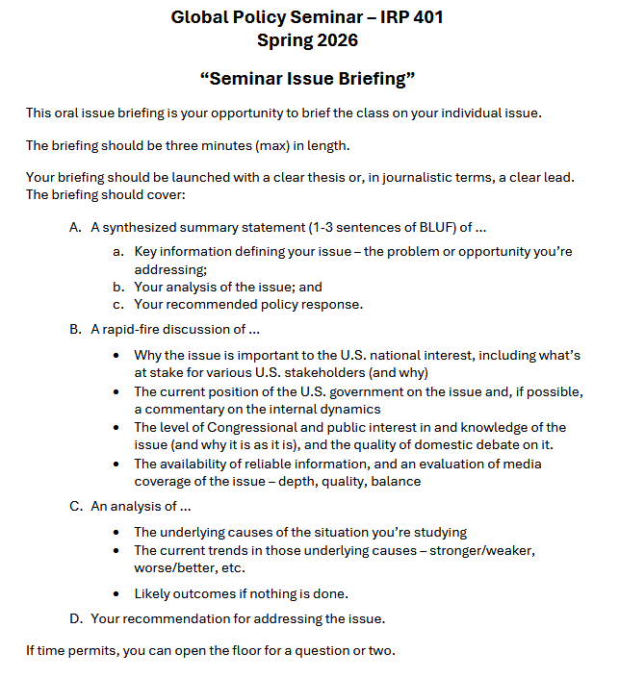
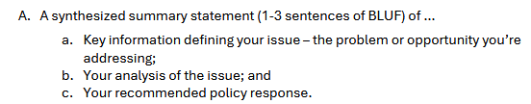
BRIEFINGS
One-Minute Briefing
Your 401 topic
For intelligent non-specialist
Problem-drivers-options-
recommendation
Interesting

Slide 77
BRIEFINGS
One-Minute Briefing
Your 401 topic
For intelligent non-specialist
Problem-drivers-options-
recommendation
Interesting
FEEL GOOD?
Diego | Eli | Filippo | Michael
Emmett | Meghavarshini | Kennedy | Kaiwen
John | Miles | Molisa | Bijan
Yvette

Slide 78
Next week …

Slide 79

WRAPUP

Slide 80
Questions? Comments? Concerns? Suggestions?

Slide 81
Global Policy Seminar and NSC Simulation
IRP 401 - IRP 402
Week Twelve
10 Apr 2026
Prof. Fulton T. Armstrong

