Slide 1

Global Policy Seminar and NSC Simulation
IRP 401 - IRP 402
Week Eleven 07 November 2025
Prof. Fulton T. Armstrong

Slide 2
Week 1 (29 Aug)
Week 2 (5 Sep)
Week 3 (12 Sep)
Week 4 (19 Sep)
Week 5 (26 Sep)
Week 6 (3 Oct)
Week 7 (10 Oct)
Week 8 (17 Oct)
Week 9 (24 Oct)
Week 10 (31 Oct )
Week 11 (7 Nov)
Week 12 (14 Nov)
Week 13 (21 Nov)
Thanksgiving Break
Week 14 (5 Dec)
Fall 2025

Slide 3

TODAY’S AGENDA
9:00 | SKILLS: How to do Well in a Job or Internship Interview (Fulton and Samantha)
~9:45 | INTERNSHIP Conversations Mo, Katelyn, Erik
~10:20 | DISCUSSION: Project Updates and Preps
11:00 | José Pertierra, Immigration Attorney - Introduced by Bobby
12:10 | Lunch
1:00 | Trita Parsi, Executive VP, Quincy Institute, and expert on M.E. affairs - Introduced by Syarra
~2:15 | Wrapup

Slide 4
TODAY’S AGENDA
9:00 | SKILLS: How to do Well in a Job or Internship Interview (Fulton and Samantha)
~9:45 | INTERNSHIP Conversations Mo, Katelyn, Erik
~10:20 | DISCUSSION: Project Updates and Preps
11:00 | José Pertierra, Immigration Attorney - Introduced by Bobby
12:10 | Lunch
1:00 | Trita Parsi, Executive VP, Quincy Institute, and expert on M.E. affairs - Introduced by Syarra
~2:15 | Wrapup

Slide 5
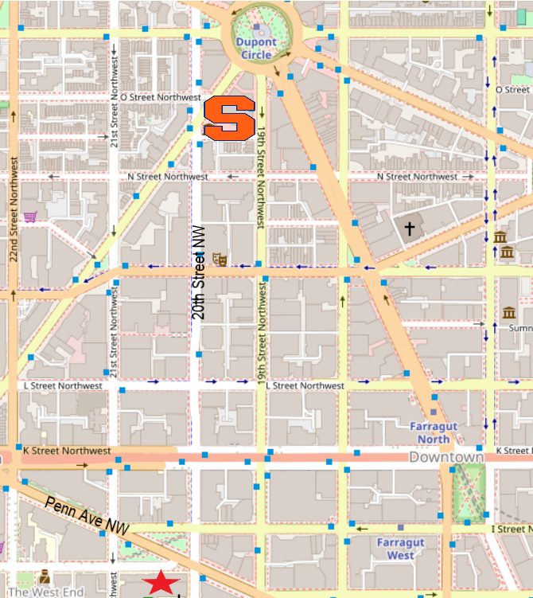

QUINCY INSTITUTE for Responsible Statecraft
2000 Pennsylvania Ave NW. Suite 7000

Slide 6
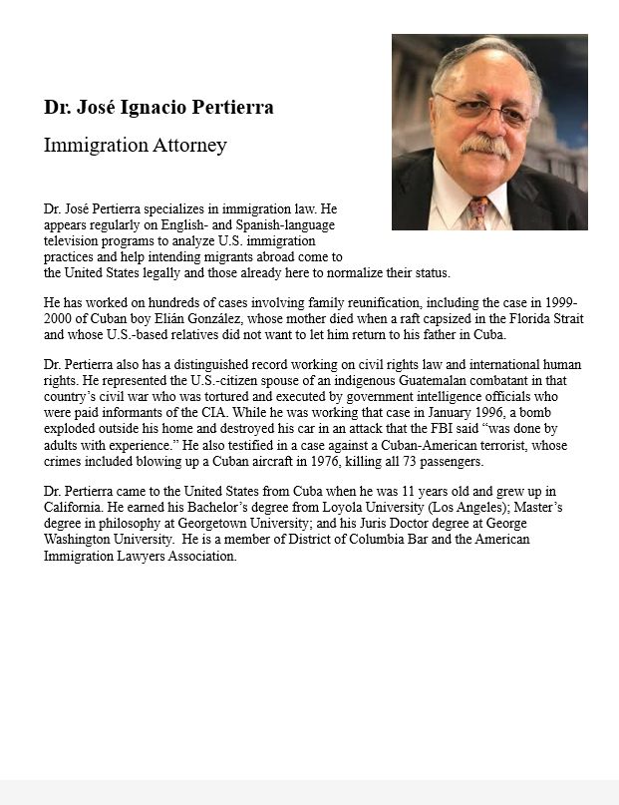
GUEST SPEAKER
José Pertierra
Immigration Lawyer and expert on immigration law and Latin America
- Introduced by Bobby

Slide 7
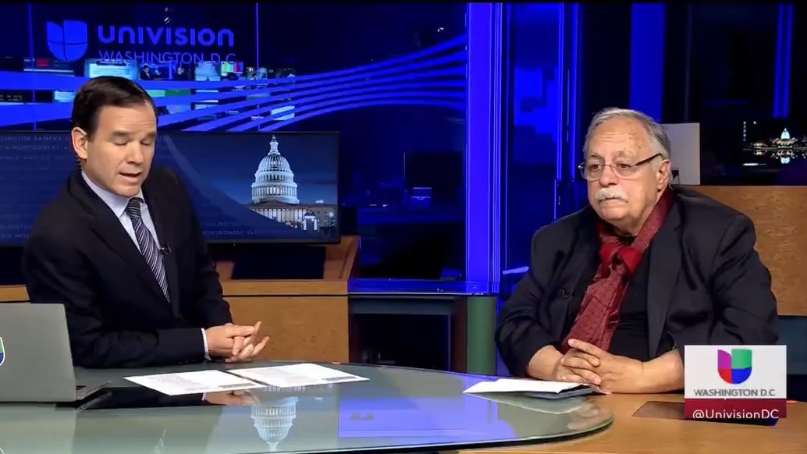

GUEST SPEAKER
José Pertierra

Slide 8
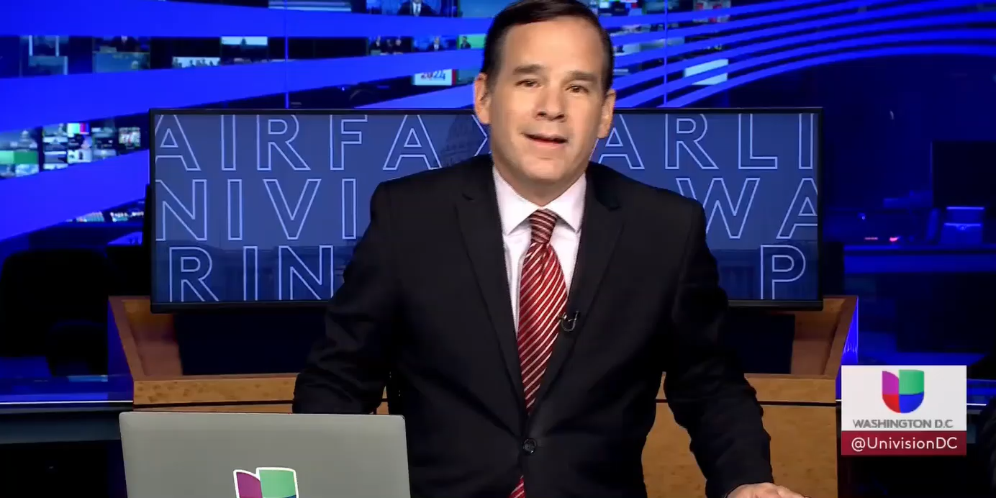
GUEST SPEAKER
José Pertierra

Slide 9
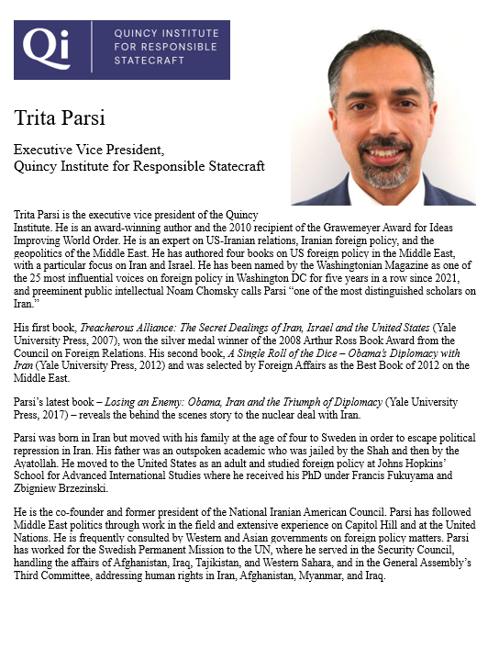
GUEST SPEAKER
Trita Parsi
Executive VP, Quincy Institute for Responsible Statecraft
Introduced by Syarra
Questions led by Syarra, Alex, Gabby, Katelyn

Slide 10

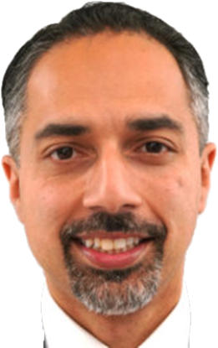
The Quincy Institute stands for responsible statecraft, defined as follows:
Responsible statecraft serves the public interest.
Responsible statecraft engages the world.
Responsible statecraft builds a peaceful world.
Responsible statecraft abhors war.
Responsible statecraft is democratic.
Trita Parsi

Slide 11

Next week …
The Six-Party Talks

Slide 12
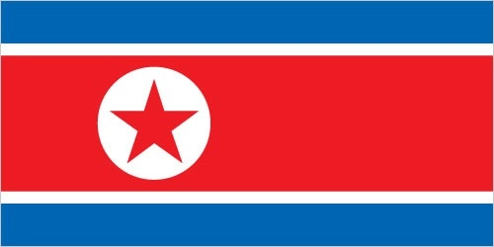


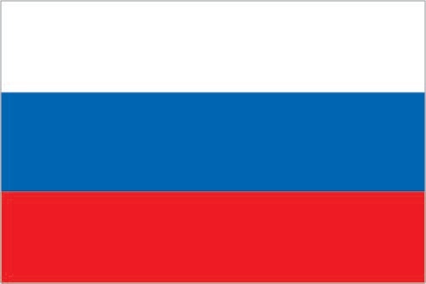


The Six-Party Talks
- An exercise in diplomatic negotiations -
You will be negotiating as representatives of
Democratic People’s Republic of Korea (DPRK – North Korea)
Republic of Korea (ROK – South Korea)
People’s Republic of China (PRC – China)
Japan
Russia
United States

Slide 13
The Six-Party Talks
- An exercise in diplomatic negotiations -
You will be negotiating as representatives of
Democratic People’s Republic of Korea (DPRK – North Korea)
Republic of Korea (ROK – South Korea)
People’s Republic of China (PRC – China)
Japan
Russia
United States

Slide 14



PICK AN ANIMAL
4 | 9 | 14 | 1 | 17 | 5
SWIMMING
RUNNING
16 | 2 | 10 | 18 | 13 | 6
REMEMBER
YOUR
NUMBER
11 | 7 | 15 | 12 | 3 | 8

Slide 15
Pick in numerical order, but you can pass or give to someone else.

Slide 16
The Six-Party Talks
 | Republic of Korea (South Korea) | Democratic People’s Republic of Korea (North Korea) | USA | People’s Republic of China | Japan | Russia
Team 1
Team 2
Team 3

Slide 17
Special reading to prep.
Activity will include lunch.
(I have reported dietary preferences or restrictions that I know of.)

Slide 18
Questions/comments about the readings on …
immigration or Iran/Israel/ME?

Slide 19
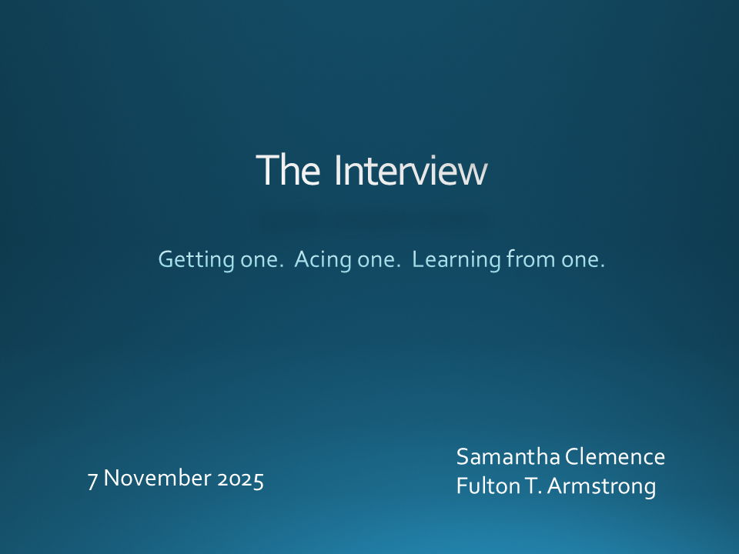

Slide 20
Internship conversations
INFORMAL DISCUSSION
Launched with 2-3 mins on …
Organization name and business
In-person, virtual, hybrid
Tasks and responsibilities
Communications and team dynamics
Fun things and challenges
Mo
Katelyn
Eric

Slide 21
DISCUSSION
The Deputies Paper
Due: Friday, 21 November Two weeks from today.

Slide 22
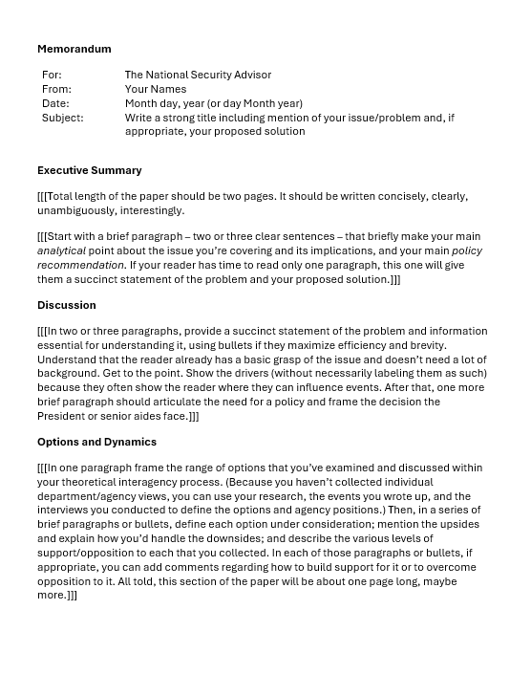
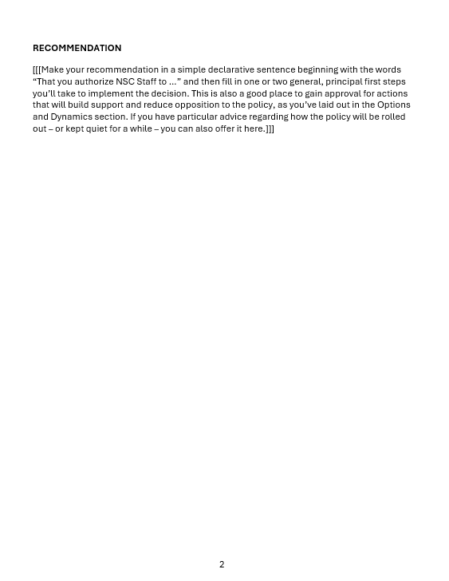
“The DEPUTIES Memo”
FIRST

Slide 23
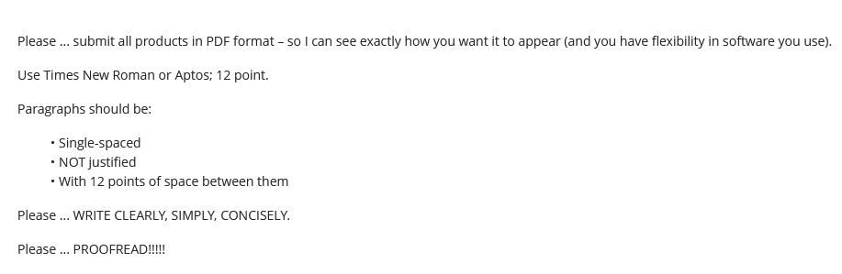
Guidance on Format

Slide 24
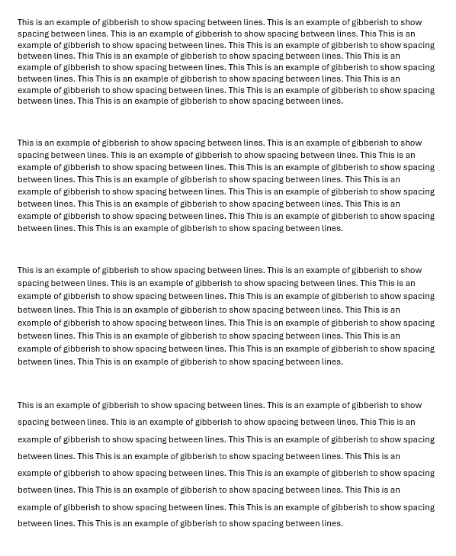
Single space (1.0)
Multiple (1.08)
Multiple (1.16)
1.5 lines (1.5)

Slide 25
REVIEW
What do good memos have in common?
JOB ONE:
MAKE IT EASY FOR YOUR READER TO GET WHAT THEY NEED TO KNOW.
Brevity | They don’t waste readers’ time.
Conciseness | They’re not sloppy, long-winded.
Clarity, precision | They don’t make reader sort through ambiguity.
Relevance | They don’t burden reader with clutter.
Objectivity | They don’t get bogged down in values, norms.
Readability | They’re not obtuse, ornate, distracting.

Slide 26
REVIEW
JOB ONE:
MAKE IT EASY FOR YOUR READER TO GET WHAT THEY NEED TO KNOW.
Digestible declarative sentences
Good, practical grammar
Unambiguous but “normal” vocabulary
Clear logic
Transparent drafter
Zero, minimal, or clearly labeled editorializing

Slide 27
REVIEW
What are the differences between academic writing and memo-writing?
“Washington Memo”
Purpose(s)
“Action”; empower reader by educating.
Scope
Background
Relevance
Only what reader needs to know to decide.
Only what’s relevant.
Examples to show point, not encyclopedia.
Style
Language
Length
Voice
Concise, direct, active.
“As brief as possible” (usually two pages).
Objective, not ornate.
Structure

Slide 28
REVIEW
Standard Info Memo
Standard Decision Memo
Subject: | Clear, crisp
Subject: | Clear, crisp
Thesis: | BLUF, analytical
Thesis: | BLUF, analytical
Framing: | What, when, who, where
Framing: | What, when, who, where
Dynamics: | Why, how
Dynamics: | Why, how
OPTIONS: | Stated, assessed; interagency views
Outcomes: | Likely, less likely (and why)
Outcomes: | Likely, less likely (and why)
Implications: | Why matter?
Implications: | Why matter?
RECOMMENDATION

Slide 29
REVIEW
Standard Info Memo
Standard Decision Memo
Subject: | Clear, crisp
Subject: | Clear, crisp
Thesis: | BLUF, analytical
Thesis: | BLUF, analytical
Framing: | What, when, who, where
STANDARD BRIEFING, TOO!
Framing: | What, when, who, where
Dynamics: | Why, how
Dynamics: | Why, how
OPTIONS | Stated, assessed; interagency views
Outcomes: | Likely, less likely (and why)
Outcomes: | Likely, less likely (and why)
Implications: | Why matter?
Implications: | Why matter?
RECOMMENDATION

Slide 30
REVIEW
The ways Washington memos are prepared, researched, drafted, and edited are different from academic, too.
Obsessively ask ourselves ...
What does the reader need to know (based on my understanding of my issue and their world)?
Does every word, phrase, sentence, and paragraph make it easy for my reader to grab and run?
If necessary, can I summarize my conclusions/ recommendations in 30 seconds or less?

Slide 31
REVIEW
Why is it important to be able to write a good “Washington Memo”?
Good writing is the single most important skill in this business because it shows …
you can think
you can communicate
you know what’s relevant
you are ready to operate
Other skills are important, but writing is central to almost all of them.

Slide 32
“The DEPUTIES Memo” -- STEP BY STEP
STEP BY STEP

Slide 33
IMPORTANT to note if you’re writing for anyone else.
For: | The National Security Advisor
From: | Your Names
Date: | Month day, year (or day Month year)
Subject: | Write a strong title including mention of your issue/problem and, if appropriate, your proposed solution

Slide 34
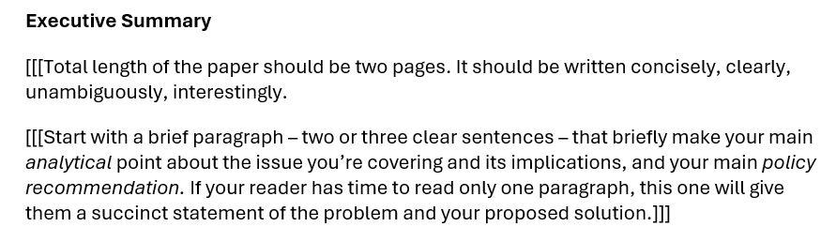

Slide 35
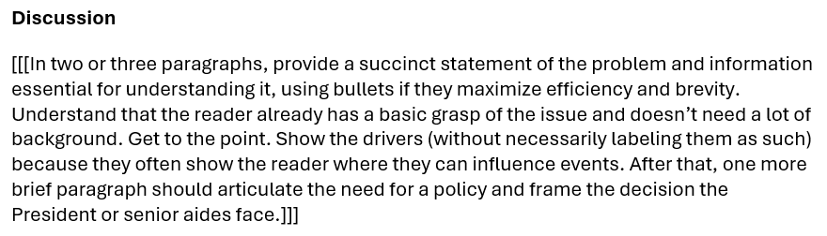

Slide 36
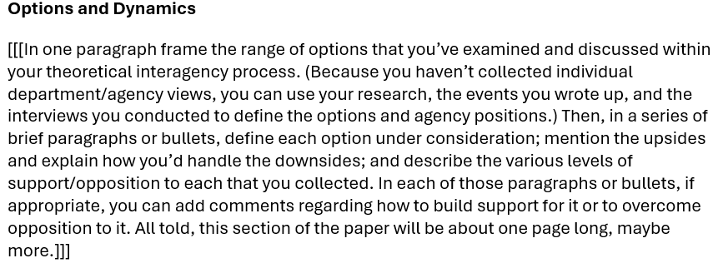

Slide 37
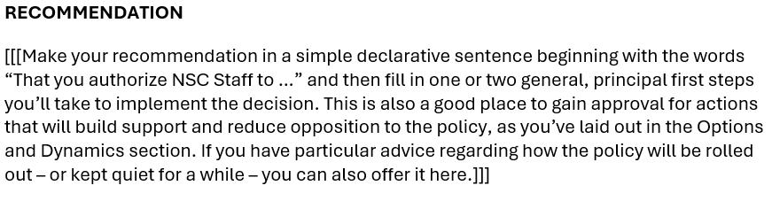

Slide 38
The memo must be good.
Friday, 14 Nov → | Choose your Deputies.
Friday evening , 21 Nov → | Memo post as assignment in BB.
Saturday/Sunday, 22-23 Nov → | I will send memo to Deputies – for them to review, digest, and prepare questions.
Wednesday evening, 3 Dec → | Slides posted as assignment in BB.
Friday, 5 Dec → | Deputies exercise.
Questions?

Slide 39
The memo must be good.
Friday, 14 Nov → | Choose your Deputies.
Friday evening , 21 Nov → | Memo post as assignment in BB.
Saturday/Sunday, 22-23 Nov → | I will send memo to Deputies – for them to review, digest, and prepare questions.
Wednesday evening, 3 Dec → | Slides posted as assignment in BB.
Friday, 5 Dec → | Deputies exercise.
Questions?

Slide 40
Project Planning
Téa | Future of NATO | Truce between Kyiv and Moscow
Brendan | India and Paris Agreement
Kennedy | Health impact of abortion restrictions | Women in Afghanistan
Katya | Inter-country adoption
Danny | Chinese pressure on Taiwan | Political situation in Venezuela
Lucienne | China’s growing influence in Peru
Mikah | Future direction of new Syrian government | Assistance to El Salvador
Brenda | Cartel violence in Mexico
Rebecca | Mongolia ecosystem and options for protection | Haiti violence and instability
Maria | Economic and social crisis in Puerto Rico
Alejandra | Venezuela crisis and border violence | China investment in infrastructure in Latin America
Julie | China-U.S. competition in global poverty alleviation
Sarah | Türkiye ambitions as regional/global player | Central Asian dependence on Chinese and Russian financing
Sam | Dedollarization
Albane | Vulnerabilities of sub-sea cables | Coup d’etats in the Sahel
Souleymane | US. Africa policy for the 21st century
Corrie | Climate crisis in Haiti | Lithium in Argentina, Bolivia, and Chile
Rider | The Ukraine-Russia War

Slide 41
GUEST SPEAKER
José Pertierra
Immigration Lawyer and expert on immigration law and Latin America
- Introduced by Bobby

Slide 42


Slide 43
GUEST SPEAKER
Trita Parsi
Executive VP, Quincy Institute for Responsible Statecraft
Introduced by Syarra
Questions led by Syarra, Alex, Gabby, Katelyn

Slide 44
Global Policy Seminar and NSC Simulation
IRP 401 - IRP 402
Week Eleven 07 November 2025
Prof. Fulton T. Armstrong

