Slide 1

Global Policy Seminar and NSC Simulation
IRP 401 - IRP 402
Week Ten 31 October 2025
Prof. Fulton T. Armstrong

Slide 2
Week 1 (29 Aug)
Week 2 (5 Sep)
Week 3 (12 Sep)
Week 4 (19 Sep)
Week 5 (26 Sep)
Week 6 (3 Oct)
Week 7 (10 Oct)
Week 8 (17 Oct)
Week 9 (24 Oct)
Week 10 (31 Oct )
Week 11 (7 Nov)
Week 12 (14 Nov)
Week 13 (21 Nov)
Thanksgiving Break
Week 14 (5 Dec)
Fall 2025

Slide 3

TODAY’S AGENDA
9:00 | Class Discussion - Readings and Quiz
10:00 | Ambassador Touqir HUSSAIN Former Ambassador of Pakistan to Brazil, Spain, and Japan Introduced by Kiana
11:10 | Professional Development: Are You Listening? Samantha Clemence
12:15 | Lunch
1:15 | Class Discussion - Projects
1:30 | Dr. Haroon HAKIMI - Former Deputy Minister for Information, Culture, Youth, and Tourism - Kabul, Afghanistan Mr. Nafees TAKAR - Chief of VOA’s Deewa Service Introduced by Katelyn
3:00 | Internship Conversations: Maeve, Gabby, Richard, Esme
3:30 | Wrapup

Slide 4
TODAY’S AGENDA
9:00 | Class Discussion - Readings and Quiz
10:00 | Ambassador Touqir HUSSAIN Former Ambassador of Pakistan to Brazil, Spain, and Japan Introduced by Kiana
11:10 | Professional Development: Are You Listening? Samantha Clemence
12:15 | Lunch
1:15 | Class Discussion - Projects
1:30 | Dr. Haroon HAKIMI - Former Deputy Minister for Information, Culture, Youth, and Tourism - Kabul, Afghanistan Mr. Nafees TAKAR - Chief of VOA’s Deewa Service Introduced by Katelyn
3:00 | Internship Conversations: Maeve, Gabby, Richard, Esme
3:30 | Wrapup

Slide 5
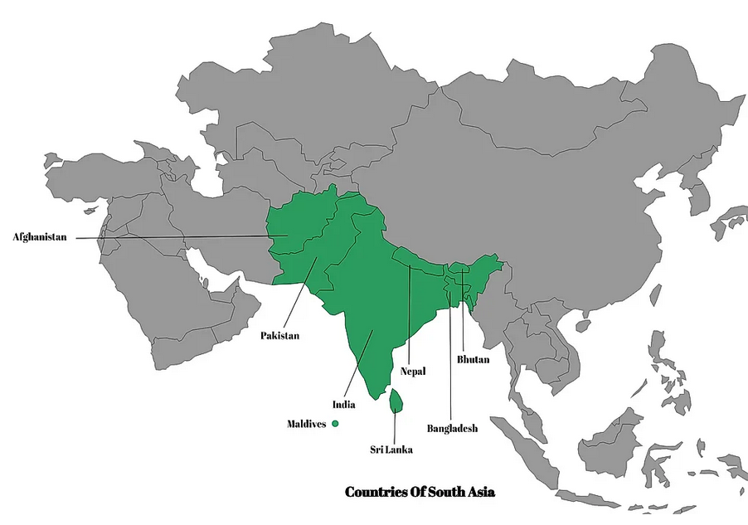
TAJIKISTAN
UZBEKISTAN
KYRGYZSTAN
TURKMENISTAN
SOUTH ASIA
1.
IRAN
2.
4.
5.
3.
8.
6.
7.

Slide 6
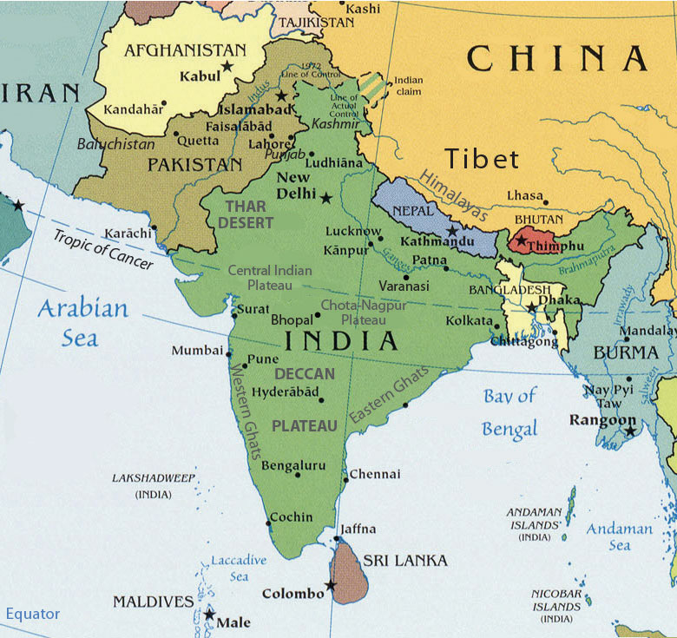

Slide 7
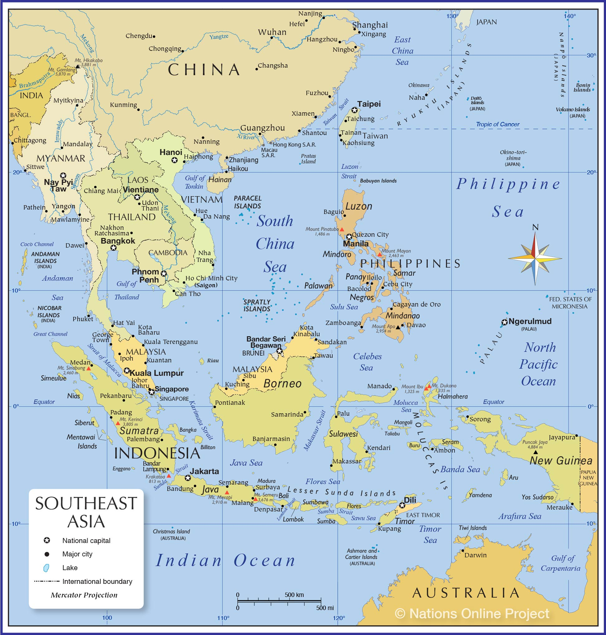

Slide 8
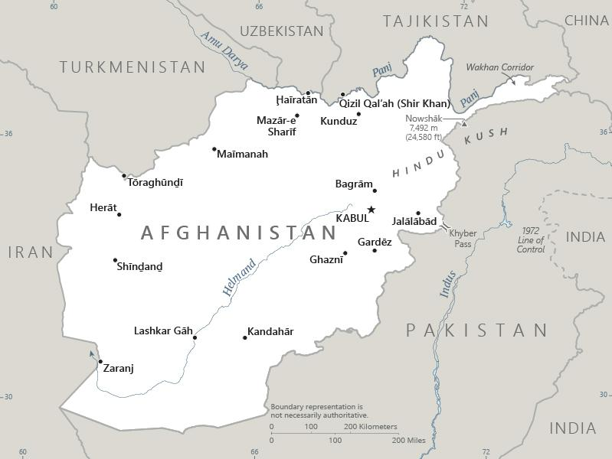

Slide 9
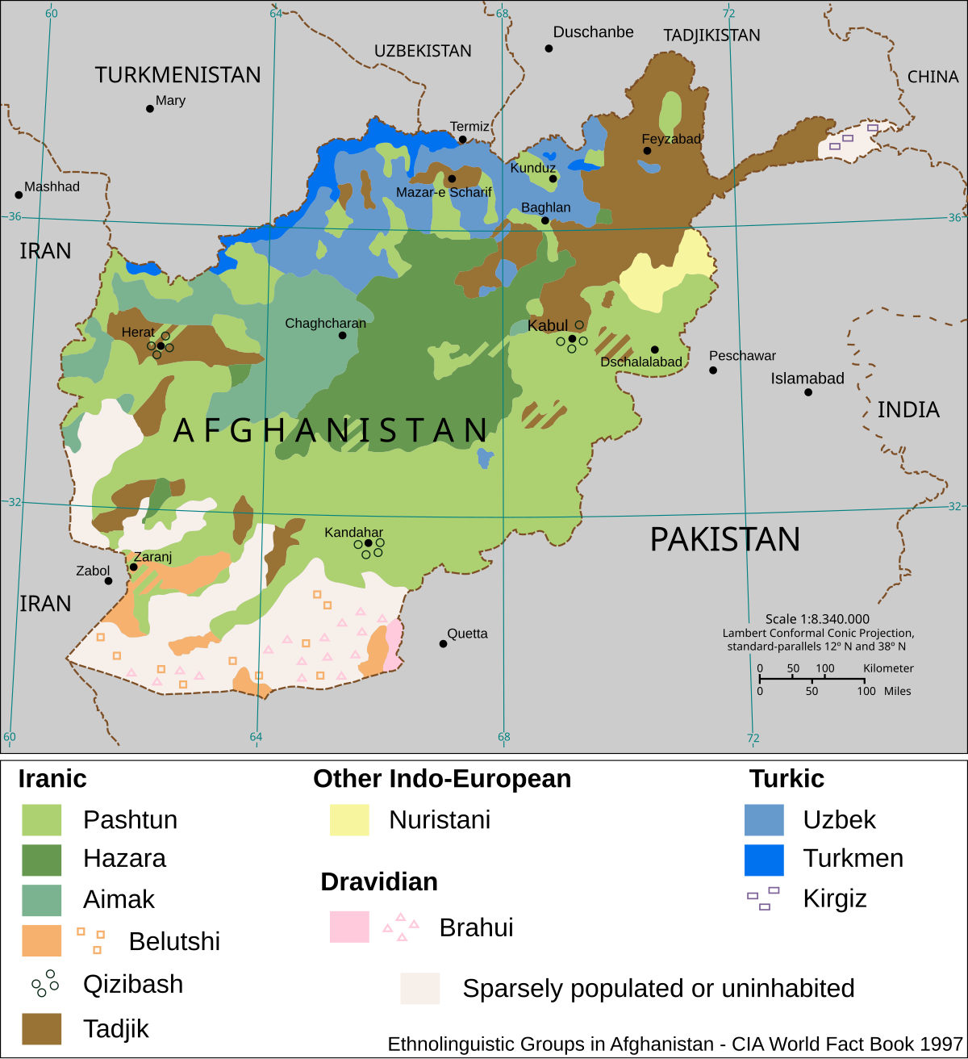

Slide 10
Quiz

Slide 11
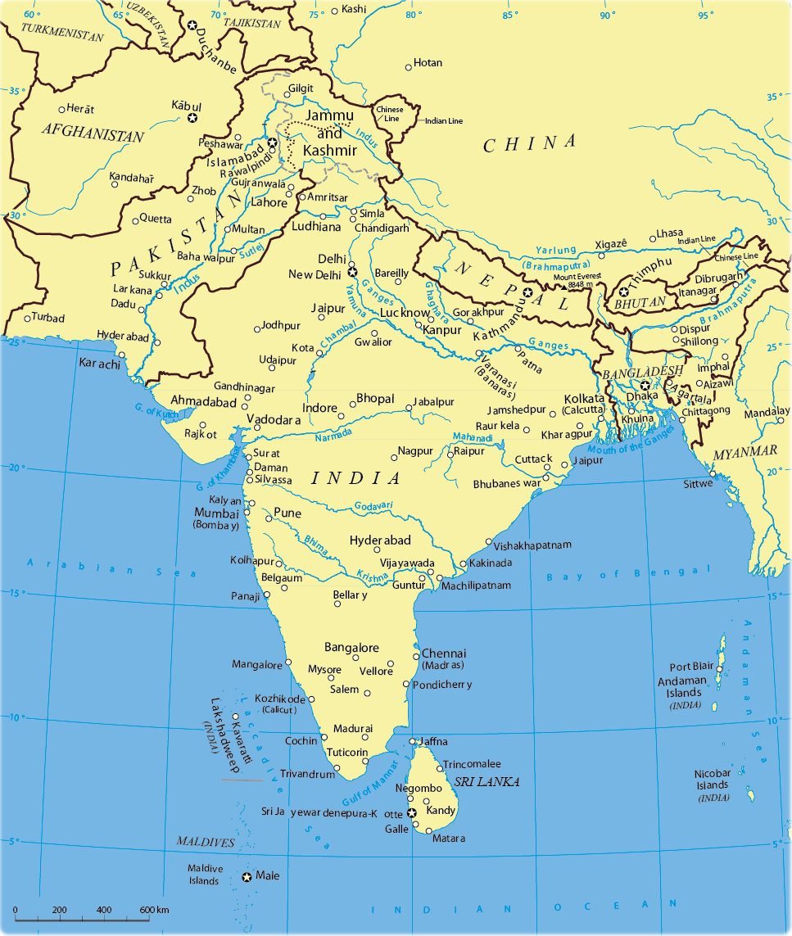








What do we need to know about …
INDIA
PAKISTAN
AFGHANISTAN
?

Slide 13
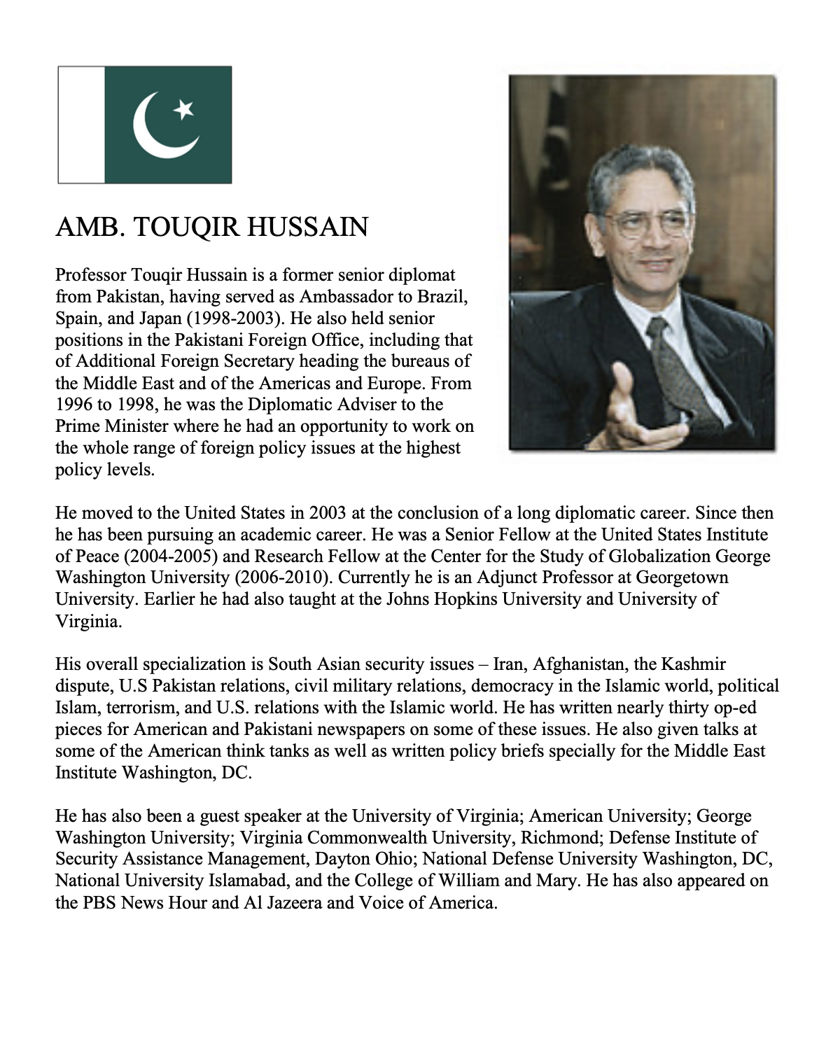
GUEST SPEAKER
Amb. Touqir Hussain
Former Senior Diplomat of Pakistan
Current Adjunct Professor, Georgetown University
- Introduced by Kiana

Slide 14
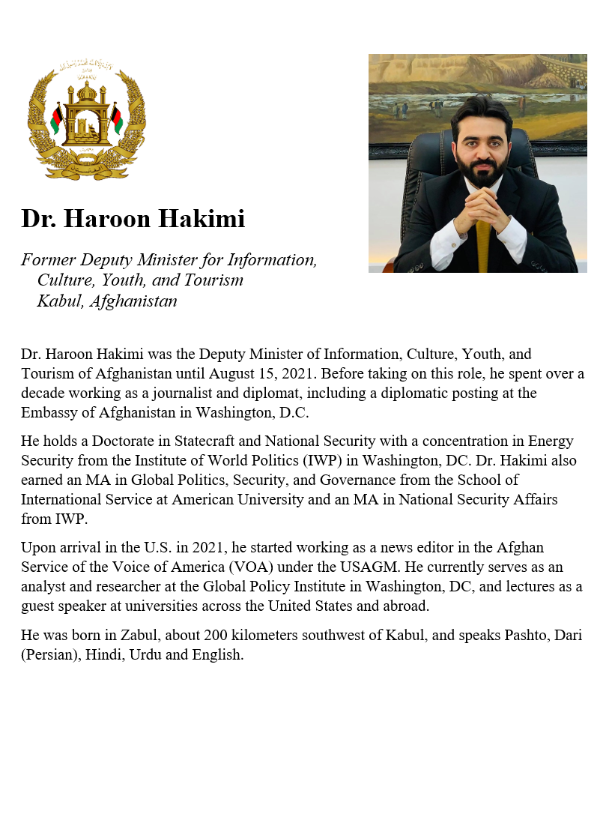
GUEST SPEAKER
Dr. Haroon Hakimi
Former Deputy Minister for Information, Culture, Youth, and Tourism Kabul, Afghanistan
- Introduced by Katelyn

Slide 15
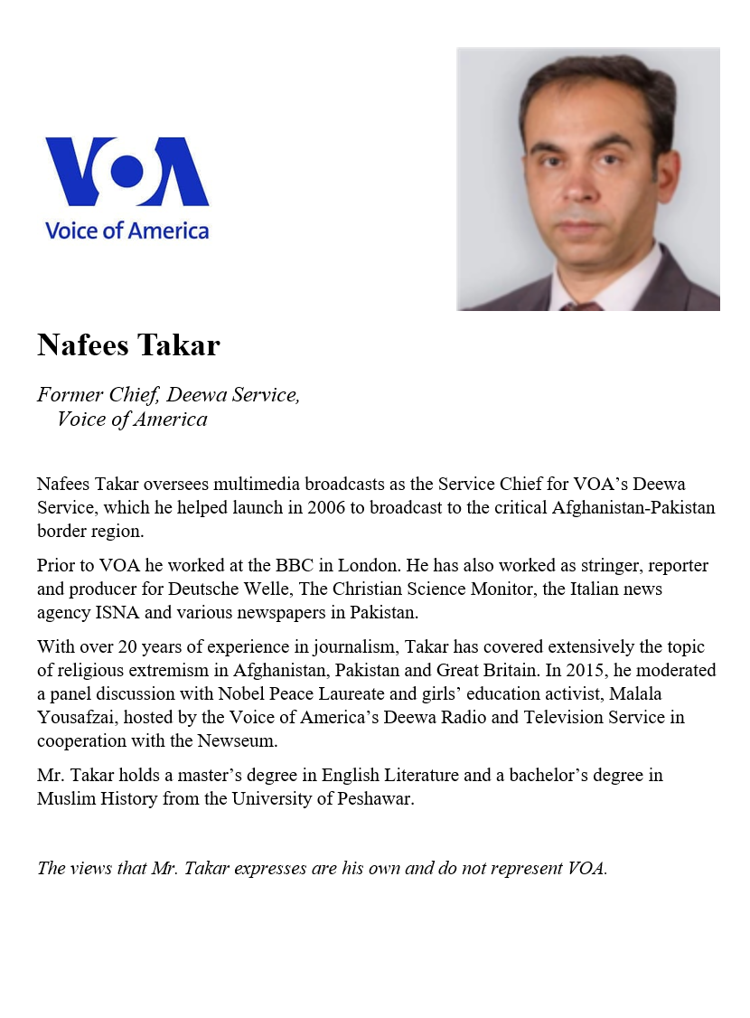
GUEST SPEAKER
Nafees Takar
Chief of VOA’s Deewa Service Washington, DC
- Introduced by Katelyn

Slide 16
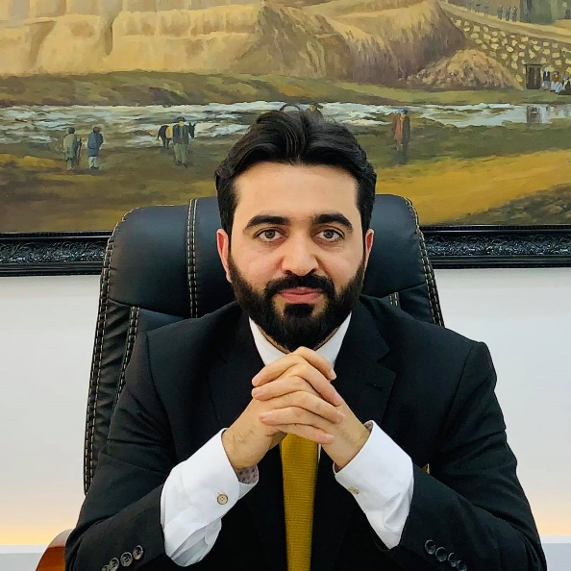
DISCUSSION
Fourteen Lessons from Afghanistan for Future U.S. Nation Building
CLEARLY DEFINE GOALS, HAVE A STRATEGY, AND STICK TO THEM
CHOOSE ALLIES AND PARTNERS CAREFULLY AND UNDERSTAND THEIR INTENTIONS
UNDERSTAND NEIGHBORS, THEIR RELATIONS, AND THE NEIGHBORHOOD
RECONCILE WITH FORMER ENEMIES AND ACCOMMODATE THEM TO MINIMIZE FUTURE THREATS
INCLUSIVENESS CREATES A STABLE AND EFFECTIVE GOVERNMENT
PRIORITIZING SECURITY INSTITUTIONS HELPS THE PROCESS AND LESSENS THE BURDEN ON U.S. FORCES
A FUNCTIONAL GOVERNMENT IS BETTER THAN A REPRESENTATIVE GOVERNMENT THAT FAILS TO FUNCTION
DIVIDE NATION BUILDING RESPONSIBILITIES CAREFULLY, PUSH FOR WIDESPREAD COORDINATION, AND MONITOR AND EVALUATE PROGRESS PROPERLY
Haroon HAKIMI

Slide 17
DISCUSSION
Fourteen Lessons from Afghanistan for Future U.S. Nation Building
BE PREPARED TO PREVENT CORRUPTION, FIGHT IT AS AN INNER ENEMY IF AND WHEN IT APPEARS
ESTABLISHING AND ENFORCING THE RULE OF LAW MUST BE A PRIORITY WITHOUT COMPROMISE
PROMOTE LONG-TERM ECONOMIC SELF-SUFFICIENCY AND SUSTAINABILITY TO AVOID AID DEPENDENCY
FIX THE PROPERTY REGIME TO REDUCE CONFLICTS AND PROTECT THE RIGHT TO OWNERSHIP
SUPPORT NATIONALISM AND THE NATIONAL IDENTITY THAT IS FUNDAMENTAL FOR DEMOCRACY
CONSISTENCY THROUGHOUT THE NATION BUILDING PROCESS HELPS TO ACHIEVING THE DESIRED GOALS
Haroon HAKIMI

Slide 18
What could we – or should we – have done differently?
Before 9/11?
After 9/11?
During the occupation?
During the negotiation?
During the withdrawal?
Since the withdrawal?

Slide 19
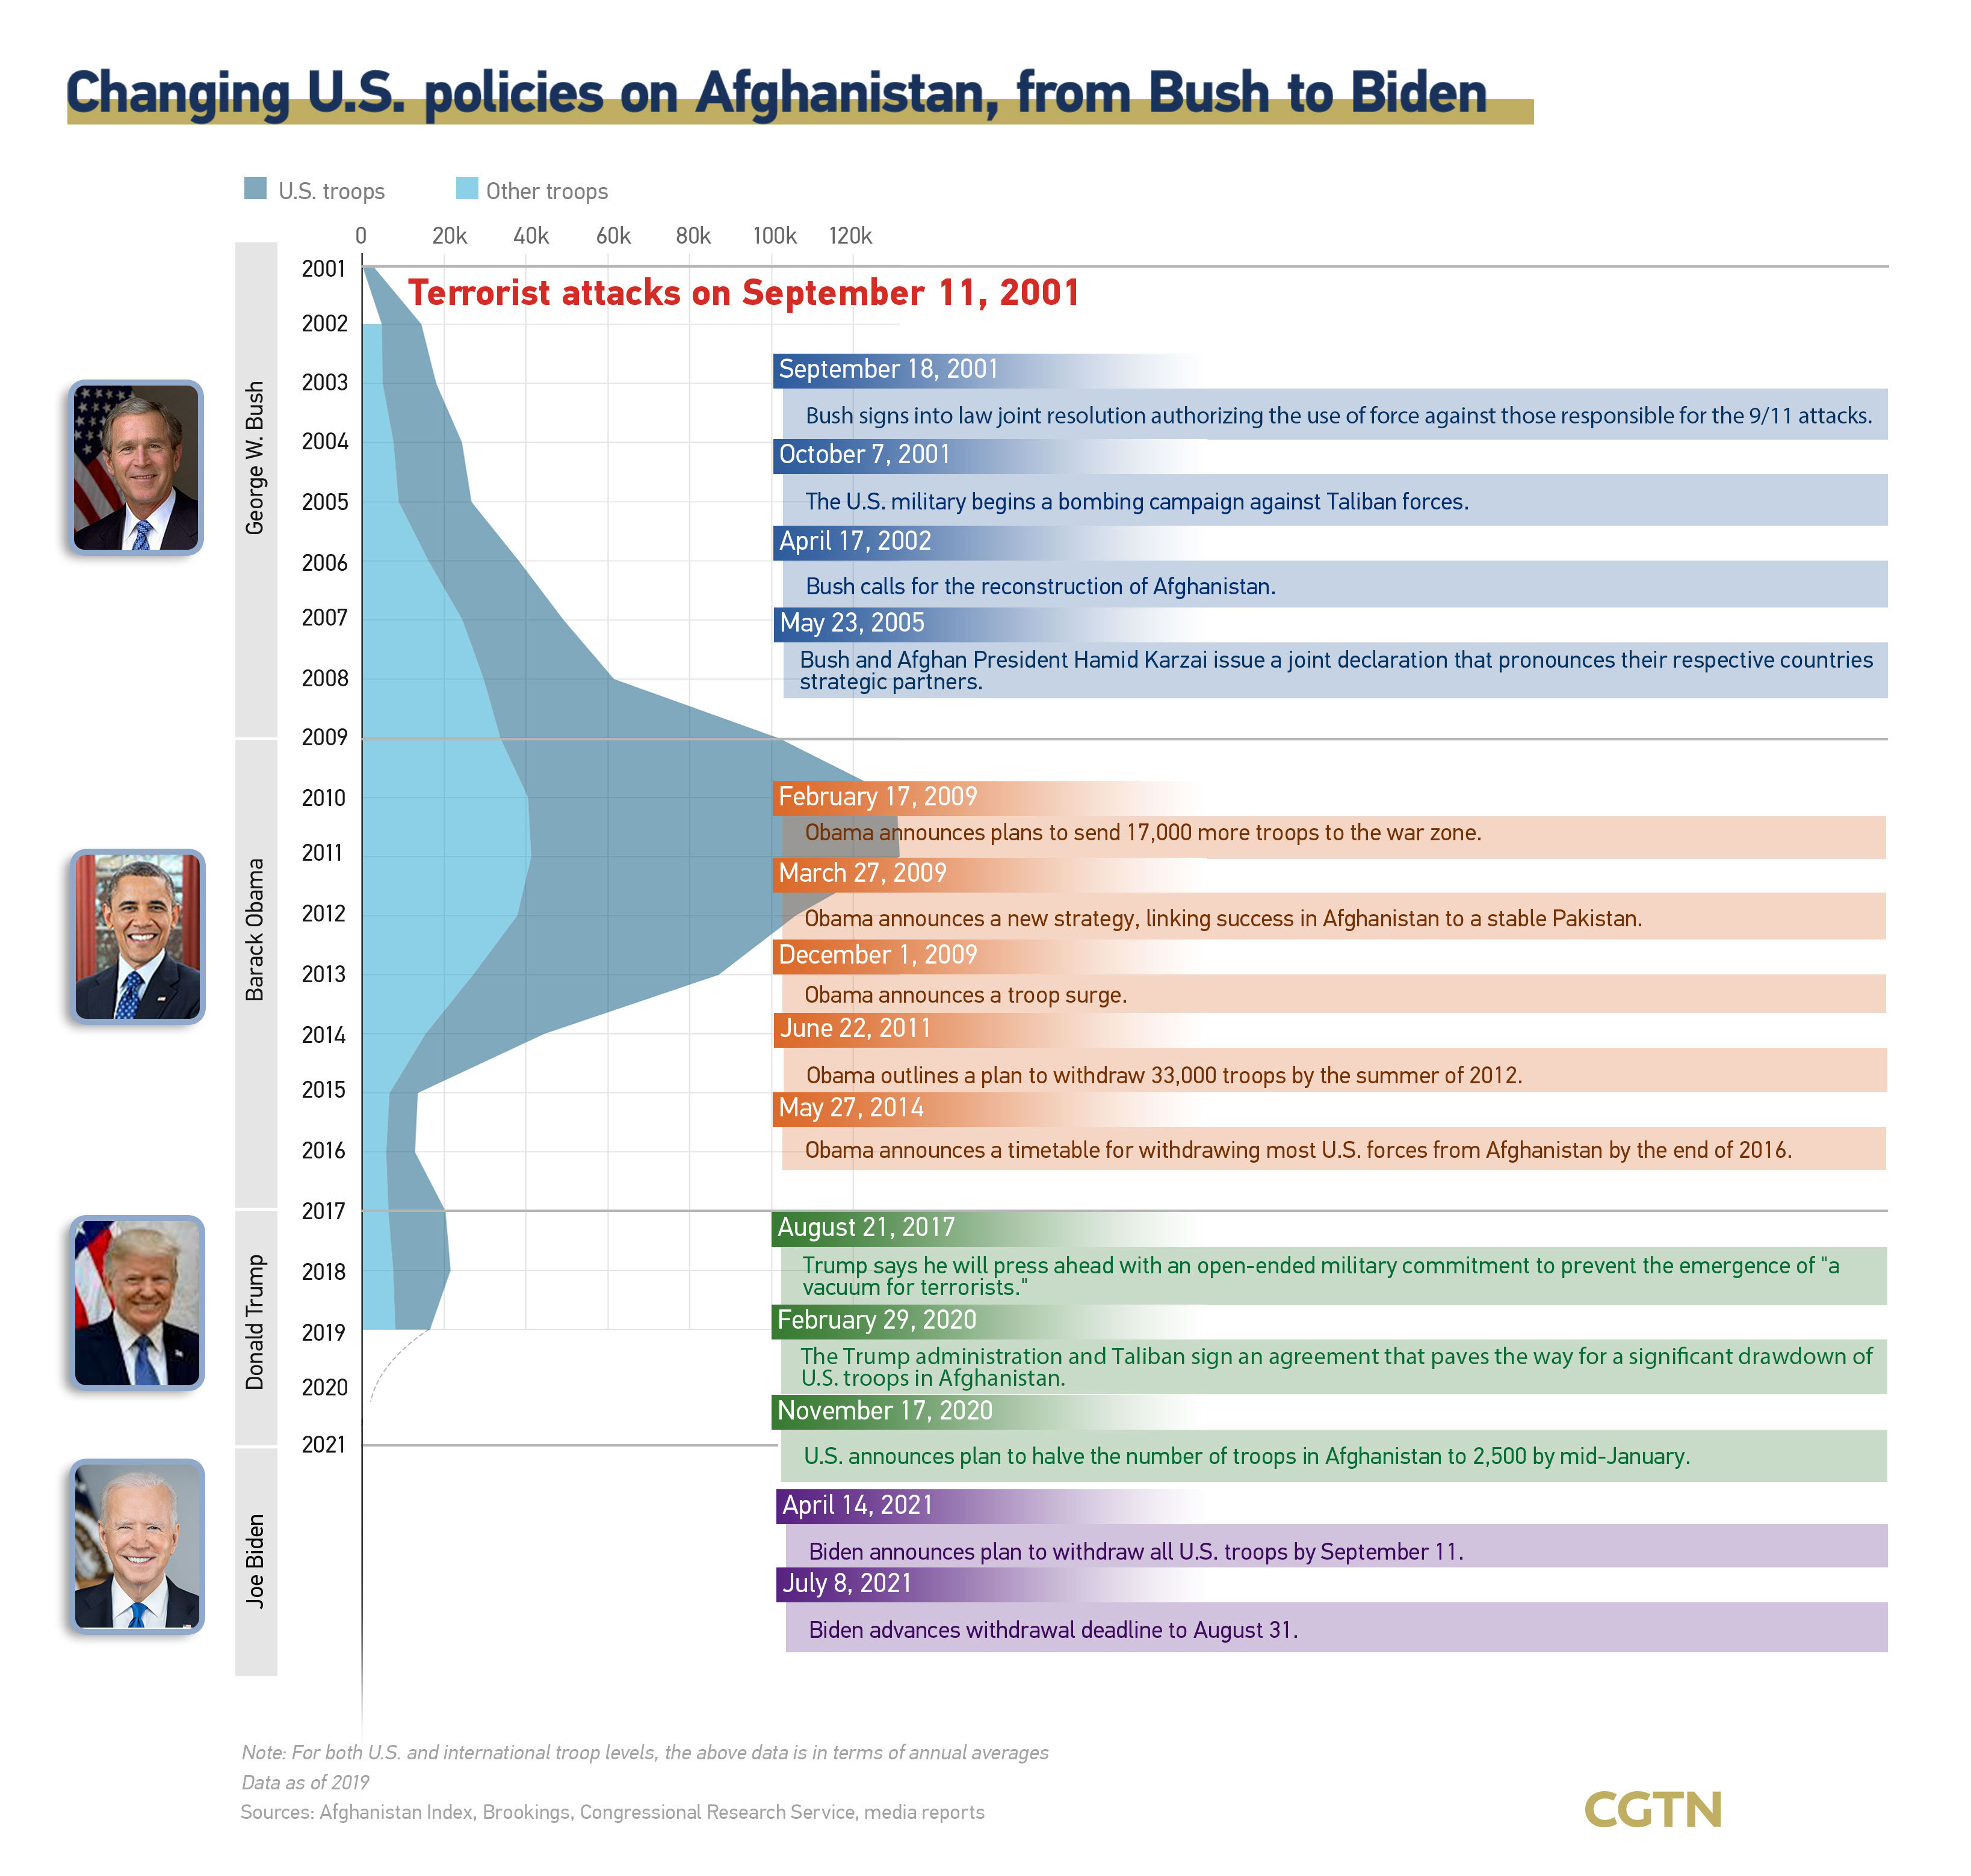
CGTN
U.S. Changing Afghanistan Policy, CGTN, 07/30/2021, https://news.cgtn.com/news/2021-07-30/Chart-of-the-Day-U-S-changing-Afghanistan-policy-12jrJZZV7kA/share_amp.html

Slide 20
GUEST SPEAKER

Slide 21
GUEST SPEAKER
Amb. Touqir Hussain
Former Senior Diplomat of Pakistan
Current Adjunct Professor, Georgetown University
- Introduced by Kiana

Slide 22


Slide 23

GUEST SPEAKERS
Ms. Prerna Shahi
First Secretary, Political
Ms. Aditi Walunj First Secretary, Education, Science, and Technology

Slide 24


Slide 25
DISCUSSION

Slide 26
DISCUSSION
The Deputies Paper
Due: Friday, 21 November Three weeks from today.

Slide 27
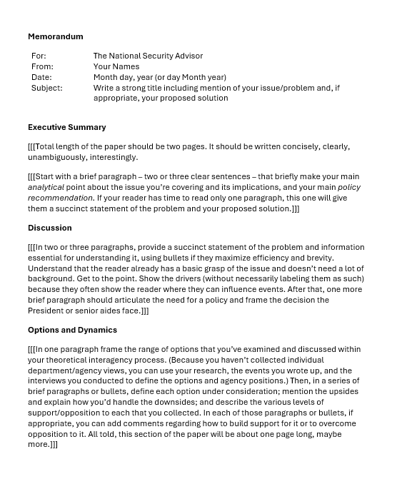
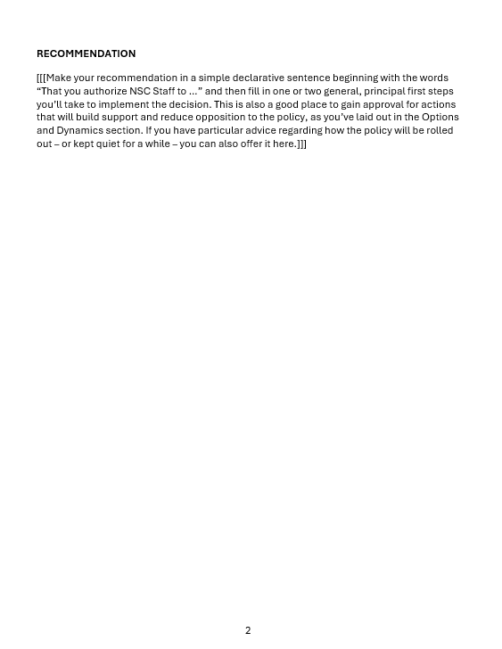
“The DEPUTIES Memo”
FIRST

Slide 28
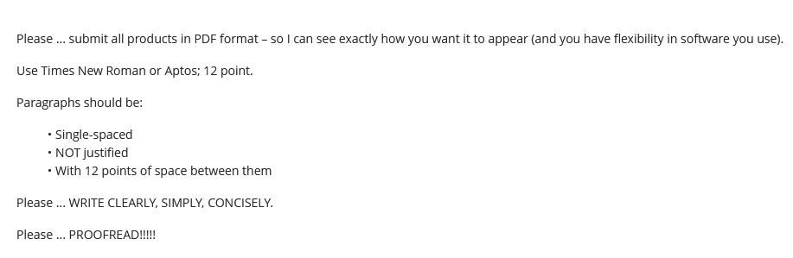
Guidance on Format

Slide 29
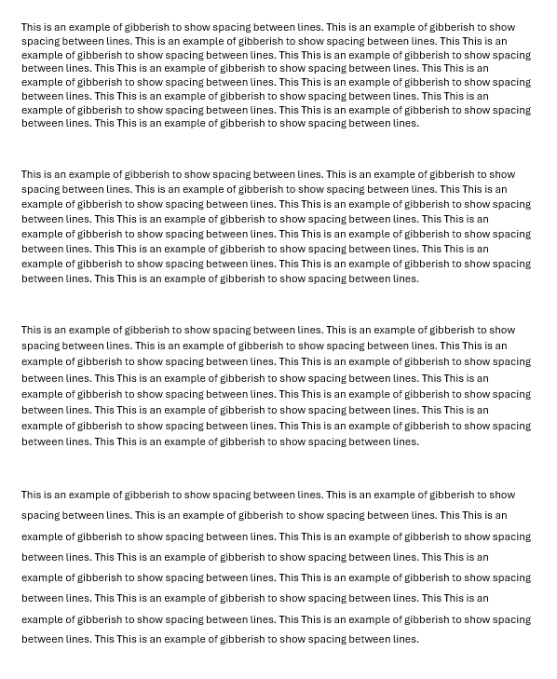
Single space (1.0)
Multiple (1.08)
Multiple (1.16)
1.5 lines (1.5)

Slide 30
REVIEW
What do good memos have in common?
JOB ONE:
MAKE IT EASY FOR YOUR READER TO GET WHAT THEY NEED TO KNOW.
Brevity | They don’t waste readers’ time.
Conciseness | They’re not sloppy, long-winded.
Clarity, precision | They don’t make reader sort through ambiguity.
Relevance | They don’t burden reader with clutter.
Objectivity | They don’t get bogged down in values, norms.
Readability | They’re not obtuse, ornate, distracting.

Slide 31
REVIEW
JOB ONE:
MAKE IT EASY FOR YOUR READER TO GET WHAT THEY NEED TO KNOW.
Digestible declarative sentences
Good, practical grammar
Unambiguous but “normal” vocabulary
Clear logic
Transparent drafter
Zero, minimal, or clearly labeled editorializing

Slide 32
REVIEW
What are the differences between academic writing and memo-writing?
“Washington Memo”
Purpose(s)
“Action”; empower reader by educating.
Scope
Background
Relevance
Only what reader needs to know to decide.
Only what’s relevant.
Examples to show point, not encyclopedia.
Style
Language
Length
Voice
Concise, direct, active.
“As brief as possible” (usually two pages).
Objective, not ornate.
Structure

Slide 33
REVIEW
Standard Info Memo
Standard Decision Memo
Subject: | Clear, crisp
Subject: | Clear, crisp
Thesis: | BLUF, analytical
Thesis: | BLUF, analytical
Framing: | What, when, who, where
Framing: | What, when, who, where
Dynamics: | Why, how
Dynamics: | Why, how
OPTIONS: | Stated, assessed; interagency views
Outcomes: | Likely, less likely (and why)
Outcomes: | Likely, less likely (and why)
Implications: | Why matter?
Implications: | Why matter?
RECOMMENDATION

Slide 34
REVIEW
Standard Info Memo
Standard Decision Memo
Subject: | Clear, crisp
Subject: | Clear, crisp
Thesis: | BLUF, analytical
Thesis: | BLUF, analytical
Framing: | What, when, who, where
STANDARD BRIEFING, TOO!
Framing: | What, when, who, where
Dynamics: | Why, how
Dynamics: | Why, how
OPTIONS | Stated, assessed; interagency views
Outcomes: | Likely, less likely (and why)
Outcomes: | Likely, less likely (and why)
Implications: | Why matter?
Implications: | Why matter?
RECOMMENDATION

Slide 35
REVIEW
The ways Washington memos are prepared, researched, drafted, and edited are different from academic, too.
Obsessively ask ourselves ...
What does the reader need to know (based on my understanding of my issue and their world)?
Does every word, phrase, sentence, and paragraph make it easy for my reader to grab and run?
If necessary, can I summarize my conclusions/ recommendations in 30 seconds or less?

Slide 36
REVIEW
Why is it important to be able to write a good “Washington Memo”?
Good writing is the single most important skill in this business because it shows …
you can think
you can communicate
you know what’s relevant
you are ready to operate
Other skills are important, but writing is central to almost all of them.

Slide 37
“The DEPUTIES Memo” -- STEP BY STEP
STEP BY STEP

Slide 38
Anyone else?
For: | The National Security Advisor
From: | Your Names
Date: | Month day, year (or day Month year)
Subject: | Write a strong title including mention of your issue/problem and, if appropriate, your proposed solution

Slide 39
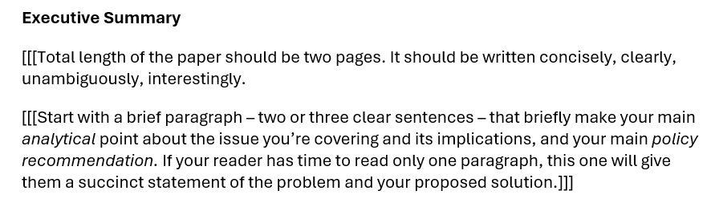

Slide 40
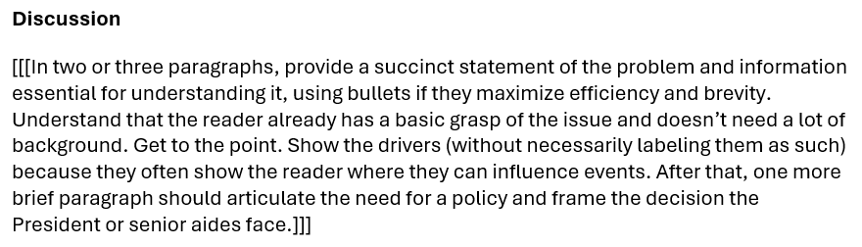

Slide 41
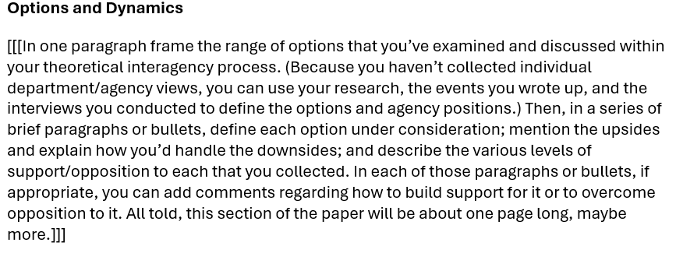

Slide 42
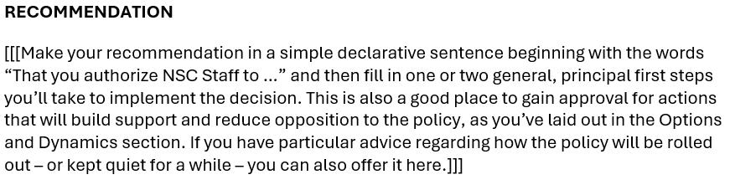

Slide 43
The memo must be good.
Questions?

Slide 44
GUEST SPEAKER
Dr. Haroon Hakimi
Former Deputy Minister for Information, Culture, Youth, and Tourism Kabul, Afghanistan
- Introduced by Katelyn

Slide 45
GUEST SPEAKERS
Dr. Haroon Hakimi
Former Deputy Minister for Information, Culture, Youth, and Tourism, Afghanistan
Nafees Takar
Chief of VOA’s Deewa Service
- Intro’d by Katelyn

Slide 46
Internship conversations
INFORMAL DISCUSSION
Launched with 2-3 mins on …
Organization name and business
In-person, virtual, hybrid
Tasks and responsibilities
Communications and team dynamics
Fun things and challenges
Maeve Gabby Richard Esme

Slide 47

WRAPUP

Slide 48
Global Policy Seminar and NSC Simulation
IRP 401 - IRP 402
Week Ten 31 October 2025
Prof. Fulton T. Armstrong

Slide 49







The Six-Party Talks
- An exercise in diplomatic negotiations -
You will be negotiating as representatives of
Democratic People’s Republic of Korea (DPRK – North Korea)
Republic of Korea (ROK – South Korea)
People’s Republic of China (PRC – China)
Japan
Russia
United States

Slide 50
The Six-Party Talks
- An exercise in diplomatic negotiations -
You will be negotiating as representatives of
Democratic People’s Republic of Korea (DPRK – North Korea)
Republic of Korea (ROK – South Korea)
People’s Republic of China (PRC – China)
Japan
Russia
United States

Slide 51



PICK AN ANIMAL
4 | 9 | 14 | 1 | 17 | 5
SWIMMING
RUNNING
16 | 2 | 10 | 18 | 13 | 6
REMEMBER
YOUR
NUMBER
11 | 7 | 15 | 12 | 3 | 8

Slide 52
Pick in numerical order, but you can pass or give to someone else.

Slide 53
The Six-Party Talks
 | Republic of Korea (South Korea) | Democratic People’s Republic of Korea (North Korea) | USA | People’s Republic of China | Japan | Russia
Team 1 | Sam | Brendan | Maria | Mikah | Alejandra | Kennedy
Team 2 | Julie | Sarah | Danny | Téa | Lucienne | Rider
Team 3 | Corrie | Souleymane | Brenda | Rebecca | Albane | Katya

Slide 54
Special reading to prep.
Activity will include lunch.
(Any dietary restrictions?)

Slide 55
PROJECT PLANNING

Slide 56
Project Planning
Téa | Future of NATO | Truce between Kyiv and Moscow
Brendan | India and Paris Agreement
Kennedy | Health impact of abortion restrictions | Women in Afghanistan
Katya | Inter-country adoption
Danny | Chinese pressure on Taiwan | Political situation in Venezuela
Lucienne | China’s growing influence in Peru
Mikah | Future direction of new Syrian government | Assistance to El Salvador
Brenda | Cartel violence in Mexico
Rebecca | Mongolia ecosystem and options for protection | Haiti violence and instability
Maria | Economic and social crisis in Puerto Rico
Alejandra | Venezuela crisis and border violence | China investment in infrastructure in Latin America
Julie | China-U.S. competition in global poverty alleviation
Sarah | Türkiye ambitions as regional/global player | Central Asian dependence on Chinese and Russian financing
Sam | Dedollarization
Albane | Vulnerabilities of sub-sea cables | Coup d’etats in the Sahel
Souleymane | US. Africa policy for the 21st century
Corrie | Climate crisis in Haiti | Lithium in Argentina, Bolivia, and Chile
Rider | The Ukraine-Russia War

Slide 57
Project Planning
Téa | Future of NATO | Truce between Kyiv and Moscow
Brendan | India and Paris Agreement
Kennedy | Health impact of abortion restrictions | Women in Afghanistan
Katya | Inter-country adoption
Danny | Chinese pressure on Taiwan | Political situation in Venezuela
Lucienne | China’s growing influence in Peru
Mikah | Future direction of new Syrian government | Assistance to El Salvador
Brenda | Cartel violence in Mexico
Rebecca | Mongolia ecosystem and options for protection | Haiti violence and instability
Maria | Economic and social crisis in Puerto Rico
Alejandra | Venezuela crisis and border violence | China investment in infrastructure in Latin America
Julie | China-U.S. competition in global poverty alleviation
Sarah | Türkiye ambitions as regional/global player | Central Asian dependence on Chinese and Russian financing
Sam | Dedollarization
Albane | Vulnerabilities of sub-sea cables | Coup d’etats in the Sahel
Souleymane | US. Africa policy for the 21st century
Corrie | Climate crisis in Haiti | Lithium in Argentina, Bolivia, and Chile
Rider | The Ukraine-Russia War

Slide 58
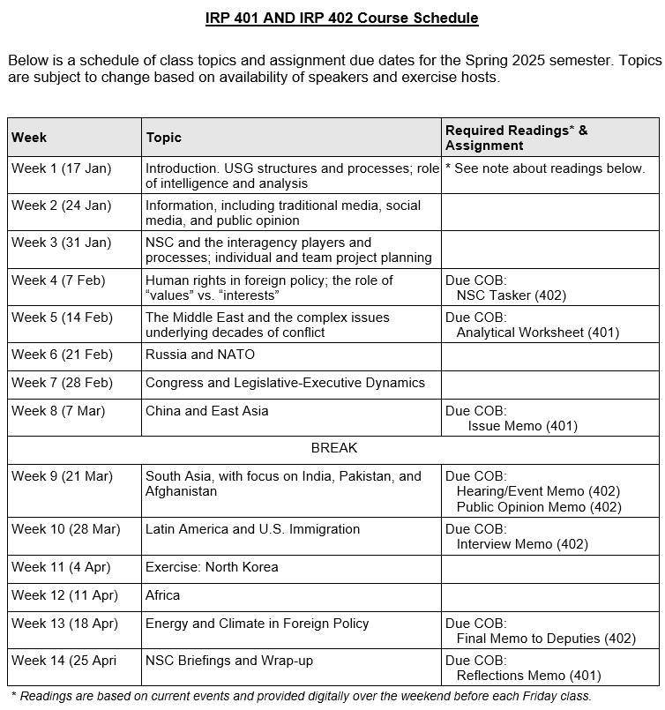
✓
401
✓
402
✓
✓
✓
✓
✓
✓

Slide 59
✓
401
✓
402
✓
✓
✓
✓
✓
✓

Slide 61

North Korea EXERCISE
Climate Change

Slide 62
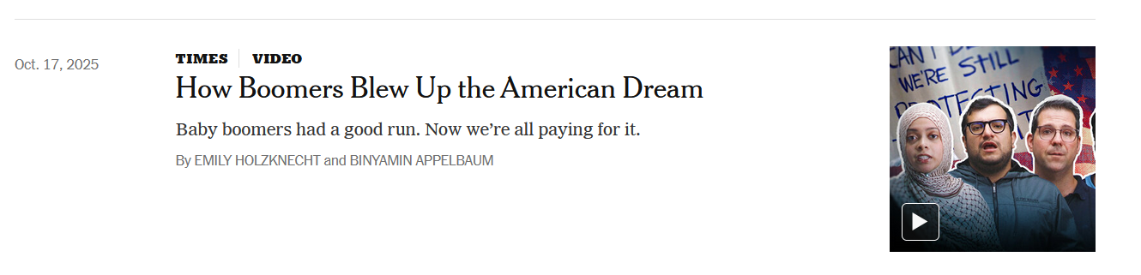
Discussion

Slide 63
What happened?
Were the Boomers fakes from the start?
If not, where’d they go wrong? Why?
Also, FWIW: Not all Boomers like what happened. Not all abandoned principles.

Slide 64
GUEST SPEAKER

Slide 65
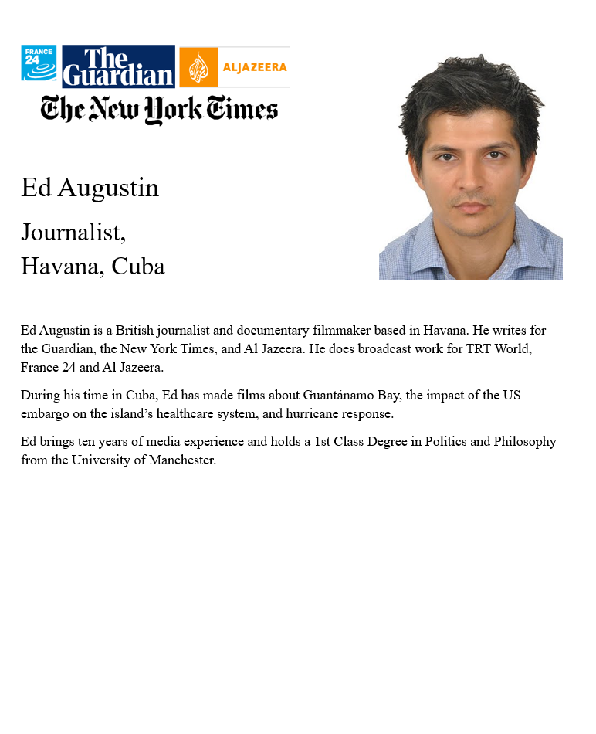
GUEST SPEAKER
Ed AUGUSTIN
Reporter for Multiple News Outlets, Havana, Cuba
- introduced by Katelyn

Slide 66
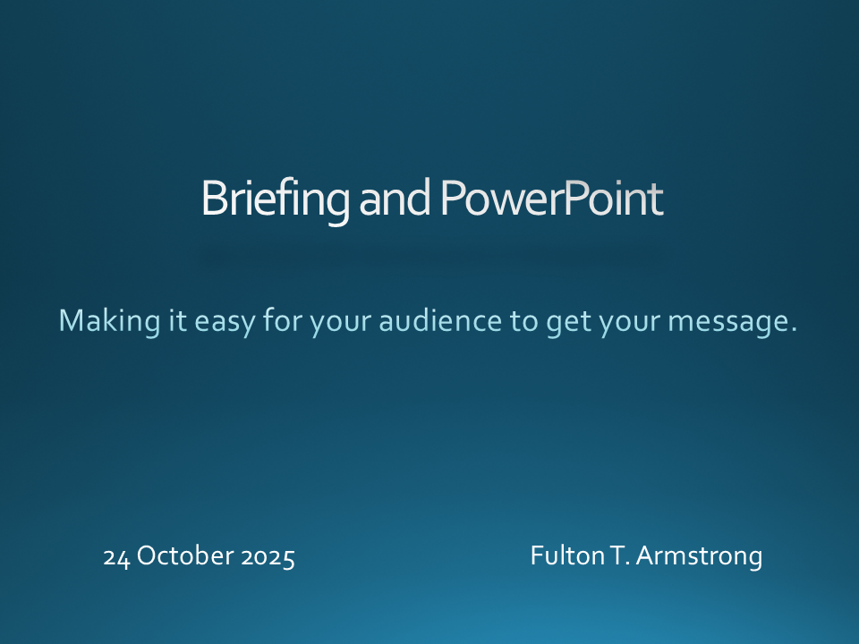

Slide 67

GUEST SPEAKER

Slide 68
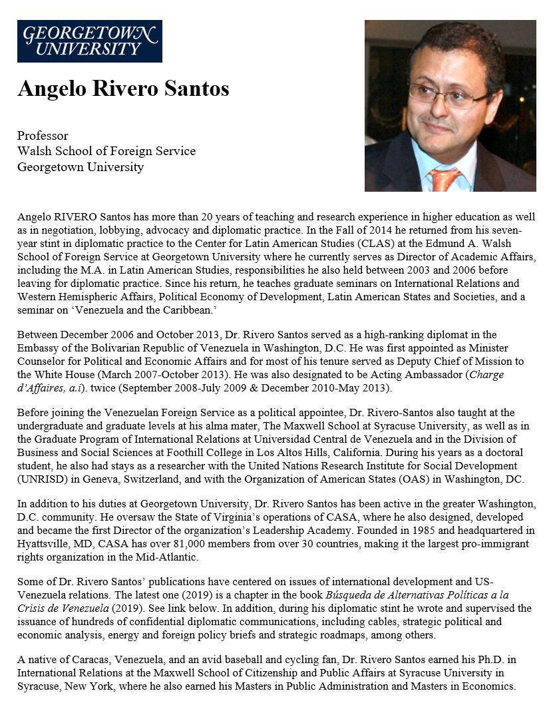
GUEST SPEAKER
Prof Angelo RIVERO Santos
Latin America Expert and Fmr Diplomat, Venezuela
- introduced by Mo

Slide 69
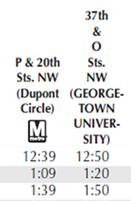
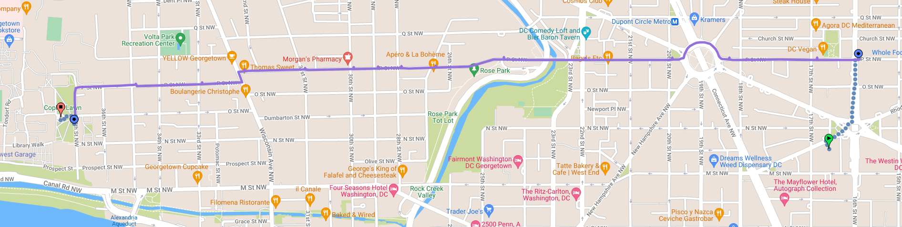

C91 Metrobus
37th & O
20th & P
18th & P

Slide 70
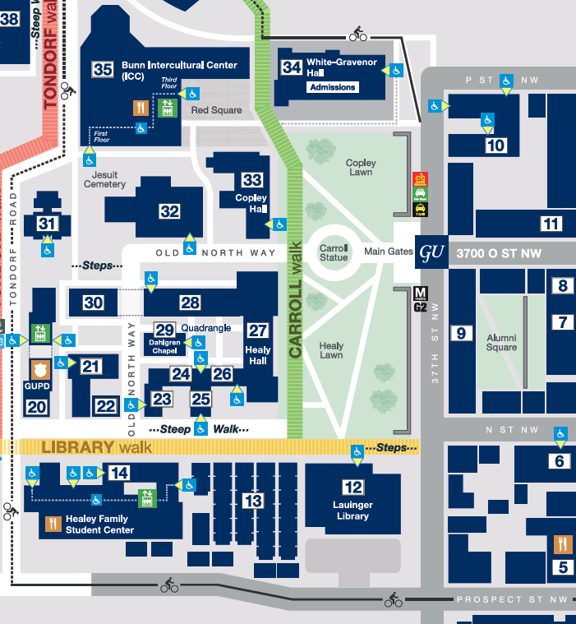



ICC
“Red Square”
1:55 sharp

Slide 71

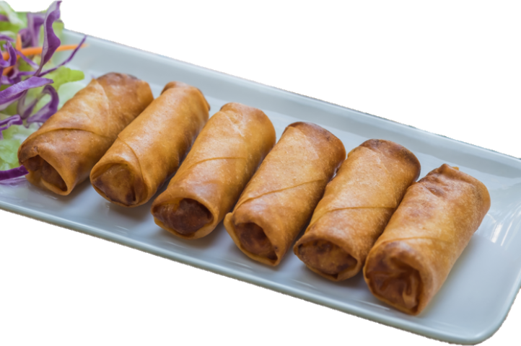
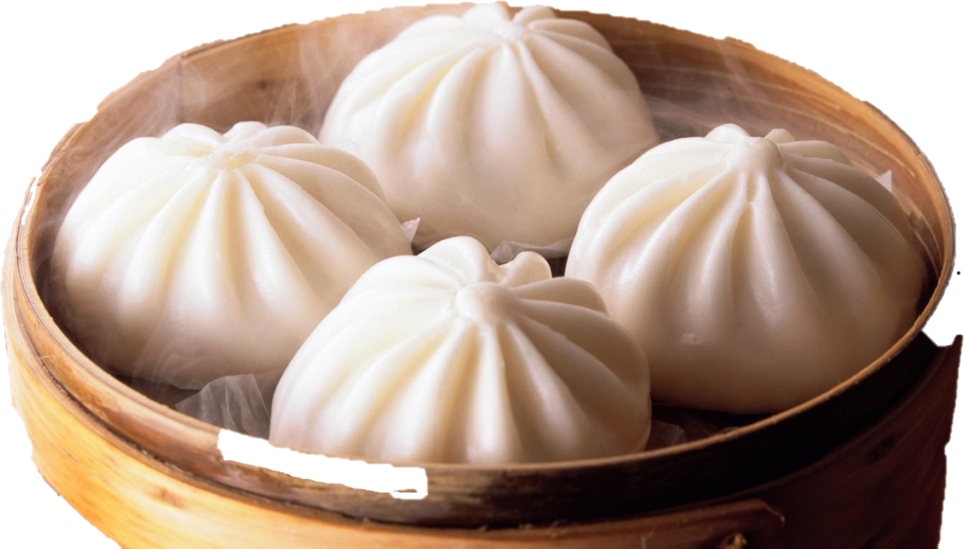
LUNCH

Slide 72
WRAPUP

Slide 73
401 Projects
If you saw comments on your analytical sheet that didn’t make sense (or you don’t agree with), let’s talk.
PLEASE …
remember “Memo #2” has to be well-written.
build on worksheets and ADD POLICY options and recommendation.
try to make sense, make interesting, make relevant.
maximum two pages (single-space).
Correct. Clean up.
Add to. Supplement. Extend.
Make more sophisticated. Raise up.
Anticipate readers’ interests, needs.
OK?

Slide 74
PROJECT PLANNING
Maisie | Microplastics | U.S. Declining Birth Rates
Skye | Ending the war in Sudan
Esme | Immigration and Balancing Interests | U.S. Culture Wars
Camille | Microplastics and PFAS
Erik | Ukraine Innovative Use of Drones | Israeli Use of Lavender AI in Targeting
Richard | Enhancing Cybersecurity
Alex | China’s Increasing Military Strength | Iranian Nationalism
Syarra | Russian Influence in Eastern Europe
Maeve | Israeli Use of AI in Military Strikes in Gaza | U.S. Declining Birth Rates
Kiana | Impact of Federal Spending … or inflation
Mo | Aid to Gaza | Impact of U.S.-China Tariffs
Bobby | U.S. Health Care: High Cost of Prescription Drugs
Gabby | U.S. Culture Wars and How Policy Fuels them | U.S.-Israel Relations After Netanyahu
Katelyn | Russia-Ukraine Negotiations
Sarina | Foreign Disinformation Targets U.S. Elections | Crisis of Legal Immigration Pathways in the U.S.
Priya | China’s Advances in Renewable Energy and EVs

Slide 75
DISCUSSION
Comfortable?
Topics
How partnership will work
The purposes
Substance, process, skills
The elements
All OK?
PREPARING AND PLANNING?
401
Analysis
“Memo #2”
402
Proposal
Hearing/event
Public opinion
Interviews
DC memo
Briefing

Slide 76
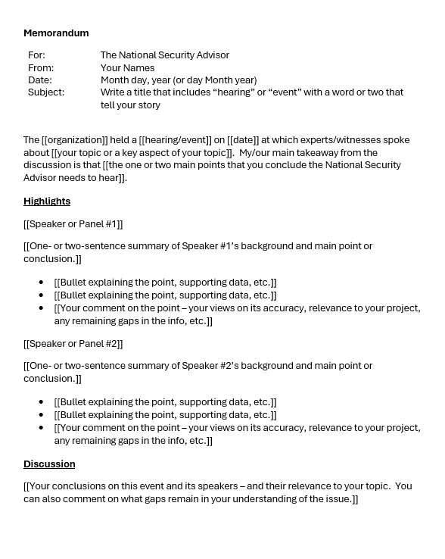
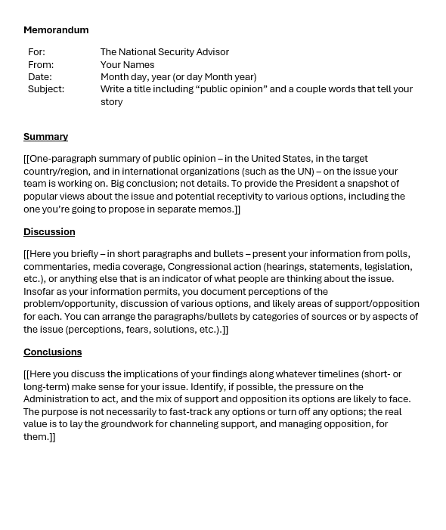
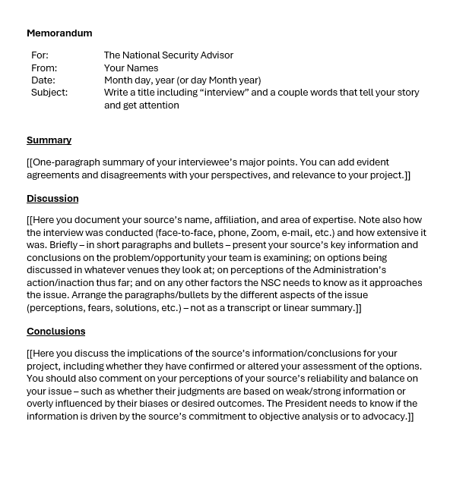
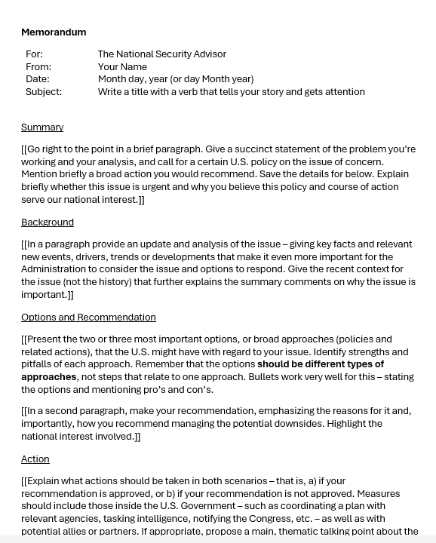
The Templates
402
401

Slide 77
NEXT WEEK
South Asia

Slide 78
Anything else?

Slide 79
Global Policy Seminar and NSC Simulation
IRP 401 - IRP 402
Week Ten 31 October 2025
Prof. Fulton T. Armstrong

