Slide 1

Global Policy Seminar and NSC Simulation
IRP 401 - IRP 402
Week Ten 27 March 2026
Prof. Fulton T. Armstrong

Slide 2
Week 1 (16 Jan)
Week 2 (23 Jan)
Week 3 (30 Jan)
Week 4 (6 Feb)
Week 5 (13 Feb)
Week 6 (20 Feb)
Week 7 (27 Feb)
Week 8 (6 Mar)
Spring Break
Week 9 (20 March)
Week 10 (27 Mar)
Week 11 (3 Apr)
Week 12 (10 Apr)
Week 13 (17 Apri)
Week 14 (24 Apr)
Spring 2026

Slide 3
TODAY’S AGENDA
9:00 | Class Discussion: Preparing for China and Taiwan guests
9:15 | Skills: Acing the Internship or Job Interview - Samantha Clemence
10:00 | Internship Discussions - John, Bijan, Filippo
10:30 | Gervasio HSU - Chief, Political Section, TECRO - Introduced by Kennedy
11:45 | Lunch
1:00 | Robert Daly - UMD Program on China and the United States - Introduced by Kaiwen
2:30 | Dr. Haroon Hakimi - Fmr DepMin for Information, Culture, Youth, and Tourism - Kabul, Afghanistan - Introduced by David
~3:00 | Wrapup

Slide 4
TODAY’S AGENDA
9:00 | Class Discussion: Preparing for China and Taiwan guests
9:15 | Skills: Acing the Internship or Job Interview - Samantha Clemence
10:00 | Internship Discussions - John, Bijan, Filippo
10:30 | Gervasio HSU - Chief, Political Section, TECRO - Introduced by Kennedy
11:45 | Lunch
1:00 | Robert Daly - UMD Program on China and the United States - Introduced by Kaiwen
2:30 | Dr. Haroon Hakimi - Fmr DepMin for Information, Culture, Youth, and Tourism - Kabul, Afghanistan - Introduced by David
~3:00 | Wrapup

Slide 5
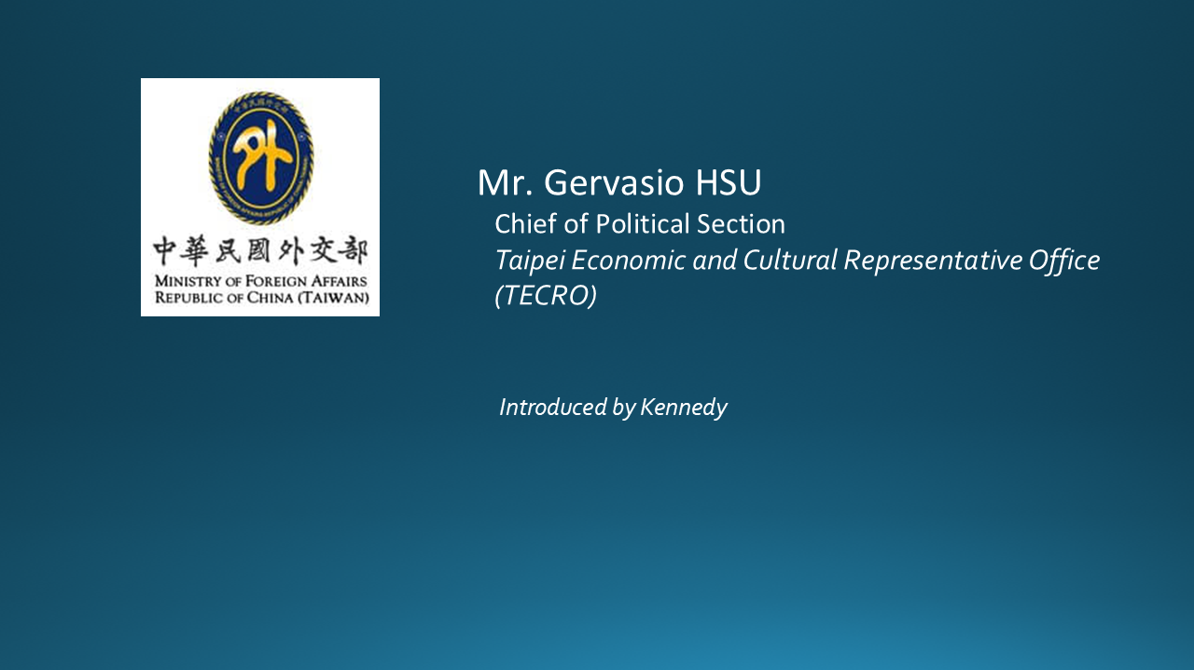
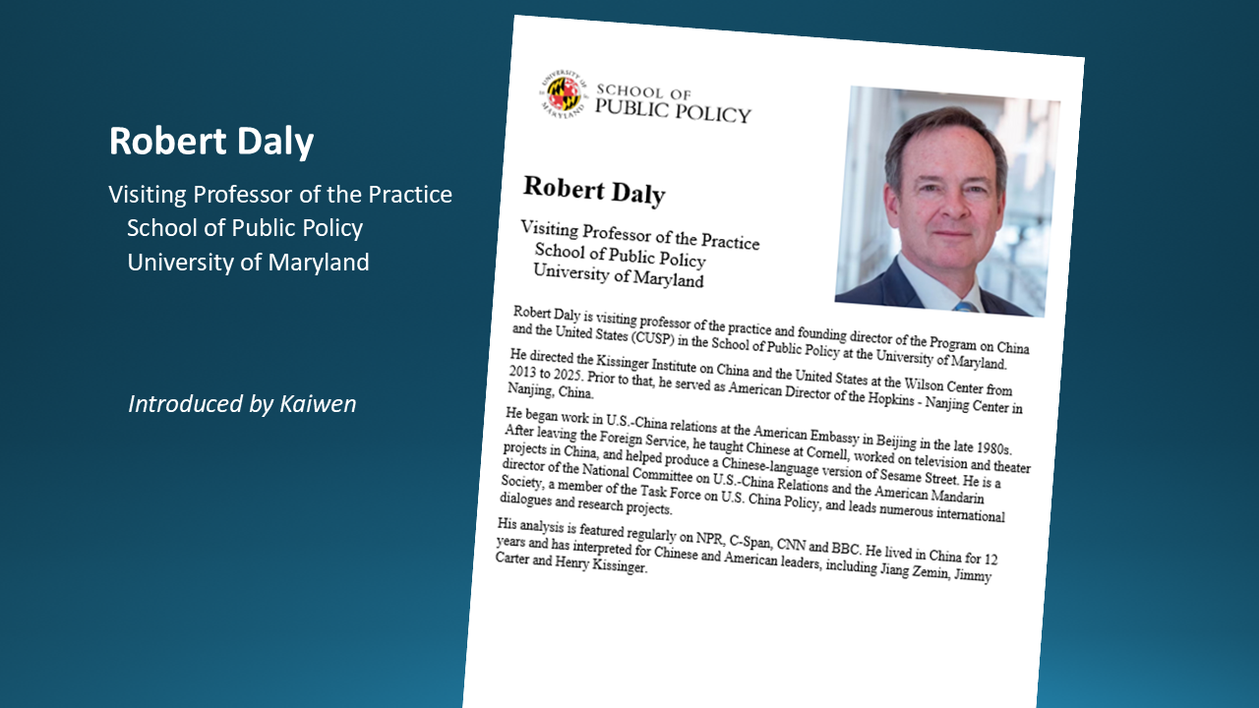
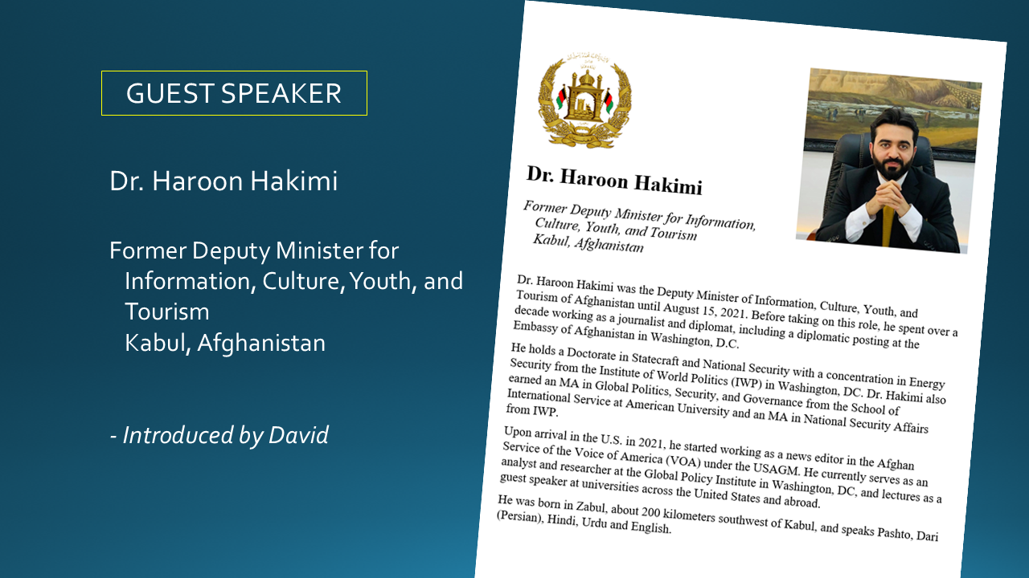
Three speakers

Slide 6
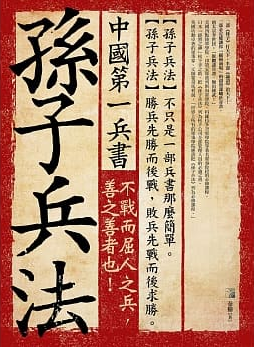
孙子
Sun Tzu
知己知彼，百战不殆。
Zhījǐzhībǐ, bǎizhànbúdài
The Art of War
Know yourself as you know your enemy, and you will win all battles.

Slide 7
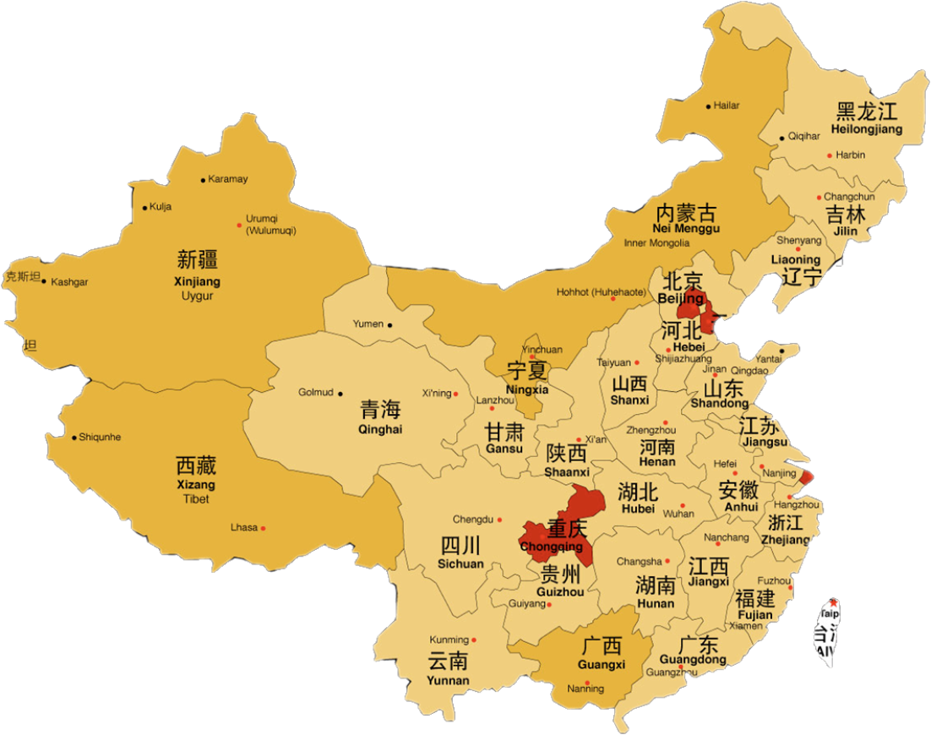
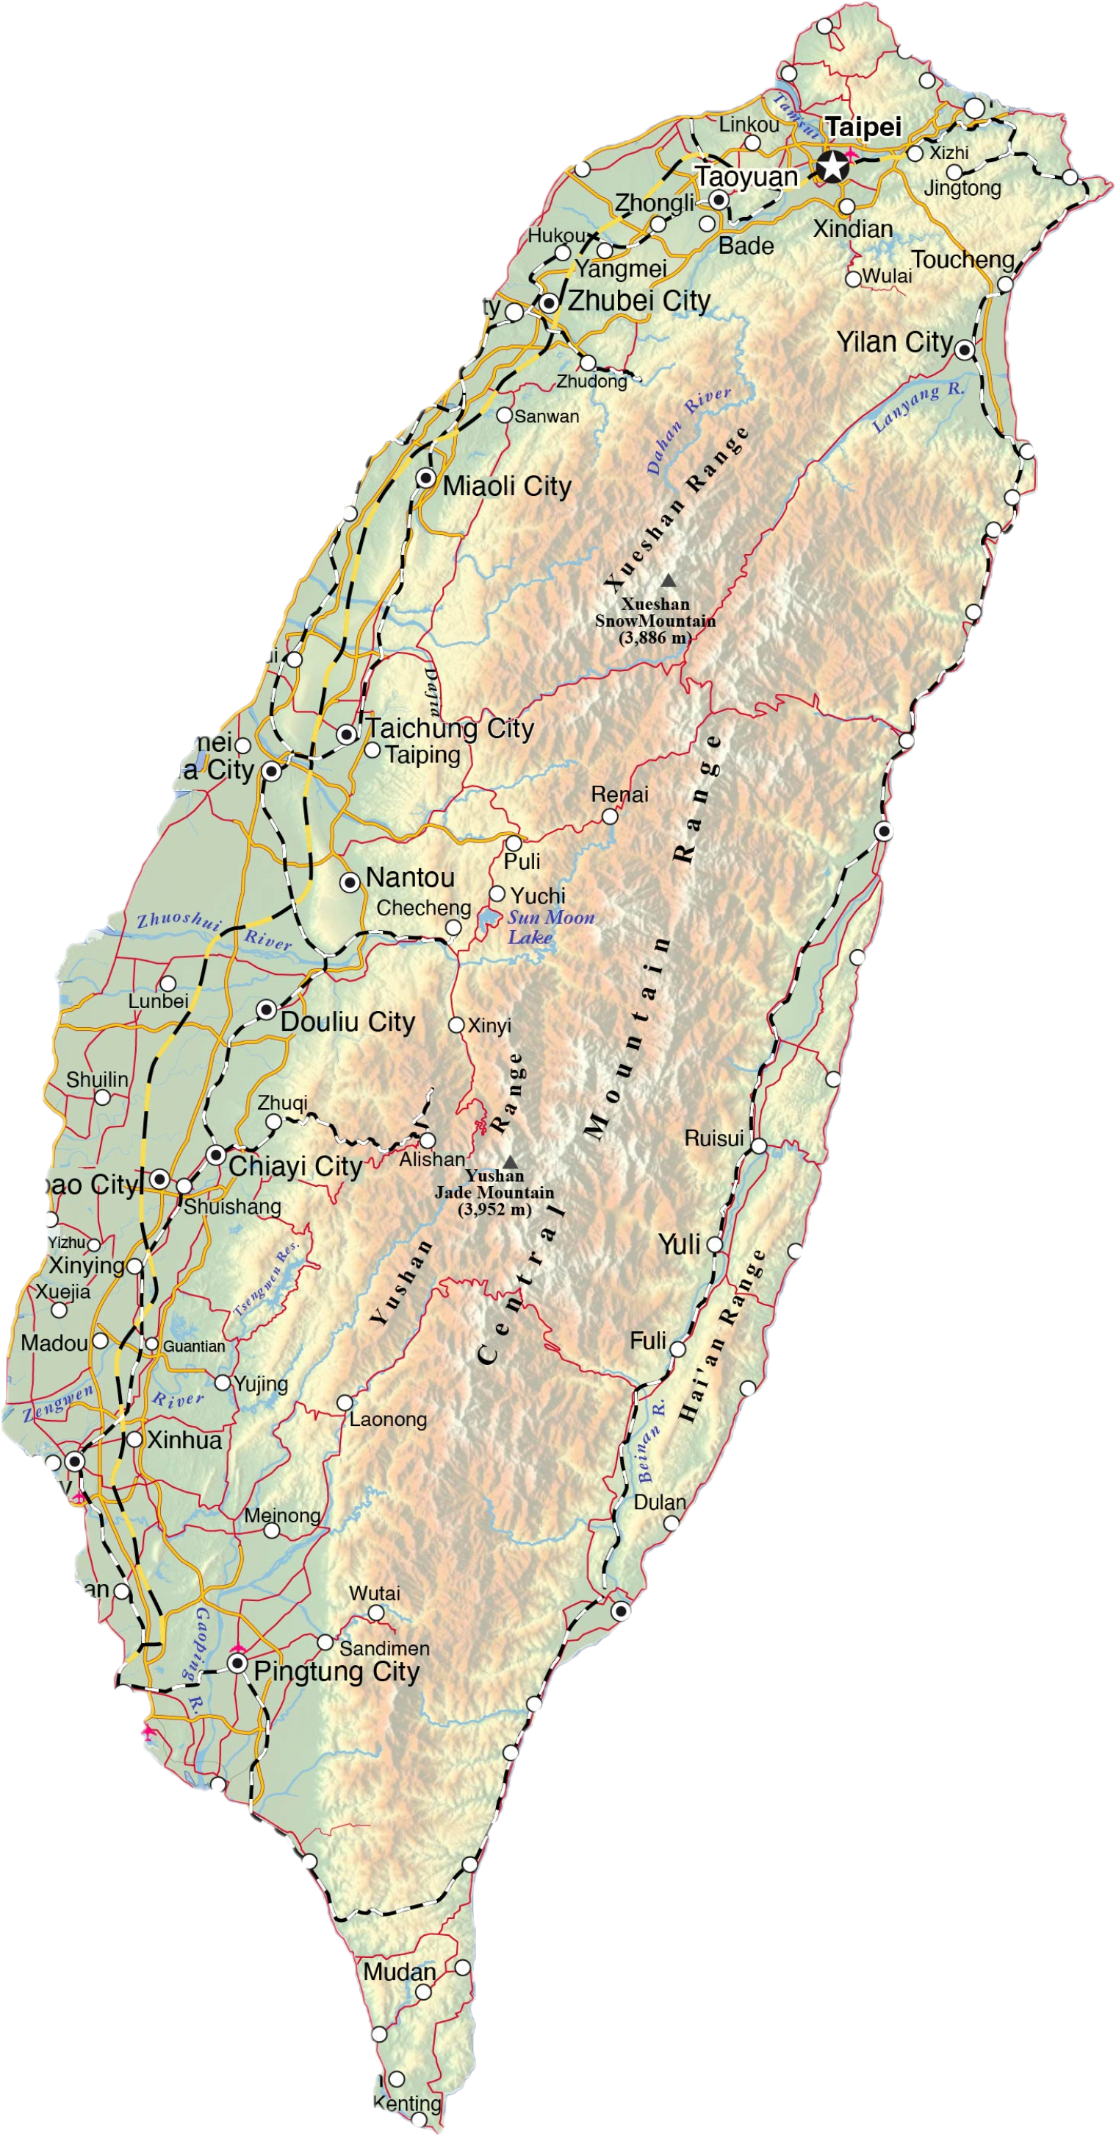
China and Taiwan

Slide 8
Diplomatic elicitation
Remember your objective is to learn and understand, not to judge, persuade, or score points.
Pursue the questions that you want.
Ask questions with sensitivity that you would want if someone were probing you.
Consider this sort of useful devices:
“I realize it’s sensitive, but I’d like to ask – if I may – what …?”
“What should we think when we see reports that …?”
“What is your (or your government’s) perspective on …?”
“What do ___ people think about …?”
“What do you see as a solution to ____ problem?”

Slide 9
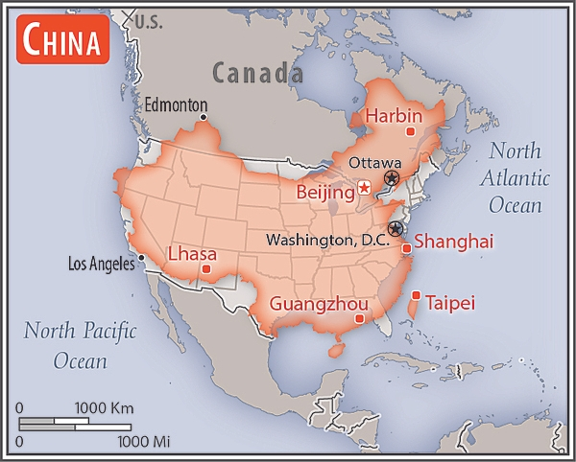

中华人民共和国
中国
9,595,960 sq km
Slightly smaller than the United States (9,984,670 sq km).
People’s Republic of China

Slide 10
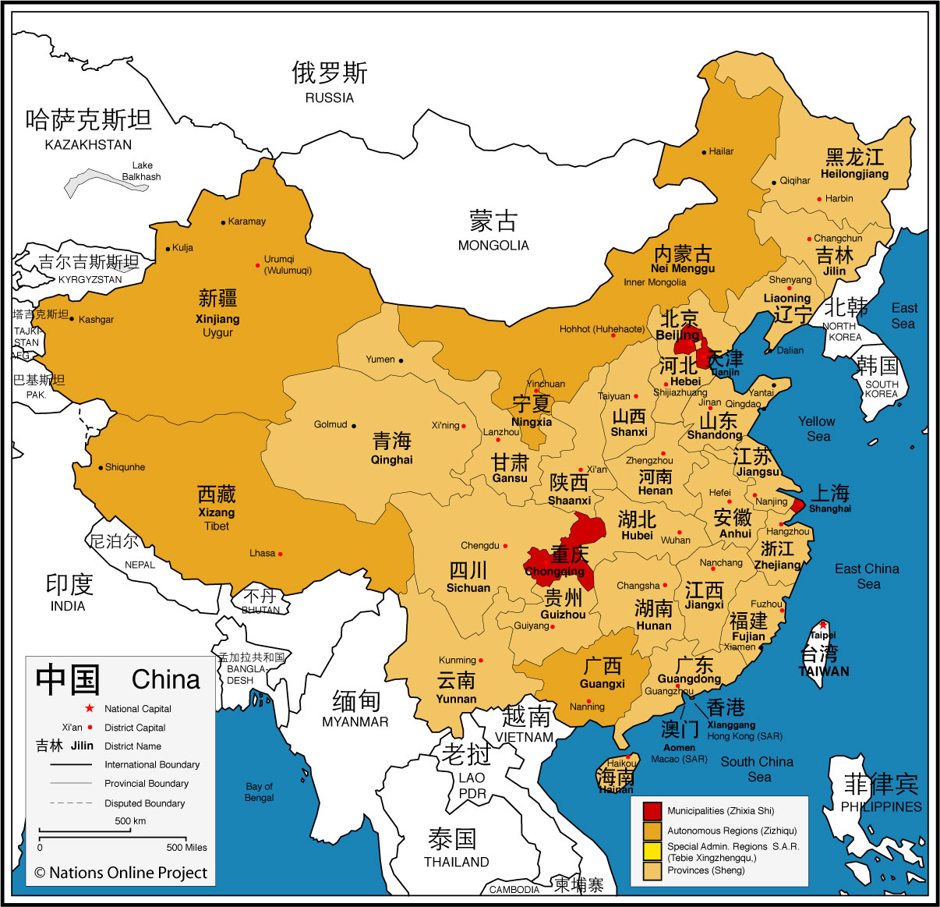
CHINA
1.4 billion
HAN = 91.1 percent
PRC recognizes 56 ethnic groups. Biggest include:
Han Zhang Hui Manchu Uighur Miao Yi Tujia Tibetan Mongol | Dong Buyei Yao Bai Korean Hani Li Kazakh Dai

Slide 11
CHINA
23 provinces
4 direct municipalities (Zhixia Shi) 北京 Beijing 重庆 Chongqing 上海 Shanghai and 天津 Tianjin
Self-governing districts under the direct jurisdiction of the central government.

Slide 12
CHINA
Autonomous Regions (Zizhiqu)
广西 Guangxi 内蒙古 Inner Mongolia 宁夏 Ningxia 西藏 Tibet 新疆 Xinjiang Uyghur Autonomous Region

Slide 13
CHINA
Special Administrative Regions (SAR)
香港 Hong Kong
澳门 Macau
This Special Administrative Regions under the policy of
"One Country, Two Systems.”

Slide 14
When you think of China , what comes to mind?

Slide 15



中華民國 台灣
Republic of China (on Taiwan)

Slide 16
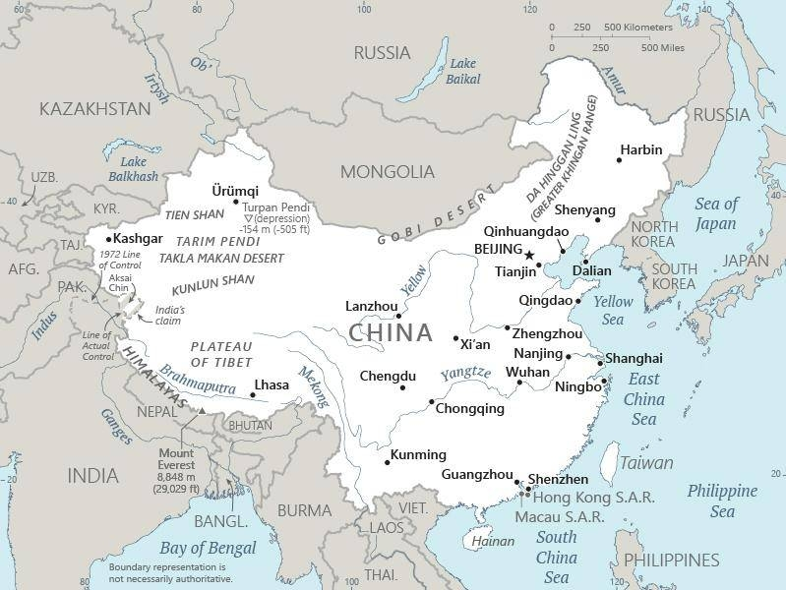

Slide 17
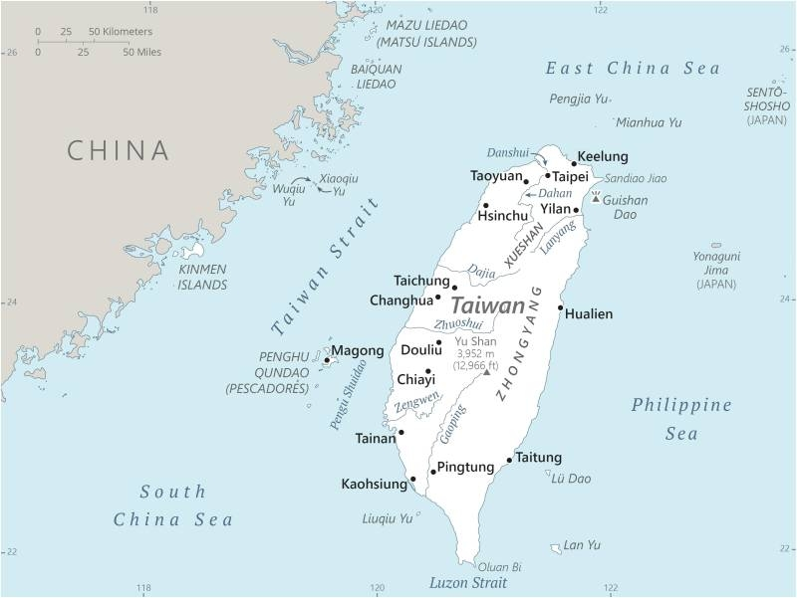
Mazu-Fuzhou = 10 mi.
Jinmen-Xiamen = 2 mi.
A little smaller than Maryland
250 miles long
100 miles from mainland
Population: 24 million
95-97 % ethnic Han
Languages: Taiwanese/Hokkienese/Minnan
Chinese
Hakka

Slide 18
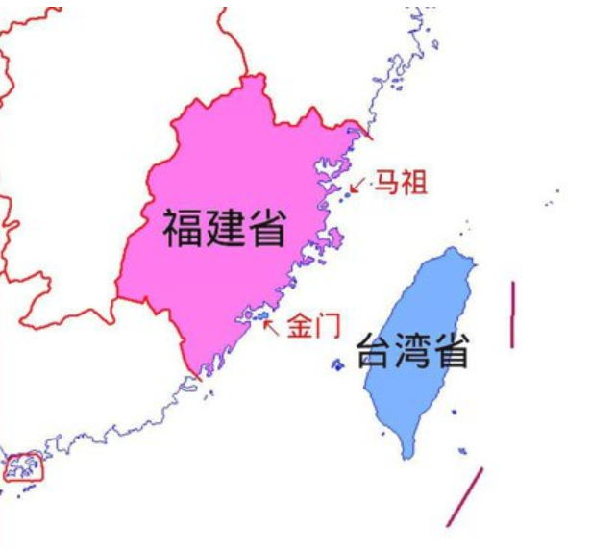
福州
廈門
Jinmen-Xiamen = 2 mi.
Mazu-Fuzhou = 10 mi.

Slide 19
When you think of Taiwan , what comes to mind?

Slide 20
QUIZ
1. Name of Taiwan’s big semiconductor producer. | 10. Level of highest-level contacts between Ch and Tw
2. Year that U.S. “normalized” relations with China. | 11. Areas of U.S.-China cooperation (2)
3. When “One China” policy started. | 12. Relationship w/ Tw China proposed in late 1990s.
4. Legislation that defines U.S.-Taiwan ties. | 13. Difference between de facto and de jure.
5. Distance from Taiwan to China mainland. | 14. Drug U.S. accuses China of turning blind eye to.
6. Names of the ruling parties in China and Taiwan. | 15. Methods of Chinese pressure on Taiwan (2).
7. Percentage of “Taiwanese” in Taiwan population. | 16. Words dropped from DOS website in January 2025.
8. Term for key U.S. policy on “Taiwan issue” (a). | 17. Names of Chinese and Taiwan presidents.
9. Term for key U.S. policy on “Taiwan issue” (b). | 18. Percentage of tariffs T put on Chinese products.

Slide 21
QUIZ
(Pick a number 1-18.)
1. Name of Taiwan’s big semiconductor producer. | 10. Level of highest-level contacts between Ch and Tw
2. Year that U.S. “normalized” relations with China. | 11. Areas of U.S.-China cooperation (2)
3. When “One China” policy started. | 12. Relationship w/ Tw China proposed in late 1990s.
4. Legislation that defines U.S.-Taiwan ties. | 13. Difference between de facto and de jure.
5. Distance from Taiwan to China mainland. | 14. Drug U.S. accuses China of turning blind eye to.
6. Names of the ruling parties in China and Taiwan. | 15. Methods of Chinese pressure on Taiwan (2).
7. Percentage of “Taiwanese” in Taiwan population. | 16. Words dropped from DOS website in January.
8. Term for key U.S. policy on “Taiwan issue” (a) | 17. Names of Chinese and Taiwan presidents.
9. Term for key U.S. policy on “Taiwan issue” (b) | 18. Percentage of tariffs T put on Chinese products.

Slide 22
OK?

Slide 23


Slide 24

Mr. Gervasio HSU Chief of Political Section Taipei Economic and Cultural Representative Office (TECRO)
Introduced by Kennedy

Slide 25


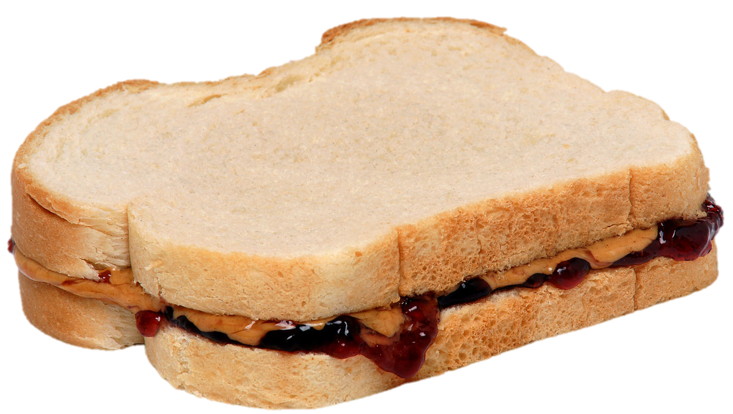
LUNCH

Slide 26
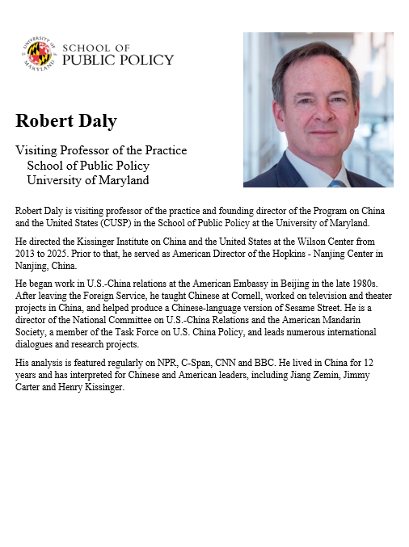
Robert Daly
Visiting Professor of the Practice School of Public Policy University of Maryland
Introduced by Kaiwen

Slide 27
China and Taiwan

Slide 28
Questions? Comments?

Slide 29
Questions? Comments?

Slide 30
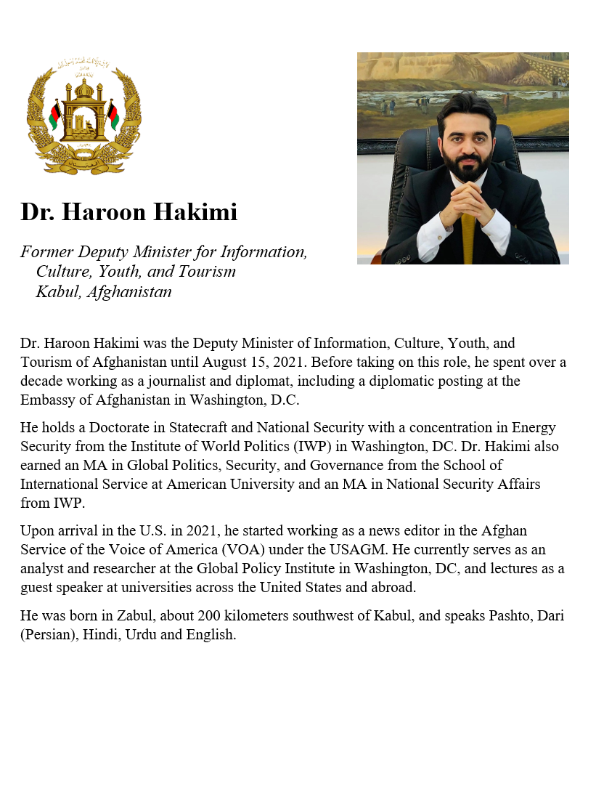
GUEST SPEAKER
Dr. Haroon Hakimi
Former Deputy Minister for Information, Culture, Youth, and Tourism Kabul, Afghanistan
- Introduced by David

Slide 31
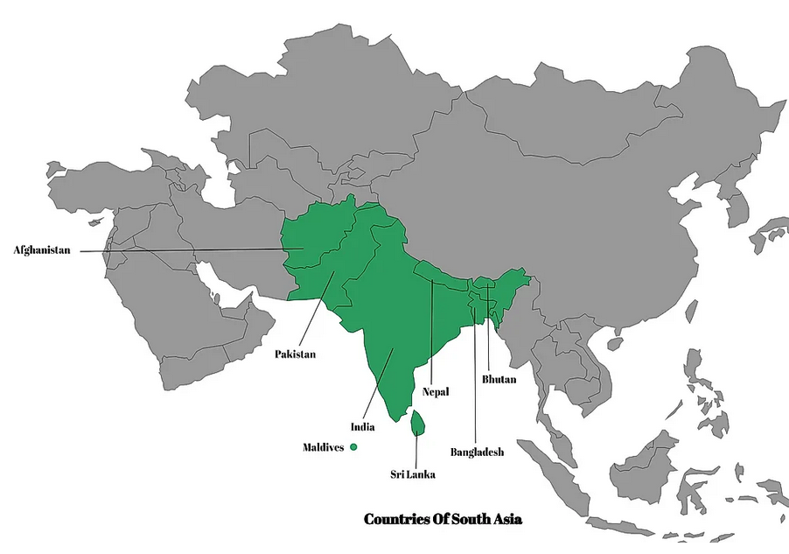
TAJIKISTAN
UZBEKISTAN
KYRGYZSTAN
TURKMENISTAN
SOUTH ASIA
1.
IRAN
2.
7.
5.
3.
6.
4.

Slide 32
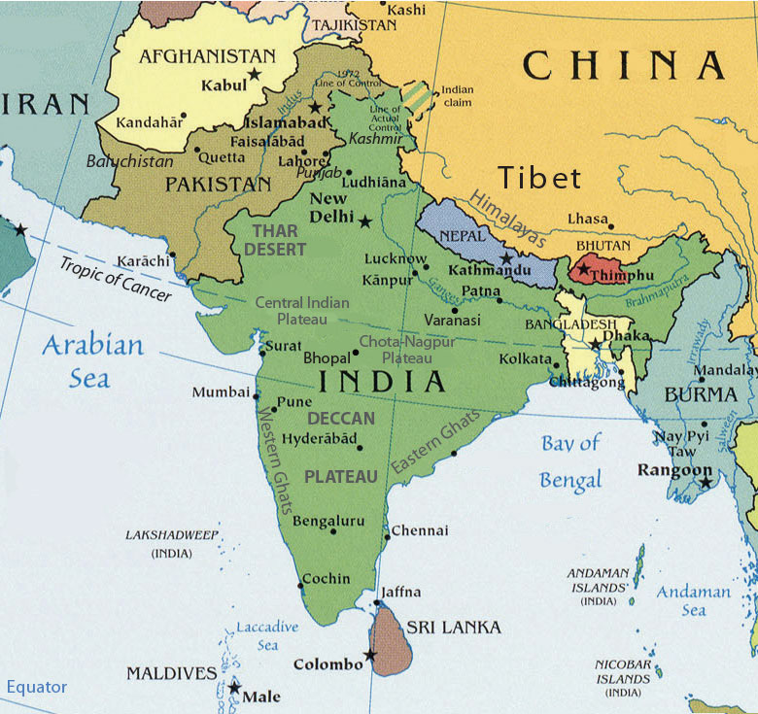

Slide 33
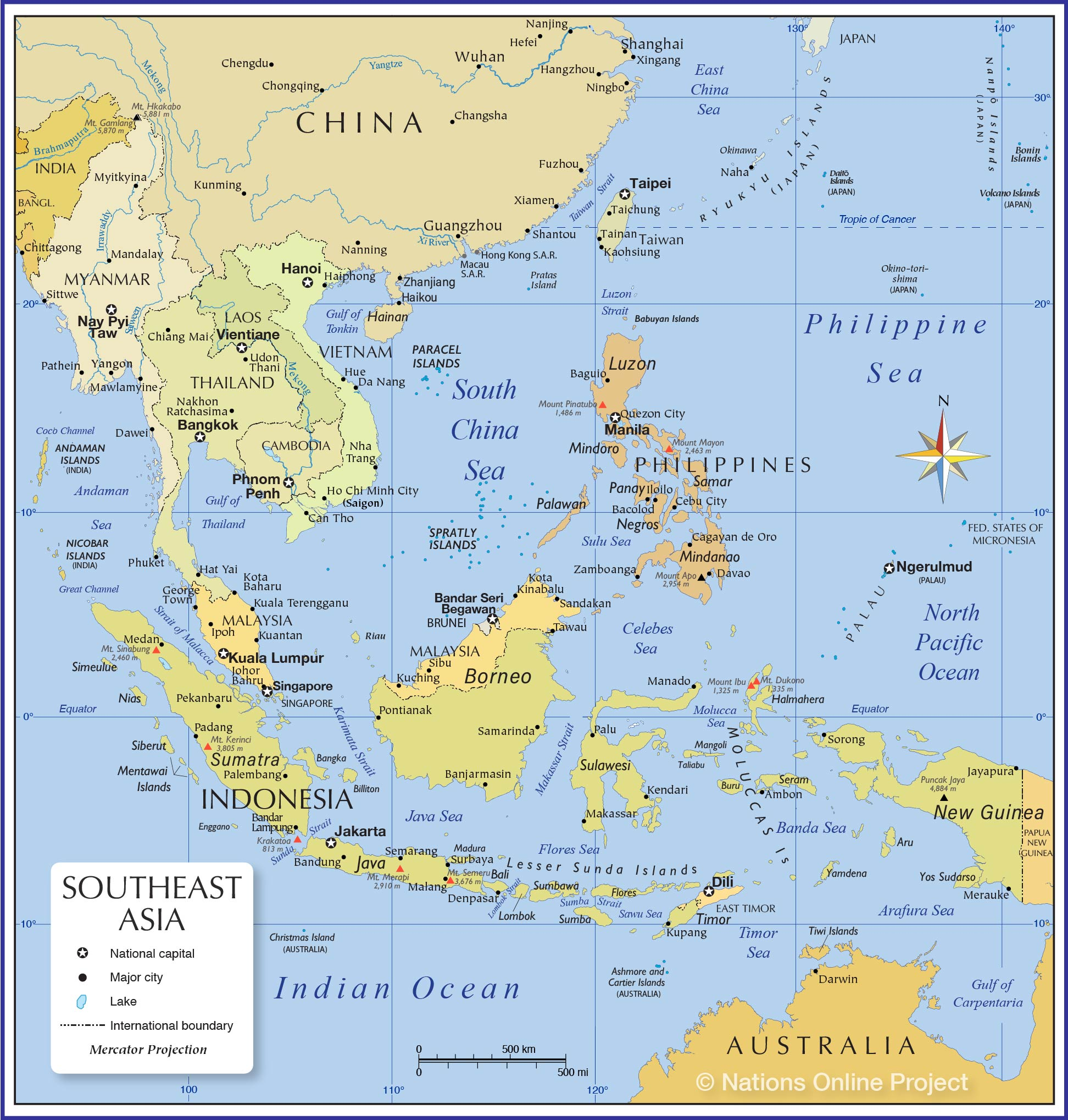

Slide 34
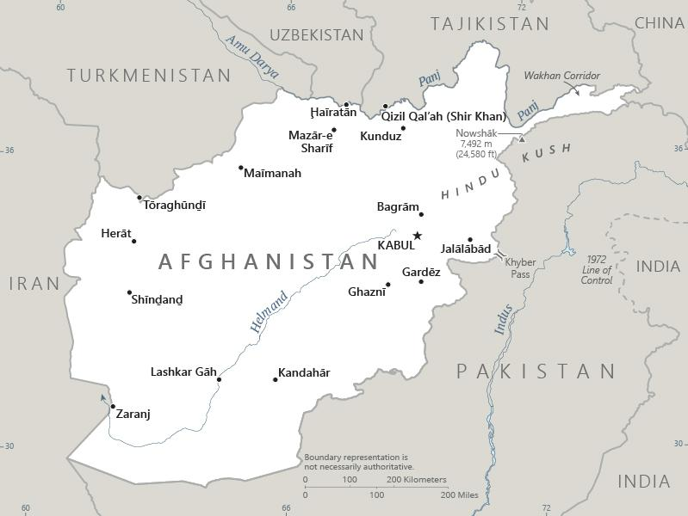

Zabul

Slide 36
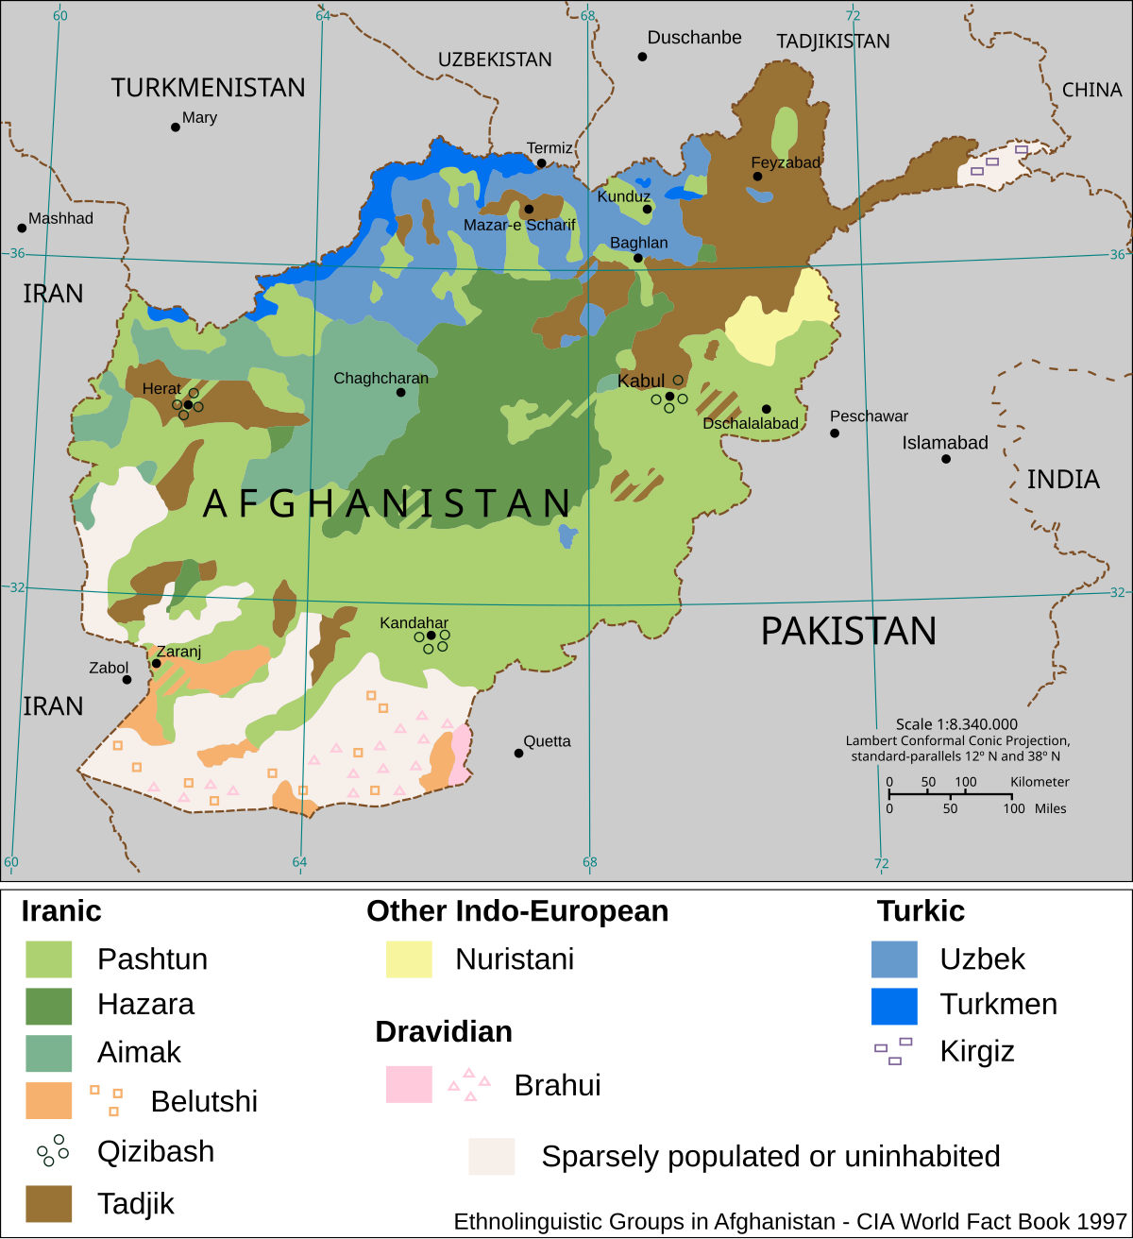

Slide 37
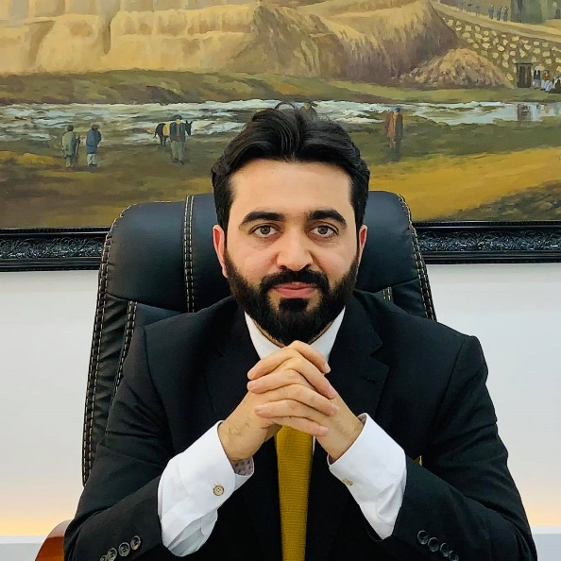
DISCUSSION
Fourteen Lessons from Afghanistan for Future U.S. Nation Building
CLEARLY DEFINE GOALS, HAVE A STRATEGY, AND STICK TO THEM
CHOOSE ALLIES AND PARTNERS CAREFULLY AND UNDERSTAND THEIR INTENTIONS
UNDERSTAND NEIGHBORS, THEIR RELATIONS, AND THE NEIGHBORHOOD
RECONCILE WITH FORMER ENEMIES AND ACCOMMODATE THEM TO MINIMIZE FUTURE THREATS
INCLUSIVENESS CREATES A STABLE AND EFFECTIVE GOVERNMENT
PRIORITIZING SECURITY INSTITUTIONS HELPS THE PROCESS AND LESSENS THE BURDEN ON U.S. FORCES
A FUNCTIONAL GOVERNMENT IS BETTER THAN A REPRESENTATIVE GOVERNMENT THAT FAILS TO FUNCTION
DIVIDE NATION BUILDING RESPONSIBILITIES CAREFULLY, PUSH FOR WIDESPREAD COORDINATION, AND MONITOR AND EVALUATE PROGRESS PROPERLY
Haroon HAKIMI

Slide 38
DISCUSSION
Fourteen Lessons from Afghanistan for Future U.S. Nation Building
BE PREPARED TO PREVENT CORRUPTION, FIGHT IT AS AN INNER ENEMY IF AND WHEN IT APPEARS
ESTABLISHING AND ENFORCING THE RULE OF LAW MUST BE A PRIORITY WITHOUT COMPROMISE
PROMOTE LONG-TERM ECONOMIC SELF-SUFFICIENCY AND SUSTAINABILITY TO AVOID AID DEPENDENCY
FIX THE PROPERTY REGIME TO REDUCE CONFLICTS AND PROTECT THE RIGHT TO OWNERSHIP
SUPPORT NATIONALISM AND THE NATIONAL IDENTITY THAT IS FUNDAMENTAL FOR DEMOCRACY
CONSISTENCY THROUGHOUT THE NATION BUILDING PROCESS HELPS TO ACHIEVING THE DESIRED GOALS
Haroon HAKIMI

Slide 39
DISCUSSION
Fourteen Lessons from Afghanistan for Future U.S. Nation Building
CLEARLY DEFINE GOALS, HAVE A STRATEGY, AND STICK TO THEM
CHOOSE ALLIES AND PARTNERS CAREFULLY AND UNDERSTAND THEIR INTENTIONS
UNDERSTAND NEIGHBORS, THEIR RELATIONS, AND THE NEIGHBORHOOD
RECONCILE WITH FORMER ENEMIES AND ACCOMMODATE THEM TO MINIMIZE FUTURE THREATS
INCLUSIVENESS CREATES A STABLE AND EFFECTIVE GOVERNMENT
PRIORITIZING SECURITY INSTITUTIONS HELPS THE PROCESS AND LESSENS THE BURDEN ON U.S. FORCES
A FUNCTIONAL GOVERNMENT IS BETTER THAN A REPRESENTATIVE GOVERNMENT THAT FAILS TO FUNCTION
DIVIDE NATION BUILDING RESPONSIBILITIES CAREFULLY, PUSH FOR WIDESPREAD COORDINATION, AND MONITOR AND EVALUATE PROGRESS PROPERLY
Haroon HAKIMI

Slide 40
DISCUSSION
Fourteen Lessons from Afghanistan for Future U.S. Nation Building
BE PREPARED TO PREVENT CORRUPTION, FIGHT IT AS AN INNER ENEMY IF AND WHEN IT APPEARS
ESTABLISHING AND ENFORCING THE RULE OF LAW MUST BE A PRIORITY WITHOUT COMPROMISE
PROMOTE LONG-TERM ECONOMIC SELF-SUFFICIENCY AND SUSTAINABILITY TO AVOID AID DEPENDENCY
FIX THE PROPERTY REGIME TO REDUCE CONFLICTS AND PROTECT THE RIGHT TO OWNERSHIP
SUPPORT NATIONALISM AND THE NATIONAL IDENTITY THAT IS FUNDAMENTAL FOR DEMOCRACY
CONSISTENCY THROUGHOUT THE NATION BUILDING PROCESS HELPS TO ACHIEVING THE DESIRED GOALS
Haroon HAKIMI

Slide 42

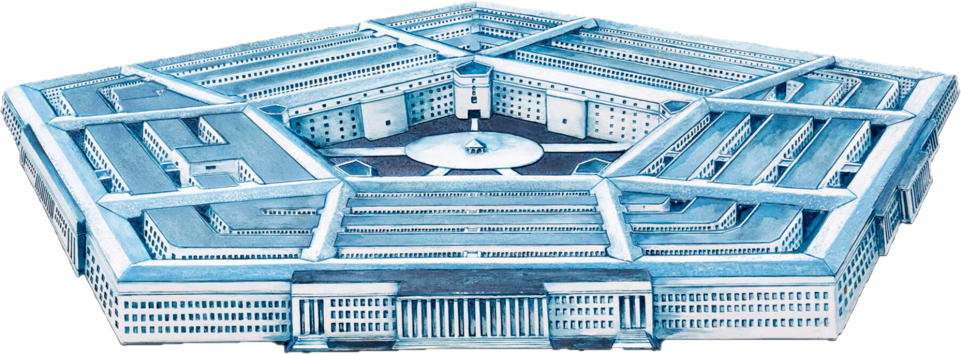
Next week
Embassy of People’s Republic of China
The Pentagon

Slide 43
LUNCH

Slide 44
PROJECT UPDATES

Slide 45
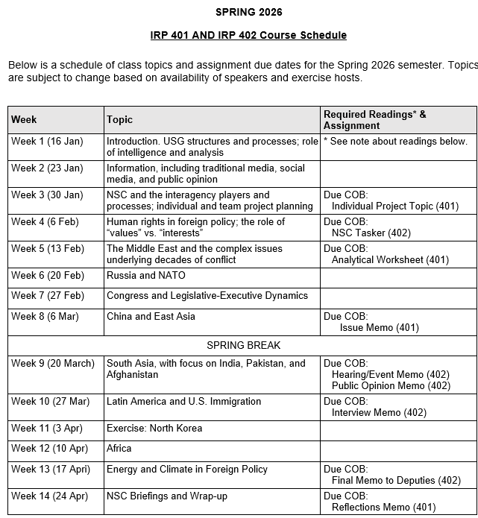
✓
✓
✓
✓
401
✓
✓
✓
✓
✓
✓
✓
✓
402
✓
✓
✓
✓
✓
✓
✓
✓
✓
✓
✓
✓
✓
✓
✓
✓
✓
✓
✓
✓
✓
✓
✓
✓

Slide 46
PROJECT PLANNING
Emmett | Countering “CRINK” Alignment | Danger of one-dimensional energy sector
John | Innovation and Environmental Capacity
Miles | Capitalism and Environment Protection | Climate change and refugees/sovereignty
Kennedy | Taiwan Prosperity and U.S. Interests
Eli | Prediction Markets | Iran-US relations
Michael | Foreign Manipulation of U.S. Elections
Diego | Russian Invasion of Ukraine | Globalization and environmental impact
Molisa | U.S.-China Competition in Critical Technologies
Kaiwen | U.S.-China Economic and Trade Competition | China’s Influence in Africa
Yvette | Rwanda-DRC Conflict and Resolution
Bijan | Housing Shortage and its Implications | Humanitarian Crisis in Gaza
Megha | Restrictive U.S. Immigration and Visa Policies
Filippo | Transatlantic Relations | North Korea illegal ops to support goals
David | ???? | ??????

Slide 47
DISCUSSION
Comfortable?
Topics
How partnership will work
The purposes
Substance, process, skills
The elements
401
Analysis
“Memo #2”
402
Proposal
Hearing/event
Public opinion
Interviews
DC memo
Briefing

Slide 48
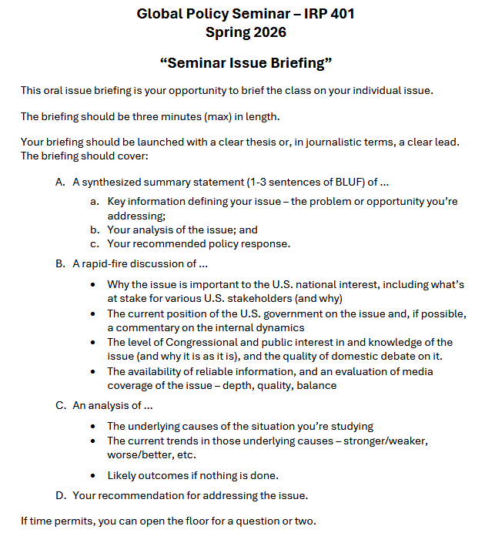
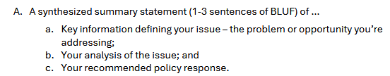
BRIEFINGS
One-Minute Briefing
Your 401 topic
For intelligent non-specialist
Problem-drivers-options- recommendation
Interesting

Slide 49
BRIEFINGS
One-Minute Briefing
Your 401 topic
For intelligent non-specialist
Problem-drivers-options- recommendation
Interesting
FEEL GOOD?
Diego | Eli | Filippo | Michael
Emmett | Meghavarshini | Kennedy | Kaiwen
John | Miles | Molisa | Bijan
Yvette

Slide 50
Next week …

Slide 51

WRAPUP

Slide 52
Questions? Comments? Concerns? Suggestions?

Slide 53
Global Policy Seminar and NSC Simulation
IRP 401 - IRP 402
Week Ten 27 March 2026
Prof. Fulton T. Armstrong

