Slide 1

Global Policy Seminar and NSC Simulation
IRP 401 - IRP 402
Week Nine 20 March 2026
Prof. Fulton T. Armstrong

Slide 2
Week 1 (16 Jan)
Week 2 (23 Jan)
Week 3 (30 Jan)
Week 4 (6 Feb)
Week 5 (13 Feb)
Week 6 (20 Feb)
Week 7 (27 Feb)
Week 8 (6 Mar)
Spring Break
Week 9 (20 March)
Week 10 (27 Mar)
Week 11 (3 Apr)
Week 12 (10 Apr)
Week 13 (17 Apri)
Week 14 (24 Apr)
Spring 2026

Slide 3
TODAY’S AGENDA
9:00 | Skills: Professional Listening - Samantha Clemence
10:00 | Melinda Kimble Senior Fellow, United Nations Foundation - Introduced by Miles
11:30 | Lunch
1:00 | José Pertierra Immigration Attorney - Introduced by Kaiwen
2:15 | Class Discussion - 401 briefings - Project updates
~3:00 | Wrapup

Slide 4
TODAY’S AGENDA
9:00 | Skills: Professional Listening - Samantha Clemence
10:00 | Melinda Kimble Senior Fellow, United Nations Foundation - Introduced by Miles
11:30 | Lunch
1:00 | José Pertierra Immigration Attorney - Introduced by Kaiwen
2:15 | Class Discussion - 401 briefings - Project updates
~3:00 | Wrapup

Slide 5
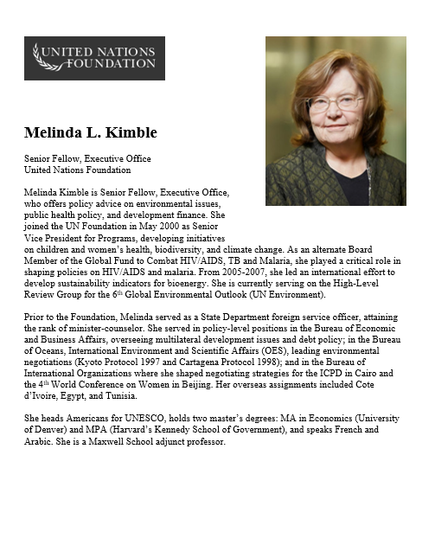
GUEST SPEAKER
Melinda Kimble
UN Foundation
- introduced by Miles

Slide 6
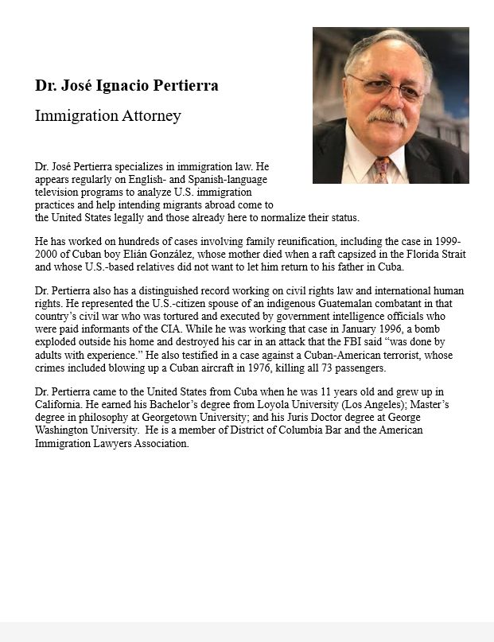
GUEST SPEAKER
José Pertierra
Immigration Lawyer and expert on immigration law and Latin America
- Introduced by Kaiwen

Slide 7
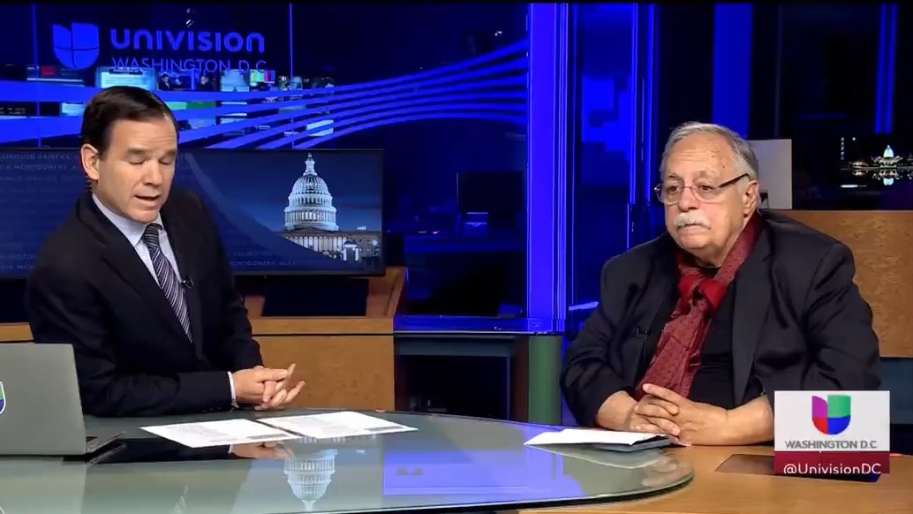
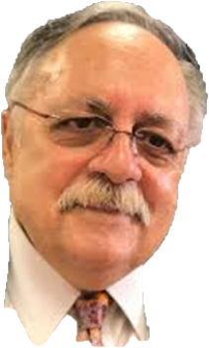
GUEST SPEAKER
José Pertierra

Slide 8
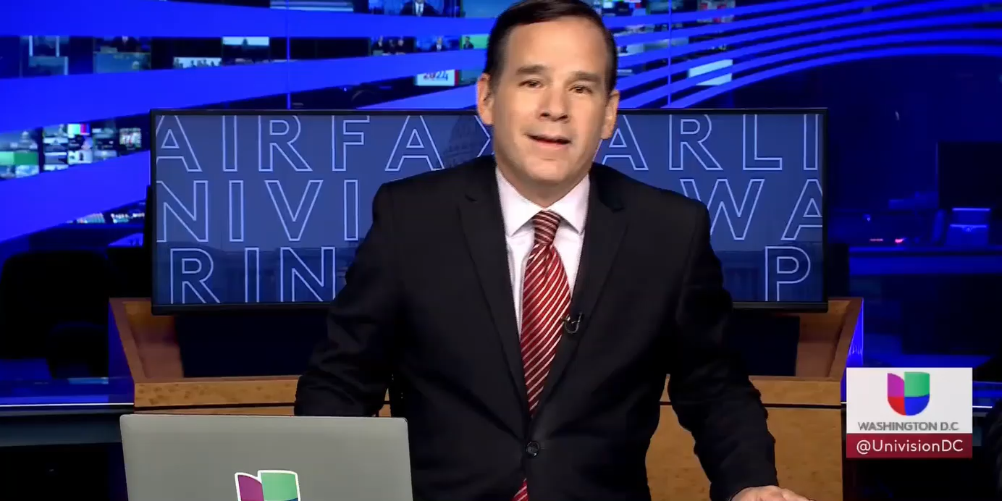
GUEST SPEAKER
José Pertierra

Slide 9
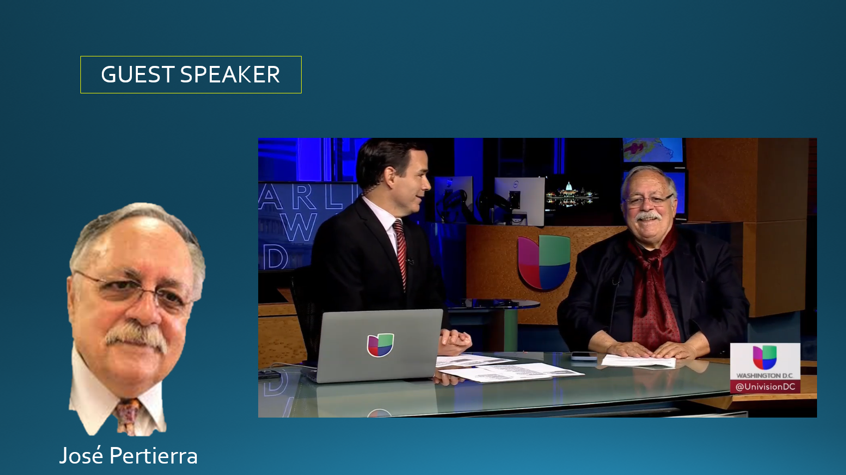
[[ video ]]

Slide 10

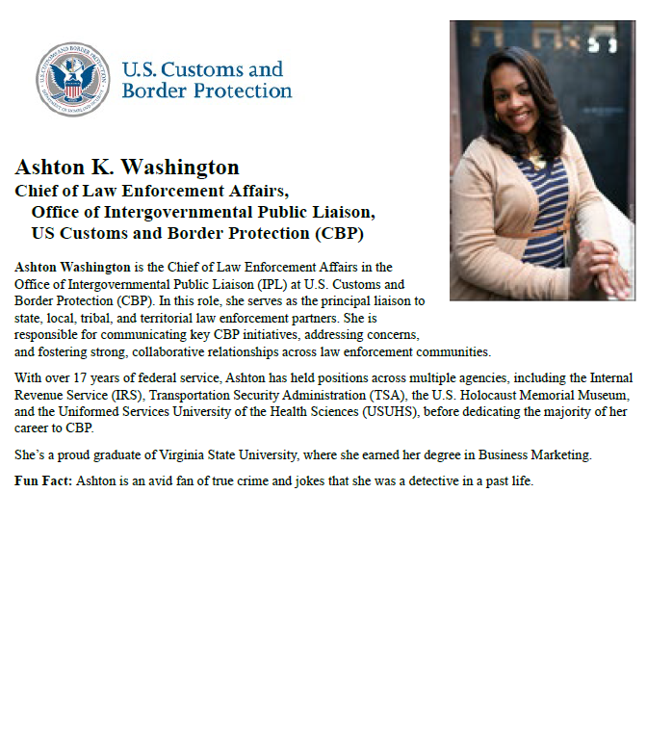
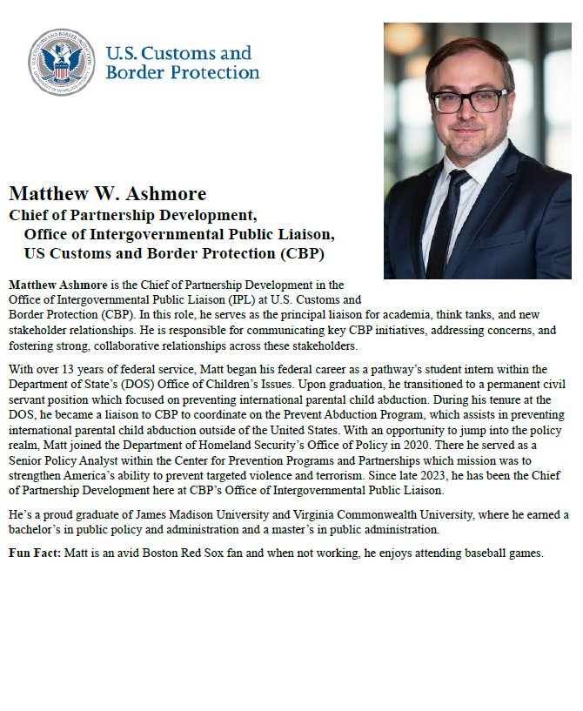
Followup Questions?

Slide 11
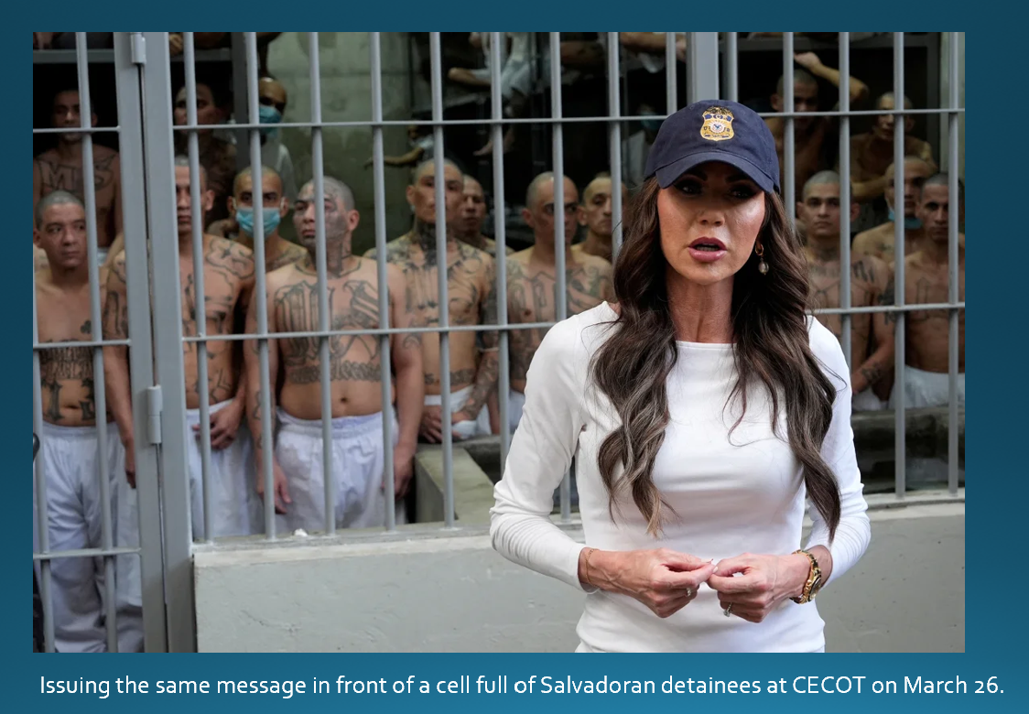
Takeaways?

Slide 12
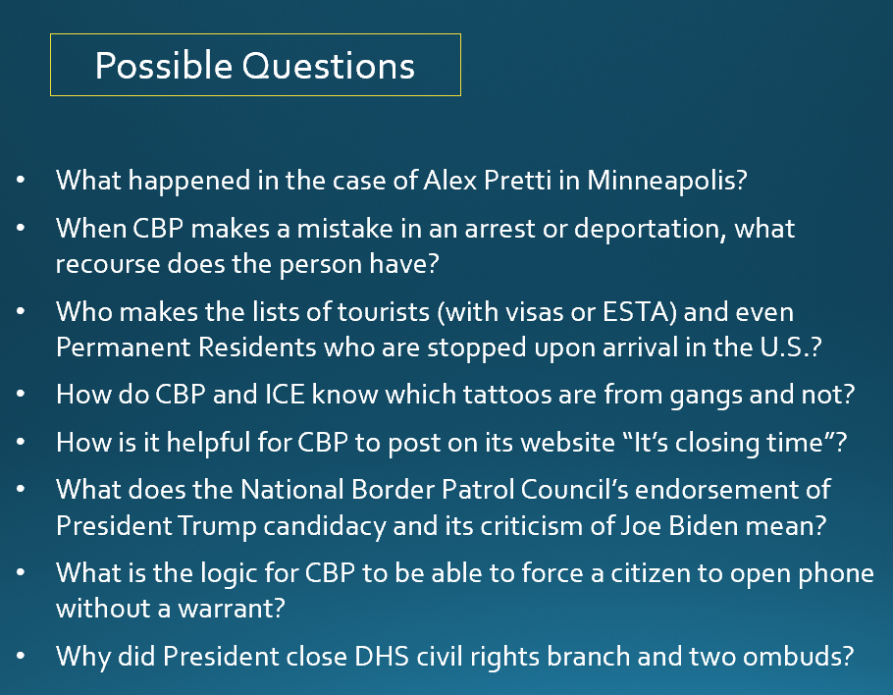
Takeaways?

Slide 13
Special reading to prep.
Activity will include lunch.
(Let me know dietary preferences if any.)

Slide 14
U.S. Customs and Border Protection
-CBP Mission and Policies-

Slide 15
Preparing for visit of CBP speakers
Customs and Border Protection
Trade and revenue
Lawful travel
Migration and border security
Countering drug smuggling
HOT ISSUE of the day: Deporting migrants
Few question that immigration has been crisis.
Trump made it centerpiece of his election campaign.
Deportations are “promise made, promise kept.”

Slide 16
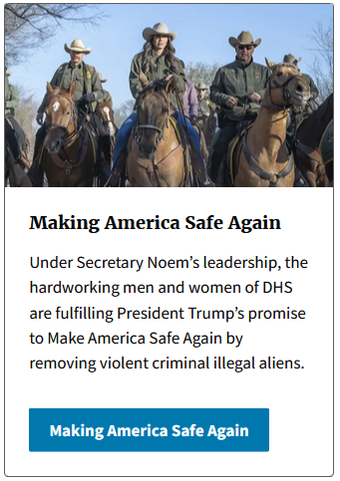

Secretary Kristi Noem

Slide 17
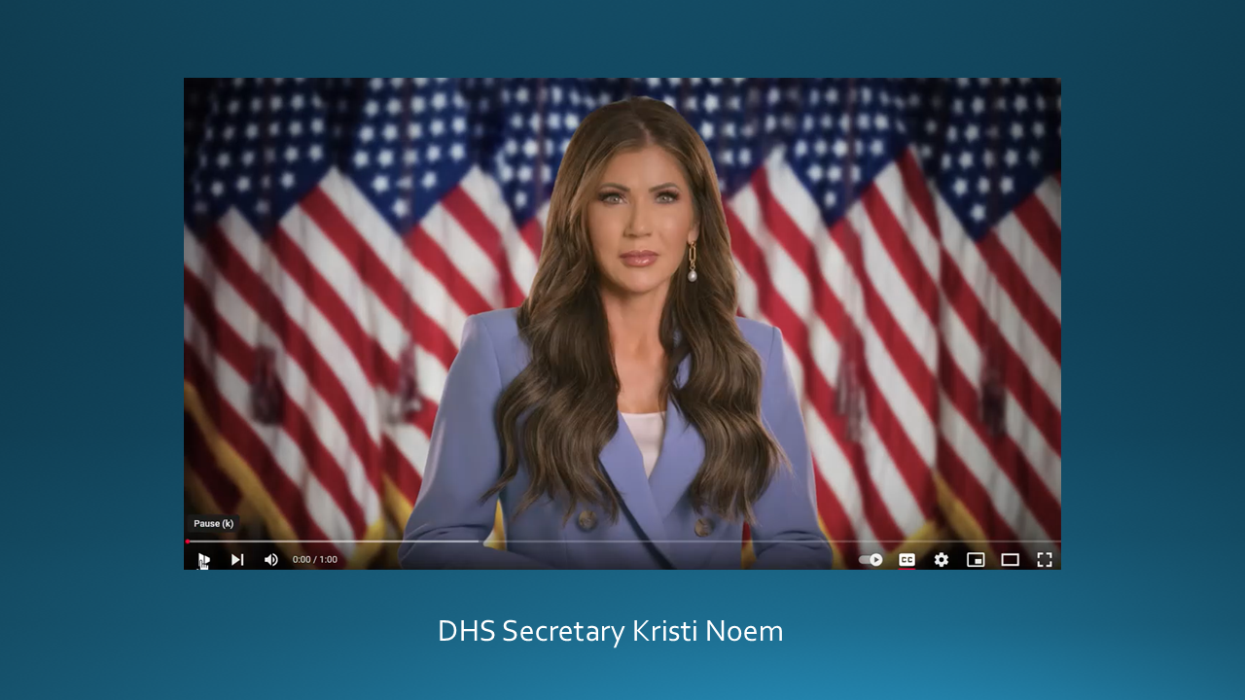
[[ VIDEO ]]

Slide 18
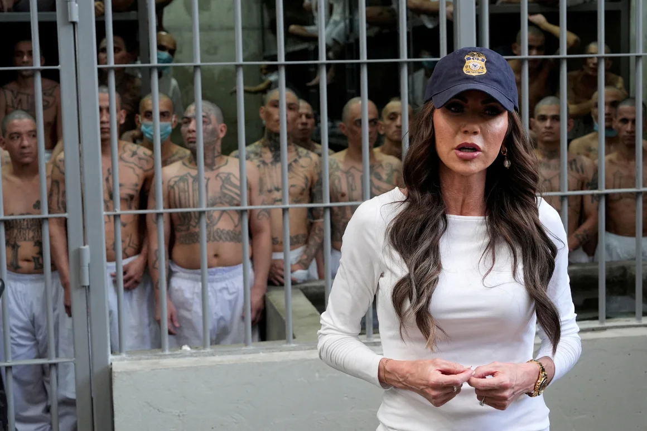
Issuing the same message in front of a cell full of Salvadoran detainees at CECOT on March 26.

Slide 19

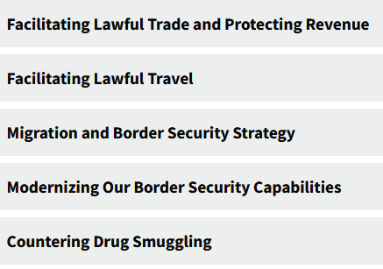
MISSION
With more than 60,000 employees, U.S. Customs and Border Protection, CBP, is one of the world's largest law enforcement organizations and is charged with keeping terrorists and their weapons out of the U.S. while facilitating lawful international travel and trade.
Action areas:

Slide 20
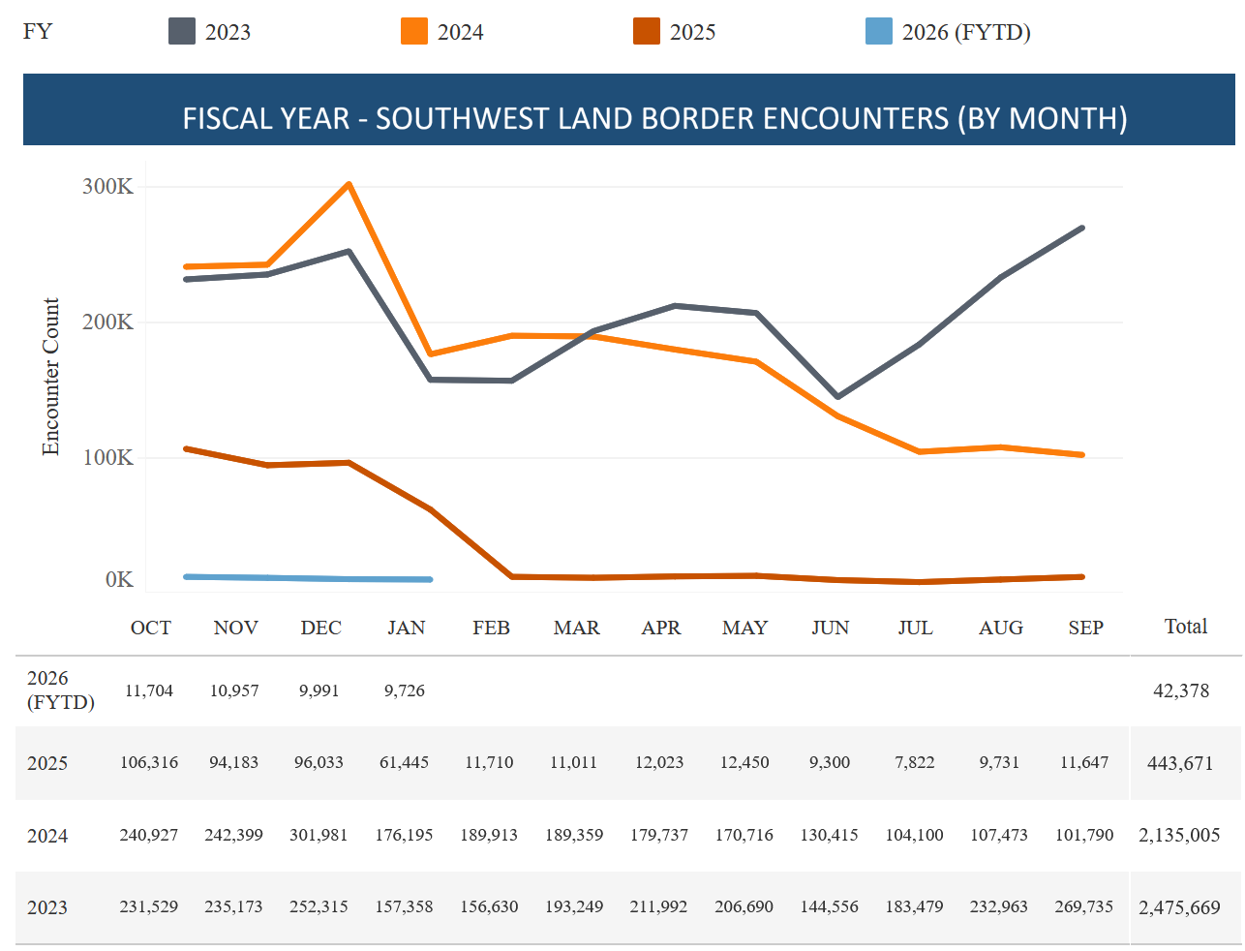
The numbers speak: Encounters Down Drastically
2026
2025
DHS website
CBP “encounters” on Southwest Border

Slide 21
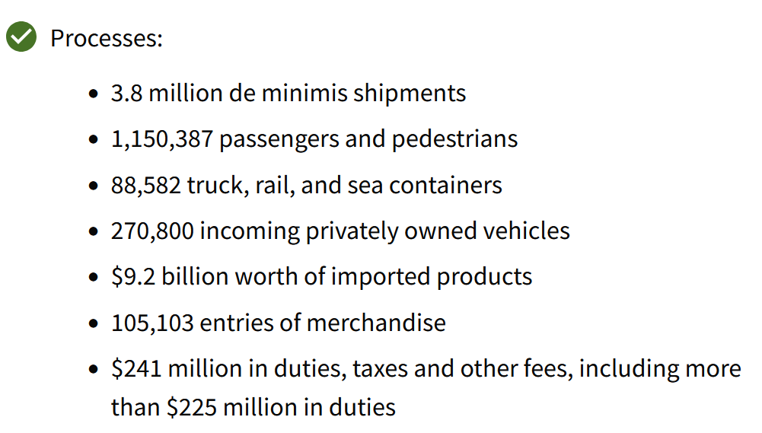
What CBP does
DHS website

Slide 22
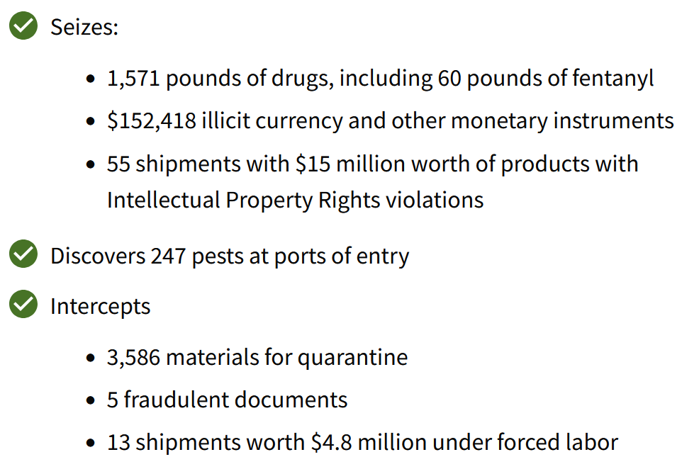
What CBP does
DHS website

Slide 23
Briefers
Matthew ASHMORE, Chief of Partnership Development
[plus a colleague – TBD]
Remember: They are not ICE.

Slide 24
Briefers
Mission of the Office of Intergovernmental Public Liaison (IPL)
Advising the Commissioner, Deputy Commissioner, and program offices on the impact U.S. Customs & Border Protection’s (CBP) mission, policies, and initiatives have on key stakeholders (i.e., state, local, tribal, and territorial governments, law enforcement; the national associations representing them; non-governmental organizations; and the public), and
Serving as CBP's principal liaison to these key stakeholders.

Slide 25
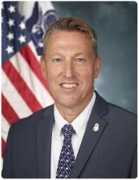
Overview
CPB enforces laws and implements policies.
It may advise, but not make, policy.
Rodney S. Scott
Commissioner

Slide 26
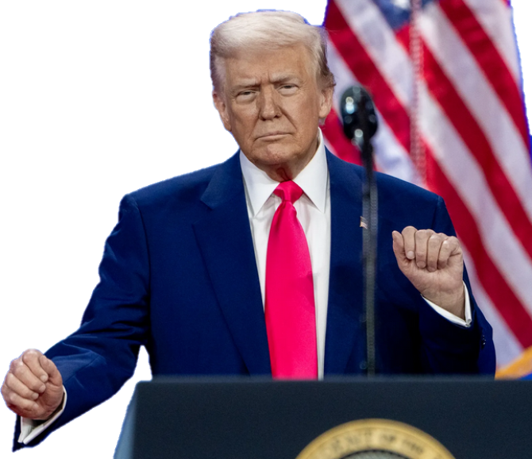
Executive Order (22 Jan 2025)
Protect against “invasion”
“Immediately repel, repatriate, and remove illegal aliens involved in the invasion.”
Alien Enemies Act of 1789 (Mar 15)
Numerous statements
Illegal immigrants are “animals” and “not human” (Apr 2024)
They are drug dealers, rapists, criminals “poisoning our blood” (Mar 2024)

Slide 27
Issues
Administration says …
Other evidence points to …
Deporting undocumented who’ve committed crimes.
Crime of many is only illegal entry.
Deporting “pro-terrorist, antisemitic, anti-American.”
No allegation of terrorism. Unknown criteria.
Purpose is to defend from invasion (Alien Enemies Act) and protect national security.
Courts contesting because no evidence of foreign government involvement.
Rights being respected.
Rights violated, regarding access to legal counsel, habeas corpus, etc.
Not related to persons’ political views or free expression.
Pattern so far: criticism of Israel and support for Palestine/Hamas.

Slide 28
What does this mean for your questions?
As always, ask what you think appropriate in appropriate fashion.
As always, offer analysis and conclusions.
Understand difference between law/policy and enforcement.
Understand that everyone has choice to stay in job and carry out orders.
Professional courtesy doesn’t mean a) you have to agree, or b) not stating disagreement is agreement.

Slide 29
Possible Questions
What happened in the case of Alex Pretti in Minneapolis?
When CBP makes a mistake in an arrest or deportation, what recourse does the person have?
Who makes the lists of tourists (with visas or ESTA) and even Permanent Residents who are stopped upon arrival in the U.S.?
How do CBP and ICE know which tattoos are from gangs and not?
How is it helpful for CBP to post on its website “It’s closing time”?
What does the National Border Patrol Council’s endorsement of President Trump candidacy and its criticism of Joe Biden mean?
What is the logic for CBP to be able to force a citizen to open phone without a warrant?
Why did President close DHS civil rights branch and two ombuds?

Slide 30
Questions? Comments?

Slide 31
Questions? Comments?

Slide 32


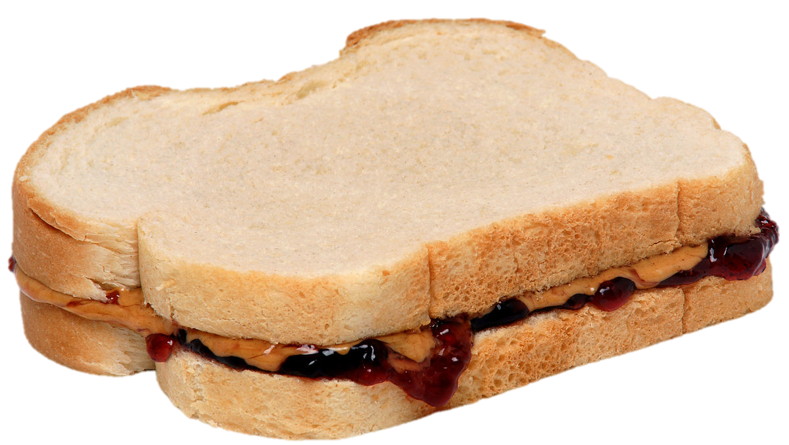
LUNCH

Slide 33


Slide 34
GUEST SPEAKER
Melinda Kimble
UN Foundation
- introduced by Miles

Slide 35
LUNCH

Slide 36
GUEST SPEAKER
José Pertierra
Immigration Lawyer and expert on immigration law and Latin America
- Introduced by Kaiwen

Slide 37
PROJECT UPDATES

Slide 38
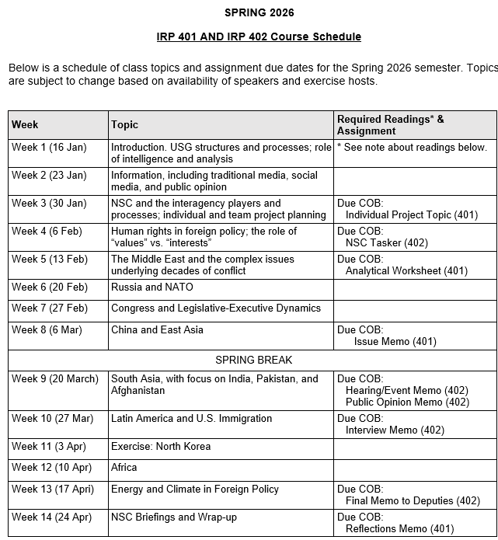
✓
✓
✓
✓
401
✓
✓
✓
✓
✓
✓
✓
✓
402
✓
✓
✓
✓
✓
✓
✓
✓
✓
✓
✓
✓
✓
✓
✓
✓
✓
✓
✓
✓
✓
✓
✓
✓

Slide 39
PROJECT PLANNING
Emmett | Countering “CRINK” Alignment | Danger of one-dimensional energy sector
John | Innovation and Environmental Capacity
Miles | Capitalism and Environment Protection | Climate change and refugees/sovereignty
Kennedy | Taiwan Prosperity and U.S. Interests
Eli | Prediction Markets | Iran-US relations
Michael | Foreign Manipulation of U.S. Elections
Diego | Russian Invasion of Ukraine | Globalization and environmental impact
Molisa | U.S.-China Competition in Critical Technologies
Kaiwen | U.S.-China Economic and Trade Competition | China’s Influence in Africa
Yvette | Rwanda-DRC Conflict and Resolution
Bijan | Housing Shortage and its Implications | Humanitarian Crisis in Gaza
Megha | Restrictive U.S. Immigration and Visa Policies
Filippo | Transatlantic Relations | North Korea illegal ops to support goals
David | ???? | ??????

Slide 40
DISCUSSION
Comfortable?
Topics
How partnership will work
The purposes
Substance, process, skills
The elements
401
Analysis
“Memo #2”
402
Proposal
Hearing/event
Public opinion
Interviews
DC memo
Briefing

Slide 41
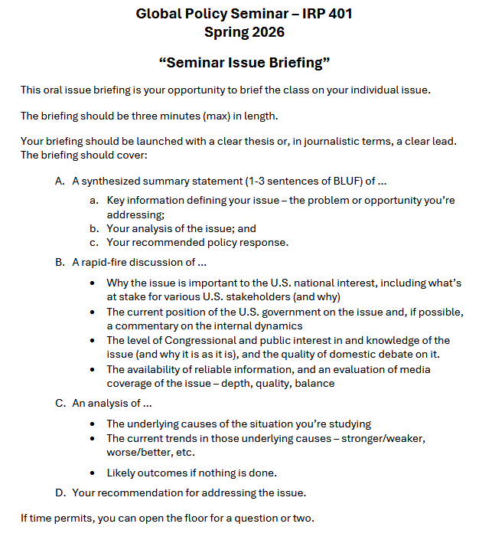
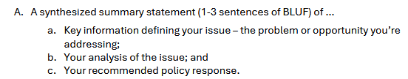
BRIEFINGS
One-Minute Briefing
Your 401 topic
For intelligent non-specialist
Problem-drivers-options- recommendation
Interesting

Slide 42
BRIEFINGS
One-Minute Briefing
Your 401 topic
For intelligent non-specialist
Problem-drivers-options- recommendation
Interesting
FEEL GOOD?
Diego | Eli | Filippo | Michael
Emmett | Meghavarshini | Kennedy | Kaiwen
John | Miles | Molisa | Bijan
Yvette

Slide 43
Next week …

Slide 44
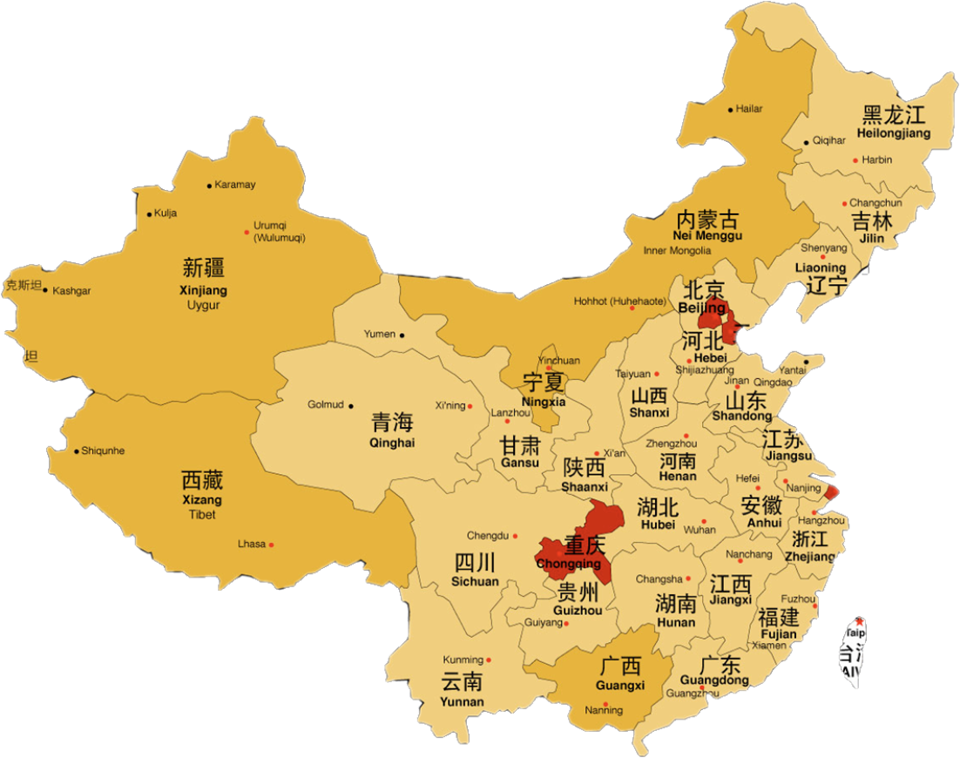
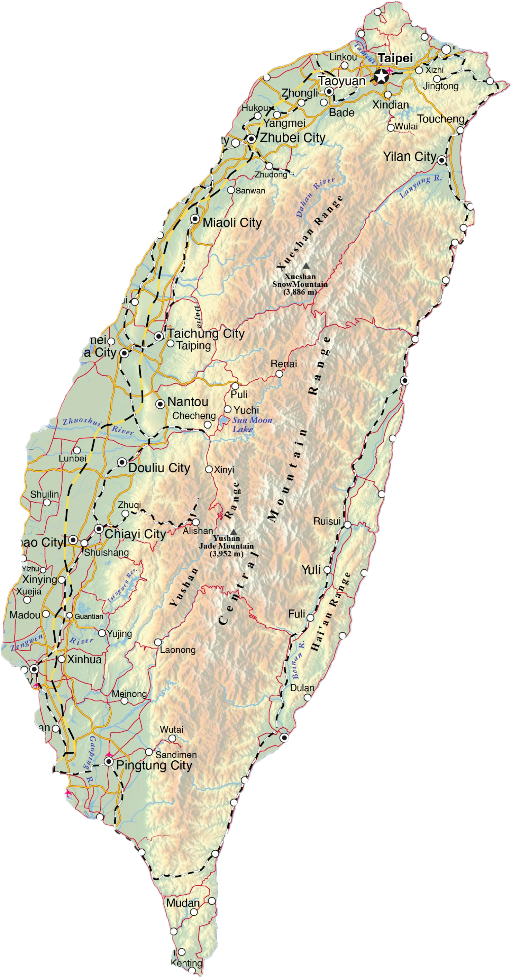
China and Taiwan
Next week …

Slide 45

WRAPUP

Slide 46
Questions? Comments? Concerns? Suggestions?

Slide 47
Global Policy Seminar and NSC Simulation
IRP 401 - IRP 402
Week Nine 20 March 2026
Prof. Fulton T. Armstrong

