Slide 1

Global Policy Seminar and NSC Simulation
IRP 401 - IRP 402
Week Eight 6 March 2026
Prof. Fulton T. Armstrong

Slide 2
Week 1 (16 Jan)
Week 2 (23 Jan)
Week 3 (30 Jan)
Week 4 (6 Feb)
Week 5 (13 Feb)
Week 6 (20 Feb)
Week 7 (27 Feb)
Week 8 (6 Mar)
Spring Break
Week 9 (20 March)
Week 10 (27 Mar)
Week 11 (3 Apr)
Week 12 (10 Apr)
Week 13 (17 Apri)
Week 14 (24 Apr)
Spring 2026

Slide 3
Week 1 (16 Jan)
Week 2 (23 Jan)
Week 3 (30 Jan)
Week 4 (6 Feb)
Week 5 (13 Feb)
Week 6 (20 Feb)
Week 7 (27 Feb)
Week 8 (6 Mar)
Spring Break
Week 9 (20 March)
Week 10 (27 Mar)
Week 11 (3 Apr)
Week 12 (10 Apr)
Week 13 (17 Apri)
Week 14 (24 Apr)
Spring 2026

Slide 4
TODAY’S AGENDA
10:00 | KEI Diplomatic Negotiation and Lunch
1:00 | Walk back to SUDC
2:00 | Ashton Washington and Matthew Ashmore Chief of Law Enforcement Affairs & Chief of Partnership Development Office of the Commissioner, Customs and Border Patrol
3:00 | Skills: Professional Listening
~3:45 | Wrapup and … start spring break!

Slide 5
TODAY’S AGENDA
10:00 | KEI Diplomatic Negotiation and Lunch
1:00 | Walk back to SUDC
2:00 | Ashton Washington and Matthew Ashmore Chief of Law Enforcement Affairs & Chief of Partnership Development Office of the Commissioner, Customs and Border Patrol
3:00 | Skills: Professional Listening
~3:45 | Wrapup and … start spring break!

Slide 6







The Six-Party Talks
Takeaways?
- An exercise in diplomatic negotiations -
You will be negotiating as representatives of
Democratic People’s Republic of Korea (DPRK – North Korea)
Republic of Korea (ROK – South Korea)
People’s Republic of China (PRC – China)
Diego Emmett
Yvette Kaiwen
Megha Kennedy
Japan
Russia
United States
Michael – Filippo Eli
Miles Molisa
John - David Bijan

Slide 7
The Six-Party Talks
 | Republic of Korea (South Korea) | Democratic People’s Republic of Korea (North Korea) | USA | People’s Republic of China | Japan | Russia
Universe 1 | Yvette | Diego | John David | Megha | Michael Filippo | Miles
Universe 2 | Kaiwen | Emmett | Bijan | Kennedy | Eli | Molisa

Slide 8


Slide 9
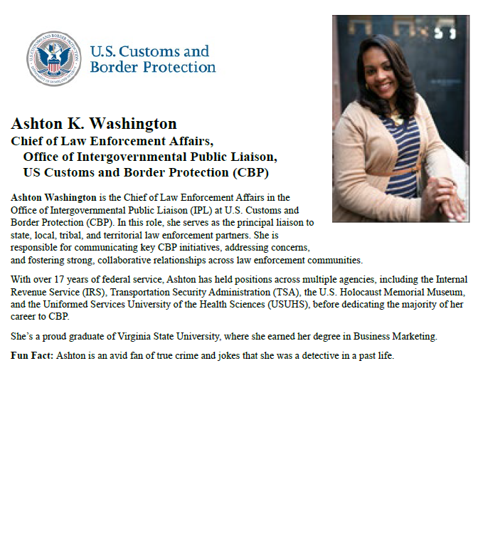
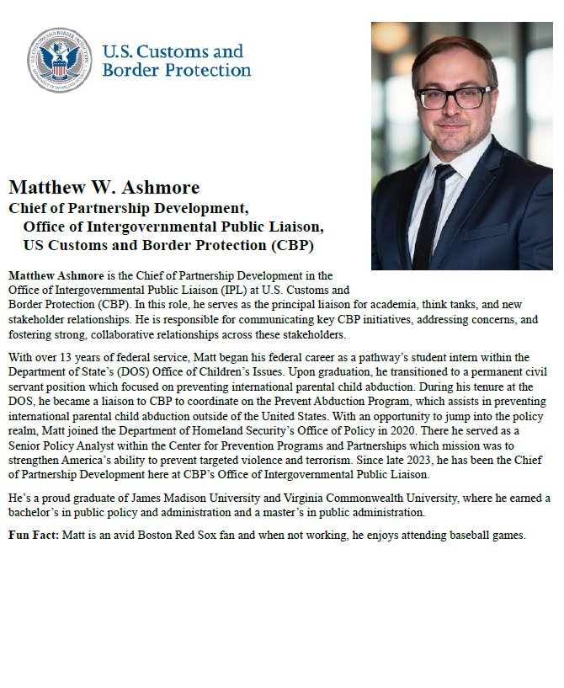
Takeaways?

Slide 10
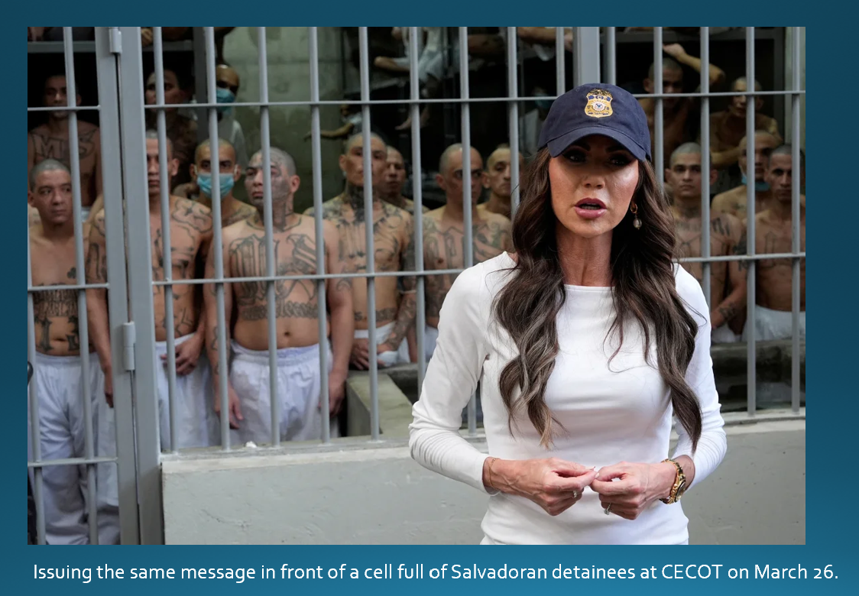
Takeaways?

Slide 11
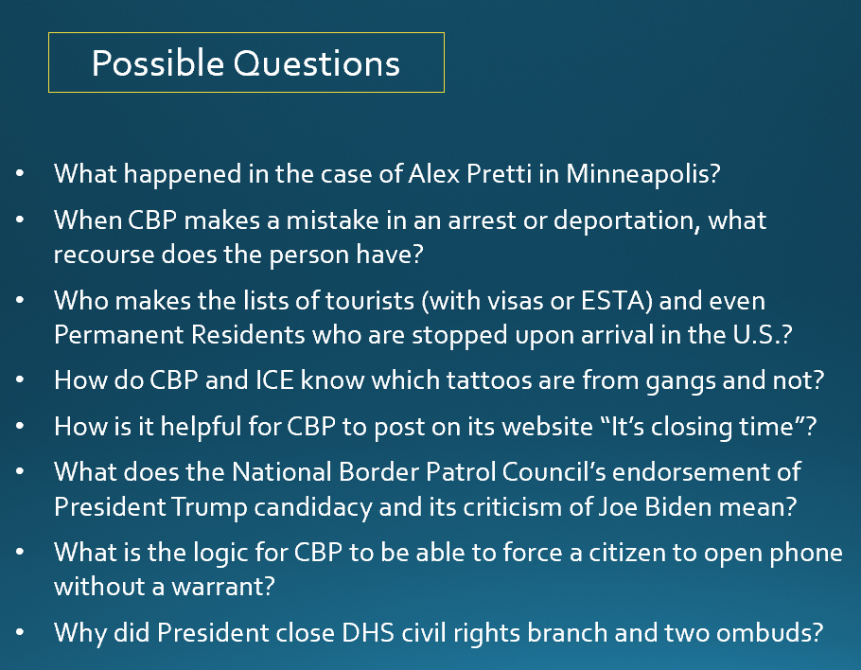
Takeaways?

Slide 12
Special reading to prep.
Activity will include lunch.
(Let me know dietary preferences if any.)

Slide 13
U.S. Customs and Border Protection
-CBP Mission and Policies-

Slide 14
Preparing for visit of CBP speakers
Customs and Border Protection
Trade and revenue
Lawful travel
Migration and border security
Countering drug smuggling
HOT ISSUE of the day: Deporting migrants
Few question that immigration has been crisis.
Trump made it centerpiece of his election campaign.
Deportations are “promise made, promise kept.”

Slide 15
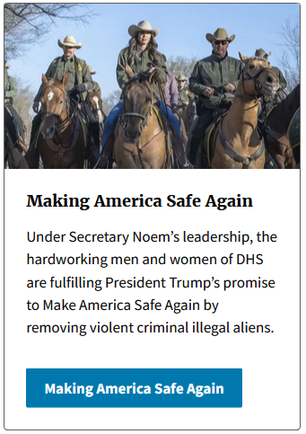

Secretary Kristi Noem

Slide 16
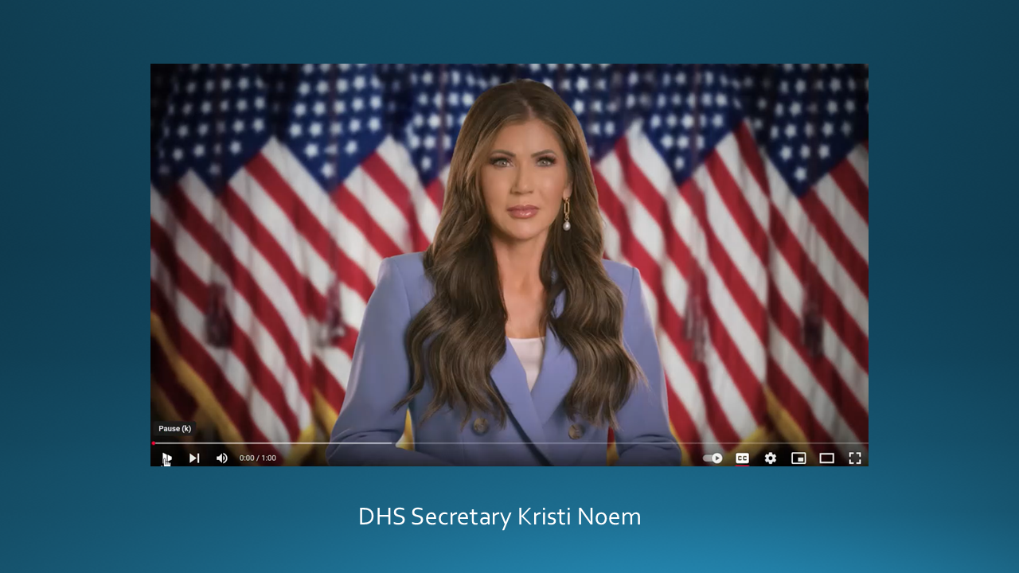
[[ VIDEO ]]

Slide 17
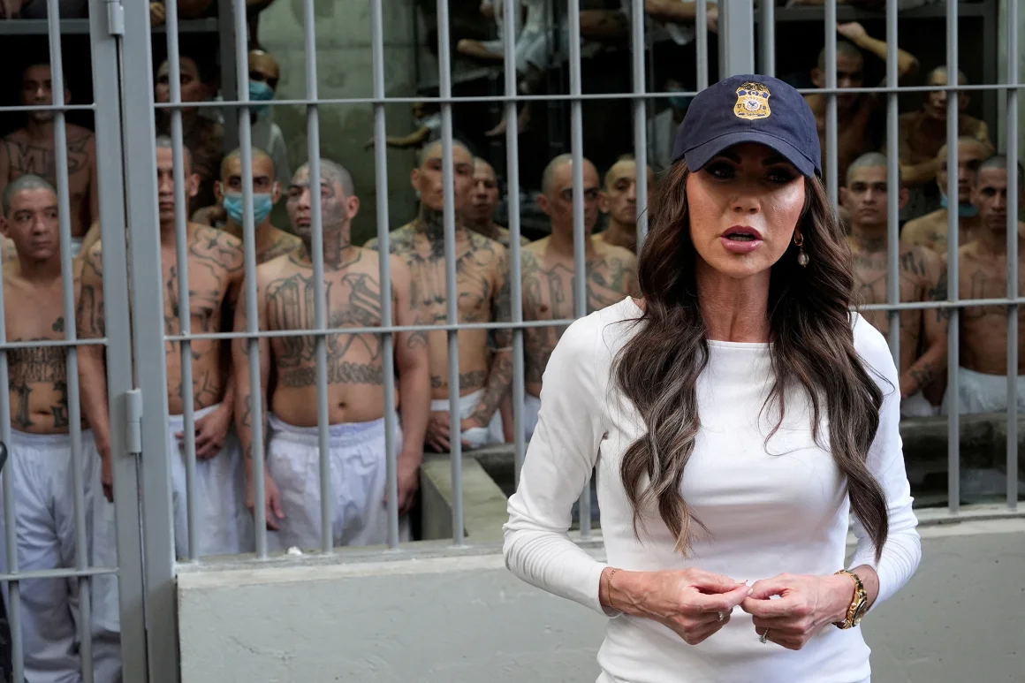
Issuing the same message in front of a cell full of Salvadoran detainees at CECOT on March 26.

Slide 18

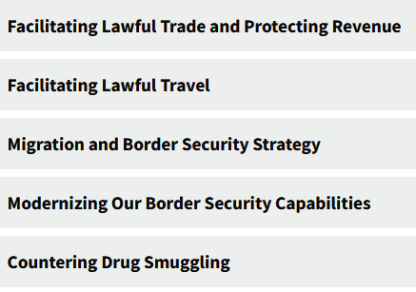
MISSION
With more than 60,000 employees, U.S. Customs and Border Protection, CBP, is one of the world's largest law enforcement organizations and is charged with keeping terrorists and their weapons out of the U.S. while facilitating lawful international travel and trade.
Action areas:

Slide 19
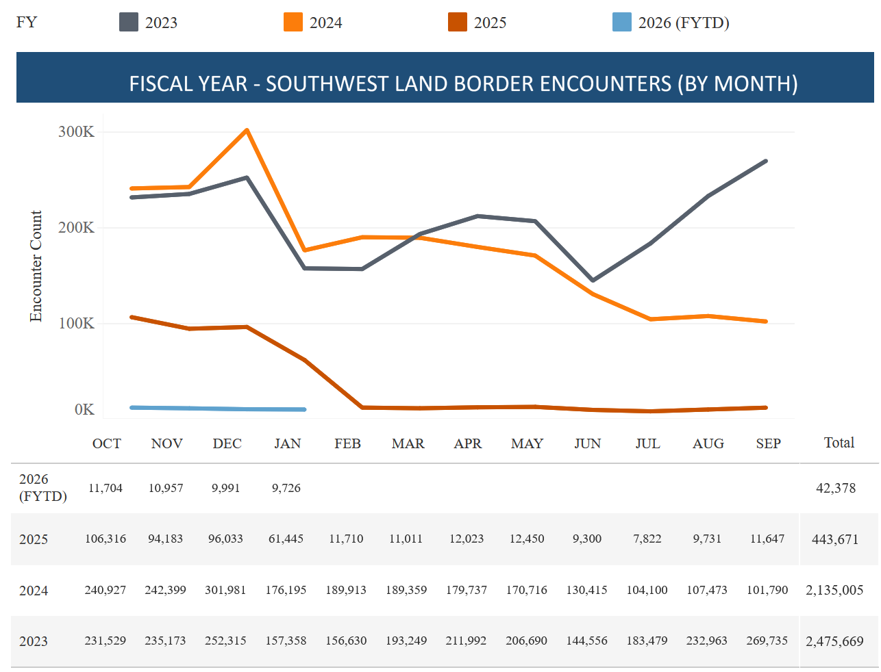
The numbers speak: Encounters Down Drastically
2026
2025
DHS website
CBP “encounters” on Southwest Border

Slide 20
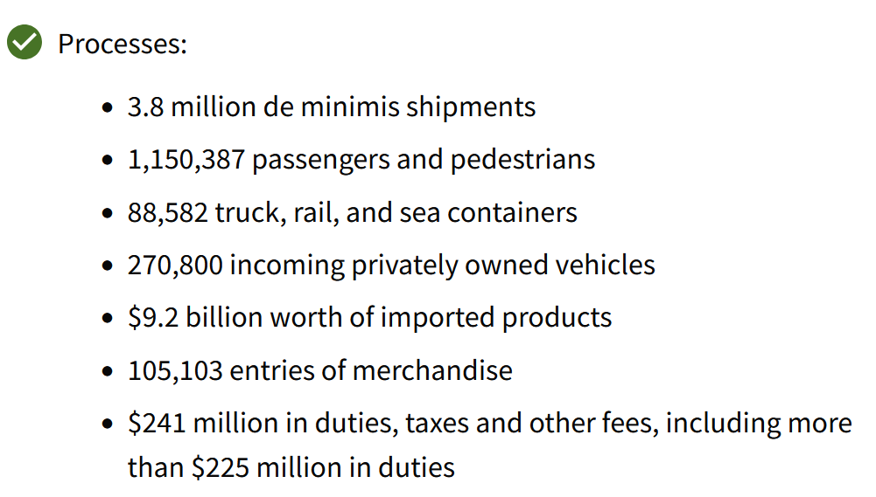
What CBP does
DHS website

Slide 21
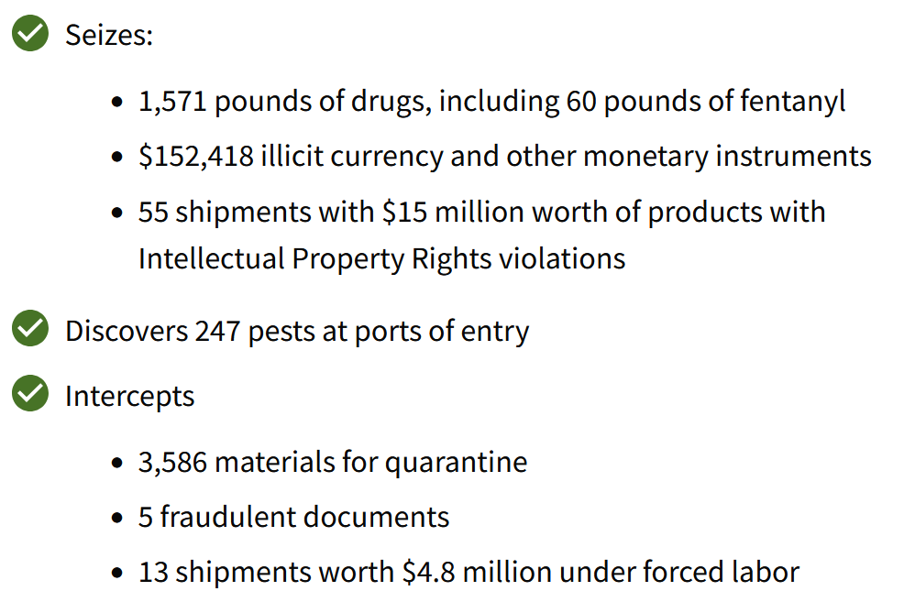
What CBP does
DHS website

Slide 22
Briefers
Matthew ASHMORE, Chief of Partnership Development
[plus a colleague – TBD]
Remember: They are not ICE.

Slide 23
Briefers
Mission of the Office of Intergovernmental Public Liaison (IPL)
Advising the Commissioner, Deputy Commissioner, and program offices on the impact U.S. Customs & Border Protection’s (CBP) mission, policies, and initiatives have on key stakeholders (i.e., state, local, tribal, and territorial governments, law enforcement; the national associations representing them; non-governmental organizations; and the public), and
Serving as CBP's principal liaison to these key stakeholders.

Slide 24
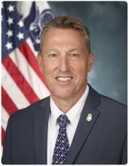
Overview
CPB enforces laws and implements policies.
It may advise, but not make, policy.
Rodney S. Scott
Commissioner

Slide 25
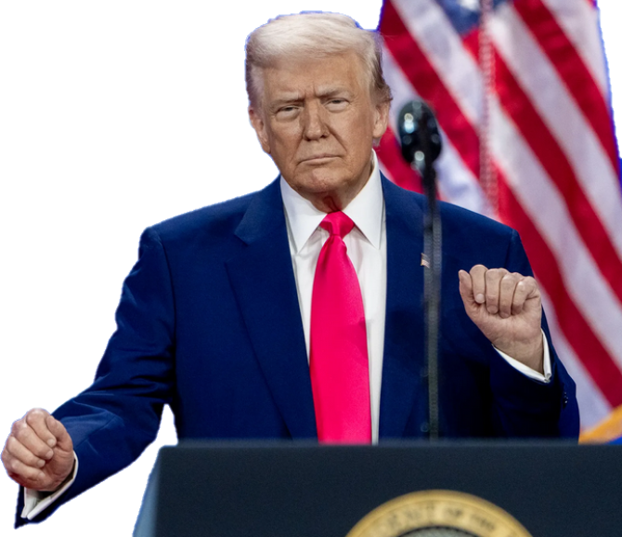
Executive Order (22 Jan 2025)
Protect against “invasion”
“Immediately repel, repatriate, and remove illegal aliens involved in the invasion.”
Alien Enemies Act of 1789 (Mar 15)
Numerous statements
Illegal immigrants are “animals” and “not human” (Apr 2024)
They are drug dealers, rapists, criminals “poisoning our blood” (Mar 2024)

Slide 26
Issues
Administration says …
Other evidence points to …
Deporting undocumented who’ve committed crimes.
Crime of many is only illegal entry.
Deporting “pro-terrorist, antisemitic, anti-American.”
No allegation of terrorism. Unknown criteria.
Purpose is to defend from invasion (Alien Enemies Act) and protect national security.
Courts contesting because no evidence of foreign government involvement.
Rights being respected.
Rights violated, regarding access to legal counsel, habeas corpus, etc.
Not related to persons’ political views or free expression.
Pattern so far: criticism of Israel and support for Palestine/Hamas.

Slide 27
What does this mean for your questions?
As always, ask what you think appropriate in appropriate fashion.
As always, offer analysis and conclusions.
Understand difference between law/policy and enforcement.
Understand that everyone has choice to stay in job and carry out orders.
Professional courtesy doesn’t mean a) you have to agree, or b) not stating disagreement is agreement.

Slide 28
Possible Questions
What happened in the case of Alex Pretti in Minneapolis?
When CBP makes a mistake in an arrest or deportation, what recourse does the person have?
Who makes the lists of tourists (with visas or ESTA) and even Permanent Residents who are stopped upon arrival in the U.S.?
How do CBP and ICE know which tattoos are from gangs and not?
How is it helpful for CBP to post on its website “It’s closing time”?
What does the National Border Patrol Council’s endorsement of President Trump candidacy and its criticism of Joe Biden mean?
What is the logic for CBP to be able to force a citizen to open phone without a warrant?
Why did President close DHS civil rights branch and two ombuds?

Slide 29
Questions? Comments?

Slide 30
Questions? Comments?

Slide 31


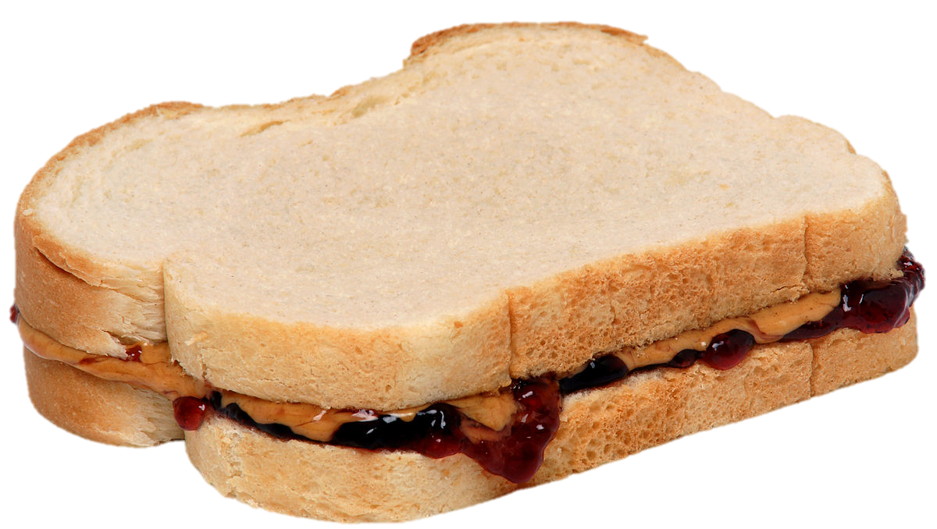
LUNCH

Slide 32


Slide 33
TODAY’S AGENDA
10:00 | KEI Diplomatic Negotiation and Lunch
1:00 | Walk back to SUDC
2:00 | Ashton Washington and Matthew Ashmore Chief of Law Enforcement Affairs & Chief of Partnership Development Office of the Commissioner, Customs and Border Patrol
3:00 | Skills: Professional Listening
~3:45 | Wrapup and … start spring break!

Slide 34
Global Policy Seminar and NSC Simulation
IRP 401 - IRP 402
Week Eight 6 March 2026
Prof. Fulton T. Armstrong

Slide 35
LUNCH

Slide 36
PROJECT UPDATES

Slide 37
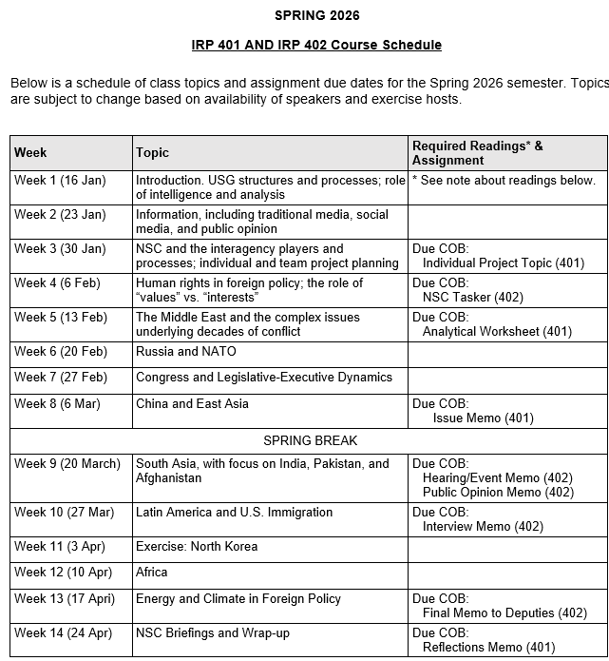
✓
✓
✓
✓
401
✓
✓
✓
✓
✓
✓
✓
✓
402
✓
✓
✓
✓
✓
✓
✓
✓
✓
✓
✓
✓
✓
✓
✓
✓
✓
✓
✓
✓
✓
✓
✓
✓

Slide 38
PROJECT PLANNING
Emmett | Countering “CRINK” Alignment | Danger of one-dimensional energy sector
John | Innovation and Environmental Capacity
Miles | Capitalism and Environment Protection | Climate change and refugees/sovereignty
Kennedy | Taiwan Prosperity and U.S. Interests
Eli | Prediction Markets | Iran-US relations
Michael | Foreign Manipulation of U.S. Elections
Diego | Russian Invasion of Ukraine | Globalization and environmental impact
Molisa | U.S.-China Competition in Critical Technologies
Kaiwen | U.S.-China Economic and Trade Competition | China’s Influence in Africa
Yvette | Rwanda-DRC Conflict and Resolution
Bijan | Housing Shortage and its Implications | Humanitarian Crisis in Gaza
Megha | Restrictive U.S. Immigration and Visa Policies
Filippo | Transatlantic Relations | North Korea illegal ops to support goals
David | ???? | ??????

Slide 39
DISCUSSION
Comfortable?
Topics
How partnership will work
The purposes
Substance, process, skills
The elements
401
Analysis
“Memo #2”
402
Proposal
Hearing/event
Public opinion
Interviews
DC memo
Briefing

Slide 40
DISCUSSION
DUE last Friday: | Memo proposing 402 project
DUE tonight: | “Analytical Worksheet” or “Seminar Issue Worksheet” for 401 project

Slide 41
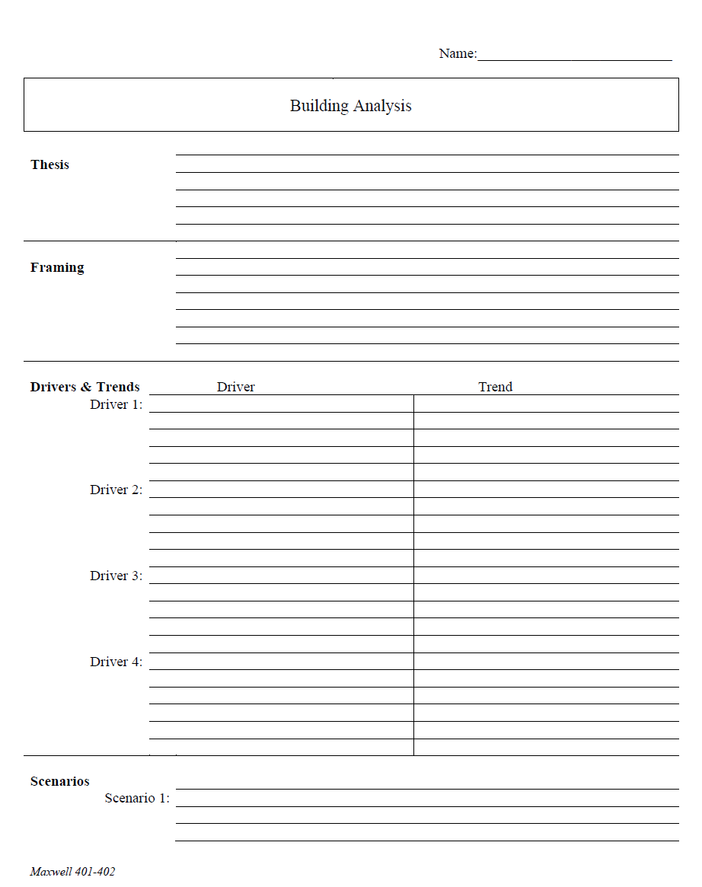
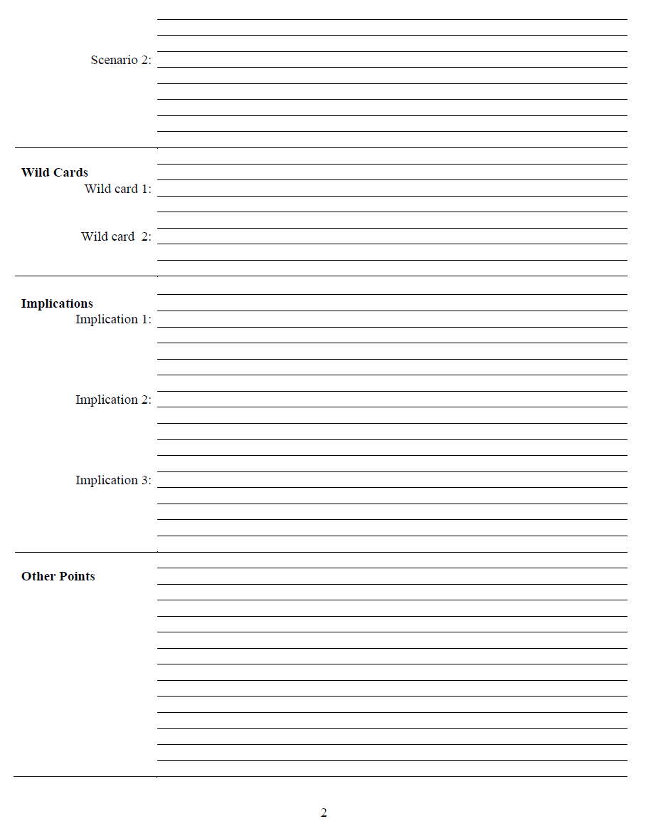
The Analytical Worksheet: One Proven, Effective Way to Build Analysis for Presentation

Slide 42
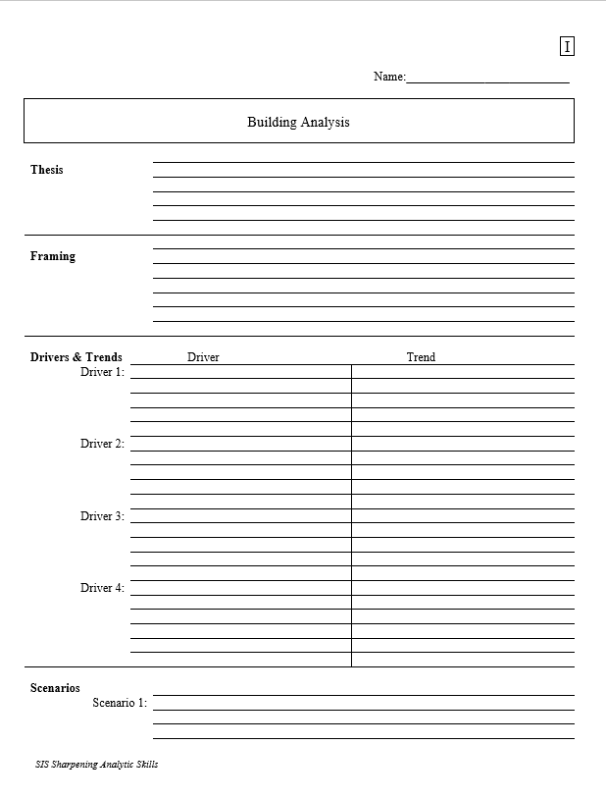
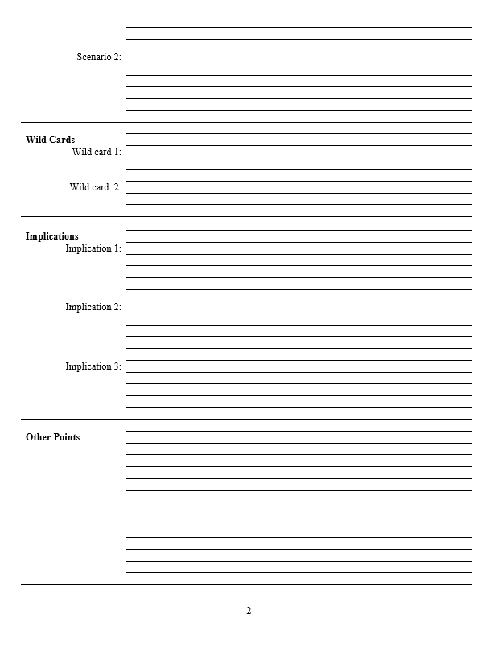
With a thesis sentence at the top, here’s the whole model.
Other Points | Things that don’t fit in rigid structure
 | Give color, texture to analysis
 | Useful in building “narrative” when you write
 | Pet facts, thoughts that you like (and show you care)
Thesis sentence(s): Main conclusion.
“Bottom Line Up Front.”
Short, concise summary – including as many elements as needed to tell the whole story.
Framing: The information your decisionmaker needs to get into the story.
Basics
Not “research or encylopedia”

Slide 43
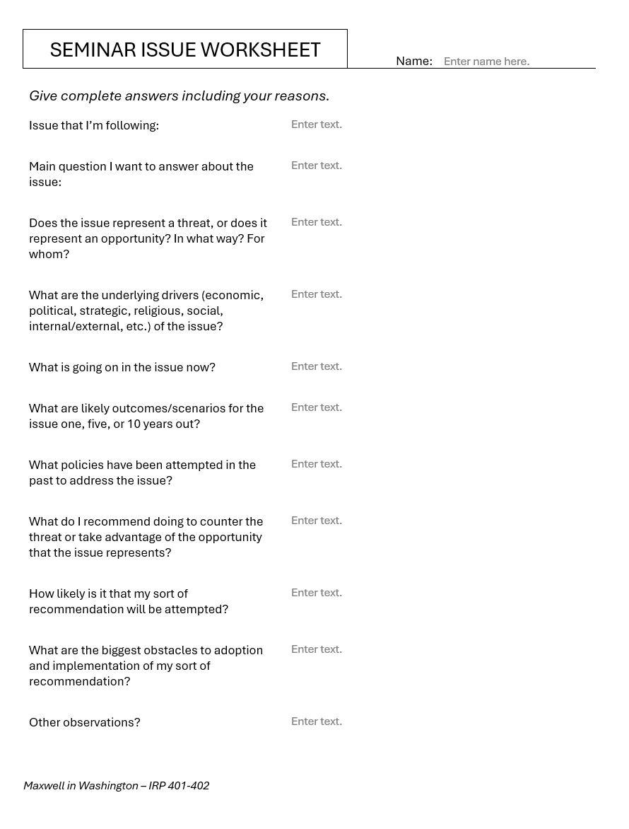
Alternative
Should be two or three pages of text.

Slide 44
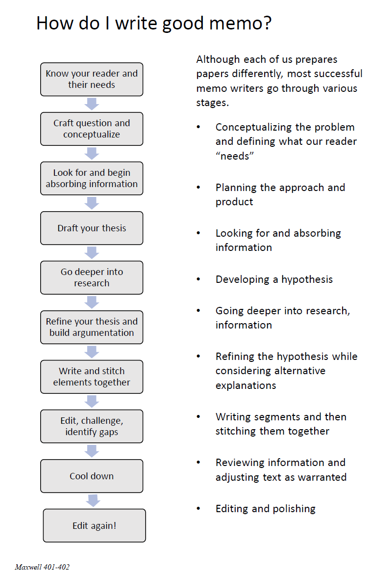
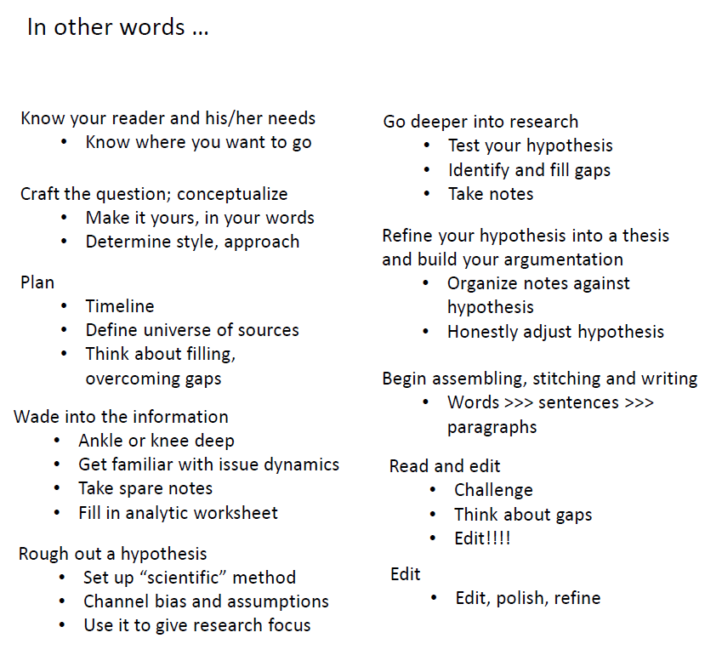
The overall process

Slide 45
DISCUSSION
Comfortable?
Topics
How partnership will work
The purposes
Substance, process, skills
The elements
All OK?
PREPARING AND PLANNING?
401
Analysis
“Memo #2”
402
Proposal
Hearing/event
Public opinion
Interviews
DC memo
Briefing

Slide 46
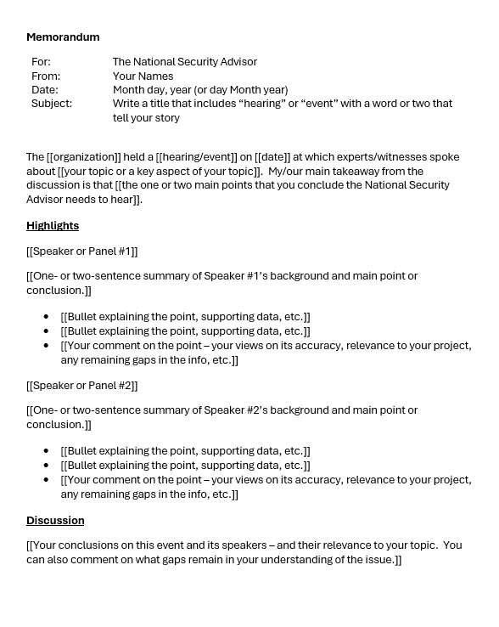
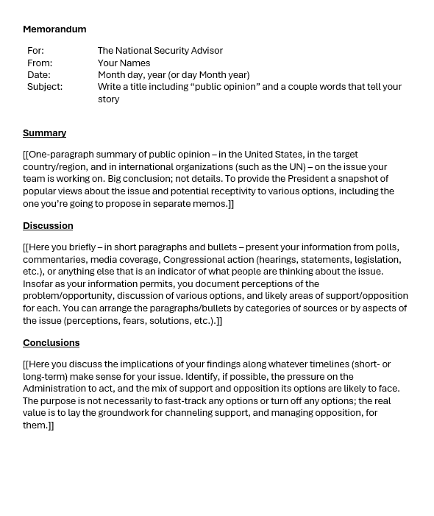
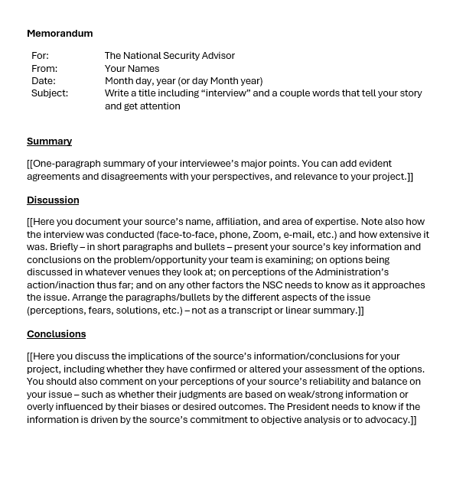
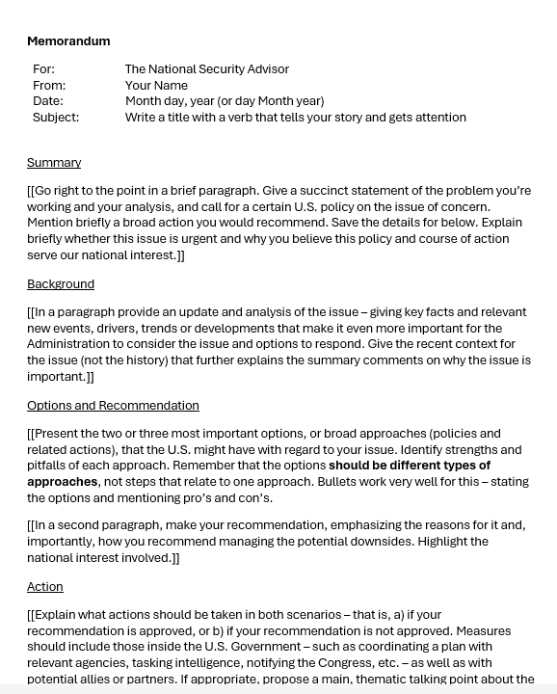
The Templates
402
401

Slide 47

QUESTIONS ?

Slide 48

LUNCH

Slide 49

WRAPUP

