Slide 1

Global Policy Seminar and NSC Simulation
IRP 401 - IRP 402
Week Seven 27 February 2026
Prof. Fulton T. Armstrong

Slide 2
Week 1 (16 Jan)
Week 2 (23 Jan)
Week 3 (30 Jan)
Week 4 (6 Feb)
Week 5 (13 Feb)
Week 6 (20 Feb)
Week 7 (27 Feb)
Week 8 (6 Mar)
Spring Break
Week 9 (20 March)
Week 10 (27 Mar)
Week 11 (3 Apr)
Week 12 (10 Apr)
Week 13 (17 Apri)
Week 14 (24 Apr)
Spring 2026

Slide 3
TODAY’S AGENDA
9:45 | Class Discussion - Preps
10:00 | Nicole Widdersheim – Deputy Washington Director, Human Rights Watch - Introduced by Filippo
11:15 | Class Discussion – Israel-Palestine; Human Rights; Ukraine
12:00 | Skills: Writing the Washington Memo - Project Updates
1:00 | Lunch
3:30 | Ubers to Embassy of Ukraine
4:00 | Denys Sienek Deputy Chief of Mission, Embassy of Ukraine - Introduced by Yvette
~5:30 | Wrapup and individual return transportation

Slide 4
TODAY’S AGENDA
9:45 | Class Discussion - Preps
10:00 | Nicole Widdersheim – Deputy Washington Director, Human Rights Watch - Introduced by Filippo
11:15 | Class Discussion – Israel-Palestine; Human Rights; Ukraine
12:00 | Skills: Writing the Washington Memo - Project Updates
1:00 | Lunch
3:30 | Ubers to Embassy of Ukraine
4:00 | Denys Sienek Deputy Chief of Mission, Embassy of Ukraine - Introduced by Yvette
~5:30 | Wrapup and individual return transportation

Slide 5

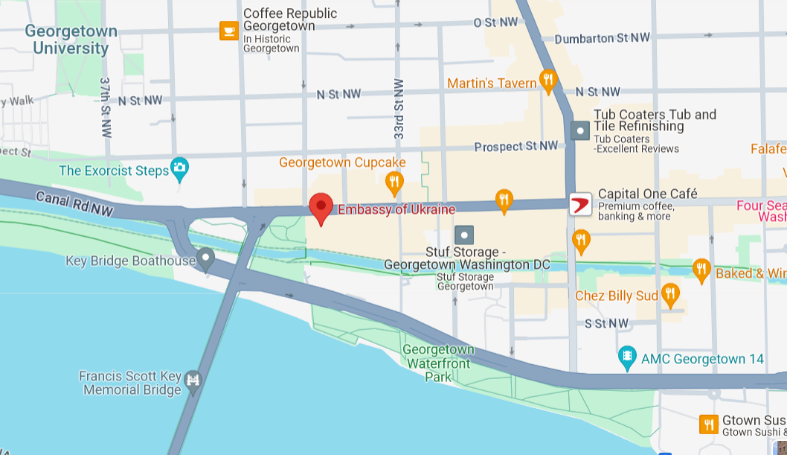

Meet for Ubers at 1:30
34th ST NW
WISCONSIN AVE NW
Embassy of Ukraine
3350 M St NW
M ST NW
WHITEHURST FREEWAY
To Farragut Sq.

Slide 6

GUEST SPEAKER
Nicole Widdersheim
Deputy Washington Director, Human Rights Watch
- Introduced by Filippo

Slide 7
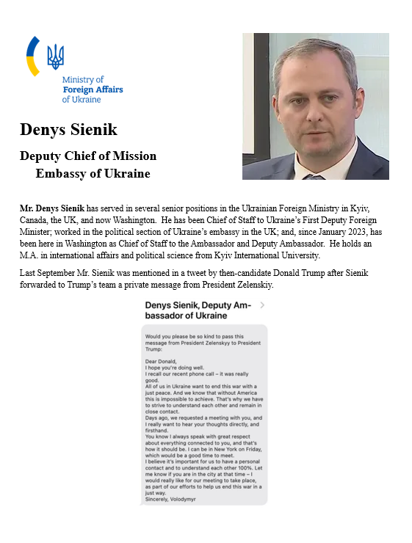
GUEST SPEAKER
Denys Sienik
Deputy Chief of Mission, Embassy of Ukraine
- Introduced by Yvette

Slide 8
GUEST SPEAKER
Nicole Widdersheim
Deputy Washington Director, Human Rights Watch
- Introduced by Filippo

Slide 9


GUEST SPEAKER
Nicole Widdersheim
Deputy Washington Director, Human Rights Watch

Slide 10

孙子
Sun Tzu
知己知彼，百战不殆。
Zhījǐzhībǐ, bǎizhànbúdài
The Art of War
Know yourself as you know your enemy, and you will win all battles.

Slide 11

Next week …
The Six-Party Talks

Slide 12






The Six-Party Talks
- An exercise in diplomatic negotiations -
You will be negotiating as representatives of
Democratic People’s Republic of Korea (DPRK – North Korea)
Republic of Korea (ROK – South Korea)
People’s Republic of China (PRC – China)
Japan
Russia
United States

Slide 13
The Six-Party Talks
- An exercise in diplomatic negotiations -
You will be negotiating as representatives of
Democratic People’s Republic of Korea (DPRK – North Korea)
Republic of Korea (ROK – South Korea)
People’s Republic of China (PRC – China)
Japan
Russia
United States

Slide 14



PICK AN ANIMAL
4 | 9 | 14 | 1 | 17 | 5
SWIMMING
RUNNING
16 | 2 | 10 | 18 | 13 | 6
REMEMBER
YOUR
NUMBER
11 | 7 | 15 | 12 | 3 | 8

Slide 15
Pick in numerical order, but you can pass or give to someone else.

Slide 16
The Six-Party Talks
 | Republic of Korea (South Korea) | Democratic People’s Republic of Korea (North Korea) | USA | People’s Republic of China | Japan | Russia
Universe 1
Universe 2
Universe 3

Slide 17
Special reading to prep.
Activity will include lunch.
(Let me know dietary preferences if any.)

Slide 18
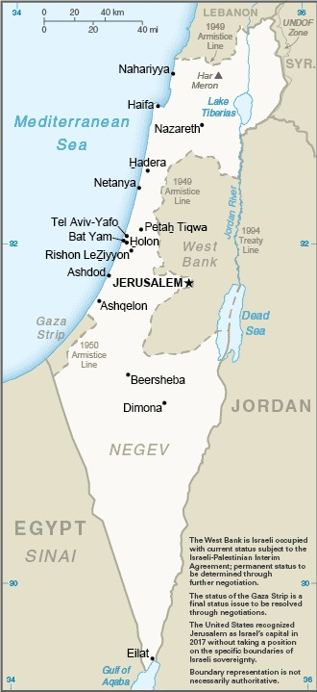
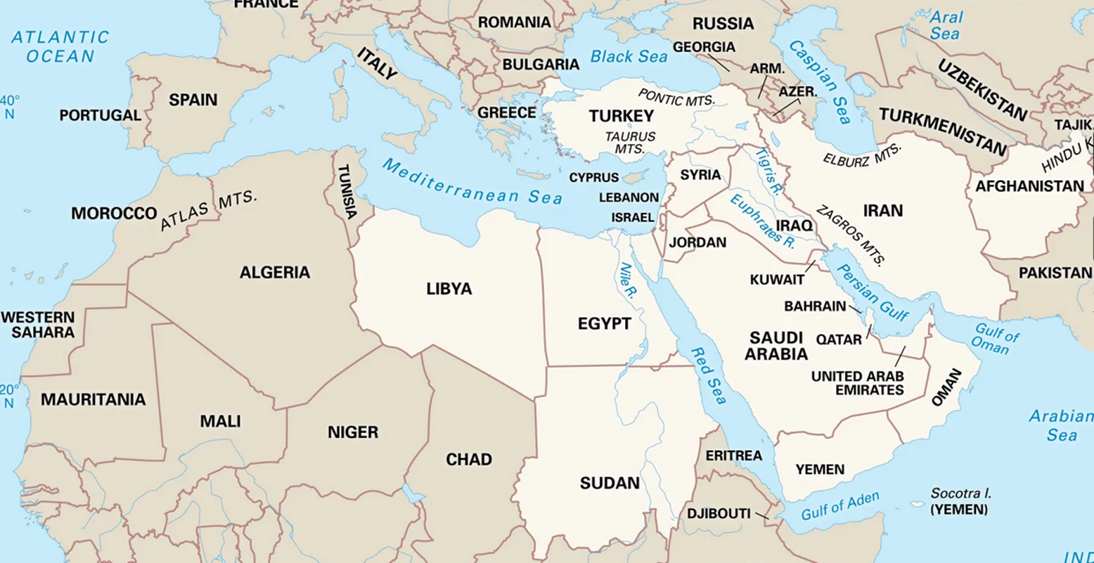
DISCUSSION

Slide 19
DISCUSSION
Israel-Gaza-Palestine
What did you hear from last week’s guests?
How did you process it?
How did it change your views (if it did)?
What policy solutions do you see as feasible?

Slide 20

DISCUSSION

Slide 21
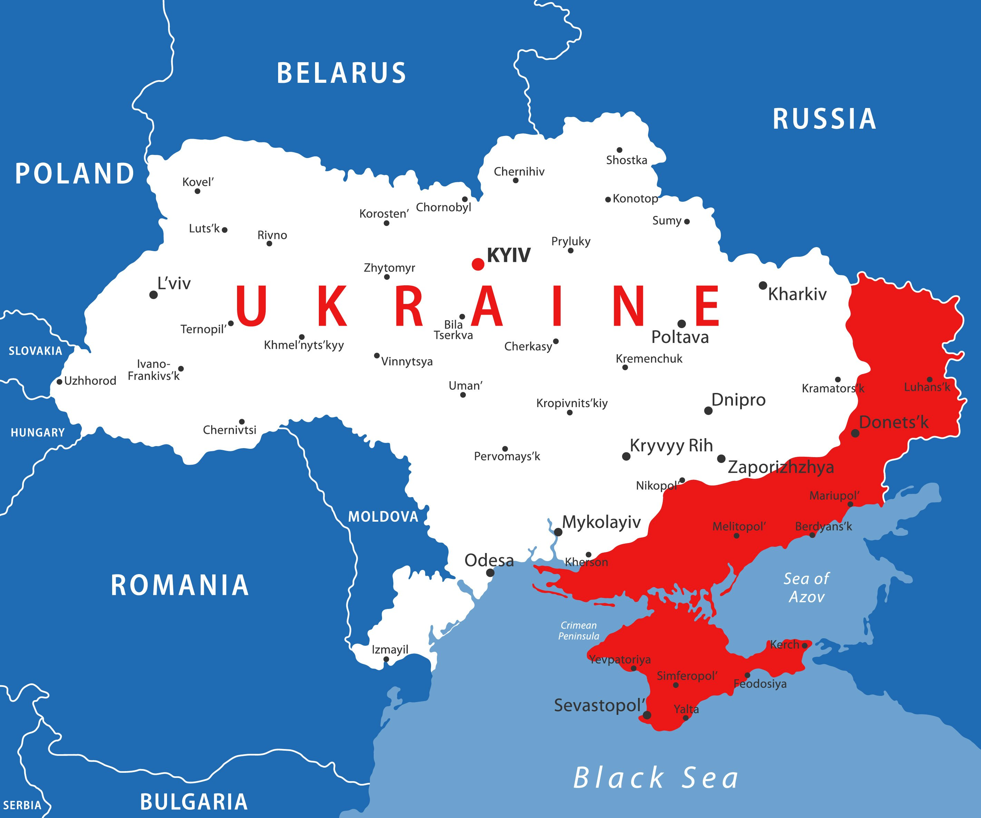
DISCUSSION

Slide 22
DISCUSSION
Ukraine-Russia-NATO
Through what lens should we look at the war?
What is the status of the war … or negotiations?
How united does the alliance need to be?
What is the more likely outcome?

Slide 23
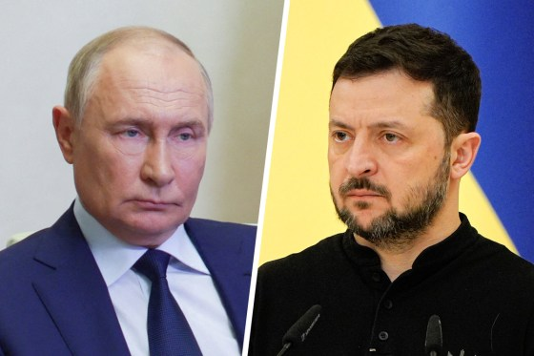


Lean on him?
or him?
Russian President Vladimir Putin Ukrainian President Volodymyr Zelenskyy
since 1999
since 2019

Slide 24
Lean on him?
or him?
Russian President Vladimir Putin Ukrainian President Volodymyr Zelenskyy
since 1999
since 2019

Slide 25
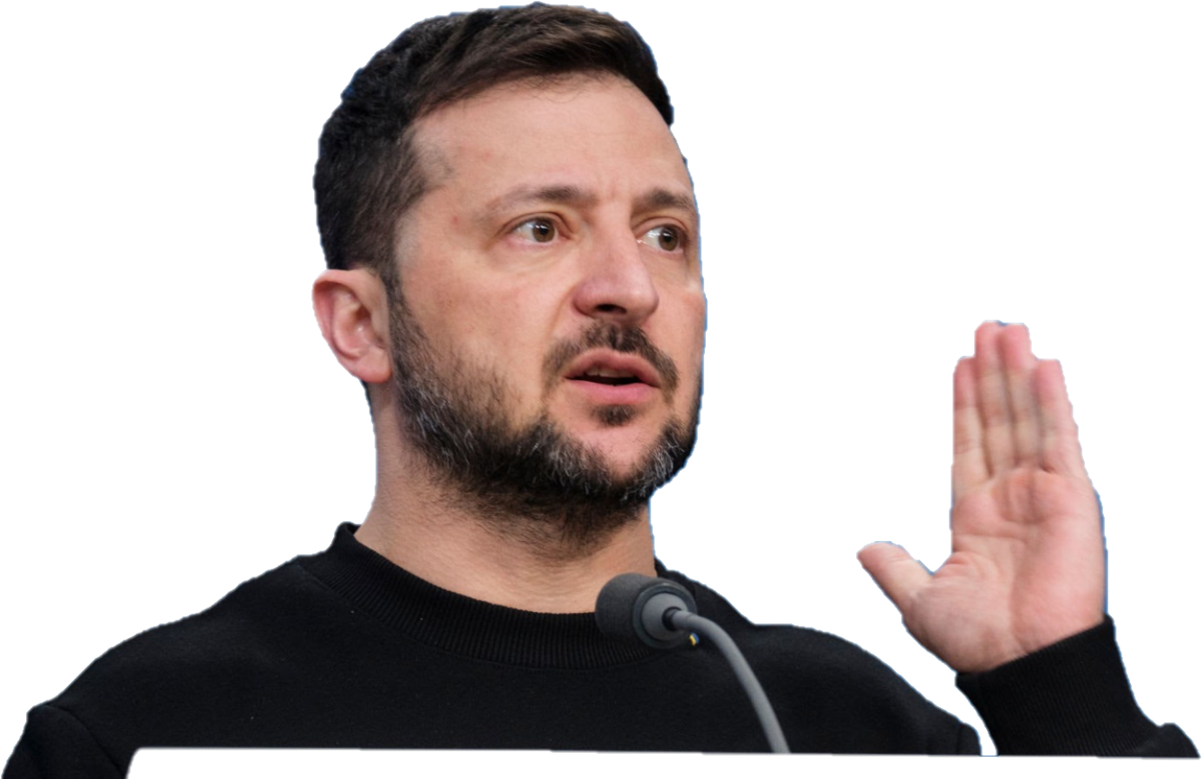
DISCUSSION
What U.S. policy solutions do you see as *feasible*?

Slide 26
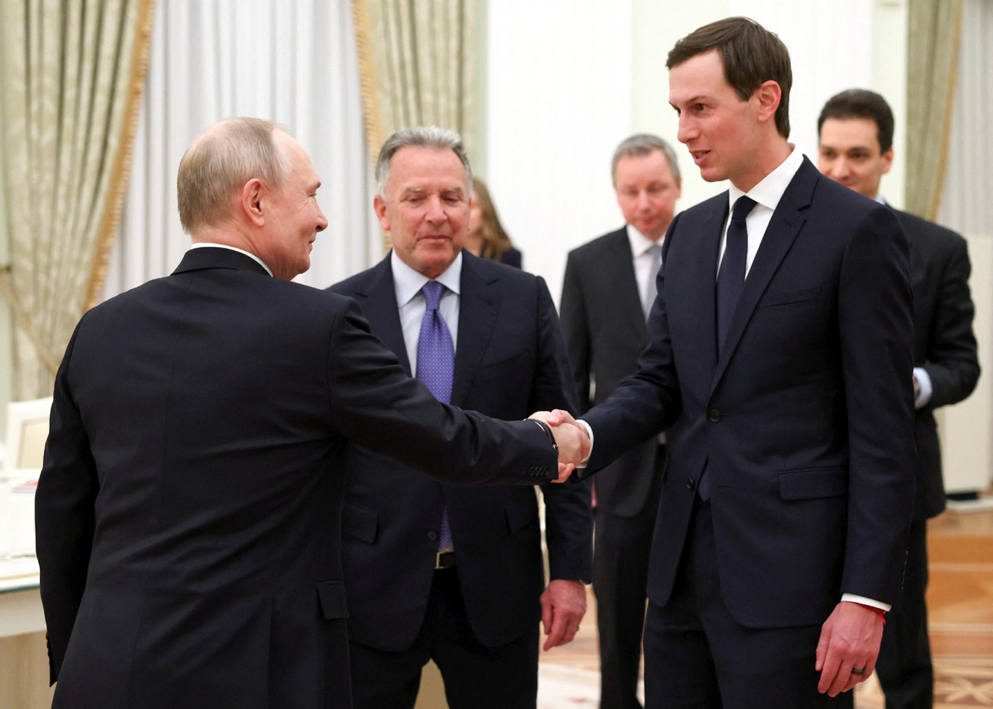
DISCUSSION
Steve Witkoff
Jared Kushner

Slide 27
On fourth anniversary (24 Feb) …
How is the war going for the two sides?
Which can better endure a war of attrition?
DISCUSSION
U.S. aid down 99% in 2025 from 2024.
Both increasing production of drones, missiles, etc.
Russia = 1.2m dead (143m); UKR = 500k-600k dead (43m).
UKR civilian deaths up 20% each year – 2,500 in 2025.
Destroy power generation, transmission.
Fourth round of negotiations in Geneva yesterday.
P dragging feet, pocketing T patience and making Z more anxious.
RU Demands: cut UKR military; dismantle Z government; guaranteed neutrality.
Europeans pessimistic of deal in 2026.
What does it mean …
for UKR?
for EU?
for US?

Slide 28
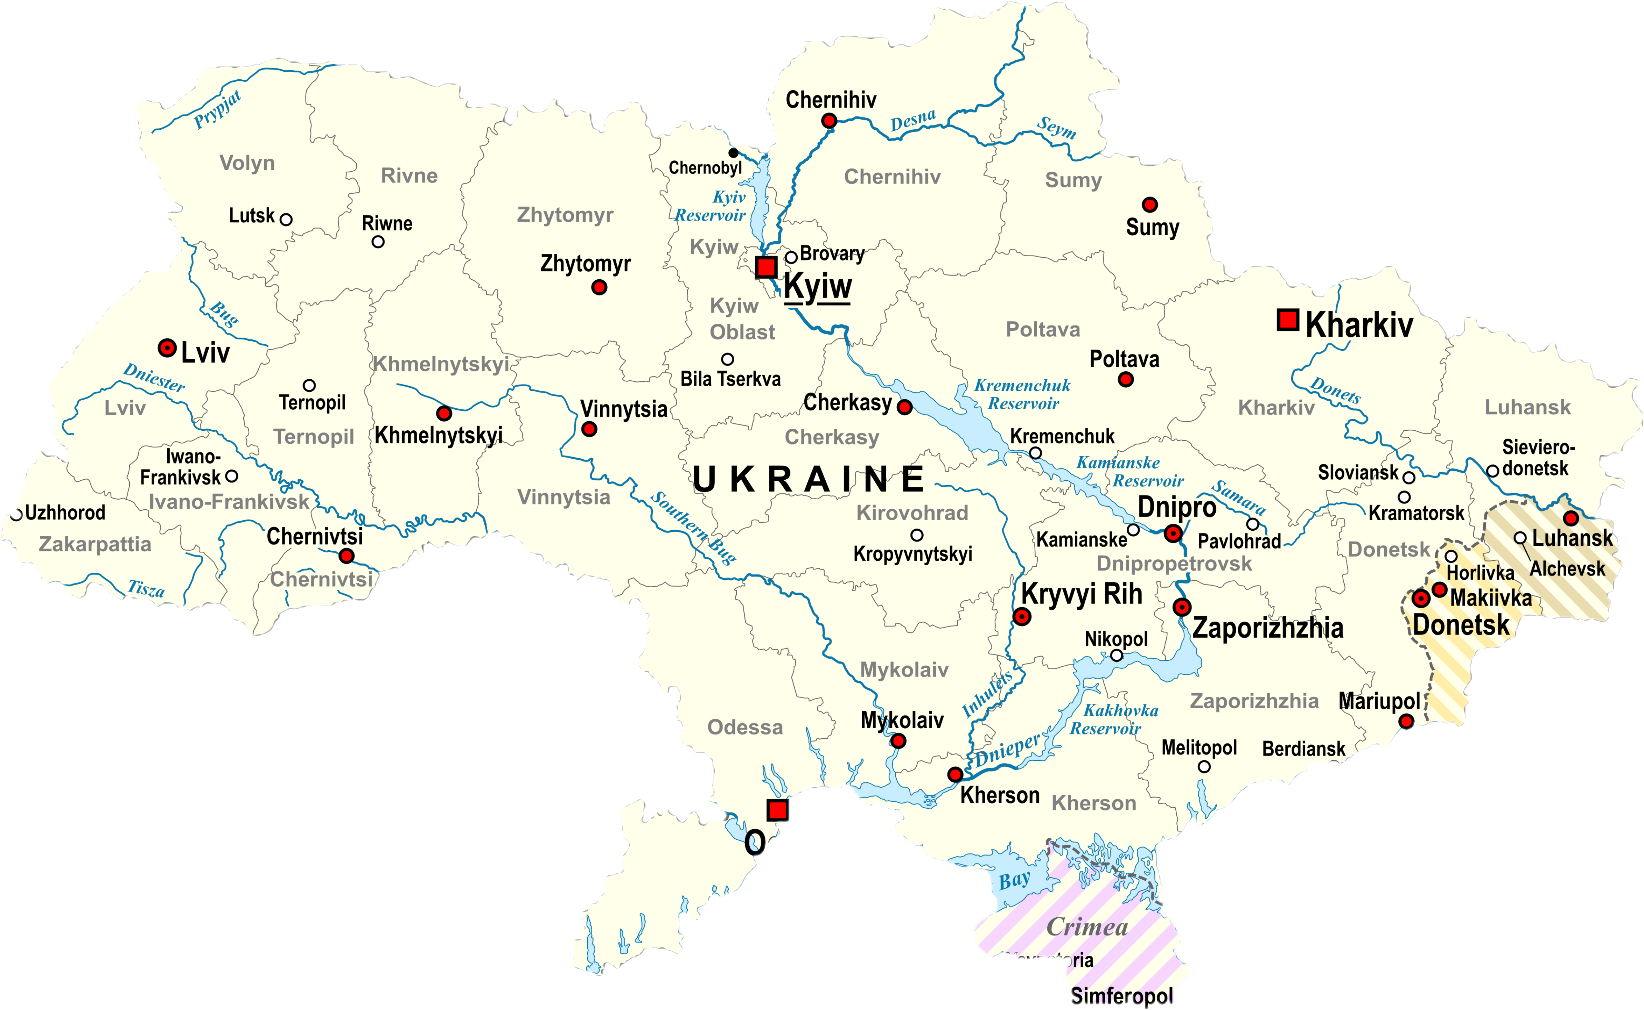
What will Ukraine look like in 1, 5 or 10 years?
Before 2014

Slide 29
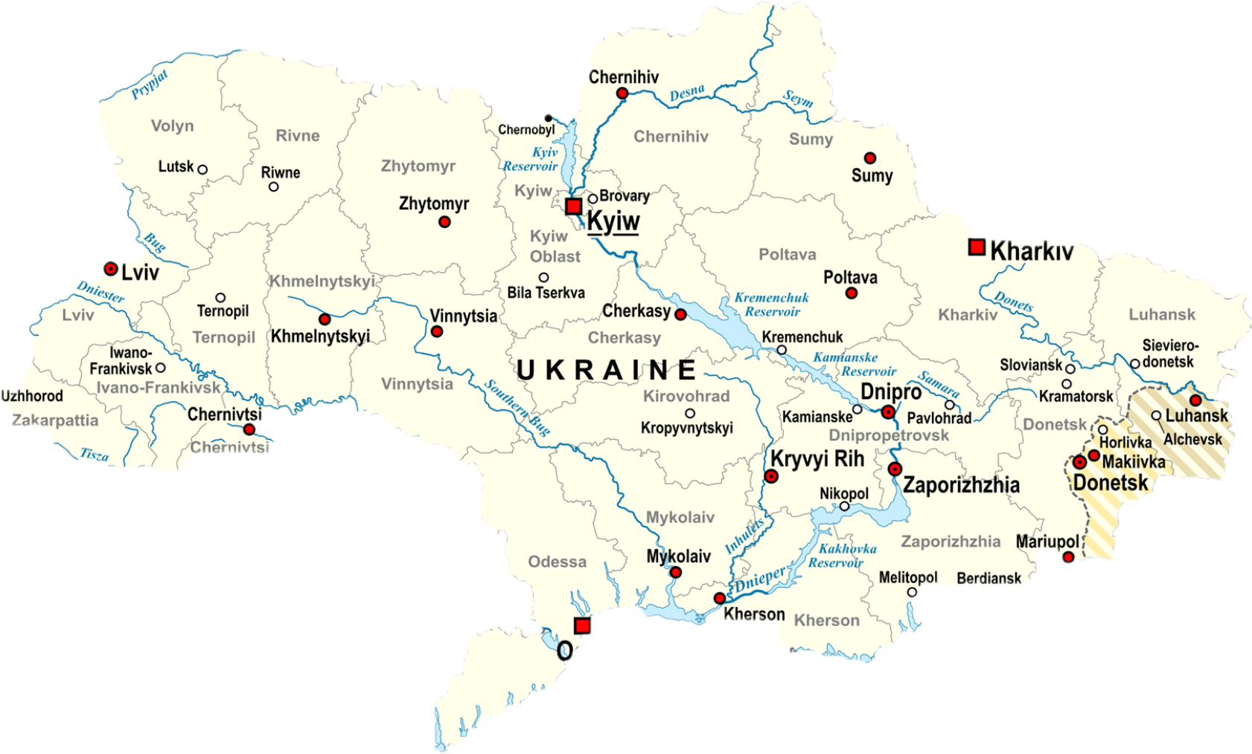

Slide 30




What will Ukraine look like in 1, 5 or 10 years?

Slide 31





What will Ukraine look like in 1, 5 or 10 years?

Slide 32






What will Ukraine look like in 1, 5 or 10 years?
?

Slide 33
DISCUSSION
On fourth anniversary (24 Feb) …
How is the war going for the two sides?
Which can better endure a war of attrition?
How well informed are we?

Slide 34


Slide 35

Be on 19th Street at 3:30
BRING GOVERNMENT-ISSUED PHOTO I.D.

Slide 36
Meet for Ubers at 3:30
34th ST NW
WISCONSIN AVE NW
Embassy of Ukraine
3350 M St NW
M ST NW
WHITEHURST FREEWAY
To Farragut Sq.

Slide 37
TODAY’S AGENDA
9:45 | Class Discussion - Preps
10:00 | Nicole Widdersheim – Deputy Washington Director, Human Rights Watch - Introduced by Filippo
11:15 | Class Discussion – Israel-Palestine; Human Rights; Ukraine
12:00 | Skills: Writing the Washington Memo - Project Updates
1:00 | Lunch
3:30 | Ubers to Embassy of Ukraine
4:00 | Denys Sienek Deputy Chief of Mission, Embassy of Ukraine - Introduced by Yvette
~5:30 | Wrapup and individual return transportation

Slide 38
Global Policy Seminar and NSC Simulation
IRP 401 - IRP 402
Week Seven 27 February 2026
Prof. Fulton T. Armstrong

Slide 39


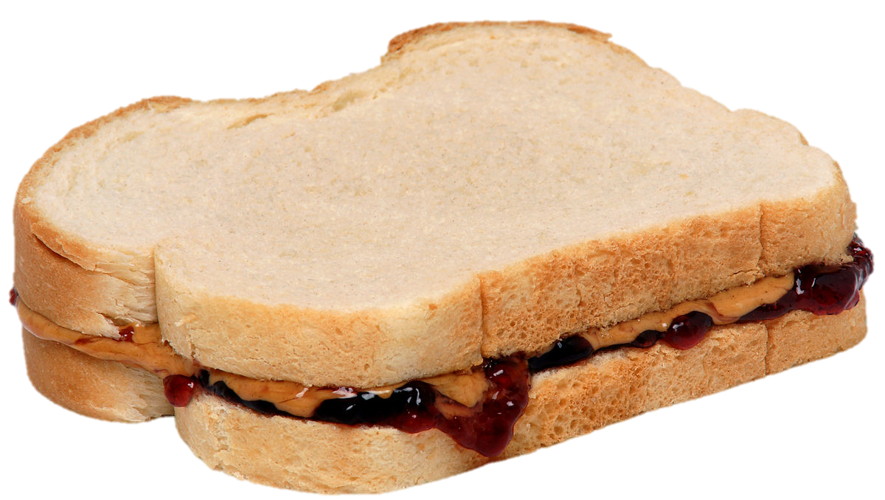
LUNCH

Slide 40
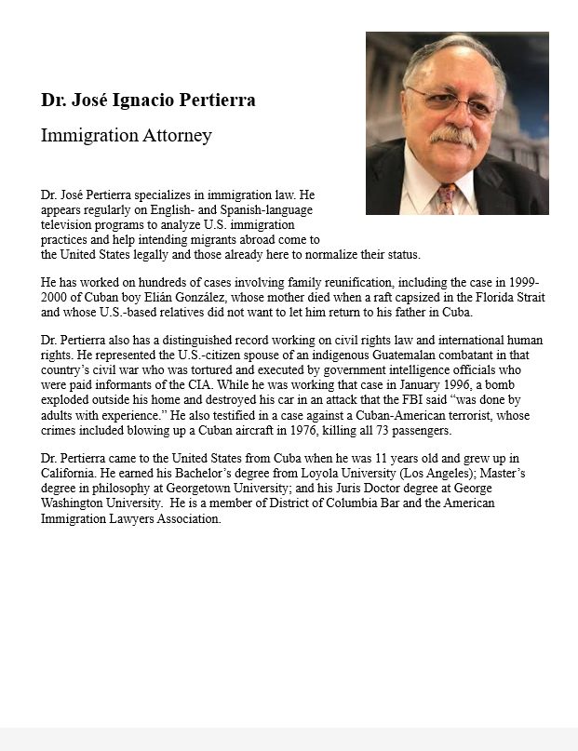
GUEST SPEAKER
José Pertierra
Immigration Lawyer and expert on immigration law and Latin America
- Introduced by Sarina

Slide 41
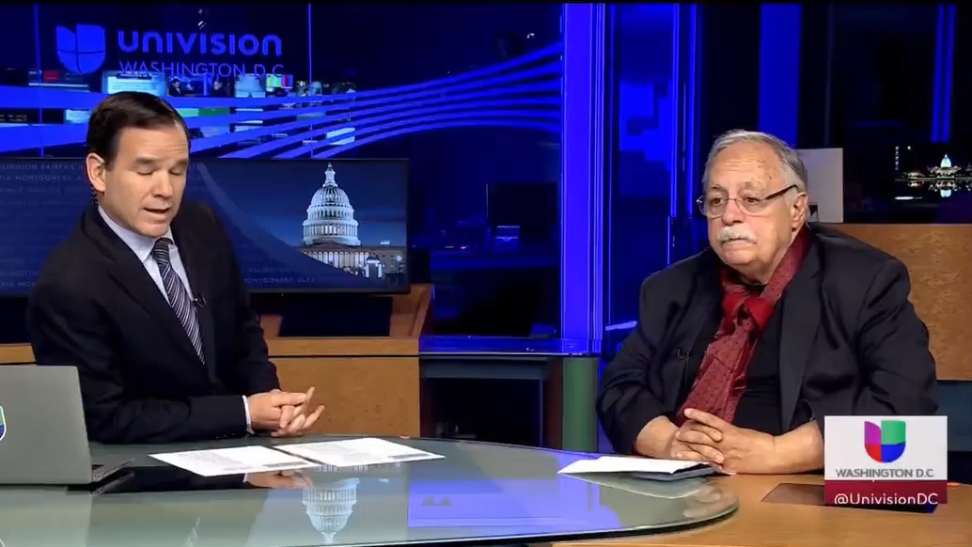

GUEST SPEAKER
José Pertierra

Slide 42
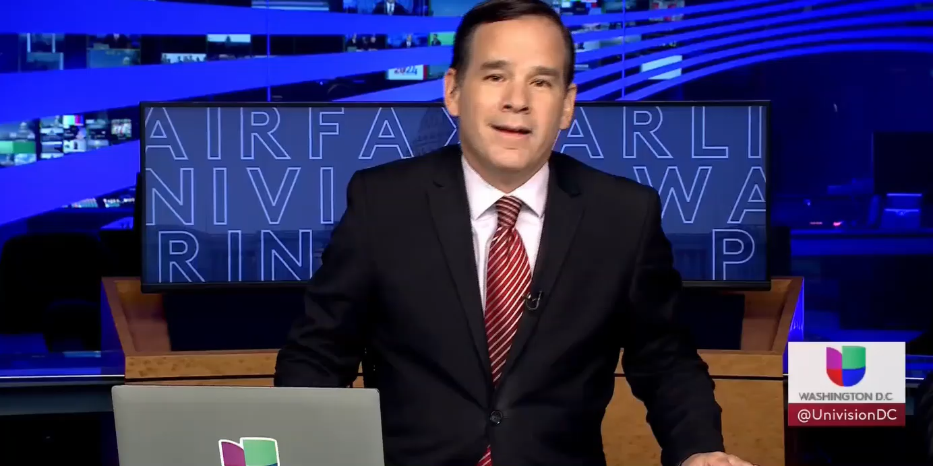
GUEST SPEAKER
José Pertierra

Slide 43
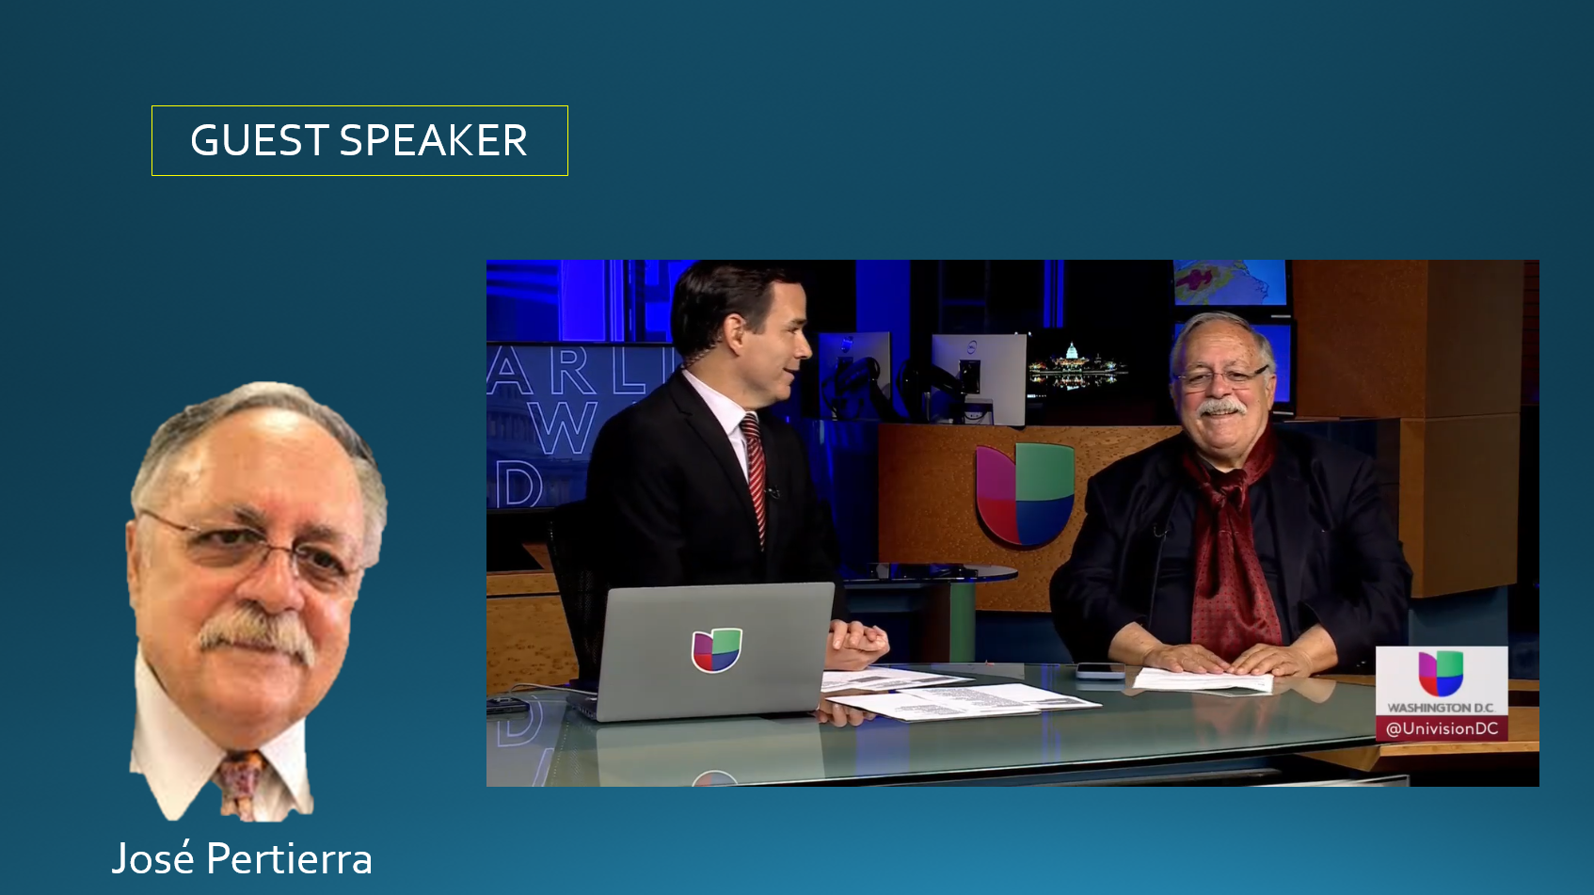
[[ video ]]

Slide 44
PROJECT UPDATES

Slide 45
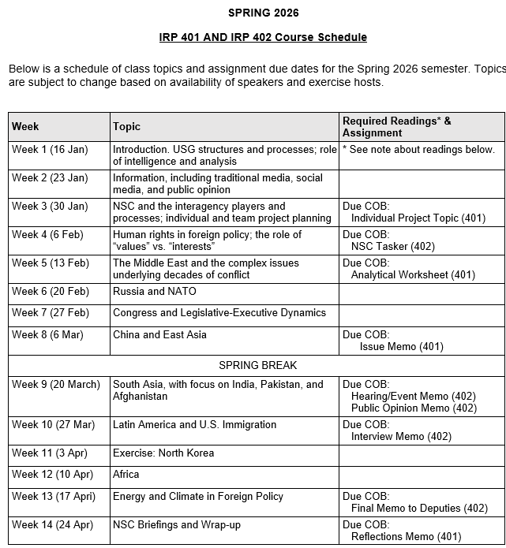
✓
✓
✓
✓
401
✓
✓
✓
✓
✓
✓
✓
✓
402
✓
✓
✓
✓
✓
✓
✓
✓
✓
✓
✓
✓
✓
✓
✓
✓
✓
✓
✓
✓
✓
✓
✓
✓

Slide 46
PROJECT PLANNING
Emmett | Countering “CRINK” Alignment | Danger of one-dimensional energy sector
John | Innovation and Environmental Capacity
Miles | Capitalism and Environment Protection | Climate change and refugees/sovereignty
Kennedy | Taiwan Prosperity and U.S. Interests
Eli | Prediction Markets | Iran-US relations
Michael | Foreign Manipulation of U.S. Elections
Diego | Russian Invasion of Ukraine | Globalization and environmental impact
Molisa | U.S.-China Competition in Critical Technologies
Kaiwen | U.S.-China Economic and Trade Competition | China’s Influence in Africa
Yvette | Rwanda-DRC Conflict and Resolution
Bijan | Housing Shortage and its Implications | Humanitarian Crisis in Gaza
Megha | Restrictive U.S. Immigration and Visa Policies
Filippo | Transatlantic Relations | North Korea illegal ops to support goals
David | ???? | ??????

Slide 47
DISCUSSION
Comfortable?
Topics
How partnership will work
The purposes
Substance, process, skills
The elements
401
Analysis
“Memo #2”
402
Proposal
Hearing/event
Public opinion
Interviews
DC memo
Briefing

Slide 48
DISCUSSION
DUE last Friday: | Memo proposing 402 project
DUE tonight: | “Analytical Worksheet” or “Seminar Issue Worksheet” for 401 project

Slide 49
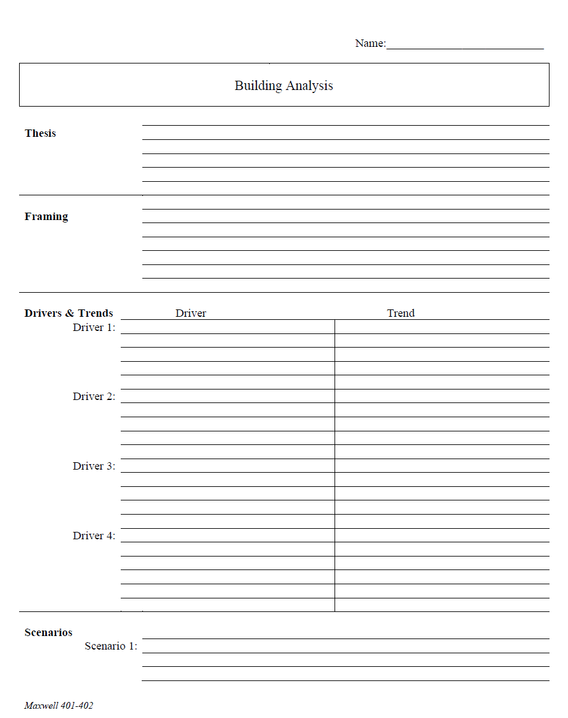
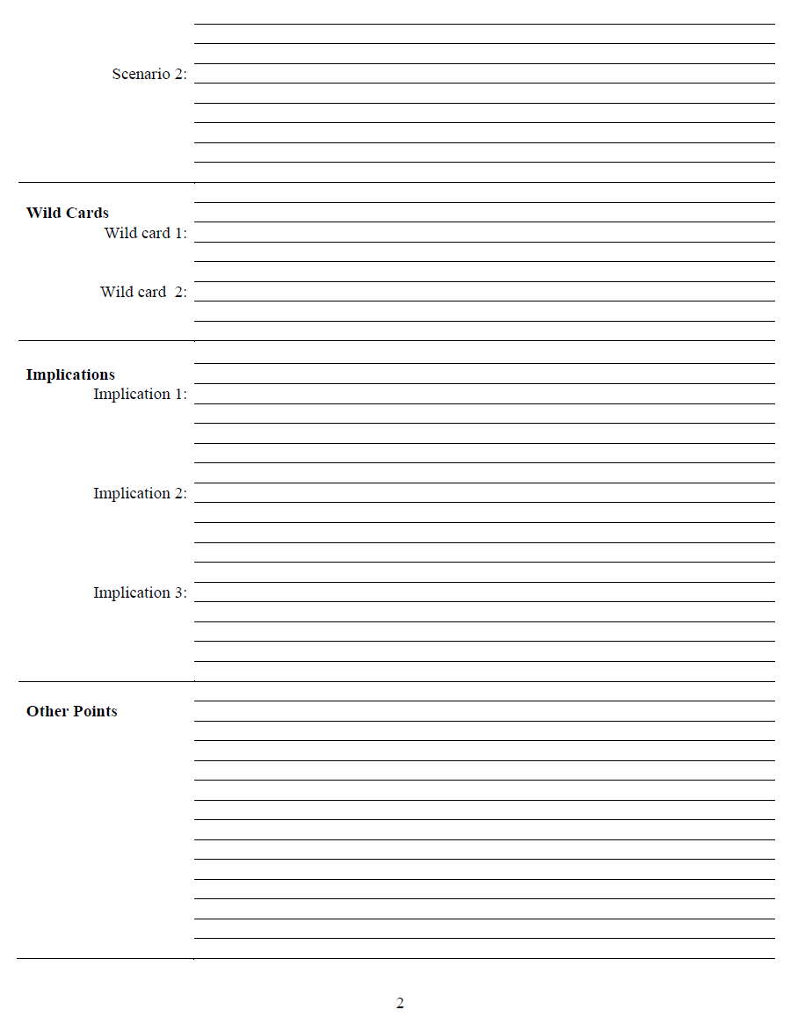
The Analytical Worksheet: One Proven, Effective Way to Build Analysis for Presentation

Slide 50
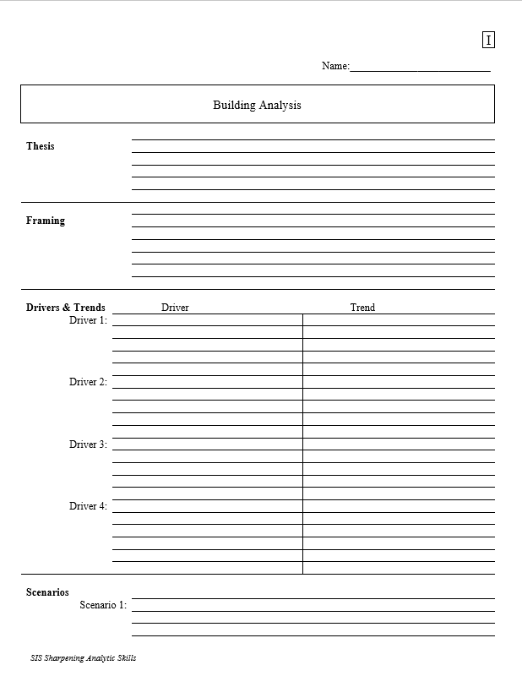
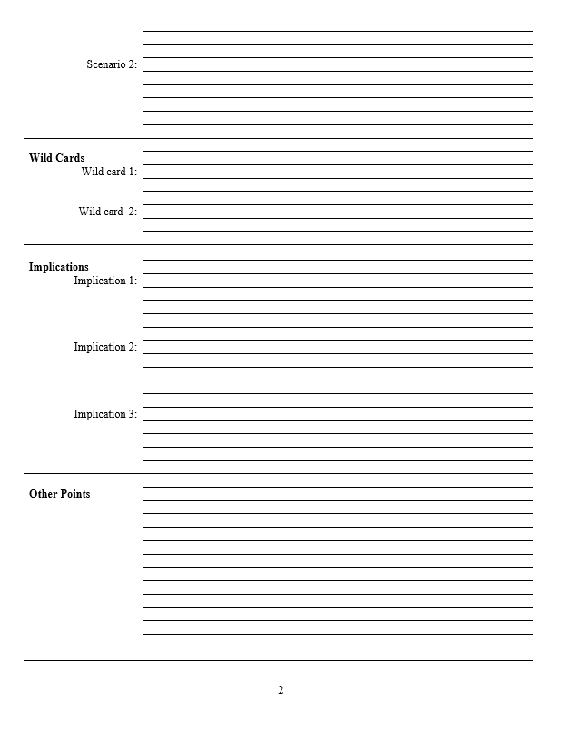
With a thesis sentence at the top, here’s the whole model.
Other Points | Things that don’t fit in rigid structure
 | Give color, texture to analysis
 | Useful in building “narrative” when you write
 | Pet facts, thoughts that you like (and show you care)
Thesis sentence(s): Main conclusion.
“Bottom Line Up Front.”
Short, concise summary – including as many elements as needed to tell the whole story.
Framing: The information your decisionmaker needs to get into the story.
Basics
Not “research or encylopedia”

Slide 51
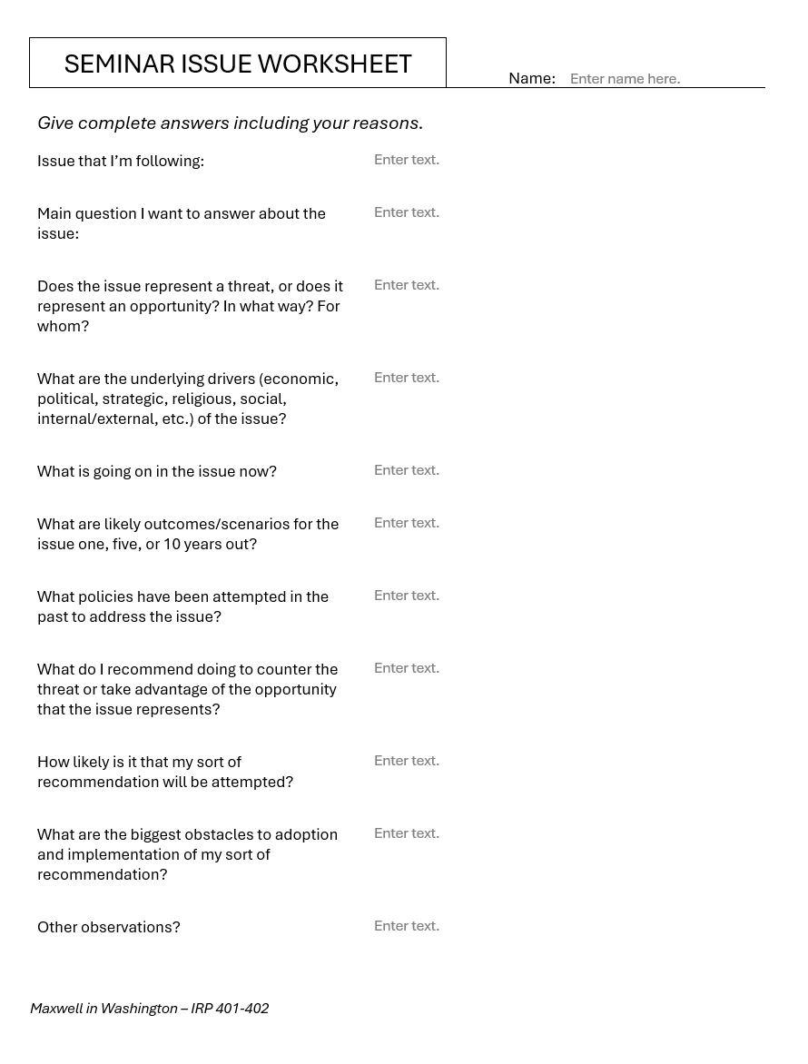
Alternative
Should be two or three pages of text.

Slide 52
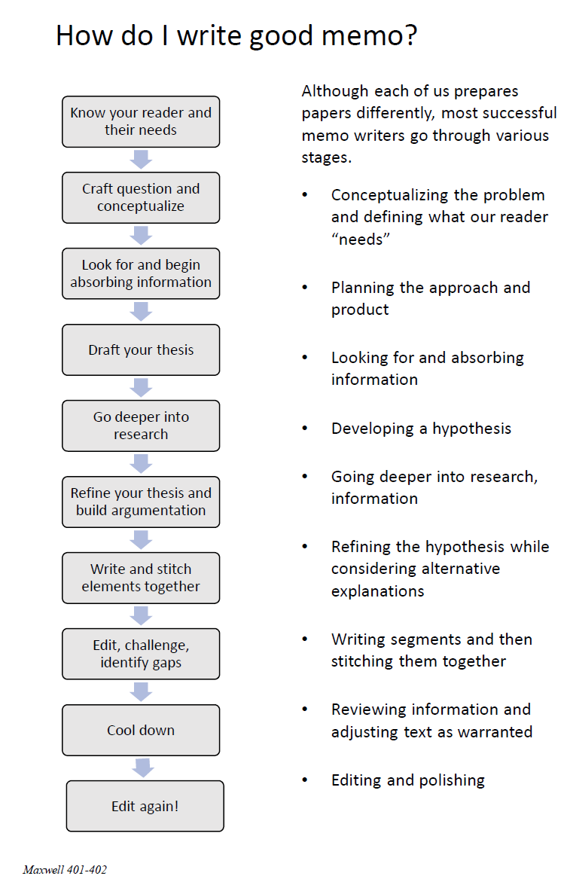
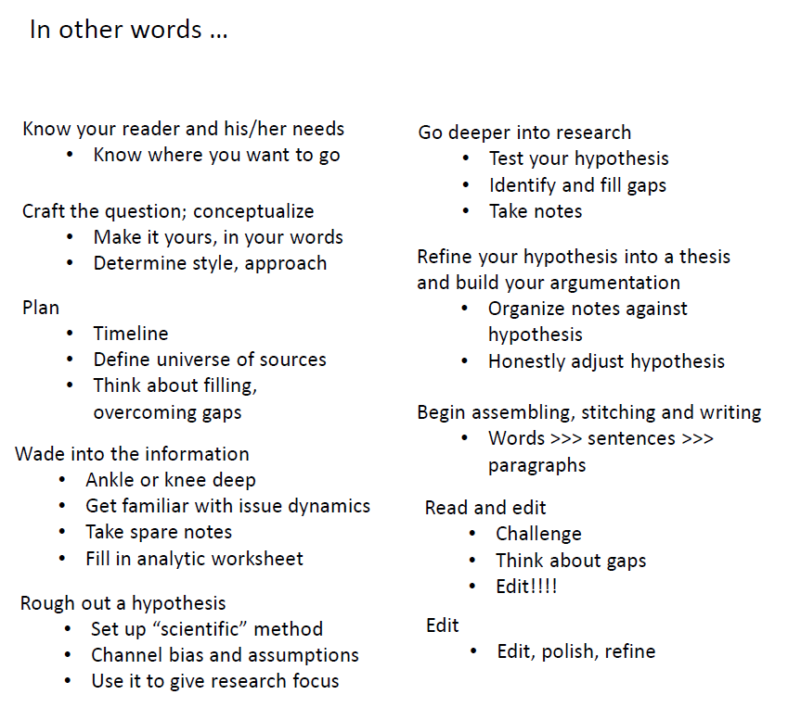
The overall process

Slide 53
DISCUSSION
Comfortable?
Topics
How partnership will work
The purposes
Substance, process, skills
The elements
All OK?
PREPARING AND PLANNING?
401
Analysis
“Memo #2”
402
Proposal
Hearing/event
Public opinion
Interviews
DC memo
Briefing

Slide 54
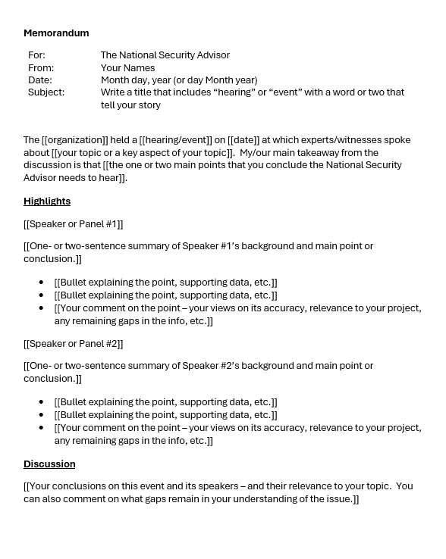
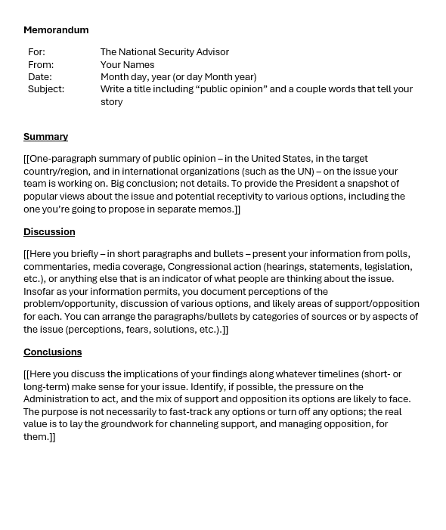
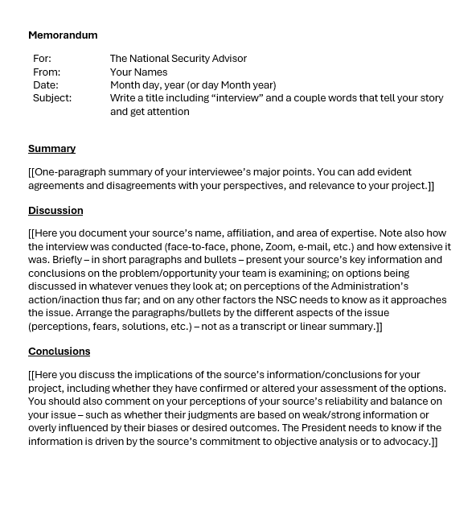
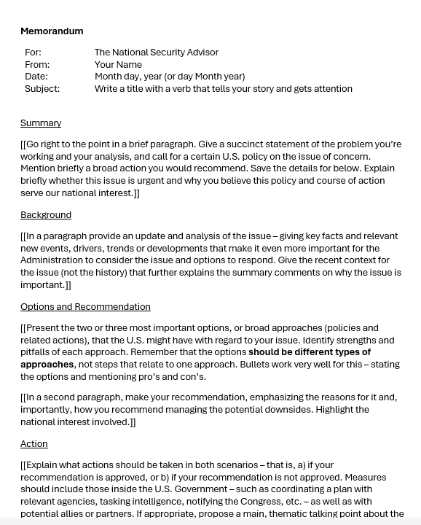
The Templates
402
401

Slide 55

QUESTIONS ?

Slide 56

LUNCH

Slide 57

WRAPUP

