Slide 1

Global Policy Seminar and NSC Simulation
IRP 401 - IRP 402
Week Six 03 October 2025
Prof. Fulton T. Armstrong

Slide 2
Week 1 (29 Aug)
Week 2 (5 Sep)
Week 3 (12 Sep)
Week 4 (19 Sep)
Week 5 (26 Sep)
Week 6 (3 Oct)
Week 7 (10 Oct)
Week 8 (17 Oct)
Week 9 (24 Oct)
Week 10 (31 Oct )
Week 11 (7 Nov)
Week 12 (14 Nov)
Week 13 (21 Nov)
Thanksgiving Break
Week 14 (5 Dec)
Fall 2025

Slide 3
TODAY’S AGENDA
9:00 | Class Discussion – Readings, current events updates, and meeting preps
9:40 | Ubers to Embassy of Israel
10:00 | Yoav Katz Minister Counselor, Embassy of Israel - Introduced by Erik
11:30 | Metro back to SUDC and Lunch
1:00 | Hunter Stoll Defense Analyst, RAND - Introduced by Sarina
2:30 | D.J. Shea Lead Client Solutions Manager, LinkedIn - Introduced by Priya
3:30 | Wrapup

Slide 4
TODAY’S AGENDA
9:00 | Class Discussion – Readings, current events updates, and meeting preps
9:40 | Ubers to Embassy of Israel
10:00 | Yoav Katz Minister Counselor, Embassy of Israel - Introduced by Erik
11:30 | Metro back to SUDC and Lunch
1:00 | Hunter Stoll Defense Analyst, RAND - Introduced by Sarina
2:30 | D.J. Shea Lead Client Solutions Manager, LinkedIn - Introduced by Priya
3:30 | Wrapup

Slide 5

Be on 19th Street at 9:40
BRING GOVERNMENT-ISSUED PHOTO I.D.

Slide 6
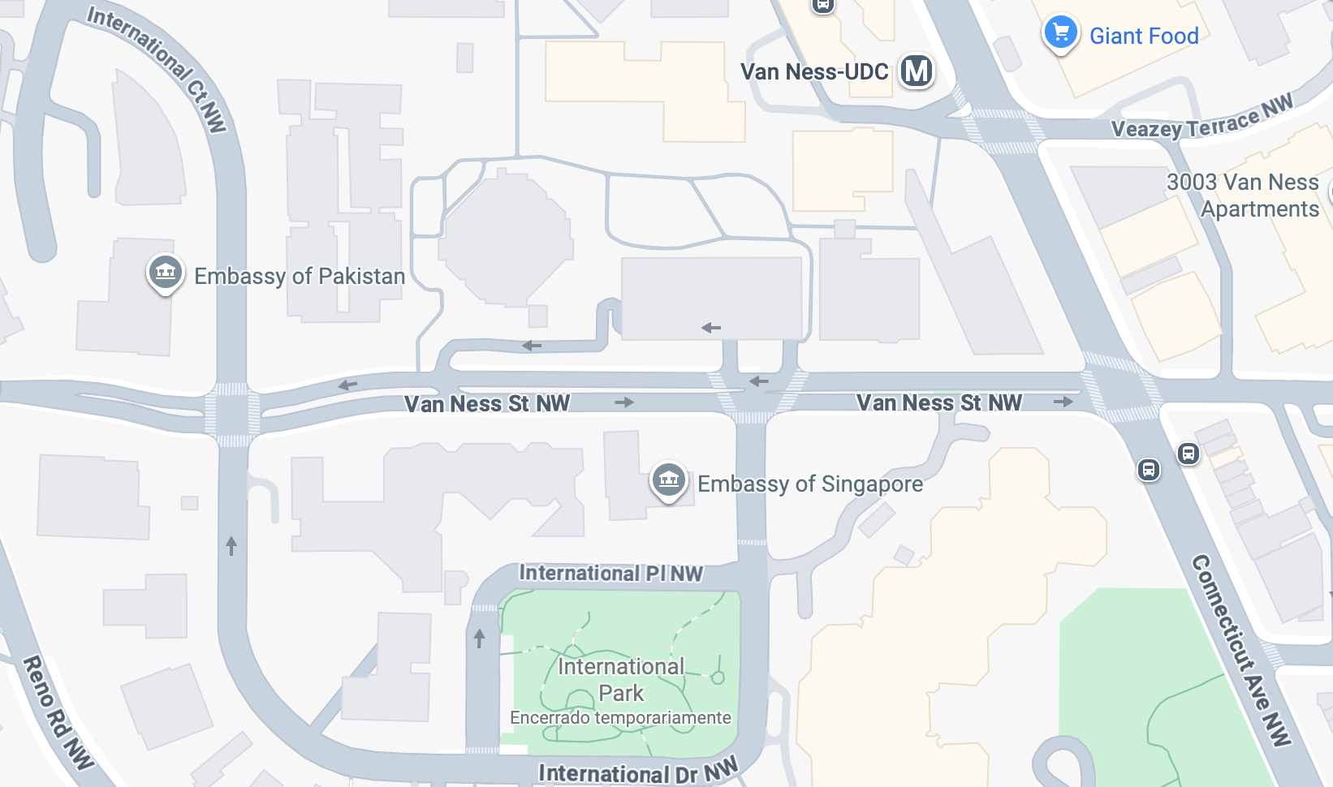



Embassy of Israel

Slide 7

Security Team asks …
Government-issued photo ID (such as license or passport) required.
Security screening.
Recommend not bringing electronic devices if don’t need.
No luggage or baggage.
No weapons, explosives, self-defense items.

Slide 8
WHO’S WHO IN AN EMBASSY?
CONSULATES
Consul General
Consul
Vice consul
INTERNATIONAL ORGANIZATIONS
Permanent Representative
Deputy Permanent Representative
Ambassador
(Deputy Chief of Mission)
Minister
Minister-counselor
Counselor
First secretary
Second secretary
Third secretary
Attaché
Assistant attaché
Yoav Katz – Minister-Counselor
TAO Song – Counselor for Political Affairs
Gervasio HSU – Chief of Political Affairs
Examples of job titles
Political Officer
Economics Officer
Regional Security Officer
Administrative Officer
Public Affairs Officer
Defense Attache
MilGroup Member
FLEXIBILITY
Ambassador-at-Large
Envoy or Special Envoy

Slide 9
ETIQUETTE or PROTOCOL
In ANY meeting … if guest/speaker is repeating self, consider …
Using body language to signal “message received”
Depending on your style, interrupting gently with a brief …
“thanks” or “I understand” or “I see”
paraphrasing
segue to colleague’s question/point
ask if you can ask followup
UNDERSTAND this: some people feel obligated to fill the time.

Slide 10

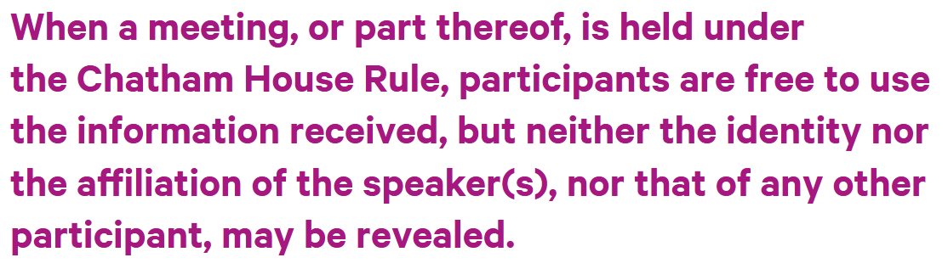
REMINDER
ETIQUETTE or PROTOCOL
Personal vs official views
Chatham House Rule
St. James’s Square London

Slide 11
REMINDER
ETIQUETTE or PROTOCOL
Professional respect
Smart, analytical questions
Non-combative tone
Depending on your style, perhaps preface question
What is your perspective on …?
What should we make of reports that …?
What do we need to know to understand …
Neutral vocabulary

Slide 12
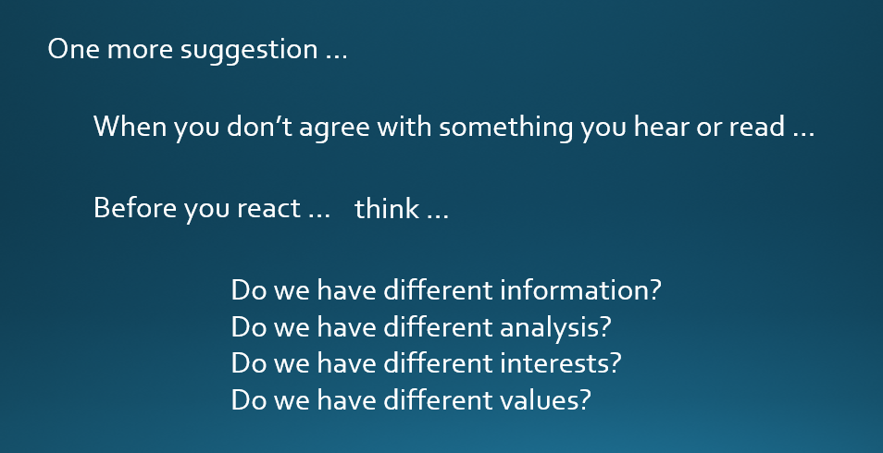
DISCUSSION
Can discuss sensitive, complex, politicized issues.
Remember …
Understand that words can have different meanings.
OUR MISSION (among ourselves and with guests):
TO UNDERSTAND AND ANALYZE
(NOT TO JUDGE)
LISTEN, THINK, TRY TO UNDERSTAND, BE DIPLOMATIC

Slide 13
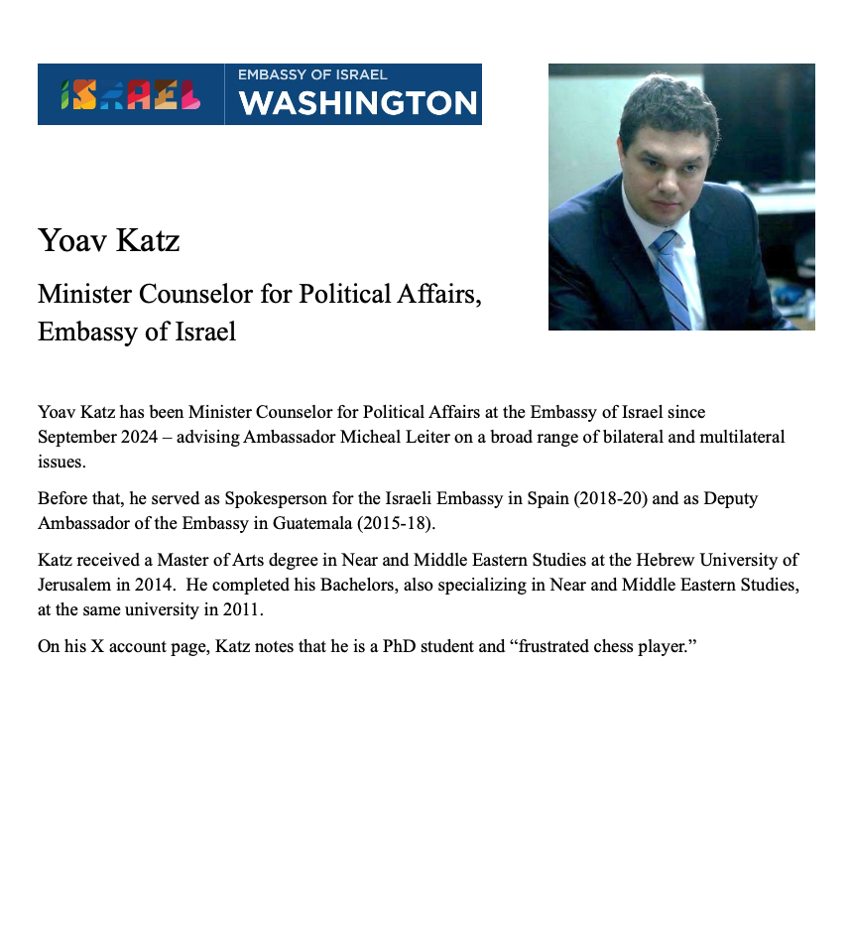
DISCUSSION
Three speakers. Three topics.
Yoav Katz
- introduced by Erik

Slide 14
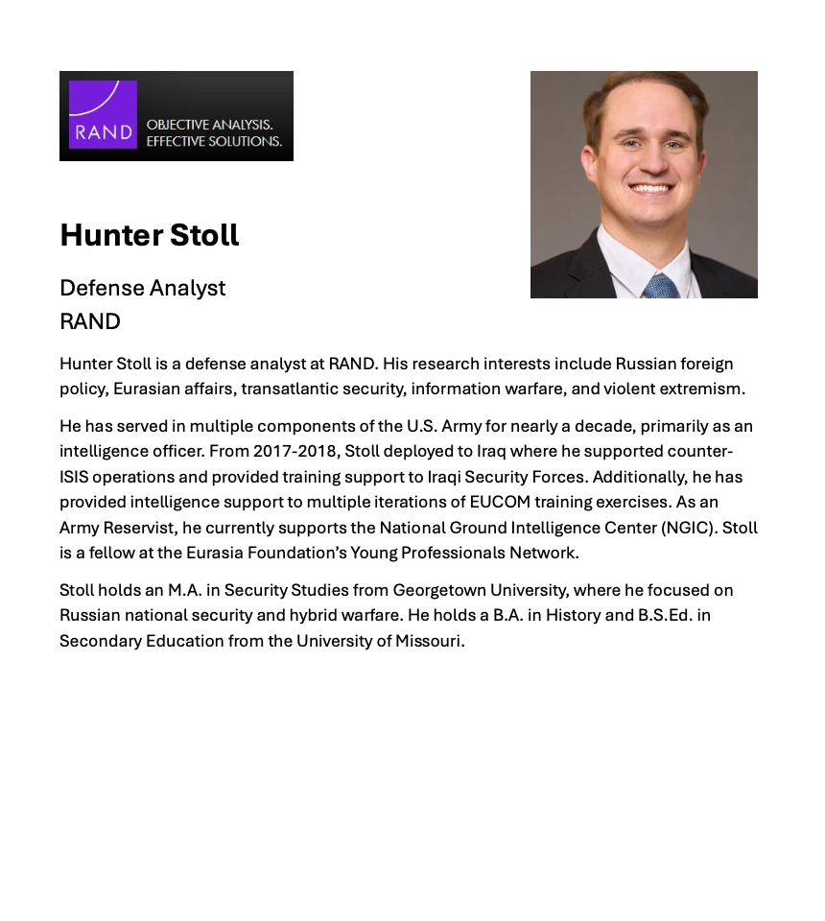
DISCUSSION
Three speakers. Three topics.
Hunter Stoll
- introduced by Sarina

Slide 15
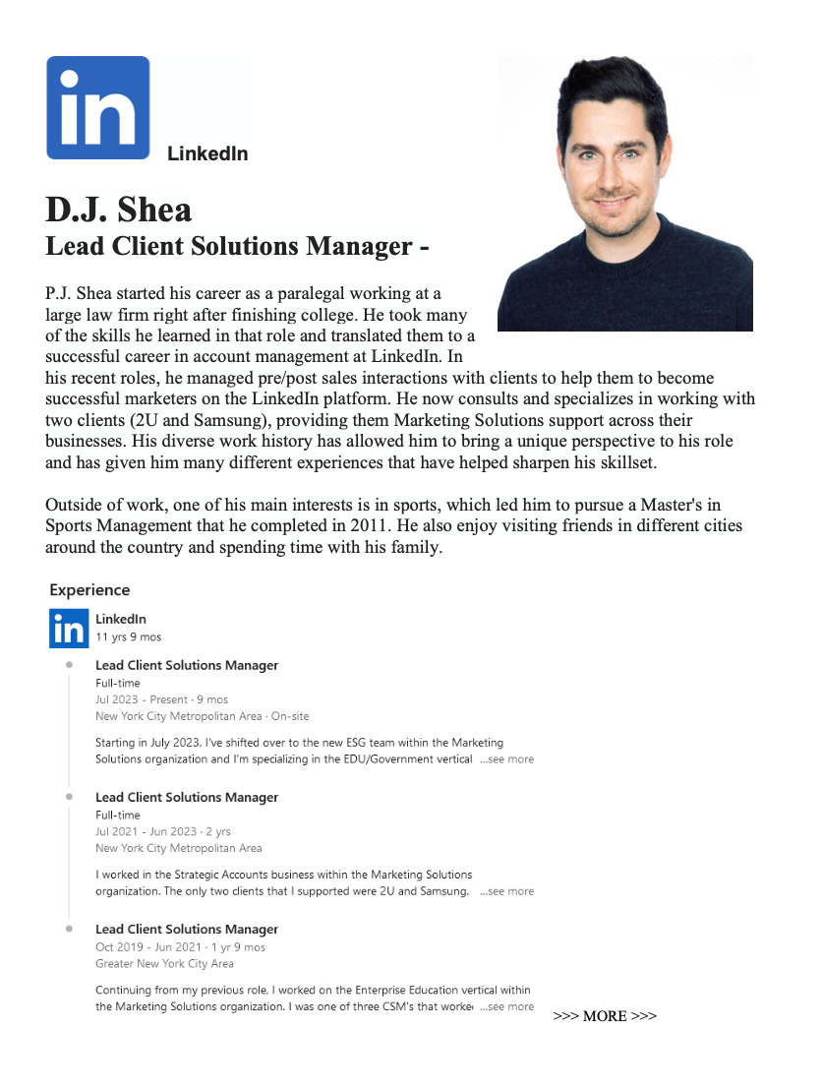
DISCUSSION
Three speakers. Three topics.
D.J. Shea
- introduced by Priya

Slide 16
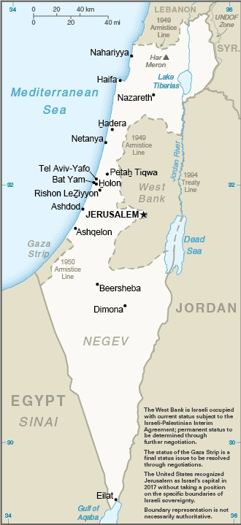
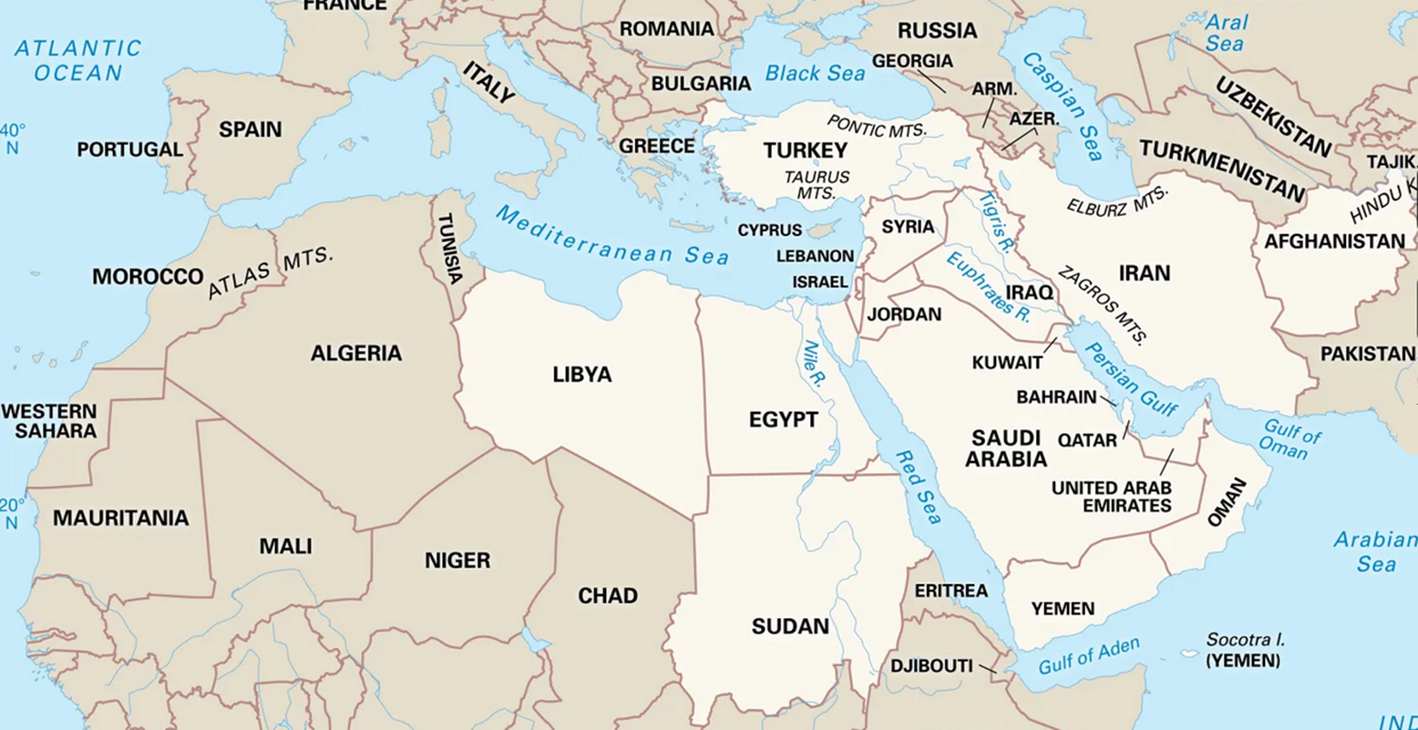
DISCUSSION

Slide 17
DISCUSSION

Slide 18
REVIEW
DISCUSSION
Some of the basics …
Creation of Jewish State in 1948.
Never resolved Palestinian homeland issues.
Six-Day War in 1967; Yom Kippur War in 1973.
Intifadas in 1987-93 and 2000-05.
Camp David Accords in 1978.
Oslo Accords in 1993 and 1995.
Numerous failed attempts.

Slide 19
REVIEW
DISCUSSION
Some of the basics …
Abraham Accords (2020) did not include Palestine.
UAE, Bahrain first.
Sudan, Morocco later.
Saudi Arabia talk but not sign.
Gaza War
7 Oct 2023 – Hamas attack, killing 1.3K
Only a short ceasefire since then

Slide 20
REVIEW
DISCUSSION
Other aspects …
Gaza
West Bank
Syria
Iran
Netanyahu’s political problems
The USA

Slide 21
NEW
DISCUSSION
Monday’s news …
potential advantages
potential flaws
Trump’s 20-point plan
Israel
Palestinians
U.S.
international
Reactions

Slide 22
NEW
DISCUSSION
Wednesday and Thursday’s news …
Humanitarian flotilla intercepted
“Final warning” to Gaza City

Slide 23
DISCUSSION
What questions have you developed?
About …
Trump plans (20 pts and Riviera)
Netanyahu’s plan
Gaza and Gaza City strategies
Humanitarian flotilla and aid
West Bank settlements/annexation
Next steps on Iran
Two-State solution
Long-term consequences in Gaza

Slide 24
DISCUSSION
I asked: What questions have you developed?
Now I ask:
What do you make of the answers?
What do you think the future holds?
What is U.S. policy, and what should be?
What lessons should learn from this?

Slide 25


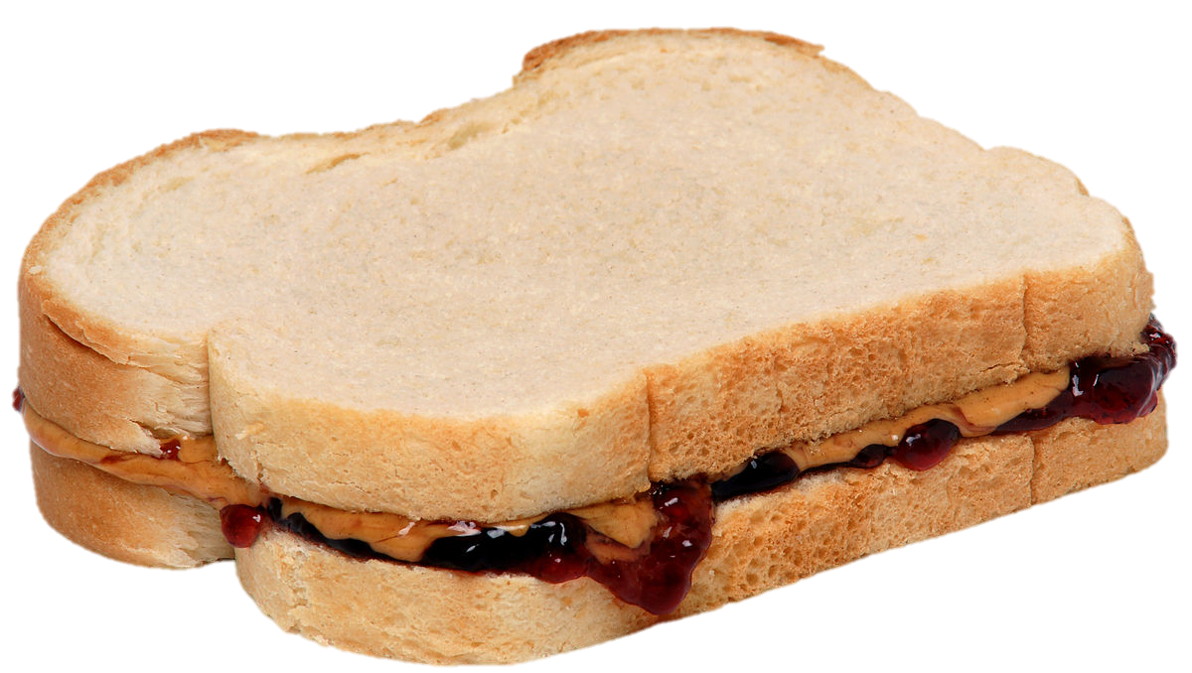
LUNCH

Slide 26
DISCUSSION
Comfortable with 401 and 402 projects?

Slide 27
Be on 19th Street at 9:40

Slide 28
GUEST SPEAKER

Slide 29
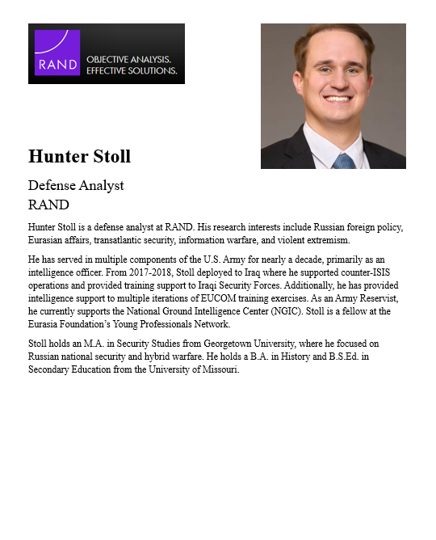
GUEST SPEAKER
Hunter Stoll
Defense Analyst RAND
- Introduced by Sarina

Slide 30
Questions? Comments?

Slide 31
GUEST SPEAKER

Slide 32
GUEST SPEAKER
D.J. Shea
Lead Client Solutions Manager, LinkedIn
- Introduced by Priya

Slide 33

WRAPUP

Slide 34
PROJECT PLANNING
Maisie | Microplastics | U.S. Declining Birth Rates
Skye | Ending the war in Sudan
Esme | Immigration and Balancing Interests | U.S. Culture Wars
Camille | Microplastics and PFAS
Erik | Ukraine Innovative Use of Drones | Israeli Use of Lavender AI in Targeting
Richard | Enhancing Cybersecurity
Alex | China’s Increasing Military Strength | Iranian Nationalism
Syarra | Russian Influence in Eastern Europe
Maeve | Israeli Use of AI in Military Strikes in Gaza | U.S. Declining Birth Rates
Kiana | Impact of Federal Spending … or inflation
Mo | Aid to Gaza | Impact of U.S.-China Tariffs
Bobby | U.S. Health Care: High Cost of Prescription Drugs
Gabby | U.S. Culture Wars and How Policy Fuels them | U.S.-Israel Relations After Netanyahu
Katelyn | Russia-Ukraine Negotiations
Sarina | Foreign Disinformation Targets U.S. Elections | Crisis of Legal Immigration Pathways in the U.S.
Priya | China’s Advances in Renewable Energy and EVs
Looking at others’ topics, what are you interested in learning about from them? What analysis and policy?
(Give them guidance.)

Slide 35
DISCUSSION
Comfortable?
Topics
How partnership will work
The purposes
Substance, process, skills
The elements
All OK?
PREPARING AND PLANNING?
401
Analysis
“Memo #2”
402
Proposal
Hearing/event
Public opinion
Interviews
DC memo
Briefing

Slide 36
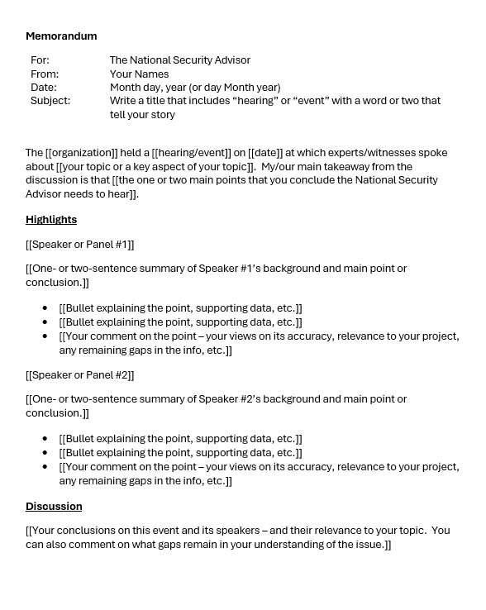
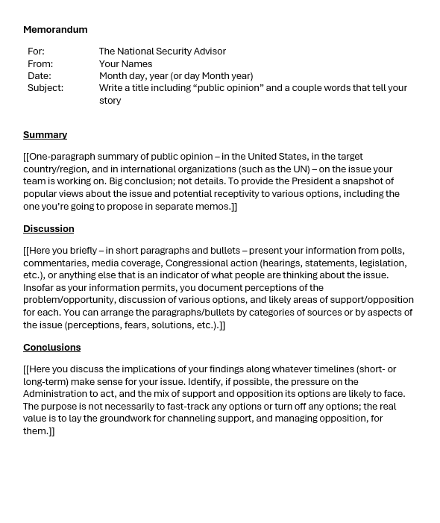
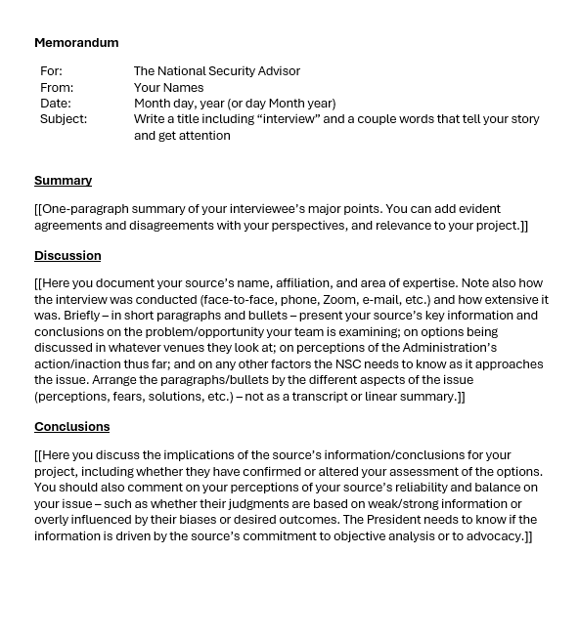
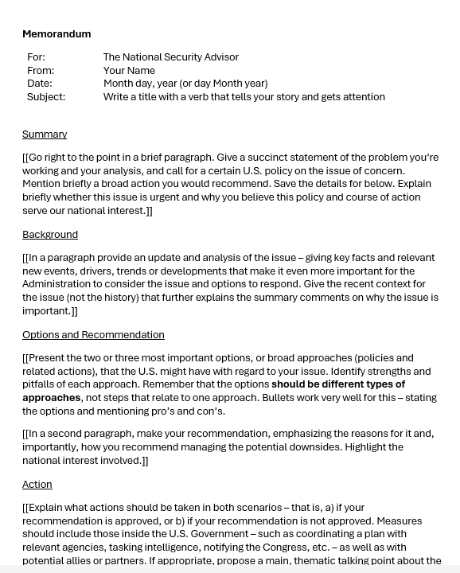
The Templates
402
401

Slide 37
NEXT WEEK

Slide 38
Anything else?

Slide 39
Global Policy Seminar and NSC Simulation
IRP 401 - IRP 402
Week Six 03 October 2025
Prof. Fulton T. Armstrong

