Slide 1

Global Policy Seminar and NSC Simulation
IRP 401 - IRP 402
Week Five 26 September 2025
Prof. Fulton T. Armstrong

Slide 2
Week 1 (29 Aug)
Week 2 (5 Sep)
Week 3 (12 Sep)
Week 4 (19 Sep)
Week 5 (26 Sep)
Week 6 (3 Oct)
Week 7 (10 Oct)
Week 8 (17 Oct)
Week 9 (24 Oct)
Week 10 (31 Oct )
Week 11 (7 Nov)
Week 12 (14 Nov)
Week 13 (21 Nov)
Thanksgiving Break
Week 14 (5 Dec)
Fall 2025

Slide 3
TODAY’S AGENDA
9:00 | Class Discussion Review and possible quiz on readings Preparation for guest speakers
10:00 | David Makovsky The Washington Institute for Near East Policy - introduced by Maeve
11:15 | Class Discussion
12:00 | Lunch
1:15 | Class Discussion – Project Updates 401 and 402 Templates
2:00 | Mitchell Plitnick President, ReThinking Foreign Policy - introduced by Skye
3:15 | Wrapup

Slide 4
TODAY’S AGENDA
9:00 | Class Discussion Review and possible quiz on readings Preparation for guest speakers
10:00 | David Makovsky The Washington Institute for Near East Policy - introduced by Maeve
11:15 | Class Discussion
12:00 | Lunch
1:15 | Class Discussion – Project Updates 401 and 402 Templates
2:00 | Mitchell Plitnick President, ReThinking Foreign Policy - introduced by Skye
3:15 | Wrapup

Slide 5


Will go through transportation options during wrapup

Slide 6

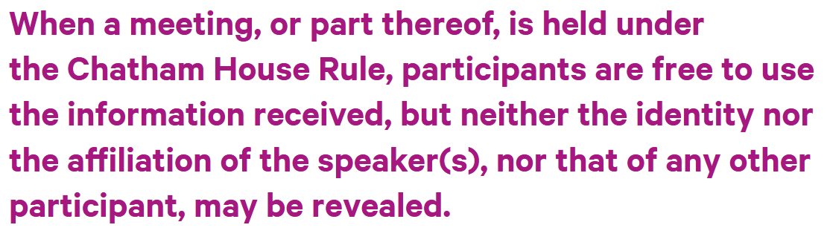
ETIQUETTE or PROTOCOL
Personal vs official views
Chatham House Rule
St. James’s Square London

Slide 7
ETIQUETTE or PROTOCOL
Professional respect
Smart, analytical questions
Non-combative tone
Depending on your style, perhaps preface question
What is your perspective on …?
What should we make of reports that …?
What do we need to know to understand …
Neutral vocabulary

Slide 8
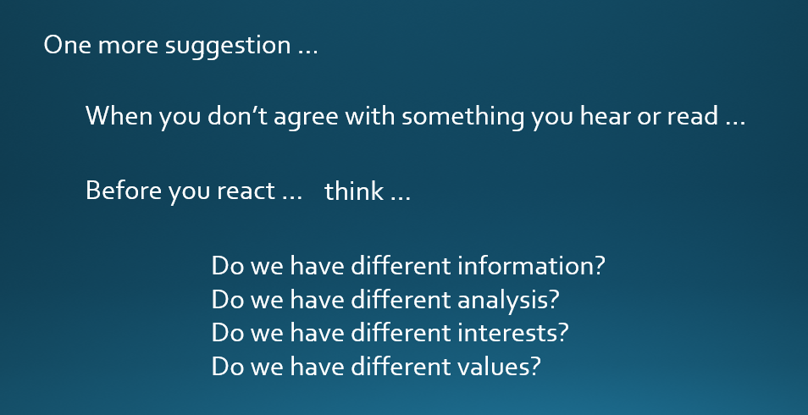
DISCUSSION
Can discuss sensitive, complex, politicized issues.
Remember …
Understand that words can have different meanings.
OUR MISSION (among ourselves and with guests):
TO UNDERSTAND AND ANALYZE
(NOT TO JUDGE)
LISTEN, THINK, TRY TO UNDERSTAND, BE DIPLOMATIC

Slide 9
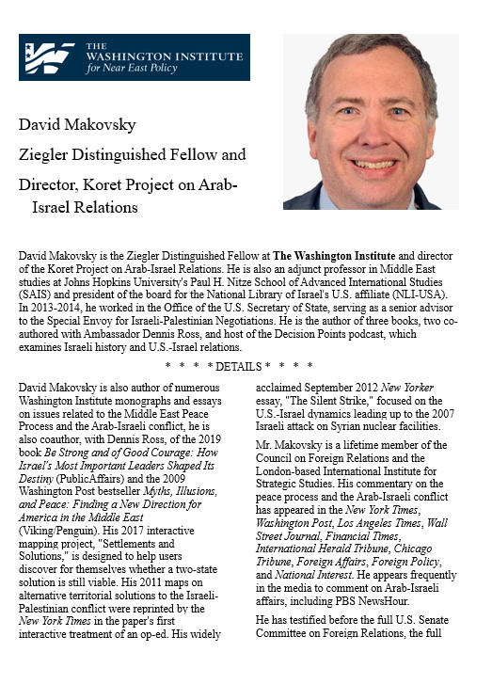
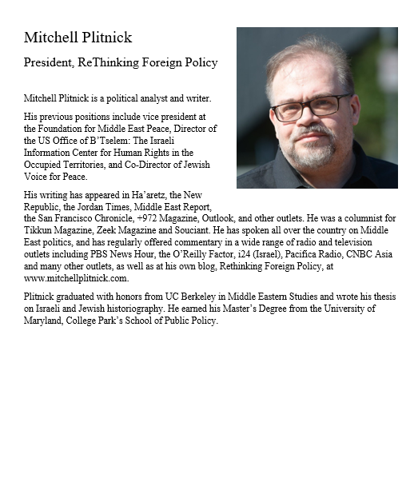
DISCUSSION
Two speakers. Two perspectives.
A great chance to ask questions.

Slide 10
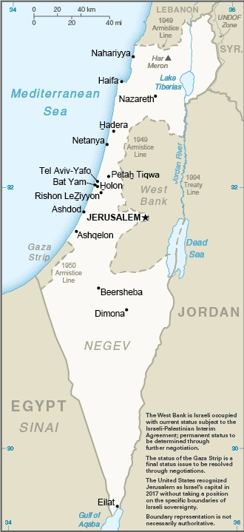
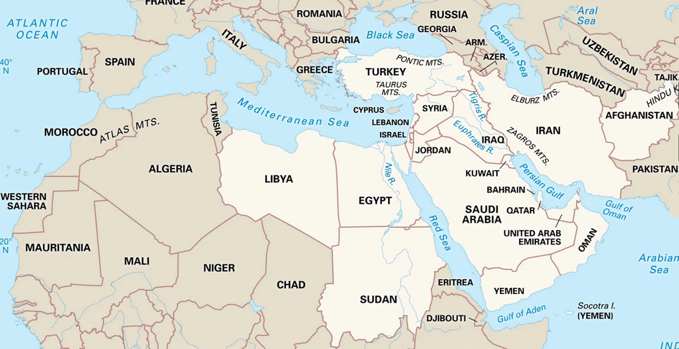
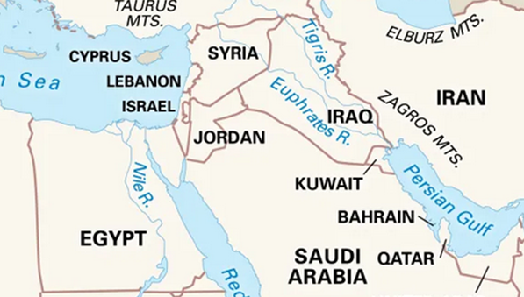
DISCUSSION

Slide 11
QUIZ

Slide 12
DISCUSSION
Some of the basics …
Creation of Jewish State in 1948.
Never resolved Palestinian homeland issues.
Six-Day War in 1967; Yom Kippur War in 1973.
Intifadas in 1987-93 and 2000-05.
Camp David Accords in 1978.
Oslo Accords in 1993 and 1995.
Numerous failed attempts.

Slide 13
DISCUSSION
Some of the basics …
Abraham Accords (2020) did not include Palestine.
UAE, Bahrain first.
Sudan, Morocco later.
Saudi Arabia talk but not sign.
Gaza War
7 Oct 2023 – Hamas attack, killing 1.3K
Only a short ceasefire since then

Slide 14
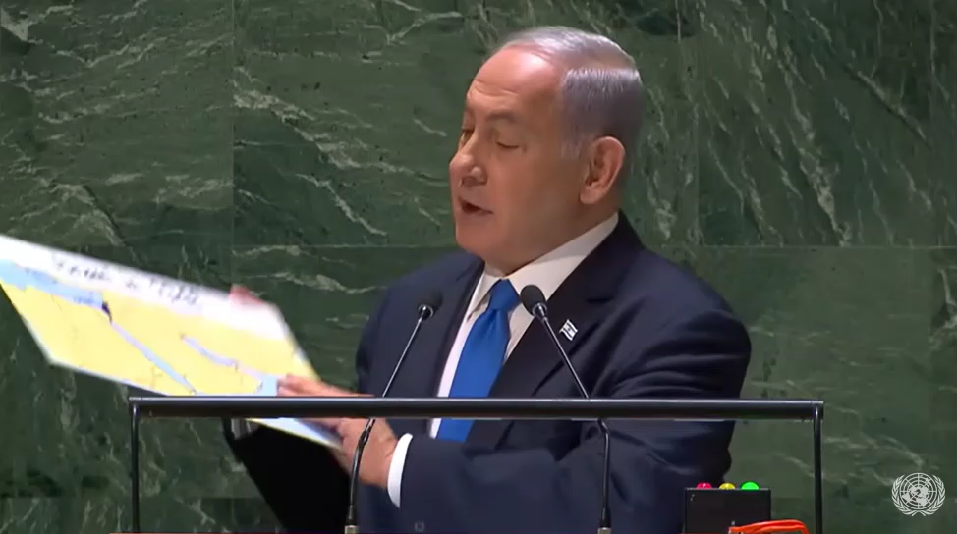
UNGA
22 Sep 2023

Slide 15
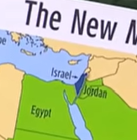
What’s missing?

Slide 16
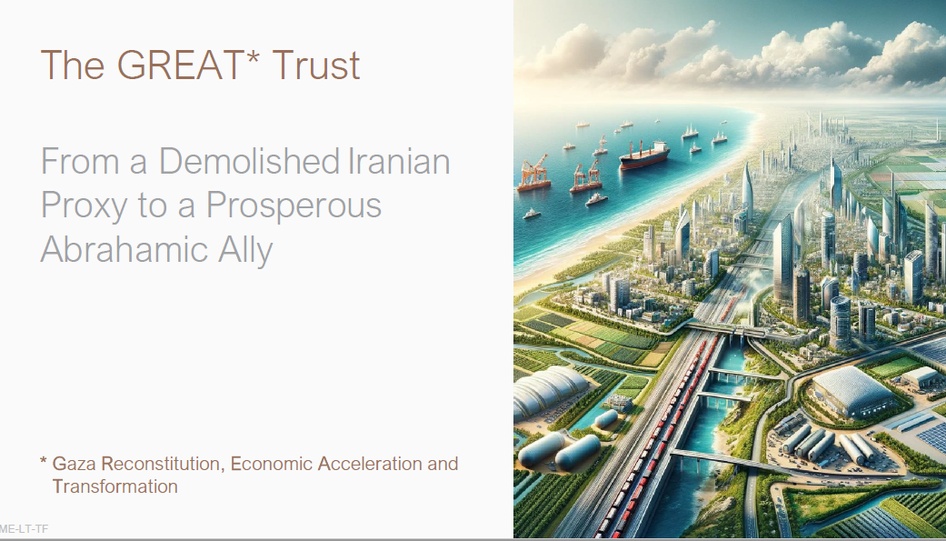
“Trusteeship” at least 10 years.
Gazans “voluntary” departures to outside country ($5K support) or secure “enclaves.”
38 pages  Riviera of the Middle East 

Slide 17
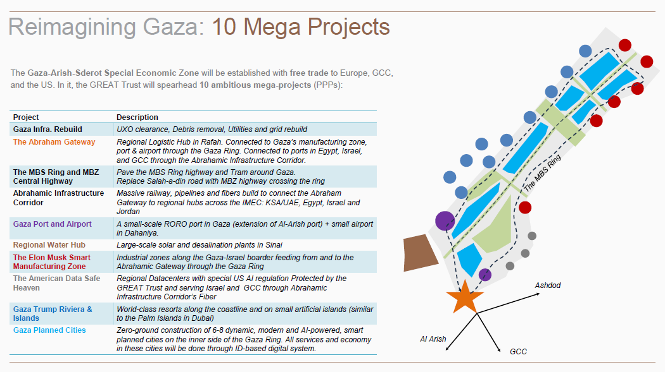
Sderot
(Israel)
Arish
(Egypt)

Slide 18
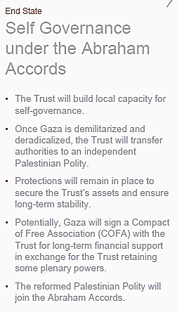
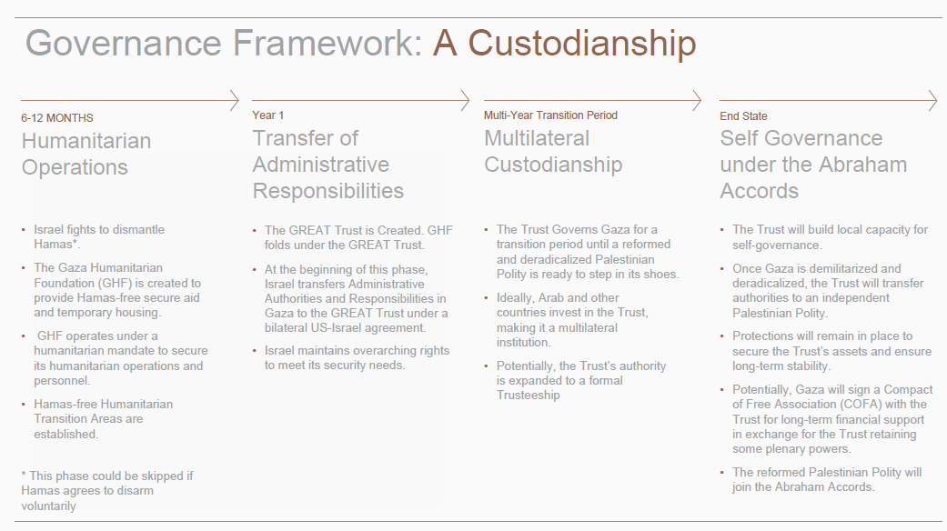

Slide 19
DISCUSSION
Other aspects …
Gaza
West Bank
Syria
Iran
Netanyahu’s political problems
The USA

Slide 20
DISCUSSION
What questions have you developed?

Slide 21

GUEST SPEAKER

Slide 22
GUEST SPEAKER
David Makovsky
Washington Institute for Nar East Policy
- Introduced by Maeve

Slide 23
DISCUSSION
I asked: What questions have you developed?
Now I ask:
What do you make of the answers?
What do you think the future holds?
What is U.S. policy, and what should be?
What lessons should learn from this?

Slide 24
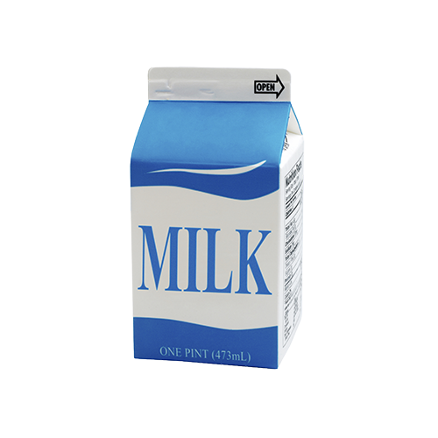

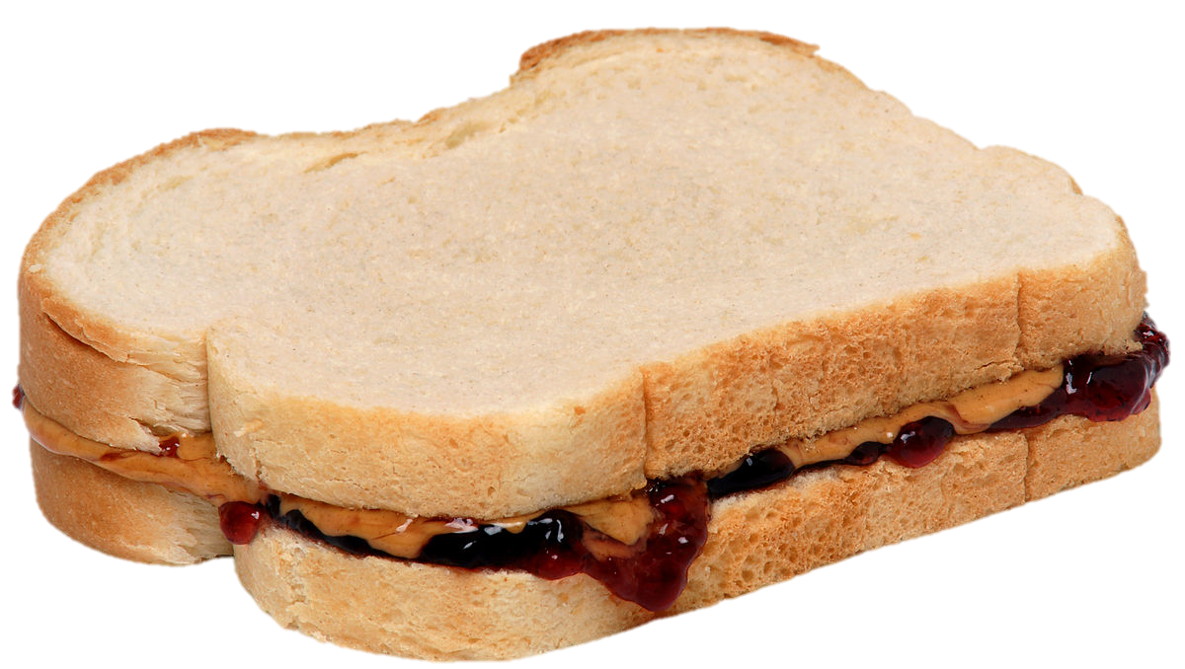
LUNCH

Slide 25
DISCUSSION
Comfortable with 401 and 402 projects?

Slide 26
PROJECT PLANNING
Maisie | Microplastics | U.S. Declining Birth Rates
Skye | Ending the war in Sudan
Esme | Immigration and Balancing Interests | U.S. Culture Wars
Camille | Microplastics and PFAS
Erik | Ukraine Innovative Use of Drones | Israeli Use of Lavender AI in Targeting
Richard | Enhancing Cybersecurity
Alex | China’s Increasing Military Strength | Iranian Nationalism
Syarra | Russian Influence in Eastern Europe
Maeve | Israeli Use of AI in Military Strikes in Gaza | U.S. Declining Birth Rates
Kiana | Impact of Federal Spending … or inflation
Mo | Aid to Gaza | Impact of U.S.-China Tariffs
Bobby | U.S. Health Care: High Cost of Prescription Drugs
Gabby | U.S. Culture Wars and How Policy Fuels them | U.S.-Israel Relations After Netanyahu
Katelyn | Russia-Ukraine Negotiations
Sarina | Foreign Disinformation Targets U.S. Elections | Crisis of Legal Immigration Pathways in the U.S.
Priya | China’s Advances in Renewable Energy and EVs
Looking at others’ topics, what are you interested in learning about from them? What analysis and policy?
(Give them guidance.)

Slide 27
DISCUSSION
Comfortable?
Topics
How partnership will work
The purposes
Substance, process, skills
The elements
All OK?
PREPARING AND PLANNING?
401
Analysis
“Memo #2”
402
Proposal
Hearing/event
Public opinion
Interviews
DC memo
Briefing

Slide 28
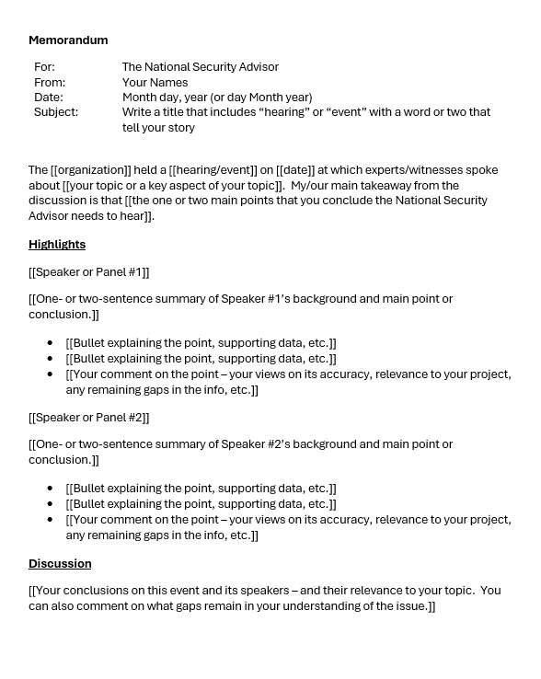
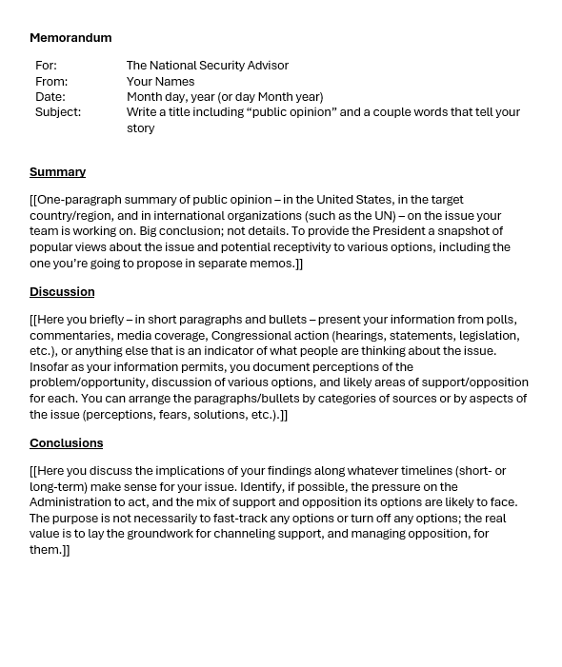
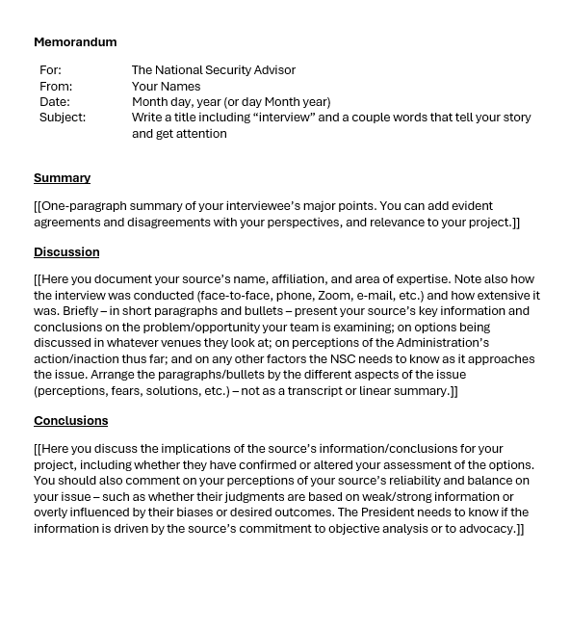
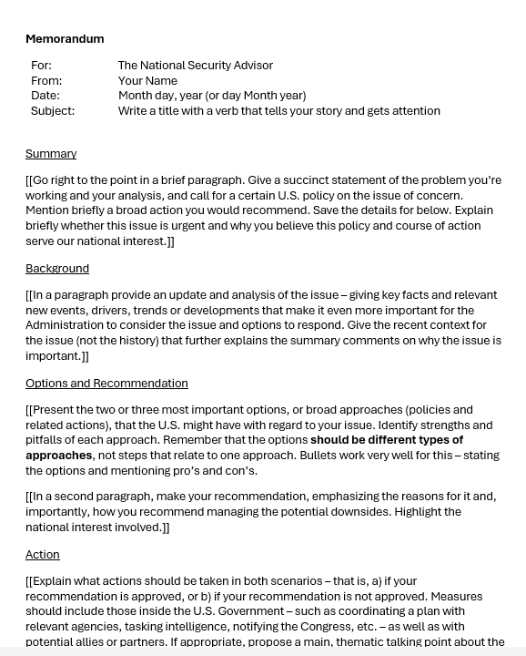
The Templates
401
402

Slide 29
GUEST SPEAKER

Slide 30
GUEST SPEAKER
Mitchell Plitnick
President, Re-Thinking Foreign Policy
- Introduced by Skye

Slide 31
DISCUSSION
I asked: What questions have you developed?
Now I ask:
What do you make of the answers?
What do you think the future holds?
What is U.S. policy, and what should be?
What lessons should learn from this?

Slide 32

WRAPUP

Slide 33
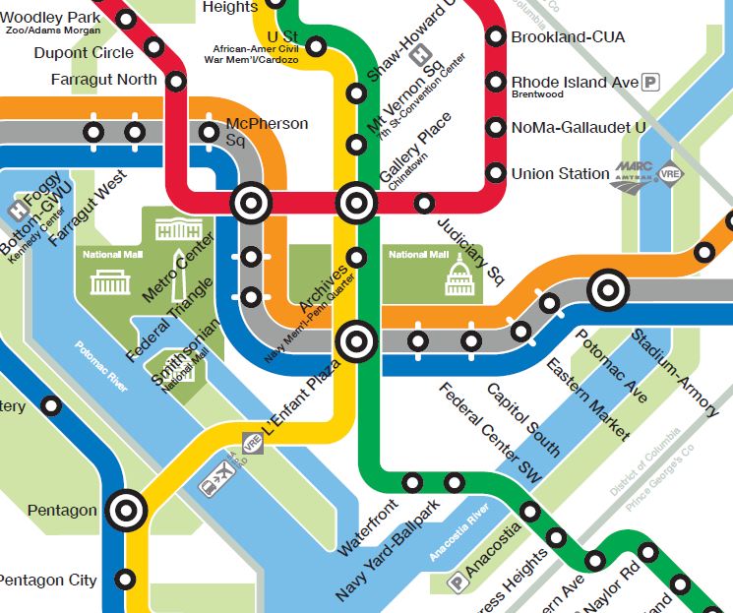
RED line (direction: Glenmont)
→ Gallery Place
GREEN line (direction: Branch Ave)
→ Navy Yard-Ballpark
SILVER/ORANGE/ BLUE line (toward Largo or New Carrollton)
→ L’Enfant Plaza
GREEN line (direction: Branch Ave)
→ Navy Yard-Ballpark

Slide 34
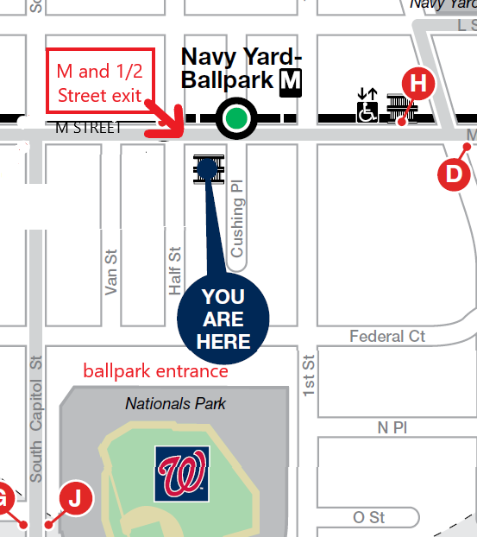
EXIT –
SE corner M & Half Sts., SE

Slide 35
Anything else?

