Slide 1

Global Policy Seminar and NSC Simulation
IRP 401 - IRP 402
Week Four
19 September 2025
Prof. Fulton T. Armstrong

Slide 2
Week 1 (29 Aug)
Week 2 (5 Sep)
Week 3 (12 Sep)
Week 4 (19 Sep)
Week 5 (26 Sep)
Week 6 (3 Oct)
Week 7 (10 Oct)
Week 8 (17 Oct)
Week 9 (24 Oct)
Week 10 (31 Oct )
Week 11 (7 Nov)
Week 12 (14 Nov)
Week 13 (21 Nov)
Thanksgiving Break
Week 14 (5 Dec)
Fall 2025

Slide 3
TODAY’S AGENDA
9:00 | Skills – Using AI Assistant Dean Haq and Fulton Armstrong
10:00 | Class Discussion – Project Updates
10:30 | Guest Speaker: Nicole Widdersheim Deputy Washington Director, Human Rights Watch - introduced by Camille
11:45 | Lunch
12:45 | Class Discussion – Project Updates 401 and 402 Templates
1:55 | Meet in 14th Street lobby of National Press Club
2:00 | Jerry Zremski Buffalo News Columnist and University of Maryland Professor. - introduced by Bobby
3:00 | Wrapup

Slide 4
TODAY’S AGENDA
9:00 | Skills – Using AI Assistant Dean Haq and Fulton Armstrong
10:00 | Class Discussion – Project Updates
10:30 | Guest Speaker: Nicole Widdersheim Deputy Washington Director, Human Rights Watch - introduced by Camille
11:45 | Lunch
12:45 | Class Discussion – Project Updates 401 and 402 Templates
1:55 | Meet in 14th Street lobby of National Press Club
2:00 | Jerry Zremski Buffalo News Columnist and University of Maryland Professor. - introduced by Bobby
3:00 | Wrapup

Slide 5
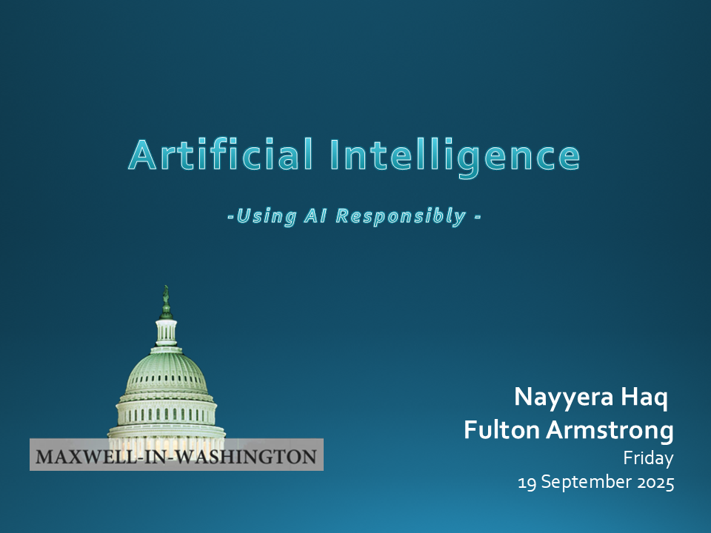

Slide 6
DISCUSSION
INFO FOR EMBASSY VISIT

Slide 7
DISCUSSION
Comfortable with 401 and 402 projects?
Understand the purposes?
  Substance, process, skills
Any questions about each element of 402 project?

Slide 8
PROJECT PLANNING
Maisie | Microplastics | U.S. Declining Birth Rates
Skye | Ending the war in Sudan
Esme | Immigration and Balancing Interests | U.S. Culture Wars
Camille | Microplastics and PFAS
Erik | Ukraine Innovative Use of Drones | Israeli Use of Lavender AI in Targeting
Richard | Enhancing Cybersecurity
Alex | China’s Increasing Military Strength | Iranian Nationalism
Syarra | Russian Influence in Eastern Europe
Maeve | Israeli Use of AI in Military Strikes in Gaza | U.S. Declining Birth Rates
Kiana | Impact of Federal Spending … or inflation
Mo | Aid to Gaza | Impact of U.S.-China Tariffs
Bobby | U.S. Health Care: High Cost of Prescription Drugs
Gabby | U.S. Culture Wars and How Policy Fuels them | U.S.-Israel Relations After Netanyahu
Katelyn | Russia-Ukraine Negotiations
Sarina | Foreign Disinformation Targets U.S. Elections | Crisis of Legal Immigration Pathways in the U.S.
Priya | China’s Advances in Renewable Energy and EVs

Slide 9
DISCUSSION
Comfortable?
  Topics
  How partnership will work
The purposes
  Substance, process, skills
The elements
401
  Analysis
  “Memo #2”
402
  Proposal
  Hearing/event
  Public opinion
  Interviews
  DC memo
  Briefing

Slide 10
GUEST SPEAKER

Slide 11

GUEST SPEAKER
Nicole Widdersheim
Deputy Washington Director,
Human Rights Watch
- Introduced by Camille

Slide 12
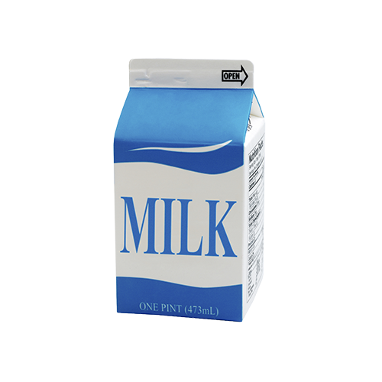

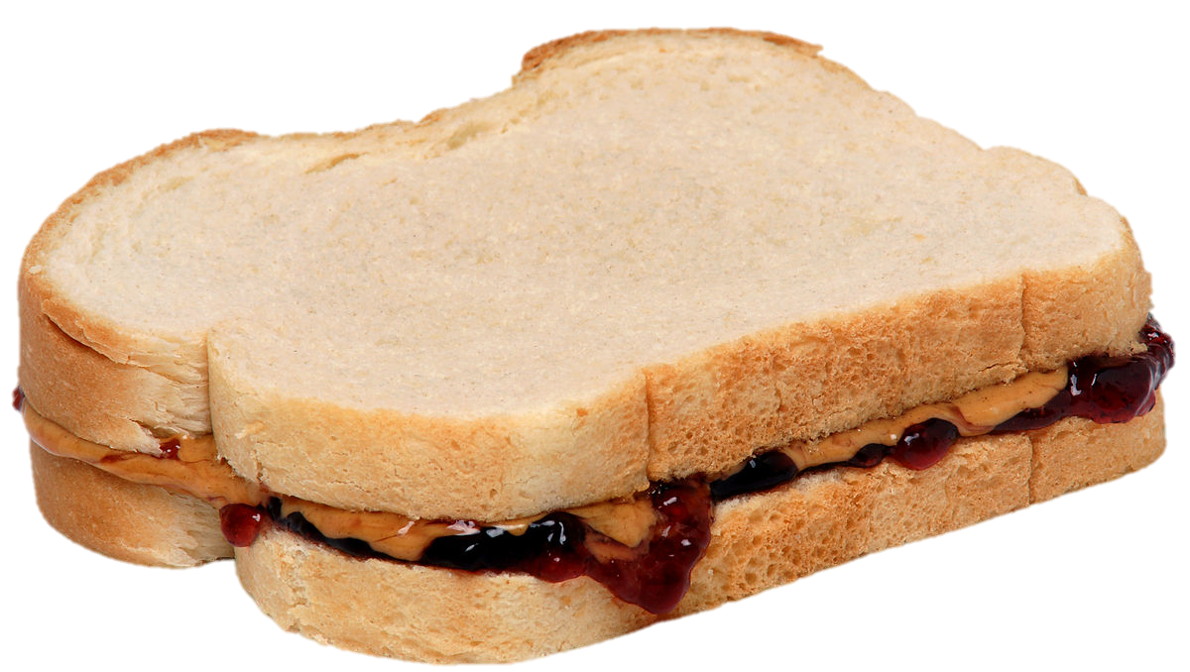
LUNCH

Slide 13
DISCUSSION
All OK?
Comfortable with 401 and 402 projects?
Understand the purposes?
  Substance, process, skills
Any questions about each element of 402 project?

Slide 14
DISCUSSION
Comfortable?
  Topics
  How partnership will work
The purposes
  Substance, process, skills
The elements
All OK?
PREPARING AND PLANNING?
401
  Analysis
  “Memo #2”
402
  Proposal
  Hearing/event
  Public opinion
  Interviews
  DC memo
  Briefing

Slide 15
DISCUSSION
Snowflake
Analytical model
  Drivers and Scenarios
Your assignment

Slide 16


Remember : The Snowflake

Slide 17
EXAMPLE
What does collapse of Afghanistan mean (circa September 2021)?
    The Taliban victory in Kabul has created conditions of repression and instability in Afghanistan. … Restoration of Sharia Law, which international community rejects, will provoke suspension of financial, humanitarian aid, intensifying economic crisis and hunger. … Taliban reaction likely to result in collaboration with terrorists.
BLUF
INFO / ARGU-
MENTATION
PREDICTION / IMPLICATION
41 words!

Slide 18

The Heartbeat of Analysis
(… and POLICY)
“DRIVERS”

Slide 19
Good policy decisions focus on changing drivers
React to symptoms
DRIVERS
situations/ scenarios
Make policies,
programs,
operations that alter scenarios
So … identify the drivers for your decisionmaker!

Slide 20
What are drivers?
Interests
Borrowing from the “3-i framework” …
In our PERSONAL lives …
Ideas
Institutions
Interests | Ideas | Institutions
Work Food Love - Sex Family Home Transportation Entertainment Recreation Challenges | Education Religion or values Political thought Ideology Imposed expectations | Parents Boy/Girlfriend Husband/Wife Colleagues Friends Political party Employer
drivers

Slide 21
What are drivers?
Interests
In our PERSONAL lives …
Ideas
Institutions
Interests | Ideas | Institutions
Work Food Love - Sex Family Home Transportation Entertainment Recreation Challenges | Education Religion or values Political thought Ideology Imposed expectations | Parents Boy/Girlfriend Husband/Wife Colleagues Friends Political party Employer
drivers

Slide 22
What are drivers?
Interests
In our NATIONAL lives …
Ideas
Institutions
Interests | Ideas | Institutions
Power/influence Needs Desires/ambitions Wealth Economic performance | Self-definition Nationalism History Concepts/logic Values Ideology | Leadership Abilities/constraints Economic structures Intermediation Inclusion Topography/geography Climate
drivers

Slide 23
What are drivers?
Interests
In our NATIONAL lives …
Ideas
Institutions
Interests | Ideas | Institutions
Power/influence Needs Desires/ambitions Wealth Economic performance | Self-definition Nationalism History Concepts/logic Values Ideology | Leadership Abilities/constraints Economic structures Intermediation Inclusion Topography/geography Climate
drivers

Slide 24
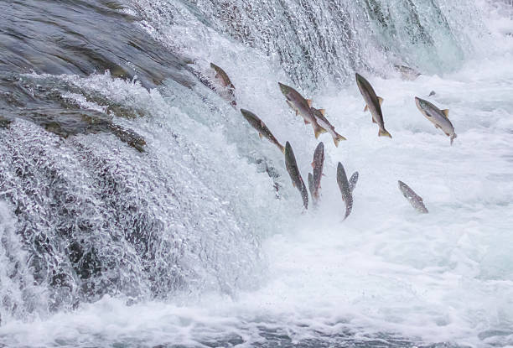
Another way of looking at drivers - I
“sub-drivers”
or
“super-drivers”
What creates the drivers that we see in action?
How far “upstream” do we chase the drivers?
What’s driving/causing/influencing the situation you’re analyzing?
    What’s driving/causing/influencing that driver?
      And what’s driving/causing/influencing THAT driver??
          Etc., etc., etc.

Slide 25
Q: How far “upstream” do I want to go?
  A: To the highest point that has greatest relevant meaning for your decisionmaker.

Slide 26
Another way of looking at drivers - II
“FUEL”
“FRICTION”
Effort/energy
Resources
Technology, etc.
to PUSH a solution.
Obstacles
Resistence
Limitations, etc.
that OBSTRUCT a solution.
“Forward” drivers
“Status Quo” or “Backward” drivers
Examples

Slide 27
Drivers
Trends (Behavior)
Scenarios
Building Scenarios
Stronger – Weaker?
Aggravate – Mitigate?
Most Likely – Less Likely?

Slide 28
Building the Principal Scenario
driver and trend
Principal Scenario
driver and trend
driver and trend
driver and trend
driver and trend
driver and trend

Slide 29
Building the ALTERNATIVE Scenario
driver and trend
driver and trend
driver and trend
driver and trend
Alternative Scenario
driver and trend
driver and trend

Slide 30
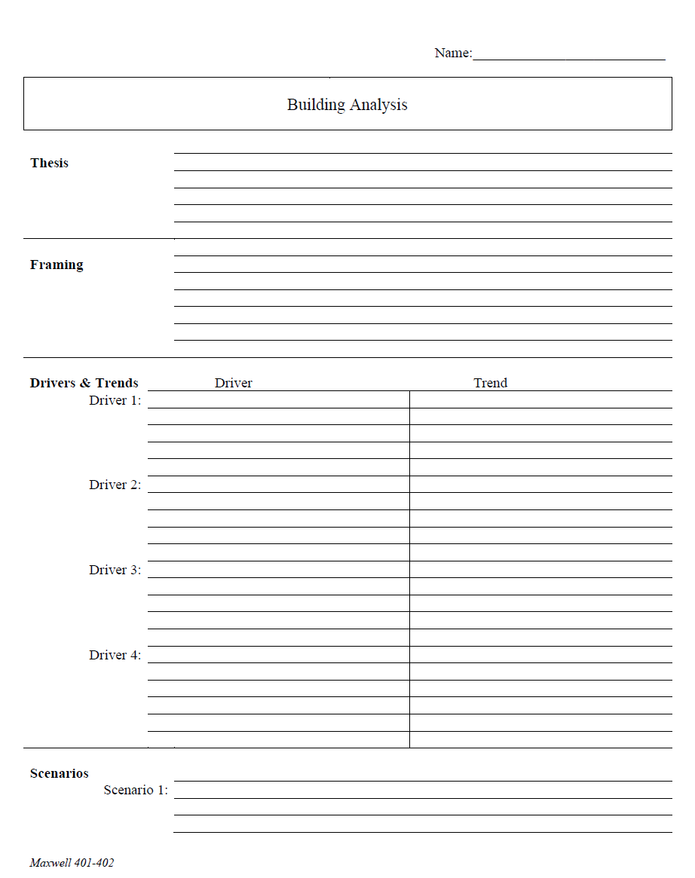
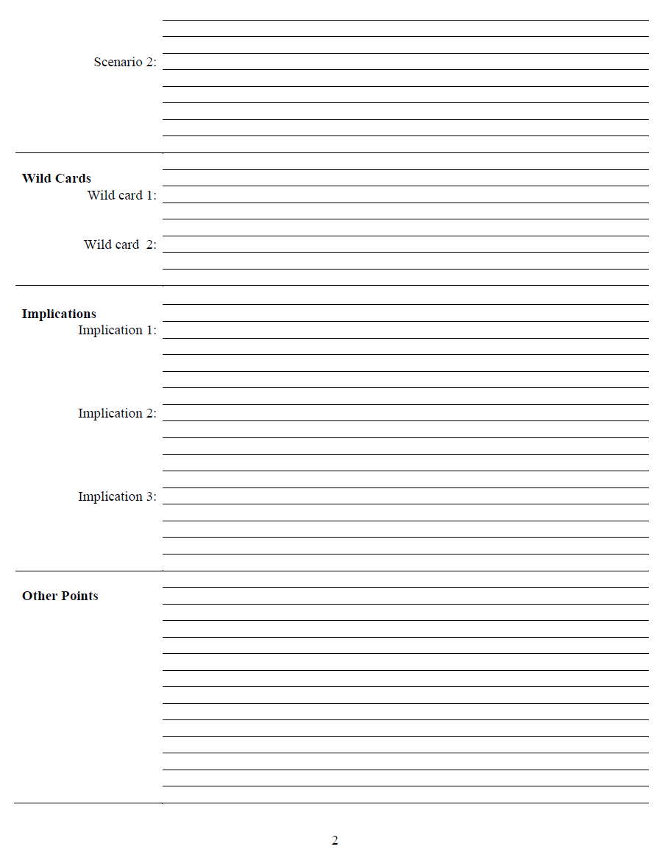
The Analytical Worksheet: One Proven, Effective Way to Build Analysis for Presentation

Slide 31
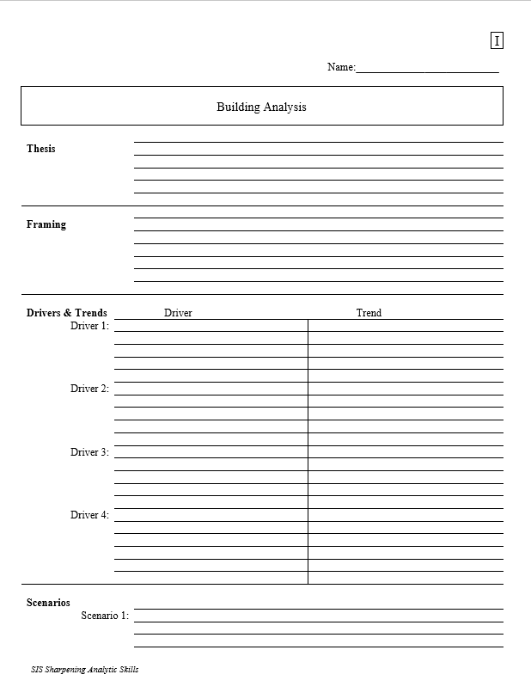
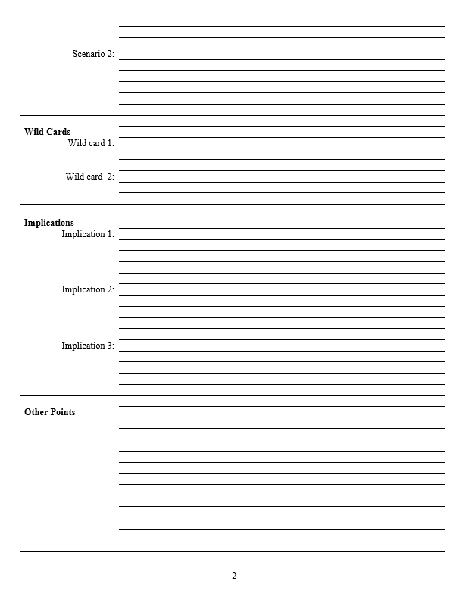
With a thesis sentence at the top, here’s the whole model.
Other Points | Things that don’t fit in rigid structure
 | Give color, texture to analysis
 | Useful in building “narrative” when you write
 | Pet facts, thoughts that you like (and show you care)
Thesis sentence(s): Main conclusion.
            “Bottom Line Up Front.”
            Short, concise summary – including as many elements as needed to tell the whole story.
Framing: The information your decisionmaker needs to get into the story.
Basics
Not “research or encylopedia”

Slide 32
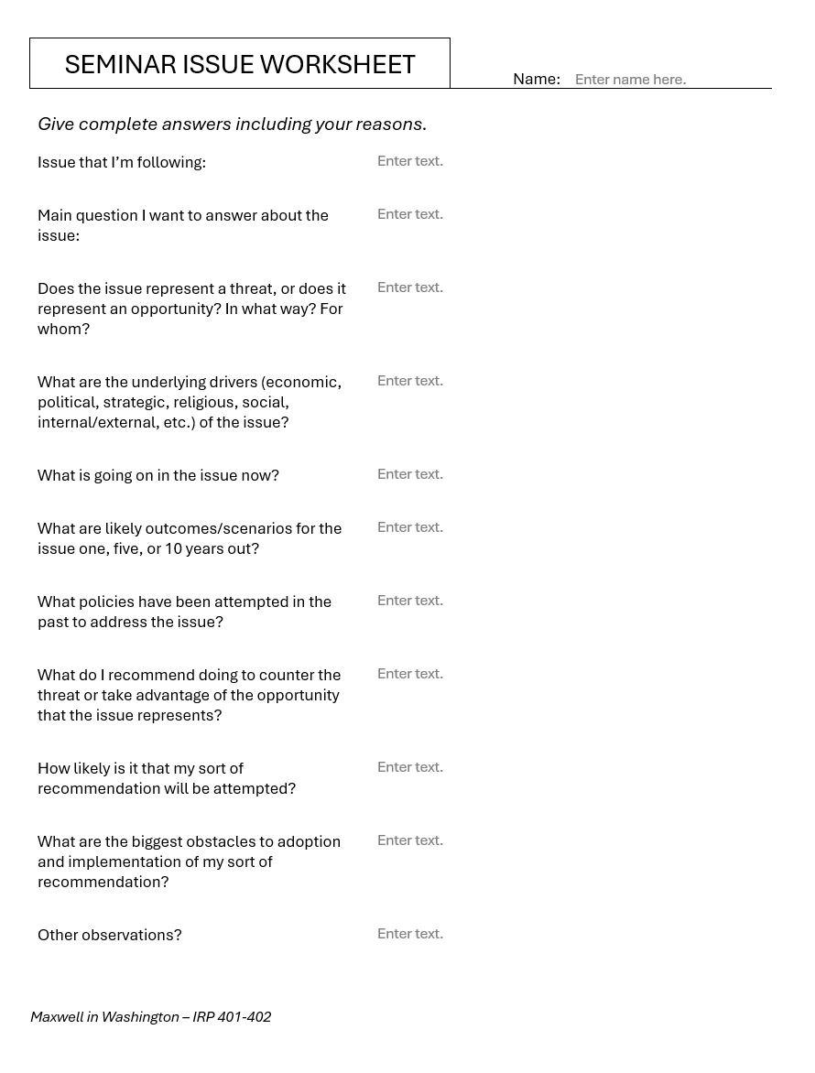
Alternative
Should be two or three pages of text.

Slide 33
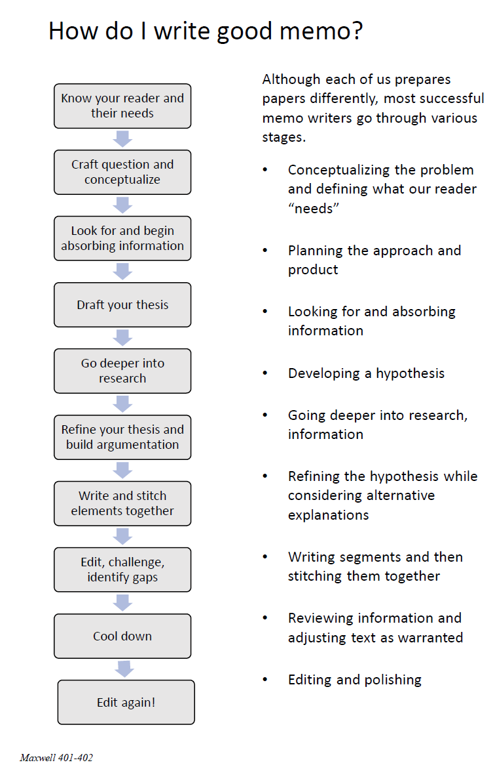
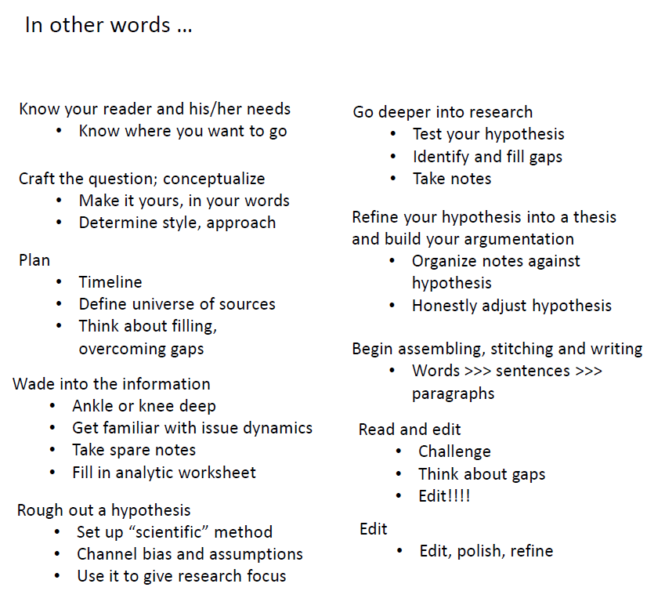
The overall process

Slide 34
DISCUSSION
All OK?
Snowflake
Analytical model
  Drivers and Scenarios
Your assignment

Slide 35
GUEST SPEAKER
Jerry Zremski
University of Maryland
Merrill College of Journalism
The Buffalo News
What does the media-policy dynamic look like from his perch?
What’s happening in the news industry?
What’s it like to be a journalist?
- Introduced by Kennedy

Slide 36
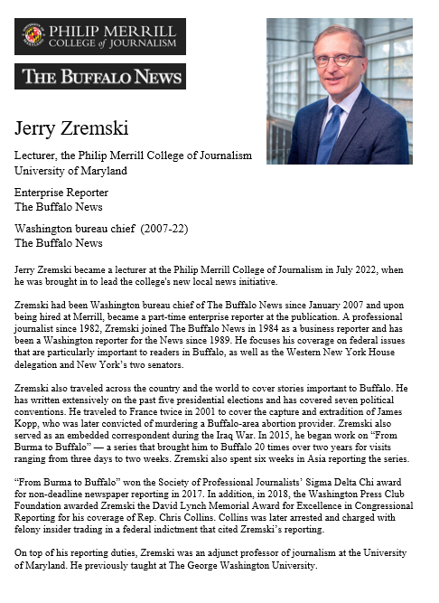
GUEST SPEAKER
Jerry Zremski
University of Maryland
Merrill College of Journalism
The Buffalo News
- Introduced by Bobby

Slide 37
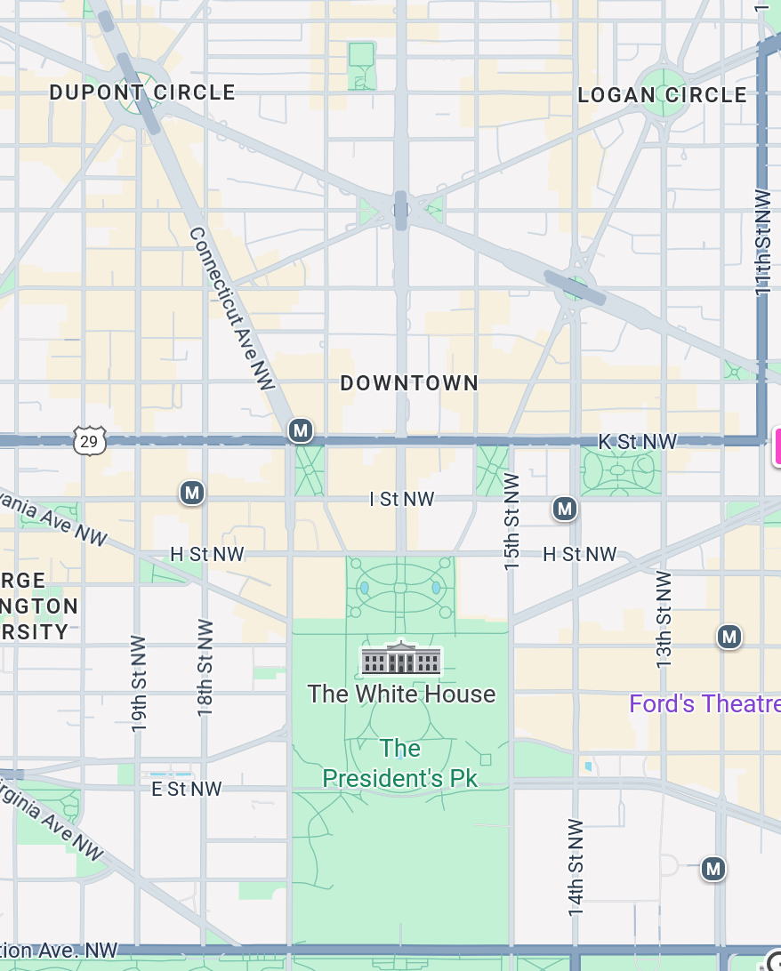
National Press Club
529 14th Street NW
Meet in 14th Street lobby (downstairs) at 1:55
METRO: RED LINE
METRO
CENTER
12th and F Street Exit

Slide 38
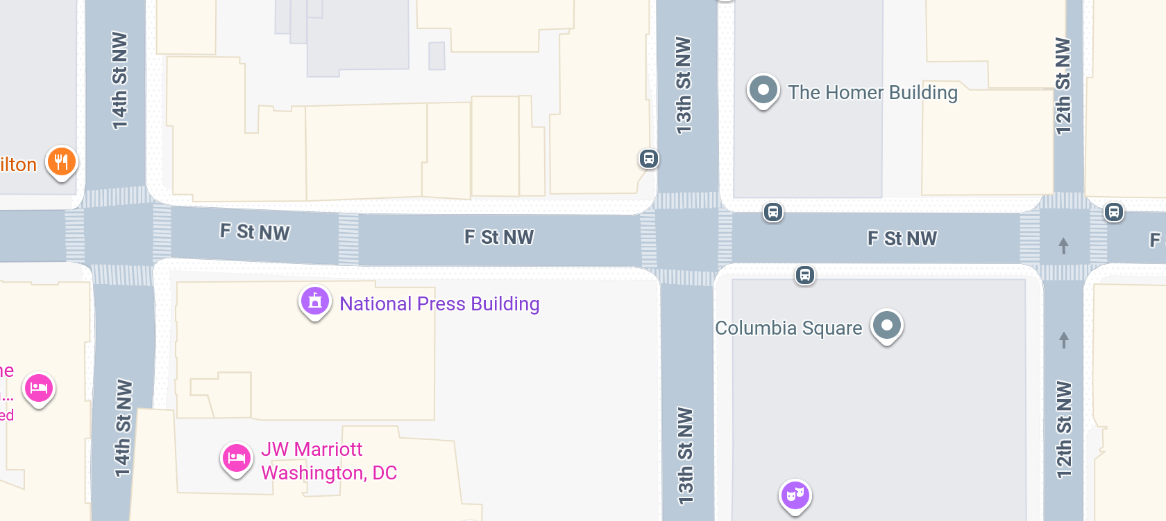



Slide 39

National Press Club
529 14th Street NW
Meet in 14th Street lobby (downstairs) at 1:55
METRO: RED LINE
Walk 1.3 miles
METRO
CENTER

Slide 40
Global Policy Seminar and NSC Simulation
IRP 401 - IRP 402
Week Four
19 September 2025
Prof. Fulton T. Armstrong

