Slide 1

Global Policy Seminar and NSC Simulation
IRP 401 - IRP 402
Week Four
06 February 2026
Prof. Fulton T. Armstrong

Slide 2
Week 1 (16 Jan)
Week 2 (23 Jan)
Week 3 (30 Jan)
Week 4 (6 Feb)
Week 5 (13 Feb)
Week 6 (20 Feb)
Week 7 (27 Feb)
Week 8 (6 Mar)
Spring Break
Week 9 (20 March)
Week 10 (27 Mar)
Week 11 (3 Apr)
Week 12 (10 Apr)
Week 13 (17 Apri)
Week 14 (24 Apr)
Spring 2026

Slide 3
TODAY’S AGENDA
9:00 | Skills Discussion – Networking and Building the Elevator Pitch Samantha Clemence
10:00 | Class Discussion and Quiz Readings
10:30 | Guest Speaker: Hunter Stoll – Russia, Ukraine, NATO Defense Analyst, RAND - Introduced by Eli
12:30 | Lunch and Metro to Smithsonian Station and Holocaust Museum
1:55 | Meet at Museum Entrance (14th Street)
2:00 | Enter Museum as group
~3:30 | Wrapup and depart from Museum

Slide 4
TODAY’S AGENDA
9:00 | Skills Discussion – Networking and Building the Elevator Pitch Samantha Clemence
10:00 | Class Discussion and Quiz Readings
10:30 | Guest Speaker: Hunter Stoll Defense Analyst, RAND - Introduced by Eli
12:30 | Lunch and Metro to Smithsonian Station and Holocaust Museum
1:55 | Meet at Museum Entrance (14th Street)
2:00 | Enter Museum as group
~3:30 | Wrapup and depart from Museum

Slide 5

Professional Skills

Slide 6
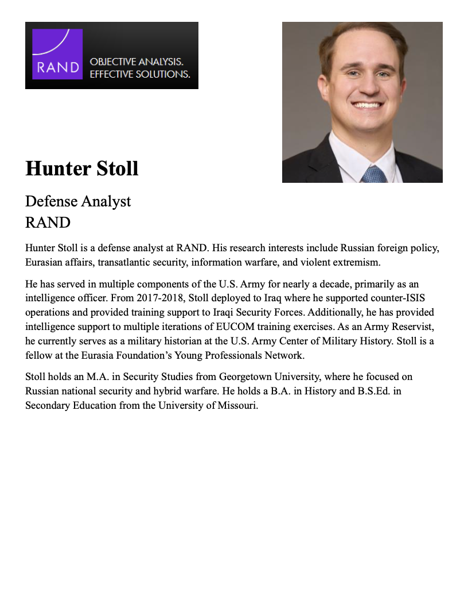
GUEST SPEAKER
Hunter Stoll
Defense Analyst
RAND
- Introduced by Eli

Slide 7
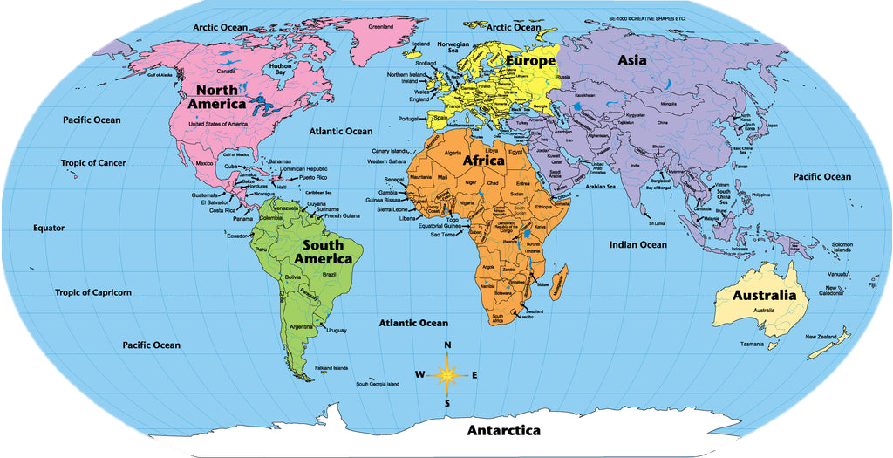

Slide 8
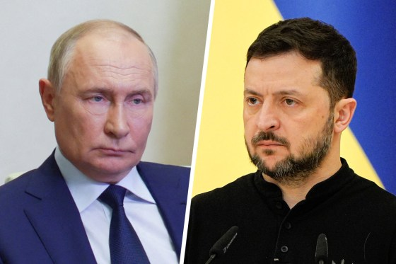

Russian President Vladimir Putin Ukrainian President Volodymyr Zelenskyy
since 1999
since 2019

Slide 9
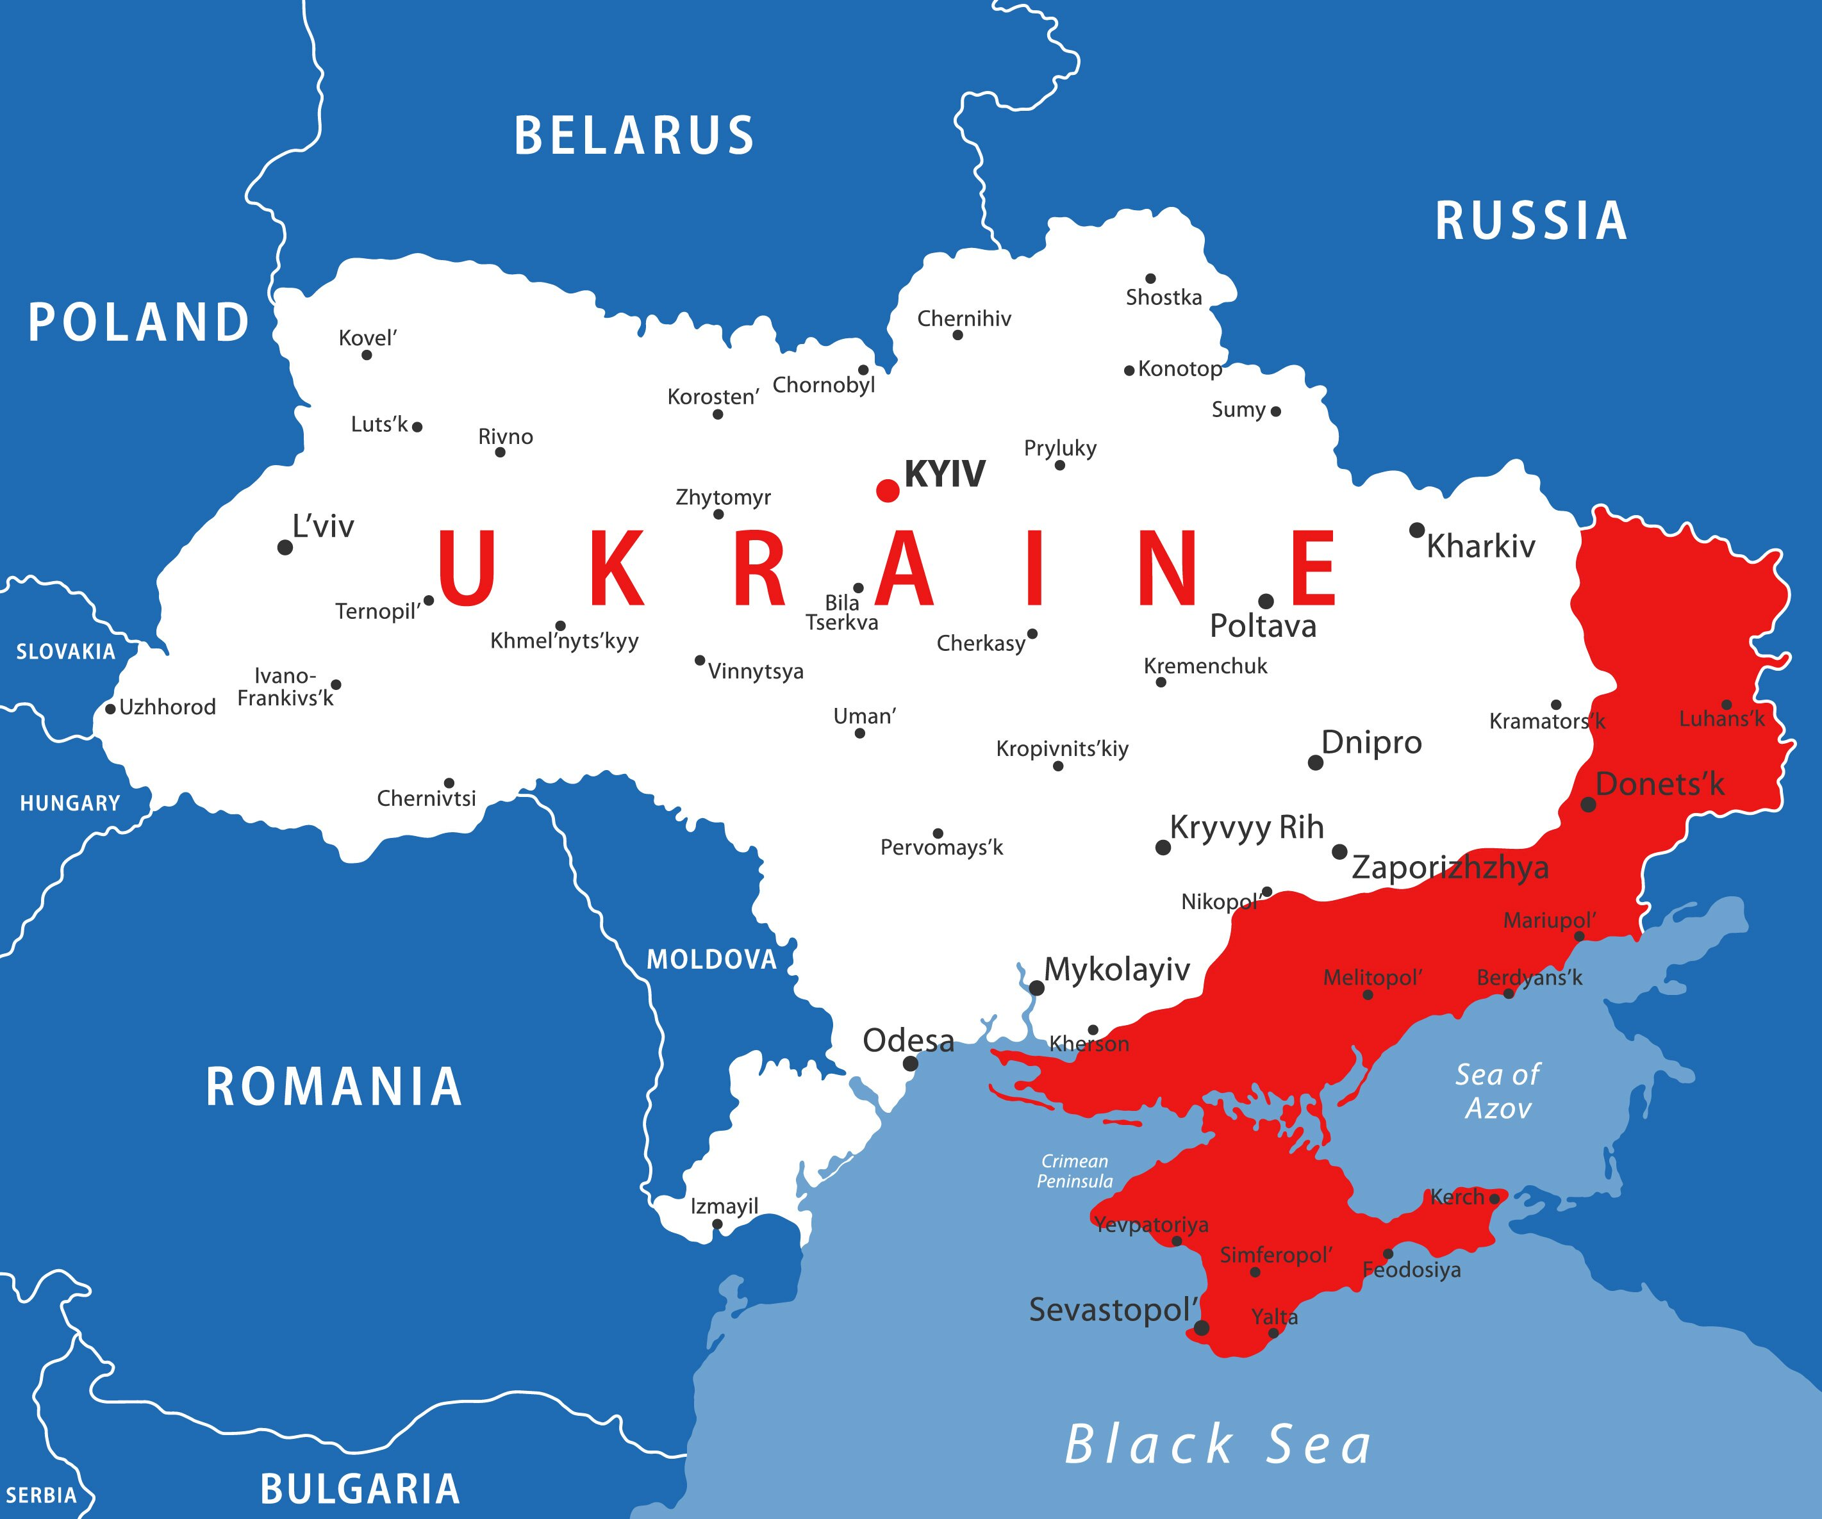


Slide 10
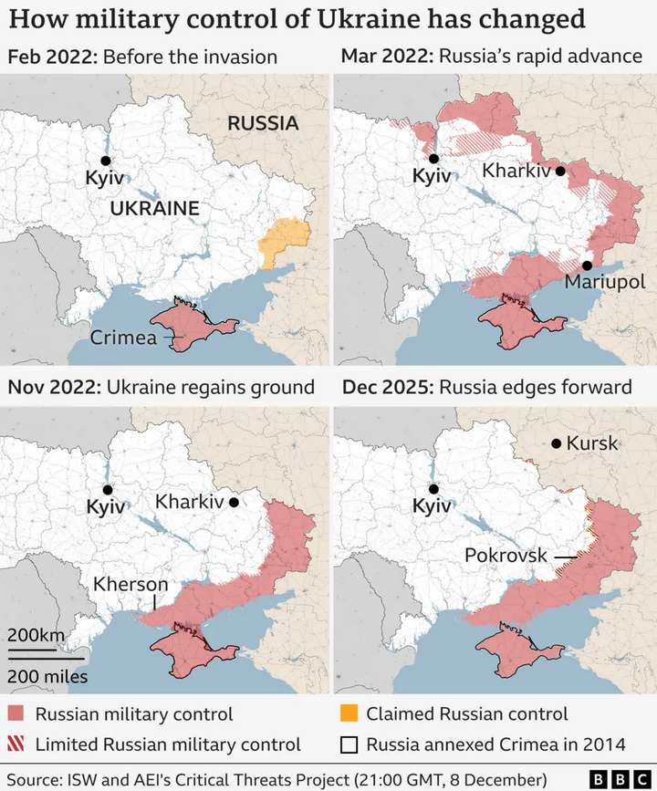

Slide 11
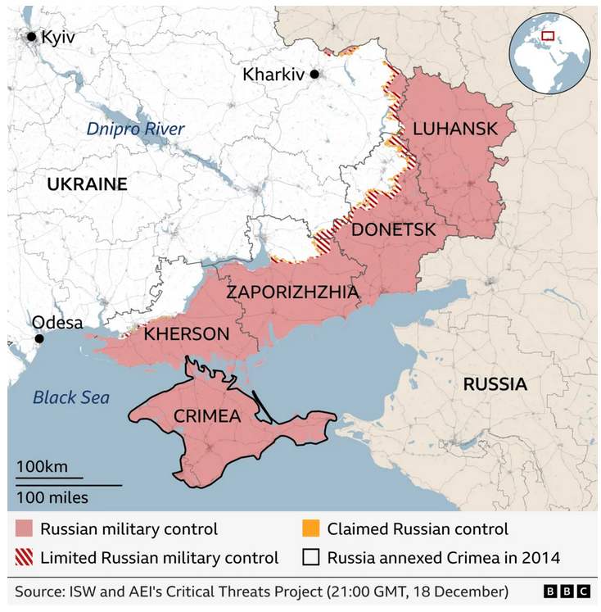

Slide 12
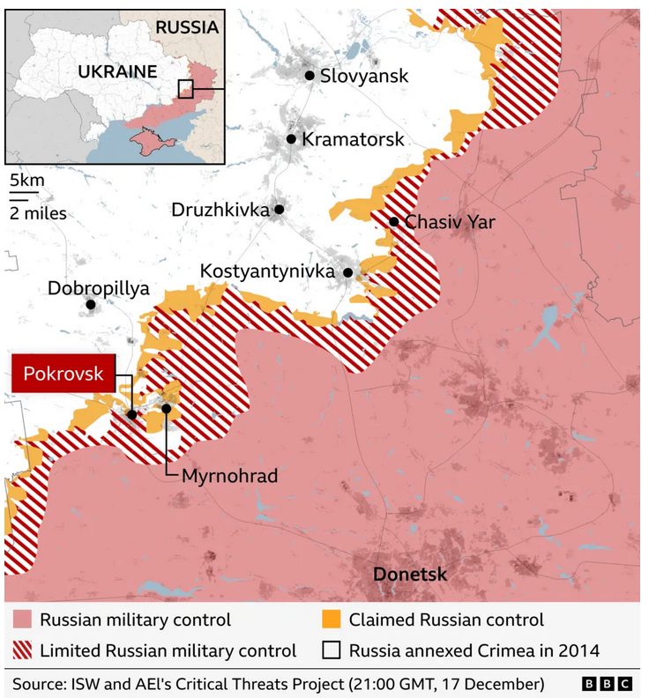

Slide 13

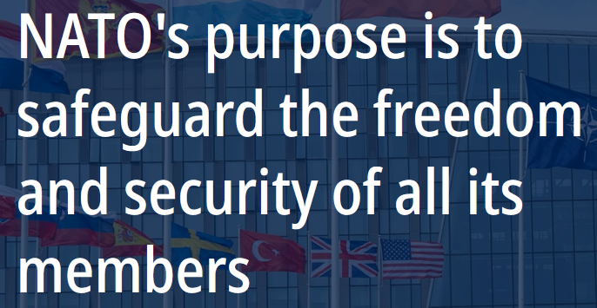
NATO website carousel
1/4

Slide 14
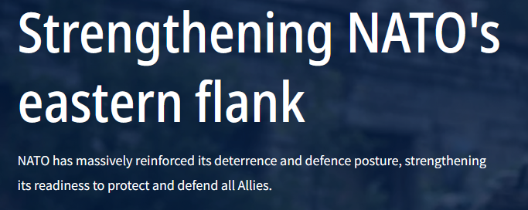
NATO website carousel
2/4

Slide 15
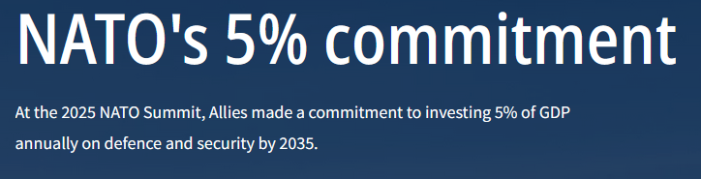
NATO website carousel
3/4

Slide 16
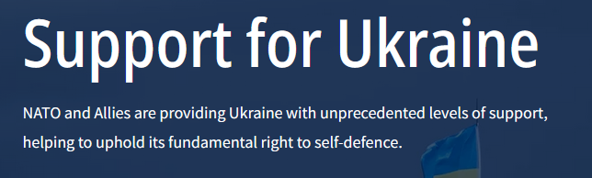
NATO website carousel
4/4

Slide 17
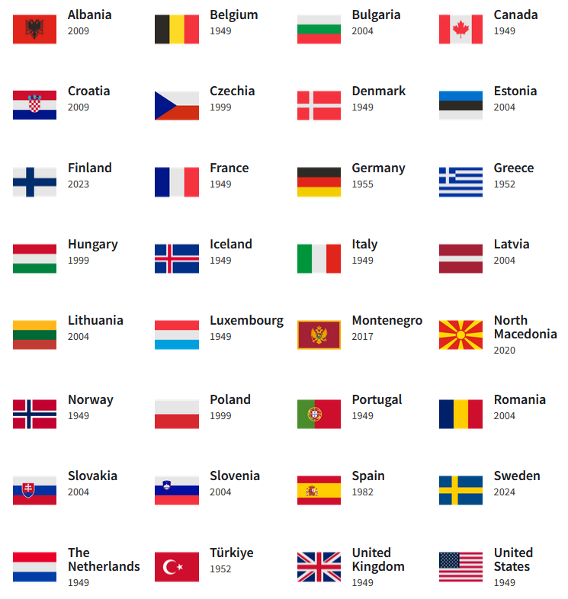
MEMBER COUNTRIES
12 in 1949
32 now
IN LAST 10 YEARS

Slide 18
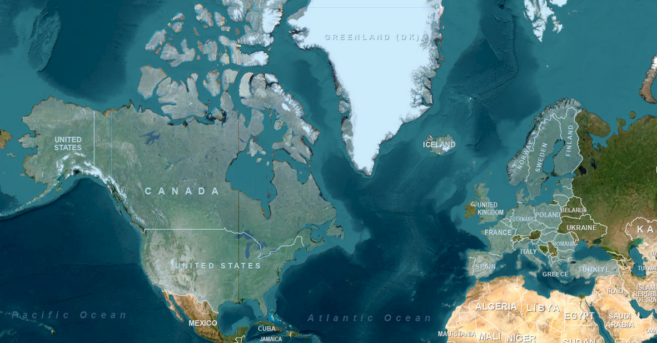
NATO members (in blue)

Slide 19
RUSSIA
NATO members (in blue)

Slide 20
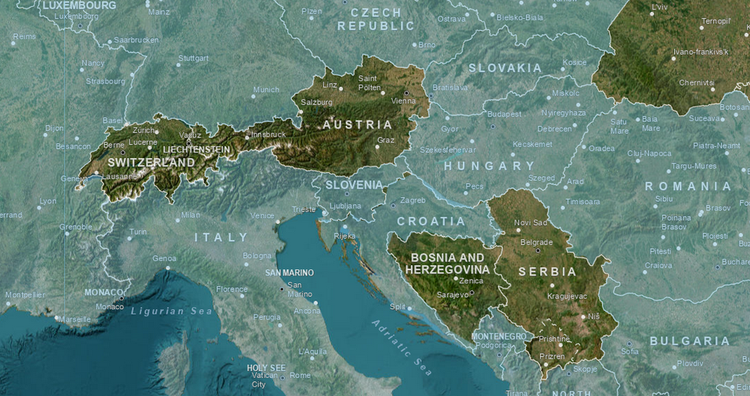
UKRAINE
NATO members (in blue)

Slide 21
What is Russia (or Putin) doing?
What are prospects for the war … and negotiations?
What’s holding back either victory or a settlement?
What does it all mean for NATO?
What’s the U.S. role?
What other policies are driving outcomes?

Slide 22
GUEST SPEAKER
Hunter Stoll
Defense Analyst
RAND

Slide 23
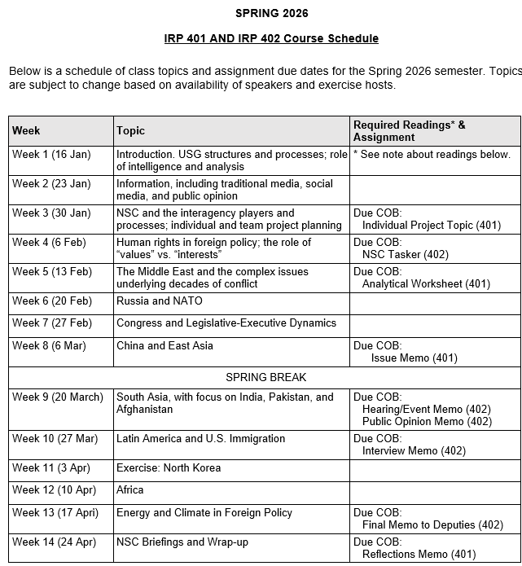
✓
✓
✓
✓
401
✓
✓
✓
✓
✓
✓
✓
✓
402
✓
✓
✓
✓
✓
✓
✓
✓
✓
✓
✓
✓
✓
✓
✓
✓
✓
✓
✓
✓
✓
✓
✓
✓

Slide 24
PROJECT PLANNING
Emmett | Countering “CRINK” Alignment | Danger of one-dimensional energy sector
John | Innovation and Environmental Capacity
Miles | Capitalism and Environment Protection | Climate change and refugees/sovereignty
Kennedy | Taiwan Prosperity and U.S. Interests
Eli | Prediction Markets | Iran-US relations
Michael | Foreign Manipulation of U.S. Elections
Diego | Russian Invasion of Ukraine | Globalization and environmental impact
Molisa | U.S.-China Competition in Critical Technologies
Kaiwen | U.S.-China Economic and Trade Competition | China’s Influence in Africa
Yvette
Bijan | Housing Shortage and its Implications | Humanitarian Crisis in Gaza
Megha | Restrictive U.S. Immigration and Visa Policies
Chancey | Evolving U.S.-ROK Security Framework | North Korea illegal ops to support goals
Filippo | Transatlantic Relations

Slide 25
DISCUSSION
Comfortable?
  Topics
  How partnership will work
The purposes
  Substance, process, skills
The elements
401
  Analysis
  “Memo #2”
402
  Proposal
  Hearing/event
  Public opinion
  Interviews
  DC memo
  Briefing

Slide 26
DISCUSSION
DUE tonight: | Memo proposing 402 project
DUE next Friday: | “Analytical Worksheet” or “Seminar Issue Worksheet” for 401 project

Slide 27
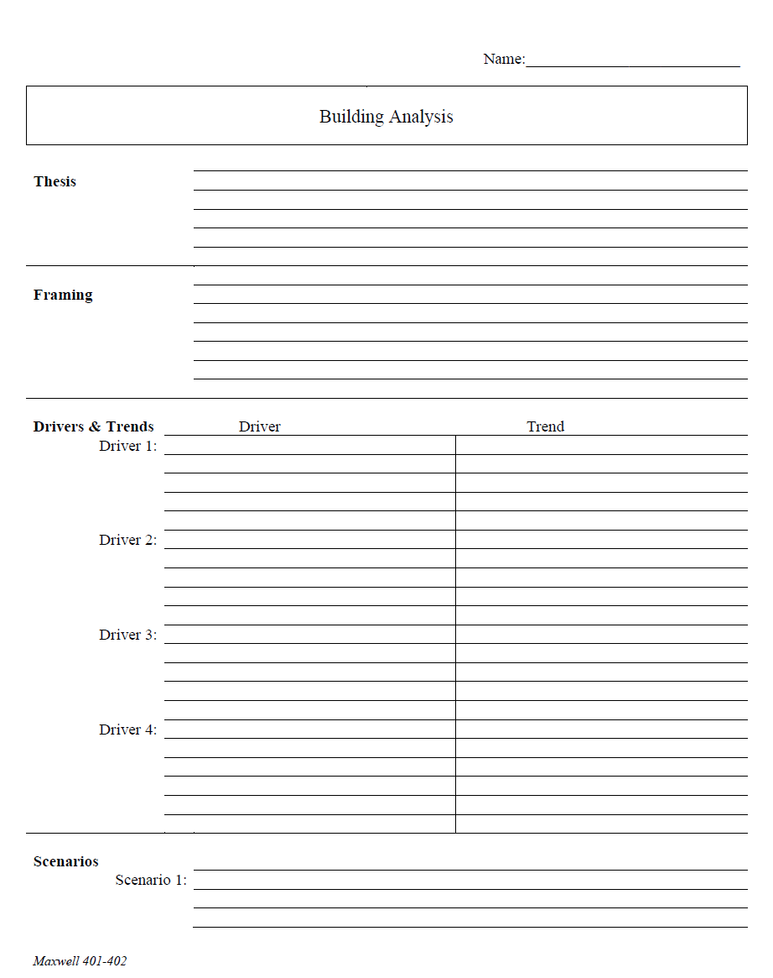
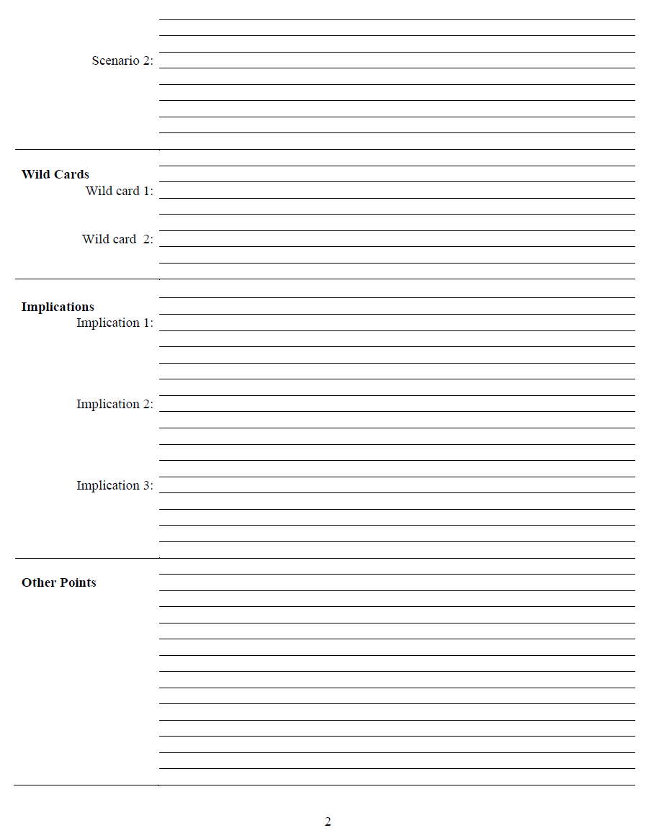
The Analytical Worksheet: One Proven, Effective Way to Build Analysis for Presentation

Slide 28
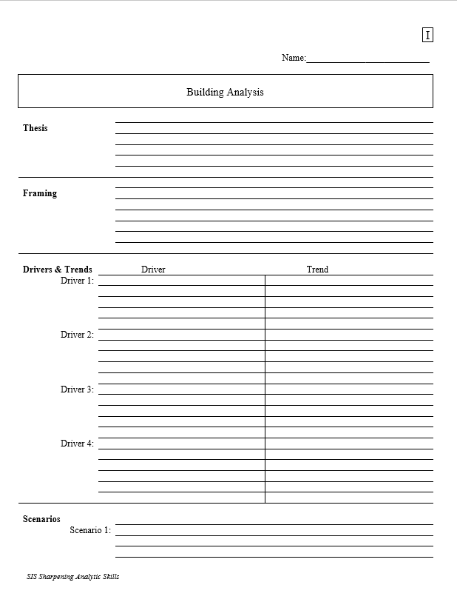
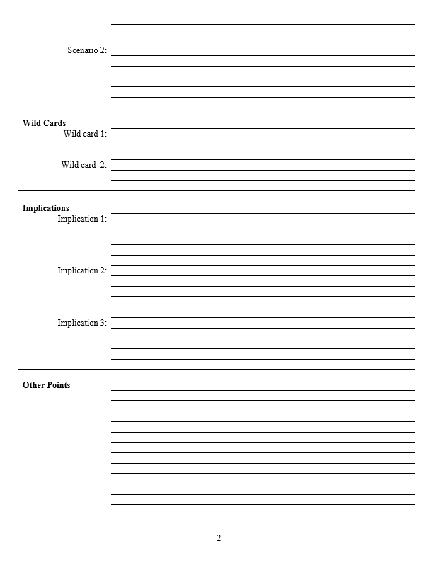
With a thesis sentence at the top, here’s the whole model.
Other Points | Things that don’t fit in rigid structure
 | Give color, texture to analysis
 | Useful in building “narrative” when you write
 | Pet facts, thoughts that you like (and show you care)
Thesis sentence(s): Main conclusion.
            “Bottom Line Up Front.”
            Short, concise summary – including as many elements as needed to tell the whole story.
Framing: The information your decisionmaker needs to get into the story.
Basics
Not “research or encylopedia”

Slide 29
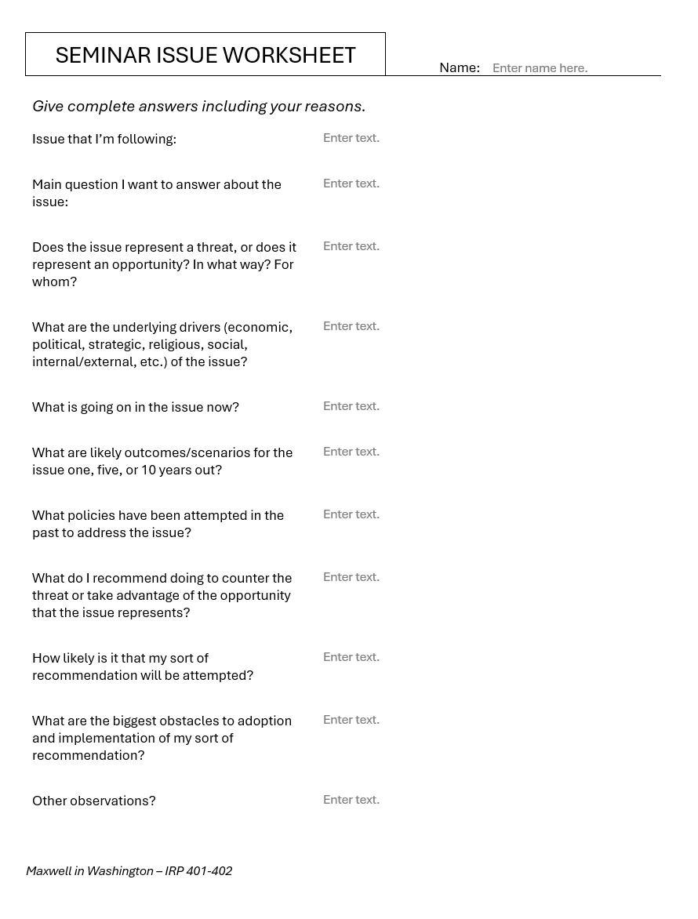
Alternative
Should be two or three pages of text.

Slide 30
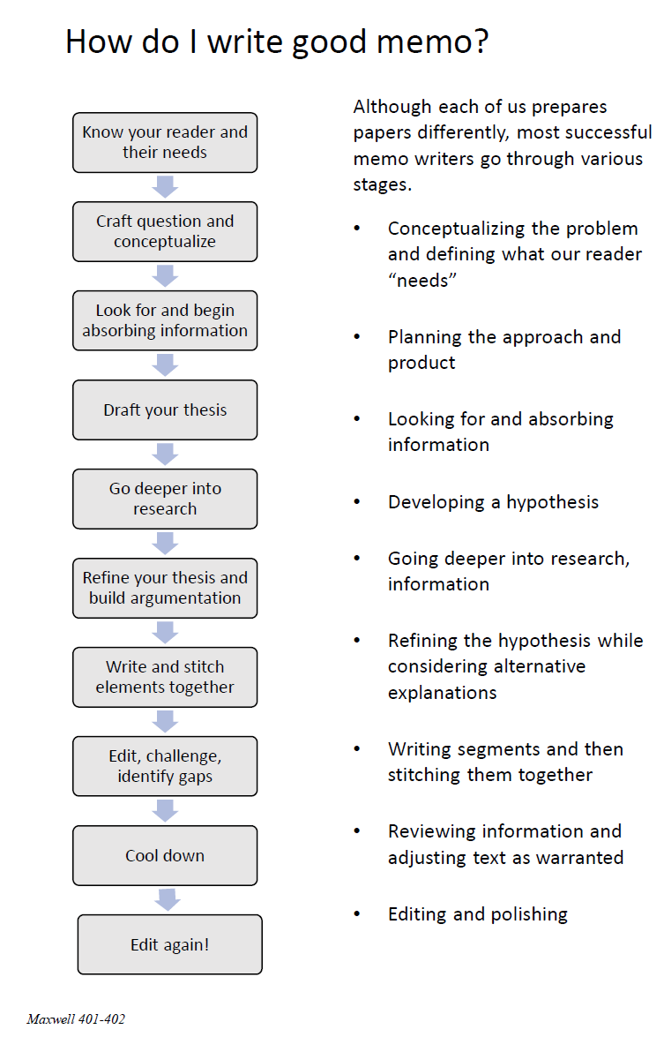
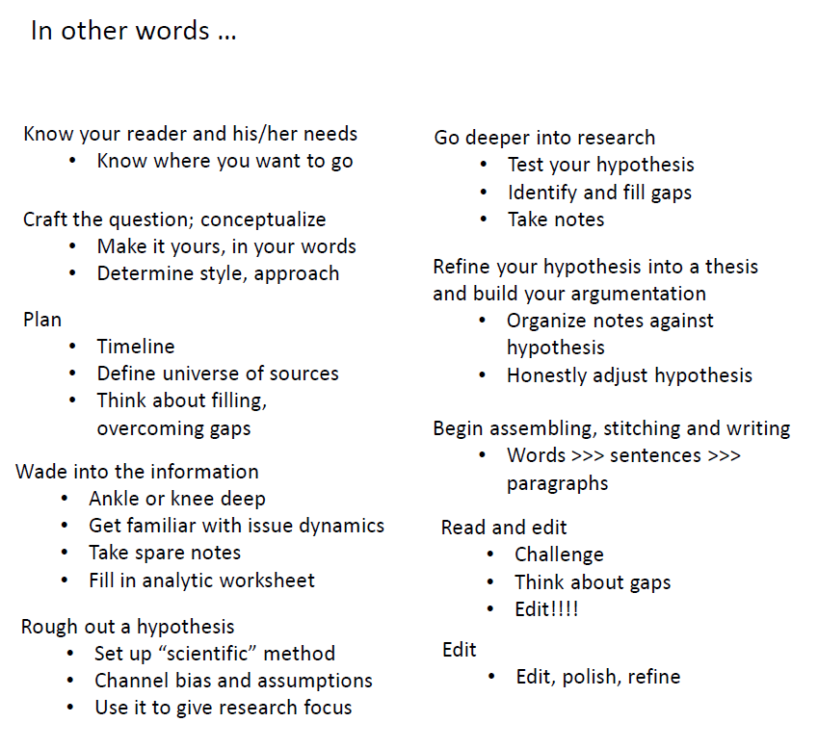
The overall process

Slide 31

QUESTIONS ?

Slide 32
Human Rights in Foreign Policy
  How effectively has the United States promoted human rights?
  Have we achieved a good balance?
  Implications for your 401 and 402 issues

Slide 33
READINGS
The U.S. Reaction to the Holocaust and Other Evil
  https://encyclopedia.ushmm.org/content/en/article/the-united-states-and-the-holocaust
  https://www.theatlantic.com/culture/archive/2022/09/ken-burns-documentary-the-us-and-the-holocaust-review/671455/
Views of the state of human rights.
  https://www.state.gov/reports/2023-country-reports-on-human-rights-practices/
  https://www.hrw.org/world-report/2025
  https://freedomhouse.org/report/nations-transit/2021/antidemocratic-turn
  https://freedomhouse.org/explore-the-map?type=fiw&year=2024
  https://www.amnestyusa.org/issues/
International human rights agreements and organizations
  https://www.ohchr.org/EN/UDHR/Documents/UDHR_Translations/eng.pdf
  https://www.ohchr.org/en/professionalinterest/pages/vienna.aspx
  https://www.ohchr.org/en/professionalinterest/pages/ccpr.aspx

Slide 34
QUESTIONS
Is consistency important?
If so, is it OK to have different policies on h.r. and democracy in China and Saudi Arabia? Or Venezuela and El Salvador? Or Hungary and Türkiye?
Are results important?
If so, why do we continue some policies that don’t seem to work? Moral satisfaction? Domestic politics? (Is that OK?)
How can we know when to intervene?
To what degree should we involve ourselves in other countries’ human rights situations?
How and when should we “engage”?
What principles guide this engagement? Our values? Or our interests? Or an interplay of the two?
In which U.S. policies and regions do you see a consistent emphasis on human rights? In which is the emphasis inconsistent? Does the United States play favorites? Why?

Slide 35

The individual interest … the social interest?

Slide 36
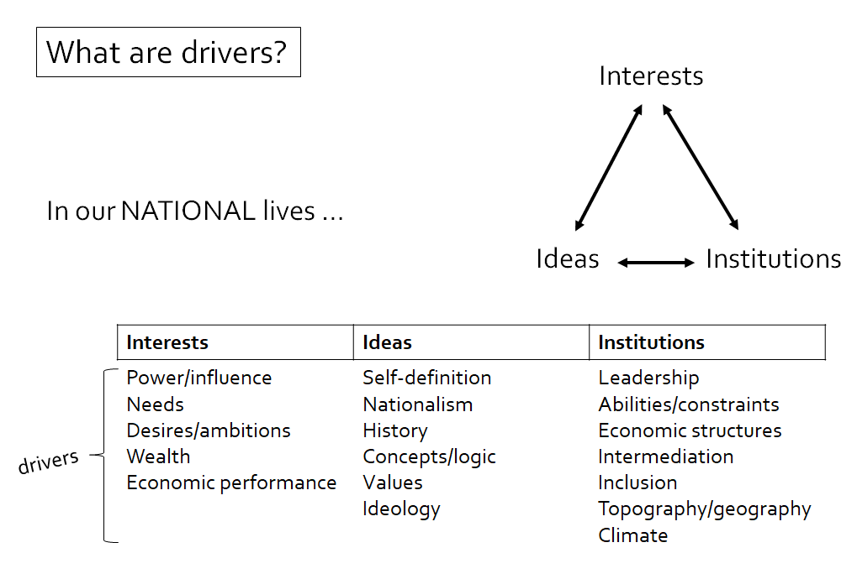
QUESTIONS
Is consistency important?
If so, is it OK to have different policies on h.r. and democracy in China and Saudi Arabia? Or Venezuela and El Salvador? Or Hungary and Türkiye?
Are results important?
If so, why do we continue some policies that don’t seem to work? Moral satisfaction? Domestic politics? (Is that OK?)
How can we know when to intervene?
To what degree should we involve ourselves in other countries’ human rights situations?
How and when should we “engage”?
What principles guide this engagement? Our values? Or our interests? Or an interplay of the two?
In which U.S. policies and regions do you see a consistent emphasis on human rights? In which is the emphasis inconsistent? Does the United States play favorites? Why?

Slide 37
QUESTIONS
Is consistency important?
If so, is it OK to have different policies on h.r. and democracy in China and Saudi Arabia? Or Venezuela and El Salvador? Or Hungary and Türkiye?
Are results important?
If so, why do we continue some policies that don’t seem to work? Moral satisfaction? Domestic politics? (Is that OK?)
How can we know when to intervene?
To what degree should we involve ourselves in other countries’ human rights situations?
How and when should we “engage”?
What principles guide this engagement? Our values? Or our interests? Or an interplay of the two?
In which U.S. policies and regions do you see a consistent emphasis on human rights? In which is the emphasis inconsistent? Does the United States play favorites? Why?

Slide 38
TO DISCUSS LATER
Military intervention (in defense of human rights or democracy) is in our national interest when ___________.
Non-military intervention (sanctions, threats, etc.) is in our national interest when _____________.
We should give _________ priority to applying our values of democracy and human rights consistently?
When a friend or ally violates human rights or other democratic norms, we
should _________.
When we (the United States) stray from the norms that we espouse, we
should _______.

Slide 39
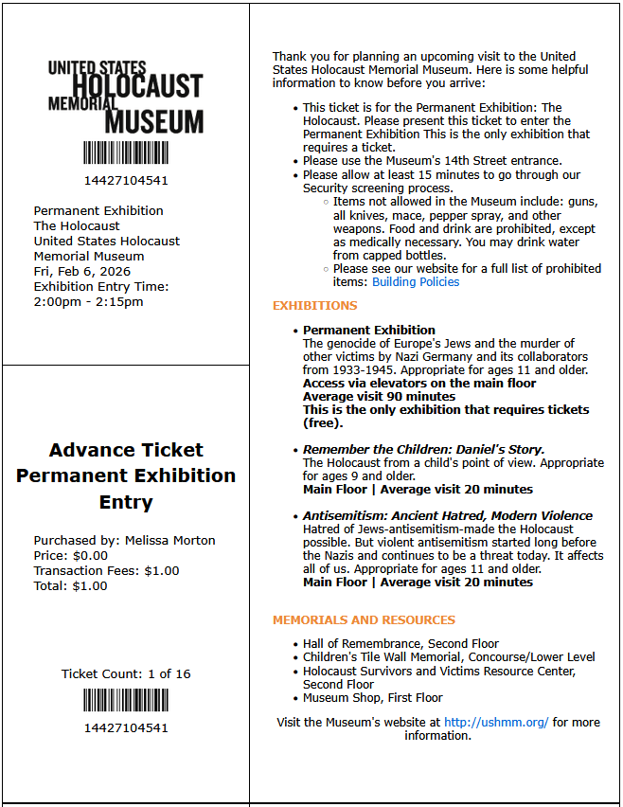


Slide 40
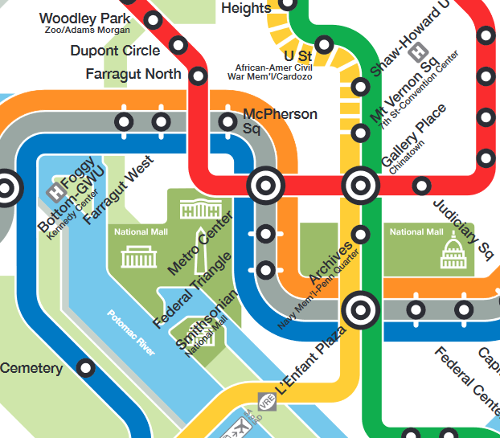


RED LINE (→Glenmont)
from Dupont Circle to Metro Center
then
ORANGE (→New Carrollton) or
BLUE (→ Largo) or SILVER (→ Largo)
from Metro Center to Smithsonian

Slide 41
TODAY’S AGENDA
9:00 | Skills Discussion – Networking and Building the Elevator Pitch Samantha Clemence
10:00 | Class Discussion and Quiz Readings
10:30 | Guest Speaker: Hunter Stoll – Russia, Ukraine, NATO Defense Analyst, RAND - Introduced by Eli
12:30 | Lunch and Metro to Smithsonian Station and Holocaust Museum
1:55 | Meet at Museum Entrance (14th Street)
2:00 | Enter Museum as group
~3:30 | Wrapup and depart from Museum

Slide 42
Global Policy Seminar and NSC Simulation
IRP 401 - IRP 402
Week Four
06 February 2026
Prof. Fulton T. Armstrong

Slide 43

LUNCH

Slide 44
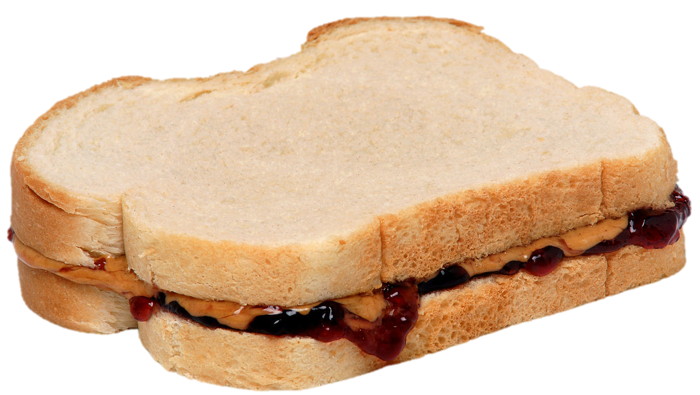
LUNCH

Slide 45

WRAPUP

