Slide 1

Global Policy Seminar and NSC Simulation
IRP 401 - IRP 402
Week Three
30 January 2026
Prof. Fulton T. Armstrong

Slide 2
Week 1 (16 Jan)
Week 2 (23 Jan)
Week 3 (30 Jan)
Week 4 (6 Feb)
Week 5 (13 Feb)
Week 6 (20 Feb)
Week 7 (27 Feb)
Week 8 (6 Mar)
Spring Break
Week 9 (20 March)
Week 10 (27 Mar)
Week 11 (3 Apr)
Week 12 (10 Apr)
Week 13 (17 Apri)
Week 14 (24 Apr)
Spring 2026

Slide 3
TODAY’S AGENDA
9:00 | Skills session – Word Processing Formats, Tips and Tricks
10:00 | Guest Speaker: Siobhan Sheils: “Washington Policymaking and Processes” Chief People Officer, The Cohen Group - Introduced by Kennedy
11:30 | Guest Speaker: Yasmeen Alamiri, Former Senior Editor for video and special projects, PBS News Hour - Introduced by Emmett
12:45 | Lunch and Metro to National Press Building
2:25 | Meet in lobby of National Press Building
2:30 | Guest Speaker: Jerry Zremski, U of Maryland and Buffalo News - Introduced by Bijan
~3:30 | Wrapup and depart from National Press Club

Slide 4
TODAY’S AGENDA
9:00 | Skills session – Word Processing Formats, Tips and Tricks
10:00 | Guest Speaker: Siobhan Sheils: “Washington Policymaking and Processes” Chief People Officer, The Cohen Group - Introduced by Kennedy
11:30 | Guest Speaker: Yasmeen Alamiri, Former Senior Editor for video and special projects, PBS News Hour - Introduced by Emmett
12:45 | Lunch and Metro to National Press Building
2:25 | Meet in lobby of National Press Building
2:30 | Guest Speaker: Jerry Zremski, U of Maryland and Buffalo News - Introduced by Bijan
~3:30 | Wrapup and depart from National Press Club

Slide 5
PROJECT PLANNING
Emmett | Countering “CRINK” alignment | Danger of one-dimensional energy sector
John
Miles | Capitalism and environment protection | Climate change and refugees/sovereignty
Kennedy
Eli | Prediction markets | Iran-US relations
Michael
Diego |  | Globalization and environmental impact
Molisa
Kaiwen | U.S.-China economic and trade competition | China’s Influence in Africa
Yvette
Bijan | Housing shortage and its implications | Humanitarian Crisis in Gaza
Megha
Chancey | U.S.-ROK relations (pending more info) | North Korea (pending more)
Filippo

Slide 6
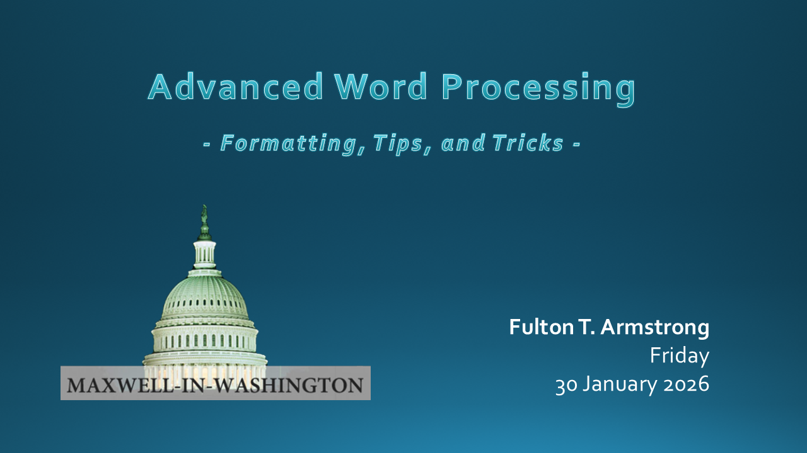
Professional Skills

Slide 7
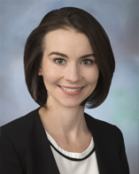
GUEST SPEAKER
Siobhan Sheils
Associate Vice President with The Cohen Group
2015-2017 | - NSC Director for Central America and the Caribbean - Reestablishment of US-Cuba ties
Prior | - Special Assistant to two Deputy Secretaries of State and the Under Secretary of State for Political Affairs
 | - Desk Officer for Guatemala; resolve CAFTA trade dispute
 | - Bureau of Human Resources and Staff Assistant in the Bureau of Western Hemisphere Affairs
 | - Superior honor award and four meritorious honor awards
Teach for America | Taught eighth grade English for four years in the South Bronx and Newark, New Jersey
Higher Education | Master’s of International Relations and Master’s in Public Relations, Syracuse University
 | Bachelor’s, Boston College

Slide 8
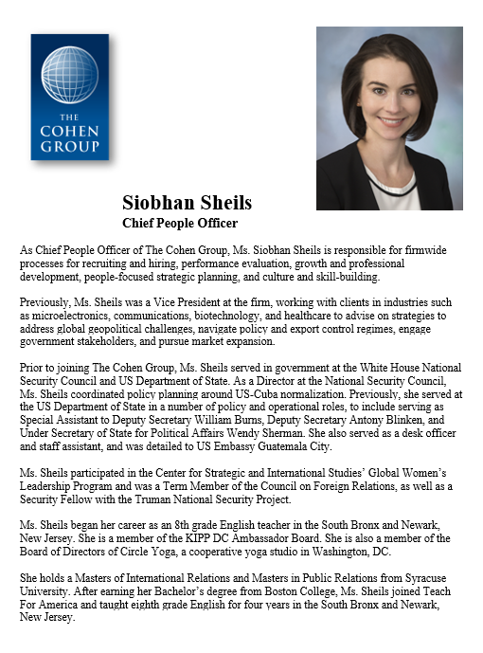
GUEST SPEAKER
Introduced by Kennedy

Slide 9
BREAK

Slide 10
GUEST SPEAKERS
Yasmeen Alamiri
and
Jerry Zremski
What does the media-policy dynamic look like from their perch?
What’s happening in the news industry?
What’s it like to be a journalist?

Slide 11
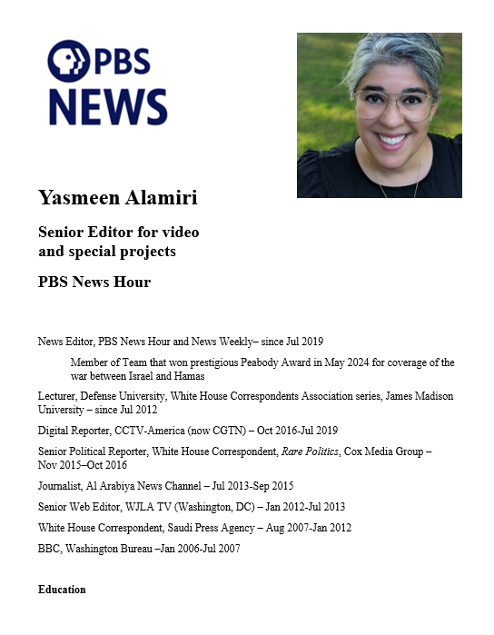
GUEST SPEAKER
Yasmeen Alamiri
- introduced by Emmett

Slide 12
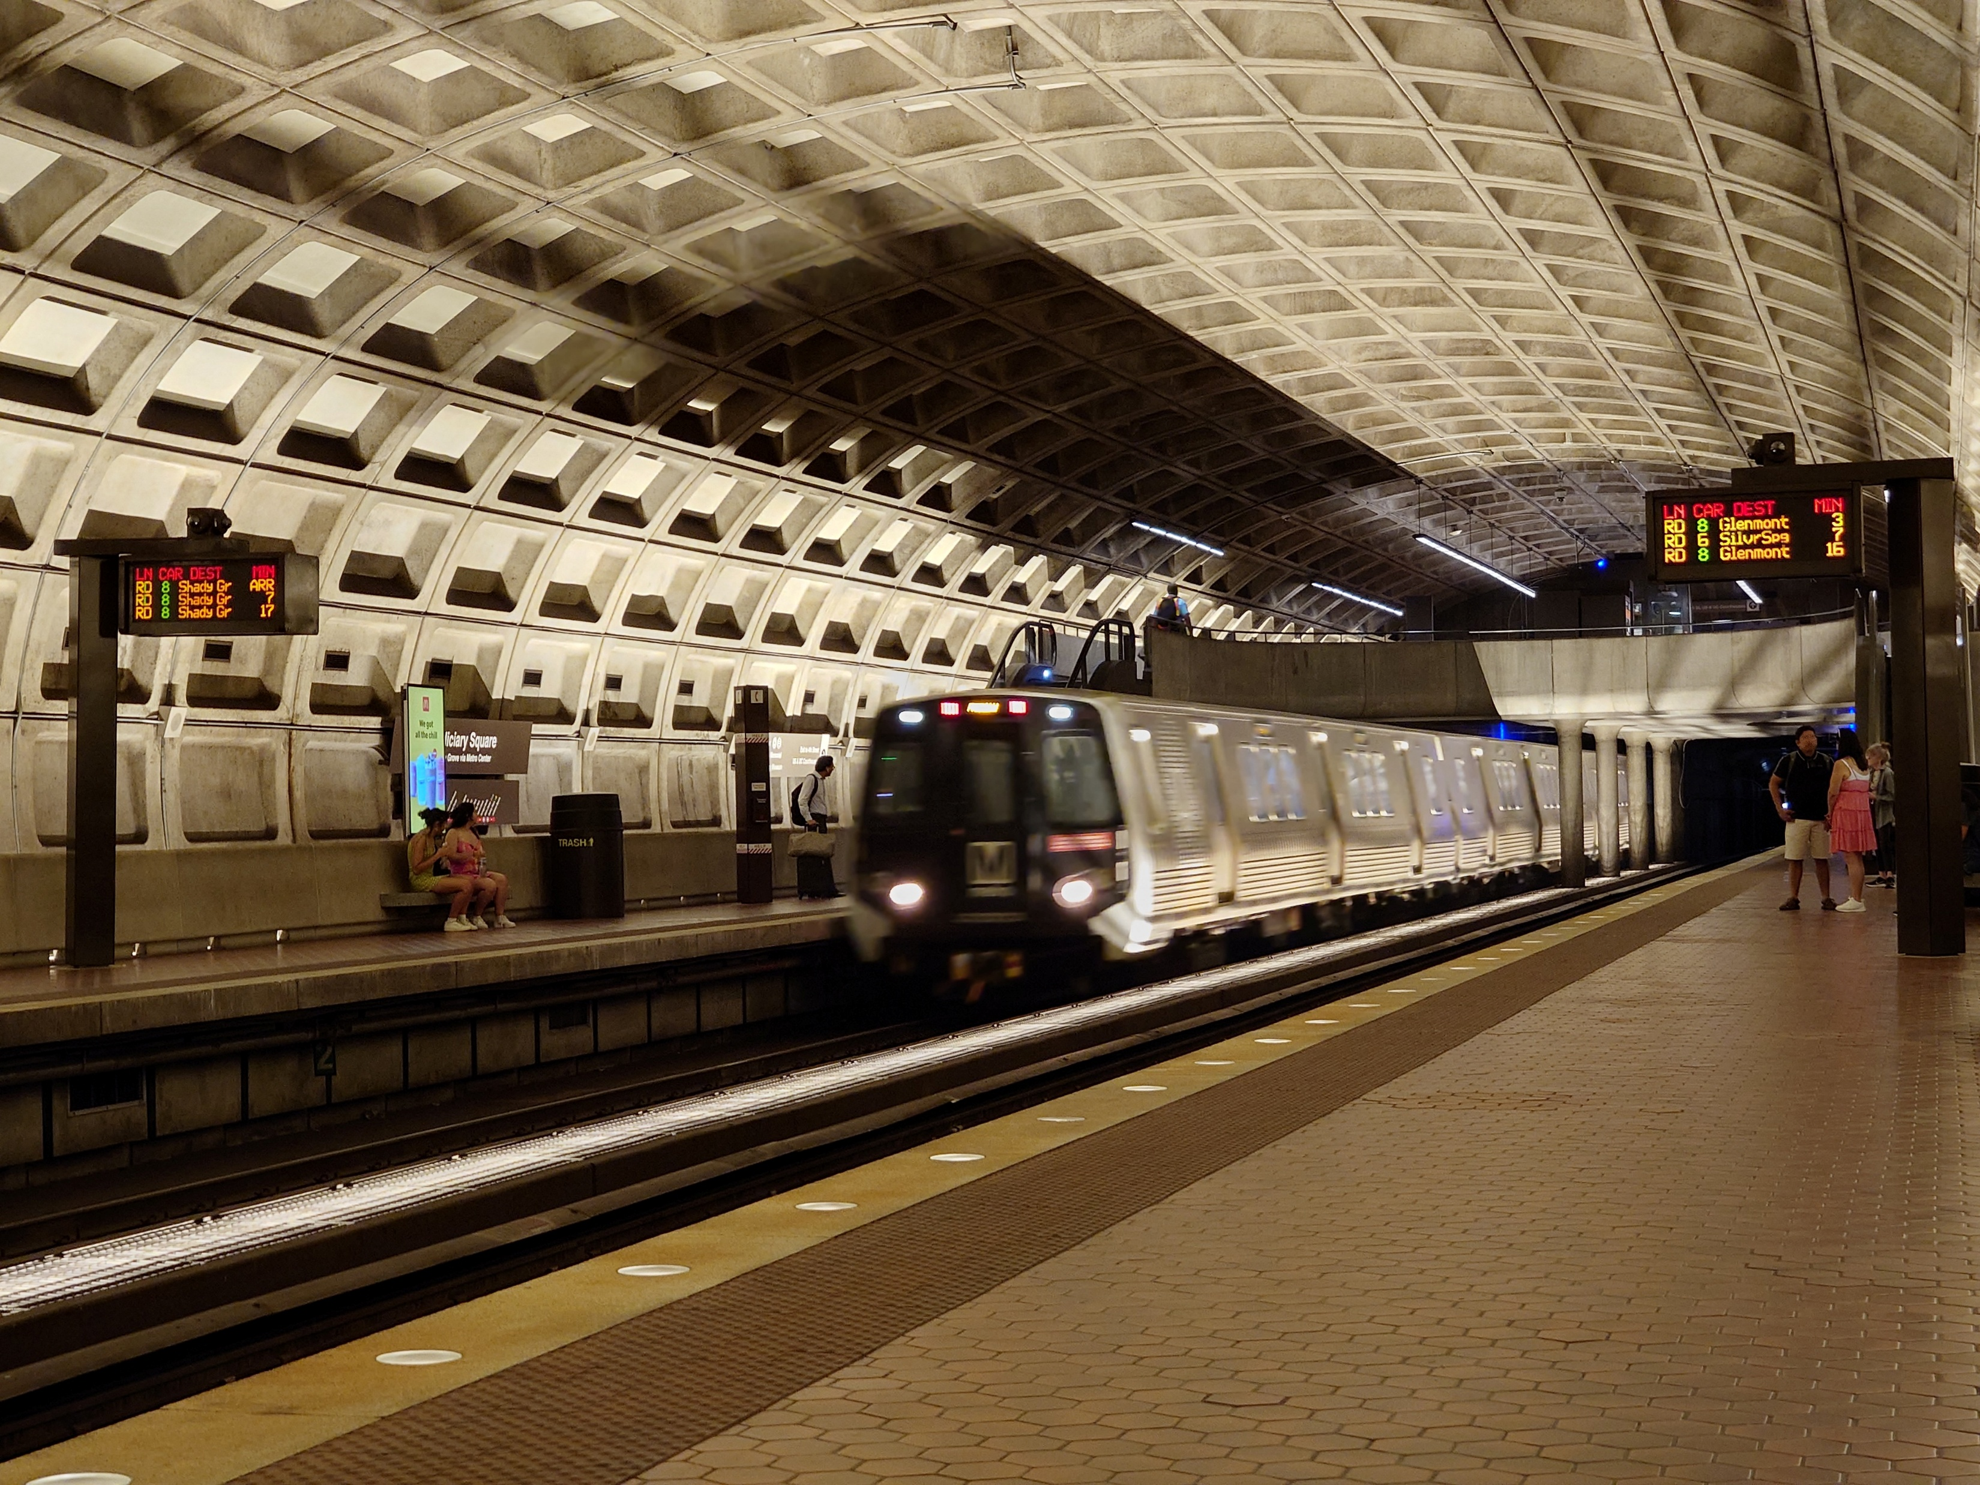
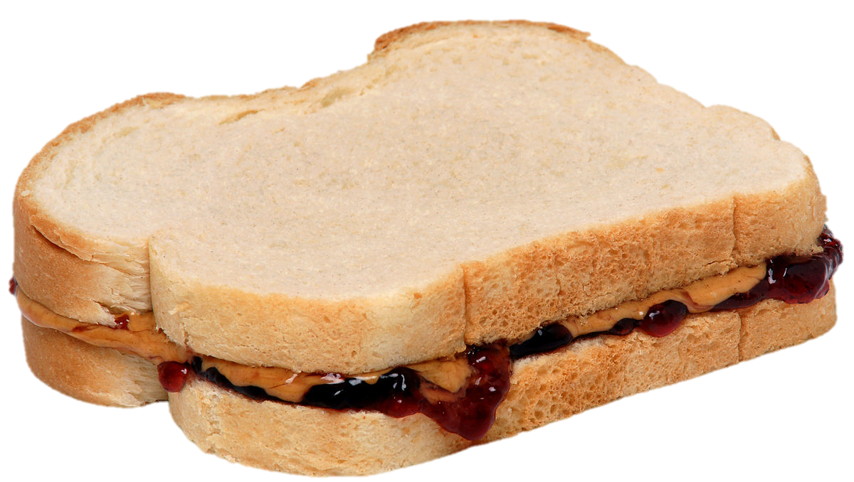
LUNCH and METRO to
Metro Center and National Press Club

Slide 13
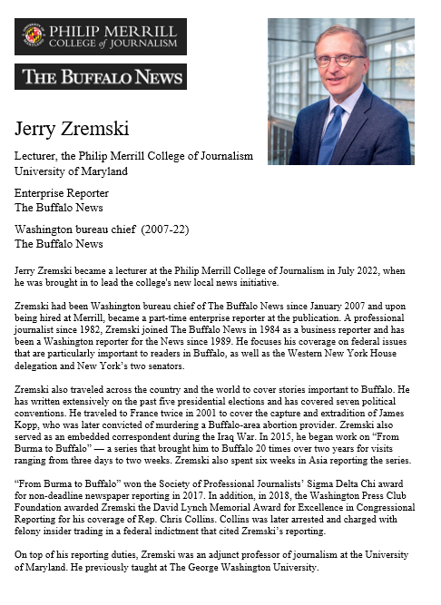
GUEST SPEAKER
Jerry Zremski
University of Maryland
Merrill College of Journalism
The Buffalo News
- Introduced by Bijan

Slide 14

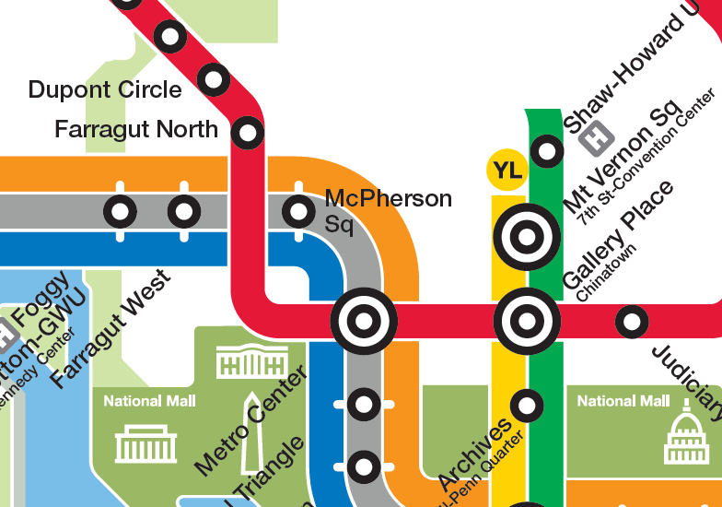
National Press Club
529 14th Street NW
Enter on 14th Street
Meet in lobby (downstairs) at 2:25
RED LINE (→Glenmont)
from Dupont Circle to Metro Center

Slide 15
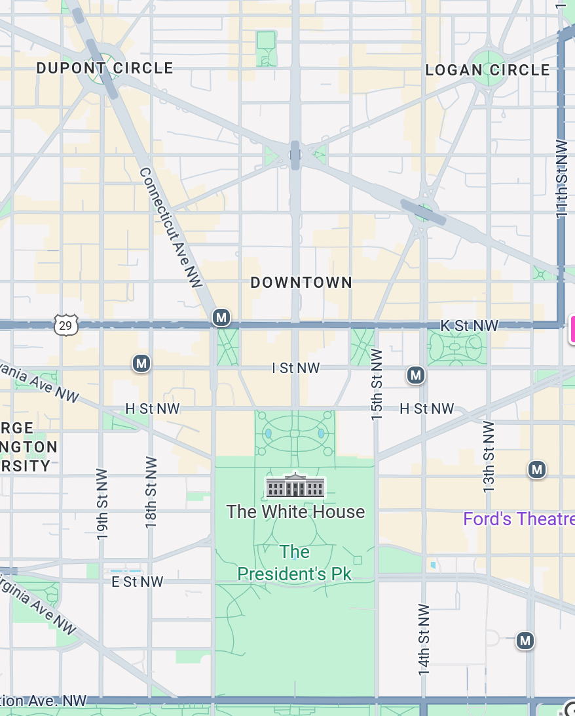
National Press Club
529 14th Street NW
Meet in 14th Street lobby (downstairs) at 2:25
METRO: RED LINE
METRO
CENTER
12th and F Street Exit

Slide 16
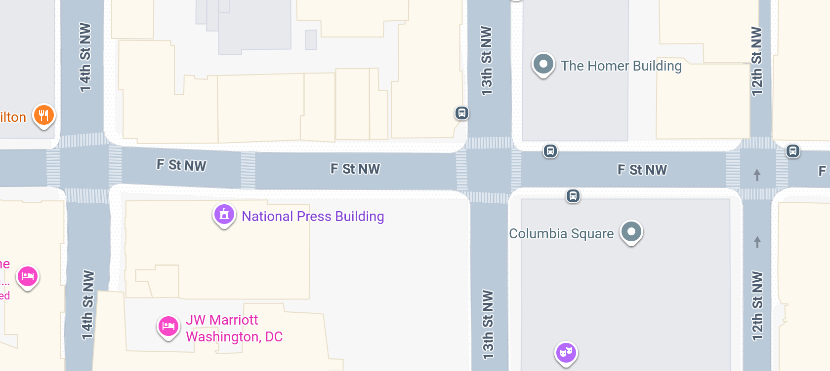



Slide 17

National Press Club
529 14th Street NW
Meet in 14th Street lobby (downstairs) at 2:25
METRO: RED LINE
Walk 1.3 miles
METRO
CENTER

Slide 18

LUNCH

Slide 19
LUNCH

Slide 20
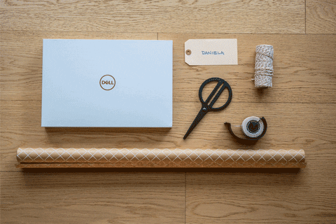
WRAPUP

Slide 21
TODAY’S AGENDA
9:00 | Skills session – Word Processing Formats, Tips and Tricks
10:00 | Guest Speaker: Siobhan Sheils: “Washington Policymaking and Processes” Chief People Officer, The Cohen Group - Introduced by Kennedy
11:30 | Guest Speaker: Yasmeen Alamiri, Former Senior Editor for video and special projects, PBS News Hour - Introduced by Emmett
12:45 | Lunch and Metro to National Press Building
2:25 | Meet in lobby of National Press Building
2:30 | Guest Speaker: Jerry Zremski, U of Maryland and Buffalo News - Introduced by Bijan
~3:30 | Wrapup and depart from National Press Club

Slide 22
Global Policy Seminar and NSC Simulation
IRP 401 - IRP 402
Week Three
30 January 2026
Prof. Fulton T. Armstrong

