Slide 1

Global Policy Seminar and NSC Simulation
IRP 401 - IRP 402
Week Three 12 September 2025
Prof. Fulton T. Armstrong

Slide 2
Week 1 (29 Aug)
Week 2 (5 Sep)
Week 3 (12 Sep)
Week 4 (19 Sep)
Week 5 (26 Sep)
Week 6 (3 Oct)
Week 7 (10 Oct)
Week 8 (17 Oct)
Week 9 (24 Oct)
Week 10 (31 Oct )
Week 11 (7 Nov)
Week 12 (14 Nov)
Week 13 (21 Nov)
Thanksgiving Break
Week 14 (5 Dec)
Fall 2025

Slide 3
TODAY’S AGENDA
9:00 | Skills – Networking and the Elevator Pitch Deputy Director Samantha Clemence
10:15 | Guest Speaker: Mike Orfini Former Aide to Vice Presidents The Interagency as seen from OVP - introduced by Richard
11:30 | Prep for Customs and Border Patrol conversation
11:45 | Lunch
1:00 | Daniel Githens and Matthew Ashmore Office of the Commissioner, Customs and Border Patrol - self-introduction
2:10 | Depart for Holocaust Museum
2:45 | Holocaust Museum - enter together as group

Slide 4
TODAY’S AGENDA
9:00 | Skills – Networking and the Elevator Pitch Deputy Director Samantha Clemence
10:15 | Guest Speaker: Mike Orfini Former Aide to Vice Presidents The Interagency as seen from OVP - introduced by Richard
11:30 | Prep for Customs and Border Patrol conversation
11:45 | Lunch
1:00 | Daniel Githens and Matthew Ashmore Office of the Commissioner, Customs and Border Patrol - self-introduction
2:10 | Depart for Holocaust Museum
2:45 | Holocaust Museum - enter together as group

Slide 5
PROJECT PLANNING
Maisie | Microplastics | U.S. Declining Birth Rates
Skye | Ending the war in Sudan
Esme | xxxx | U.S. Culture Wars
Camille | Microplastics and PFAS
Erik | Ukraine Innovative Use of Drones | Israeli Use of Lavender AI in Targeting
Richard | Enhancing Cybersecurity
Alex | China’s Increasing Military Strength | Iranian Nationalism
Syarra | Russian Influence in Eastern Europe
Maeve | Israeli Use of AI in Military Strikes in Gaza | U.S. Declining Birth Rates
Kiana | Impact of Federal Spending … or inflation
Mo | Aid to Gaza | Impact of U.S.-China Tariffs
Bobby | U.S. Health Care: High Cost of Prescription Drugs
Gabby | U.S. Culture Wars and How Policy Fuels them | U.S.-Israel Relations After Netanyahu
Katelyn | Russia-Ukraine Negotiations
Sarina | Foreign Disinformation Targets U.S. Elections | Crisis of Legal Immigration Pathways in the U.S.
Priya | China’s Advances in Renewable Energy and EVs

Slide 6
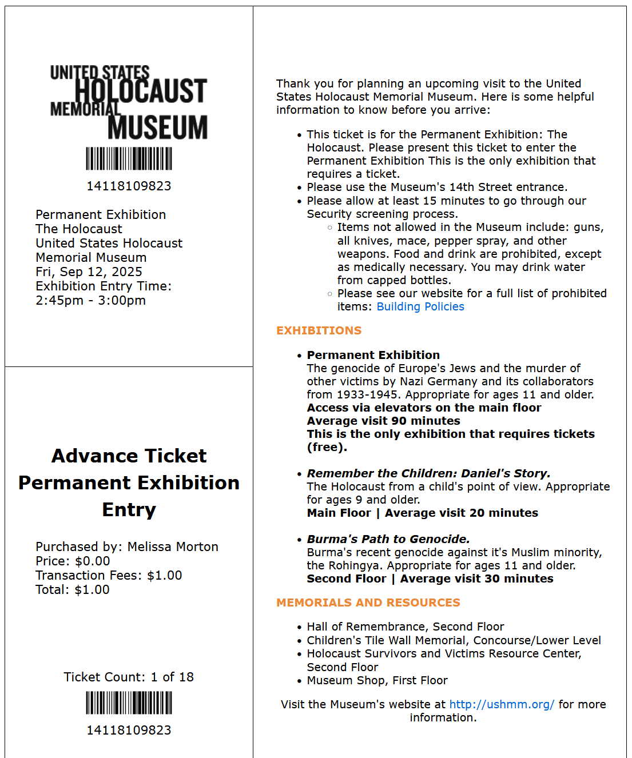


Slide 7
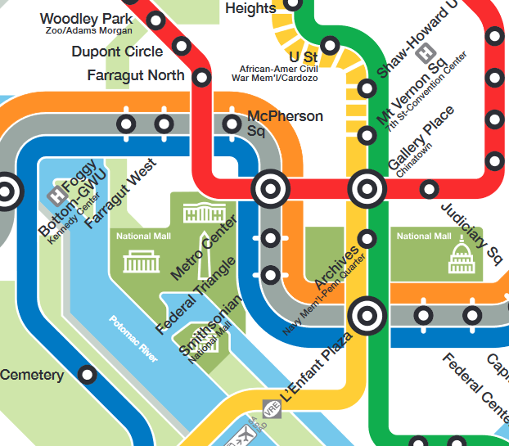

RED LINE (→Glenmont)
from Dupont Circle to Metro Center
then
ORANGE (→New Carrollton) or BLUE (→ Largo) or SILVER (→ Largo)
from Metro Center to Smithsonian

Slide 8
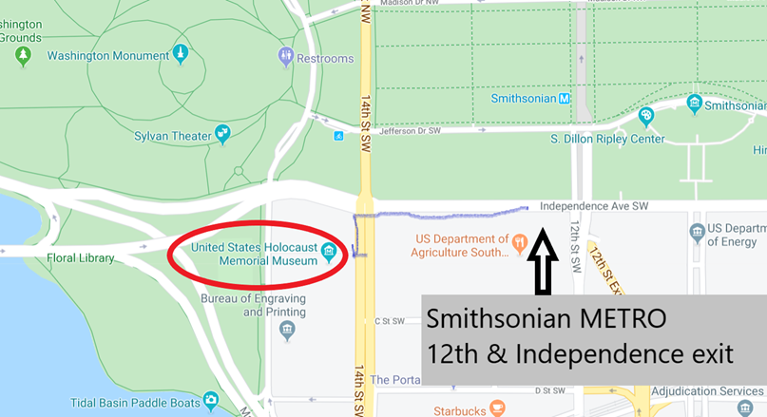

HOLOCAUST MUSEUM

Slide 9
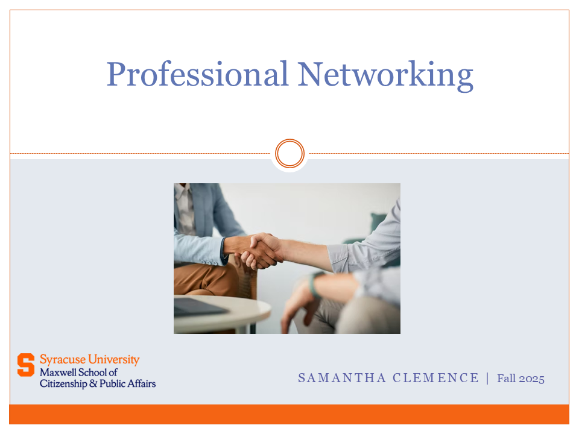

Slide 10
GUEST SPEAKER

Slide 11
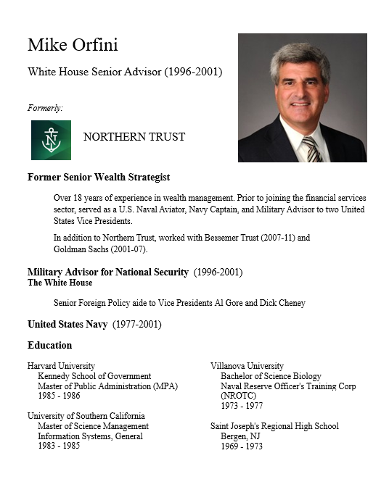
GUEST SPEAKER
Mike Orfini
Former White House Senior Advisor
- Introduced by Richard

Slide 12
U.S. Customs and Border Protection
-CBP Mission and Policies-

Slide 13
Preparing for visit of CBP speakers
Customs and Border Protection
Trade and revenue
Lawful travel
Migration and border security
Countering drug smuggling
HOT ISSUE of the day: Deporting migrants
Few question that immigration has been crisis.
Trump made it centerpiece of his election campaign.
Deportations are “promise made, promise kept.”

Slide 14

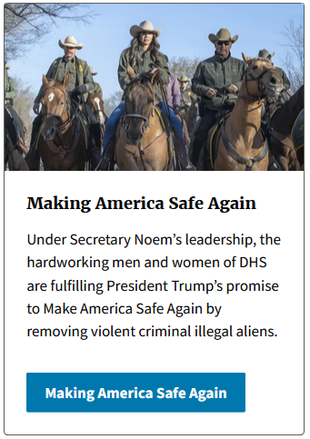
Secretary Kristi Noem

Slide 15
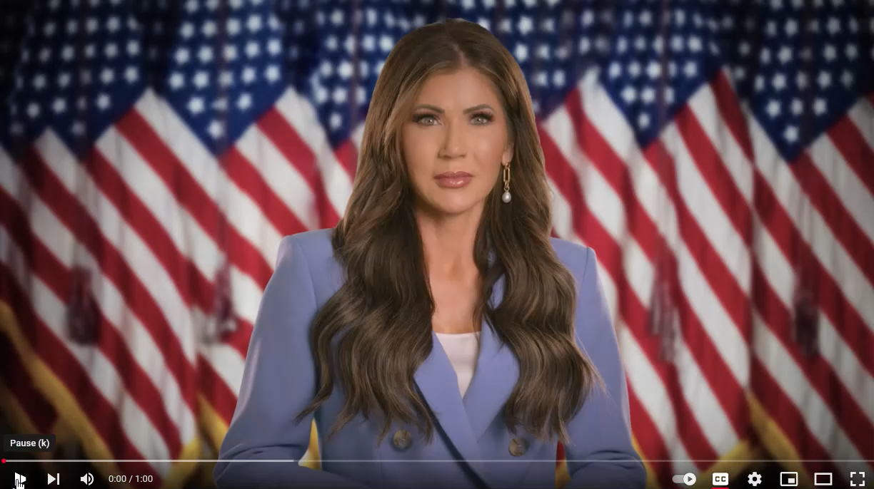
DHS Secretary Kristi Noem

Slide 16
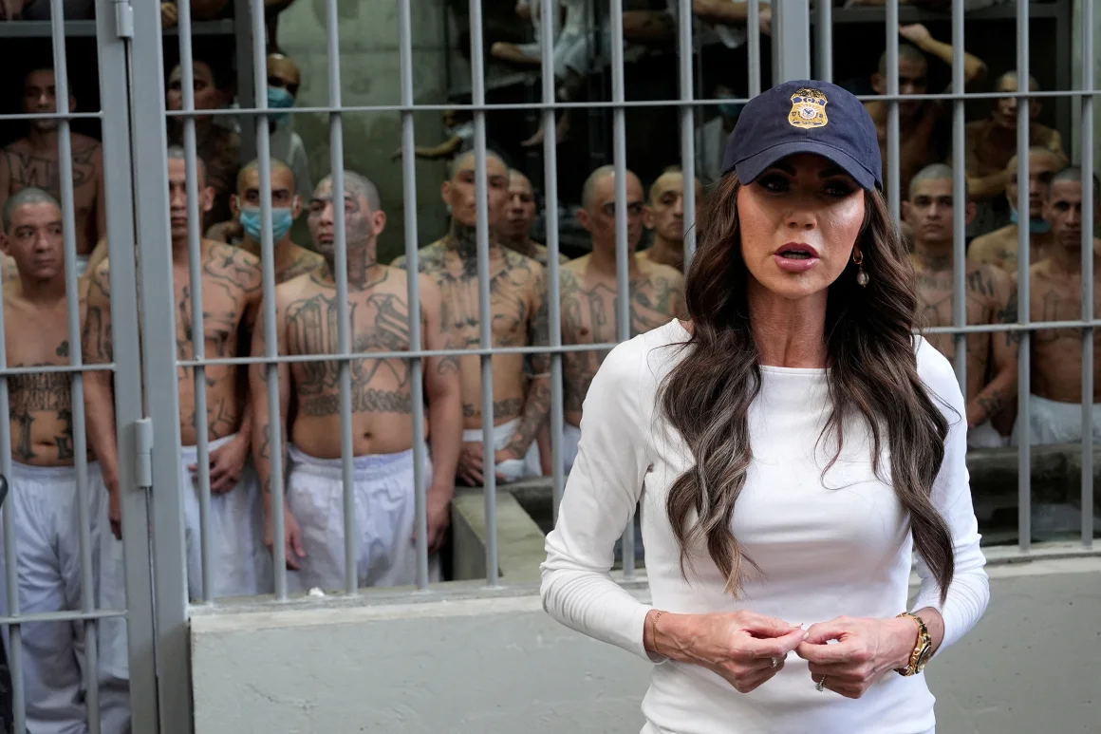
Issuing the same message in front of a cell full of Salvadoran detainees at CECOT on March 26.

Slide 17

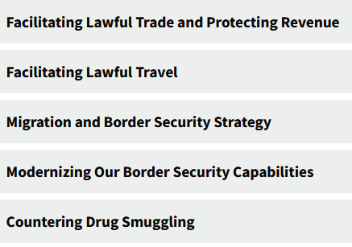
MISSION
With more than 60,000 employees, U.S. Customs and Border Protection, CBP, is one of the world's largest law enforcement organizations and is charged with keeping terrorists and their weapons out of the U.S. while facilitating lawful international travel and trade.
Action areas:

Slide 18
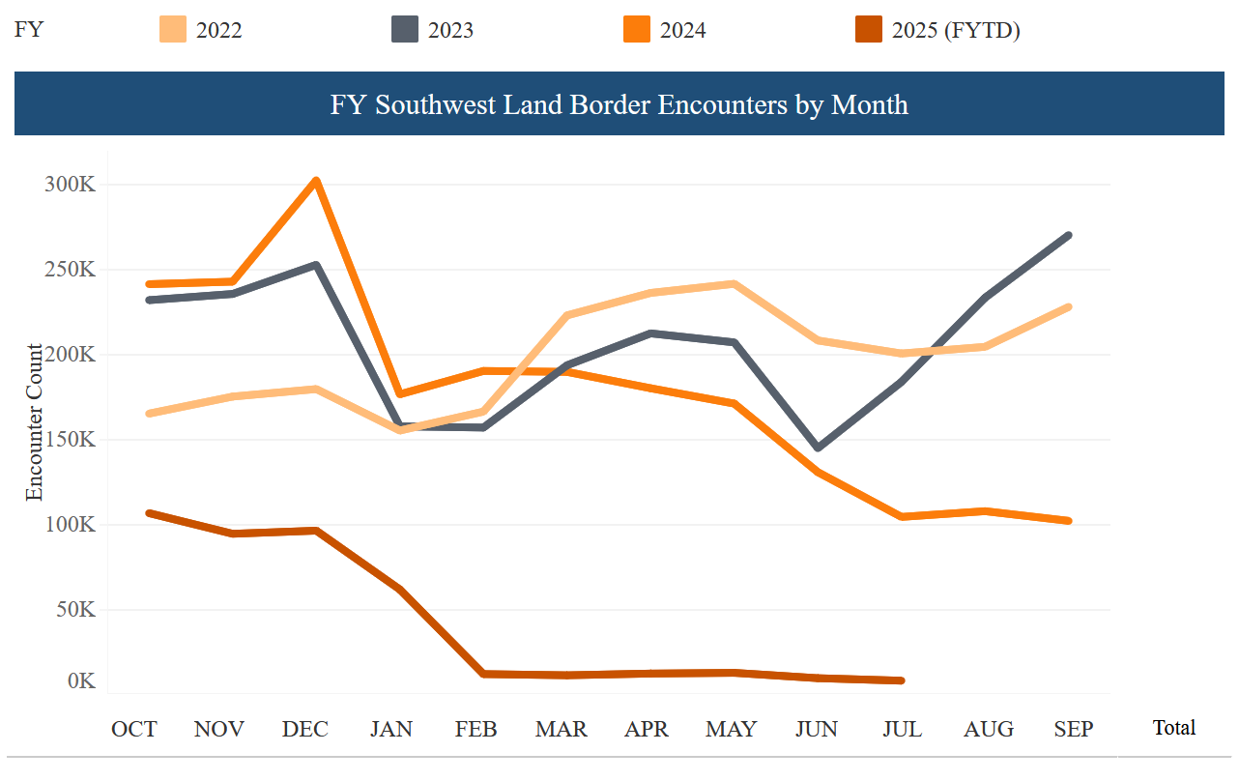
The numbers speak: Encounters Down Drastically
2025
CBP “encounters” on Southwest Border
DHS website

Slide 19
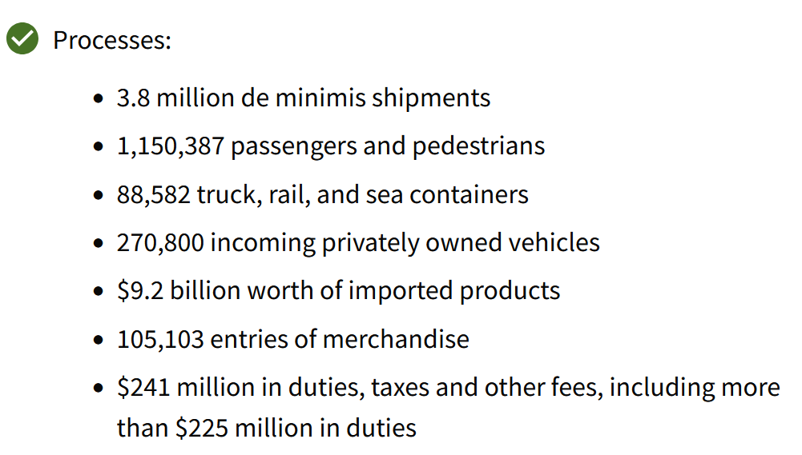
What CBP does
DHS website

Slide 20
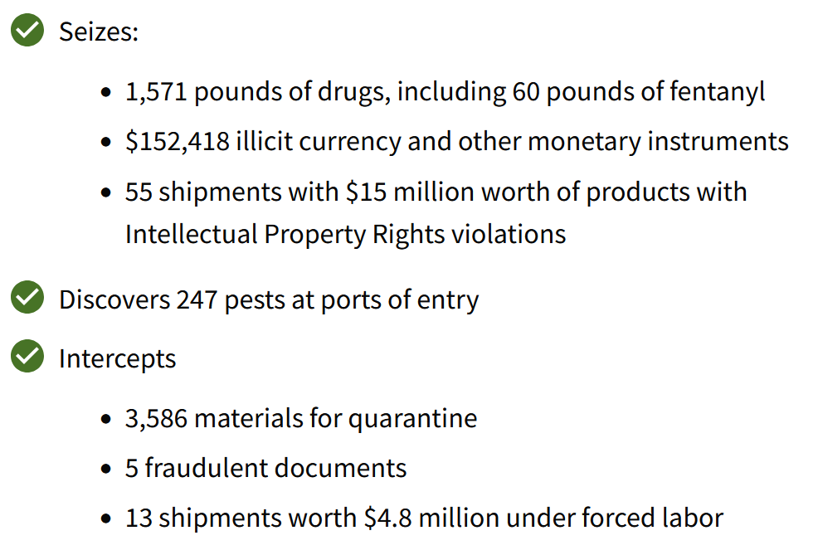
What CBP does
DHS website

Slide 21
Briefers
Daniel GITHENS, Chief of Intergovernmental Affairs and Deputy Chief of Staff
Matthew ASHMORE, Chief of Partnership Development
Remember: They are not ICE.

Slide 22
Briefers
Office of Intergovernmental Public Liaison (IPL)
Timothy QUINN, Executive Director
Matthew ASHMORE, Chief of Partnership Development
ONE OF FOUR IPL BRANCHES:
Partnership Development Liaison
Designated lead for academia, think tanks, new stakeholder relationships, and the associations that represent them.

Slide 23
Briefers
Mission of the Office of Intergovernmental Public Liaison (IPL)
Advising the Commissioner, Deputy Commissioner, and program offices on the impact U.S. Customs & Border Protection’s (CBP) mission, policies, and initiatives have on key stakeholders (i.e., state, local, tribal, and territorial governments, law enforcement; the national associations representing them; non-governmental organizations; and the public), and
Serving as CBP's principal liaison to these key stakeholders.

Slide 24

Overview
With more than 60,000 employees, U.S. Customs and Border Protection, CBP, is one of the world's largest law enforcement organizations and is charged with keeping terrorists and their weapons out of the U.S. while facilitating lawful international travel and trade.

Slide 25
Overview
As the United States’ first unified border entity, CBP takes a comprehensive approach to border management and control, combining
customs,
immigration,
border security, and
agricultural protection
into one coordinated and supportive activity.

Slide 26
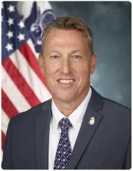
Overview
CPB enforces laws and implements policies.
It may advise, but not make, policy.
Randy S. Scott,
Commissioner

Slide 27
Overview
Interesting bits:
CBP has officers (like law enforcement), not agents (like specialized investigators).
They are civilian employees of the government

Slide 28
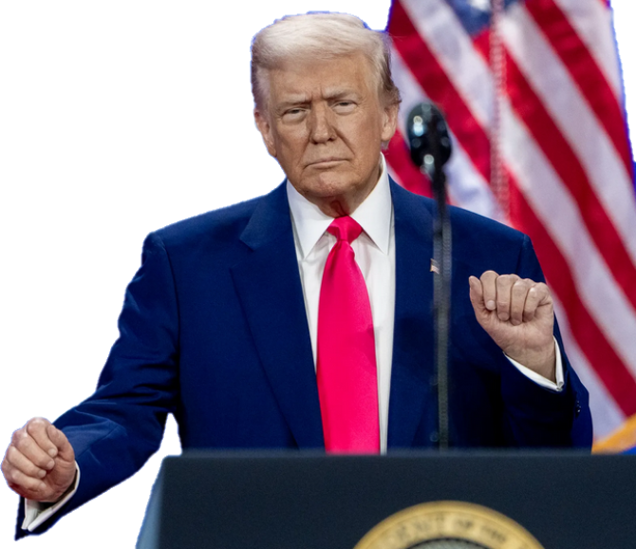
Executive Order (Jan 22)
Protect against “invasion”
“Immediately repel, repatriate, and remove illegal aliens involved in the invasion.”
Alien Enemies Act of 1789 (Mar 15)
Numerous statements
Illegal immigrants are “animals” and “not human” (Apr 2024)
They are drug dealers, rapists, criminals “poisoning our blood” (Mar 2024)

Slide 29
Issues
Administration says …
Other evidence points to …
Deporting undocumented who’ve committed crimes.
Crime of many is only illegal entry.
Deporting “pro-terrorist, antisemitic, anti-American.”
No allegation of terrorism. Unknown criteria.
Purpose is to defend from invasion (Alien Enemies Act) and protect national security.
Courts contesting because no evidence of foreign government involvement.
Rights being respected.
Rights violated, regarding access to legal counsel, habeas corpus, etc.
Not related to persons’ political views or free expression.
Pattern so far: criticism of Israel and support for Palestine/Hamas.

Slide 30
Issues
Administration says …
Other evidence points to …
Deporting undocumented who’ve committed crimes.
Crime of many is only illegal entry.
Deporting “pro-terrorist, antisemitic, anti-American.”
No allegation of terrorism. Unknown criteria.
Purpose is to defend from invasion (Alien Enemies Act) and protect national security.
Courts contesting because no evidence of foreign government involvement.
Rights being respected.
Rights violated, regarding access to legal counsel, habeas corpus, etc.
Not related to persons’ political views or free expression.
Pattern so far: criticism of Israel and support for Palestine/Hamas.

Slide 31
Examples
Deportation of thousands. (Many with cases pending.)
Several hundred Venezuelans sent to Salvadoran prison for alleged connections to Tren de Aragua gangs.
Arrest of recent Columbia grad (Mahmoud Kahlil) for alleged “support for terrorists.” (No evidence, except activism against Gaza action.)
Efforts to arrest two other Columbia students who spoke out against Israel. (One fled to Canada; one got court stay.)
Arrest of Tufts student (Rumeysa Ozturk). (Co-wrote student op-ed urging university to stop Israeli investments.)

Slide 32
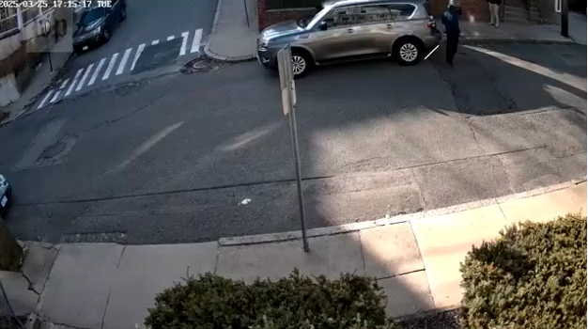
Example
Turkish doctoral student Rumeysa Ozturk at Tufts University on March 25.

Slide 33
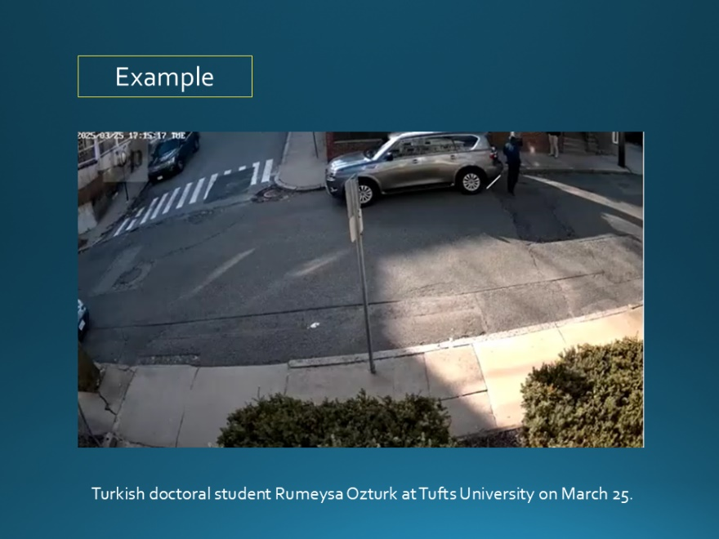
Example
Rumeysa Ozturk
On way to interfaith center to break Ramadan fast
Masked men, and then woman, identified later only as DHS
No criminal charges cited
30-yr-old Fulbright scholar
PhD in child study and human development
F-1 student visa

Slide 34
Example
Followup
On Tuesday, Judge ordered she not be removed from Massachusetts.
On Wednesday, she was in a detention facility in Louisiana.
Still no charges brought.
Apparent offense: Co-authored op-ed in Tufts student newspaper criticizing university’s response to pro-Palestinian movement.

Slide 35
What does this mean for our guest speakers?
Be careful making accusations against CBP or them.
Columbia and Tufts actions were by Immigration and Customs Enforcement (ICE).
The DHS website says all agencies are involved, but doesn’t discuss CBP role.

Slide 36
What does this mean for your questions?
As always, ask what you think appropriate in appropriate fashion.
As always, offer analysis and conclusions.
Understand difference between law/policy and enforcement.
Understand that everyone has choice to stay in job and carry out orders.
Professional courtesy doesn’t mean a) you have to agree, or b) not stating disagreement is agreement.

Slide 37
Possible Questions
When CBP makes a mistake in an arrest or deportation, what recourse does the person have?
Why shut down “CBP One” app to set up asylum meetings (and replace with “CBP Home”)?
Who makes the lists of tourists (with visas or ESTA) and even Permanent Residents who are stopped upon arrival in the U.S.?
How do CBP and ICE know which tattoos are from gangs and not?
How is it helpful for CBP to post on its website “It’s closing time”?
What does the National Border Patrol Council’s endorsement of President Trump candidacy and its criticism of Joe Biden mean?
What is the logic for CBP to be able to force a citizen to open phone without a warrant?
Why did President close DHS civil rights branch and two ombuds?

Slide 38
Questions? Comments?

Slide 39
U.S. Customs and Border Protection
-CBP Mission and Policies-
Fulton Armstrong Nayyera Haq Friday 4 April 2025

Slide 42

DISCUSSION
(We’ll revisit the syllabus, projects, and other class issues later.)
The media as a policy INPUT
How would you rank it/them in importance … in quality?
Which is horse and which is cart?
Do you agree with what the Founders said about the press?
“Our liberty depends on the freedom of the press, and that cannot be limited without being lost” -Thomas Jefferson, 1786 (Quipped: Would rather have newspapers without government than government without newspapers.)

Slide 43
DISCUSSION
Where do you get your news?
What or who sets your news interests?
How do you receive information?
What sources do you trust?

Slide 44
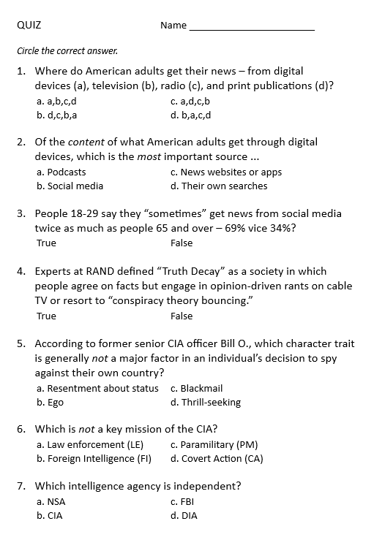
QUIZ

Slide 45
QUIZ
“Society pulling itself apart over facts”

Slide 46
QUIZ

Slide 47
DISCUSSION
Yasmeen Alamiri
Jerry Zremski
What our guest speakers can tell us …
Their view of their role
Their view of the challenges they face as institutions and individuals
How their organizations are adapting
Advice on how you can/should approach media
Practice elicitation of information.

Slide 48
DISCUSSION
Yasmeen Alamiri PBS News
- introduced by Gabby
What does the media-policy dynamic look like from her perch?
What’s happening in the news industry?
What’s it like to be a journalist?

Slide 49


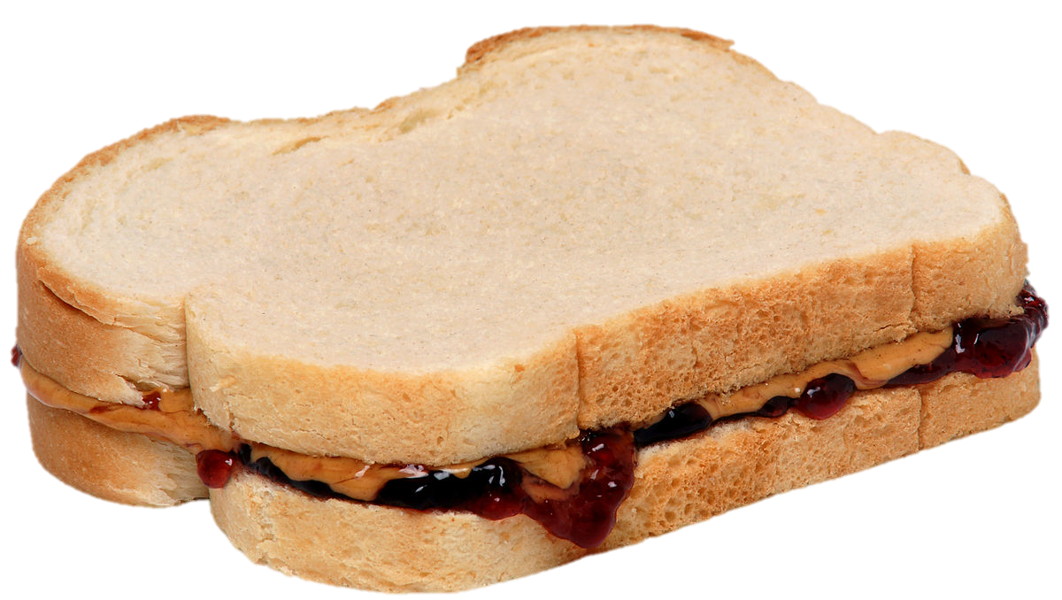
LUNCH

Slide 50
Office of Intergovernmental Public Liaison (IPL)
Daniel GITHENS, Chief of Intergovernmental Affairs Deputy Chief of Staff
Matthew ASHMORE Chief of Partnership Development

Slide 51
RED LINE (→Glenmont)
from Dupont Circle to Metro Center
then
ORANGE (→New Carrollton) or BLUE (→ Largo) or SILVER (→ Largo)
from Metro Center to Smithsonian

Slide 52
HOLOCAUST MUSEUM

Slide 53
Global Policy Seminar and NSC Simulation
IRP 401 - IRP 402
Week Three 12 September 2025
Prof. Fulton T. Armstrong

