Slide 1

Global Policy Seminar and NSC Simulation
IRP 401 - IRP 402
Week Two 05 September 2025
Prof. Fulton T. Armstrong

Slide 2
Week 1 (29 Aug)
Week 2 (5 Sep)
Week 3 (12 Sep)
Week 4 (19 Sep)
Week 5 (26 Sep)
Week 6 (3 Oct)
Week 7 (10 Oct)
Week 8 (17 Oct)
Week 9 (24 Oct)
Week 10 (31 Oct )
Week 11 (7 Nov)
Week 12 (14 Nov)
Week 13 (21 Nov)
Thanksgiving Break
Week 14 (5 Dec)
Fall 2025

Slide 3
TODAY’S AGENDA
9:30 | Skills – Word Processing Formats, Tips and Tricks
~10:15 | Class Discussion – Readings and Quiz
11:00 | Lunch
12:00 | Guest Speaker: Ms. Yasmeen Alamiri Senior Editor for video and special projects PBS News Hour - introduced by Gabby
1:30 | Class Discussion – Projects and Museum
2:30 | International Spy Museum - enter together as group
~4:00 | Wrapup

Slide 4
TODAY’S AGENDA
9:30 | Skills – Word Processing Formats, Tips and Tricks
~10:15 | Class Discussion – Readings and Quiz
11:00 | Lunch
12:00 | Guest Speaker: Ms. Yasmeen Alamiri Senior Editor for video and special projects PBS News Hour - introduced by Gabby
1:30 | Class Discussion – Projects and Museum
2:30 | International Spy Museum - enter together as group
~4:00 | Wrapup

Slide 5

DISCUSSION
(We’ll revisit the syllabus, projects, and other class issues later.)
The media as a policy INPUT
How would you rank it/them in importance … in quality?
Which is horse and which is cart?
Do you agree with what the Founders said about the press?
“Our liberty depends on the freedom of the press, and that cannot be limited without being lost” -Thomas Jefferson, 1786 (Quipped: Would rather have newspapers without government than government without newspapers.)

Slide 6
DISCUSSION
Where do you get your news?
What or who sets your news interests?
How do you receive information?
What sources do you trust?

Slide 7
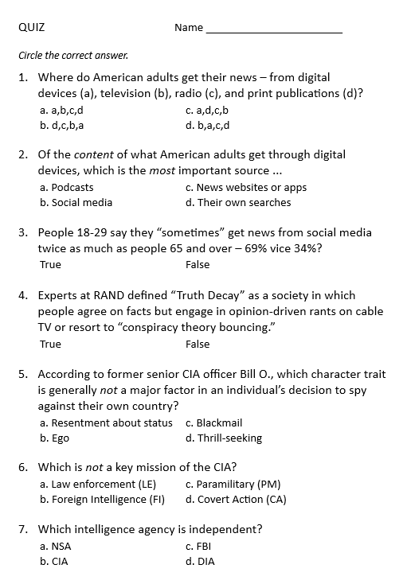
QUIZ

Slide 8
QUIZ
“Society pulling itself apart over facts”

Slide 9
QUIZ

Slide 10
DISCUSSION
Yasmeen Alamiri
Jerry Zremski
What our guest speakers can tell us …
Their view of their role
Their view of the challenges they face as institutions and individuals
How their organizations are adapting
Advice on how you can/should approach media
Practice elicitation of information.

Slide 11
DISCUSSION
Yasmeen Alamiri PBS News
- introduced by Gabby
What does the media-policy dynamic look like from her perch?
What’s happening in the news industry?
What’s it like to be a journalist?

Slide 12

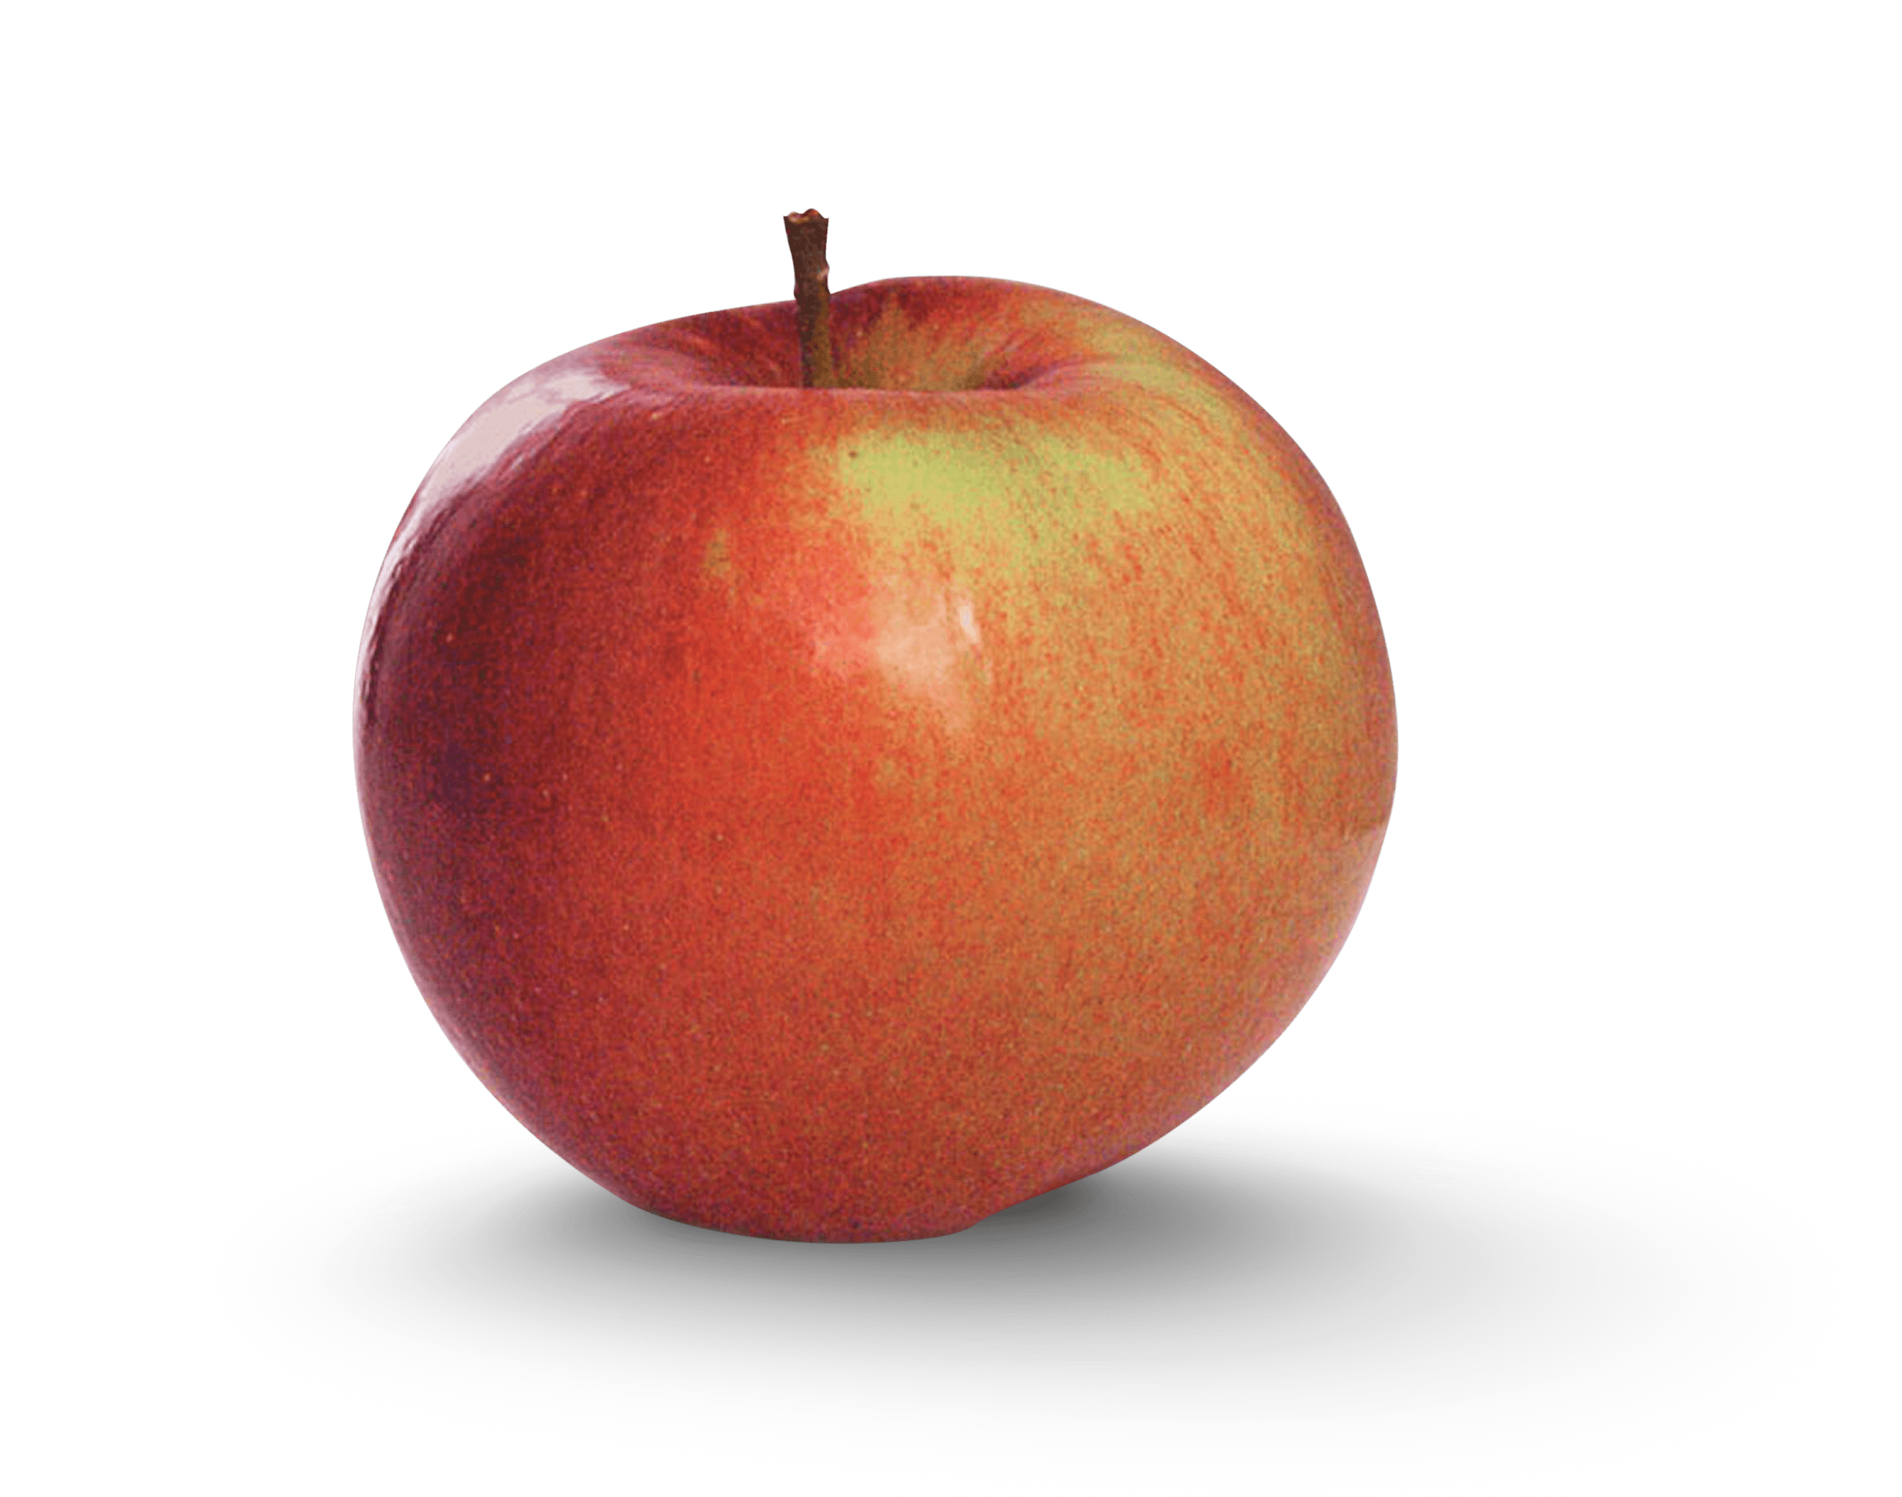
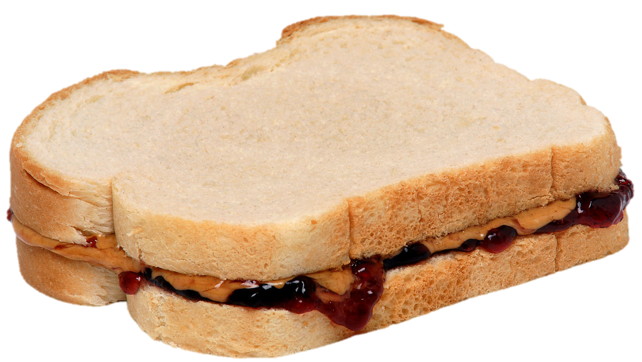
LUNCH

Slide 13
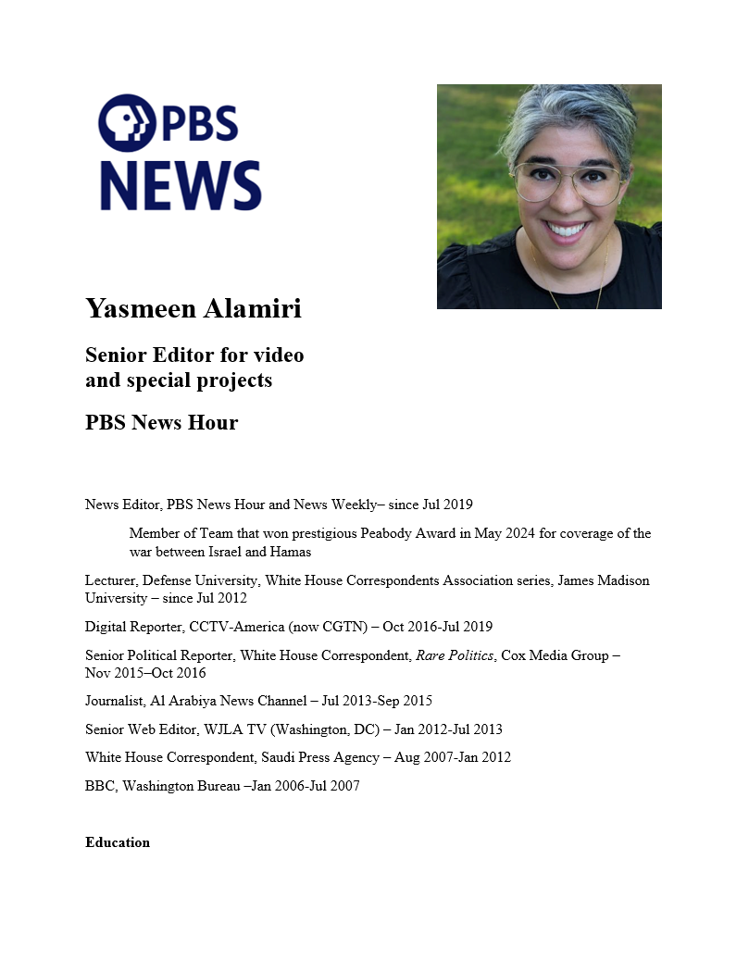
GUEST SPEAKER
Yasmeen Alamiri
- introduced by Gabby

Slide 14
Comments?

Slide 15

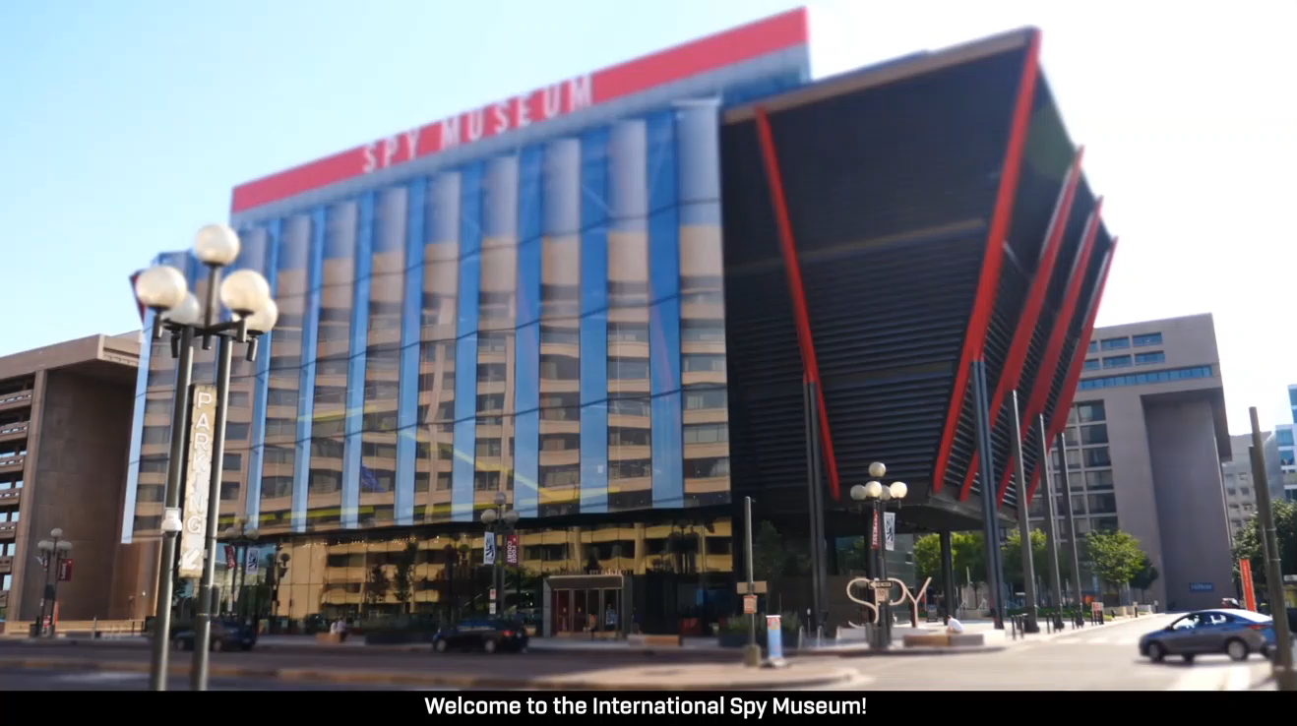
Offsite Visit
Remember …
Role of intelligence in policy
“Foreign Intelligence”
“Covert Action” and “PM”
The “INT’s”
HUMINT SIGINT
IMINT MASINT
OSINT
Evolution
Human vs technical
The International Spy Museum

Slide 16
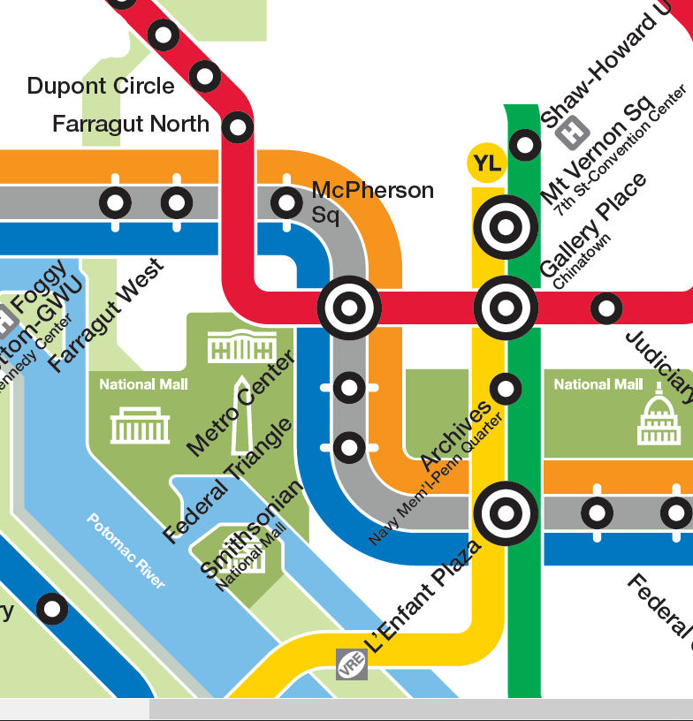
International Spy Museum
700 L'Enfant Plaza, SW Washington, DC 20024
RED LINE (→Glenmont)
from Dupont Circle to Metro Center
then
ORANGE (→New Carrollton) or BLUE (→ Largo) or SILVER (→ Largo)
from Metro Center to L’Enfant Plaza

Slide 17
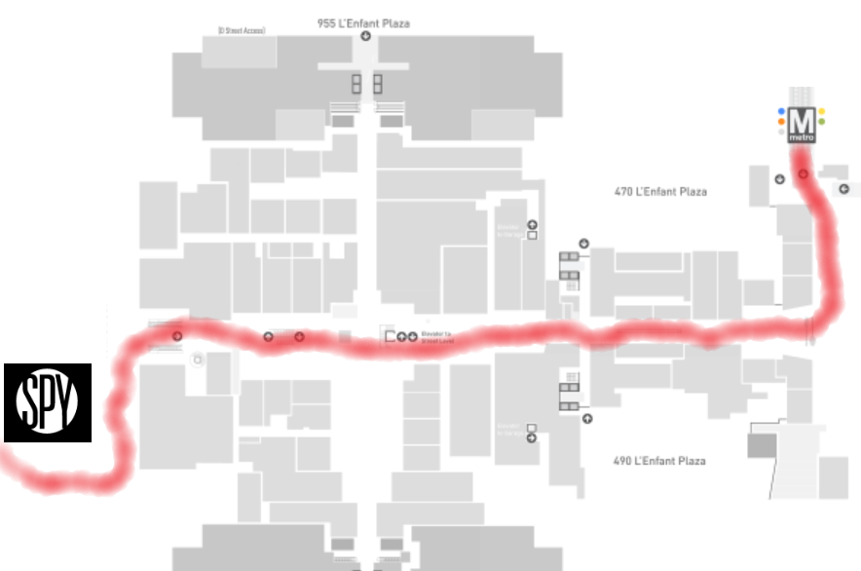

METRO: L'Enfant Plaza
L'Enfant Plaza Exit go up the escalator to enter the L’Enfant Plaza food court.
Enter at 2:30

Slide 18
DISCUSSION
Syllabus? Projects? Video intro?

Slide 19
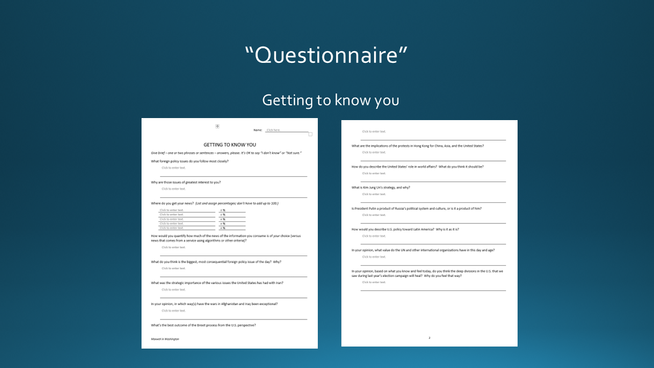

Slide 20
GUEST SPEAKER
Jerry Zremski
University of Maryland Merrill College of Journalism
The Buffalo News
What does the media-policy dynamic look like from his perch?
What’s happening in the news industry?
What’s it like to be a journalist?
- Introduced by Kennedy

Slide 21
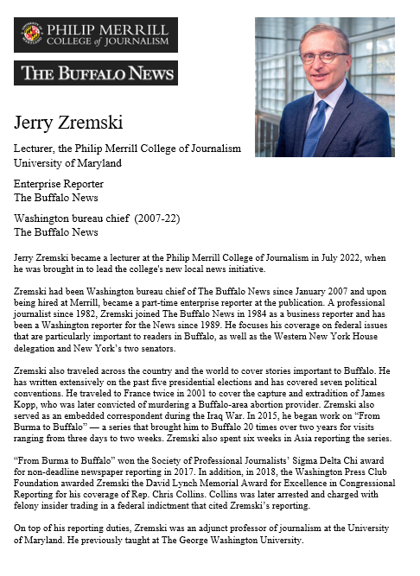
GUEST SPEAKER
Jerry Zremski
University of Maryland Merrill College of Journalism
The Buffalo News
- Introduced by Kennedy

Slide 22
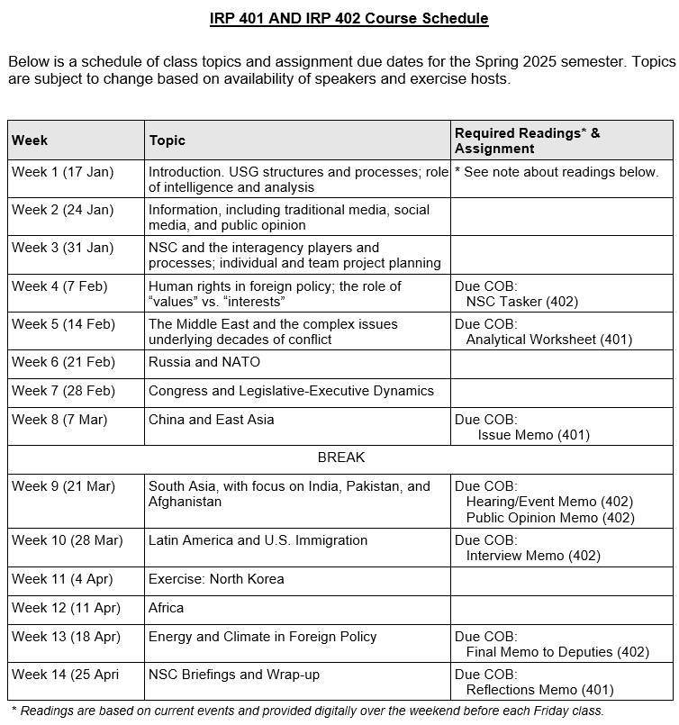
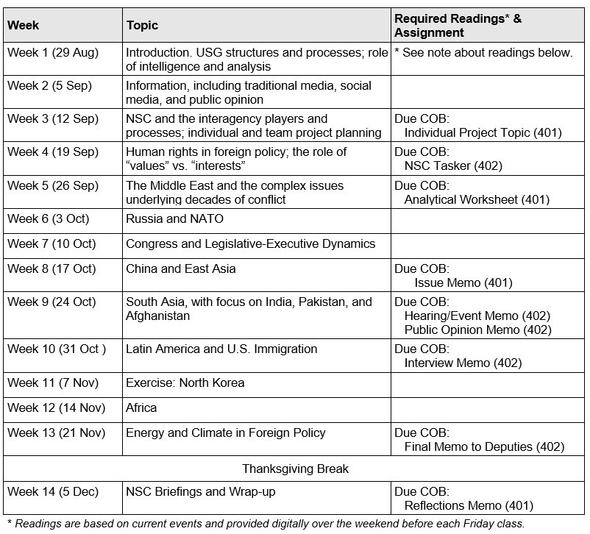
✓
✓
401
✓
402
✓
✓
✓
✓
✓
✓

Slide 23
THREE TASKS TO START IMMEDIATELY (last week)
1. Think of topics you would like to do for 401 and 402.
Interested in.
Relevant to U.S.
Developing, evolving.
International or domestic.
Some policy decision.
Balance between tactical and strategic.
You do it alone.
You do with one partner.
2. Start talking with potential partners.
(Not just a friend. Look for value-added.)
3. Here’s a list of candidate issues for team project.

Slide 24
TOPICS FOR YOUR CONSIDERATION
What should the United States do about … ?
Ukraine cease-fire or treaty
Gaza war, sovereignty, future
Israel relations after Netanyahu
Iran and its evolving nationalism
China (multiple aspects)
Enhancing cybersecurity
Aid to Gaza
DPRK and Kim’s strategy
UN environmental efforts
Russia and dealing with Putin
U.S. culture wars
Microplastics and PFAS
AI and socio-economic
Cryptocurrency risks
Declining birth rates
Economic, trade competition
Southeast Asia
Taiwan
Other challenges.
CRITERIA:
Interesting to classmates.
Relevant.
Already know something.
Dynamic, evolving.
Articulable U.S. interest.

Slide 25
Ukraine cease-fire or treaty
Gaza war, sovereignty, future
Israel relations after Netanyahu
Iran and its evolving nationalism
China (multiple aspects)
Enhancing cybersecurity
Aid to Gaza
DPRK and Kim’s strategy
UN environmental efforts
Russia and dealing with Putin
U.S. culture wars
Microplastics and PFAS
AI and socio-economic
Cryptocurrency risks
Declining birth rates
WANT TO EXPRESS AN INTEREST NOW?
Send me TWO e-mails by 9pm tonight (5 September):
One on your individual project proposal.
One with a proposed partner on a team proposal.
Topic with one sentence on main story and one sentence on policy options.

Slide 26
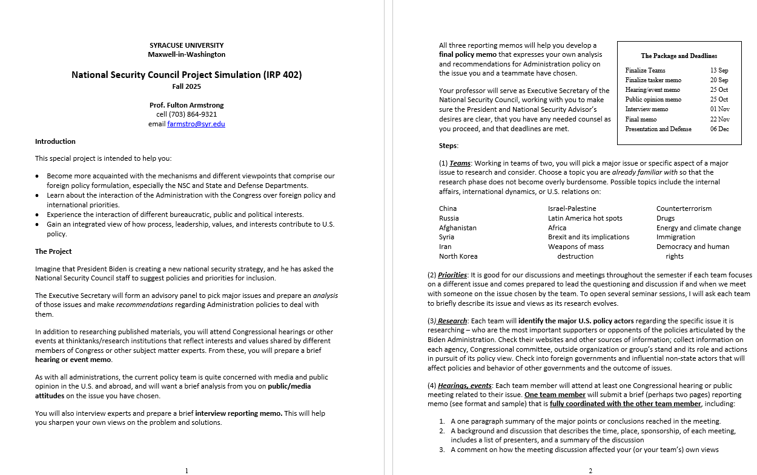
Project Overview
402

Slide 27
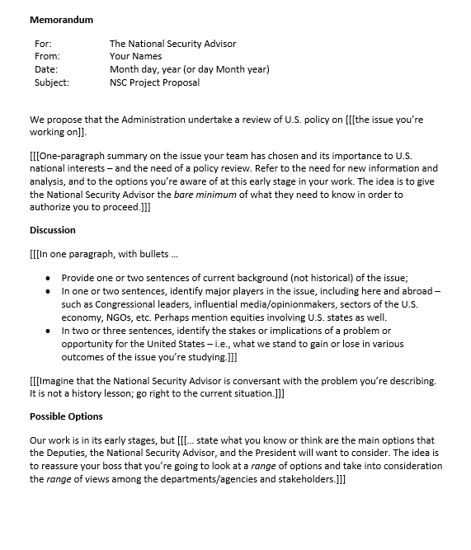
402
Proposal Memo
Show the National Security Advisor
that you’ve got …
a good, relevant topic
worth some good analysis
and some good policy options
due 12 Sep

Slide 28
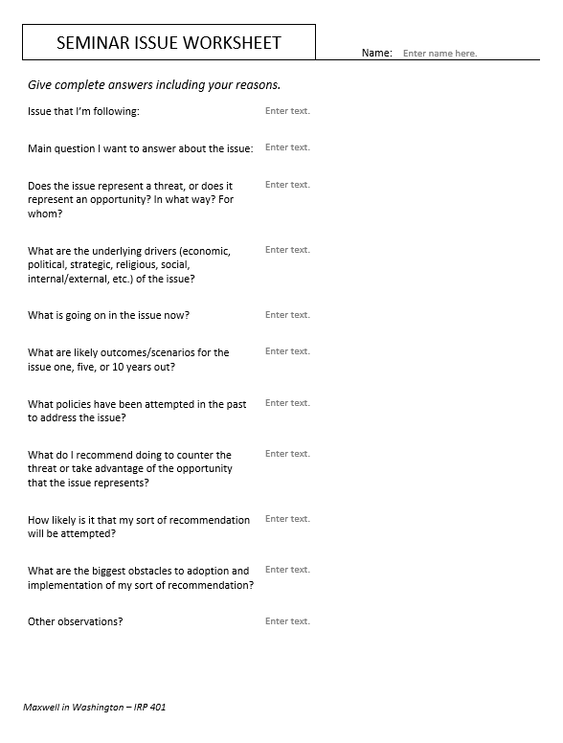
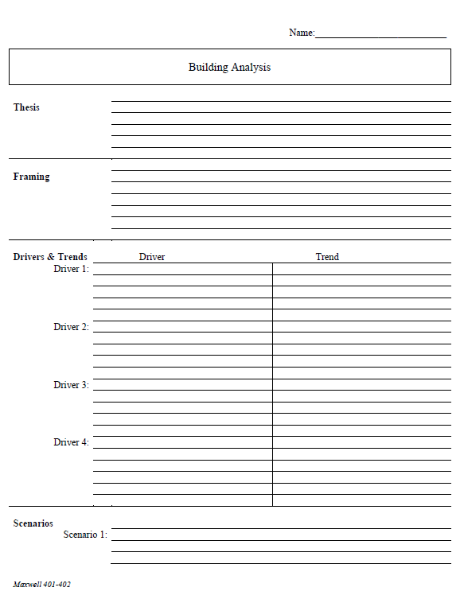
401
“Memo #1”
Analytical Sheet (your choice)
due 19 Sep

Slide 29
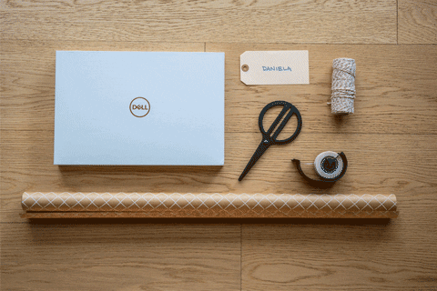
WRAPUP

Slide 30
DISCUSSION
Syllabus? Projects? Video intro?

Slide 31
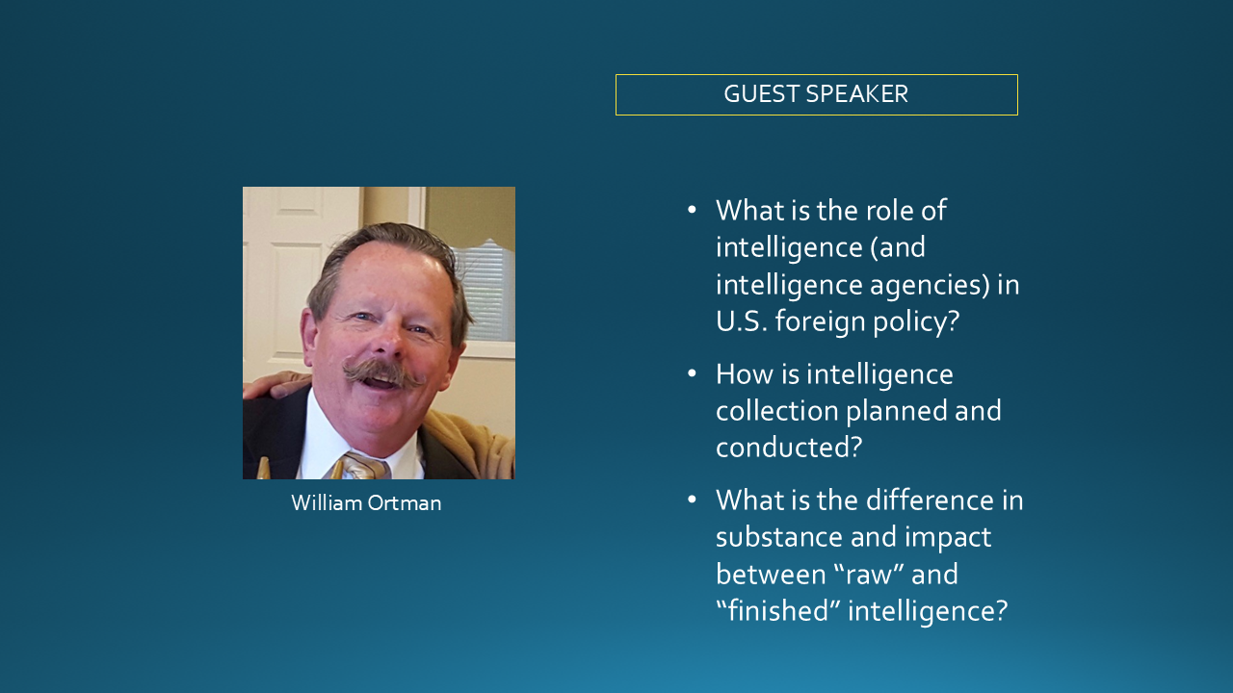
Information as inputs to policy
How important?
Same in all/most administrations?
What other inputs do you see?

Slide 32
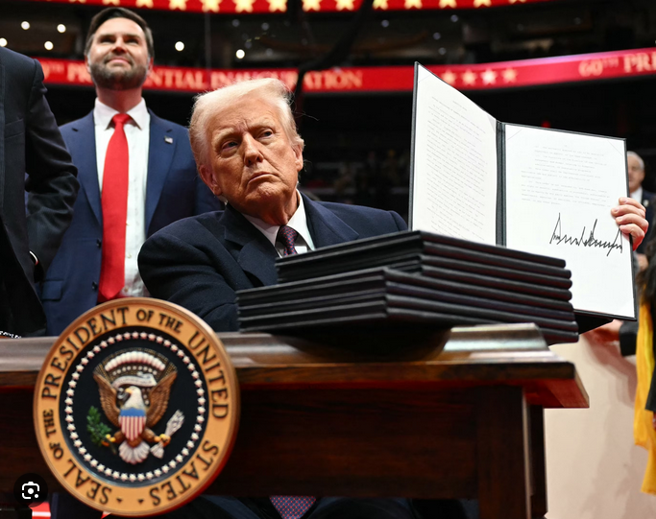
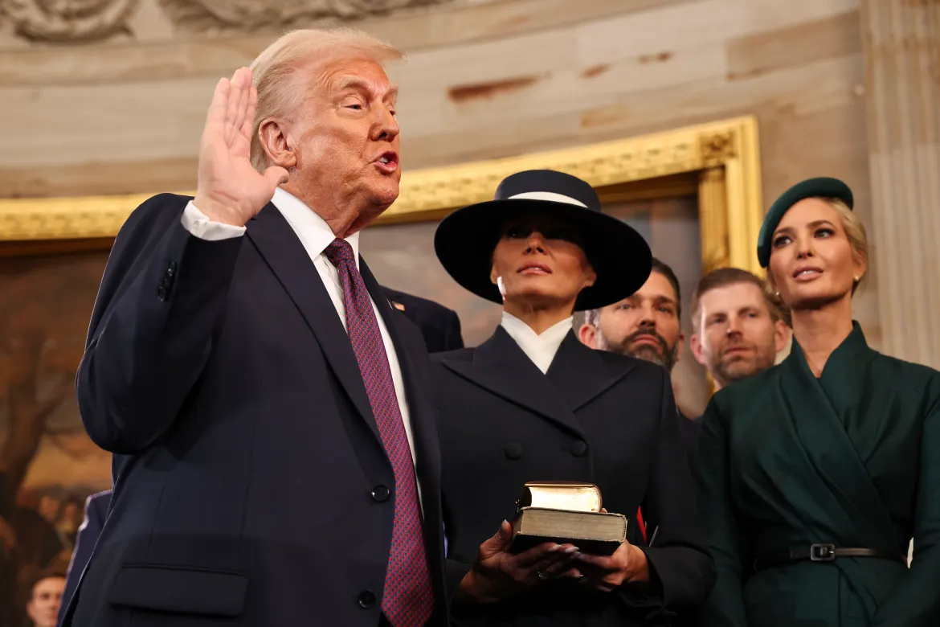
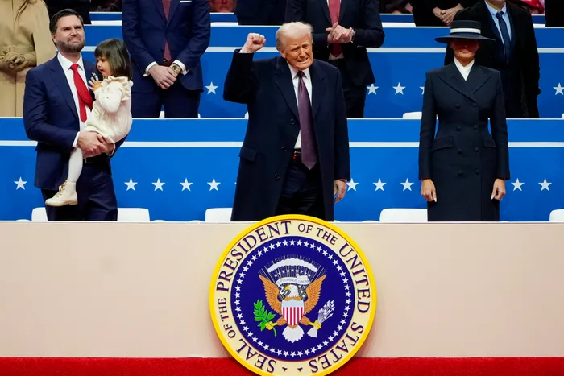
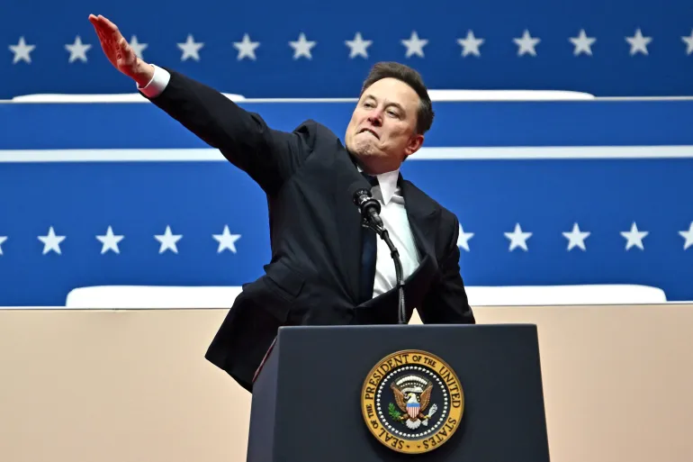
How well did the media (all kinds) cover the inauguration and executive orders?

Slide 33
QUESTIONS or COMMENTS?

Slide 34
TODAY’S AGENDA
9:30 | Skills – Word Processing Formats, Tips and Tricks
~10:15 | Class Discussion – Readings and Quiz
11:00 | Lunch
12:00 | Guest Speaker: Ms. Yasmeen Alamiri Senior Editor for video and special projects PBS News Hour - introduced by Gabby
1:30 | Class Discussion – Projects and Museum
2:30 | International Spy Museum - enter together as group
~4:00 | Wrapup

Slide 35
Global Policy Seminar and NSC Simulation
IRP 401 - IRP 402
Week Two 05 September 2025
Prof. Fulton T. Armstrong

