Slide 1

Global Policy Seminar and NSC Simulation
IRP 401 - IRP 402
Week One 29 August 2025
Prof. Fulton T. Armstrong

Slide 2
Week 1 (29 Aug)
Week 2 (5 Sep)
Week 3 (12 Sep)
Week 4 (19 Sep)
Week 5 (26 Sep)
Week 6 (3 Oct)
Week 7 (10 Oct)
Week 8 (17 Oct)
Week 9 (24 Oct)
Week 10 (31 Oct )
Week 11 (7 Nov)
Week 12 (14 Nov)
Week 13 (21 Nov)
Thanksgiving Break
Week 14 (5 Dec)
Fall 2025

Slide 3
TODAY’S AGENDA
9:00 | Skills session - Analysis
10:15 | Welcome; Introductions; Questionnaire; Semester Overview; Syllabus and Projects
12:00 | Lunch (provided) Samantha Clemence – Ass’t Director, Washington Programs Internship Course Overview and Requirements
~1:15 | Finish morning session Intro to Intelligence Community
2:30 | Guest speaker: Bill O. Former senior intelligence officer Intelligence and its Role in Policy
3:30 | Discussion
4:00 | Wrapup

Slide 4
TODAY’S AGENDA
9:00 | Skills session - Analysis
10:15 | Welcome; Introductions; Questionnaire; Semester Overview; Syllabus and Projects
12:00 | Lunch (provided) Samantha Clemence – Ass’t Director, Washington Programs Internship Course Overview and Requirements
~1:15 | Finish morning session Intro to Intelligence Community
2:30 | Guest speaker: Bill O. Former senior intelligence officer Intelligence and its Role in Policy
3:30 | Discussion
4:00 | Wrapup

Slide 5
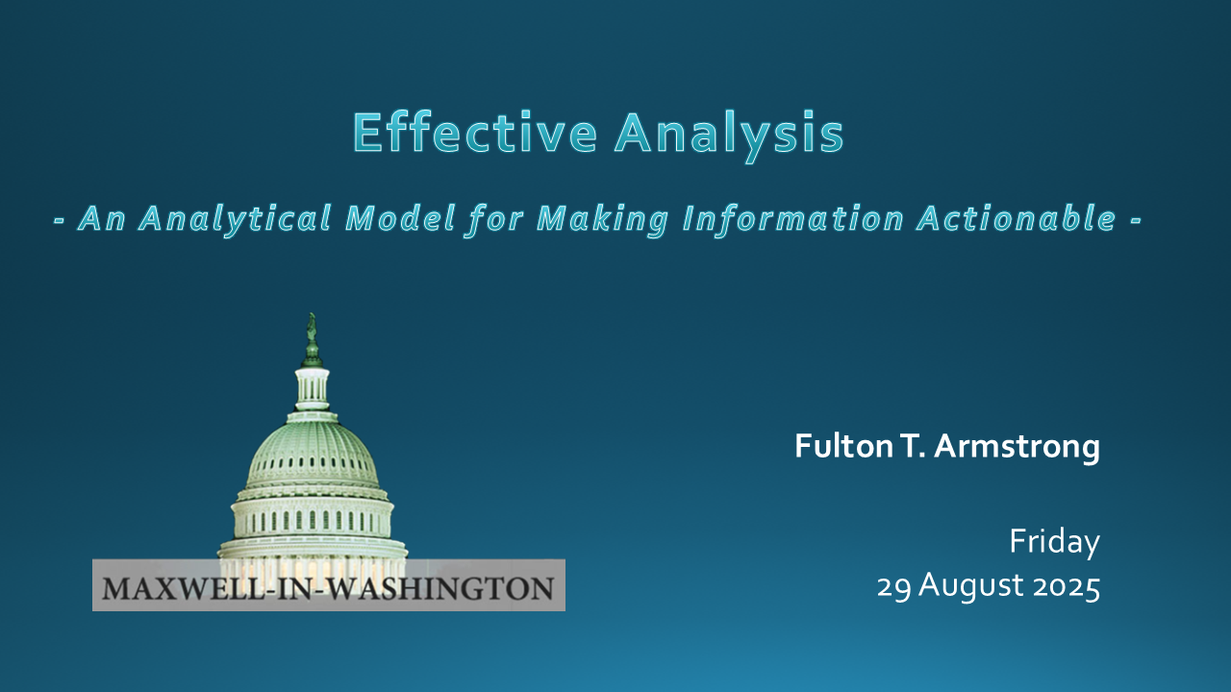
Most Fridays will start with a talk on skills.

Slide 6
OUR CLASS
Global Policy Studies (GPS)
401-402

Slide 7
Ground Rules and Suggestions
Respect, inclusion, full participation – listen to each other
Openness, experiment with ideas
No such thing as a bad question
Take ego out of it (either offense or defense)
“Be here” – i.e., no distractions (phone, laptop) unless otherwise approved
Don’t assume there’s one right answer
Place your nameplate on its side to signal interest in speaking
Be contrarian
THINK OF THIS AS A PROFESSIONAL WORKSPACE.
PROFESSIONAL DRESS
Other practices you’d like to suggest, drop me a line.

Slide 8
One more suggestion …
When you don’t agree with something you hear or read …
Before you react …
think …
Do we have different information?
Do we have different analysis?
Do we have different interests?
Do we have different values?

Slide 9

Fulton T. Armstrong
A spontaneous career in information, analysis, policy and politics
Forty-plus years of analytical writing
Linguistics and study in Spain
journalism in Taiwan
U.S. House of Representatives
CIA
State Department
National Security Council
National Intelligence Council
U.S. Military – Intelligence Advisor
U.S. Senate
Taught junior analysts
Led intelligence community
Wrote about tradecraft
Teach URJC, Salamanca and others
American University Syracuse University/Maxwell

Slide 10
Fulton T. Armstrong
A spontaneous career in information, analysis, policy and politics
Forty years of analytical writing
Linguistics and study in Spain
journalism in Taiwan
U.S. House of Representatives
CIA
State Department
National Security Council
National Intelligence Council
U.S. Military – Intelligence Advisor
U.S. Senate
American University Syracuse University/Maxwell

Slide 11
New York | Washington
Barcelona and Madrid | Taipei
Havana | Mons, Belgium
San José, CR
And traveled extensively between those periods.

Slide 12
A Bias:
Good information and good analysis are at the heart of MOST good policy.
And bad information and bad analysis are at the heart of A LOT OF bad policy.
A Second bias:
Dealing with the “symptoms” of a problem, while often politically necessary, is not a good substitute for good policy.

Slide 13
A Third Bias:
Discussion is a lot richer (if less exciting) if we differentiate between
OPINION
and
ANALYSIS.

Slide 14
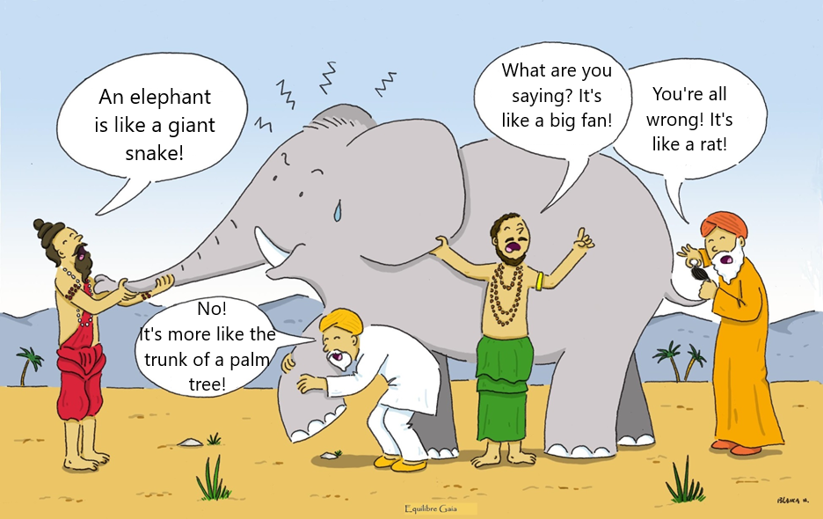
The Role of Intelligence: : The Blind Men and the Elephant
Second Purpose: Listening to all other points of view.
First Purpose: Putting facts together to say WHAT we perceive.
Notes:
Somos como en la historia india … los ciegos que quieren entender qué es un elefante. Cada uno lo toca, pero nadie entiende qué es hasta que se unan sus observaciones.
Un analista de una agencia de inteligencia … o un académico … o un periodista … o un representante de un negocio … quizás tenga información interesante, pero no es inteligencia hasta que, como sociedad, se una lo que saben y opinan del fenómeno que están observando.

Slide 15
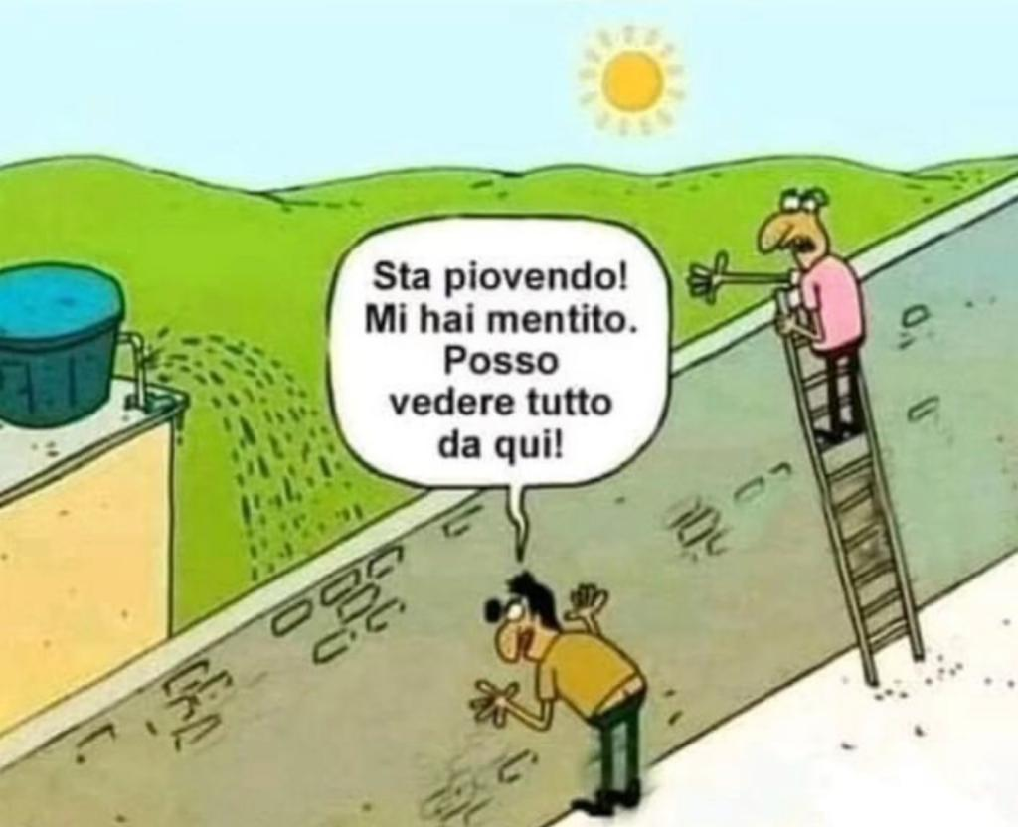
Italian version: Two men and a wall
It's raining!!! You lied! I can see everything from here!!!
Both are “right” … and
Both are wrong.
Does this help?
Notes:
Somos como en la historia india … los ciegos que quieren entender qué es un elefante. Cada uno lo toca, pero nadie entiende qué es hasta que se unan sus observaciones.
Un analista de una agencia de inteligencia … o un académico … o un periodista … o un representante de un negocio … quizás tenga información interesante, pero no es inteligencia hasta que, como sociedad, se una lo que saben y opinan del fenómeno que están observando.

Slide 16
Indian Story: The Blind Men and the Elephant
Notes:
Somos como en la historia india … los ciegos que quieren entender qué es un elefante. Cada uno lo toca, pero nadie entiende qué es hasta que se unan sus observaciones.
Un analista de una agencia de inteligencia … o un académico … o un periodista … o un representante de un negocio … quizás tenga información interesante, pero no es inteligencia hasta que, como sociedad, se una lo que saben y opinan del fenómeno que están observando.

Slide 17
As we proceed, I’ll ask you to explore … how do you know what you “know”?
How do you determine “real” or “fake”?
How do you control your wishes and biases when handling information?
How do you evaluate the accuracy of your information, analysis, and recommendations?
How do you think these practices play out on the issues you care about?

Slide 18
When you see something that you agree with – or disagree with – how do you process it?
These are challenging times for many people.
Try to understand that.
When you don’t agree with something,
before you escalate … consider …
Disagree because of different info?
Disagree because of different analysis?
Disagree because of different (imputed) values and objectives?

Slide 19
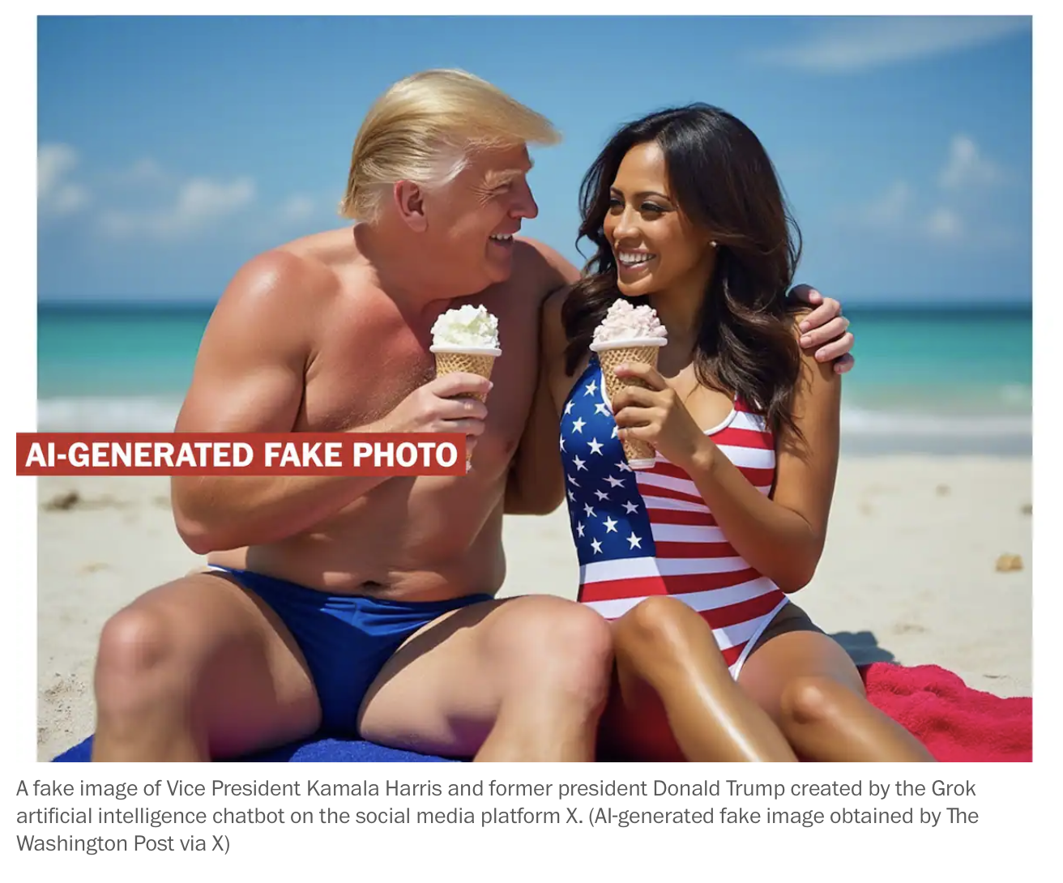
THE WASHINGTON POST
Grok AI Chatbot
xAI and Elon Musk

Slide 20
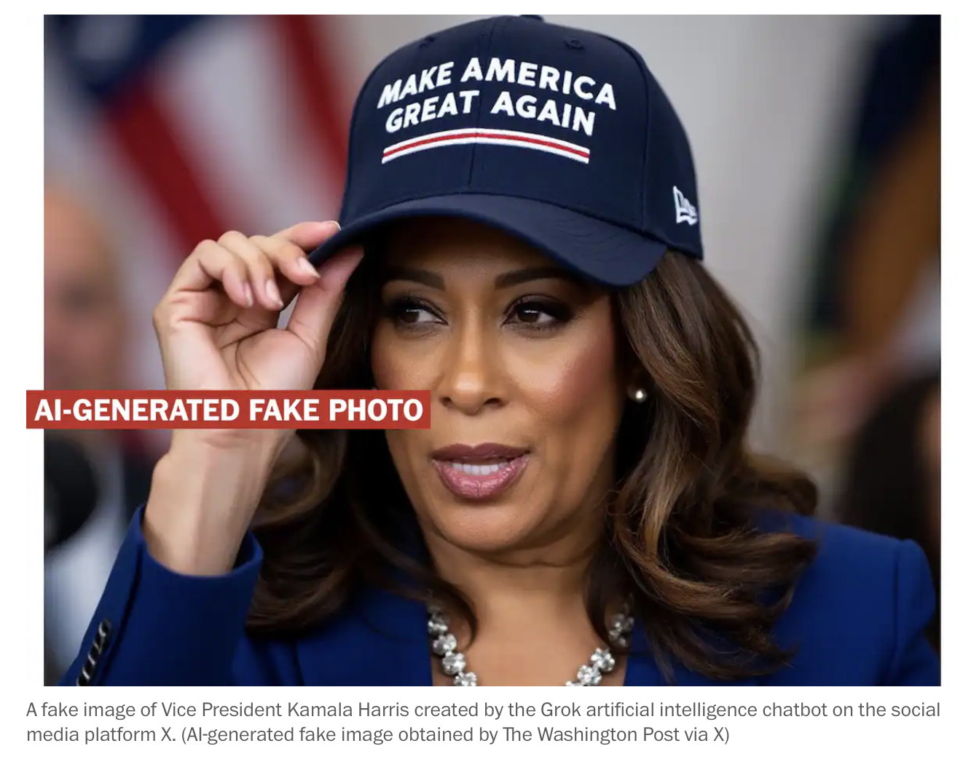
THE WASHINGTON POST

Slide 21
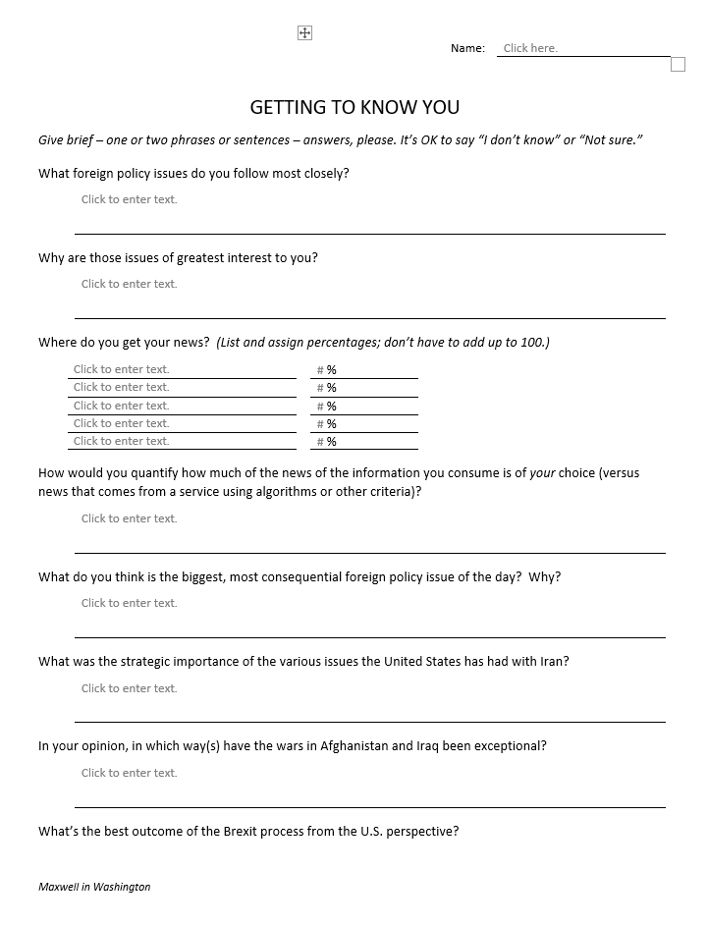
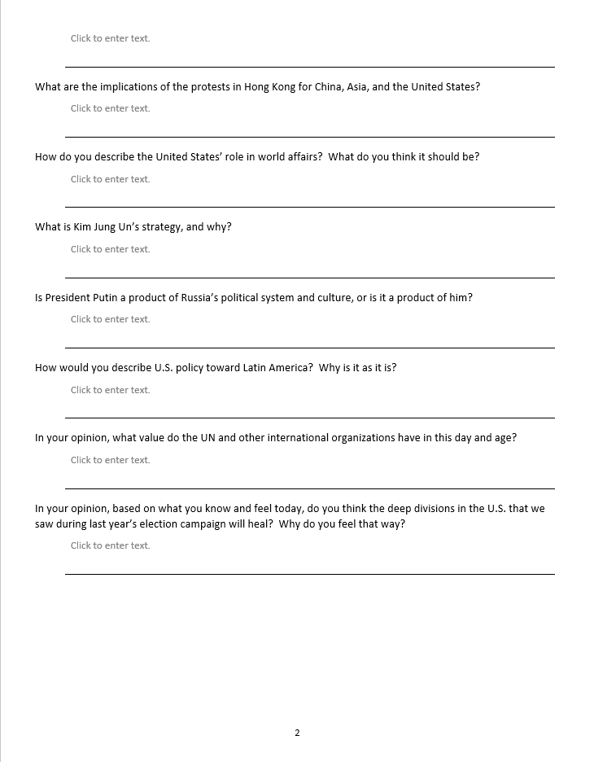

“Questionnaire”
Use MS “form” in SUBMIT ASSIGNMENTS section of Blackboard, but submit in PDF.
Getting to know you
~15 minutes
Get started now.
Submit final by 9pm Sunday

Slide 22
INTRODUCTIONS
Anzaldua, Bobby
Barry, Mouhammadou B
Condino, Richard Anthony
Dang, Sarina
Dorcellus, Esme C
Faison, Skye Amari
Gabel, Gabriella M
Goldstein, Syarra
Hanley, Priya Jasmine
Heisey, Maisie
Kosloff, Katelyn
Rees, Erik Davy
Ryan, Maeve
Tan, Kiana Wen-Ying
Tingley, Alex
Valdez, Camille Sydney
Preferred name and nameplate
Hometown
Year
Major(s)

Slide 23
INTRODUCTIONS
Anzaldua, Bobby
Barry, Mouhammadou B
Condino, Richard Anthony
Dang, Sarina
Dorcellus, Esme C
Faison, Skye Amari
Gabel, Gabriella M
Goldstein, Syarra
Hanley, Priya Jasmine
Heisey, Maisie
Kosloff, Katelyn
Rees, Erik Davy
Ryan, Maeve
Tan, Kiana Wen-Ying
Tingley, Alex
Valdez, Camille Sydney
Preferred name and nameplate
Hometown
Major(s)

Slide 24
SYLLABUS
Objectives
Design
Assignments
Grading
Questions? Concerns?
In Blackboard

Slide 25
Course Description:
Combined six-credit policy seminar (IRP 401) and NSC simulation (IRP 402).
Explores U.S. interests in world affairs, available policy options, and how policies are made in Washington.
Also draws together internships and evening courses.

Slide 26
IRP 401 includes …
“Traveling” seminar that meets with U.S. and foreign government officials, experts and advocates, as well as journalists and public opinion specialists.
Introduction and practice of artforms used for developing policy options and communicating them in a Washington context, primarily information and policy memoranda.

Slide 27
IRP 402 features …
Simulation of a National Security Council policy review, through each stage – from analysis, to elaboration of options, to recommendation, through decision, and into implementation.
Small-team collaboration and responsibility.
Activities that should help you visualize selves as future policymakers, advocates and communicators.
Appreciation of the core professional skills needed for success in these areas.

Slide 28
Learning Objectives:
Critical elements and processes of the U.S. Government and foreign countries whose actions impact the United States.
Practical steps to identify and pursue opportunities in Washington, DC.
Learning from intern experiences, including workplace challenges and personal aspects of coping.

Slide 29
After taking this course, you will be better able to:
Evaluate U.S. foreign policy and the many the forces influencing it.
Understand different roles of the Executive Branch, Congress, media, NGOs, diplomatic missions in Washington, and international organizations.
Find, validate, and effectively use publicly available information. Obtain information from busy officials, activists, and media professionals.
Create, self-edit, and communicate analysis and policy proposals in both written (policy memos) and verbal (presentations, simulations) forms.
Think about your own futures.

Slide 30
Course Requirements and Expectations:
For the policy seminar (IRP 401), you will prepare three memos – two on a pressing policy topic, and one with personal reflections on policy and related processes over the course of the semester. You will also brief the class on their topics and on their internship experiences. You will prepare the following written and oral products (per guidance and examples provided):
A running individual journal, with short (one- or two-paragraph) entries in a reserved, private space in Blackboard with key observations and conclusions from your interaction with guest speakers and visits made as a class each week.
A completed analytical worksheet (“Memo #1”) on a topic of your choosing (coordinated with the professor).
A short (two-page) memorandum (“Memo #2”) updating and analyzing information on the same topic; identifying the U.S. government’s policy options as currently understood; and predicting how the policy debate will play out and why.
A briefing to the class on the conclusions reached during development of the analytical worksheet and memorandum (if time permits).
At the end of the semester, a short (two- page) memorandum of reflections on key takeaways from the semester work and experiences, including, if desired, how they influenced your perceptions of their career interests.

Slide 31
For the National Security Council simulation (IRP 402), you – working in teams of two – will conduct a National Security Project, beginning with a mock National Security Council tasking memo, moving through each stage of policy preparation, and ending with a memo to the NSC “Deputies Committee” proposing a policy for the President’s approval. You will prepare the following written and oral products (per guidance and examples provided):
A project proposal (in the form of an NSC memo) on an issue in which you and teammate have interest and enough expertise to start, as coordinated with the professor.
A memo reporting on a Congressional hearing or public forum relevant to the chosen issue (by one team member) and a memo on U.S. and foreign public opinion relevant to that issue (by the other).
A memo reporting on an interview (one by each team member) with an expert source on the topic.
A final policy recommendation memo (jointly written) for the NSC “Deputies Committee” to consider on the issue with a final recommendation to the President.
A PowerPoint briefing for the simulated NSC meeting at which the team will brief the “Deputies” on its issue, including analysis, key interagency positions, and recommendations.

Slide 32
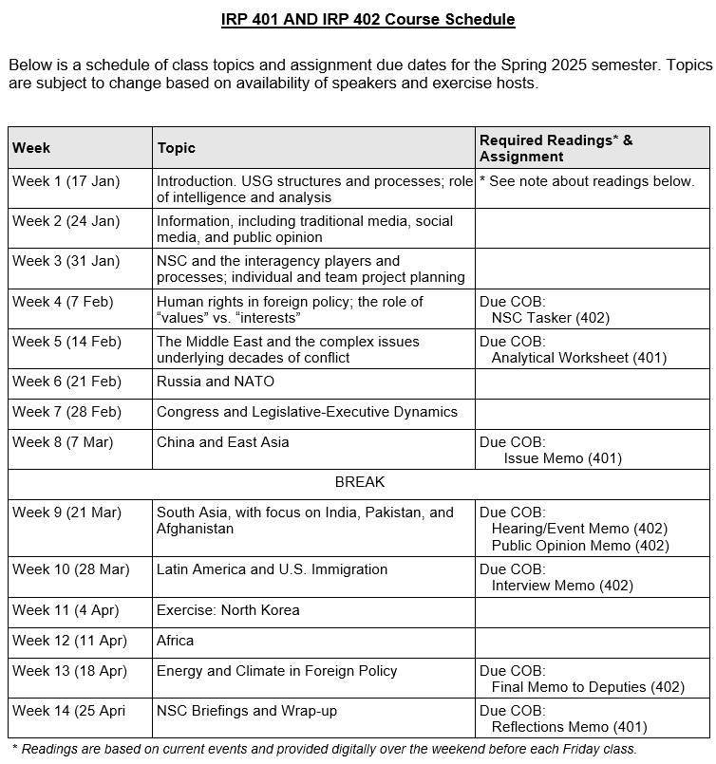
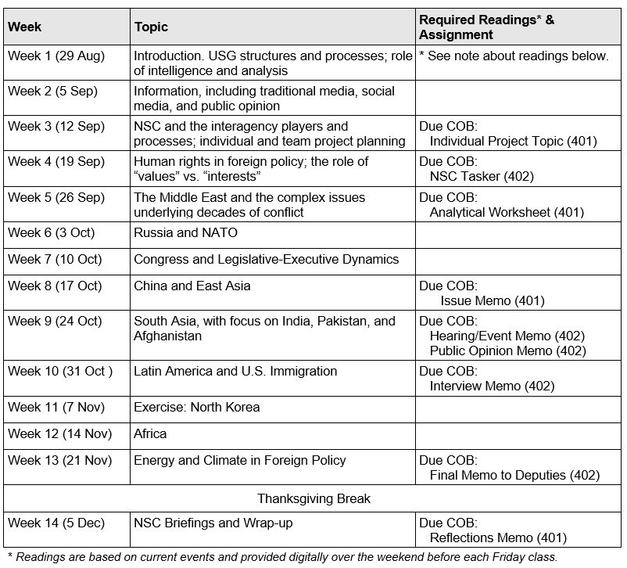
✓
✓
401
✓
402
✓
✓
✓
✓
✓
✓

Slide 33
Look like a lot?
✓
✓
✓
✓
✓
✓
✓
✓
✓

Slide 34
Look like a lot?

Slide 35
FORMAT NOTE
Submit all products in PDF format – so I can see exactly how you want it to appear (and so you have flexibility in software you use).
Use TIMES NEW ROMAN or APTOS (or CALIBRI); 12 point.
Paragraphs should be:
Single-spaced
NOT justified margins
With 12 points between them
WRITE CLEARLY, SIMPLY, CONCISELY. PROOFREAD!!!!!

Slide 36
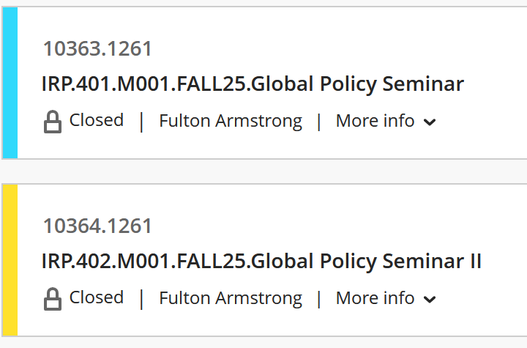
BLACKBOARD NOTES
We will use only 401.

Slide 37
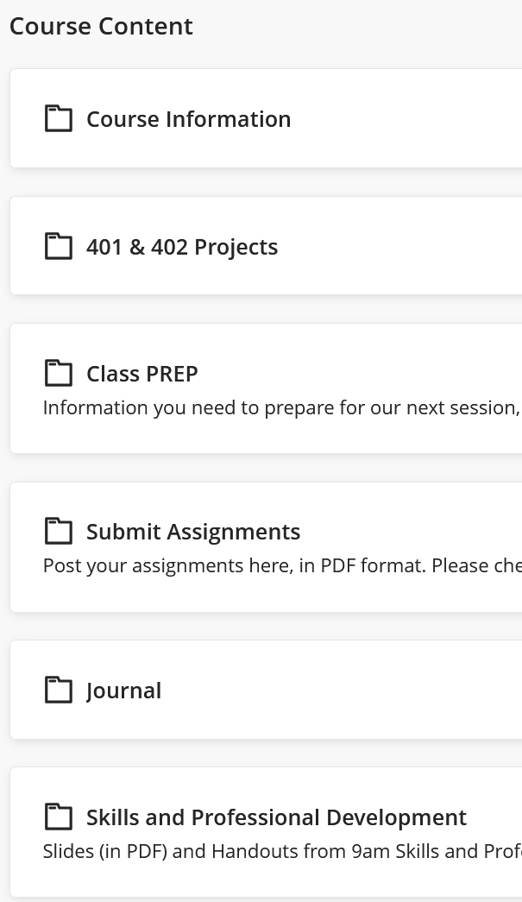
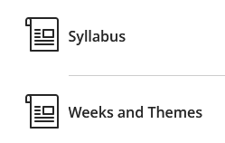

Slide 38
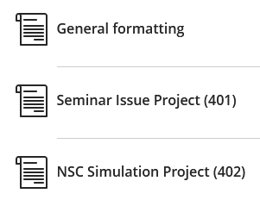
Guidance and Templates

Slide 39
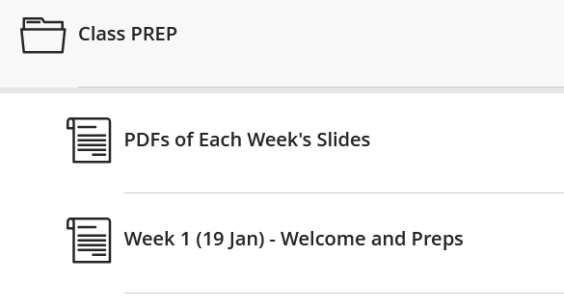
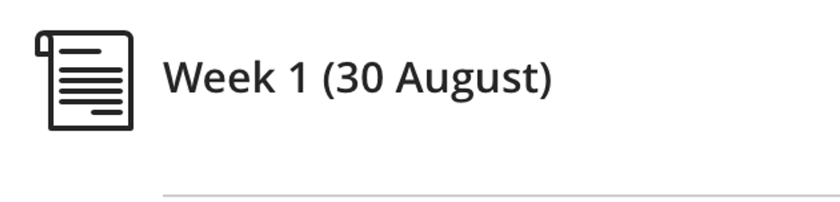
(Date)
Weekly prep e-mails from me
Saturday or Sunday; updated as needed
Schedule
Readings (for discussions and quizzes)
Assigned introductions of guests

Slide 40
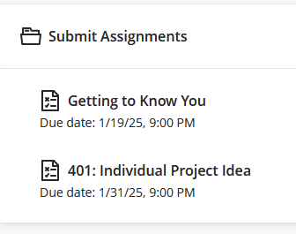

Slide 41
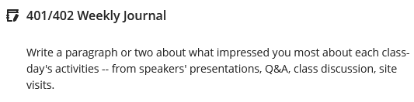
Weekly highlights from activities, speakers, readings
Short, but thoughtful
Counts toward participation grade but not graded each week

Slide 42
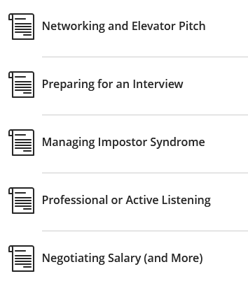

Slide 43
Soon to be added: Quizzes
On readings or current events
Brief writing exercises
Count toward participation grade

Slide 44
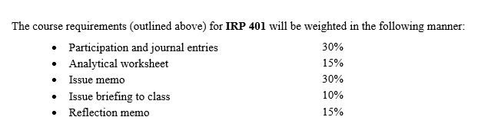
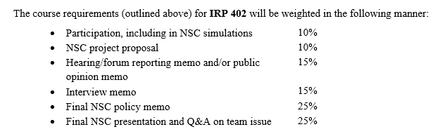
Grading
The course will provide varied opportunities for students to succeed and grow, and effort – as well as accomplishment – will be evaluated. Full attendance and active participation, including coming to each session prepared to discuss the readings and engage in thoughtful discussion with guest speakers, are expected.
Participation includes effective use of guest speakers to - Learn about the issues - Learn/practice elicitation - Explore new ideas

Slide 45
Religious Observance Notification Deadline: Monday, 15 September
Attendance and Preparation: Students are expected to attend (and be on time for) every class. Each Friday’s schedule is aggressive and requires that absences be for only exceptional purposes and be approved by the professor in advance. (Religious observances, health emergencies, and other compelling circumstances are understandable. Pursuit of long weekends is not an exceptional purpose.)
If you are absent, you will write a one-page (400 words) paper on the readings for that day.
If you feel that you cannot commit to attending every class, this may not be the right semester for you to be in the program.

Slide 46
Several words of wisdom:
Sometimes I will call you out, but … even if I don’t … don’t assume I don’t know what you’re doing.
Same thing on ethics issues such as use of ChatGPT.
I am concerned about artificial intelligence, but I worry more about natural stupidity.

Slide 47
Academic Integrity and “Artificial Intelligence”
Syracuse’s academic integrity expectations extend to the fast-growing realm of artificial intelligence (AI). In 401-402, some limited use of AI is permitted, per below.
Based on the specific learning outcomes and assignments in this course, artificial intelligence (e.g., ChatGPT) is permitted on the following: Memo #1 (for 401) and the research (pre-drafting) phase of the Project Proposal, Public Opinion, and Final Memo (for 402). Tools that aid in good writing, such as Grammarly, are also permitted. See each assignment for more information about what artificial intelligence tools are permitted and to what extent, as well as citation requirements. If no instructions are provided for a specific assignment, then no use of any artificial intelligence tool is permitted. Any AI use beyond that which is detailed in course assignments is explicitly prohibited except when documented permission is granted.
In other words, the professor’s policy is that the work for 401 and 402 must be original and produced by the students themselves. Students can use ChatGPT and other AI tools, as well as the usual search tools like Google, during the research phase of their projects (such as in building Memo #1) – to find information and identify possible primary sources of information – but the reasoning, analysis, and writing must be entirely their own. They will be required to certify that everything they submit is written by themselves and that they “have appropriately identified elements taken from other sources.”
pp. 4-5 of Syllabus

Slide 48
Late Assignment Policy: All work should be handed in on time unless otherwise arranged with the professor. Five points (or one-half grade) will be deducted for each day an assignment is late. For example, if an assignment is due on a Friday – at which time it would receive a grade of 80 – Saturday submission will lower the grade to 75.

Slide 49
✓
✓
401
✓
402
✓
✓
✓
✓
✓
✓

Slide 50
✓
✓
401
✓
402
✓
✓
✓
✓
✓
✓

Slide 51
THREE TASKS TO START IMMEDIATELY
1. Think of topics you would like to do for 401 and 402.
Interested in.
Relevant to U.S.
Developing, evolving.
International or domestic.
Some policy decision.
Balance between tactical and strategic.
You do it alone.
You do with one partner.
2. Start talking with potential partners.
(Not just a friend. Look for value-added.)
3. Here’s a list of candidate issues for team project.

Slide 52
TOPICS FOR YOUR CONSIDERATION
What should the United States do about … ?
Ukraine cease-fire or treaty
Gaza war, sovereignty, future
Israel relations after Netanyahu
Iran and its evolving nationalism
China (multiple aspects)
Enhancing cybersecurity
Aid to Gaza
DPRK and Kim’s strategy
UN environmental efforts
Russia and dealing with Putin
U.S. culture wars
Microplastics and PFAS
AI and socio-economic
Cryptocurrency risks
Declining birth rates
Economic, trade competition
Southeast Asia
Taiwan
Other challenges.
CRITERIA:
Interesting to classmates.
Relevant.
Already know something.
Dynamic, evolving.
Articulable U.S. interest.

Slide 53
Ukraine cease-fire or treaty
Gaza war, sovereignty, future
Israel relations after Netanyahu
Iran and its evolving nationalism
China (multiple aspects)
Enhancing cybersecurity
Aid to Gaza
DPRK and Kim’s strategy
UN environmental efforts
Russia and dealing with Putin
U.S. culture wars
Microplastics and PFAS
AI and socio-economic
Cryptocurrency risks
Declining birth rates
WANT TO EXPRESS AN INTEREST NOW?
Send me TWO e-mails by 9pm next Friday (5 September):
One on your individual project proposal.
One with a proposed partner on a team proposal.
Topic with one sentence on main story and one sentence on policy options.

Slide 54
REPEAT
THREE TASKS TO START IMMEDIATELY
1. Think of topics you would like to do for 401 and 402.
2. Start talking with potential partners for 402.
3. By 9pm next Friday (5 September), send me e-mails with proposals for BOTH.
One as individual on your individual (401) topic.
One with proposed partner on your NSC (402) topic.

Slide 55
QUESTIONS or COMMENTS?
About …
the syllabus?
your 401 and 402 projects?
the guest speakers and off-campus visits?
the immediate deadlines?

Slide 56
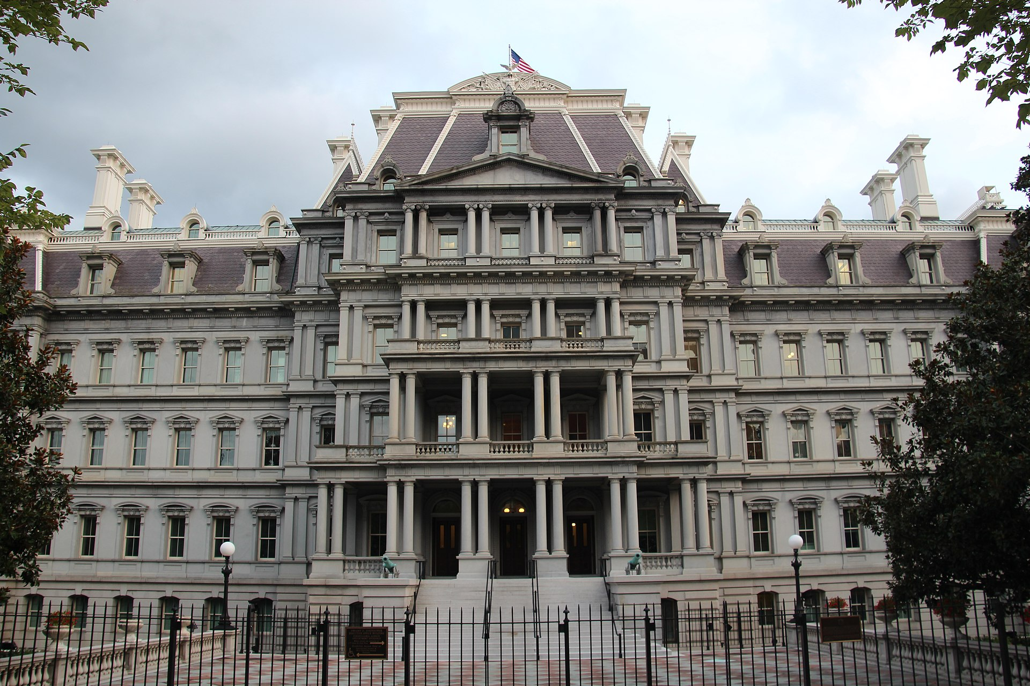
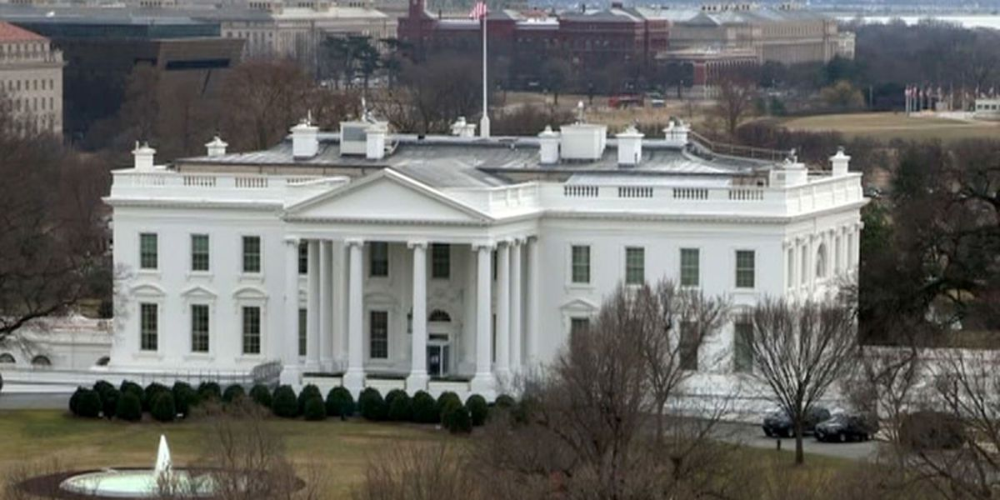
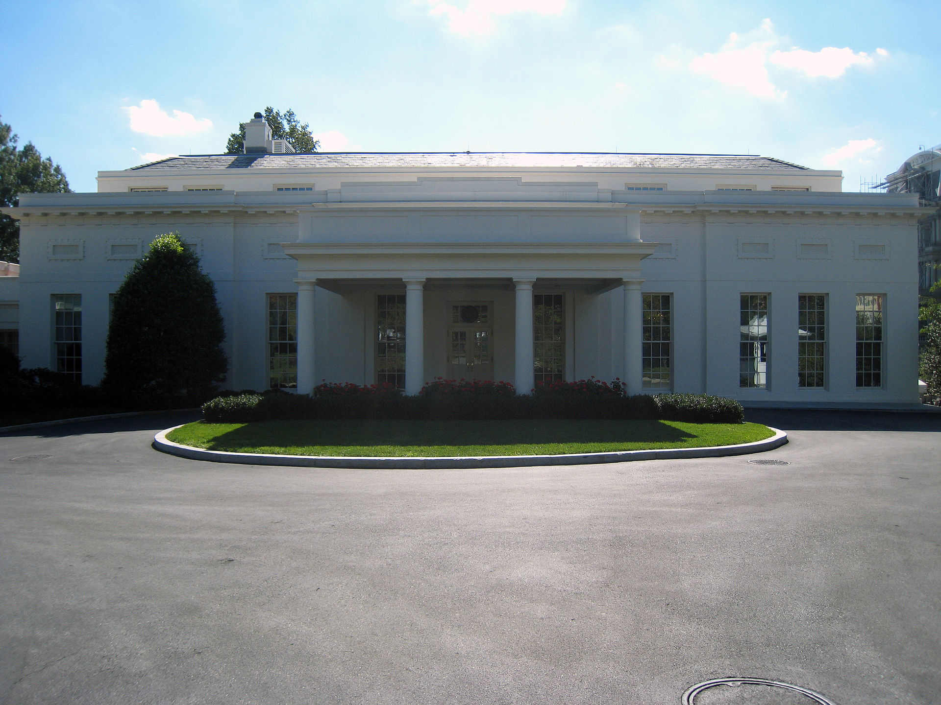
The National Security Council
NSC SIMULATION

Slide 57
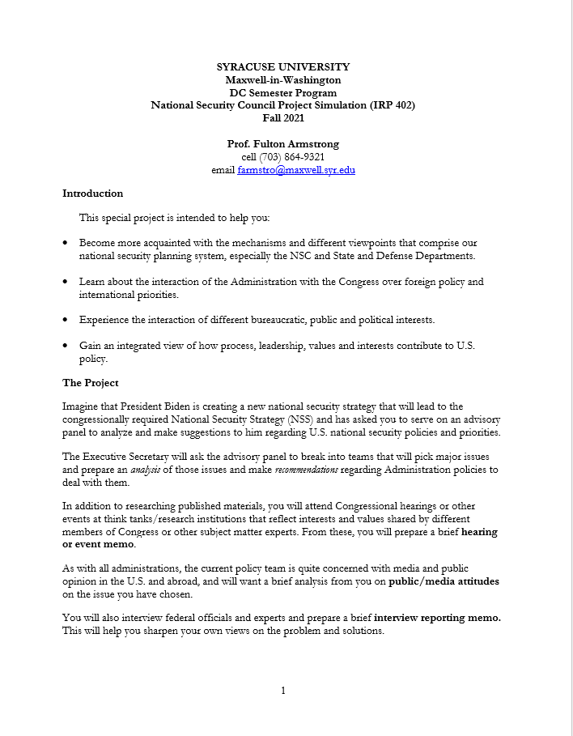
NSC PROJECT
From BlackBoard
Objectives
Design
Assignments
Grading
Any early ideas on topics you’d like to work?

Slide 58
NSC PROJECT
Teams and Proposals
1 or 2 people
“Major international issues and challenges to U.S. national security interests” or OTHER
Sample list in tasker
Other ideas, including non-IR
Common interest,
complementary skills, background

Slide 59
NSC PROJECT
DEADLINES
Choose partners and topics | Discuss today
Seek each other’s agreement and propose to me by e-mail | Deadline: 9pm on Friday, 26 Jan
Finalize Teams and topics by e-mail with me | Deadline: 9pm on Friday, 2 Feb
Finalize proposals; submit tasker | 9 Feb
Hearing/event memo | 22 Mar
Public opinion memo | 22 Mar
Interview memo | 29 Mar
Final memo | 19 Apr
Presentation and Defense | 26 Apr

Slide 60
SEMINAR PROJECT
“Issue focus worksheet”
DEADLINES
Choose a topic you’re interested in and already know pretty well | As soon as reasonable
Propose that topic to me in “Submit Assignments” area | Deadline: 9pm on Friday, 2 Feb
Begin organizing thoughts, finding info to fill gaps, thinking about issue. | As soon as reasonable
Prepare 1- or 2-sentence briefing on your topic for class | 9 Feb (in class)
Submit analytical worksheet | Deadline: 9pm on Friday, 16 Feb

Slide 61
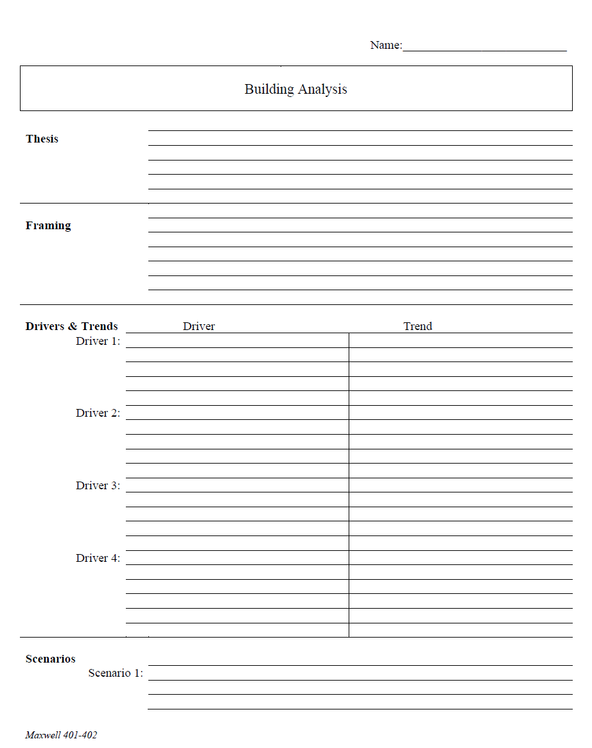
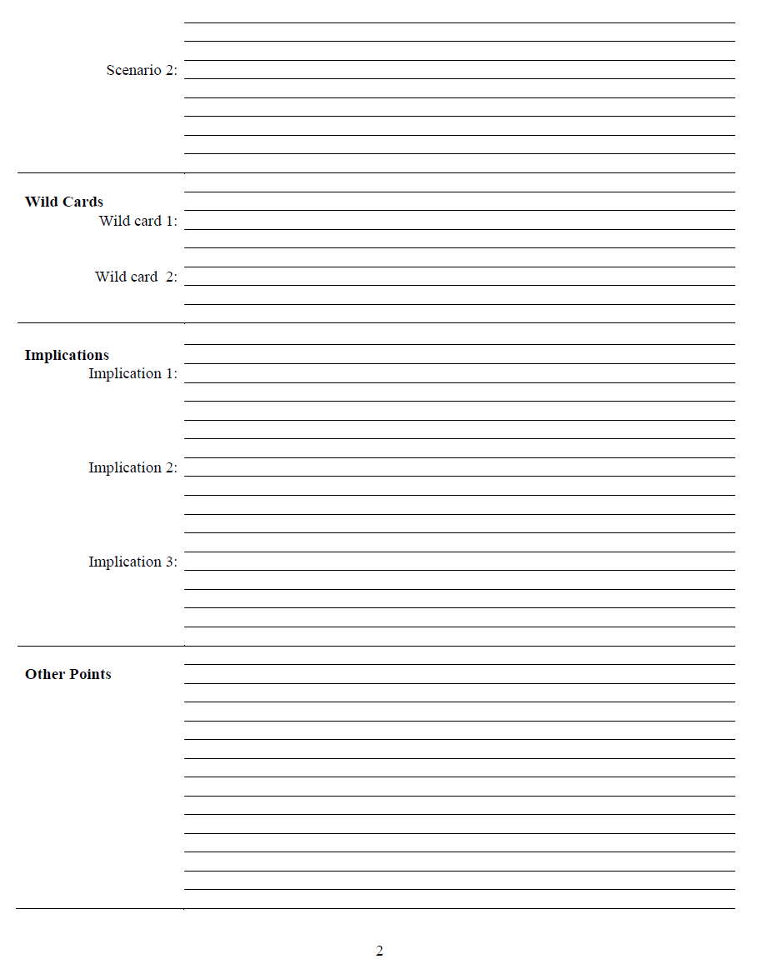
What is an analytical worksheet?
Purpose
Forms
ONE KIND
HANDOUT D

Slide 62
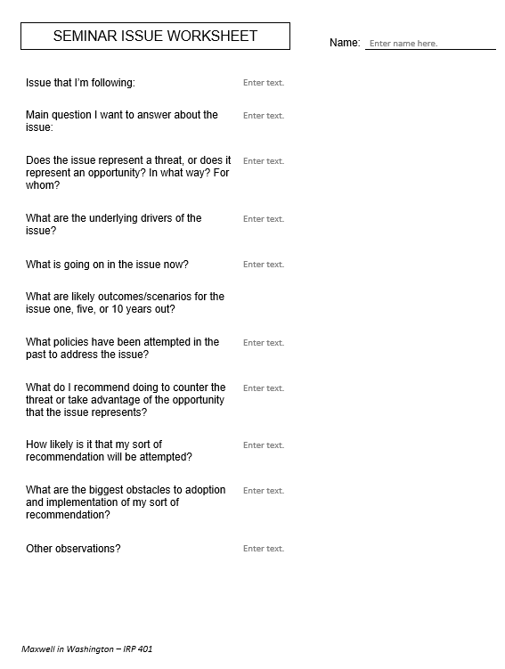
Issue that I’m following:
Main question I want to answer about the issue:
Does the issue represent a threat, or does it represent an opportunity? In what way? For whom?
What are the underlying drivers of the issue?
What is going on in the issue now?
What are likely outcomes/scenarios for the issue one, five, or 10 years out?
What policies have been attempted in the past to address the issue?
What do I recommend doing to counter the threat or take advantage of the opportunity that the issue represents?
How likely is it that my sort of recommendation will be attempted?
What are the biggest obstacles to adoption and implementation of my sort of recommendation?
Other observations?
for 401
drivers!!

Slide 63
Are you clear on what you’re going to do, and when?

Slide 64
Also …
Journal entry each week (begin today)
short, short, short
insightful
main takeaway or impression

Slide 65
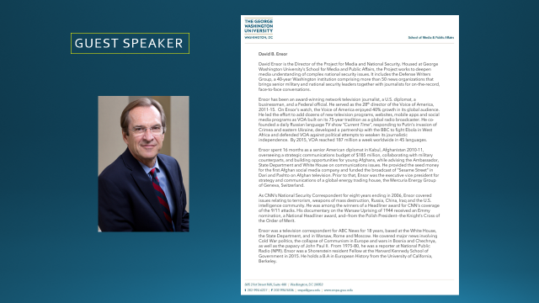

Break?
Guest?
Discussion?

Slide 66
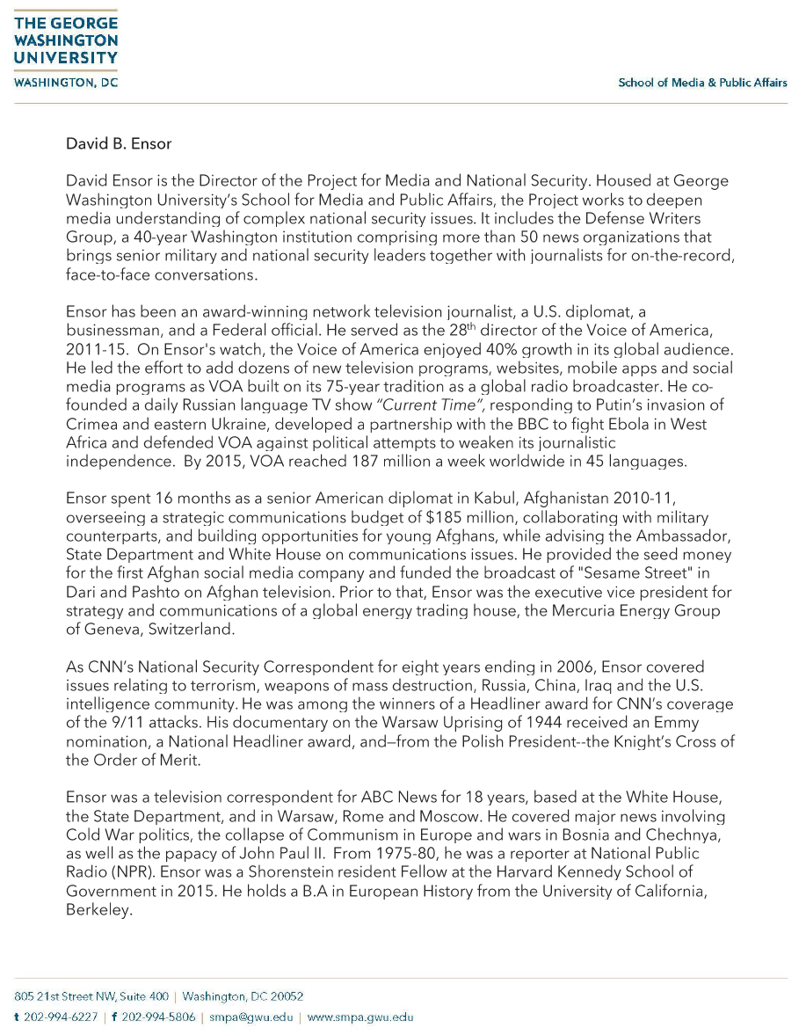
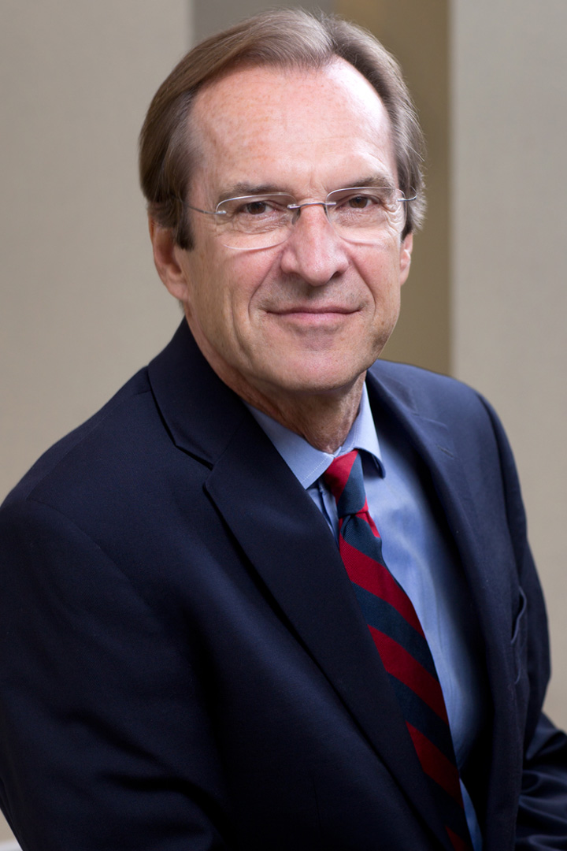
GUEST SPEAKER

Slide 67
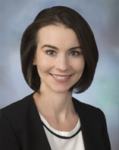
GUEST SPEAKER
Siobhan Sheils
Associate Vice President with The Cohen Group
2015-2017 | - NSC Director for Central America and the Caribbean - Reestablishment of US-Cuba ties
Prior | - Special Assistant to two Deputy Secretaries of State and the Under Secretary of State for Political Affairs
 | - Desk Officer for Guatemala; resolve CAFTA trade dispute
 | - Bureau of Human Resources and Staff Assistant in the Bureau of Western Hemisphere Affairs
 | - Superior honor award and four meritorious honor awards
Teach for America | Taught eighth grade English for four years in the South Bronx and Newark, New Jersey
Higher Education | Master’s of International Relations and Master’s in Public Relations, Syracuse University
 | Bachelor’s, Boston College

Slide 68
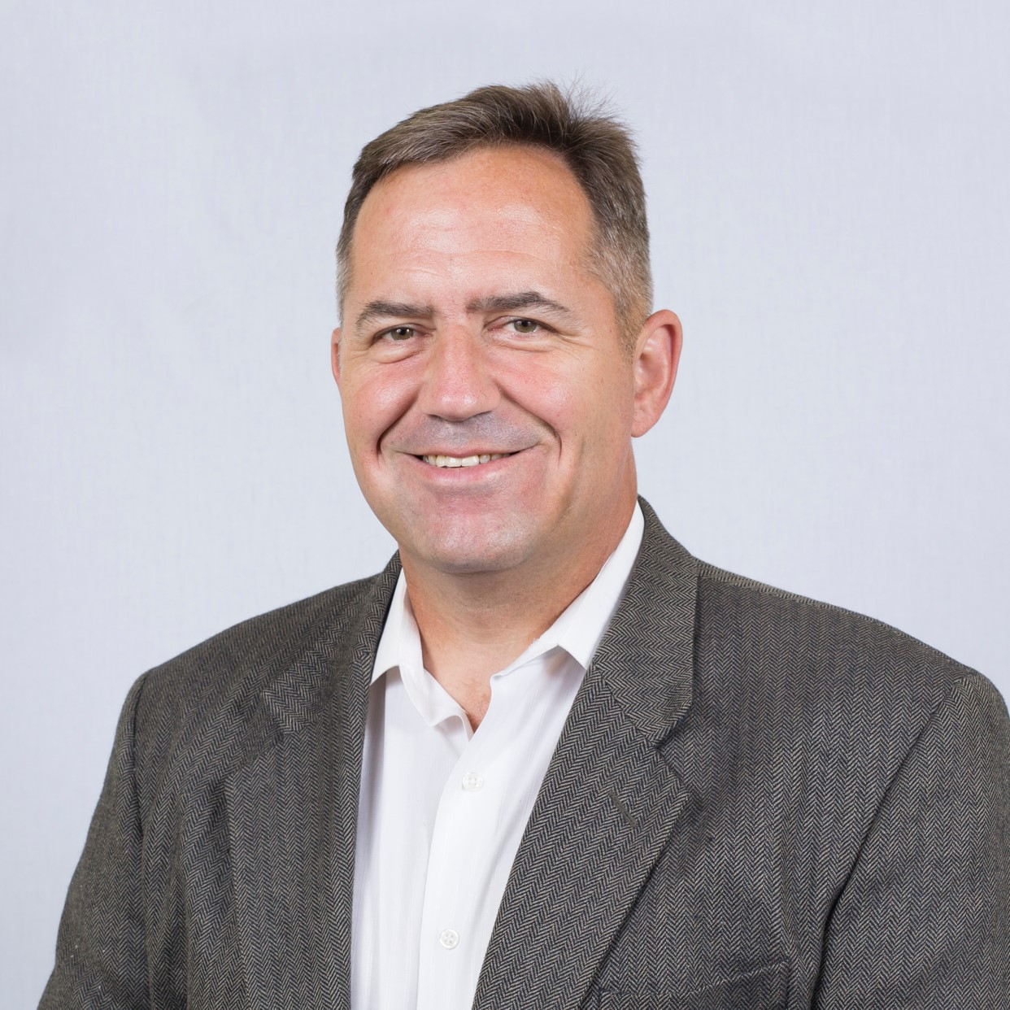
GUEST SPEAKER
COL (R) Bob Wilson
Director, Strategic Initiatives Global Venture National Resources Consulting Organic farmer Freelance writer
 | 27 years, U.S. Army Special Forces Northern and Western Africa CT activities Including al Qaeda, ISIS, Boko Haram Special Ops in Afghanistan
 | NSC Director for Counterterrorism, with focus on Africa
Education | MBA, Webster University
 | Master’s, Resource Strategy, NDU
 | Master’s, Military Arts and Sciences, School of Advanced Military Studies
 | Bachelor’s, Finance, UConn

Slide 69
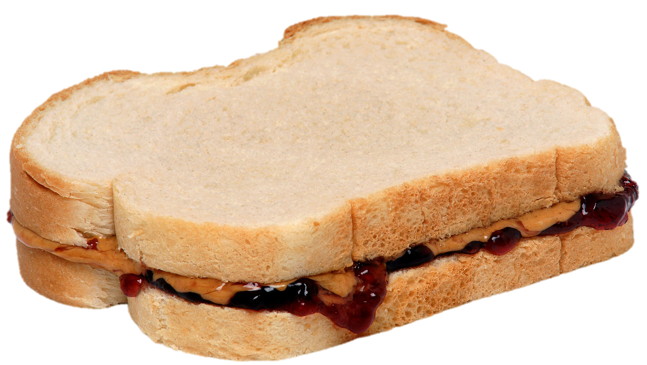
LUNCH

Slide 70
The United States Government
How does it formulate foreign policy?

Slide 71
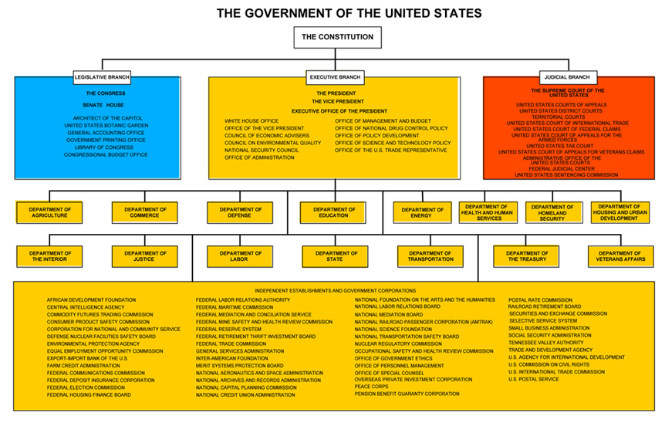
© Columbia University Library

Slide 72
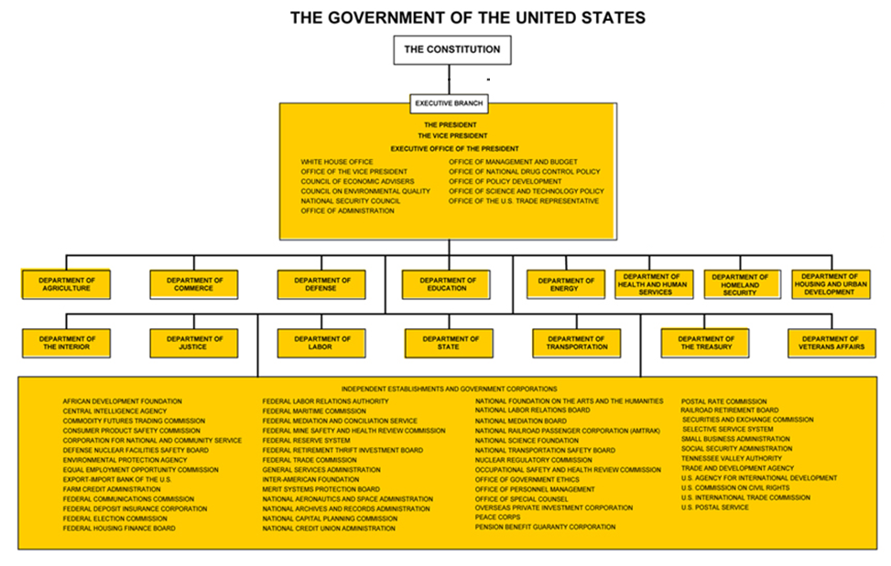
How do they
communicate?
intermediate?
coordinate?
The “Interagency Process”
NSC Principals
NSC Deputies
Interagency Policy Committees
Informal tools
© Columbia University Library

Slide 73
The U.S. “Interagency”
A super-fast tour
White House through NSC (and OMB)
“The interagency process”
Departments/agencies
State
Defense (OSD and JCS)
USTR
DHS (and agencies)
DOJ
Others with international role

Slide 74
How do they stay informed?
The media
Other public sources
Government sources
Print
Electronic
Social
Congress
Interest groups
Think tanks
Intelligence
Bureaucracy
Cabinet

Slide 75

The U.S. Intelligence Community

Slide 76
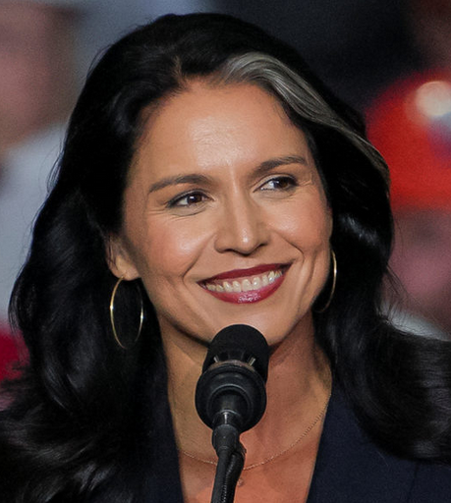
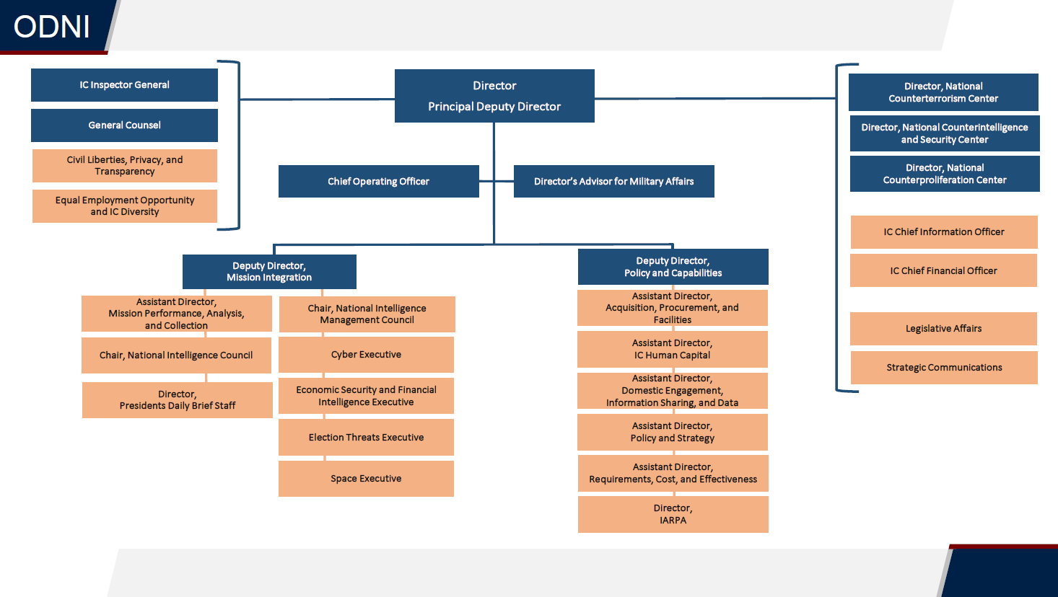
Tulsi Gabbard

Slide 77
The U.S. Intelligence Community is composed of the following 18 organizations:
Two independent agencies—the Office of the Director of National Intelligence (ODNI) and the Central Intelligence Agency (CIA);
Nine Department of Defense elements—the Defense Intelligence Agency (DIA), the National Security Agency (NSA), the National Geospatial- Intelligence Agency (NGA), the National Reconnaissance Office (NRO), and intelligence elements of the five DoD services; the Army, Navy, Marine Corps, Air Force, and Space Force.
Seven elements of other departments and agencies—the Department of Energy’s Office of Intelligence and Counter-Intelligence; the Department of Homeland Security’s Office of Intelligence and Analysis and U.S. Coast Guard Intelligence; the Department of Justice’s Federal Bureau of Investigation and the Drug Enforcement Agency’s Office of National Security Intelligence; the Department of State’s Bureau of Intelligence and Research; and the Department of the Treasury’s Office of Intelligence and Analysis

Slide 78

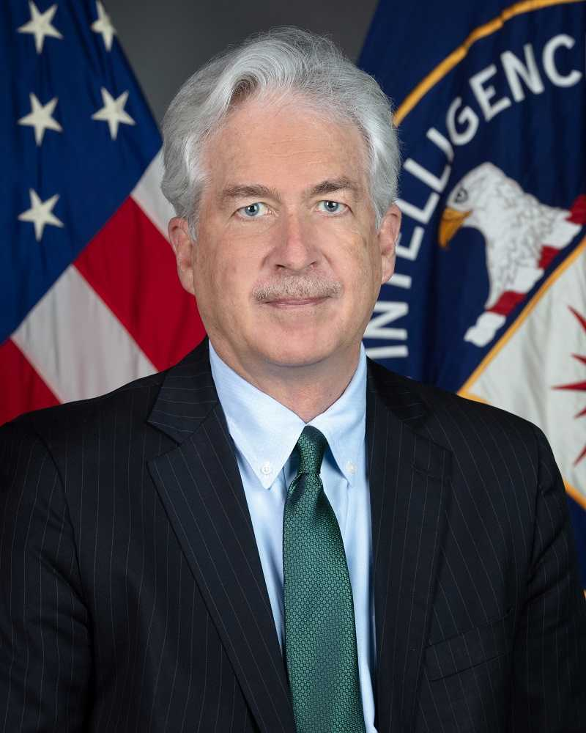
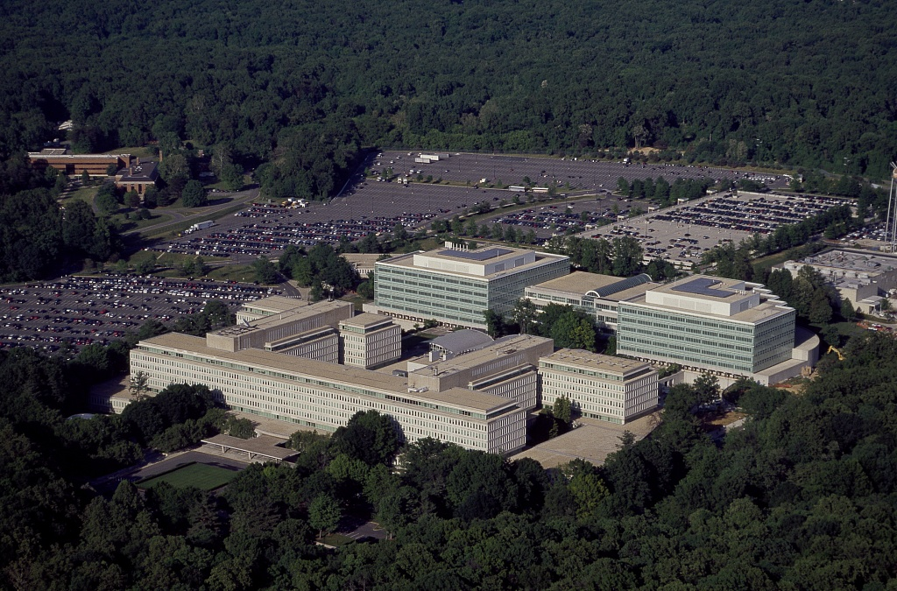
William J. Burns

Slide 79
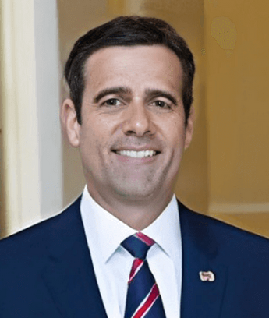
John Ratcliffe

Slide 80
“Our mission is straightforward but critical: leverage the power of information to keep our Nation safe.”
But is it just that?
Foreign Intelligence (FI)
Covert Action (CA)
Paramilitary (PM)

Slide 81
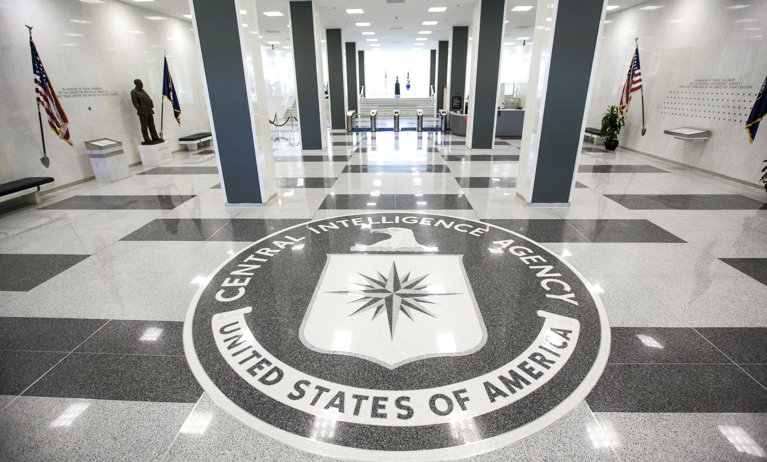


It is engraved …
John 8:32
CIA MOTTO

Slide 82
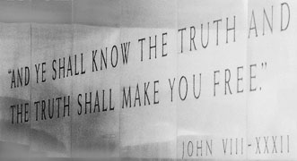
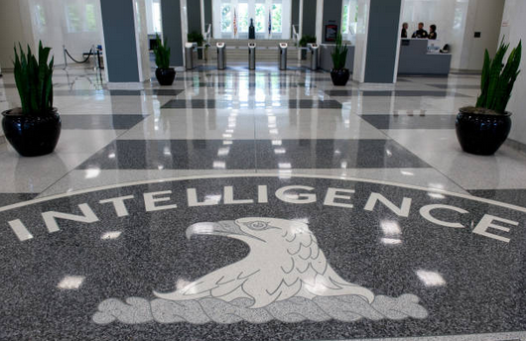
CIA Motto

Slide 83
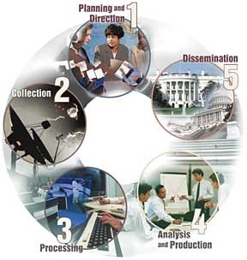
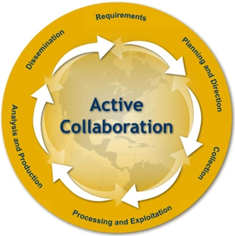
The “Intelligence Cycle”
“Requirements”

Slide 84
Discussion and Synthesis
What are your impressions of how decisions are made in Washington?
What voices influence it?
Do you think the mix of voices is correct?
Given the Intelligence Community’s mixed record, do you think it should be given more responsibility or less?
What improvements, if any, do you think should be considered, and who do you think should consider them or push them?

Slide 85
GUEST SPEAKERS

Slide 86

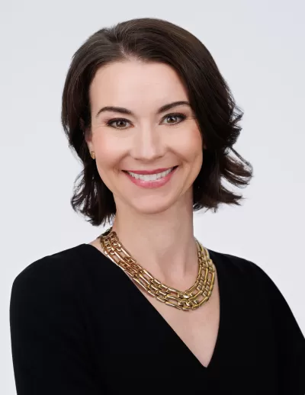
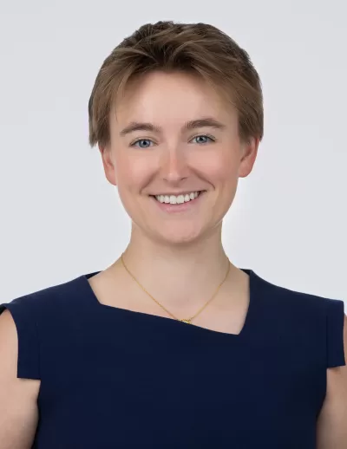
GUEST SPEAKERS
Introduced by Jessica
Siobhan Sheils
Katie Tyner

Slide 87
LUNCH

Slide 88
Interest
Expertise
Relevance
PROJECT ISSUES
Relevance
Information
Time
How to choose them?
How to frame them?
How to build them?
How to make them actionable?
Assess info and gaps
Develop hypothesis
Develop arguments
Develop options
Stay loyal to analysis
Write clearly, efficiently

Slide 89

The Heartbeat of Analysis (and Policy)
“DRIVERS”
The forces, needs, desires, and other factors that make things happen and influence outcomes.

Slide 90

What are drivers?
Interests
Borrowing from the “3-i framework” …
Ideas
Institutions
In our PERSONAL lives …
Interests | Ideas | Institutions
Work Food Love - Sex Family Home Transportation Entertainment Recreation Challenges | Education Religion or values Political thought Ideology Imposed expectations | Parents Boy/Girlfriend Husband/Wife Colleagues Friends Political party Employer
drivers

Slide 91
What are drivers?
Interests
BOOTCAMP
Borrowing from the “3-i framework” …
Ideas
Institutions
In our PERSONAL lives …
Interests | Ideas | Institutions
Work Food Love - Sex Family Home Transportation Entertainment Recreation Challenges | Education Religion or values Political thought Ideology Imposed expectations | Parents Boy/Girlfriend Husband/Wife Colleagues Friends Political party Employer
drivers

Slide 92
What are drivers?
Interests
Borrowing from the “3-i framework” …
Ideas
Institutions
In our NATIONAL lives …
Interests | Ideas | Institutions
Power/influence Needs Desires/ambitions Wealth Economic performance | Self-definition Nationalism History Concepts/logic Values Ideology | Leadership Abilities/constraints Economic structures Intermediation Inclusion Topography/geography Climate
drivers

Slide 93
What are drivers?
Interests
BOOTCAMP
Borrowing from the “3-i framework” …
Ideas
Institutions
In our NATIONAL lives …
Interests | Ideas | Institutions
Power/influence Needs Desires/ambitions Wealth Economic performance | Self-definition Nationalism History Concepts/logic Values Ideology | Leadership Abilities/constraints Economic structures Intermediation Inclusion Topography/geography Climate
drivers

Slide 94
What are drivers?
BOOTCAMP
“FUEL”
“FRICTION”
Effort/energy
Resources
Technology, etc.
to PUSH a solution.
Obstacles
Resistance
Limitations, etc.
that OBSTRUCT a solution.
“Forward” drivers
“Status Quo” or “Backward” drivers

Slide 95

The GOAL
For your work to be strong.
For you to be efficient.
For you to be confident.

Slide 96
Issue that I’m following:
Main question I want to answer about the issue:
Does the issue represent a threat, or does it represent an opportunity? In what way? For whom?
What are the underlying drivers of the issue?
What is going on in the issue now?
What are likely outcomes/scenarios for the issue one, five, or 10 years out?
What policies have been attempted in the past to address the issue?
What do I recommend doing to counter the threat or take advantage of the opportunity that the issue represents?
How likely is it that my sort of recommendation will be attempted?
What are the biggest obstacles to adoption and implementation of my sort of recommendation?
Other observations?
ALL CLEAR??

Slide 97
What topics are you interested in?
402 (team) project?
E-mail agreement on partners and topic:
Next Friday (26 Jan) evening
E-mail final agreement:
Friday, 2 Feb, evening
401 (individual) project?
E-mail on topic :
Next Friday (26 Jan) evening
Submit proposal as assignment:
Friday, 2 Feb, evening

Slide 98
Global Policy Seminar and NSC Simulation
IRP 401 - IRP 402
Week One 19 January 2024
Prof. Fulton T. Armstrong

Slide 99
GUEST SPEAKER
Former intelligence officer
What do intelligence agencies do, and what is their role in Washington policy processes?

Slide 100
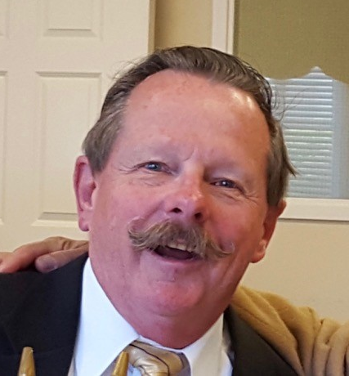
GUEST SPEAKER (2:30pm)
What is the role of intelligence (and intelligence agencies) in U.S. foreign policy?
How is intelligence collection planned and conducted?
What is the difference in substance and impact between “raw” and “finished” intelligence?
William Ortman

Slide 101
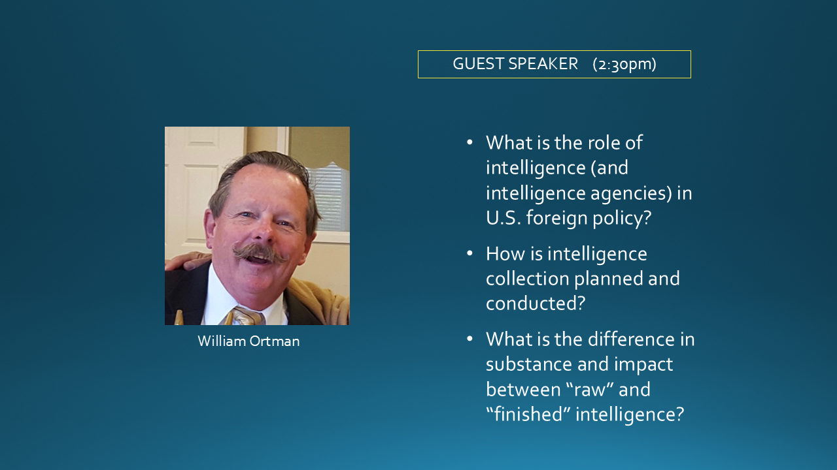

Questions
Comments
Experiences

Slide 102

WRAPUP

Slide 103
TODAY’S AGENDA
9:00 | Skills session - Analysis
10:15 | Welcome; Introductions; Questionnaire; Semester Overview; Syllabus and Projects
12:00 | Lunch (provided) Samantha Clemence – Ass’t Director, Washington Programs Internship Course Overview and Requirements
~1:15 | Continue morning session Questions, concerns, suggestions you have
2:30 | Guest speaker: Bill O. Former senior intelligence officer Intelligence and its Role in Policy
4:00 | Wrapup

Slide 104
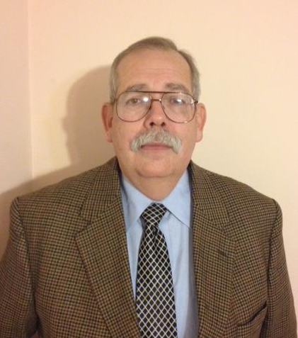
GUEST SPEAKERS (10:30am)
What is the role of intelligence (and intelligence agencies) in U.S. foreign policy?
How is intelligence collection planned and conducted?
What is the difference in substance and impact between “raw” and “finished” intelligence?
William Ortman
Rafael Aguirre-Sacasa

Slide 105
QUESTIONS or COMMENTS?

Slide 106
Global Policy Seminar and NSC Simulation
IRP 401 - IRP 402
Week One 29 August 2025
Prof. Fulton T. Armstrong

