Slide 1
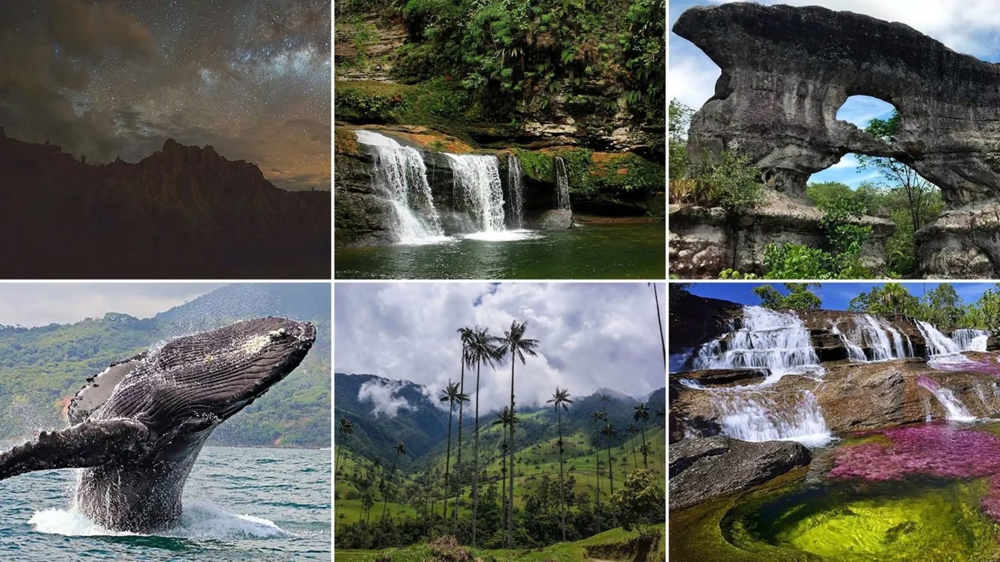
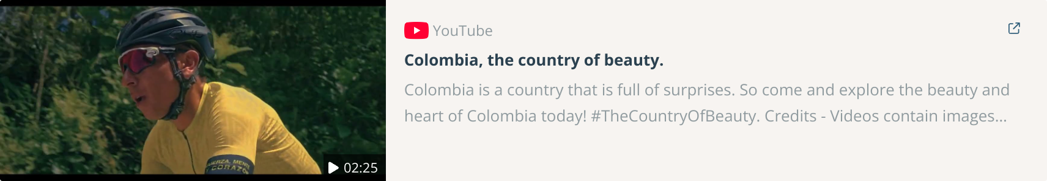
Colombia: the country of beauty

Slide 2
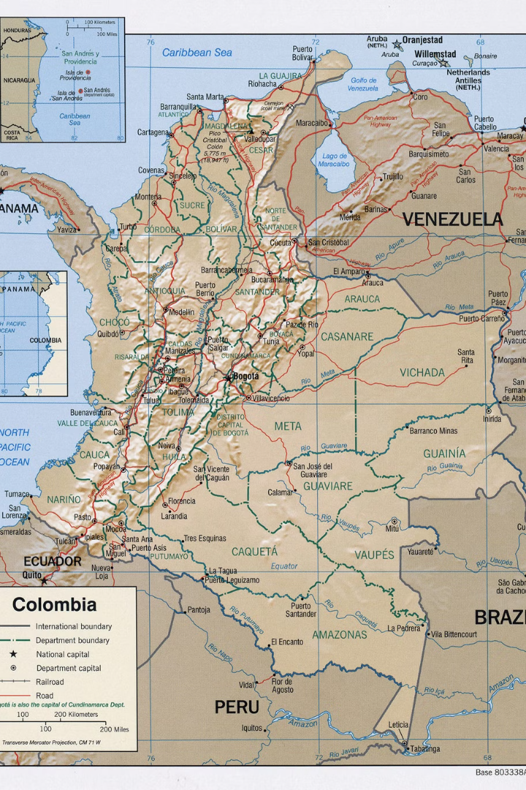
Colombia: Strategic Position, Challenges, and Opportunities
Colombia's strategic bio-oceanic location, geopolitical assets, and alliances position it as a key player in Latin America. However, economic and social inequality, armed conflict, and environmental challenges persist. This presentation explores these issues and opportunities for sustainable development and peace.

Slide 3
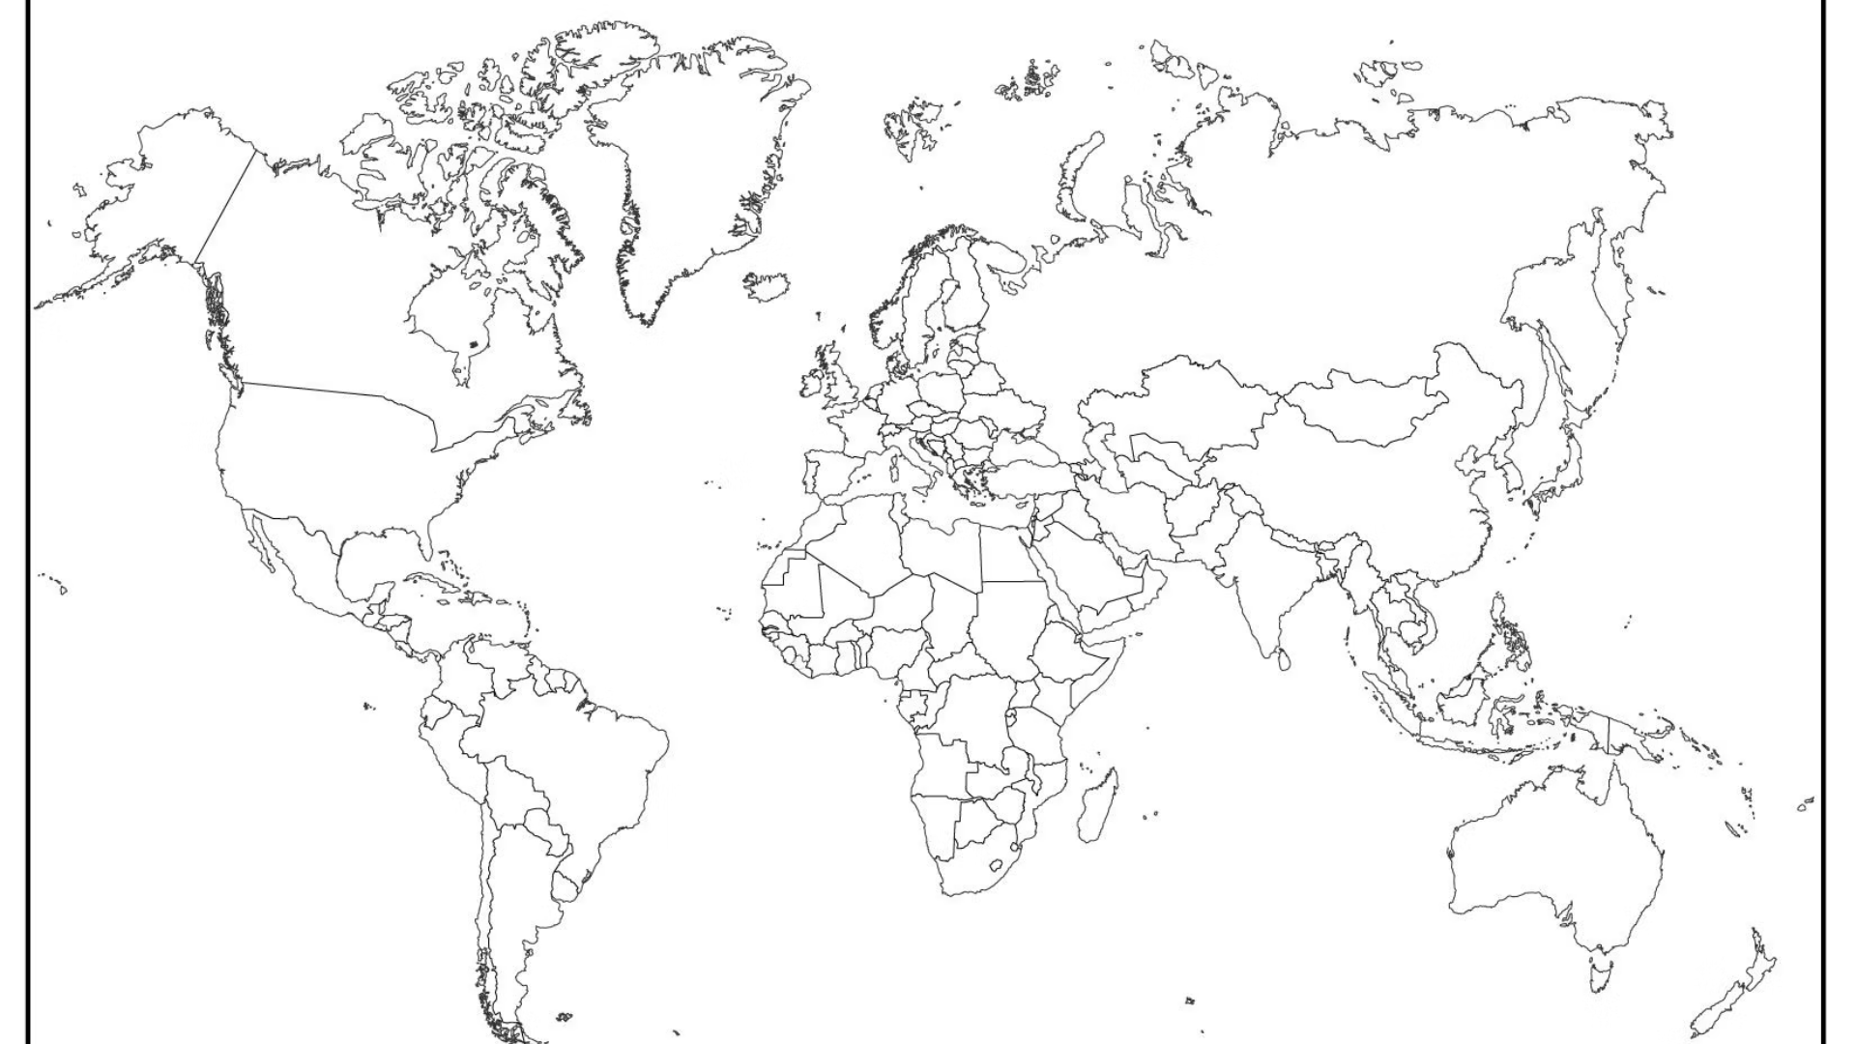
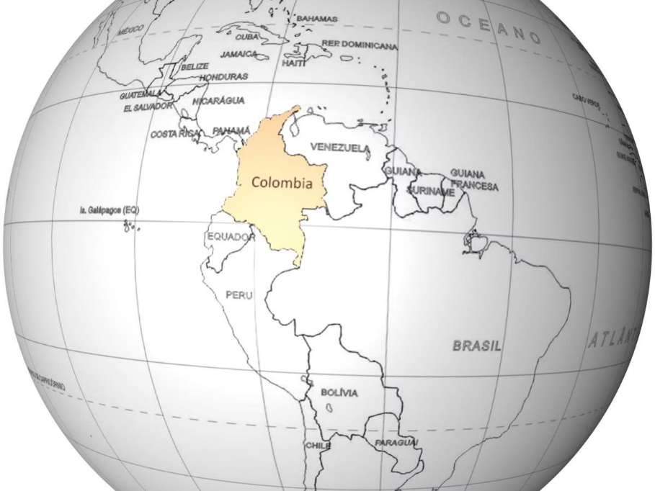
Colombia in the hemisphere

Slide 4

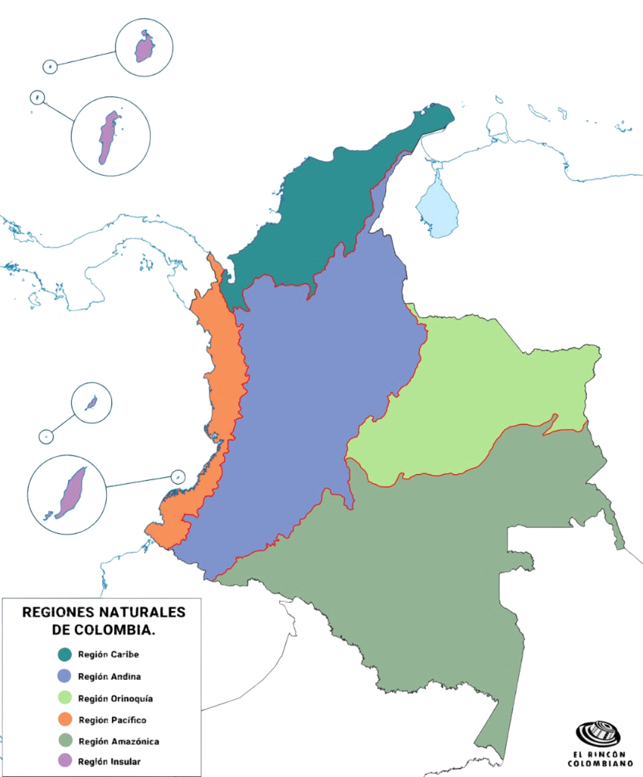
Regions of Colombia

Slide 5
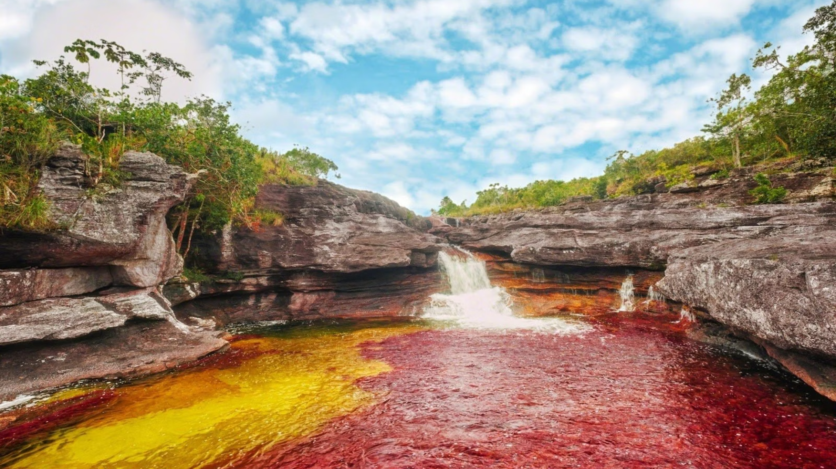
Geopolitical Assets
Strategic Location
Biodiversity Hotspot
Regional Allies
Colombia's bio-oceanic location and its position as a bridge between North and South America give it a unique geopolitical advantage.
As the second most biodiverse country globally, Colombia possesses strategic ecosystems and natural resources of immense value.
Colombia has been a strategic ally of the United States in the Andean region, particularly in security, drug trafficking, and regional stability.

Slide 6
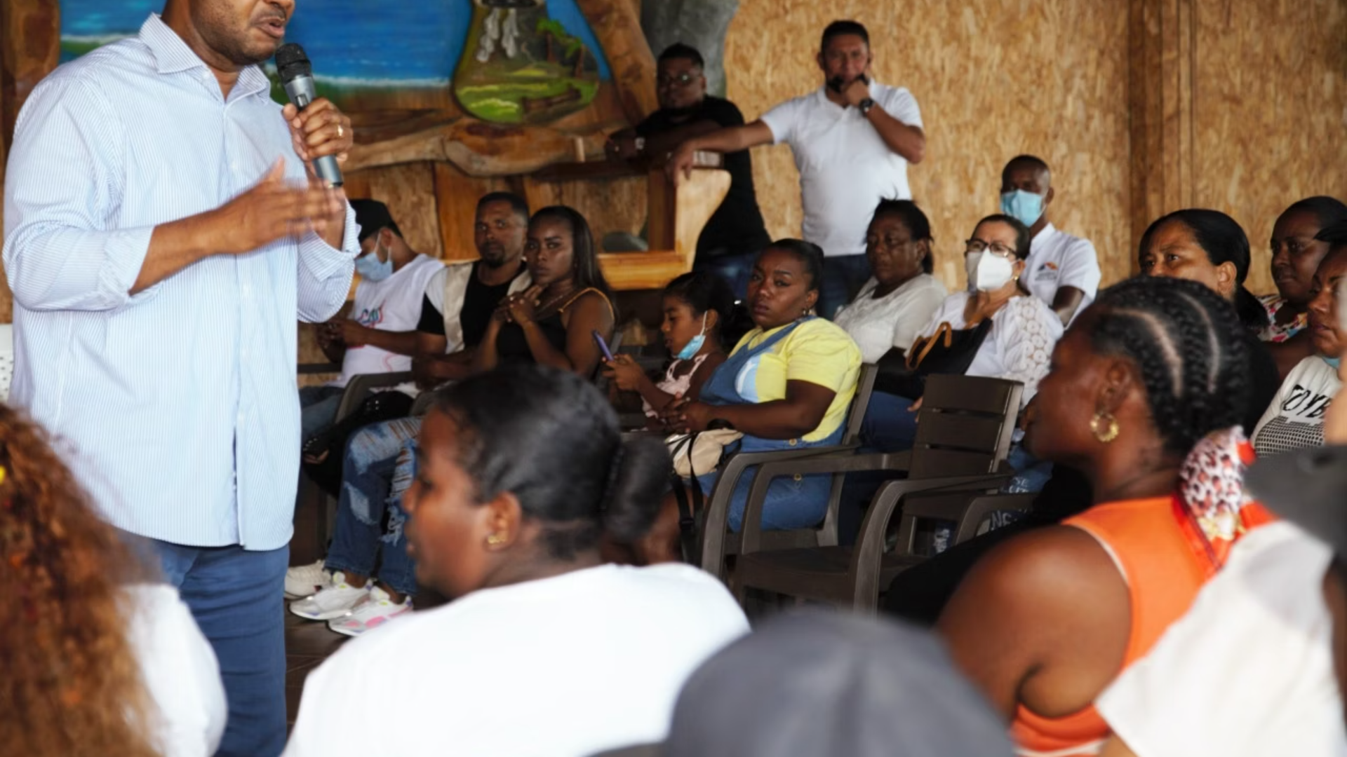
Economic and Social Inequality
Wealth Concentration
Poverty Rates
Unequal Access
High levels of inequality and wealth concentration affect social cohesion and political stability.
More than 30% of the population lives in poverty, with alarming rates in departments like Chocó and La Guajira.
Unequal access to basic services such as education and healthcare, especially in rural areas, exacerbates inequality.

Slide 7
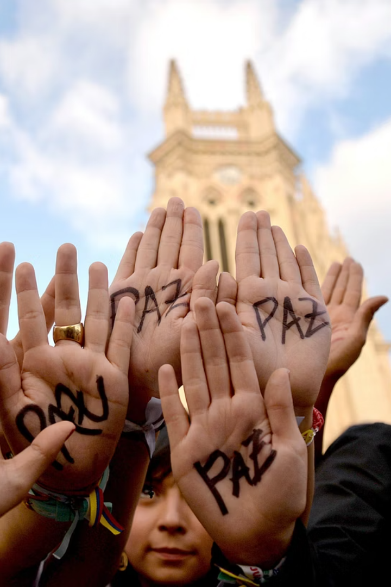



Armed Conflict and Peace Agreement
Deep Inequality
Lack of economic opportunities, particularly in rural areas, has been a determining factor in Colombia's prolonged armed conflict, pushing marginalized populations towards illegal activities.
Displacement
The armed conflict has displaced millions of people from their homes and lands, creating a vulnerable population susceptible to recruitment by illegal armed groups and further exacerbating social instability.
2016 Peace Agreement
The 2016 Peace Agreement aimed to address key issues such as demobilization of armed groups, agrarian reforms to address land inequality, and increased political participation for marginalized communities, but its implementation faces significant obstacles including funding shortages and political resistance.

Slide 8
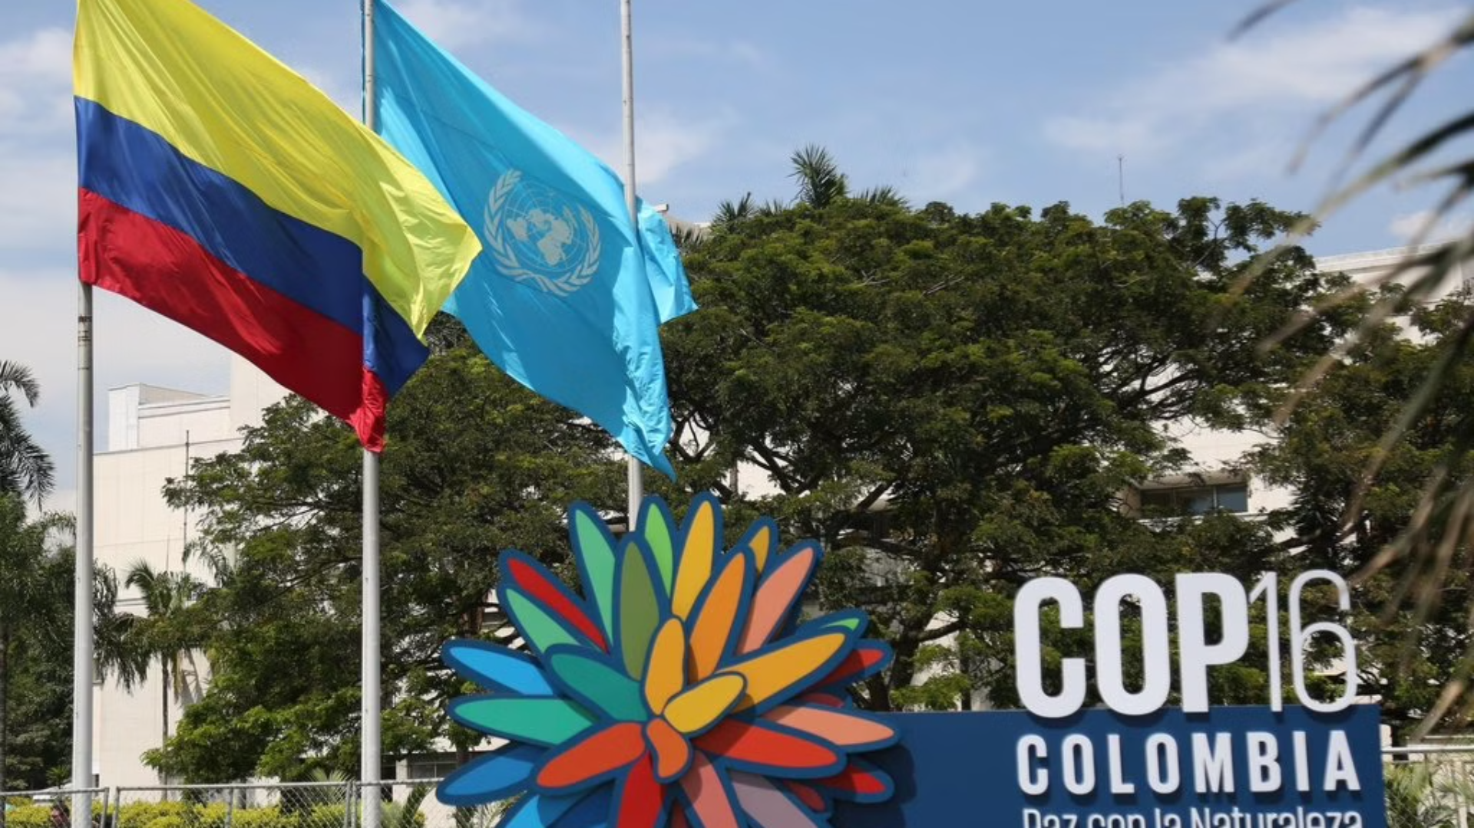



Colombia's Environmental Assets
Colombia's rich biodiversity is key to its sustainable development, with ecotourism offering opportunities for communities affected by conflict and poverty.
Sustainable Development
Conservation of environmental assets is crucial for Colombia's sustainable development.
Balances economic growth with environmental protection and social equity.
2
Biodiversity
Focuses on responsible resource management, renewable energy, and reducing pollution.
Colombia is one of the most biodiverse countries, providing a natural heritage and wealth.
Seeks to improve the quality of life for present and future generations.
Home to a significant percentage of the world's plant and animal species.
1
Includes diverse ecosystems such as rainforests, cloud forests, paramos, and coral reefs.
Ethnic Communities
Important for global climate regulation and conservation efforts.
Ethnic people have managed their territories sustainably for centuries. Their knowledgment is essential to face challenges such as climate change, food security and ecosystem conservation.
3
Much of Colombia's biodiversity is located in ethnic territories.
Cultural and biological diversity are mutually reinforcing.

Slide 9
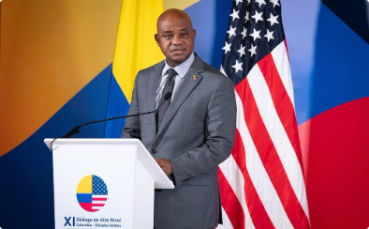
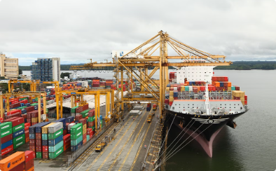

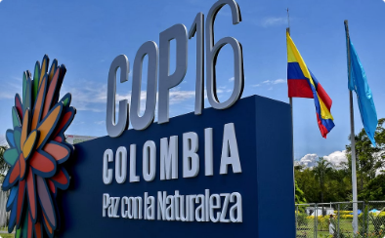
Colombia in the Global Context
Relations with the U.S.
Trade Partnerships
International Relations
Foreign Policy
Colombia is a key player in global trade, exporting goods and services to various regions worldwide.
Colombia's foreign policy is guided by principles such as sovereignty, international law, and peace. The country seeks to project an image of democracy and sustaintable development.
Colombia maintains a strong alliance with the U.S., collaborating on security, trade, and anti-narcotics efforts.
Colombia actively engages with other nations to promote peace, stability, and sustainable development.

Slide 10
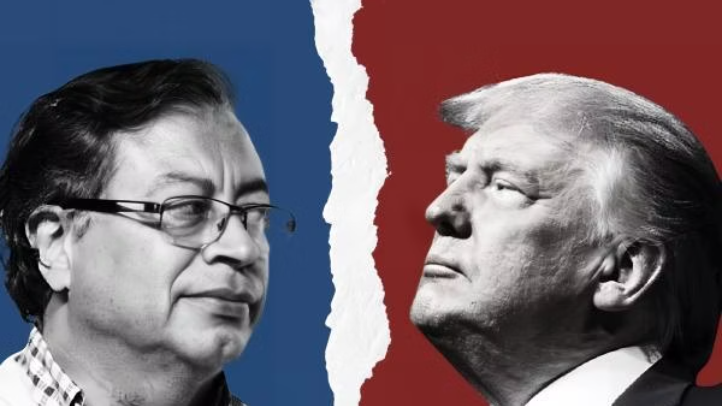
Bilateral Relations: Petro vs. Trump
Petro's Administration
Trump's Administration
Migration policy: Humanitarian and multilateral based on human rights
Migration relationship: Stricter enforcement focused on security and containment
Anti-drug approach: Holistic strategy based on a human, social and public health approch
Anti-drug measures: Emphasis on interdiction, less social strategies and coercitive measures for eradication
Environmental cooperation: Climate change is the core of his international agenda, promoting decarbonization and energy transition. Seeks International cooperation to protect the Amazon and advocatew for shared North-South responability.
Reduced environmental focus: Priorizes economic interests over environmental commitments. Skepticism about the environmental agenda. Withdrawal from the Paris Agreement…
Peace and human rights: Supports a "Total peace" policy and seeks dialogue with various armed groups. Promotes a vision based on restorative justice.
Peace and human rights: Priorizes cooperation in security over the peace process. No interest in supporting negotiation processes with armed groups.

Slide 11
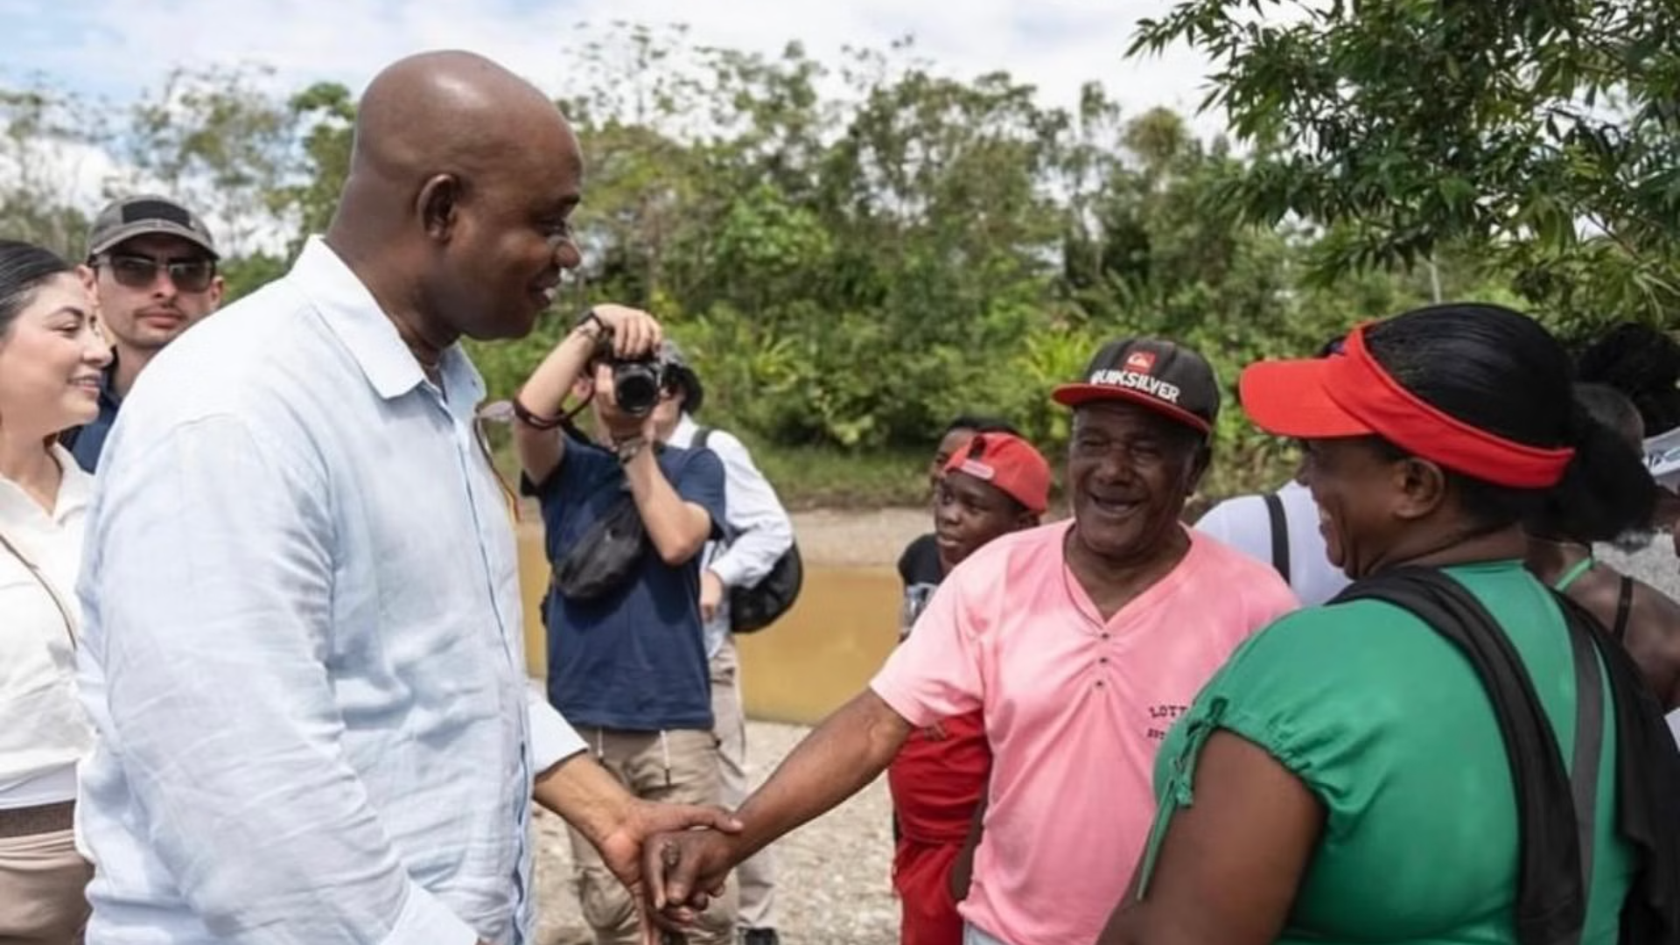
Conclusions and Key Takeaways
Addressing Inequality
Biodiversity and Social Issues
US-Colombia Relations
Peace in Colombia requires addressing inequality and poverty through social justice, economic development, and environmental protection.
The bilateral relationship has changed significantly, highlighting the impact of US domestic policy on Colombia's development.
Colombia's biodiversity is crucial for addressing social problems by promoting sustainable development and improving social conditions.

