Slide 1

Global Policy Seminar and NSC Simulation
IRP 401 - IRP 402
Week Eleven 03 Apr 2026
Prof. Fulton T. Armstrong

Slide 2
Week 1 (16 Jan)
Week 2 (23 Jan)
Week 3 (30 Jan)
Week 4 (6 Feb)
Week 5 (13 Feb)
Week 6 (20 Feb)
Week 7 (27 Feb)
Week 8 (6 Mar)
Spring Break
Week 9 (20 Mar)
Week 10 (27 Mar)
Week 11 (3 Apr)
Week 12 (10 Apr)
Week 13 (17 Apri)
Week 14 (24 Apr)
Spring 2026

Slide 3
TODAY’S AGENDA
9:00 | Class Discussion: Quiz on Speakers and Readings Final Prep for China Discussions
9:30 | Internship Discussions – with Samantha Clemence - Diego, Michael, Miles
10:00 | Ubers to Embassy of China
10:30 | Chief, Bilateral Relations, Embassy of China - Greetings by Molisa
~12:00 | Metro back to SUDC and lunch
2:30 | Meet at Pentagon entrance atop Metro escalators
 | OSD – Lily Emamian, Douglas Burt, McKenzie Wilson, James Tawney - Greetings by Emmett
~4:00 | Wrapup and departure from Pentagon

Slide 4
TODAY’S AGENDA
9:00 | Class Discussion: Quiz on Speakers and Readings Final Prep for China Discussions
9:30 | Internship Discussions – with Samantha Clemence - Diego, Michael, Miles
10:00 | Ubers to Embassy of China
10:30 | Chief, Bilateral Relations, Embassy of China - Greetings by Molisa
~12:00 | Metro back to SUDC and lunch
2:30 | Meet at Pentagon entrance atop Metro escalators
 | OSD – Lily Emamian, Douglas Burt, McKenzie Wilson, James Tawney - Greetings by Emmett
~4:00 | Wrapup and departure from Pentagon

Slide 5

PREVIOUS: Mr. TAO Song, Counselor and Chief of Political Affairs
Ms. Shuang GAO
Shan
Qingli
Molisa will open and ask first question.

Slide 6
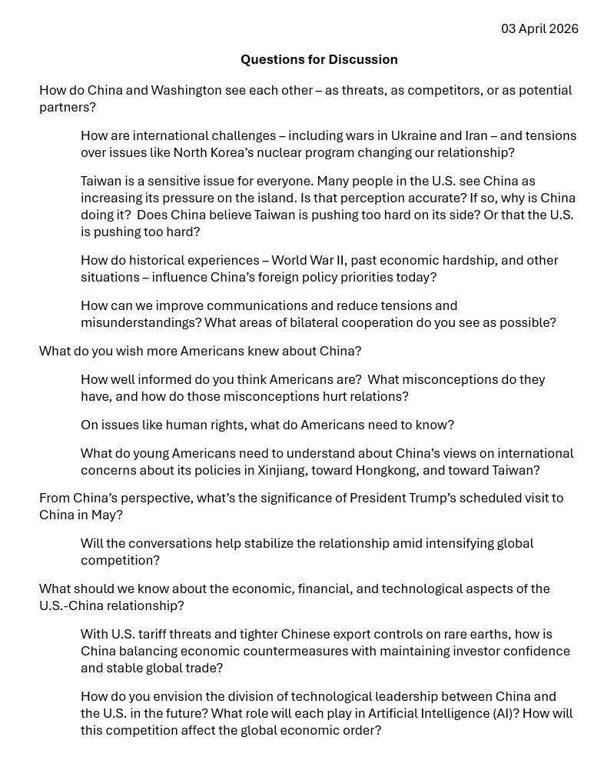
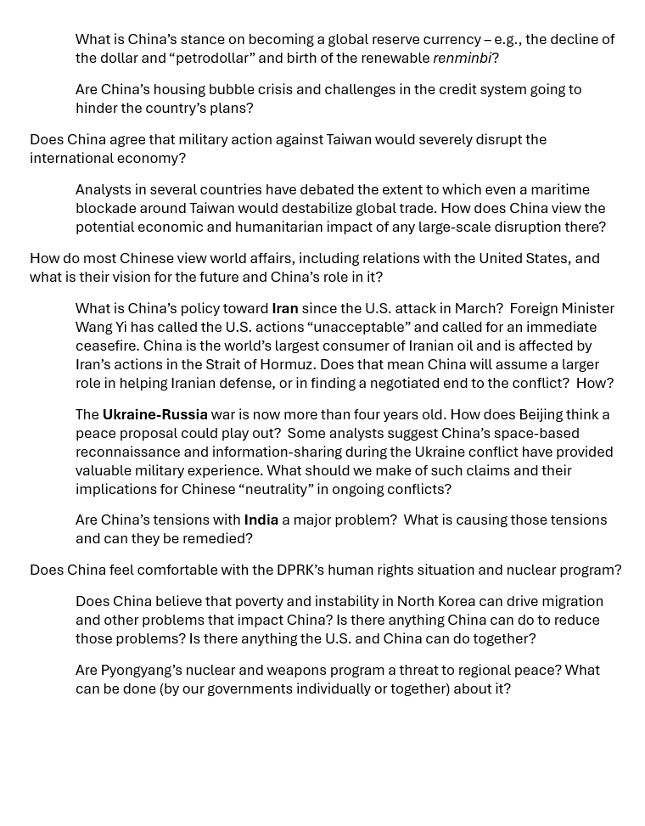
PREVIOUS: Mr. TAO Song, Counselor and Chief of Political Affairs
Ms. Shuang GAO
Shan
Qingli
Molisa will open and ask first question.

Slide 7
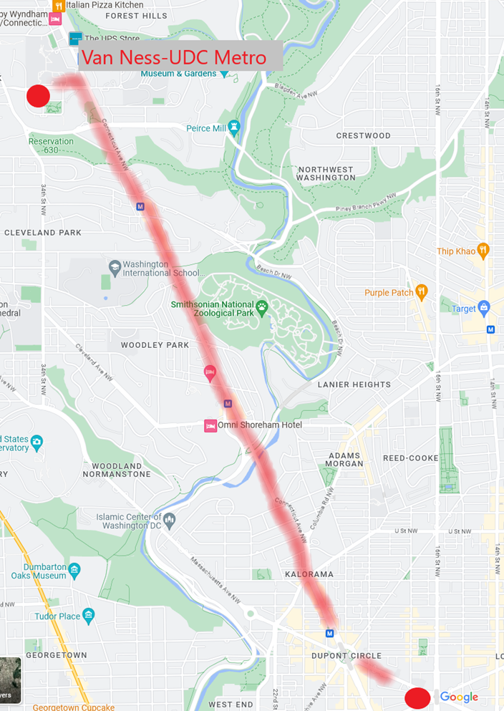
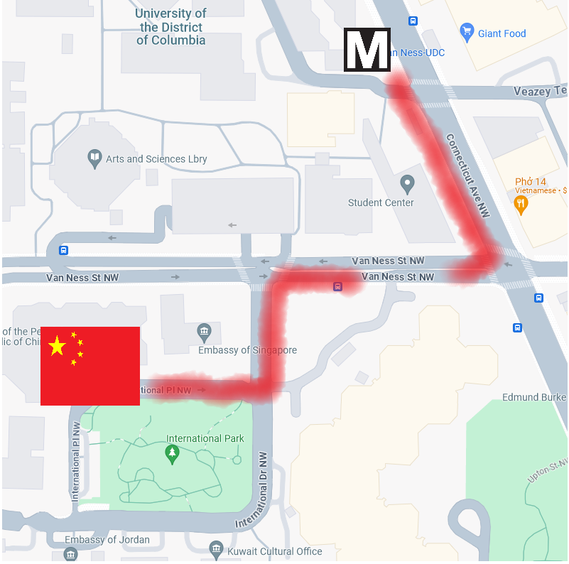
DEPART CSIS at 10am

Slide 8
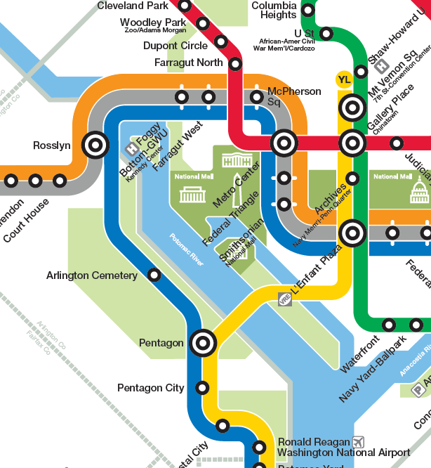
TRANSPORTATION
to Pentagon

Slide 9
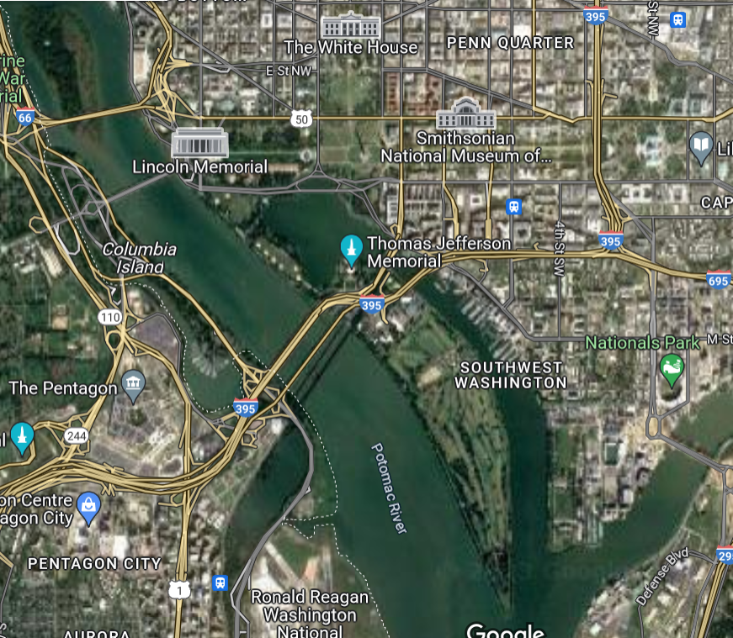
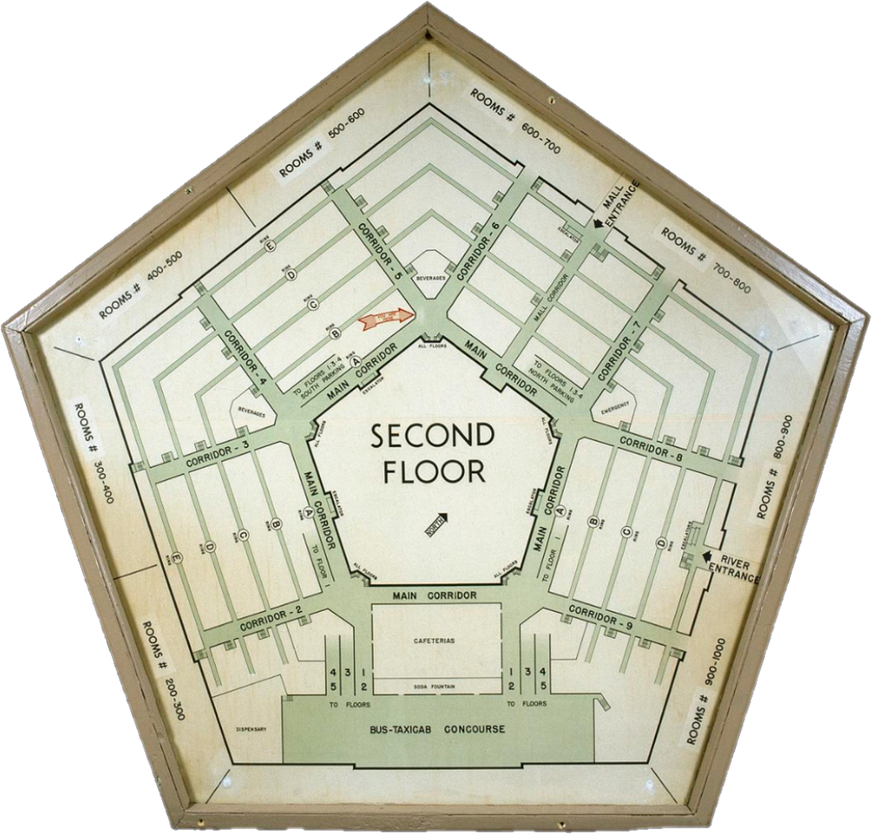

Slide 10
E D C B A
METRO

Slide 11
Pretty cool?
Constructed 1941-45
Largest “low-rise” building (6.5m sq ft); 17.5 mi of corridors
Until 2011 had only 1 passenger elevator
26k people work there

Slide 12
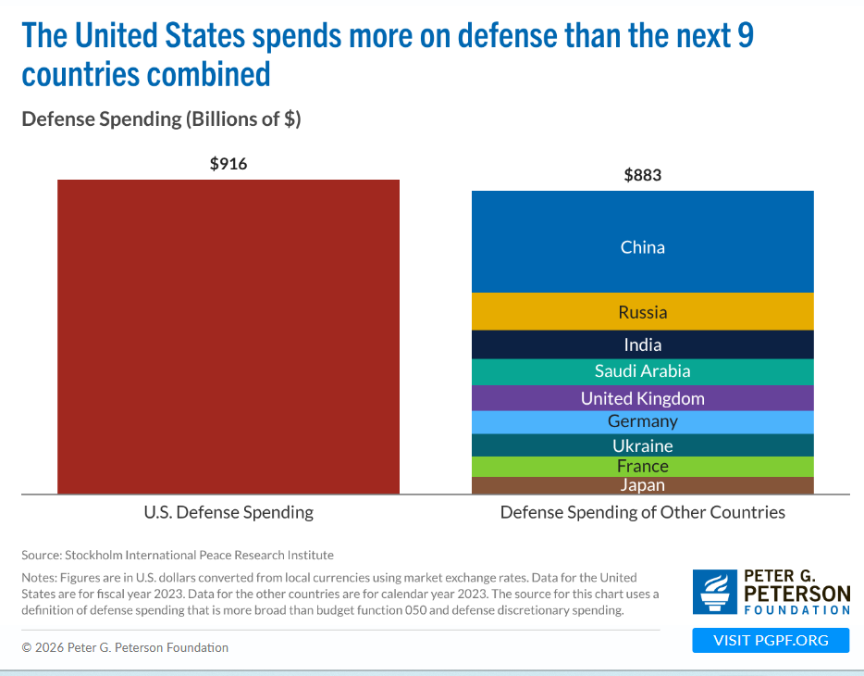
Current military:
2.5+ million (1.4m active-duty mil)
Budget: ~$916 billion (13% of total spending and ~48% of discretionary)
Zillions of contractors
Requesting additional $200 billion

Slide 13
Lily Emamian Douglas Burt McKenzie Wilson James Tawney
TOPICS
Iran
Ukraine
NATO
Cyber
Their bios
OSD vs JCS
The interagency
Emmett will open and ask first question.

Slide 14
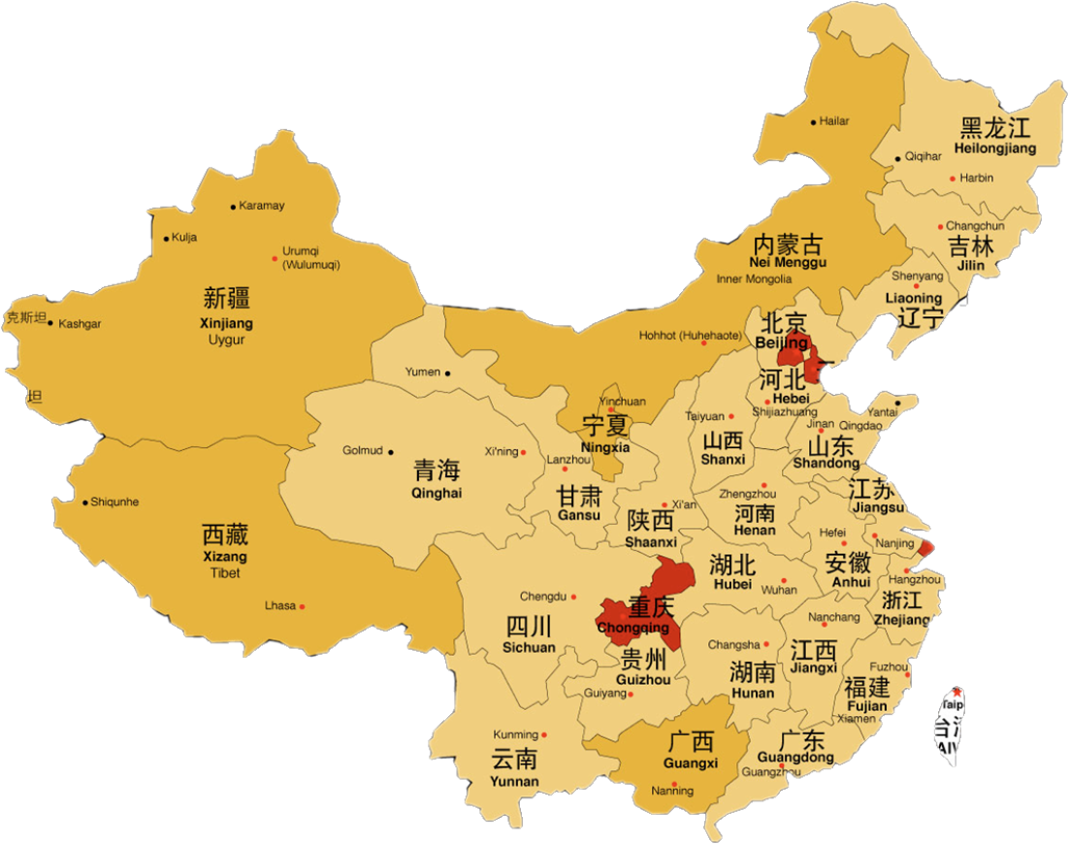
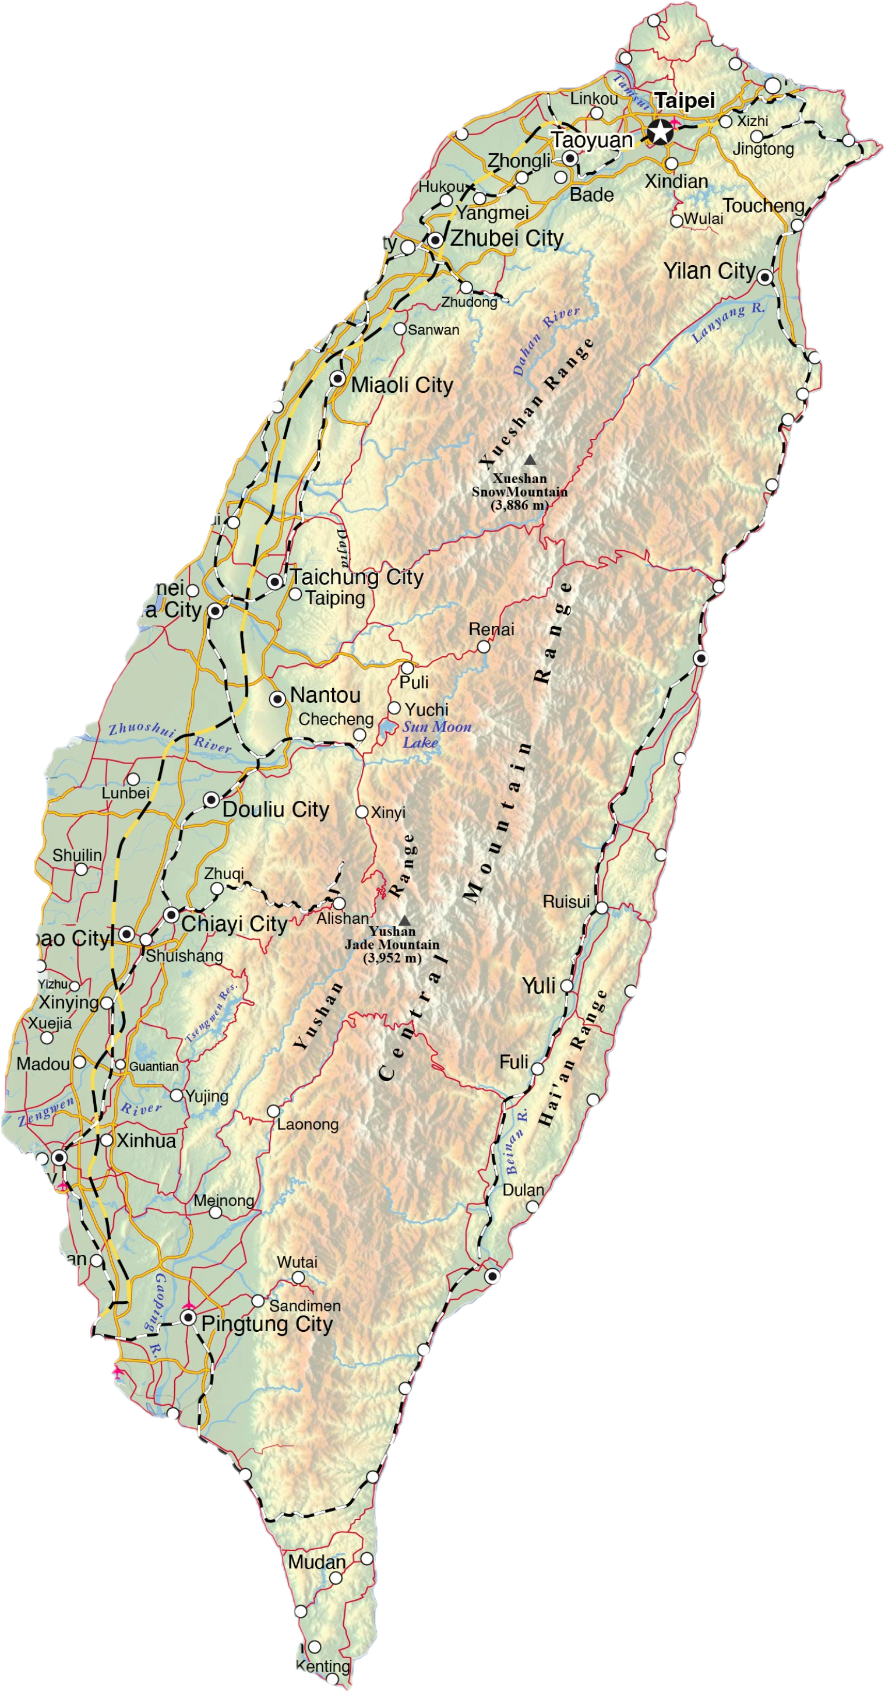
Final Prep for Meeting
China and Taiwan

Slide 15
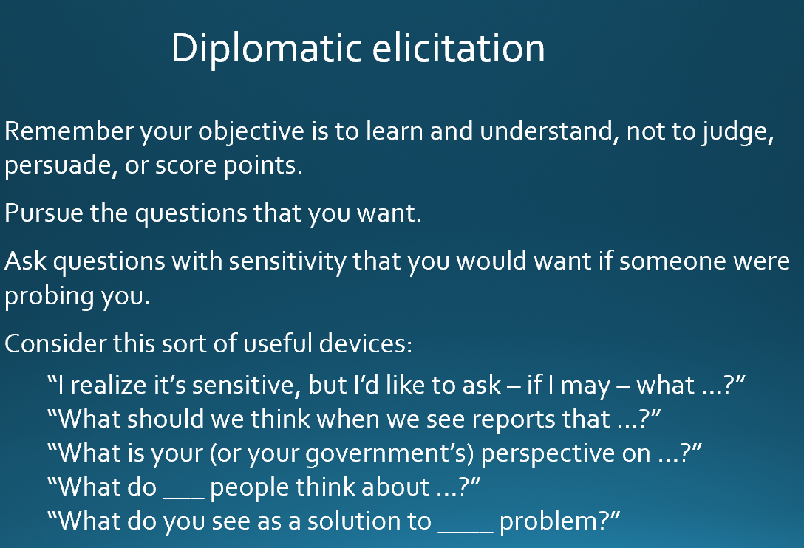
Final Prep for Meeting

Slide 16
Final Prep for Meeting

Slide 17
Diplomatic elicitation
Remember your objective is to learn and understand, not to judge, persuade, or score points.
Pursue the questions that you want.
Ask questions with sensitivity that you would want if someone were probing you.
Consider this sort of useful devices:
“I realize it’s sensitive, but I’d like to ask – if I may – what …?”
“What should we think when we see reports that …?”
“What is your (or your government’s) perspective on …?”
“What do ___ people think about …?”
“What do you see as a solution to ____ problem?”

Slide 18
INTERNSHIP CONVERSATIONS
Informal Discussion
Launched with 2-3 mins on …
Organization name, business, structure
Your role – team, function, purpose
Typical duties and responsibilities
Most challenging aspect; most rewarding aspect
Your takeaway: what you’ve learned about yourself and future interests
John
Bijan
Filippo

Slide 19


Slide 20
TRANSPORTATION
to Pentagon
MEET AT 2:30 !!

Slide 21


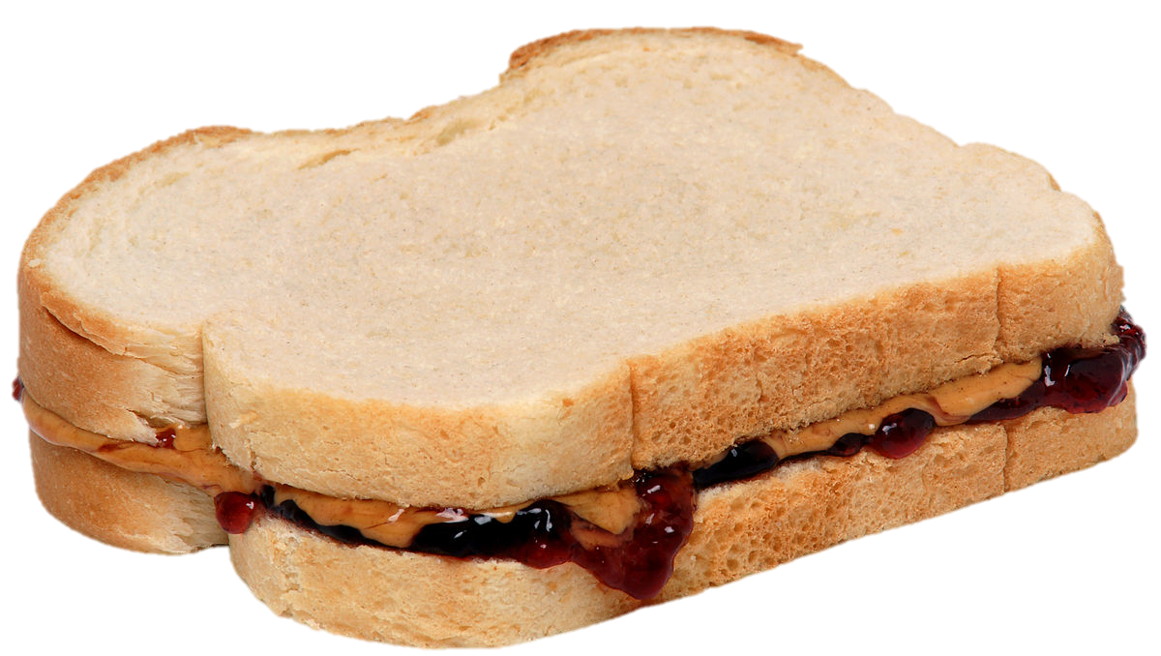
LUNCH

Slide 22


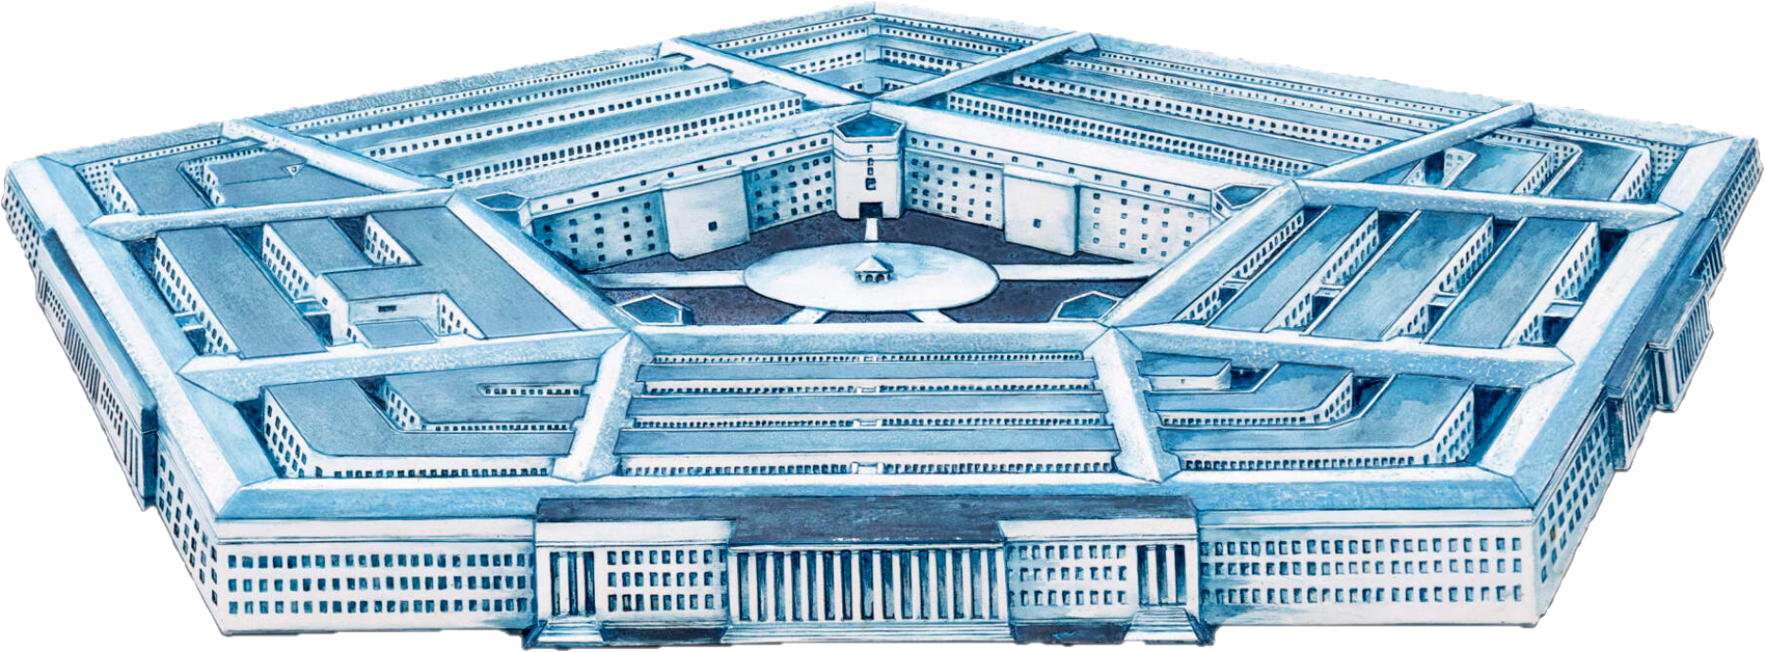
Next week
Embassy of People’s Republic of China
The Pentagon

Slide 23
PROJECT UPDATES

Slide 24
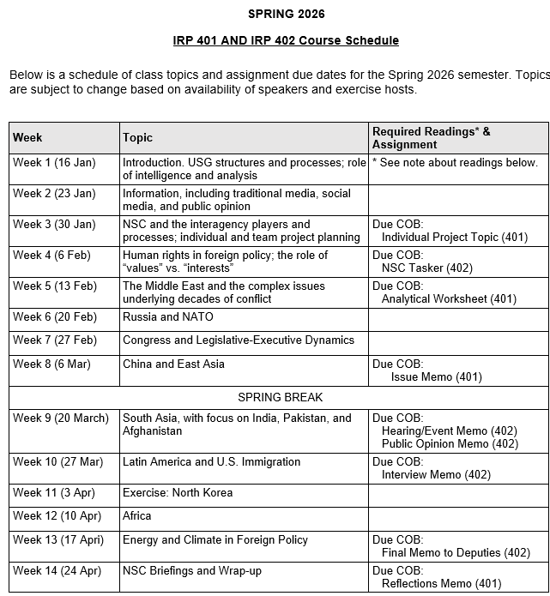
✓
✓
✓
✓
401
✓
✓
✓
✓
✓
✓
✓
✓
402
✓
✓
✓
✓
✓
✓
✓
✓
✓
✓
✓
✓
✓
✓
✓
✓
✓
✓
✓
✓
✓
✓
✓
✓

Slide 25
PROJECT PLANNING
Emmett | Countering “CRINK” Alignment | Danger of one-dimensional energy sector
John | Innovation and Environmental Capacity
Miles | Capitalism and Environment Protection | Climate change and refugees/sovereignty
Kennedy | Taiwan Prosperity and U.S. Interests
Eli | Prediction Markets | Iran-US relations
Michael | Foreign Manipulation of U.S. Elections
Diego | Russian Invasion of Ukraine | Globalization and environmental impact
Molisa | U.S.-China Competition in Critical Technologies
Kaiwen | U.S.-China Economic and Trade Competition | China’s Influence in Africa
Yvette | Rwanda-DRC Conflict and Resolution
Bijan | Housing Shortage and its Implications | Humanitarian Crisis in Gaza
Megha | Restrictive U.S. Immigration and Visa Policies
Filippo | Transatlantic Relations | North Korea illegal ops to support goals
David | ???? | ??????

Slide 26
DISCUSSION
Comfortable?
Topics
How partnership will work
The purposes
Substance, process, skills
The elements
401
Analysis
“Memo #2”
402
Proposal
Hearing/event
Public opinion
Interviews
DC memo
Briefing

Slide 27
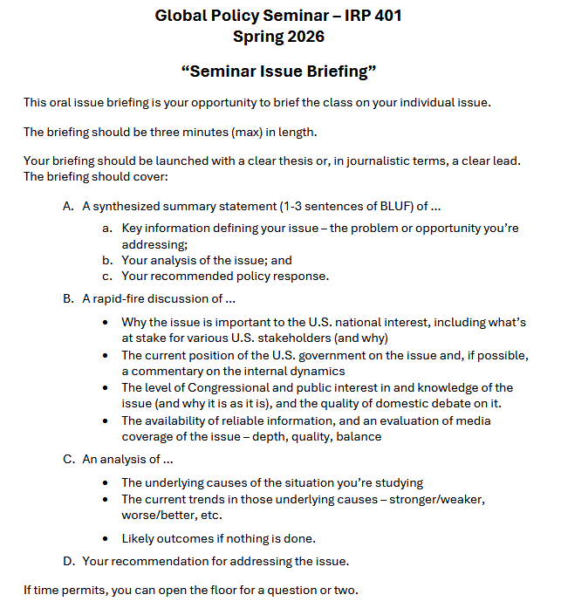
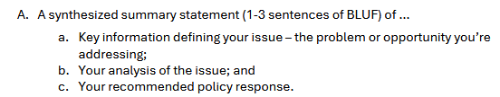
BRIEFINGS
One-Minute Briefing
Your 401 topic
For intelligent non-specialist
Problem-drivers-options- recommendation
Interesting

Slide 28
BRIEFINGS
One-Minute Briefing
Your 401 topic
For intelligent non-specialist
Problem-drivers-options- recommendation
Interesting
FEEL GOOD?
Diego | Eli | Filippo | Michael
Emmett | Meghavarshini | Kennedy | Kaiwen
John | Miles | Molisa | Bijan
Yvette

Slide 29
Next week …

Slide 30

WRAPUP

Slide 31
Questions? Comments? Concerns? Suggestions?

Slide 32
Global Policy Seminar and NSC Simulation
IRP 401 - IRP 402
Week Eleven 03 Apr 2026
Prof. Fulton T. Armstrong

