Slide 1

Global Policy Seminar and NSC Simulation
IRP 401 - IRP 402
Week Nine
23 October 2026
Prof. Fulton T Armstrong

Slide 2
Week 1 (28 Aug)
Week 2 (4 Sep)
Week 3 (11 Sep)
Week 4 (18 Sep)
Week 5 (25 Sep)
Week 6 (2 Oct)
Week 7 (9 Oct)
Week 8 (16 Oct)
Week 9 (23 Oct)
Week 10 (30 Oct)
Week 11 (6 Nov)
Week 12 (13 Nov)
Week 13 (20 Nov)
Thanksgiving
Week 14 (4 Dec)
Fall 2026

Slide 3
TODAY’S AGENDA
9:00 | Skills Presentation: Understanding Polls (Prof. Sydnor)
10:00 | Uber to Embassy of Israel
10:30 | Guest Speaker: Counselor Anna Shteingart Embassy of Israel - Introduced by Sadie
~11:50 | Metro back to SUDC and Lunch
1:30 | Discussion: Readings and Hotwash from Morning Session
2:00 | Guest Speaker: Mitchell Plitnick President, ReThinking Foreign Policy - Introduced by Hayley
~3:30 | Wrapup

Slide 4
TODAY’S AGENDA
9:00 | Skills Presentation: Understanding Polls (Prof. Sydnor)
10:00 | Uber to Embassy of Israel
10:30 | Guest Speaker: Counselor Anna Shteingart Embassy of Israel - Introduced by Sadie
~11:50 | Metro back to SUDC and Lunch
1:30 | Discussion: Readings and Hotwash from Morning Session
2:00 | Guest Speaker: Mitchell Plitnick President, ReThinking Foreign Policy - Introduced by Hayley
~3:30 | Wrapup

Slide 5
SKILL DISCUSSION
Skills Presentation: Understanding Polls
Prof. Emily Sydnor
NEXT WEEK: Smart Uses of AI

Slide 6

SKILL DISCUSSION
NEXT WEEK: TBD

Slide 7

Be on 19th Street at 10:00
BRING GOVERNMENT-ISSUED PHOTO I.D.

Slide 8
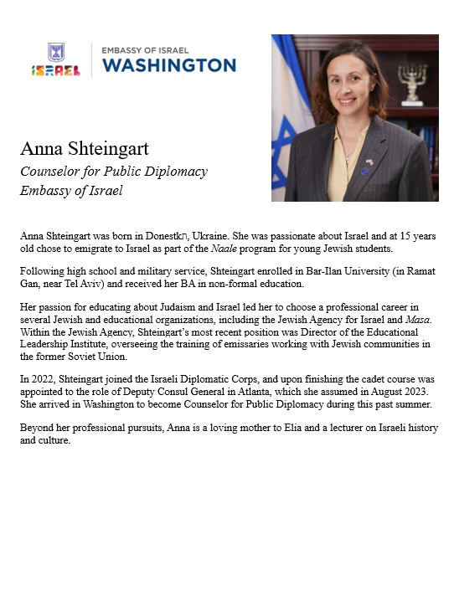
GUEST SPEAKER
Anna Shteingart
Counselor for Public Diplomacy
Embassy of Israel
- Introduced by Sadie

Slide 9
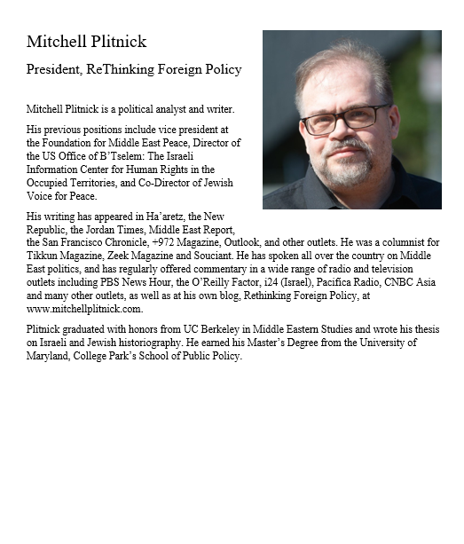
GUEST SPEAKER
Mitchell Plitnick
President, Re-Thinking Foreign
Policy
- Introduced by Hayley

Slide 10
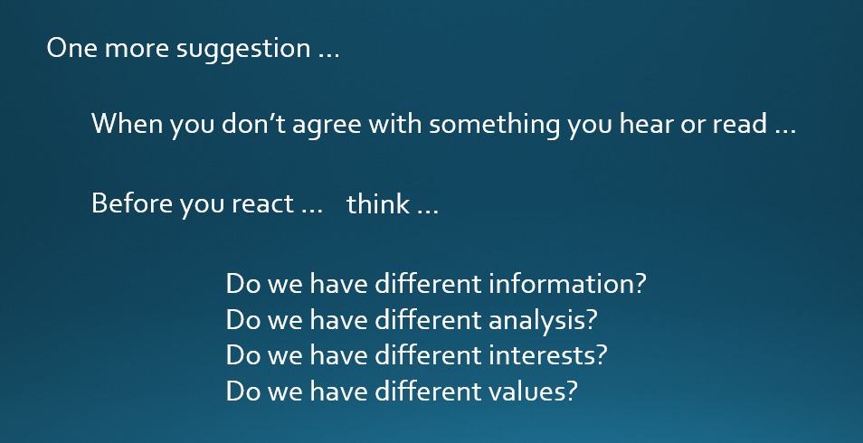
DISCUSSION
Can discuss sensitive, complex, politicized issues.
Remember …
Understand that words can have different meanings.
OUR MISSION (among ourselves and with guests):
      TO UNDERSTAND AND ANALYZE
      (NOT TO JUDGE)
      LISTEN, THINK, TRY TO UNDERSTAND, BE DIPLOMATIC

Slide 11
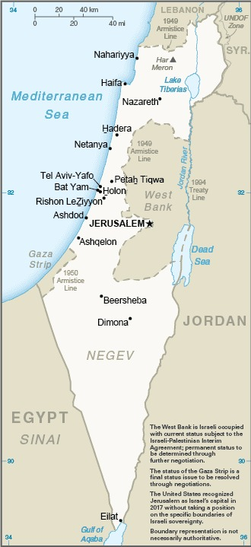
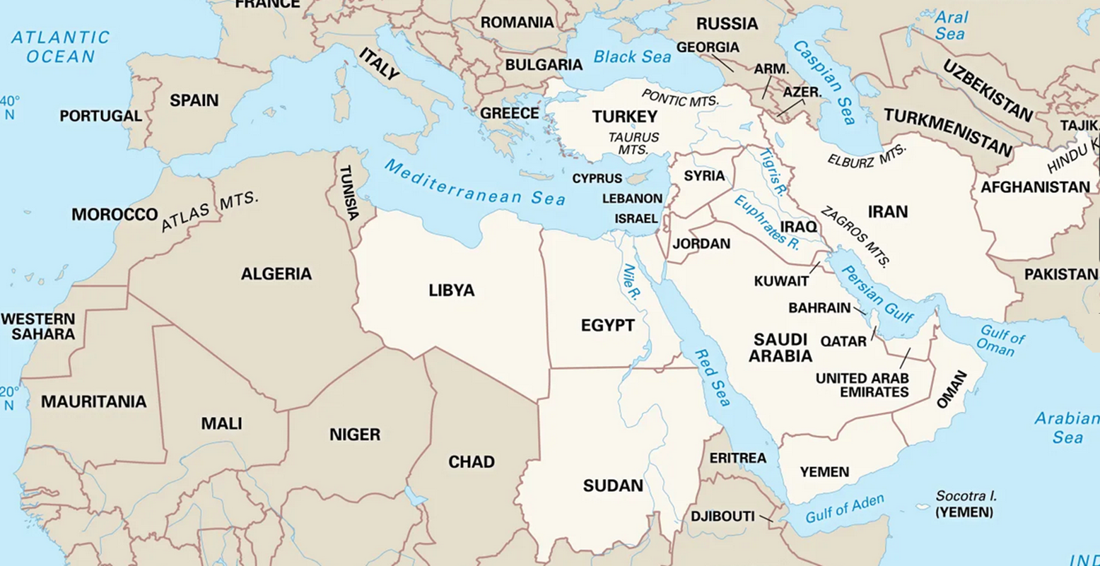
DISCUSSION

Slide 12
DISCUSSION

Slide 13
DISCUSSION
Some of the basics …
Creation of Jewish State in 1948.
Never resolved Palestinian homeland issues.
Six-Day War in 1967; Yom Kippur War in 1973.
Intifadas in 1987-93 and 2000-05.
Camp David Accords in 1978.
Oslo Accords in 1993 and 1995.
Numerous failed attempts.

Slide 14
DISCUSSION
Some of the basics …
Abraham Accords (2020) did not include Palestine.
    UAE, Bahrain first.
    Sudan, Morocco later.
    Saudi Arabia talk but not sign.
Gaza War
    7 Oct 2023 – Hamas attack, killing 1.3K.
    War (>75k dead), dislocations, disaster.

Slide 15
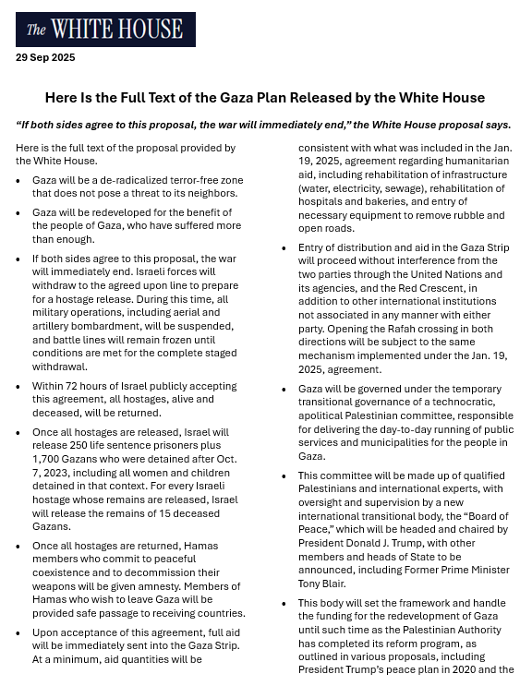
President Trump’s
“20-point plan”
(29 Sep 2025)
Framework for ceasefire, stabilization, reconstruction.
Endorsed by UN.

Slide 16
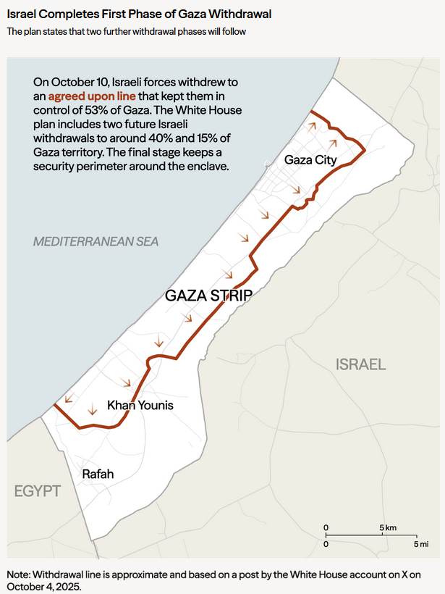
Ceasefire
(since October 2025)
But … deadlock in negotiations
Hamas disarmament
Israeli withdrawal
Future arrangements

Slide 17
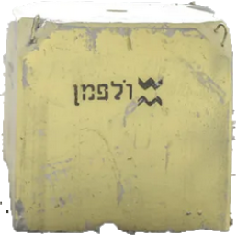
Marker
Blocks

Slide 18
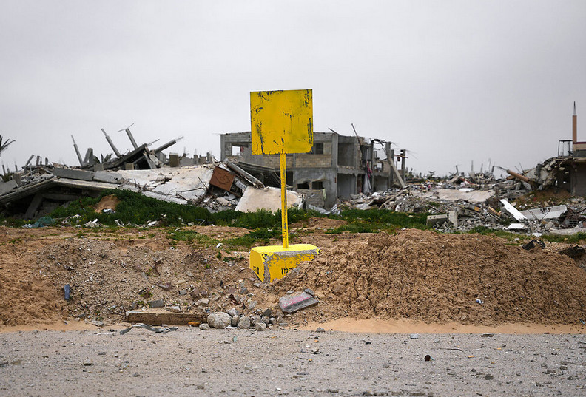
Anyone crossing the line will be “met with fire.”
- DefMin Katz

Slide 19
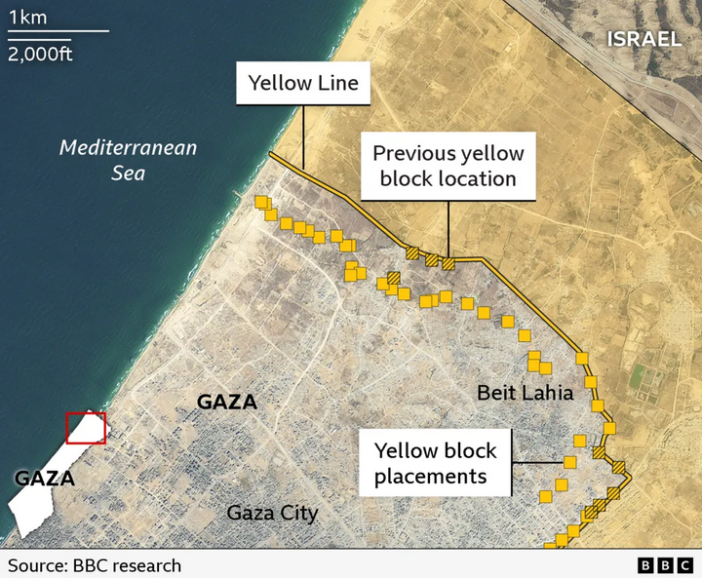
OCT
15 JAN

Slide 20
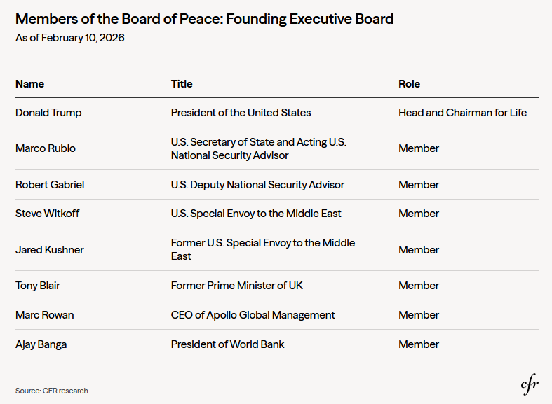
Board of
Peace
formed January as one of 20 points
inaugural meeting in Feb.
~2 dozen members (and many no’s)
$1 b in cash each
Mandate evolving. Stated as Gaza only, but now suspected as replacement for UN role.

Slide 21
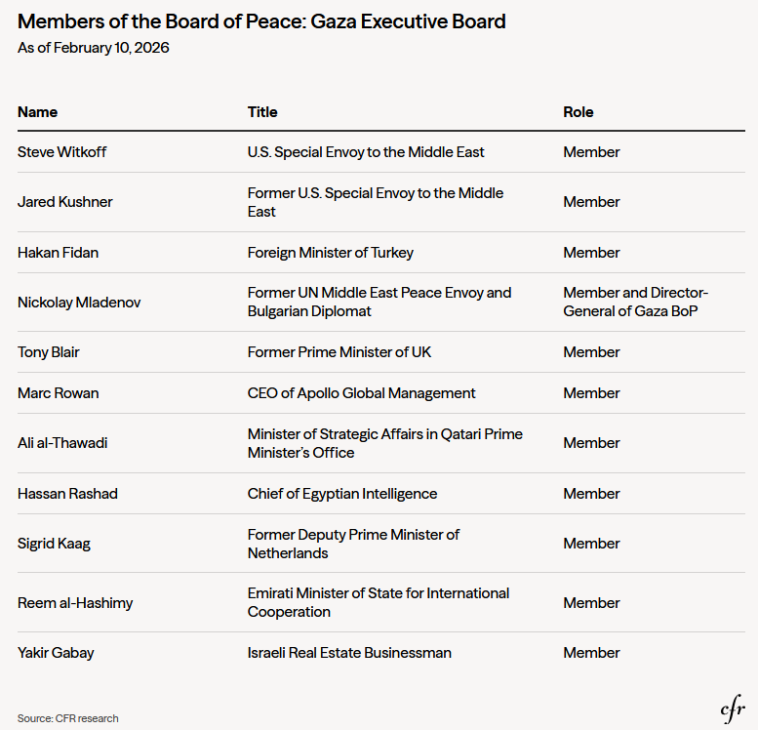
Board of
Peace
Executive
Board
Where are the Palestinians and Israelis?
National Committee for the Administration of Gaza (NCAG): Technocrats now waiting in Cairo

Slide 22
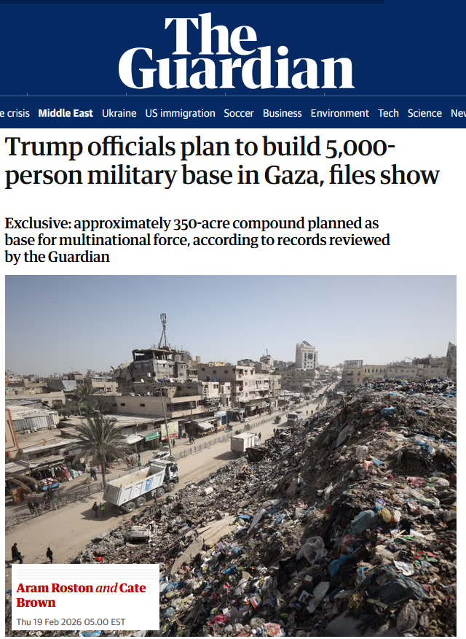
Board of
Peace
International Stabilization Force (ISF)
Many details unclear

Slide 23
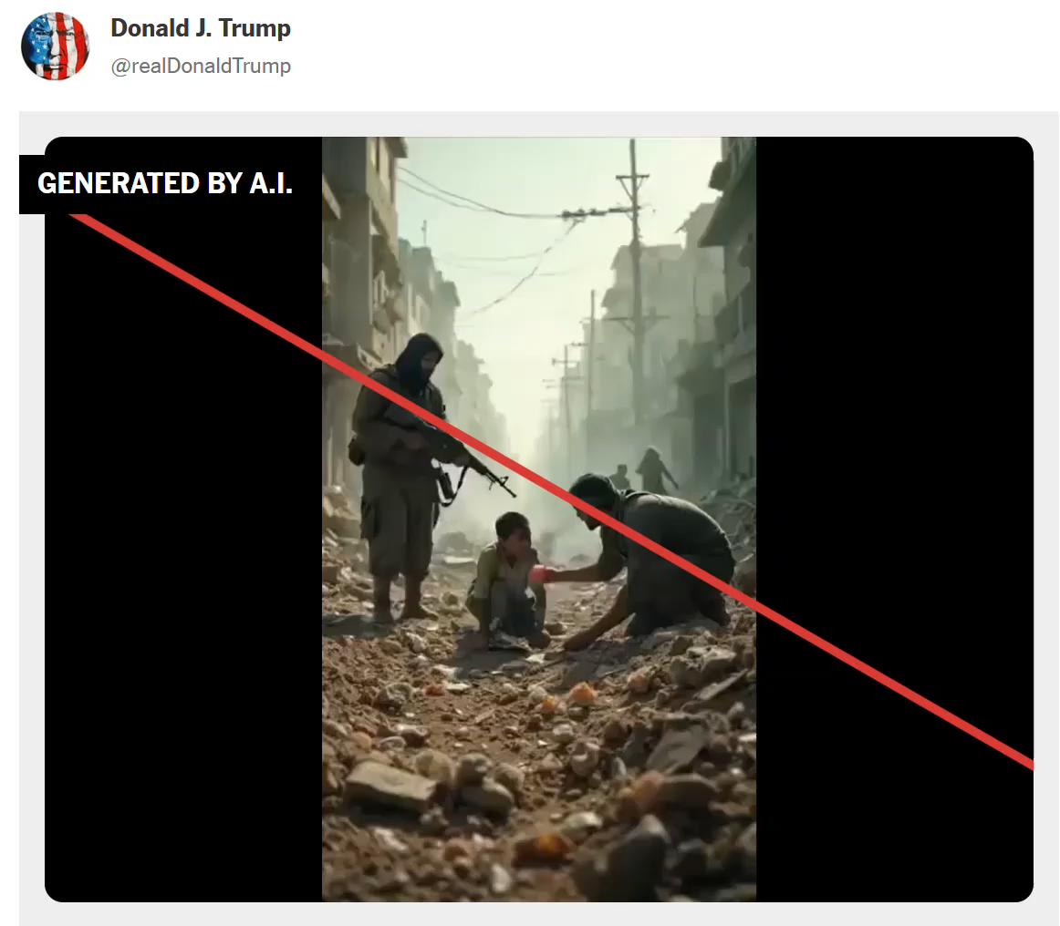
White House A.I. video

Slide 24
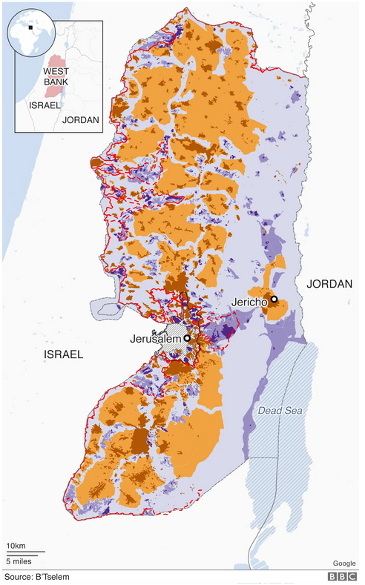
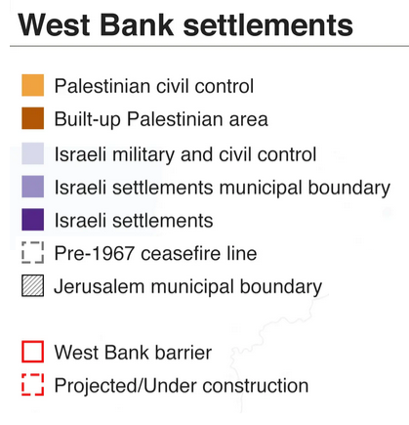
West Bank
Judea and Samaria
Israeli-occupied since 1967
3 m Palestinians
500 k Israelis
1,300 Palestinians killed by settlers since 2022, says UN
Numbers, tensions rising

Slide 25
Past | Trump Administration displeased by expansion in West Bank
8 Feb | Israel announces measures paving way for more settlements.
9 Feb | WH calls for “a stable West Bank.”
10 Feb | Trump: “I am against annexation.”
11 Feb | Netanyahu makes seventh visit to WH, with Iran at top of agenda.
15 Feb | Israeli cabinet announces further expansion measures.
Fall 2026 | Increasing confrontations, while ISF and police stand by, angering U.S.

Slide 26
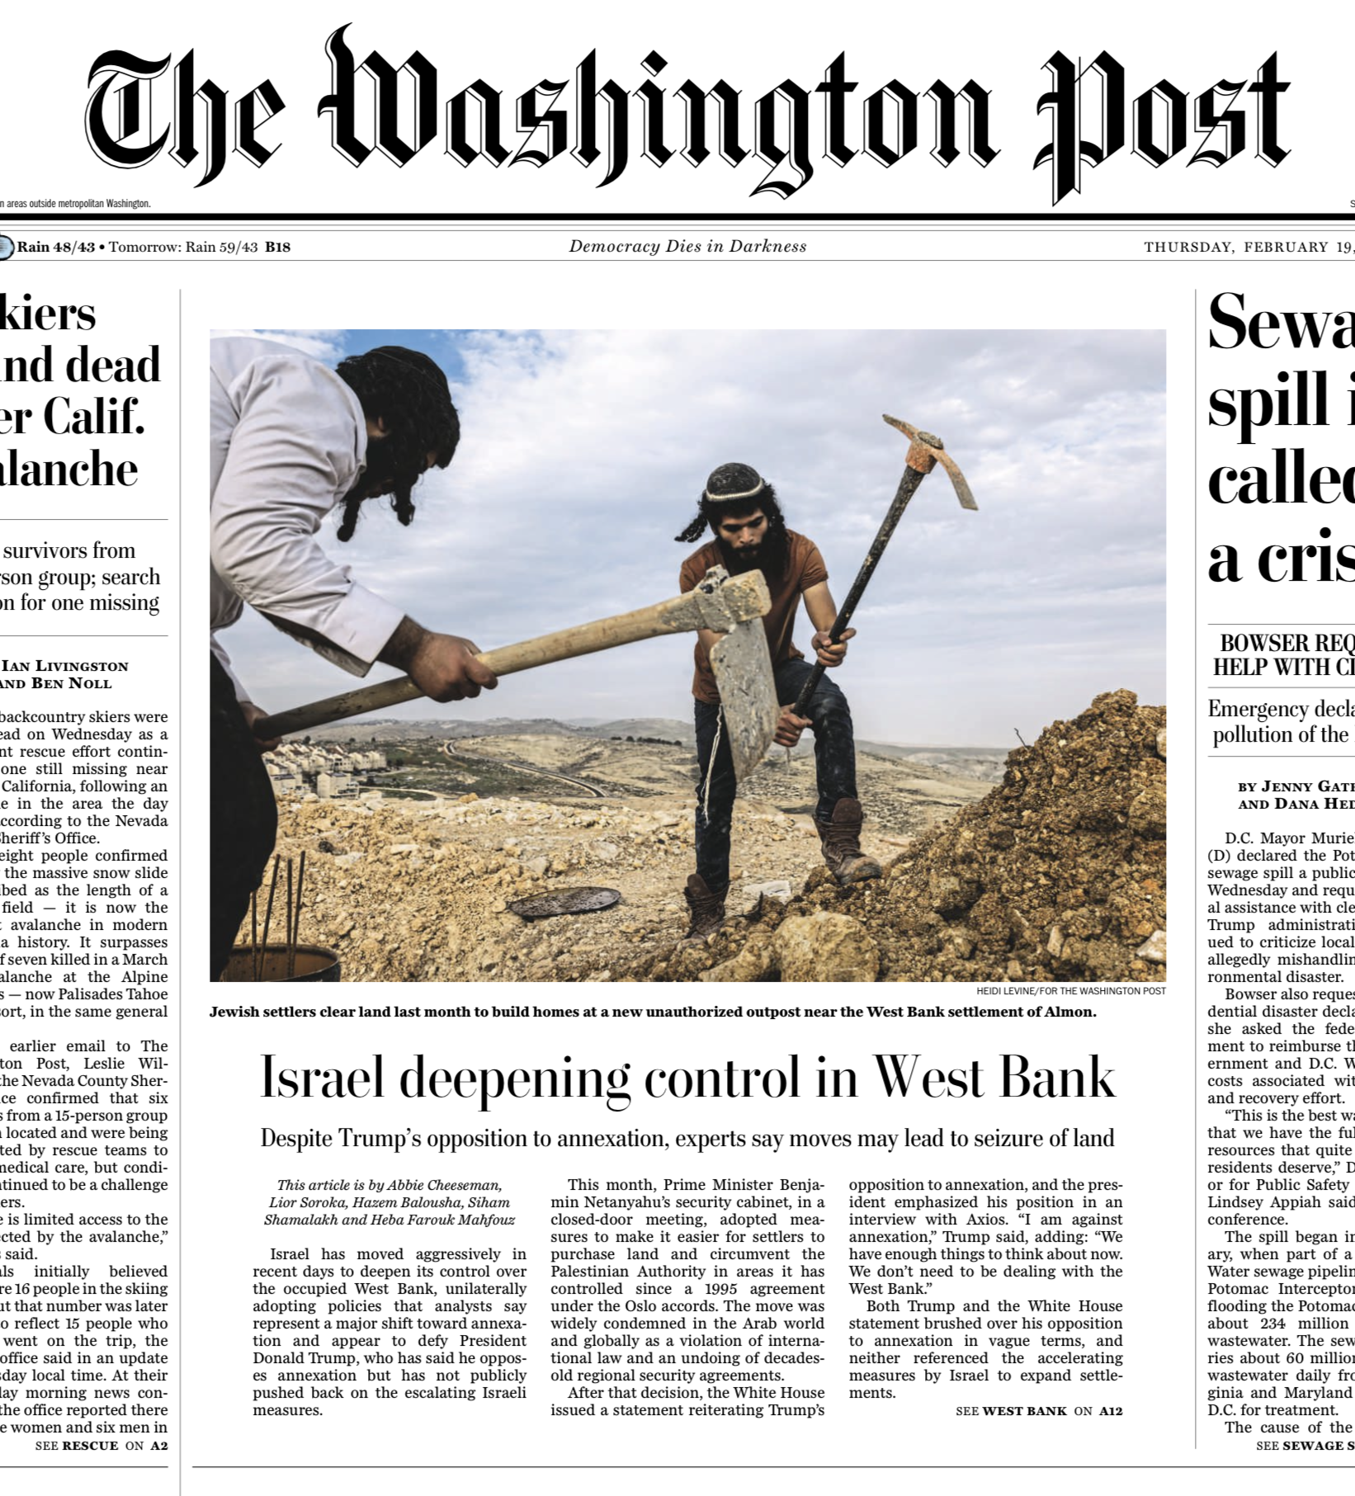

Slide 27
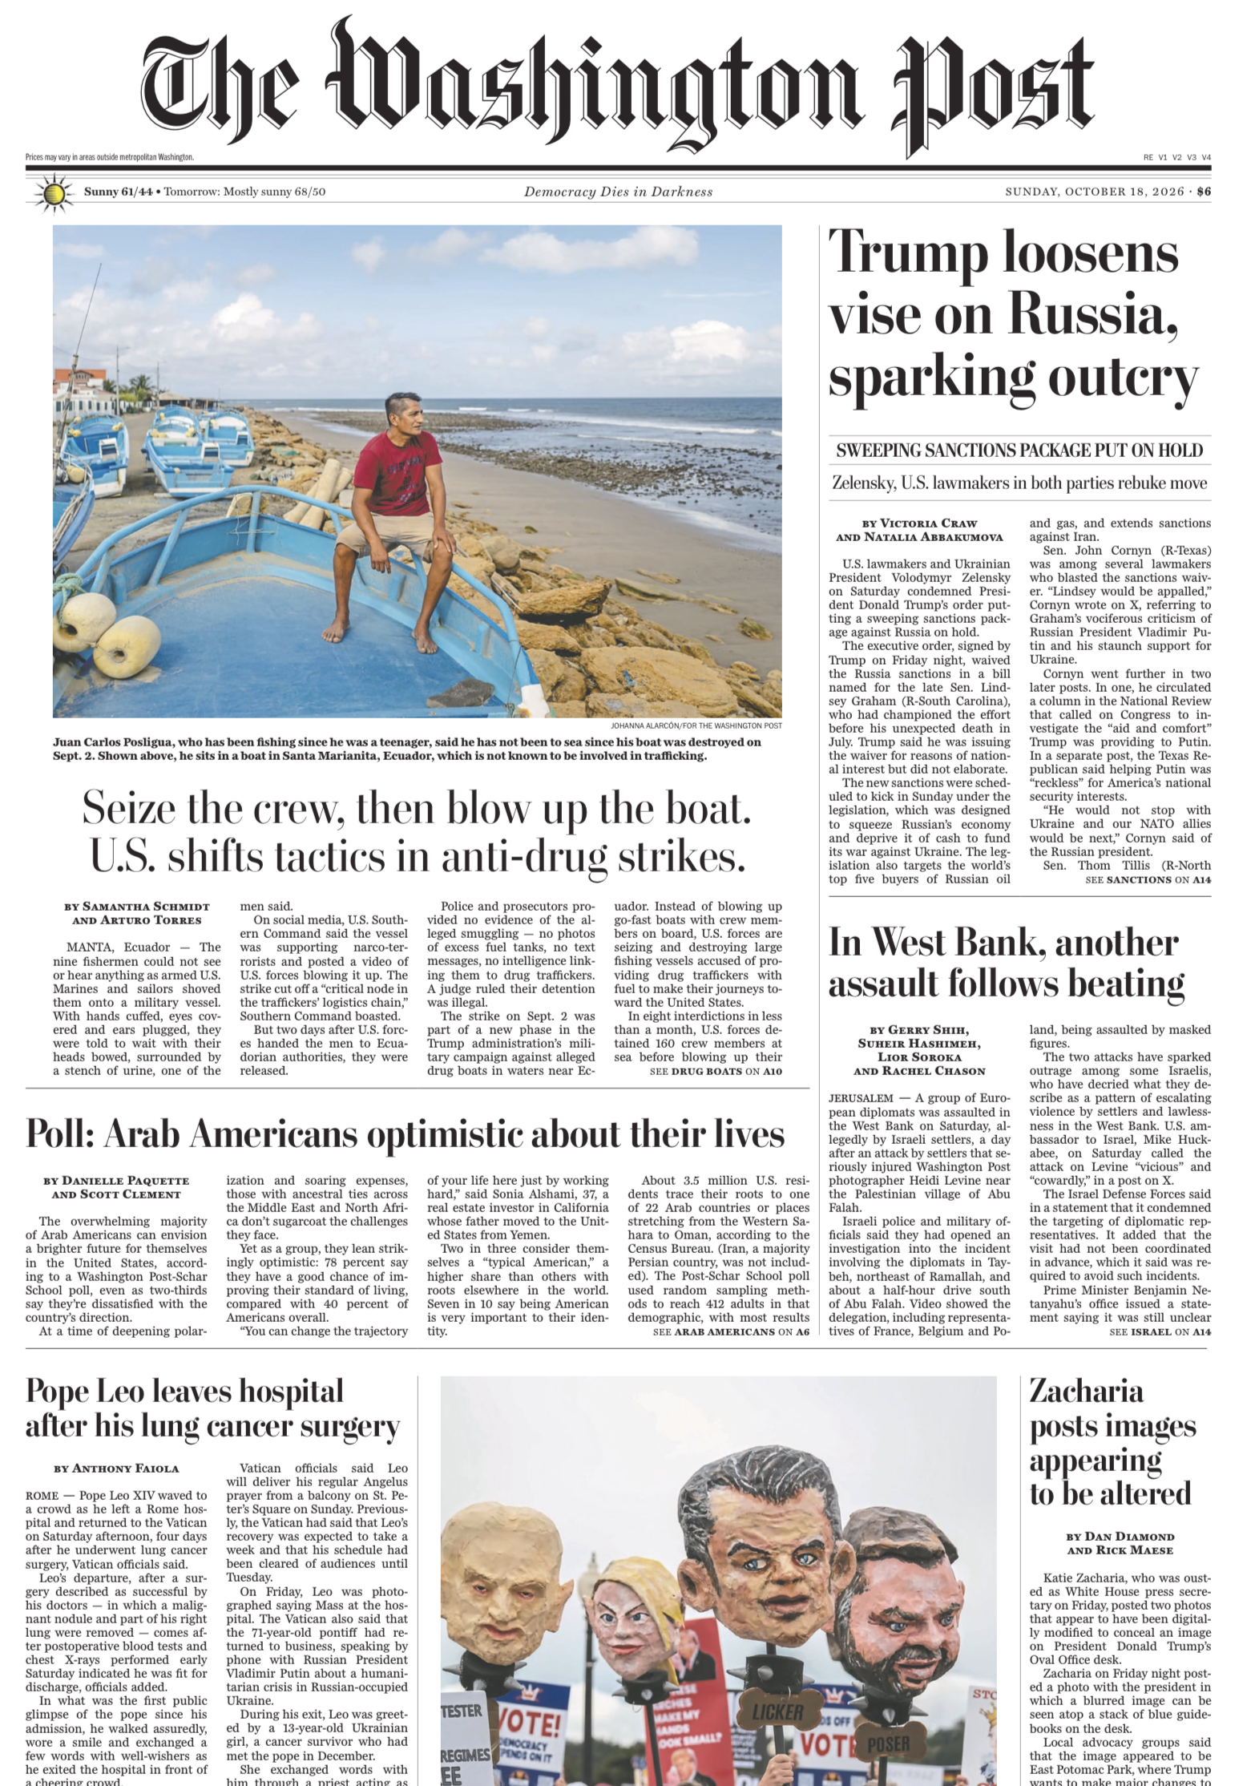
October 18

Slide 28
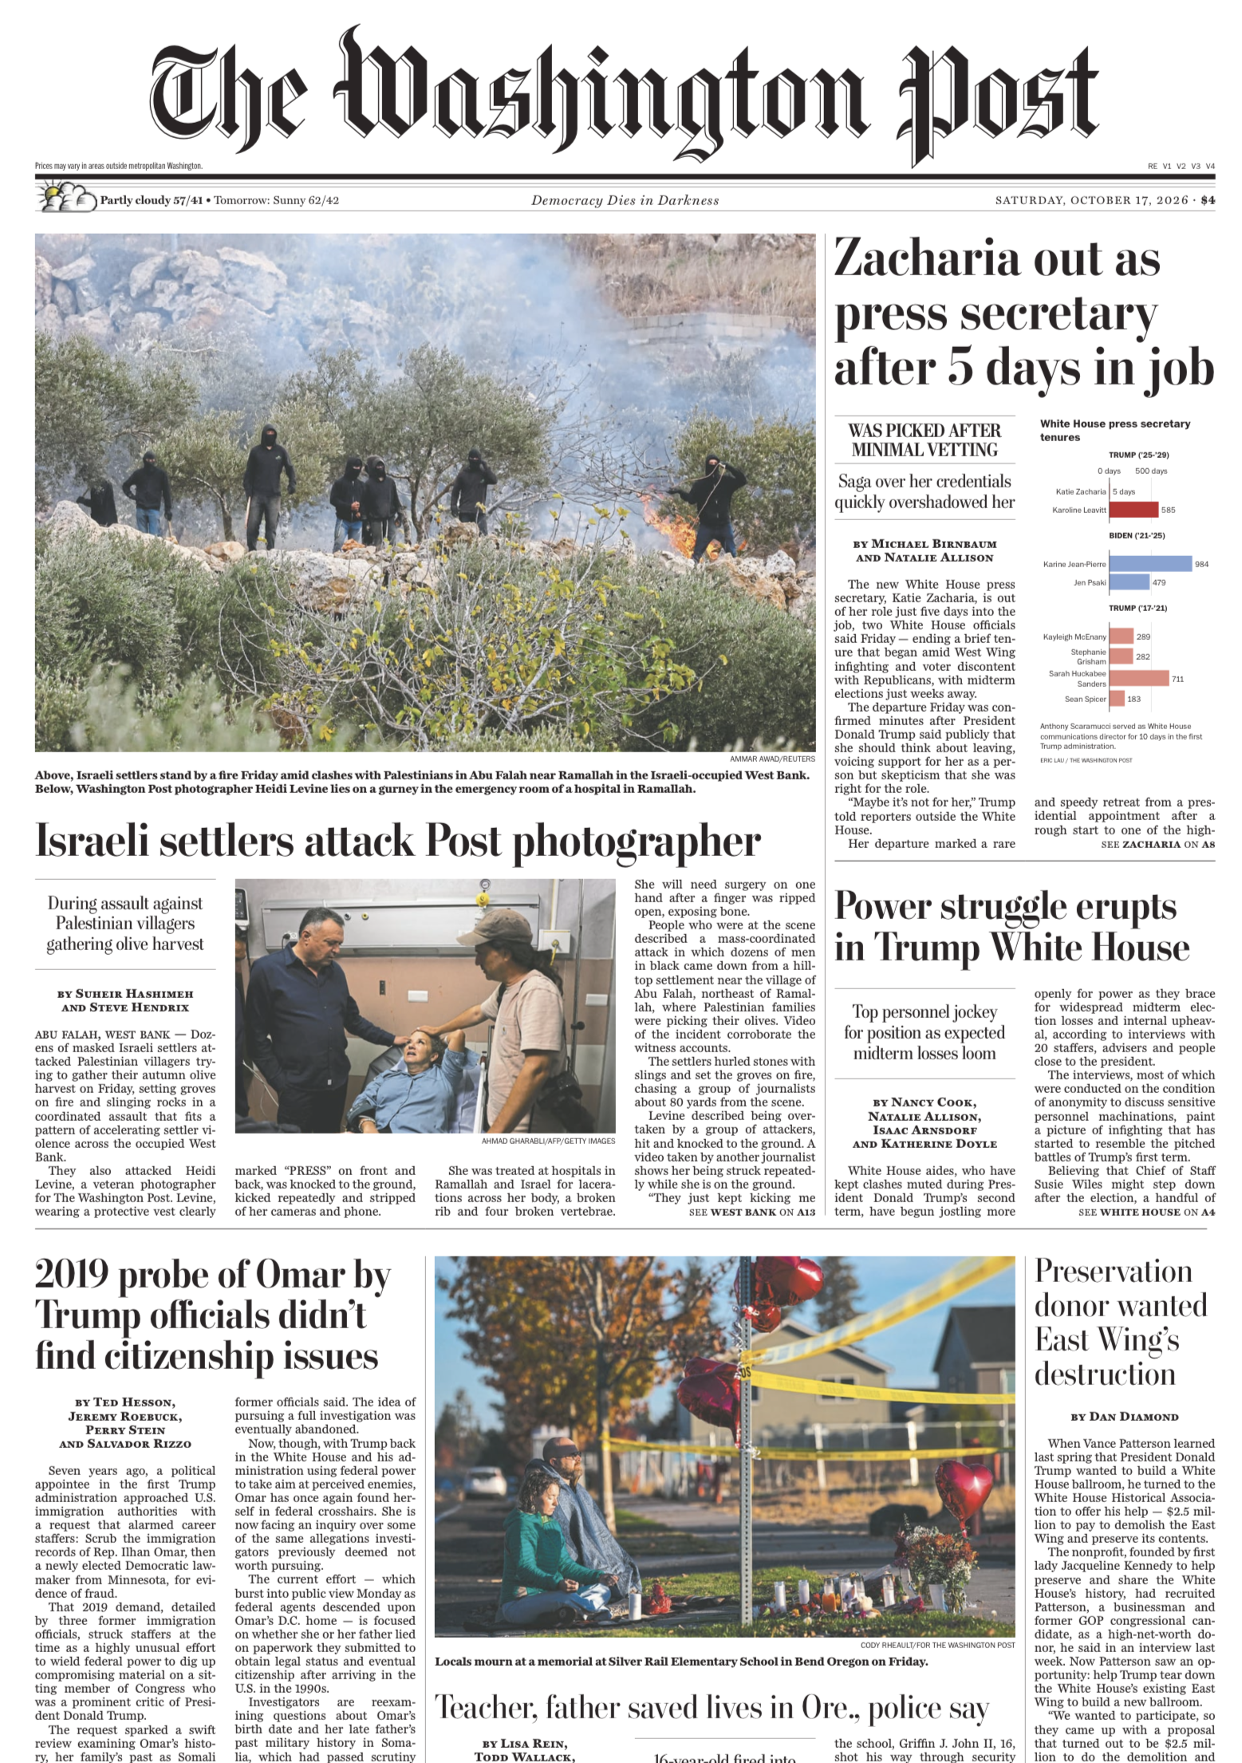
October 17

Slide 29
DISCUSSION
What questions did you develop?
About …
What will happen in Gaza
Trump plans
Netanyahu’s plans
Humanitarian flotilla and aid
West Bank settlements/annexation
Next steps on Iran
Two-State solution
Future of broader Palestine

Slide 30
Comments?

Slide 31
GUEST SPEAKER
Mitchell Plitnick
President, Re-Thinking Foreign
Policy
- Introduced by Hayley

Slide 32
GUEST SPEAKER
Q & A
What needs to change in order to make new policies (U.S. or Israel) happen?
How important, really, is the U.S. role?
What’s going to happen?

Slide 33

WRAPUP

Slide 34
DISCUSSION
Your 401 projects
Sadie | U.S.-Israel Bilateral Relations
Alice | China-Taiwan-U.S. Tensions
Bernadette | U.S. International Image
Owen | U.S. International Image
Elyza | Russia-Ukraine Ceasefire
Hayley | U.S.-Mexico River Dispute
Will | Enhancing Ukraine Military Power
Luciano | U.S. Venezuela Oil Deal
Can you give us your BLUF in one sentence or two?

Slide 35
DISCUSSION
Your 401 projects
Sadie | U.S.-Israel Bilateral Relations
Alice | China-Taiwan-U.S. Tensions
Bernadette | U.S. International Image
Owen | U.S. International Image
Elyza | Russia-Ukraine Ceasefire
Hayley | U.S.-Mexico River Dispute
Will | Enhancing Ukraine Military Power
Luciano | U.S. Venezuela Oil Deal
Can you give us your BLUF in one sentence or two?

Slide 36
Sadie | U.S.-Israel Bilateral Relations
Alice | China-Taiwan-U.S. Tensions
Bernadette | U.S. International Image
Owen | U.S. International Image
Elyza | Russia-Ukraine Ceasefire
Hayley | U.S.-Mexico River Dispute
Will | Enhancing Ukraine Military Power
Luciano | U.S. Venezuela Oil Deal
DISCUSSION
Your 401 and 402 projects
One-minute briefings to your colleagues…
Topic?
Current thesis?
Finding good drivers and options?
Sadie | Strengthening Nuclear Nonproliferation
Alice
Bernadette | Dedollarization
Owen
Elyza | Future of the United Nations
Hayley
Will | Russia-Ukraine Ceasefire Talks
Luciano

Slide 37
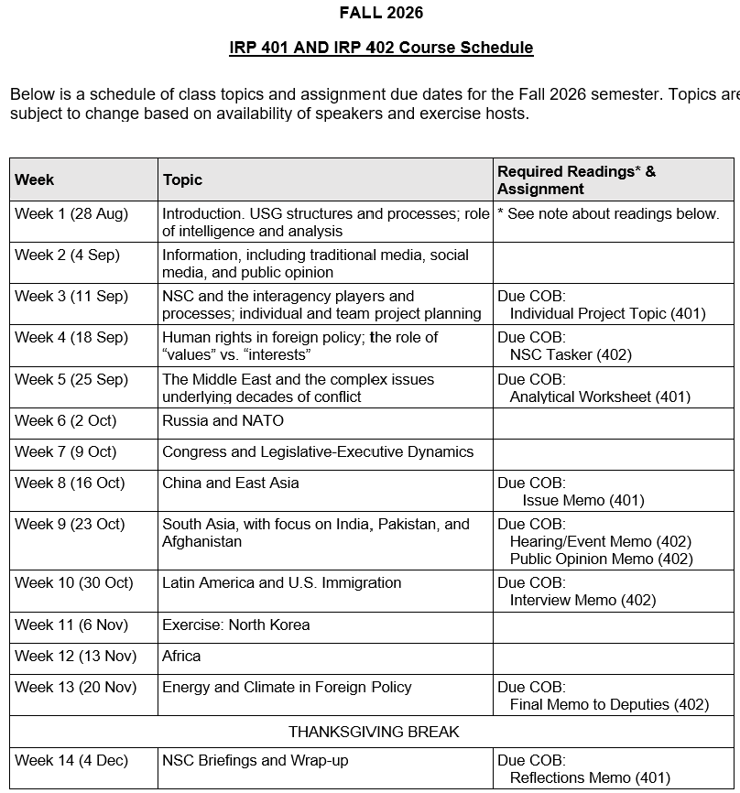
✓
401
✓
✓
402
✓
✓
✓
✓
✓
✓

Slide 38
TODAY’S AGENDA
9:00 | Skills Presentation: Understanding Polls (Prof. Sydnor)
10:00 | Uber to Embassy of Israel
10:30 | Guest Speaker: Counselor Anna Shteingart Embassy of Israel - Introduced by Sadie
~11:50 | Metro back to SUDC and Lunch
1:30 | Discussion: Readings and Hotwash from Morning Session
2:00 | Guest Speaker: Mitchell Plitnick President, ReThinking Foreign Policy - Introduced by Hayley
~3:30 | Wrapup

Slide 39
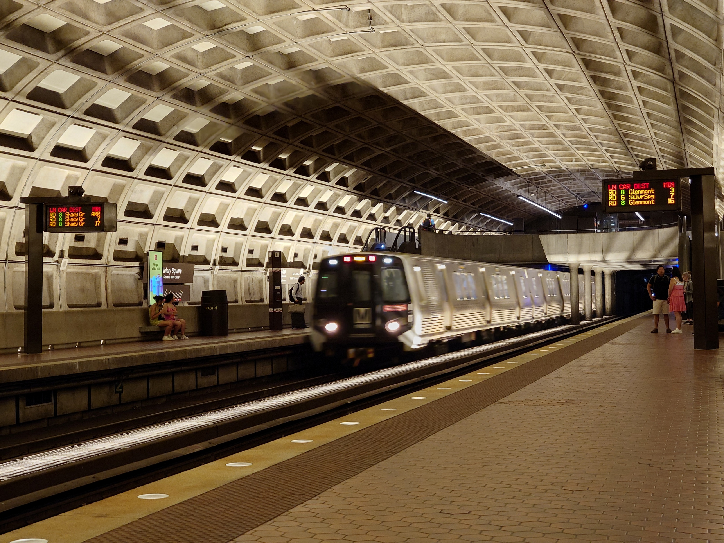
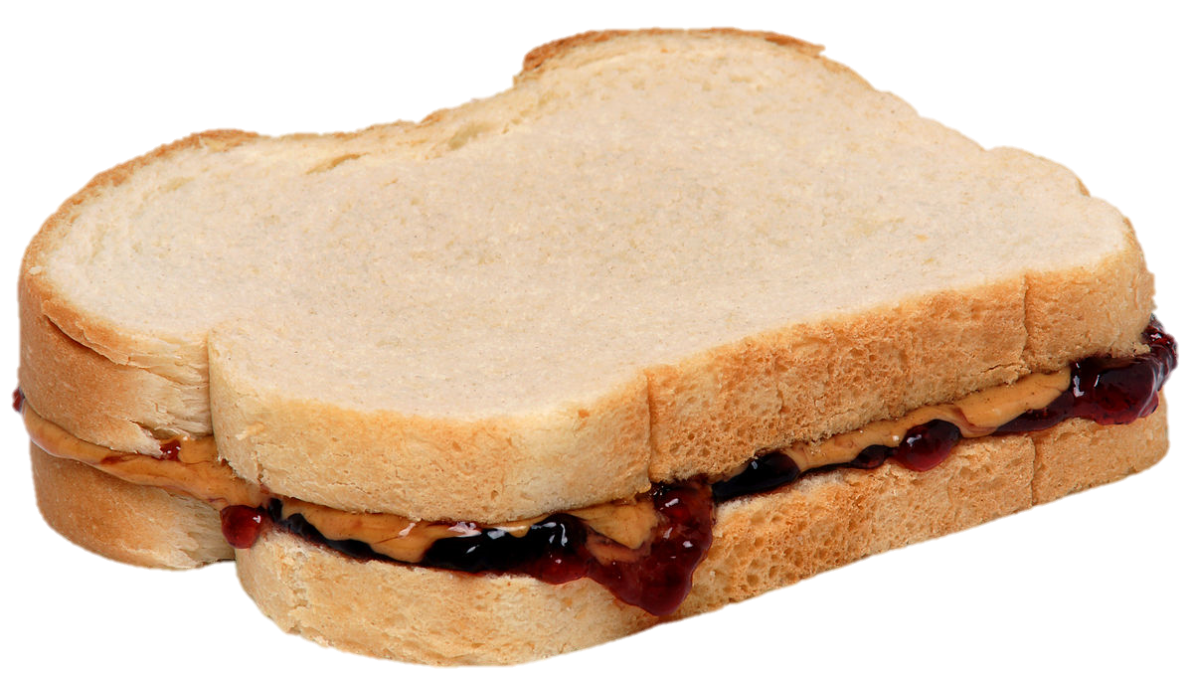
LUNCH and METRO to
Metro Center and National Press Club

Slide 40
QUESTIONS?
COMMENTS?
SUGGESTIONS?

Slide 41
Global Policy Seminar and NSC Simulation
IRP 401 - IRP 402
Week Nine
23 October 2026
Prof. Fulton T Armstrong

