Slide 1

Global Policy Seminar and NSC Simulation
IRP 401 - IRP 402
Week Eight
16 October 2026
Prof. Fulton T Armstrong

Slide 2
Week 1 (28 Aug)
Week 2 (4 Sep)
Week 3 (11 Sep)
Week 4 (18 Sep)
Week 5 (25 Sep)
Week 6 (2 Oct)
Week 7 (9 Oct)
Week 8 (16 Oct)
Week 9 (23 Oct)
Week 10 (30 Oct)
Week 11 (6 Nov)
Week 12 (13 Nov)
Week 13 (20 Nov)
Thanksgiving
Week 14 (4 Dec)
Fall 2026

Slide 3
TODAY’S AGENDA
8:40 | Meet at top of escalators, Capitol South Metro Station
9:00 | Mike Orfini, Docent, Library of Congress – LOC Tour - Meet at entrance to Jefferson Building
10:15 | Guest Speakers: Jason Cuomo, Legislative Correspondent, Rep John Mannion (D-NY), and Jake Morel, Press Secretary for Rep. Gabe Vasquez (D-NM) - Meet in 330 Cannon
11:50 | Capitol Tour - Enter through Visitor Center
1:00 | Lunch
1:40 | Ubers to Embassy of China - Meet at top of elevators, Capitol South Metro Station
2:30 | Diplomats, Bilateral Affairs Section, Embassy of China - Introduced by Alice
~3:45 | Wrapup and Metro back to SUDC or home

Slide 4
TODAY’S AGENDA
9:00 | Skills Presentation: Digital Security
10:00 | Uber to Embassy of Cuba
10:30 | Guest Speaker: Ambassador Lianys Torres Chargé d’Affaires, Embassy of Cuba - Introduced by Sadie
~11:45 | Uber back to SUDC and Lunch
1:30 | Discussion: Cuba and U.S. Policy
2:00 | Guest Speaker: Ed Augustin Reporter in Havana, Cuba - Introduced by Bernadette
3:00 | Discussion: Briefings on 401-402 Projects
~3:45 | Wrapup

Slide 5

Be on 19th Street at 10:00
BRING GOVERNMENT-ISSUED PHOTO I.D.

Slide 6
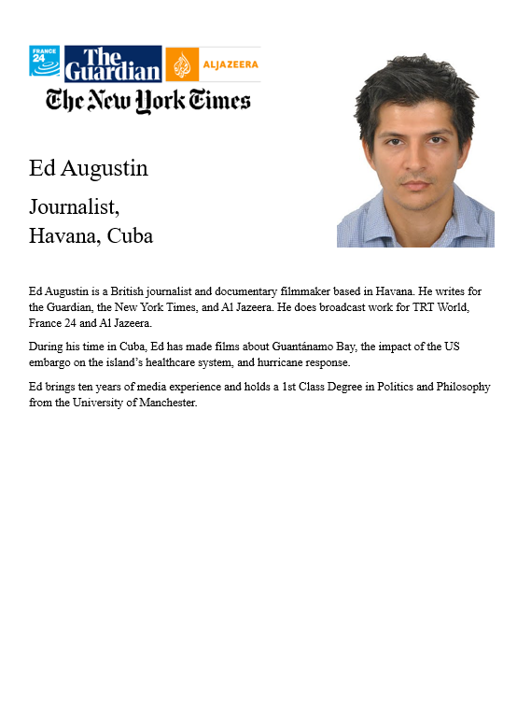
GUEST SPEAKER
Ed Augustin
Journalist,
Havana, Cuba
- Introduced by Bernadette

Slide 7
GUEST SPEAKER
Q & A
What is life in Cuba like now?
How important is the U.S. role?
From his perspective, what is the U.S. objective, and is it attainable?
What’s going to happen?

Slide 8
DISCUSSION
Your 401 and 402 projects
One-minute briefings to your colleagues…
Topic?
Current thesis?
Finding good drivers and options?

Slide 9
Sadie | U.S.-Israel Bilateral Relations
Alice | China-Taiwan-U.S. Tensions
Bernadette | U.S. International Image
Owen | U.S. International Image
Elyza | Russia-Ukraine Ceasefire
Hayley | U.S.-Mexico River Dispute
Will | Enhancing Ukraine Military Power
Luciano | U.S. Venezuela Oil Deal
DISCUSSION
Your 401 and 402 projects
One-minute briefings to your colleagues…
Topic?
Current thesis?
Finding good drivers and options?
Sadie | Strengthening Nuclear Nonproliferation
Alice
Bernadette | Dedollarization
Owen
Elyza | Future of the United Nations
Hayley
Will | Russia-Ukraine Ceasefire Talks
Luciano

Slide 10
Sadie | U.S.-Israel Bilateral Relations
Alice | China-Taiwan-U.S. Tensions
Bernadette | U.S. International Image
Owen | U.S. International Image
Elyza | Russia-Ukraine Ceasefire
Hayley | U.S.-Mexico River Dispute
Will | Enhancing Ukraine Military Power
Luciano | U.S. Venezuela Oil Deal
DISCUSSION
Your 401 and 402 projects
One-minute briefings to your colleagues…
Topic?
Current thesis?
Finding good drivers and options?
Sadie | Strengthening Nuclear Nonproliferation
Alice
Bernadette | Dedollarization
Owen
Elyza | Future of the United Nations
Hayley
Will | Russia-Ukraine Ceasefire Talks
Luciano

Slide 11
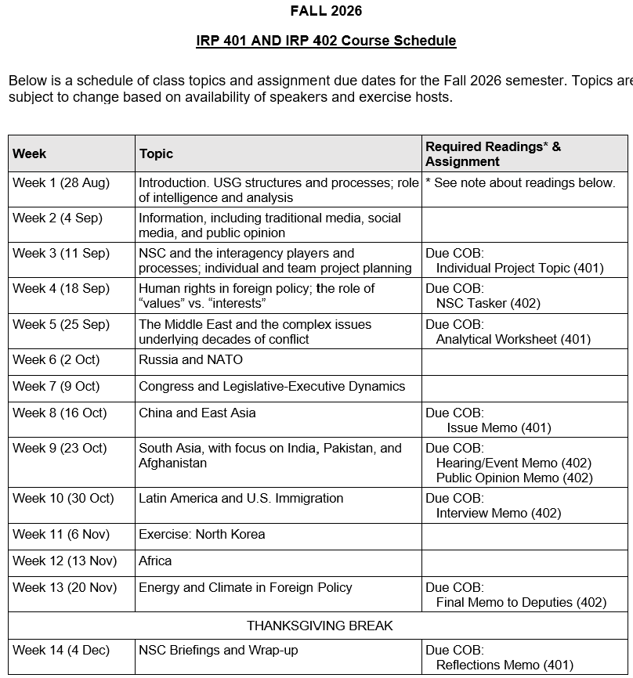
✓
401
✓
✓
402
✓
✓
✓
✓
✓
✓

Slide 12
TODAY’S AGENDA
9:00 | Skills Presentation: Digital Security
10:00 | Uber to Embassy of Cuba
10:30 | Guest Speaker: Ambassador Lianys Torres Chargé d’Affaires, Embassy of Cuba - Introduced by Sadie
~11:45 | Uber back to SUDC and Lunch
1:30 | Discussion: Cuba and U.S. Policy
2:00 | Guest Speaker: Ed Augustin Reporter in Havana, Cuba - Introduced by Bernadette
3:00 | Discussion: Briefings on 401-402 Projects
~3:45 | Wrapup

Slide 13
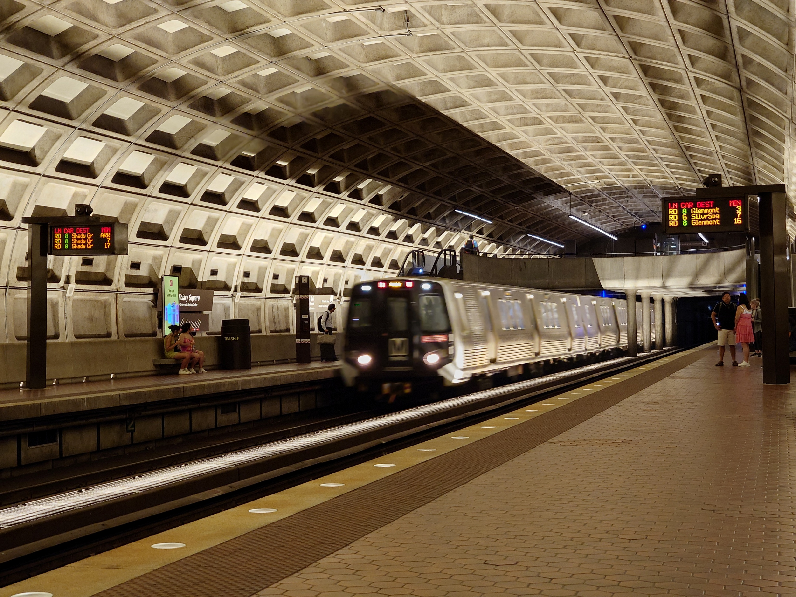
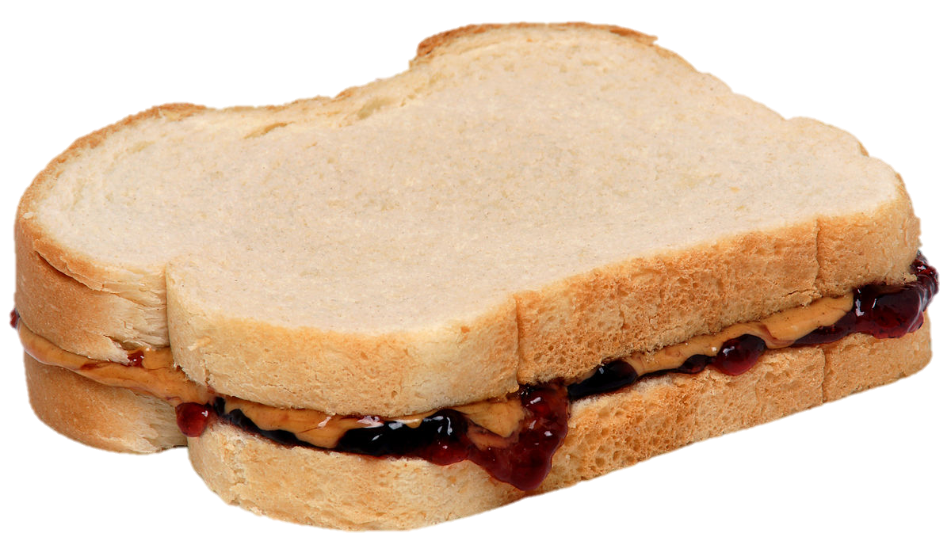
LUNCH and METRO to
Metro Center and National Press Club

Slide 14
Global Policy Seminar and NSC Simulation
IRP 401 - IRP 402
Week Eight
16 October 2026
Prof. Fulton T Armstrong

