Slide 1

Global Policy Seminar and NSC Simulation
IRP 401 - IRP 402
Week Seven
09 October 2026
Prof. Fulton T Armstrong

Slide 2
Week 1 (28 Aug)
Week 2 (4 Sep)
Week 3 (11 Sep)
Week 4 (18 Sep)
Week 5 (25 Sep)
Week 6 (2 Oct)
Week 7 (9 Oct)
Week 8 (16 Oct)
Week 9 (23 Oct)
Week 10 (30 Oct)
Week 11 (6 Nov)
Week 12 (13 Nov)
Week 13 (20 Nov)
Thanksgiving
Week 14 (4 Dec)
Fall 2026

Slide 3
TODAY’S AGENDA
9:00 | Skills Presentation: Digital Security
10:00 | Uber to Embassy of Cuba
10:30 | Guest Speaker: Ambassador Lianys Torres Chargé d’Affaires, Embassy of Cuba - Introduced by Sadie
~11:45 | Uber back to SUDC and Lunch
1:30 | Discussion: Cuba and U.S. Policy
2:00 | Guest Speaker: Ed Augustin Reporter in Havana, Cuba - Introduced by Bernadette
3:00 | Discussion: Briefings on 401-402 Projects
~3:45 | Wrapup

Slide 4
TODAY’S AGENDA
9:00 | Skills Presentation: Digital Security
10:00 | Uber to Embassy of Cuba
10:30 | Guest Speaker: Ambassador Lianys Torres Chargé d’Affaires, Embassy of Cuba - Introduced by Sadie
~11:45 | Uber back to SUDC and Lunch
1:30 | Discussion: Cuba and U.S. Policy
2:00 | Guest Speaker: Ed Augustin Reporter in Havana, Cuba - Introduced by Bernadette
3:00 | Discussion: Briefings on 401-402 Projects
~3:45 | Wrapup

Slide 5

Be on 19th Street at 10:00
BRING GOVERNMENT-ISSUED PHOTO I.D.

Slide 6
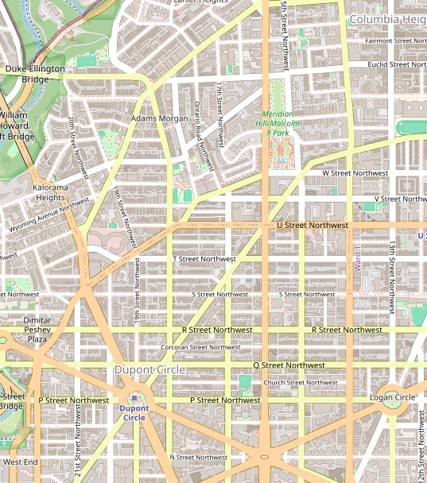



Designed 1849
Adopted 1902
Created 1895
Adopted 1952

Slide 7

SKILL DISCUSSION
NEXT WEEK: TBD

Slide 8
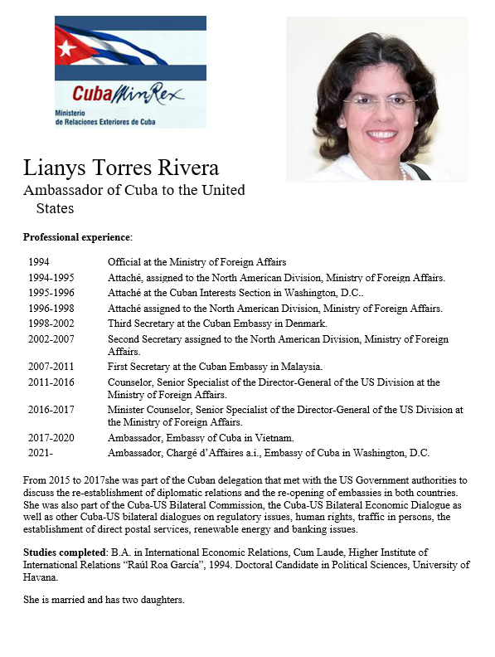
GUEST SPEAKER
Lianys TORRES
Ambassador,
Embassy of Cuba
- Introduced by Sadie

Slide 9
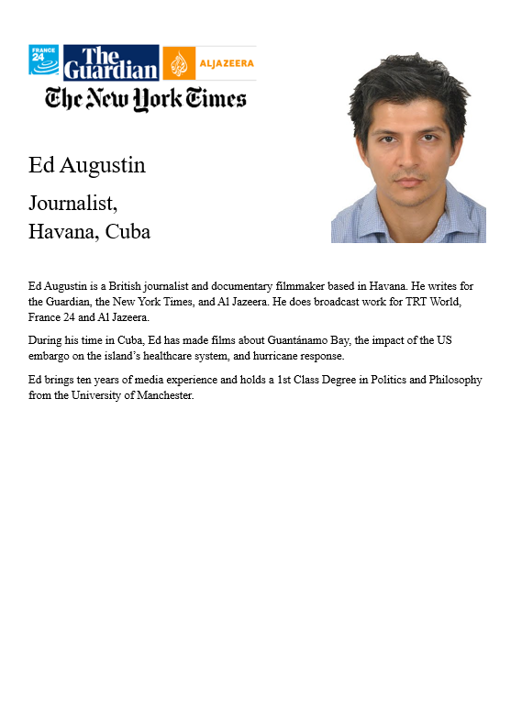
GUEST SPEAKER
Ed Augustin
Journalist,
Havana, Cuba
- Introduced by Bernadette

Slide 10
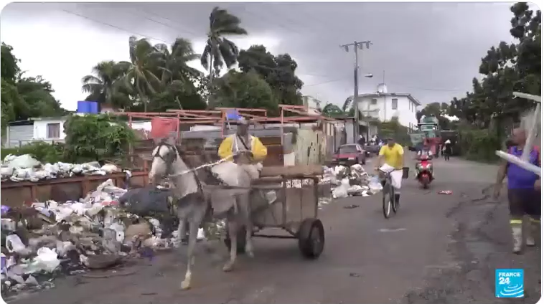
Ed Augustin reporting from Havana (October 2024)

Slide 11
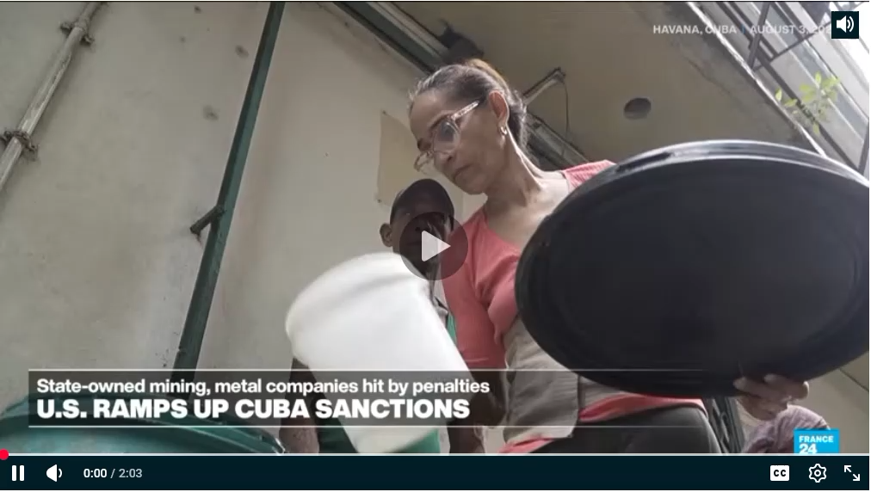
Ed Augustin reporting from Havana (August 2026)

Slide 12
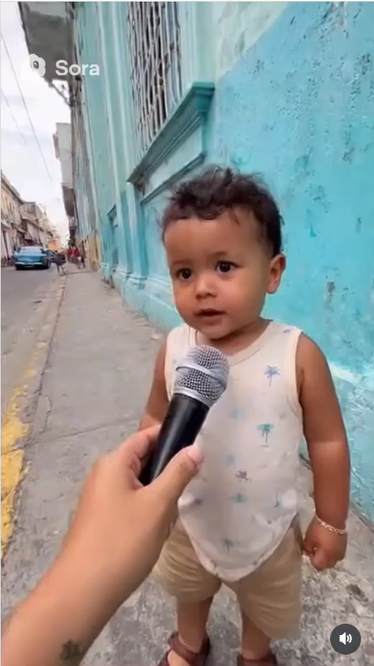
Also Sora fakes from Havana

Slide 13
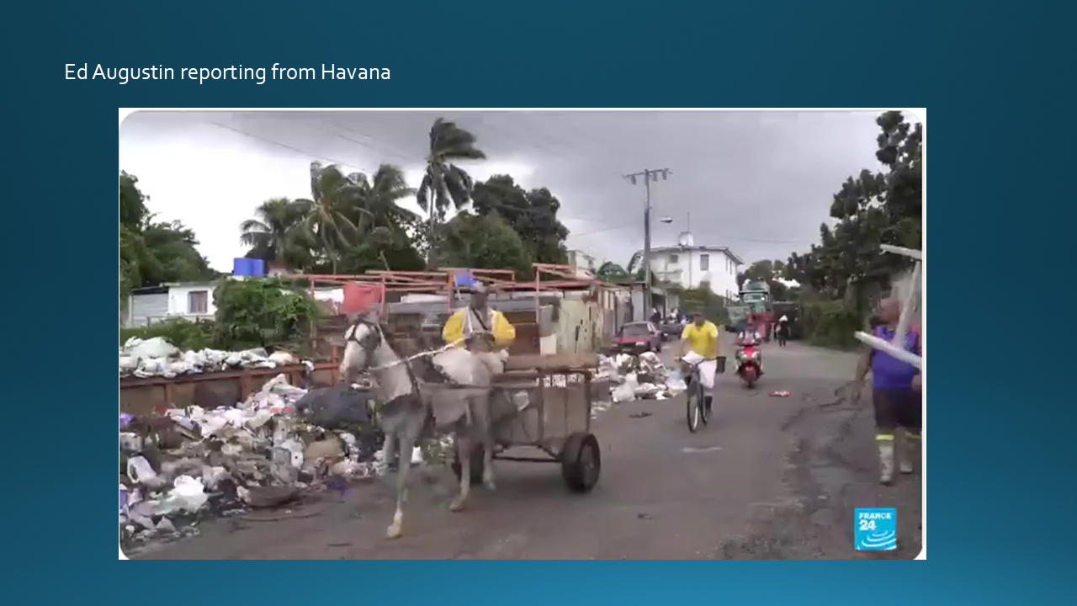

Slide 14
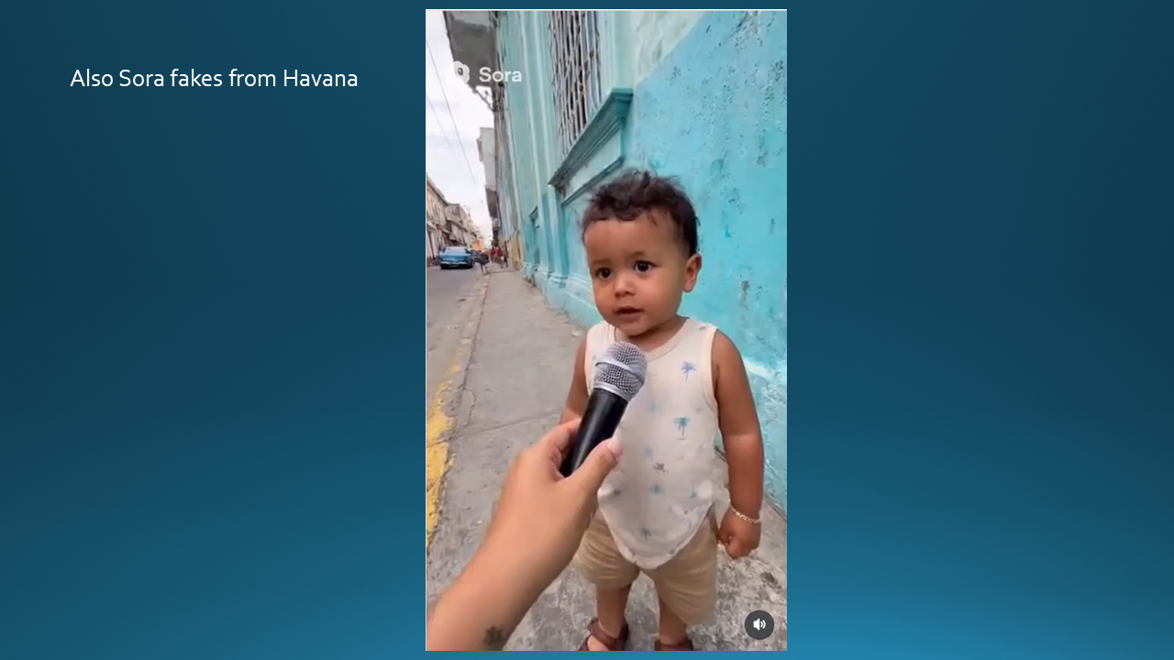

Slide 15
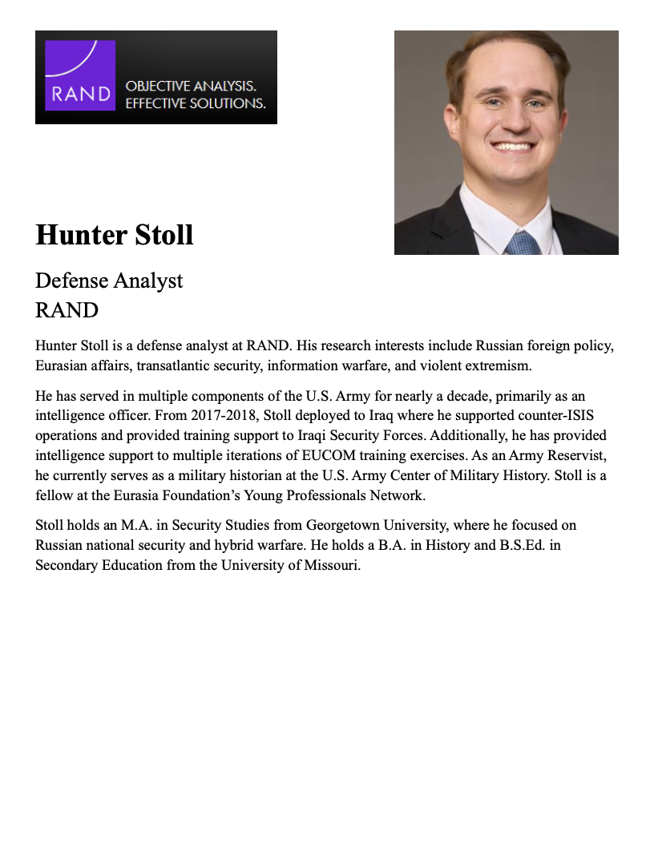
GUEST SPEAKER
Q & A
What are the drivers that could lead to resolution?
How important is the U.S. role?
How does aid support the U.S. national interest?
What scenario or two is most likely?

Slide 16


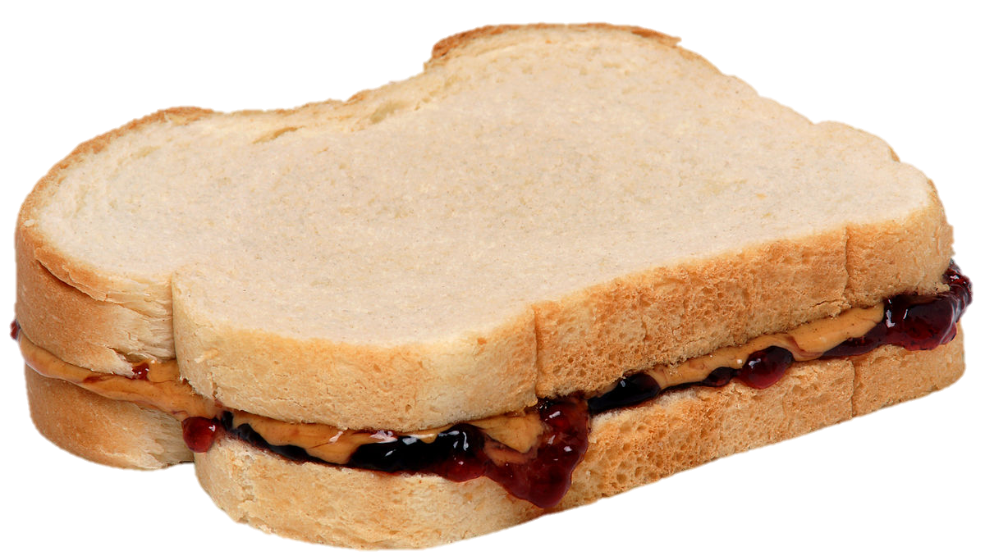
LUNCH

Slide 17
Designed 1849
Adopted 1902
Created 1895
Adopted 1952

Slide 18
DISCUSSION
Cuba
  What’s going on?
  What should the USG do?
  What bearing does the Venezuela operation have?

Slide 19
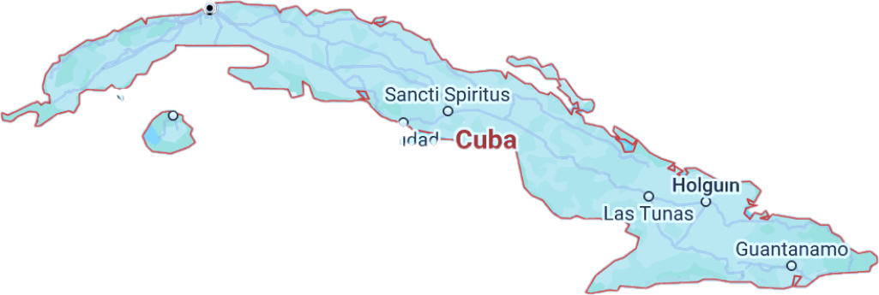
Cuba … and U.S. Policy
Notes:
REMEMBER CHATS ARE ON T.V.

Slide 20
The issue before us … “THE CUBA QUESTION”
    What is happening and why?
    Where are things headed?
    What is the U.S. angle?
      Our role?
      Our interests?
      Our policies?
Notes:
Want to provoke you … intellectually … to challenge analysis, including mine, and policy.
Will put to you whether policy represents best of American values – hr, democracy, etc., on one side, but HOW.
Will ask you whether policy should be based on process or results.

Slide 21

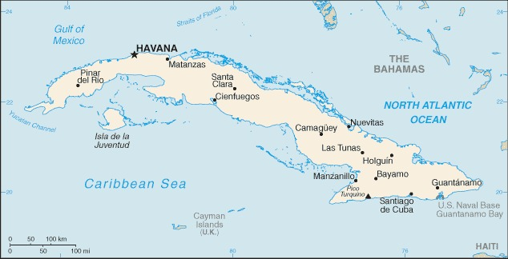
740m (1,250km)across

Slide 22
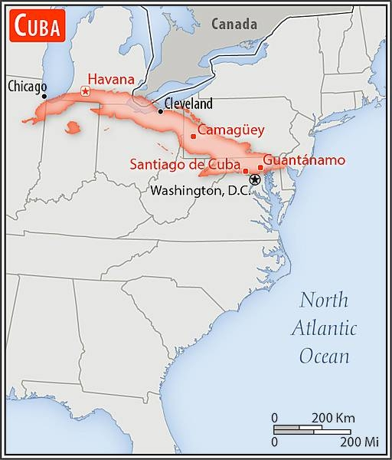

Slide 23
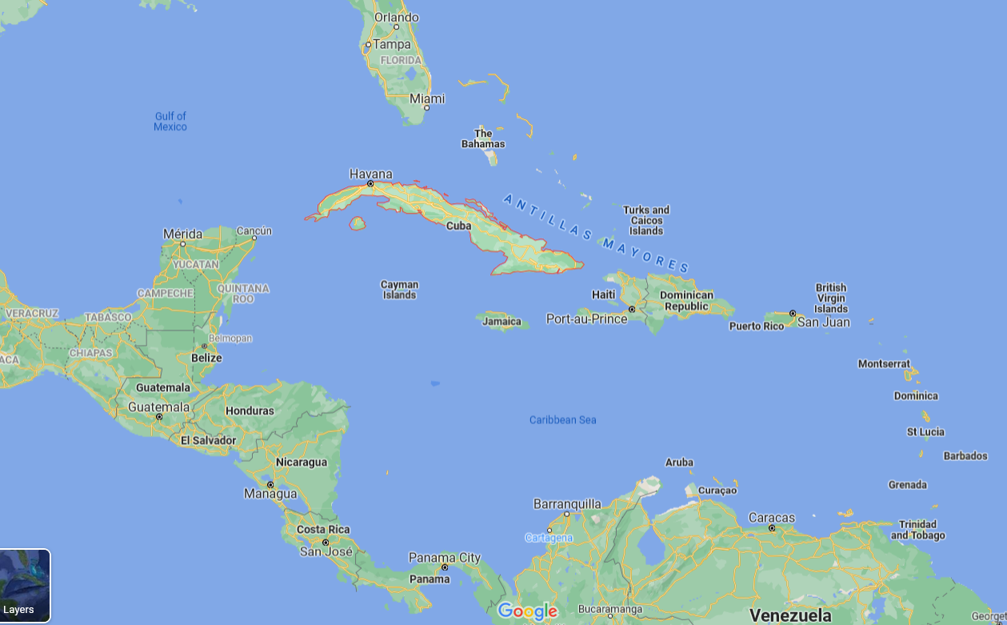
La Perla de las Antillas

Slide 24
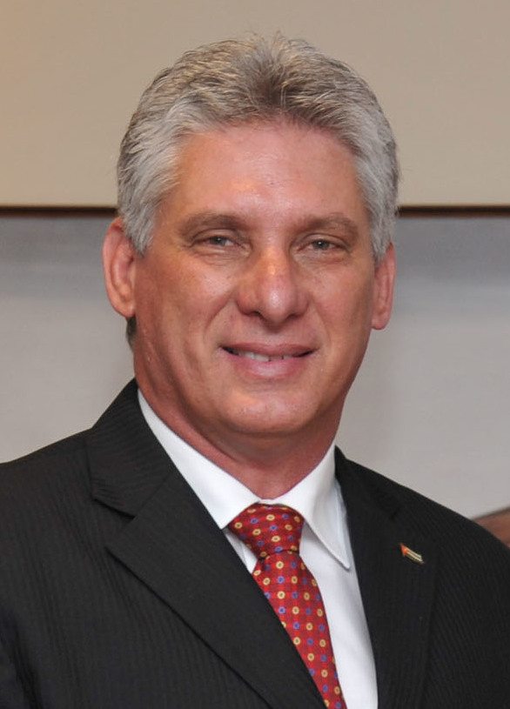
Chief of State
President Miguel DÍAZ-CANEL Bermúdez
President of the Council of State and the Council of Ministers since April 2018
First Secretary of the Communist Party of Cuba since April 2021
Prime Minister Manuel MARRERO Cruz
Head of Government (Council of Ministers) since December 2019

Slide 25
Life is TOUGH in Cuba.
Shortages of everything, including food and medicine
Unemployment/underemployment
Inflation
Electricity outages; fuel shortages
Sick and tired of it all

Slide 26
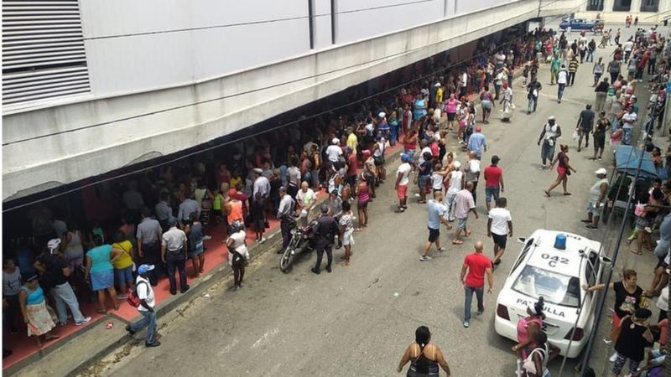
ECONOMY (NEVER GOOD) WORSE
Contracting 10% or more each year
Continued bad this year
SHORTAGES (NEVER GOOD) WORSE
Hours in line for basics
Hospitals short of supplies
Power outages in summer heat
Worst since “Special Period” in early ‘90s

Slide 27

AGGRAVATING IT ALL:
Government failure to reform inefficient
centrally controlled economy
Promised repeatedly
Done piecemeal, haltingly
Not delivered
Even good reform turned bad
ANALYTICAL DEBATE: Why’s the economy so bad?
Some controversy on how to rank reasons, but my ranking in recent years:
COVID
Trump and Biden suspended licenses for U.S. travel
Trump essentially shut down remittances; Biden reopened w/o banks
Trump pressed ahead with Title III, etc., and Biden continued
Trump and Biden put Cuba back on SSOT list, and Biden enforced punitive ESTA measures.
~$3.5 billion
2%-3% GDP
56 percent of families
U.S. SANCTIONS
Shut door to tourists, source of $3 billion/year
Depressed domestic production, consumption
Just generally wore people down
VENEZUELA
Reduced source of hard-currency for services
Oil blockade since Venezuela action
Estimated 90% drop in supplies; formerly ~112k barrels/day

Slide 28
U.S. Policy?
Notes:
REMEMBER CHATS ARE ON T.V.

Slide 29
“Maximum pressure”
WHY?
Cuban actions past/present?
Human rights?
U.S. domestic political issues?
Economic embargo since 1962
“Extraterritorial sanctions”
Diplomatic isolation
“Democracy promotion”
Radio/TV Martí
Various clandestine actions
Notes:
REMEMBER CHATS ARE ON T.V.

Slide 30
GUEST SPEAKER
Ed Augustin
Journalist,
Havana, Cuba
- Introduced by Bernadette

Slide 31
GUEST SPEAKER
Q & A
What is life in Cuba like now?
How important is the U.S. role?
From his perspective, what is the U.S. objective, and is it attainable?
What’s going to happen?

Slide 32
DISCUSSION
Your 401 and 402 projects
One-minute briefings to your colleagues…
Topic?
Current thesis?
Finding good drivers and options?

Slide 33
Sadie | U.S.-Israel Bilateral Relations
Alice | China-Taiwan-U.S. Tensions
Bernadette | U.S. International Image
Owen | U.S. International Image
Elyza | Russia-Ukraine Ceasefire
Hayley | U.S.-Mexico River Dispute
Will | Enhancing Ukraine Military Power
Luciano | U.S. Venezuela Oil Deal
DISCUSSION
Your 401 and 402 projects
One-minute briefings to your colleagues…
Topic?
Current thesis?
Finding good drivers and options?
Sadie | Strengthening Nuclear Nonproliferation
Alice
Bernadette | Dedollarization
Owen
Elyza | Future of the United Nations
Hayley
Will | Russia-Ukraine Ceasefire Talks
Luciano

Slide 34
Sadie | U.S.-Israel Bilateral Relations
Alice | China-Taiwan-U.S. Tensions
Bernadette | U.S. International Image
Owen | U.S. International Image
Elyza | Russia-Ukraine Ceasefire
Hayley | U.S.-Mexico River Dispute
Will | Enhancing Ukraine Military Power
Luciano | U.S. Venezuela Oil Deal
DISCUSSION
Your 401 and 402 projects
One-minute briefings to your colleagues…
Topic?
Current thesis?
Finding good drivers and options?
Sadie | Strengthening Nuclear Nonproliferation
Alice
Bernadette | Dedollarization
Owen
Elyza | Future of the United Nations
Hayley
Will | Russia-Ukraine Ceasefire Talks
Luciano

Slide 35
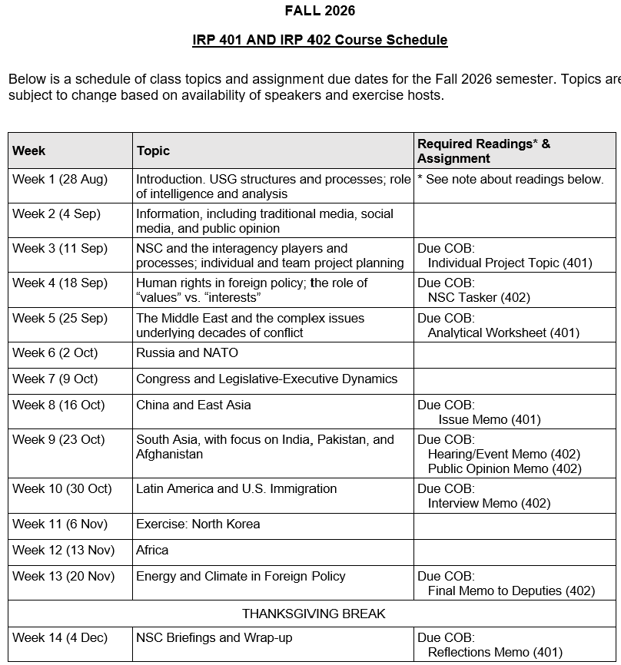
✓
401
✓
✓
402
✓
✓
✓
✓
✓
✓

Slide 36
TODAY’S AGENDA
9:00 | Skills Presentation: Digital Security
10:00 | Uber to Embassy of Cuba
10:30 | Guest Speaker: Ambassador Lianys Torres Chargé d’Affaires, Embassy of Cuba - Introduced by Sadie
~11:45 | Uber back to SUDC and Lunch
1:30 | Discussion: Cuba and U.S. Policy
2:00 | Guest Speaker: Ed Augustin Reporter in Havana, Cuba - Introduced by Bernadette
3:00 | Discussion: Briefings on 401-402 Projects
~3:45 | Wrapup

Slide 37
Global Policy Seminar and NSC Simulation
IRP 401 - IRP 402
Week Seven
09 October 2026
Prof. Fulton T. Armstrong

Slide 38
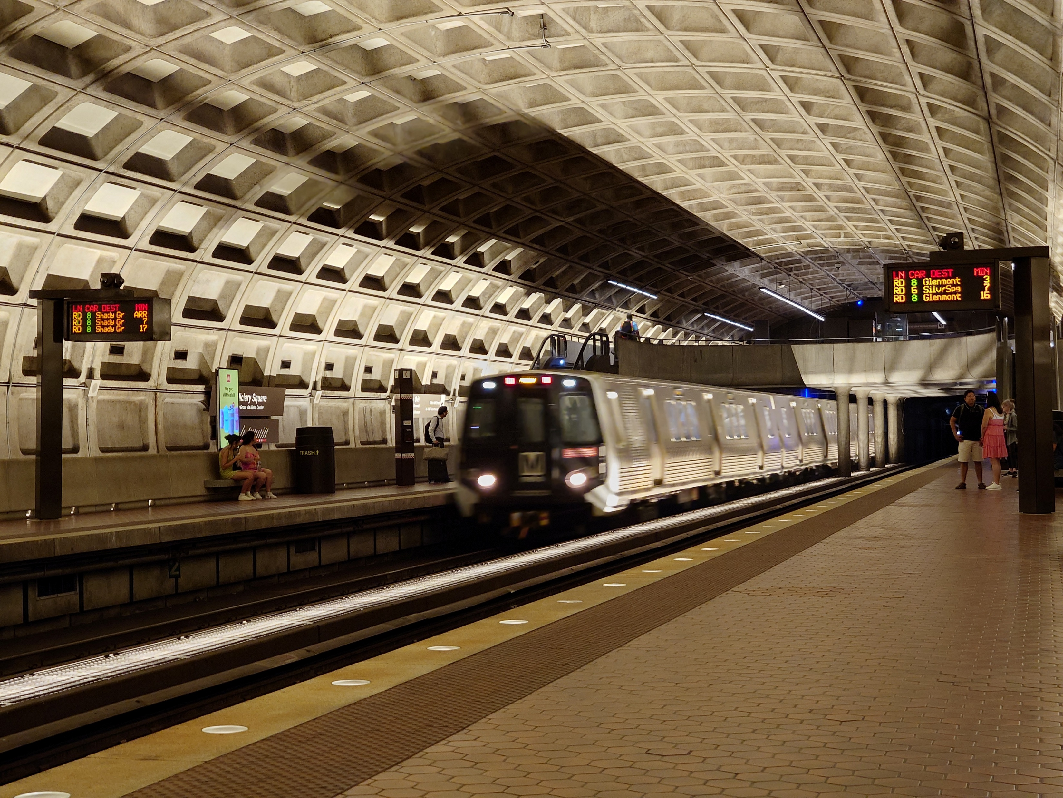
LUNCH and METRO to
Metro Center and National Press Club

