Slide 1

Global Policy Seminar and NSC Simulation
IRP 401 - IRP 402
Week Six
O2 October 2026
Prof. Fulton T. Armstrong

Slide 2
Week 1 (28 Aug)
Week 2 (4 Sep)
Week 3 (11 Sep)
Week 4 (18 Sep)
Week 5 (25 Sep)
Week 6 (2 Oct)
Week 7 (9 Oct)
Week 8 (16 Oct)
Week 9 (23 Oct)
Week 10 (30 Oct)
Week 11 (6 Nov)
Week 12 (13 Nov)
Week 13 (20 Nov)
Thanksgiving
Week 14 (4 Dec)
Fall 2026

Slide 3
TODAY’S AGENDA
9:00 | Skills Presentation: The Washington Memo
10:00 | Class Discussion: Ukraine
10:30 | Guest Speaker: Hunter Stoll - Defense Analyst, RAND - Introduced by Will
11:45 | Lunch
12:35 | Uber to Embassy of Ukraine
1:00 | Speaker: Denys Sienek Chargé d’Affaires, Embassy of Ukraine - Introduced by Elyza
~2:30 | Wrapup

Slide 4
TODAY’S AGENDA
9:00 | Skills Presentation: The Washington Memo
10:00 | Class Discussion: Ukraine
10:30 | Guest Speaker: Hunter Stoll - Defense Analyst, RAND - Introduced by Will
11:45 | Lunch
12:35 | Uber to Embassy of Ukraine
1:00 | Speaker: Denys Sienek Deputy Chief of Mission, Embassy of Ukraine - Introduced by Elyza
~2:30 | Wrapup

Slide 5

Be on 19th Street at 12:35
BRING GOVERNMENT-ISSUED PHOTO I.D.

Slide 6

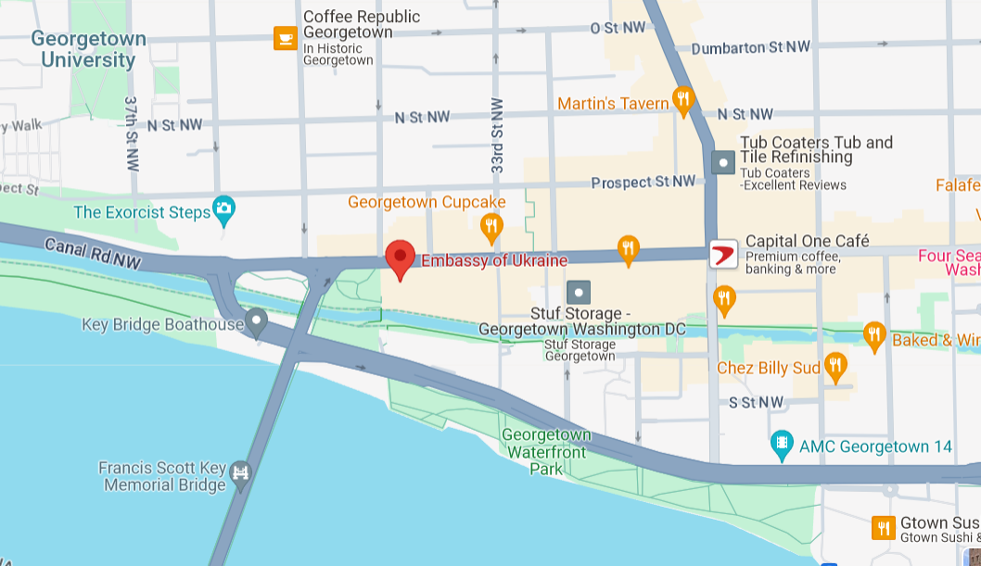

34th ST NW
WISCONSIN AVE NW
Embassy of Ukraine
3350 M St NW
M ST NW
WHITEHURST FREEWAY
To Farragut Sq.

Slide 7

SKILL DISCUSSION
NEXT WEEK: Smart Uses of A.I. (Nayyera Haq)

Slide 8
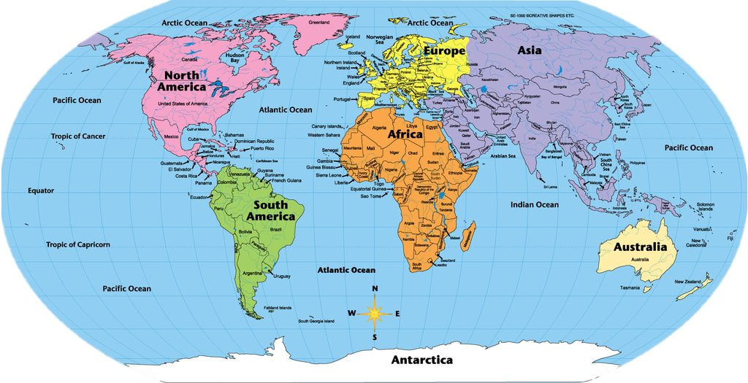
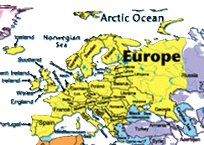

Slide 9
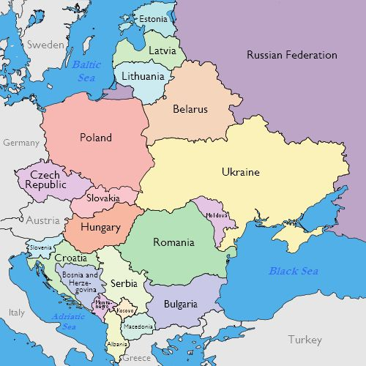
North

Slide 10
DISCUSSION
Why are they at war?
What is Russia (or Putin) doing?
What are prospects for the war … and negotiations?
What’s holding back either victory or a settlement?
What does it all mean for NATO?
What’s the U.S. role?
What other policies are driving outcomes?

Slide 11
DISCUSSION
On fourth-and-half anniversary (24 Feb) …
How is the war going for the two sides?
Which can better endure a war of attrition?
U.S. aid inconsistent and down.

Slide 12
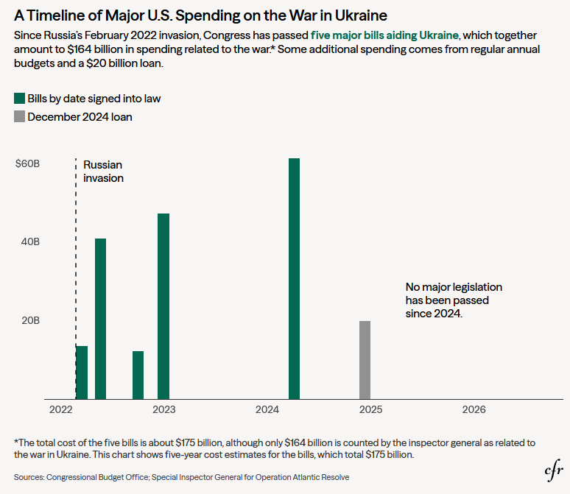
DISCUSSION
$164 billion
U.S. aid inconsistent and down.
as of March 2026

Slide 13
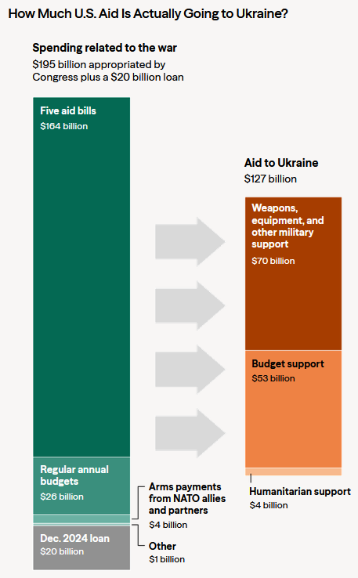
DISCUSSION
U.S. aid inconsistent and down.
as of March 2026

Slide 14
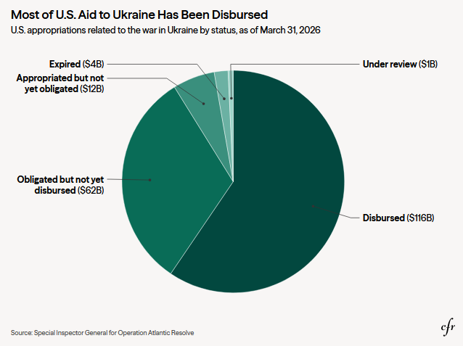
DISCUSSION
U.S. aid inconsistent and down.
as of March 2026

Slide 15
On fourth-and-half anniversary (24 Feb) …
How is the war going for the two sides?
Which can better endure a war of attrition?
DISCUSSION
U.S. aid inconsistent and down.
Both increasing production of drones, missiles, etc.
Russia = 1.2m dead (143m); UKR = 500k-600k dead (43m).
UKR civilian deaths up 20% each year – 2,500 in 2025.
Destroy power generation, transmission.
Fourth round of negotiations in Geneva failed.
P dragging feet, pocketing T patience and making Z more anxious.
  RU Demands: cut UKR military; dismantle Z government; guaranteed neutrality.
Europeans pessimistic of deal in 2026.
What does it mean …
for UKR?
for EU?
for US?

Slide 16
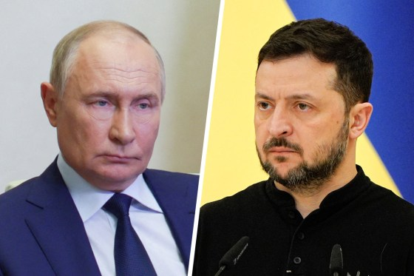

Russian President Vladimir Putin Ukrainian President Volodymyr Zelenskyy
since 1999
since 2019

Slide 17

Lean on him?
or him?
Russian President Vladimir Putin Ukrainian President Volodymyr Zelenskyy
since 1999
since 2019

Slide 18
Lean on him?
or him?
Russian President Vladimir Putin Ukrainian President Volodymyr Zelenskyy
since 1999
since 2019

Slide 19
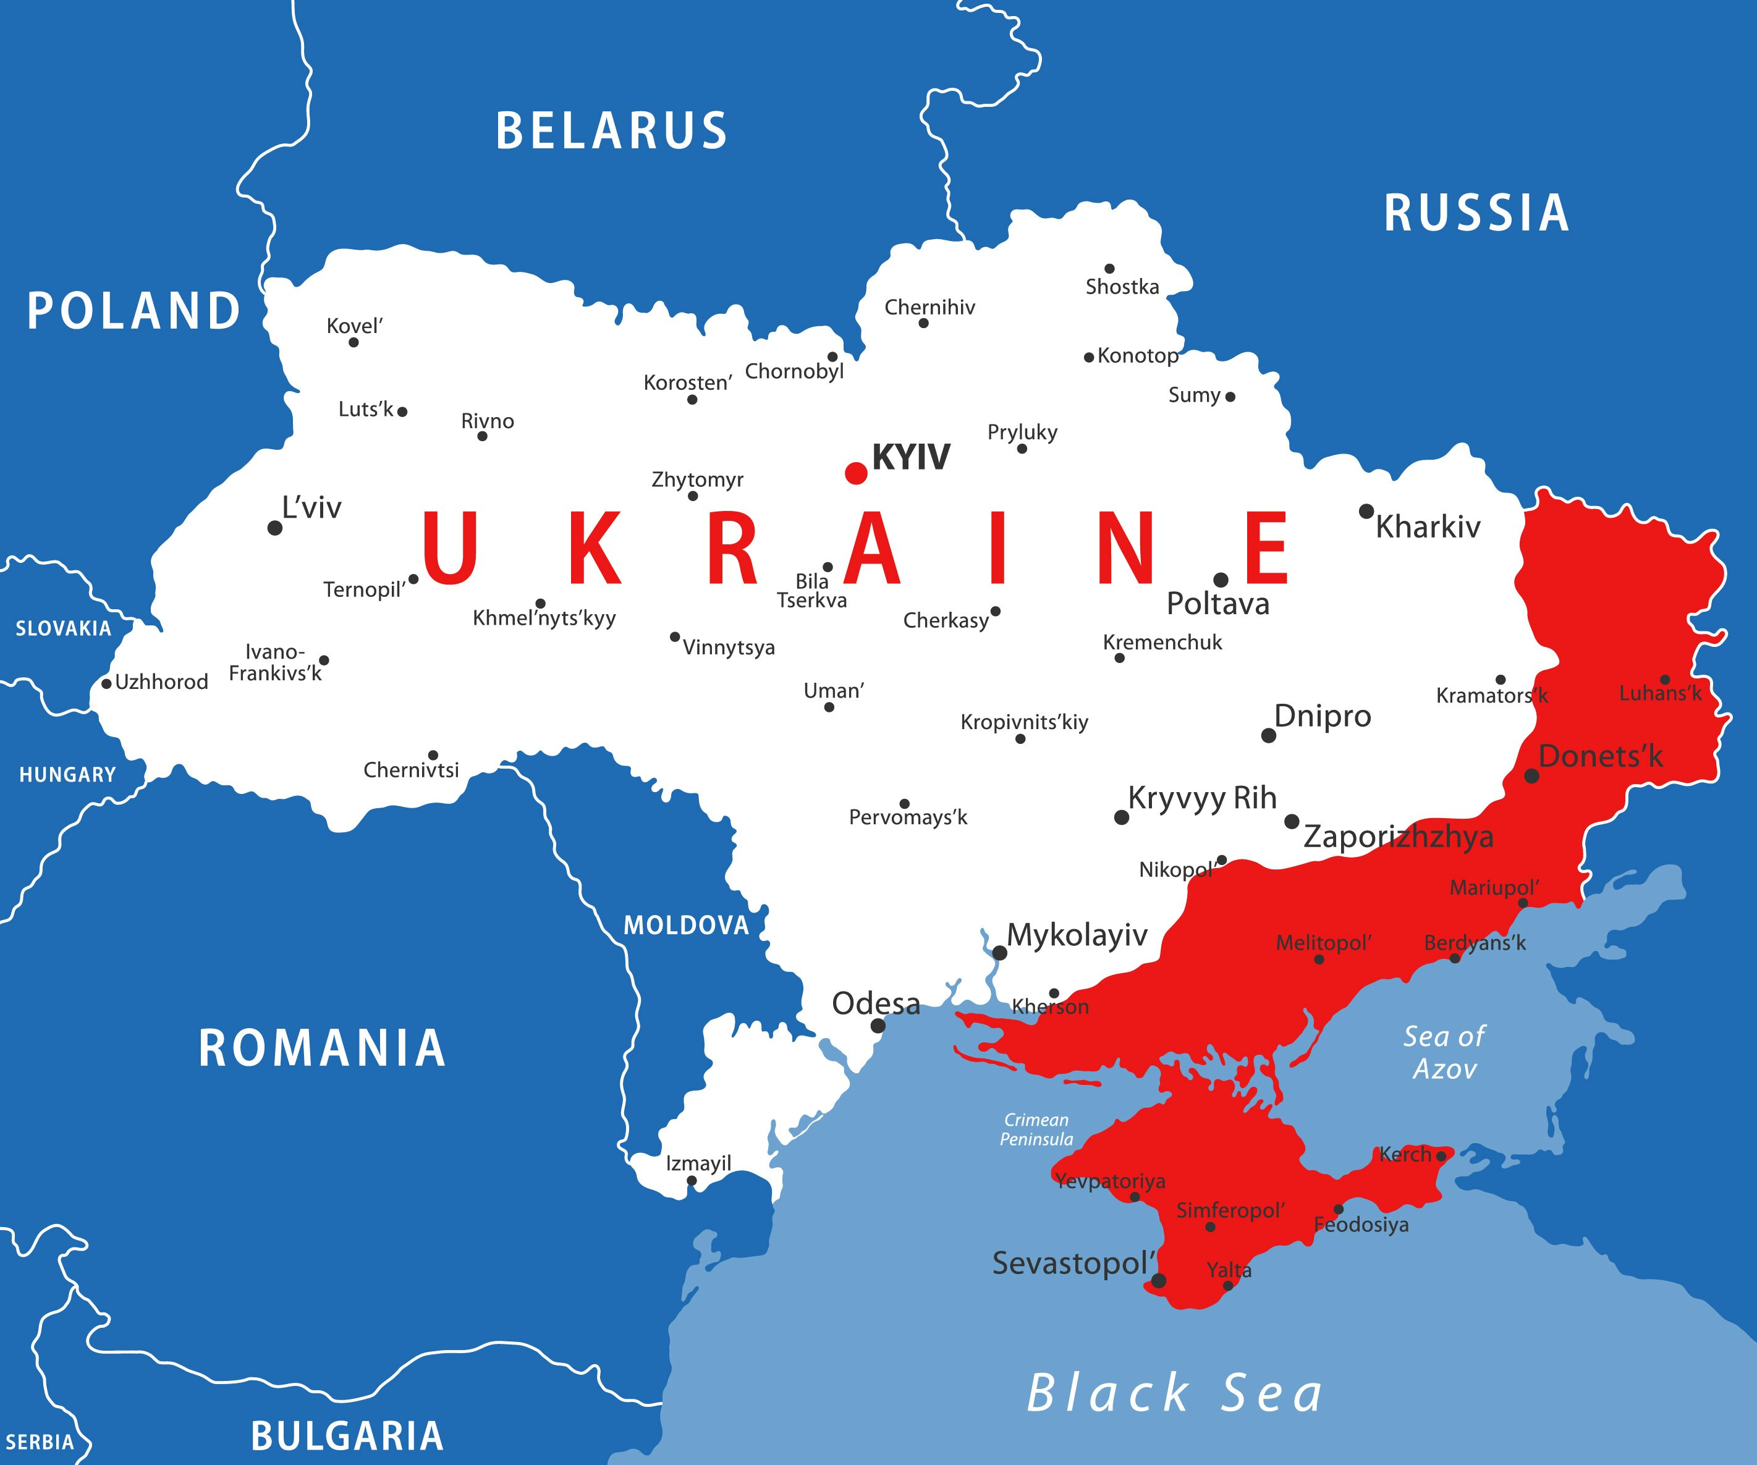
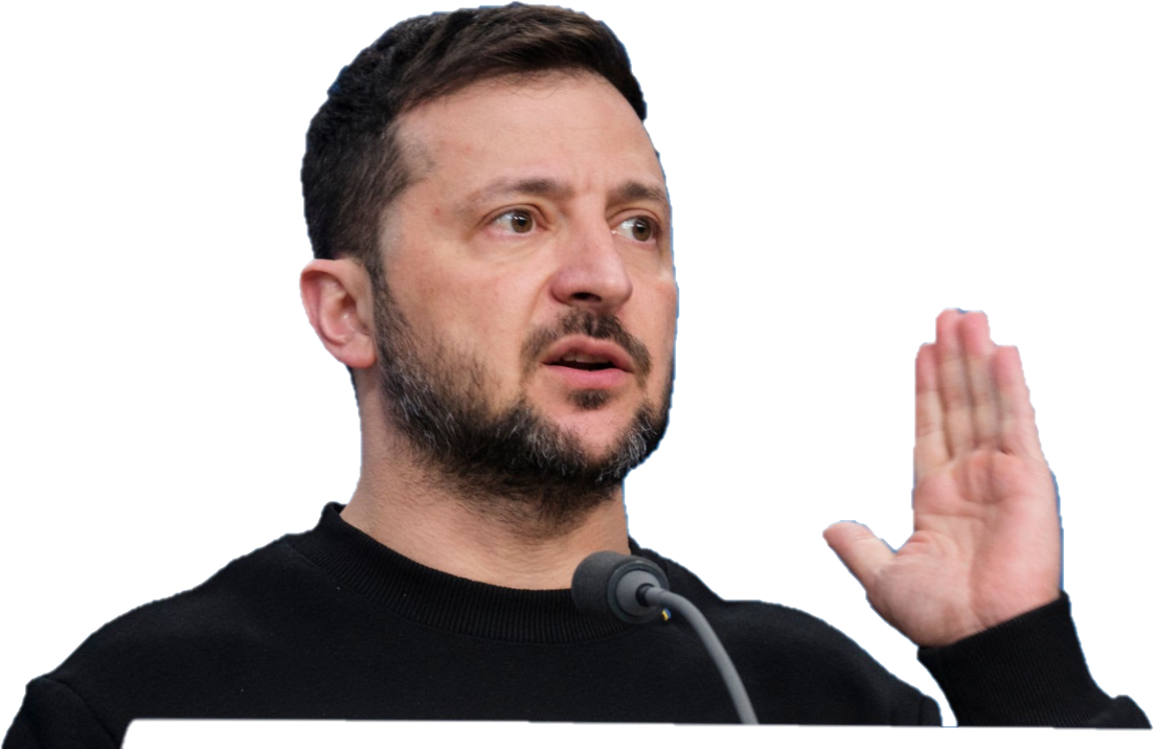
DISCUSSION
What U.S. policy solutions do you see as *feasible*?

Slide 20
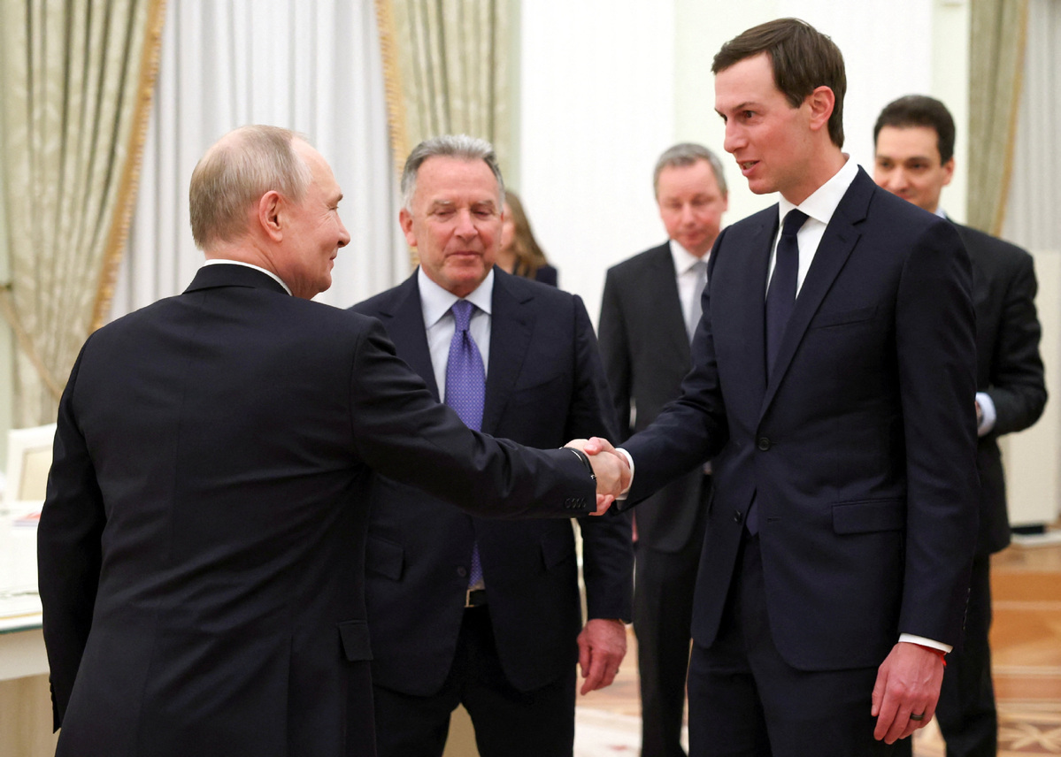
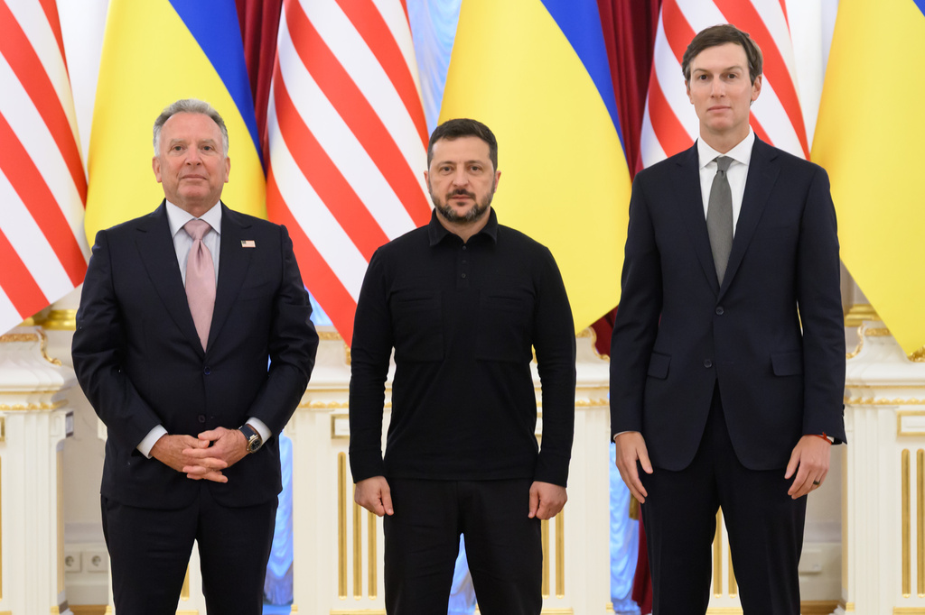
DISCUSSION
Steve Witkoff
and
Jared Kushner
Several attempts.
Most recent: 6 Sep
Usually optimistic.
January 2026

Slide 21


Slide 22
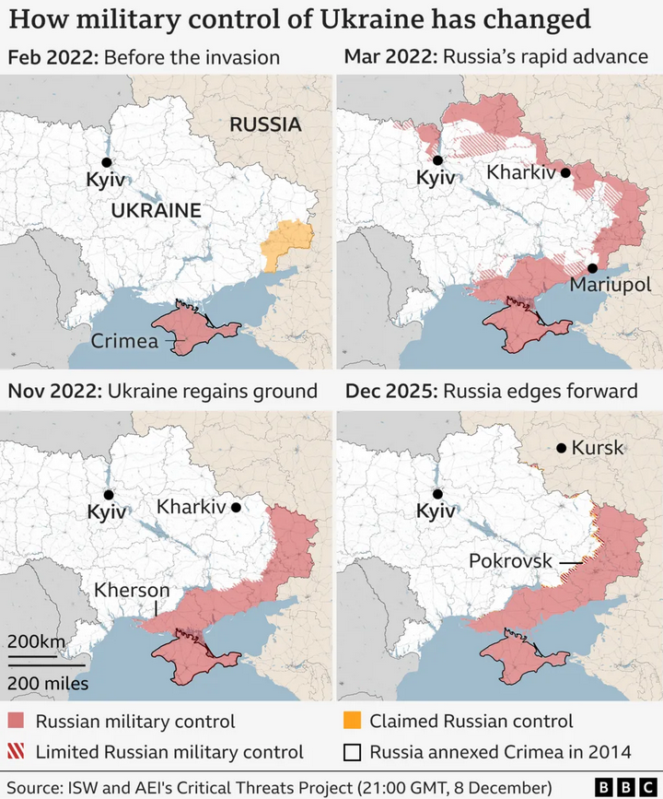

Slide 23
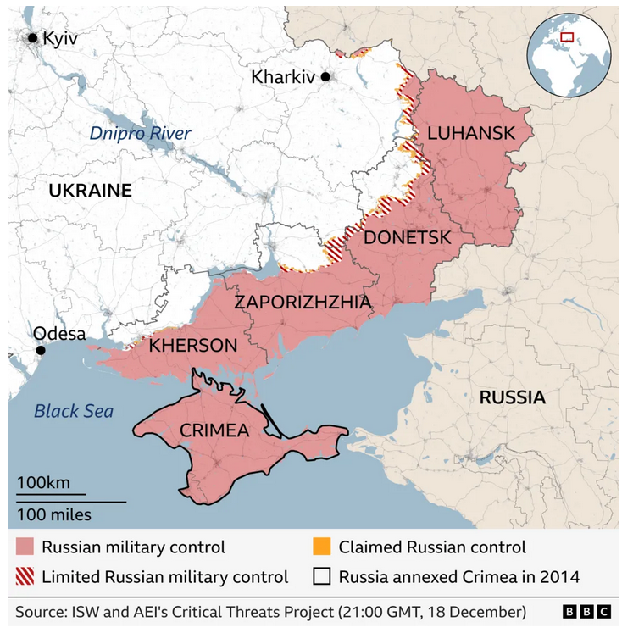

Slide 24
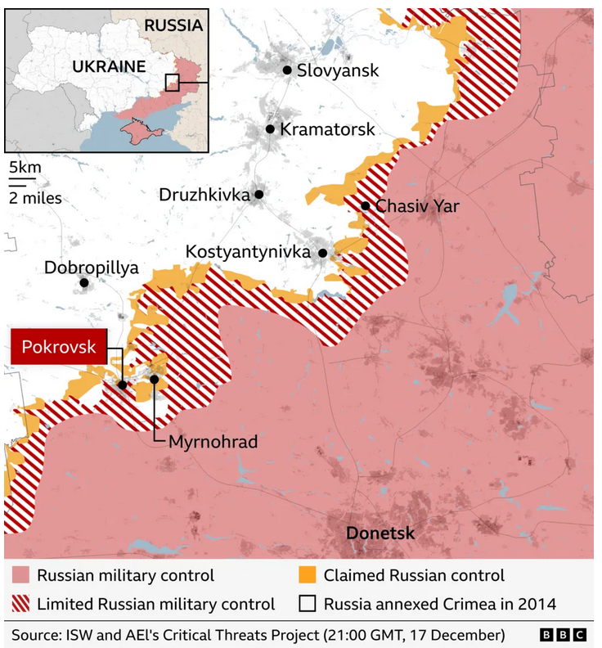

Slide 25

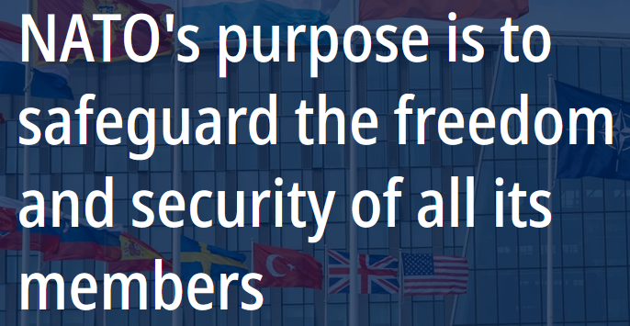
NATO website carousel
1/4

Slide 26
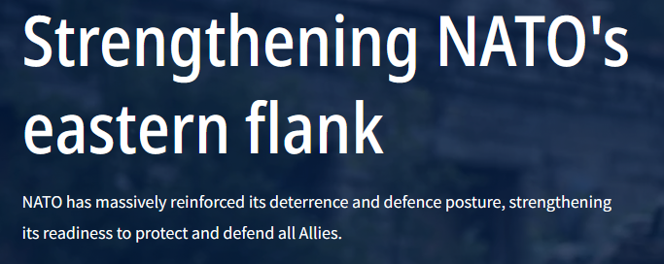
NATO website carousel
2/4

Slide 27
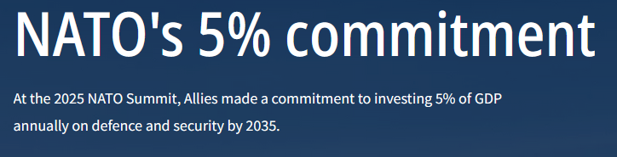
NATO website carousel
3/4

Slide 28
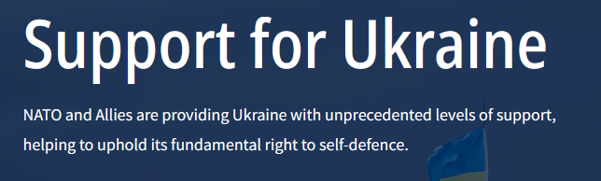
NATO website carousel
4/4

Slide 29
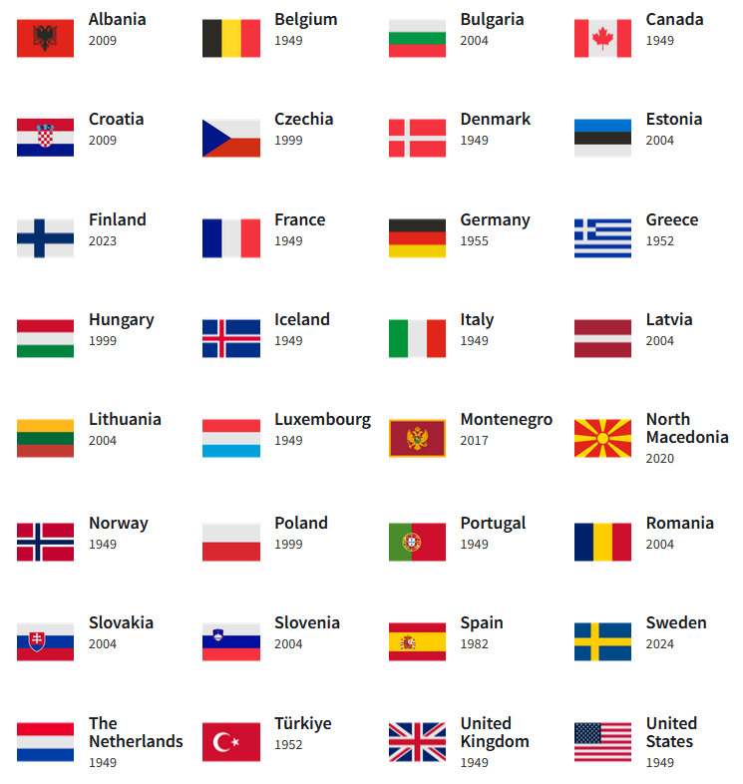
MEMBER COUNTRIES
12 in 1949
32 now
IN LAST 10 YEARS

Slide 30
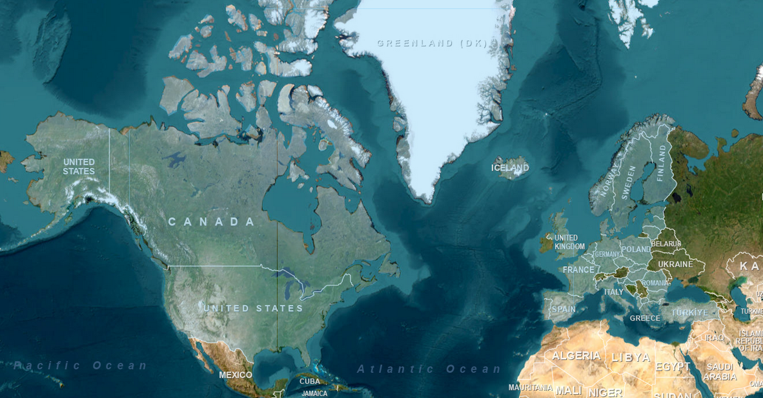
NATO members (in blue)

Slide 31
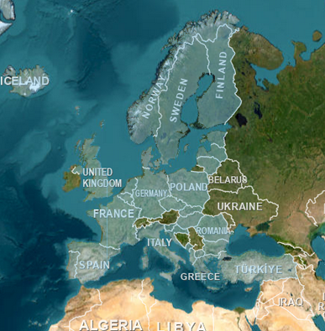
RUSSIA
NATO members (in blue)

Slide 32
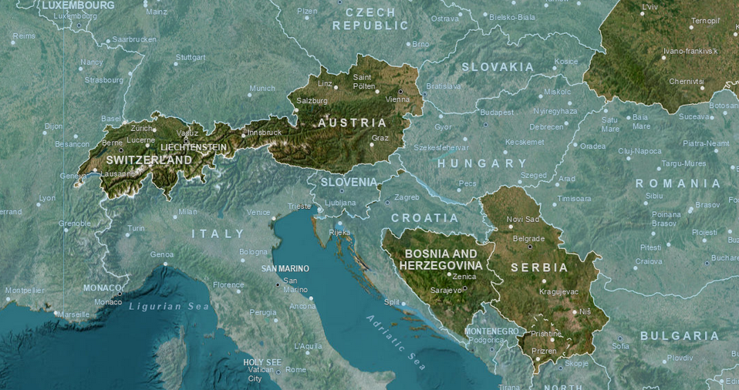
UKRAINE
NATO members (in blue)

Slide 33
What is Russia (or Putin) doing?
What are prospects for the war … and negotiations?
What’s holding back either victory or a settlement?
What does it all mean for NATO?
What’s the U.S. role?
What other policies are driving outcomes?

Slide 34
DISCUSSION

Slide 35
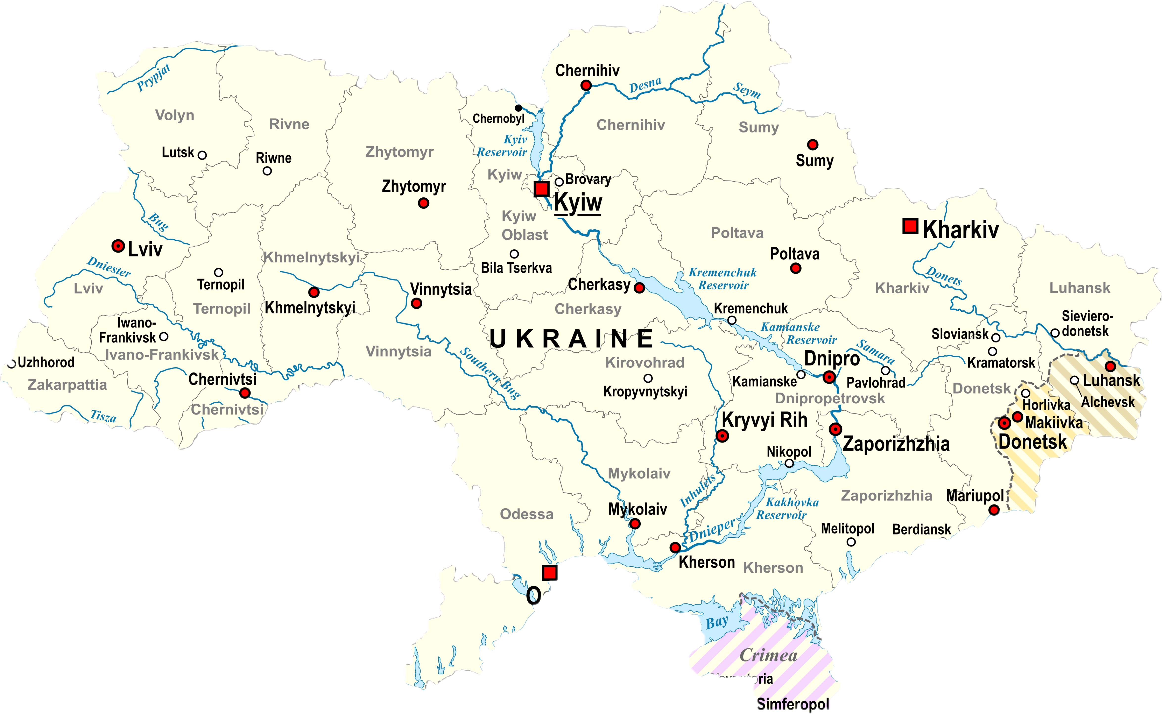
What will Ukraine look like in 1, 5 or 10 years?
Before 2014

Slide 36
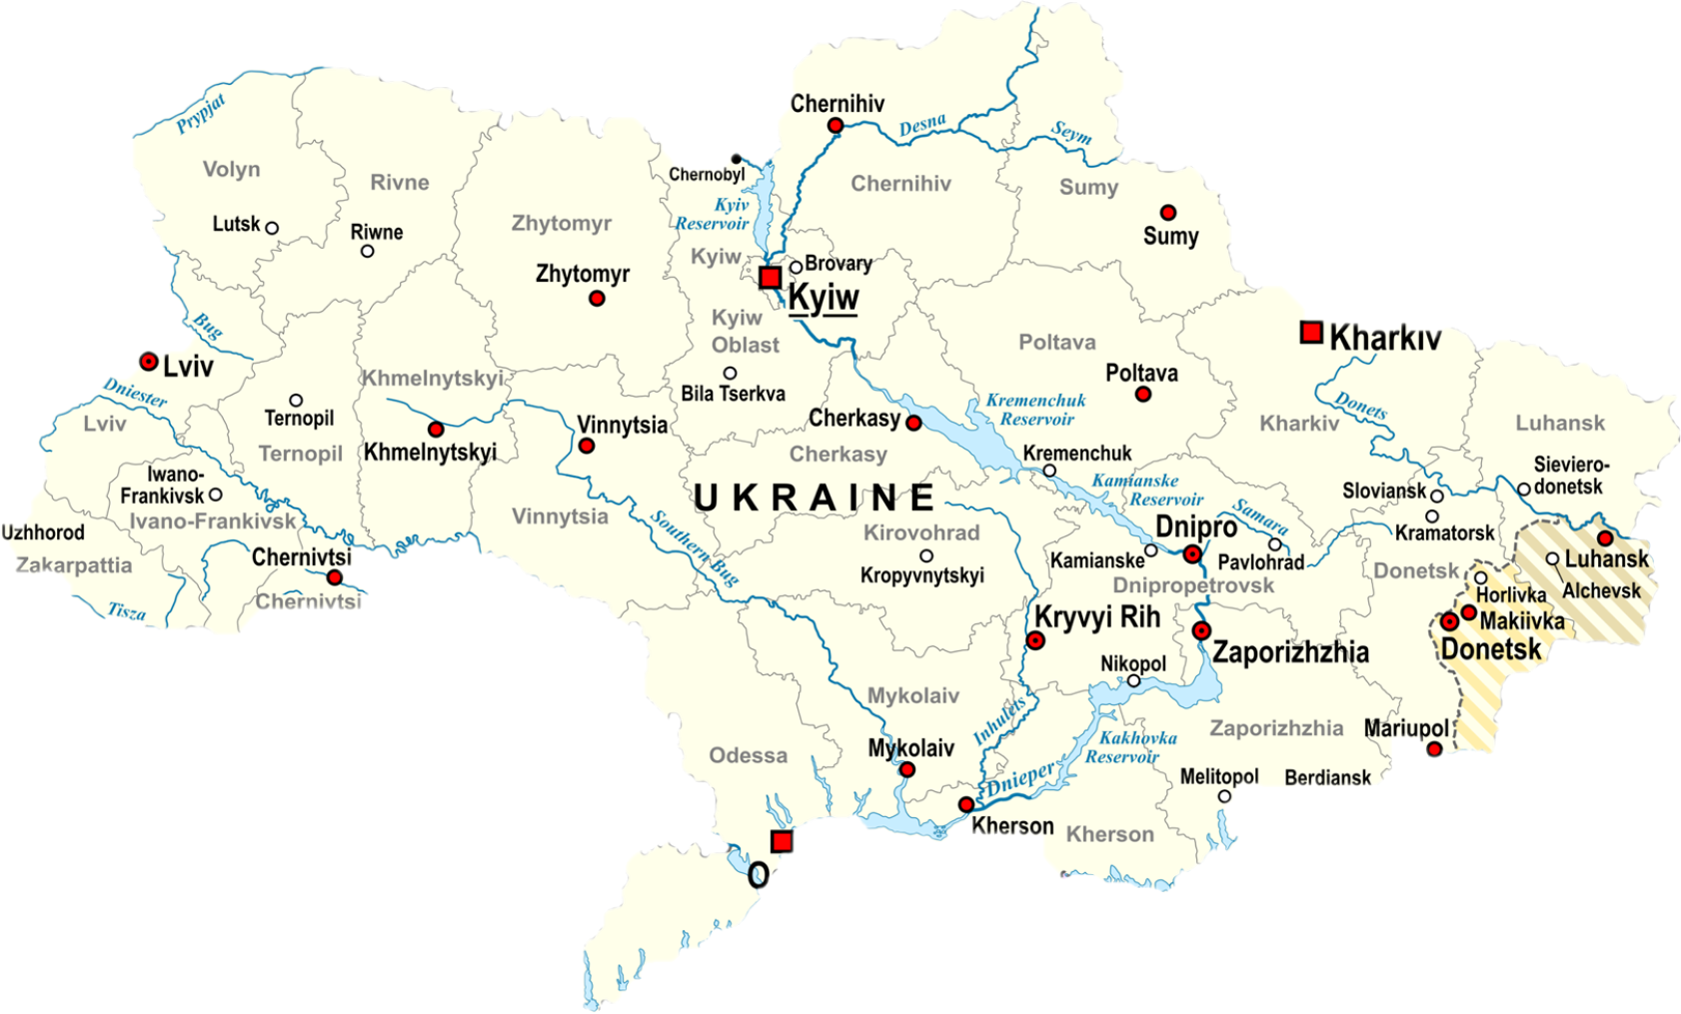

Slide 37




What will Ukraine look like in 1, 5 or 10 years?

Slide 38





What will Ukraine look like in 1, 5 or 10 years?

Slide 39






What will Ukraine look like in 1, 5 or 10 years?
?

Slide 40
DISCUSSION
On fourth-and-a-half anniversary (24 Feb) …
How is the war going for the two sides?
Which can better endure a war of attrition?
Ukraine-Russia-NATO
Through what lens should we look at the war?
What is the status of the war … or negotiations?
How united does the alliance need to be?
What is the more likely outcome?
How well informed are we?

Slide 41
DISCUSSION
Ukraine-Russia-NATO
Through what lens should we look at the war?
What is the status of the war … or negotiations?
How united does the alliance need to be?
What is the more likely outcome?

Slide 42
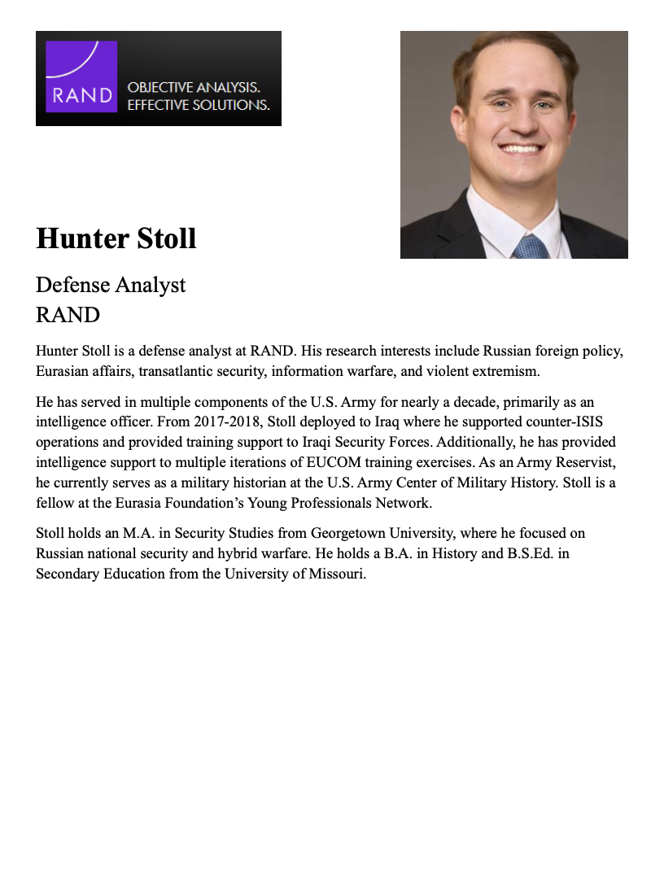
GUEST SPEAKER
Hunter Stoll
Defense Analyst
RAND
- Introduced by Will

Slide 43
GUEST SPEAKER
Q & A
What are the drivers that could lead to resolution?
How important is the U.S. role?
How does aid support the U.S. national interest?
What scenario or two is most likely?

Slide 44
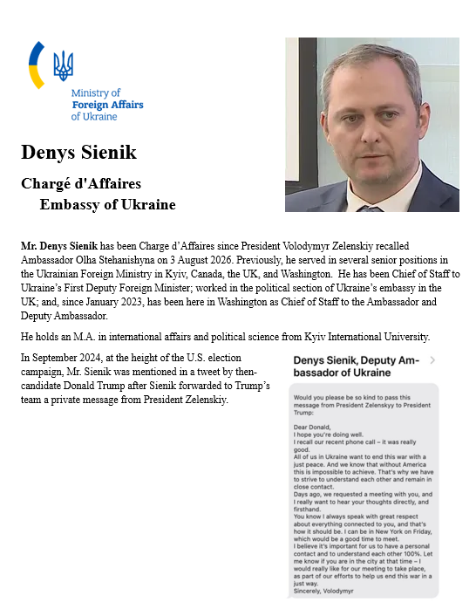
GUEST SPEAKER
Denys Sienik
Chargé d’Affaires
Embassy of Ukraine
- Introduced by Elyza

Slide 45
Be on 19th Street at 12:35
BRING GOVERNMENT-ISSUED PHOTO I.D.

Slide 46
34th ST NW
WISCONSIN AVE NW
Embassy of Ukraine
3350 M St NW
M ST NW
WHITEHURST FREEWAY
To Farragut Sq.

Slide 47
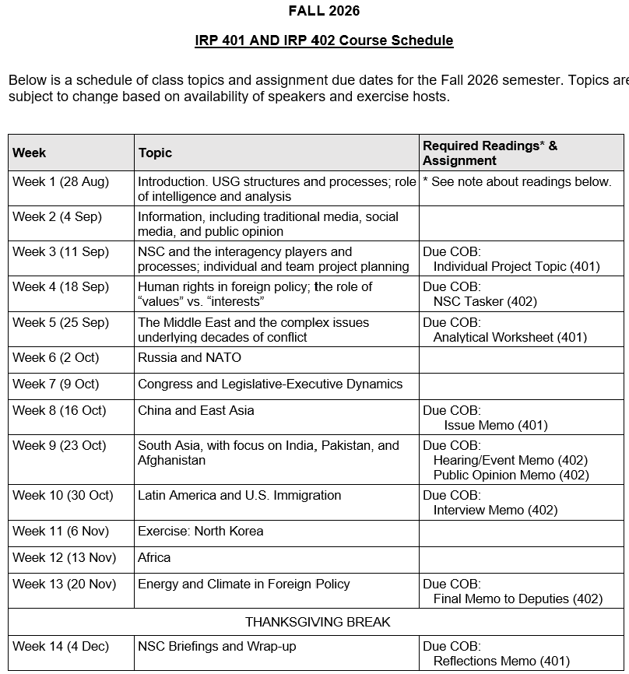
✓
401
✓
✓
402
✓
✓
✓
✓
✓
✓

Slide 48
TODAY’S AGENDA
9:00 | Skills Presentation: The Washington Memo
10:00 | Class Discussion: Ukraine
10:30 | Guest Speaker: Hunter Stoll - Defense Analyst, RAND - Introduced by Will
11:45 | Lunch
12:35 | Uber to Embassy of Ukraine
1:00 | Speaker: Denys Sienek Chargé d’Affaires, Embassy of Ukraine - Introduced by Elyza
~2:30 | Wrapup

Slide 49
Global Policy Seminar and NSC Simulation
IRP 401 - IRP 402
Week Six
O2 October 2026
Prof. Fulton T. Armstrong

Slide 50
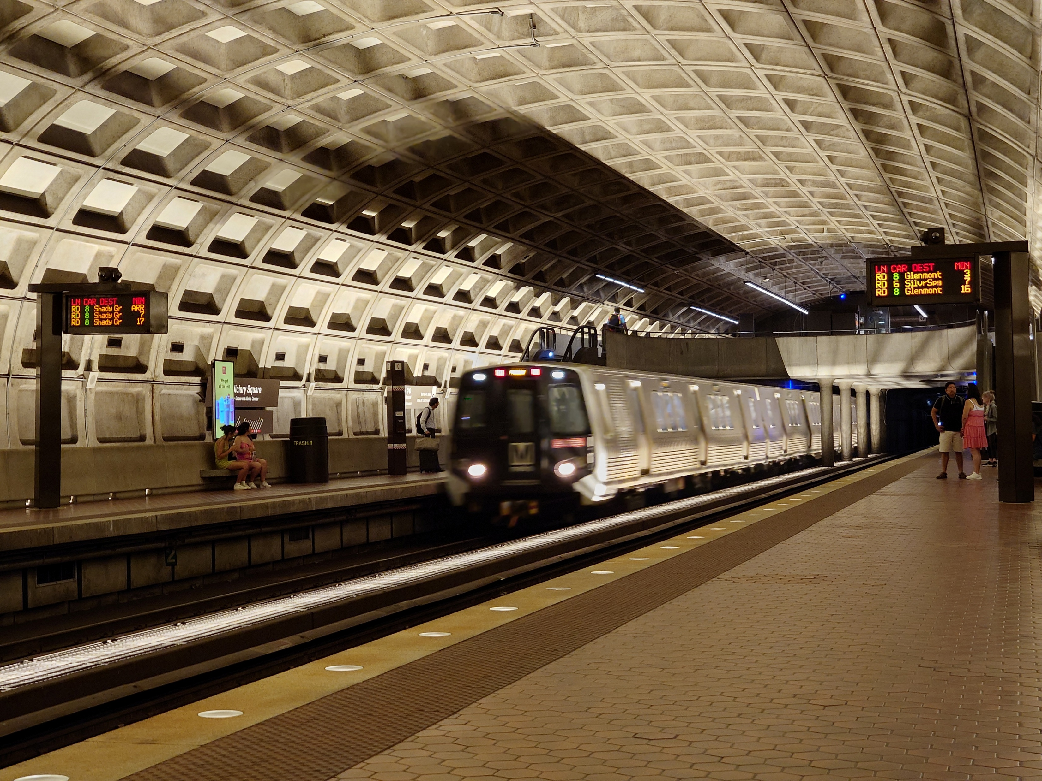
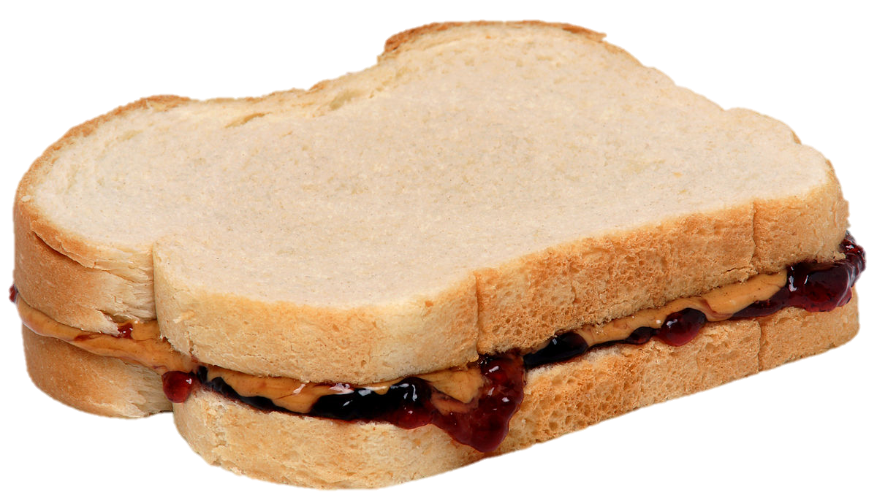
LUNCH and METRO to
Metro Center and National Press Club

