Slide 1

Global Policy Seminar and NSC Simulation
IRP 401 - IRP 402
Week Five
25 September 2026
Prof. Fulton T. Armstrong

Slide 2
Week 1 (28 Aug)
Week 2 (4 Sep)
Week 3 (11 Sep)
Week 4 (18 Sep)
Week 5 (25 Sep)
Week 6 (2 Oct)
Week 7 (9 Oct)
Week 8 (16 Oct)
Week 9 (23 Oct)
Week 10 (30 Oct)
Week 11 (6 Nov)
Week 12 (13 Nov)
Week 13 (20 Nov)
Thanksgiving
Week 14 (4 Dec)
Fall 2026

Slide 3
TODAY’S AGENDA
9:00 | Skills Presentation: Professional Networking and the Elevator Pitch
10:00 | Class Discussion: Quiz on Latin America remarks and this week’s readings
10:30 | Guest Speaker: Robert Barton, Former USAID Official How U.S. Foreign Assistance Works - Introduced by Owen
11:45 | Lunch and Transit to Human Rights Watch (1275 K Street, NW)
1:00 | Nicole Widdersheim, Deputy Washington Director, Human Rights Watch Human Rights as a Policy Priority - Introduced by Sadie
2:15 | Ubers back to Dupont Circle
2:45 | Guest Speaker: Luiza Pire, Associate Vice President, The Cohen Group Helping the Private Sector Understand Policy - Introduced by Hayley
~4:00 | Wrapup

Slide 4
TODAY’S AGENDA
9:00 | Skills Presentation: Professional Networking and the Elevator Pitch
10:00 | Class Discussion: Quiz on Latin America remarks and this week’s readings
10:30 | Guest Speaker: Robert Barton, Former USAID Official How U.S. Foreign Assistance Works - Introduced by Owen
11:45 | Lunch and Transit to Human Rights Watch (1275 K Street, NW)
1:00 | Nicole Widdersheim, Deputy Washington Director, Human Rights Watch Human Rights as a Policy Priority - Introduced by Sadie
2:15 | Ubers back to Dupont Circle
2:45 | Guest Speaker: Luiza Pire, Associate Vice President, The Cohen Group Helping the Private Sector Understand Policy - Introduced by Hayley
~4:00 | Wrapup

Slide 5

SKILL DISCUSSION
NEXT WEEK: Writing the Washington Memo (Fulton Armstrong)

Slide 6
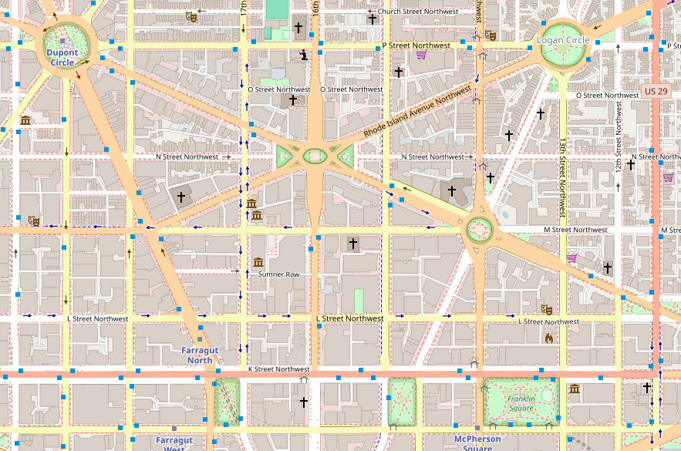


TRANSPORTATION

Slide 7

TRANSPORTATION
Walk
1.1 mile
Est 25 mins

Slide 8


TRANSPORTATION
D90 Bus
from Mass and 18th
12:08
to Mass and 12th

Slide 9
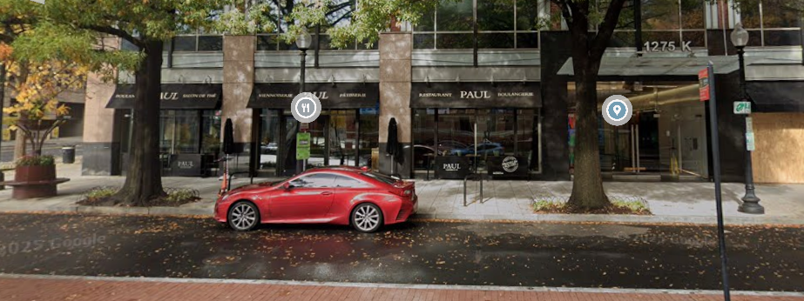
TRANSPORTATION

Slide 10
All clear?

Slide 11
Quiz
In Dr. Angelo RIVERO Santos’s analysis, Latin America is almost completely a victim of U.S. hegemonic designs.
Dr. Rivero Santos said that the U.S. removal of Venezuelan President Maduro in January was a “kidnapping” that violated international law.
Dr. Rivero Santos said that Latin America is the most culturally diverse region in the world.

Slide 12
Quiz
According to the Congressional Research Service, the U.S. Department of the Treasury appears now to be the lead U.S. foreign assistance provider.
The U.S. Congress has responsibility for conducting oversight of aid programs.
Critics of U.S. foreign assistance have advocated reforming the system, but supporters oppose reform.
U.S. foreign aid in Fiscal Year 2023 was about $100 billion, amounting to about 5.4 percent of all discretionary spending.

Slide 13
DISCUSSION
Projects
Sadie | U.S.-Israel Bilateral Relations | Strengthening Nuclear Nonproliferation
Alice | China-Taiwan-U.S. Tensions
Bernadette | U.S. International Image | Dedollarization
Owen | U.S. International Image
Elyza | Russia-Ukraine Ceasefire | Future of the United Nations
Hayley | U.S.-Mexico River Dispute
Will | Enhancing Ukraine Military Power | Russia-Ukraine Ceasefire Talks
Luciano | U.S. Venezuela Oil Deal

Slide 14
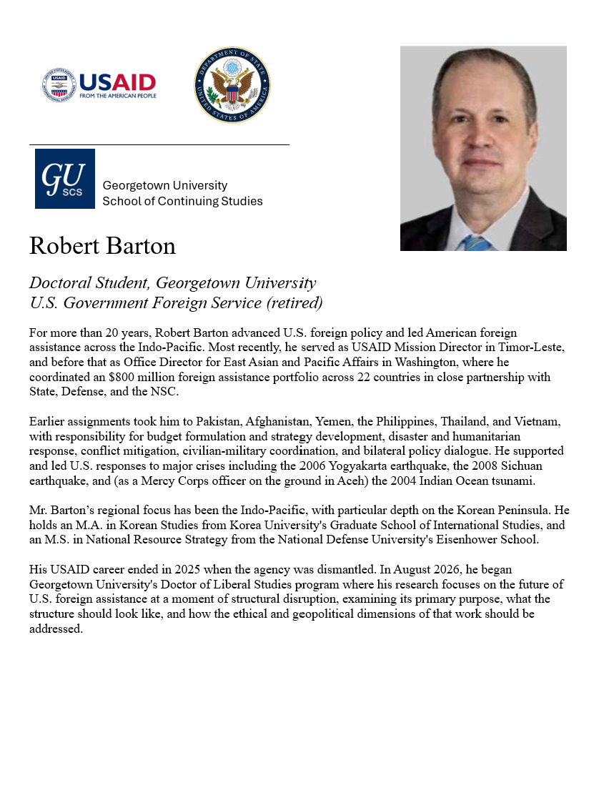
GUEST SPEAKER
Intro by Owen

Slide 15
GUEST SPEAKER
Q & A
How are aid levels and programs set?
How are they evaluated?
How does aid support the U.S. national interest?
How do you keep from becoming a political football?

Slide 16
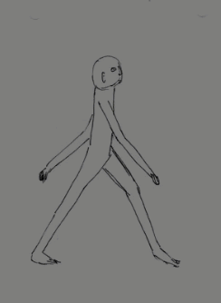
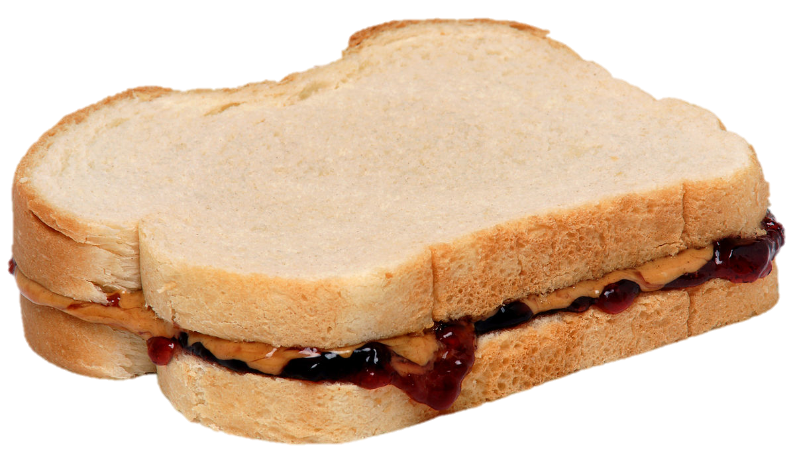

Lunch and Transit to HRW

Slide 17
TRANSPORTATION
Walk
1.1 mile
Est 25 mins

Slide 18
TRANSPORTATION
D90 Bus
from Mass and 18th
12:08
to Mass and 12th

Slide 19
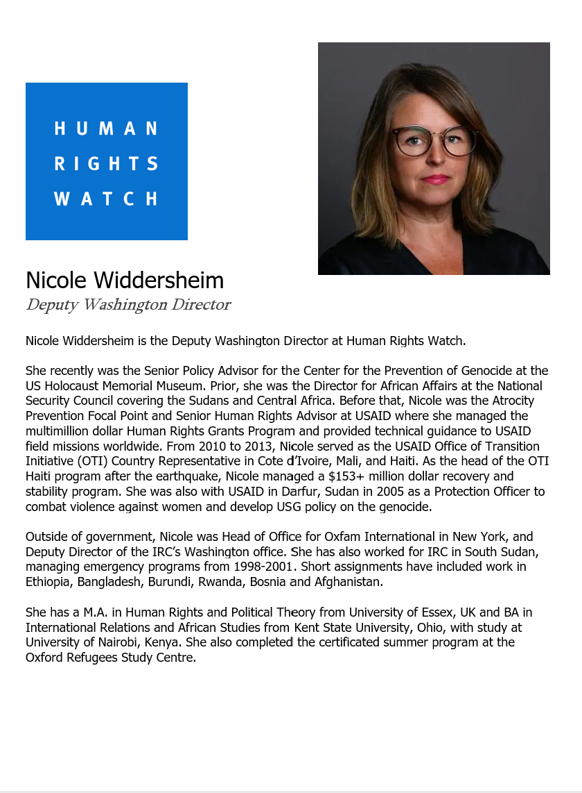
GUEST SPEAKER
Intro by Sadie

Slide 20
GUEST SPEAKER
Conclusions?

Slide 21
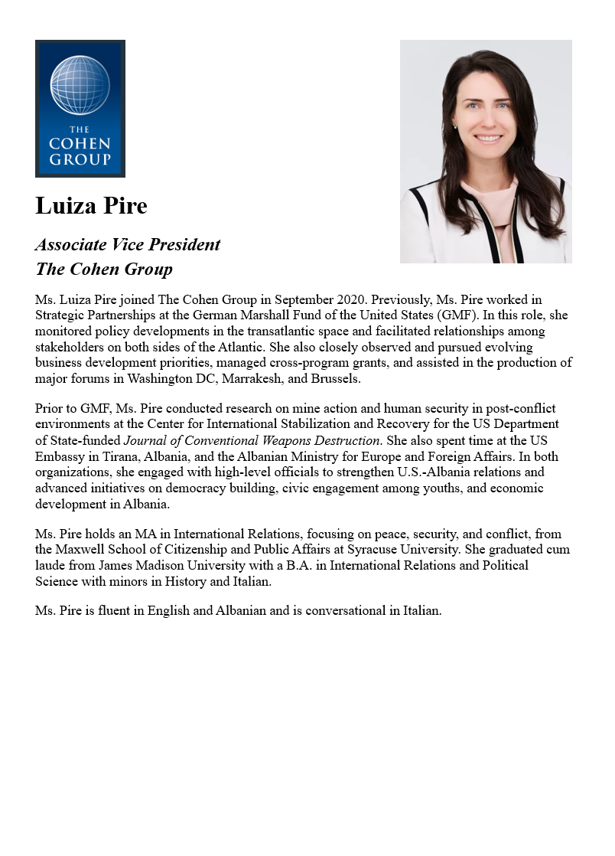
GUEST SPEAKER
Intro by Hayley

Slide 22
GUEST SPEAKER
Q & A
How does The Cohen Group support its clients?
Are you lobbyists?
How did you get where you are?

Slide 23
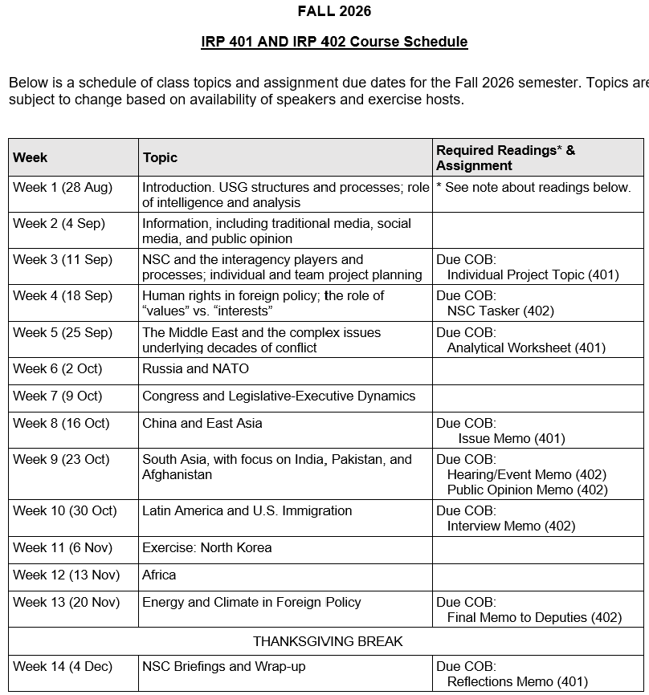
✓
401
✓
✓
402
✓
✓
✓
✓
✓
✓

Slide 24
TODAY’S AGENDA
9:00 | Skills Presentation: Professional Networking and the Elevator Pitch
10:00 | Class Discussion: Quiz on Latin America remarks and this week’s readings
10:30 | Guest Speaker: Robert Barton, Former USAID Official How U.S. Foreign Assistance Works - Introduced by Owen
11:45 | Lunch and Transit to Human Rights Watch (1275 K Street, NW)
1:00 | Nicole Widdersheim, Deputy Washington Director, Human Rights Watch Human Rights as a Policy Priority - Introduced by Sadie
2:15 | Ubers back to Dupont Circle
2:45 | Guest Speaker: Luiza Pire, Associate Vice President, The Cohen Group Helping the Private Sector Understand Policy - Introduced by Hayley
~4:00 | Wrapup

Slide 25
Global Policy Seminar and NSC Simulation
IRP 401 - IRP 402
Week Five
25 September 2026
Prof. Fulton T. Armstrong

Slide 26
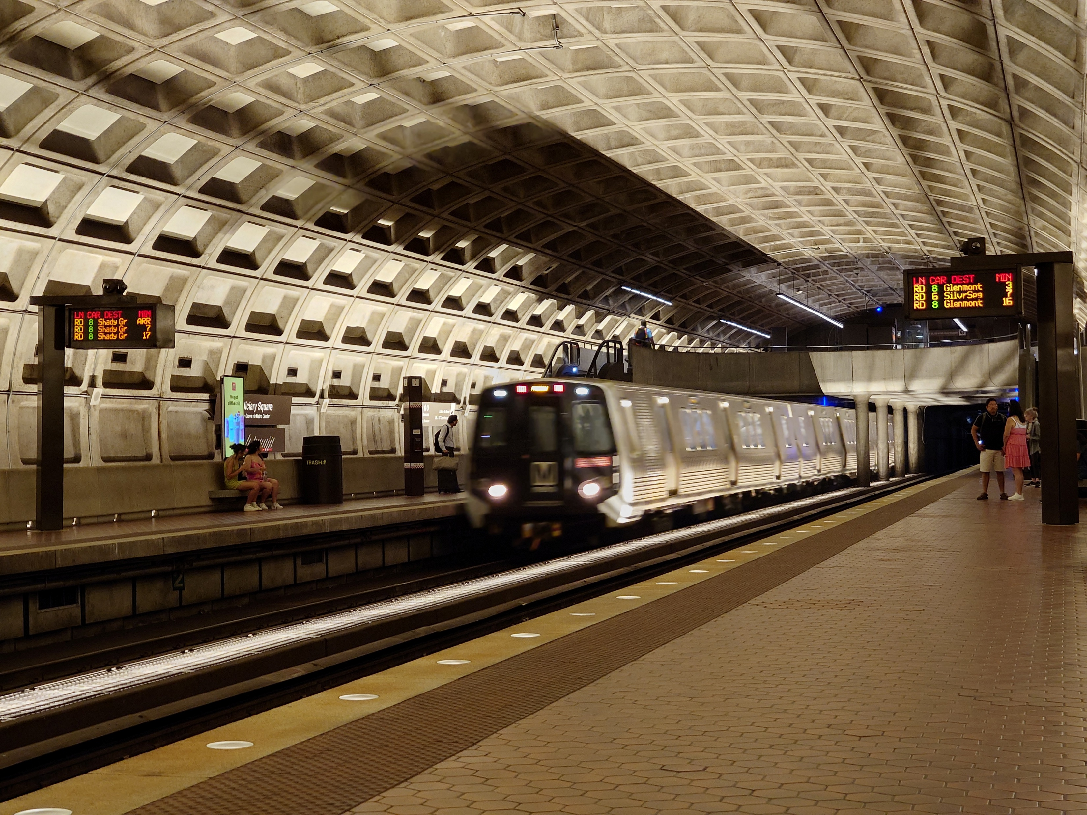
LUNCH and METRO to
Metro Center and National Press Club

