Slide 1

Global Policy Seminar and NSC Simulation
IRP 401 - IRP 402
Week Four
18 September 2026
Prof. Fulton T. Armstrong

Slide 2
Week 1 (28 Aug)
Week 2 (4 Sep)
Week 3 (11 Sep)
Week 4 (18 Sep)
Week 5 (25 Sep)
Week 6 (2 Oct)
Week 7 (9 Oct)
Week 8 (16 Oct)
Week 9 (23 Oct)
Week 10 (30 Oct)
Week 11 (6 Nov)
Week 12 (13 Nov)
Week 13 (20 Nov)
Thanksgiving
Week 14 (4 Dec)
Fall 2026

Slide 3
TODAY’S AGENDA
9:00 | Skills Presentation: Talking Across Divides (Dr. Emily Sydnor)
10:00 | Depart by Uber to Georgetown University
10:25 | Meet at Intercultural Center (“Red Square”) and proceed to Room 450.
10:30 | Guest Speaker: Professor Angelo RIVERO Santos Specialist on Latin America and Venezuela, Georgetown University - Introduced by Luciano
12:00 | Return to Dupont Circle (bus) and Lunch
2:00 | Metro to National Press Club
2:30 | Guest Speaker: Mr. Jerry Zremski Reporter and Columnist, Buffalo News; Professor, University of Maryland - Introduced by Bernadette
~3:30 | Wrapup

Slide 4
TODAY’S AGENDA
9:00 | Skills Presentation: Talking Across Divides (Dr. Emily Sydnor)
10:00 | Depart by Uber to Georgetown University
10:25 | Meet at Intercultural Center (“Red Square”) and proceed to Room 450.
10:30 | Guest Speaker: Professor Angelo RIVERO Santos Specialist on Latin America and Venezuela, Georgetown University - Introduced by Luciano
12:00 | Return to Dupont Circle (bus) and Lunch
2:00 | Metro to National Press Club
2:30 | Guest Speaker: Mr. Jerry Zremski Reporter and Columnist, Buffalo News; Professor, University of Maryland - Introduced by Bernadette
~3:30 | Wrapup

Slide 5
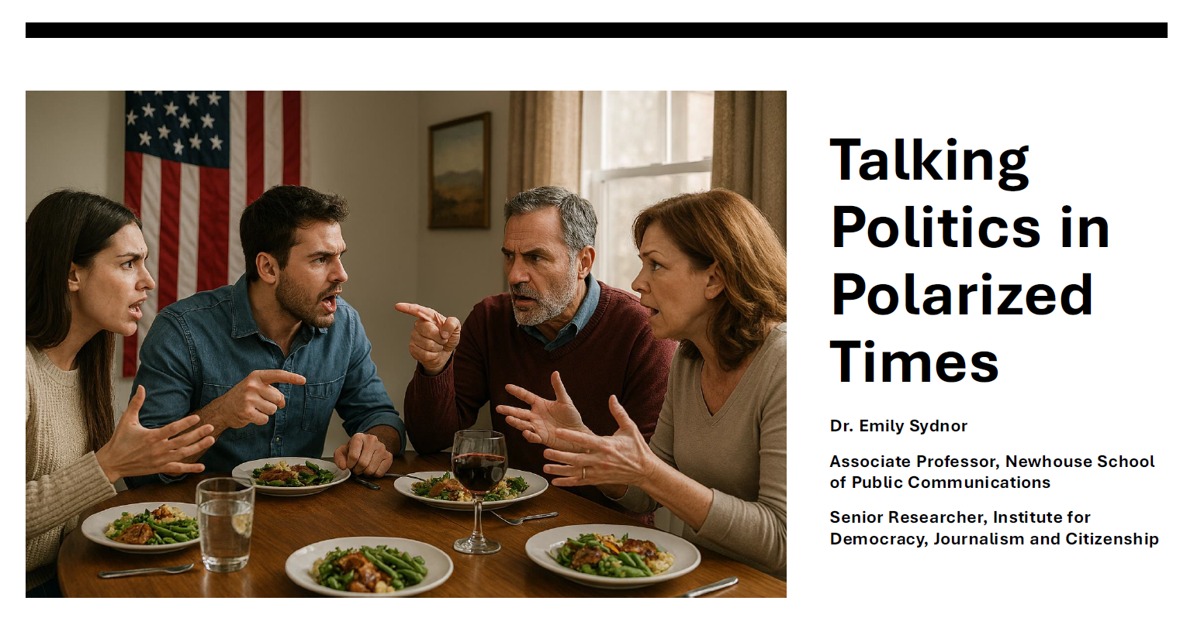
SKILL DISCUSSION
NEXT WEEK: Networking and the Elevator Pitch (Samantha Clemence)

Slide 6

GUEST SPEAKER

Slide 7
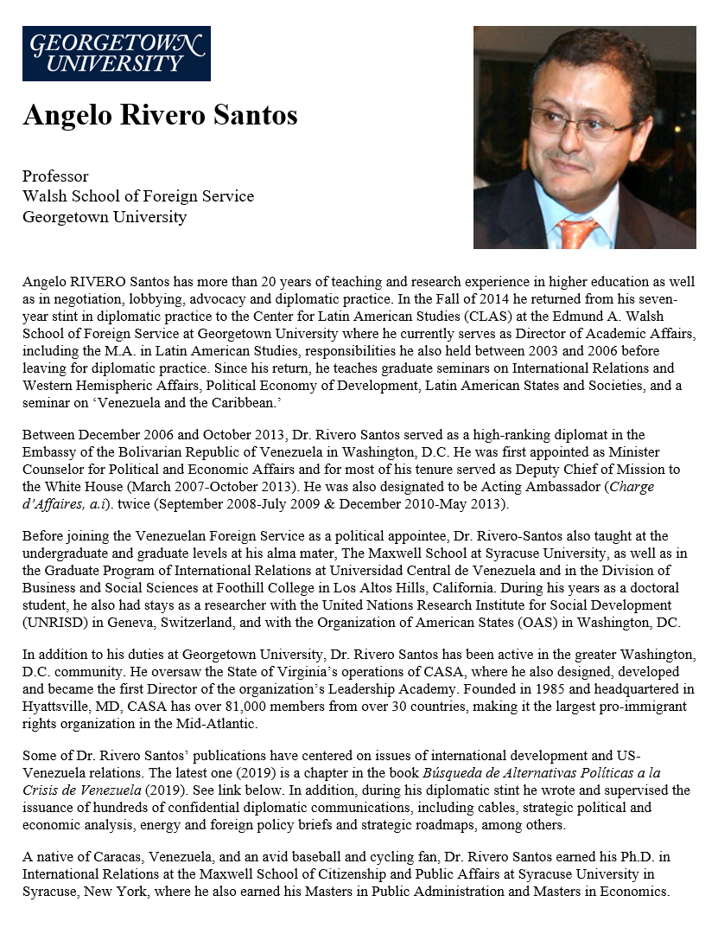
GUEST SPEAKER
Prof Angelo RIVERO Santos
Latin America Expert and
Fmr Diplomat, Venezuela
- introduced by Luciano

Slide 8
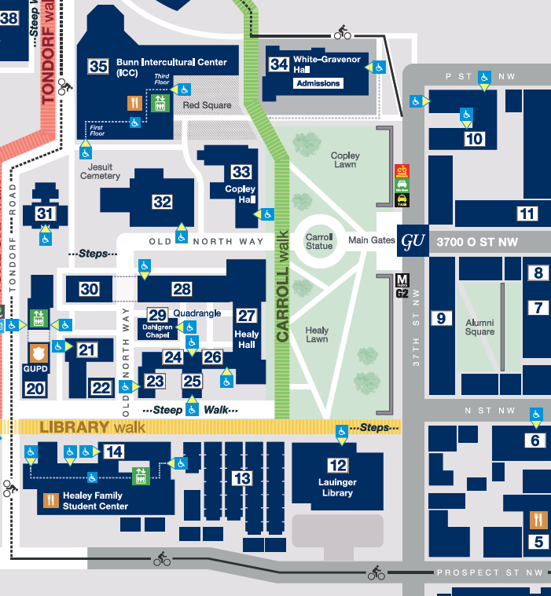

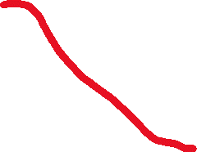
ICC
“Red Square”
10:25 sharp

Slide 9
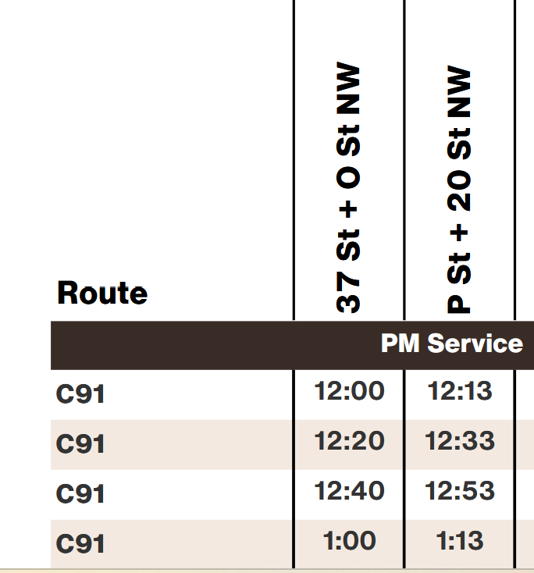
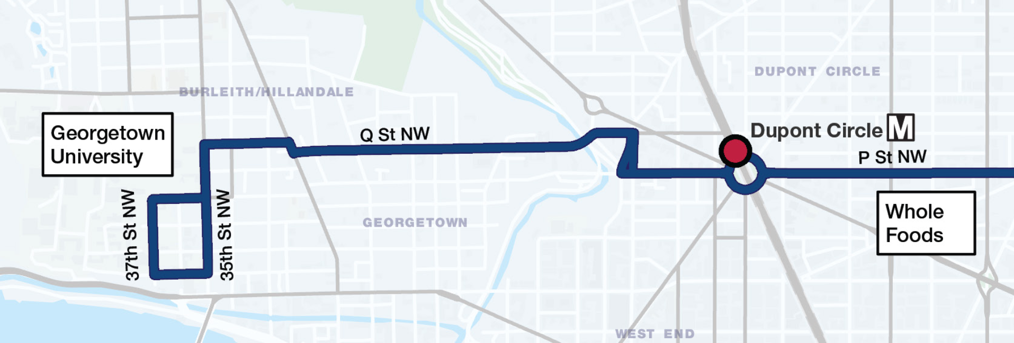

Georgetown to Dupont:
C91 Metrobus
37th & O
20th & P

Slide 10
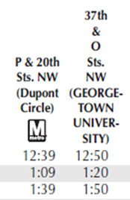
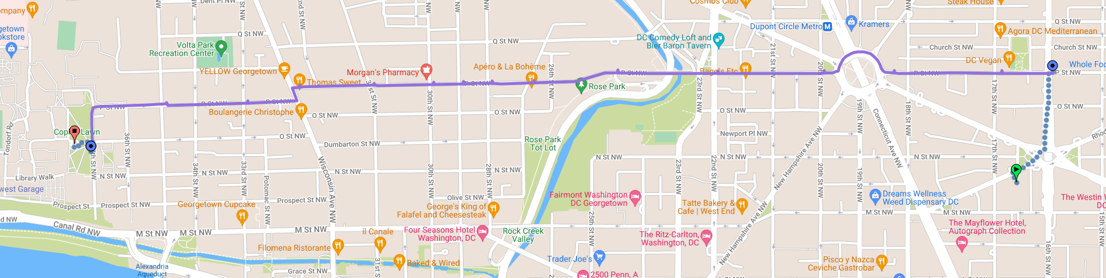
C91 Metrobus
37th & O
20th & P
18th & P

Slide 11
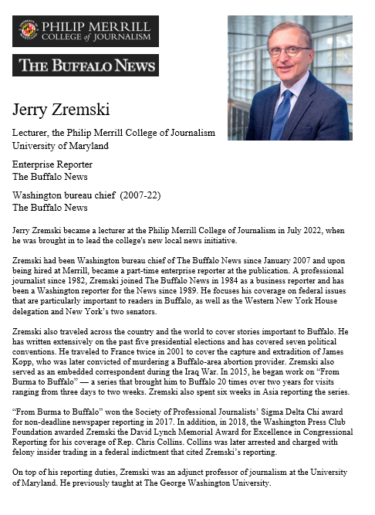
GUEST SPEAKER
Jerry Zremski
University of Maryland
Merrill College of Journalism
The Buffalo News
- Introduced by Bernadette

Slide 12

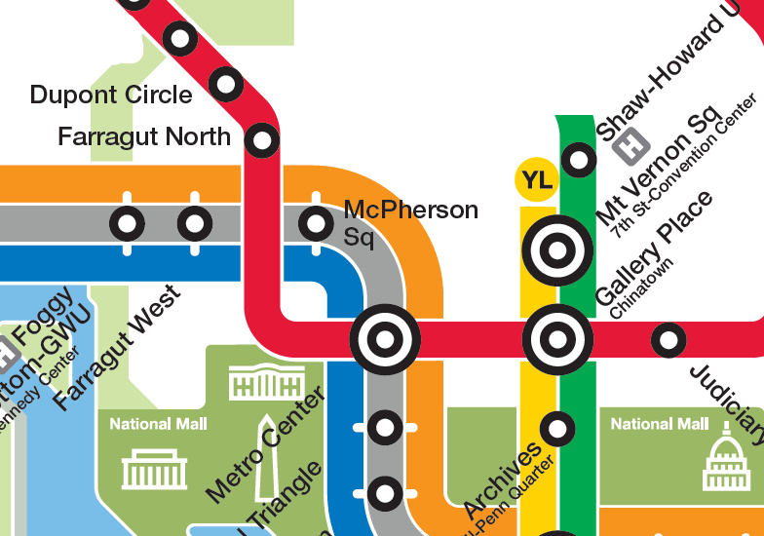
National Press Club
529 14th Street NW
Enter on 14th Street
Meet in lobby (downstairs) at 2:25
RED LINE (→Glenmont)
from Dupont Circle to Metro Center

Slide 13
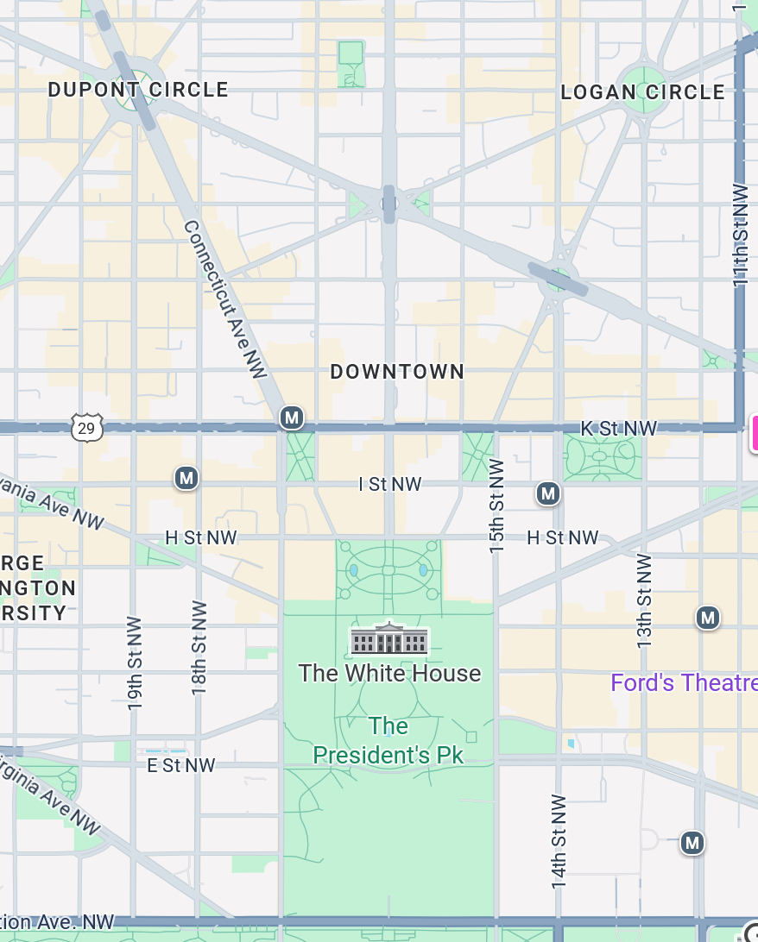
National Press Club
529 14th Street NW
Meet in 14th Street lobby (downstairs) at 2:25
METRO: RED LINE
METRO
CENTER
12th and F Street Exit

Slide 14
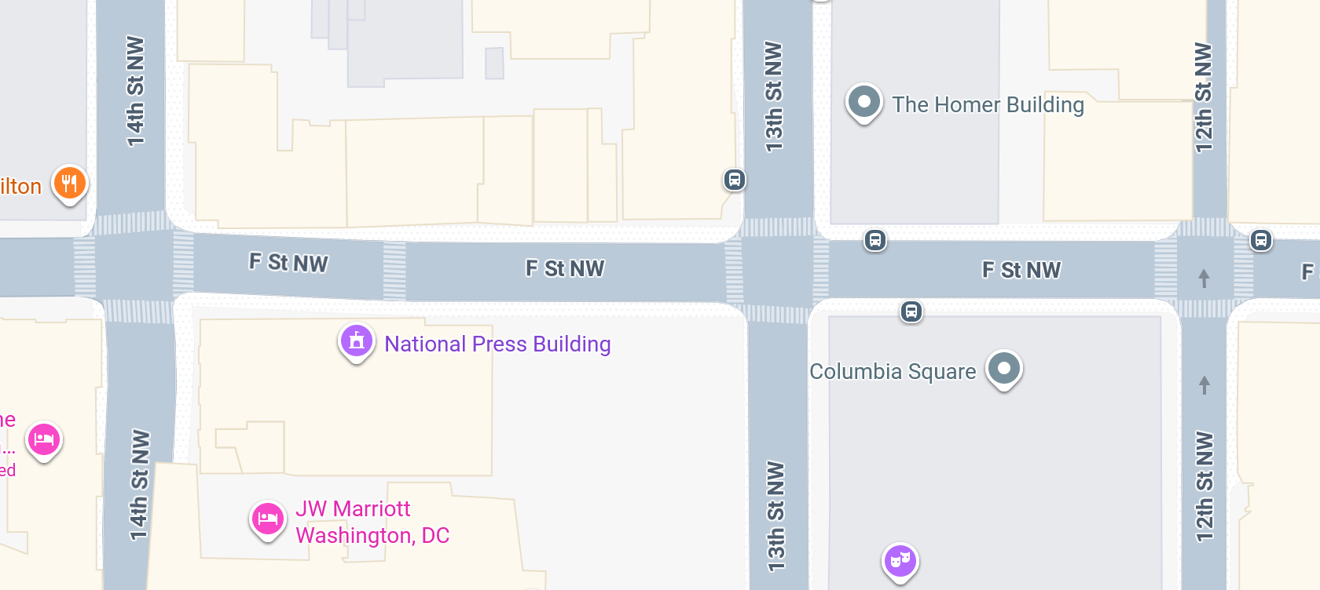


12th and F Street exit

Slide 15

National Press Club
529 14th Street NW
Meet in 14th Street lobby (downstairs) at 2:25
METRO: RED LINE
Walk 1.3 miles
METRO
CENTER

Slide 16
All clear?

Slide 17
DISCUSSION
Projects
Sadie | U.S.-Israel Bilateral Relations | Strengthening Nuclear Nonproliferation
Alice | China-Taiwan-U.S. Tensions
Bernadette | U.S. International Image | Dedollarization
Owen | U.S. International Image
Elyza | Russia-Ukraine Ceasefire | Future of the United Nations
Hayley | U.S.-Mexico River Dispute
Will | Enhancing Ukraine Military Power | Russia-Ukraine Ceasefire Talks
Luciano | U.S. Venezuela Oil Deal

Slide 18
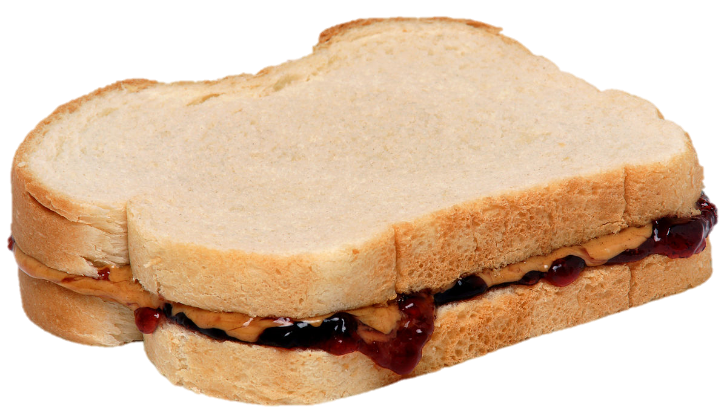
Lunch
Happy to discuss 401 and 402 topics

Slide 19
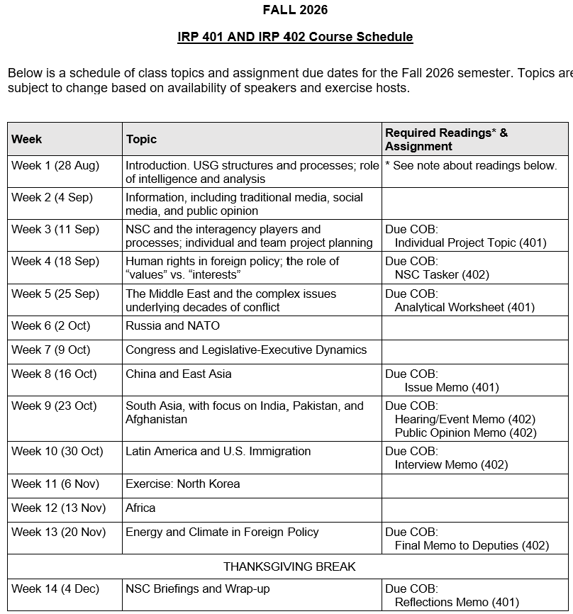
✓
401
✓
✓
402
✓
✓
✓
✓
✓
✓

Slide 20
TODAY’S AGENDA
9:00 | Skills Presentation: Talking Across Divides (Dr. Emily Sydnor)
10:00 | Depart by Uber to Georgetown University
10:25 | Meet at Intercultural Center (“Red Square”) and proceed to Room 450.
10:30 | Guest Speaker: Professor Angelo RIVERO Santos Specialist on Latin America and Venezuela, Georgetown University - Introduced by Luciano
12:00 | Return to Dupont Circle (bus) and Lunch
2:00 | Metro to National Press Club
2:30 | Guest Speaker: Mr. Jerry Zremski Reporter and Columnist, Buffalo News; Professor, University of Maryland - Introduced by Bernadette
~3:30 | Wrapup

Slide 21
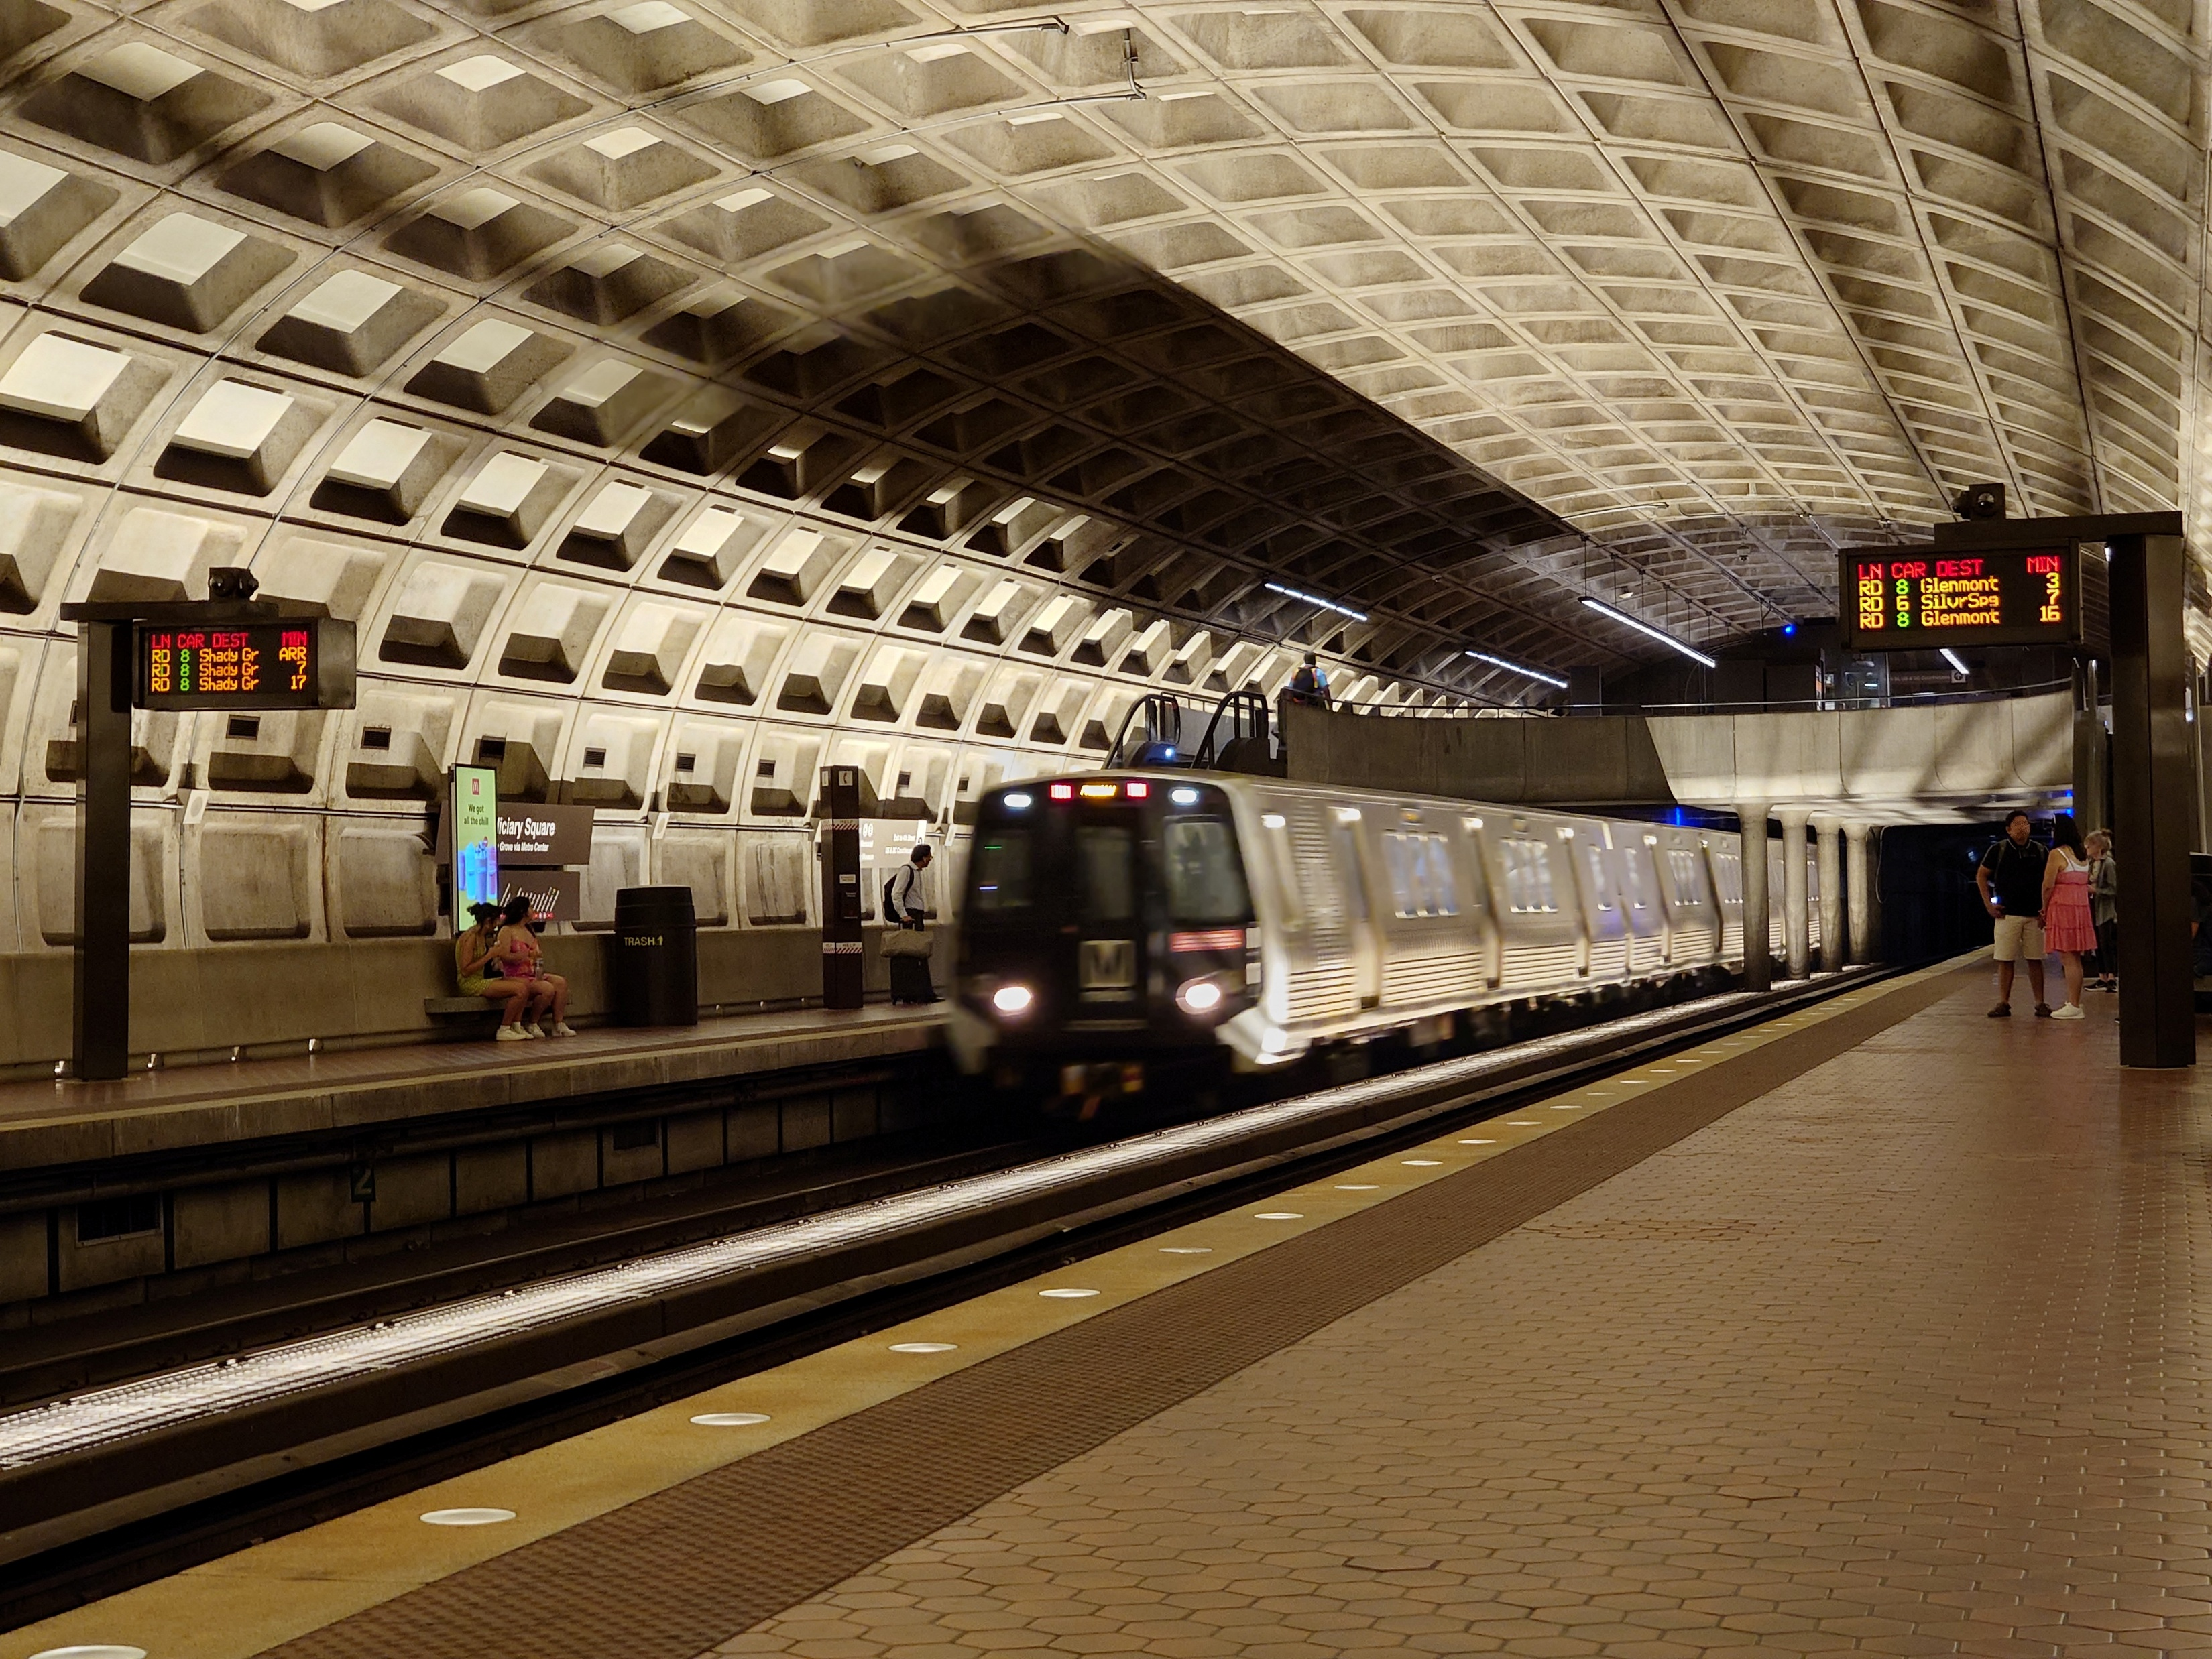
LUNCH and METRO to
Metro Center and National Press Club

Slide 22
Global Policy Seminar and NSC Simulation
IRP 401 - IRP 402
Week Four
18 September 2026
Prof. Fulton T. Armstrong

