Slide 1

Global Policy Seminar and NSC Simulation
IRP 401 - IRP 402
Week Three
11 September 2026
Prof. Fulton T. Armstrong

Slide 2
Week 1 (28 Aug)
Week 2 (4 Sep)
Week 3 (11 Sep)
Week 4 (18 Sep)
Week 5 (25 Sep)
Week 6 (2 Oct)
Week 7 (9 Oct)
Week 8 (16 Oct)
Week 9 (23 Oct)
Week 10 (30 Oct)
Week 11 (6 Nov)
Week 12 (13 Nov)
Week 13 (20 Nov)
Thanksgiving
Week 14 (4 Dec)
Fall 2026

Slide 3
TODAY’S AGENDA
9:00 | Skills Presentation: Effective Analysis: An Analytical Model for Making Information Actionable
10:00 | Discussion: Readings and Project Prep
10:30 | Guest Speaker: Mike Orfini Former Aide to Vice Presidents The Interagency as seen from OVP - Introduced by Will
12:00 | Lunch
1:00 | Guest Speaker: Heather Panton Former Senior White House Advisor The Interagency as seen by Special Advisor for Human Trafficking - Introduced by Alice
2:15 | Discussion and Exercise: Applying Analytical Tradecraft to 401 and 402 Projects
~3:15 | Wrapup

Slide 4
TODAY’S AGENDA
9:00 | Skills Presentation: Effective Analysis: An Analytical Model for Making Information Actionable
10:00 | Discussion: Readings and Project Prep
10:30 | Guest Speaker: Mike Orfini Former Aide to Vice Presidents The Interagency as seen from OVP - Introduced by Will
12:00 | Lunch
1:00 | Guest Speaker: Heather Panton Former Senior White House Advisor The Interagency as seen by Special Advisor for Human Trafficking - Introduced by Alice
2:15 | Discussion and Exercise: Applying Analytical Tradecraft to 401 and 402 Projects
~3:15 | Wrapup

Slide 5
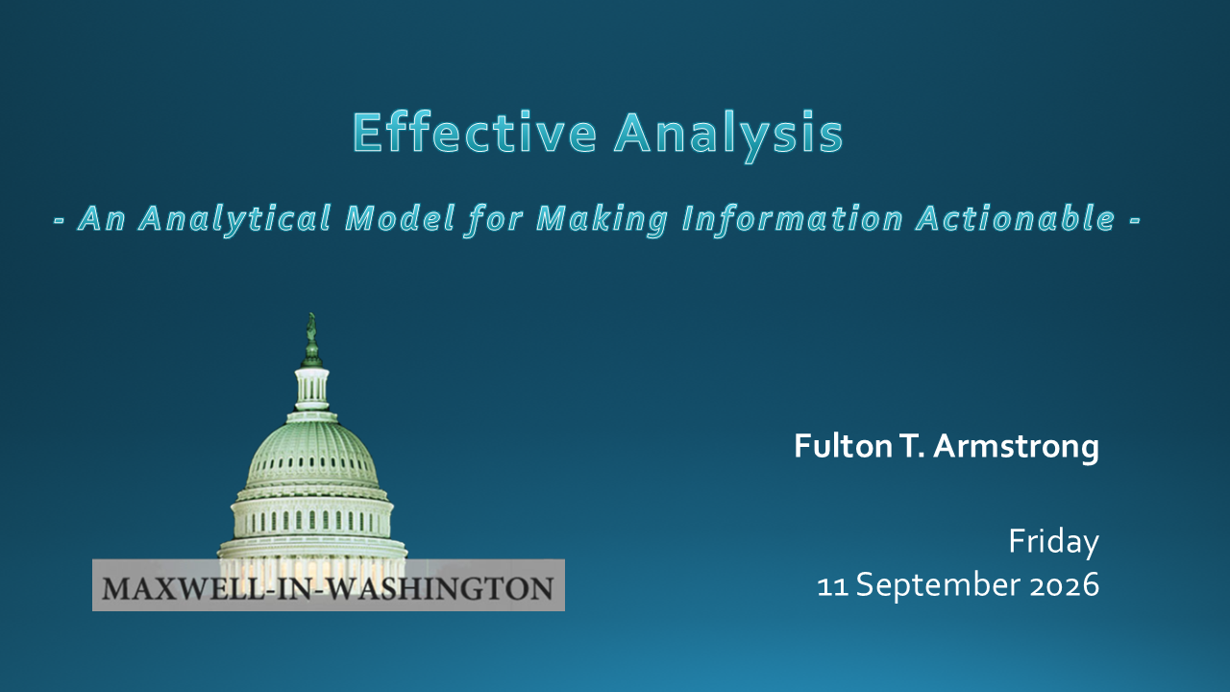
SKILL DISCUSSION
Next Friday: Talking Across Divides

Slide 6
DISCUSSION
Readings
State Dept on “interagency process”
Trump Admin NSPM-1 on NSC
Amb Neumann essay on interagency and role of ambassadors
U.S. military dictionary of interagency terms
Impressions? Surprises? Problems in need of remedying?
Questions for our guests?

Slide 7
DISCUSSION
Projects
401 individual project
- submit topic officially tonight
402 partnered project
- clarify as needed
- confirm understanding on responsibilities
- draft/submit “NSC tasking” memo by next Friday evening
- be sure to state client

Slide 8
DISCUSSION
Projects
Sadie | U.S.-Israel Bilateral Relations | Strengthening Nuclear Nonproliferation
Alice | China-Taiwan-U.S.
Bernadette | U.S. International Image | Dedollarization
Owen | xxx
Elyza | Russia-Ukraine Ceasefire | Future of the United Nations
Hayley | xxx
Will | xxx | Russia-Ukraine Ceasefire Talks
Luciano | U.S. Venezuela Oil Deal

Slide 9
DISCUSSION
Projects
This afternoon we’ll talk more about using analysis in both 401 and 402 projects.
Are you comfortable with your topics and the proposed approach?

Slide 10
DISCUSSION
CLASS INTRO VIDEO

Slide 11
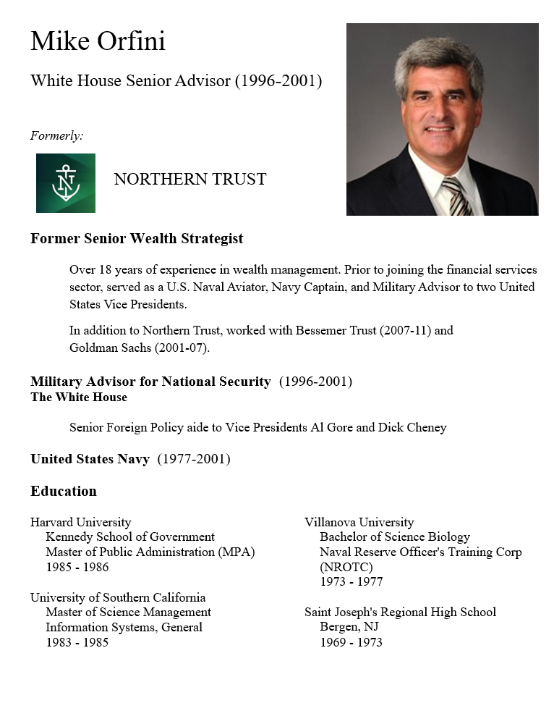
GUEST SPEAKER
Intro by Will

Slide 12
GUEST SPEAKER
Q & A
Where did Office of Vice President (OVP) fit in the interagency process?
How well did the interagency work on issues the VP cared about?
What advice do you have for us as observers of policy? As new arrivals to the professional workplace?

Slide 13
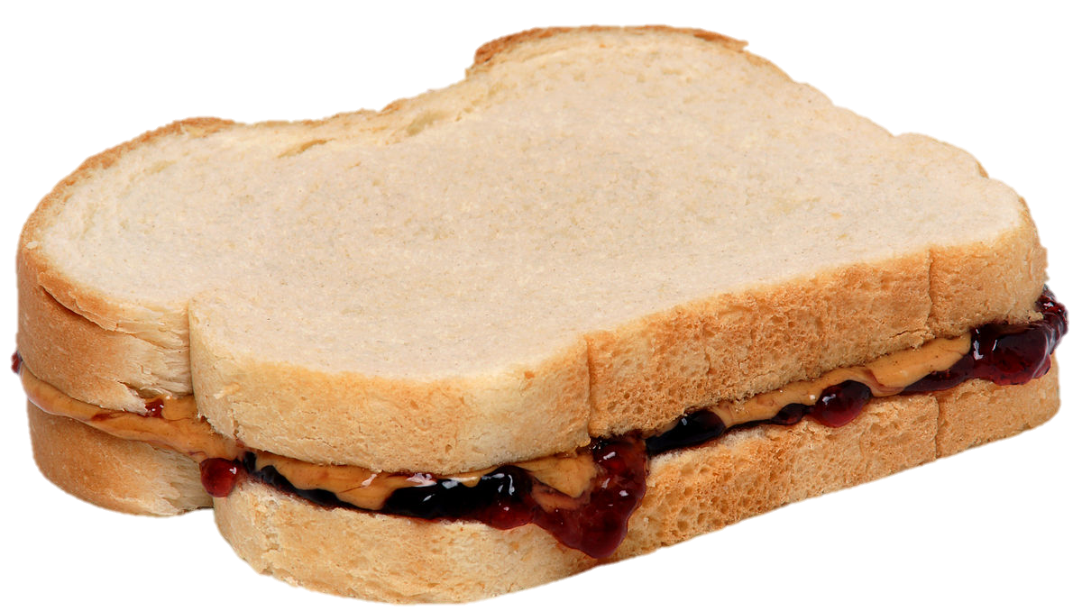
Lunch
Happy to discuss 401 and 402 topics

Slide 14

GUEST SPEAKER
Intro by Alice

Slide 15
GUEST SPEAKER
Q & A
Where did your office fit in the interagency process?
How well did the interagency work on your issues?
What advice do you have for us as observers of policy? As new arrivals to the professional workplace?

Slide 16
BREAK

Slide 18
Broad impressions?
Broad or specific questions?
Do you see how the model works?
Do you think it can/will help you?
Are you clear on …
difference between facts and analysis?
importance of being conscious of you assess
your facts?
value of how/why?
value of drivers?
value of trends … and scenarios?
role of your hypothesis(ses)?

Slide 19
EXERCISE:
What drivers do you see in your topics?
Sadie | U.S.-Israel Bilateral Relations | Strengthening Nuclear Nonproliferation
Alice | China-Taiwan-U.S.
Bernadette | U.S. International Image | Dedollarization
Owen | xxx
Elyza | Russia-Ukraine Ceasefire | Future of the United Nations
Hayley | xxx
Will | xxx | Russia-Ukraine Ceasefire Talks
Luciano | U.S. Venezuela Oil Deal

Slide 20
Analytical paper for 401
due: Friday, 25 September

Slide 21
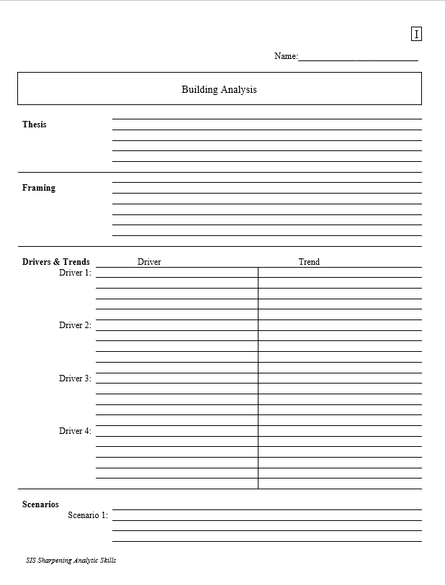
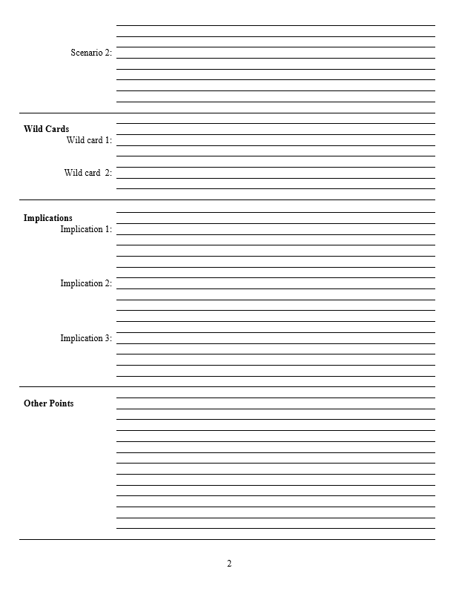
The Analytical Worksheet: One Proven, Effective Way to Build Analysis for Presentation
Other Points | Things that don’t fit in rigid structure
 | Give color, texture to analysis
 | Useful in building “narrative” when you write
 | Pet facts, thoughts that you like (and show you care)
Thesis sentence(s): Main conclusion.
            “Bottom Line Up Front.”
            Short, concise summary – including as many elements as needed to tell the whole story.
Framing: The information your decisionmaker needs to get into the story.
Basics
Not “research or encylopedia”

Slide 22
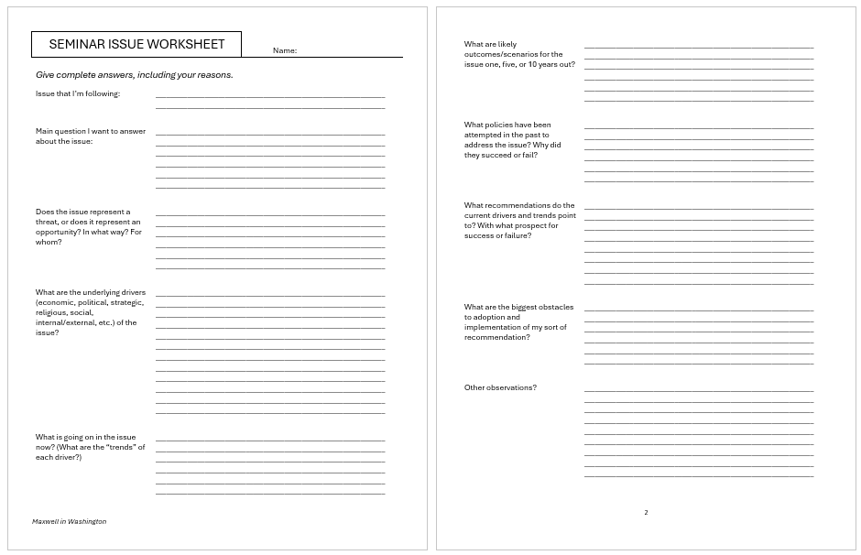
Even less intimidating …

Slide 23
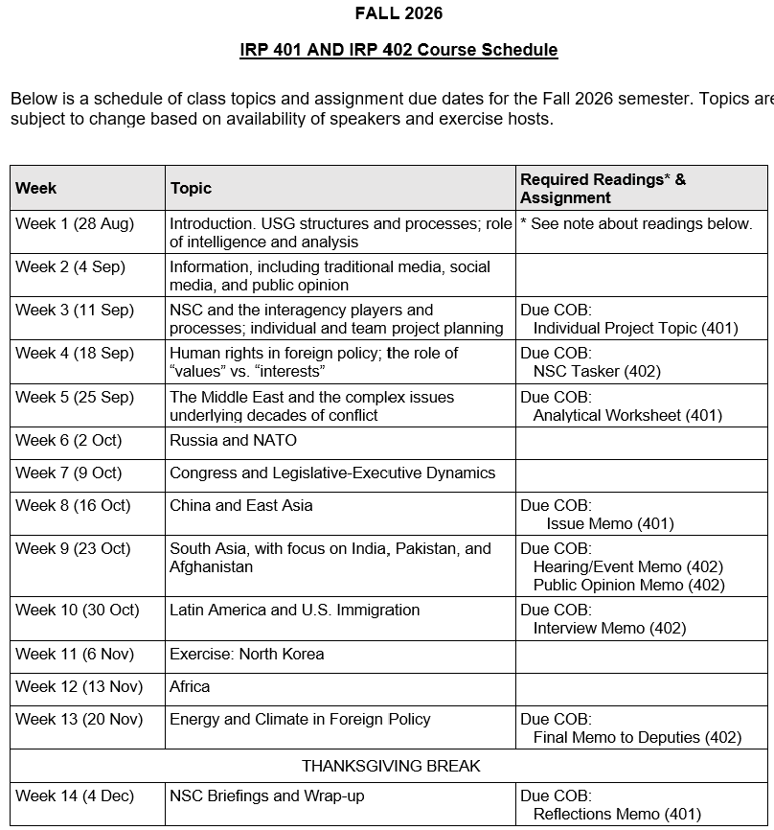
✓
401
✓
✓
402
✓
✓
✓
✓
✓
✓

Slide 24
QUESTIONS? CONCERNS? SUGGESTIONS?

Slide 25
TODAY’S AGENDA
9:00 | Skills Presentation: Effective Analysis: An Analytical Model for Making Information Actionable
10:00 | Discussion: Readings and Project Prep
10:30 | Guest Speaker: Mike Orfini Former Aide to Vice Presidents The Interagency as seen from OVP - Introduced by Will
12:00 | Lunch
1:00 | Guest Speaker: Heather Panton Former Senior White House Advisor The Interagency as seen by Special Advisor for Human Trafficking - Introduced by Alice
2:15 | Discussion and Exercise: Applying Analytical Tradecraft to 401 and 402 Projects
~3:15 | Wrapup

Slide 26
Global Policy Seminar and NSC Simulation
IRP 401 - IRP 402
Week Three
11 September 2026
Prof. Fulton T. Armstrong

