Slide 1

Global Policy Seminar and NSC Simulation
IRP 401 - IRP 402
Week Two
04 September 2026
Prof. Fulton T. Armstrong

Slide 2
Week 1 (28 Aug)
Week 2 (4 Sep)
Week 3 (11 Sep)
Week 4 (18 Sep)
Week 5 (25 Sep)
Week 6 (2 Oct)
Week 7 (9 Oct)
Week 8 (16 Oct)
Week 9 (23 Oct)
Week 10 (30 Oct)
Week 11 (6 Nov)
Week 12 (13 Nov)
Week 13 (20 Nov)
Thanksgiving
Week 14 (4 Dec)
Fall 2026

Slide 3
TODAY’S AGENDA
9:00 | Skills Presentation: Media Diet, by Margaret Talev Director of the Institute for Democracy, Journalism and Citizenship (IDJC)
10:00 | Guest Speaker: Ms. Yasmeen Alamiri Communications Director, Mercy Corps Former Senior Editor for video and special projects, PBS News Hour - Introduced by Elyza
11:30 | Guest Speaker: Mr. Merrill Brown Visting professional fellow (and media expert) Institute for Democracy, Journalism and Citizenship (IDJC) - Introduced by Luciano
12:40 | - Make intro video - Lunch and Metro to Holocaust Museum
2:15 | Holocaust Museum 100 Raoul Wallenberg Place, SW
~3:45 | Wrapup

Slide 4
TODAY’S AGENDA
9:00 | Skills Presentation: Media Diet, by Margaret Talev Director of the Institute for Democracy, Journalism and Citizenship (IDJC)
10:00 | Guest Speaker: Ms. Yasmeen Alamiri Communications Director, Mercy Corps Former Senior Editor for video and special projects, PBS News Hour - Introduced by Elyza
11:30 | Guest Speaker: Mr. Merrill Brown Visting professional fellow (and media expert) Institute for Democracy, Journalism and Citizenship (IDJC) - Introduced by Luciano
12:40 | - Make intro video - Lunch and Metro to Holocaust Museum
2:15 | Holocaust Museum 100 Raoul Wallenberg Place, SW
~3:45 | Wrapup

Slide 5

SKILL DISCUSSION
Next Friday

Slide 6
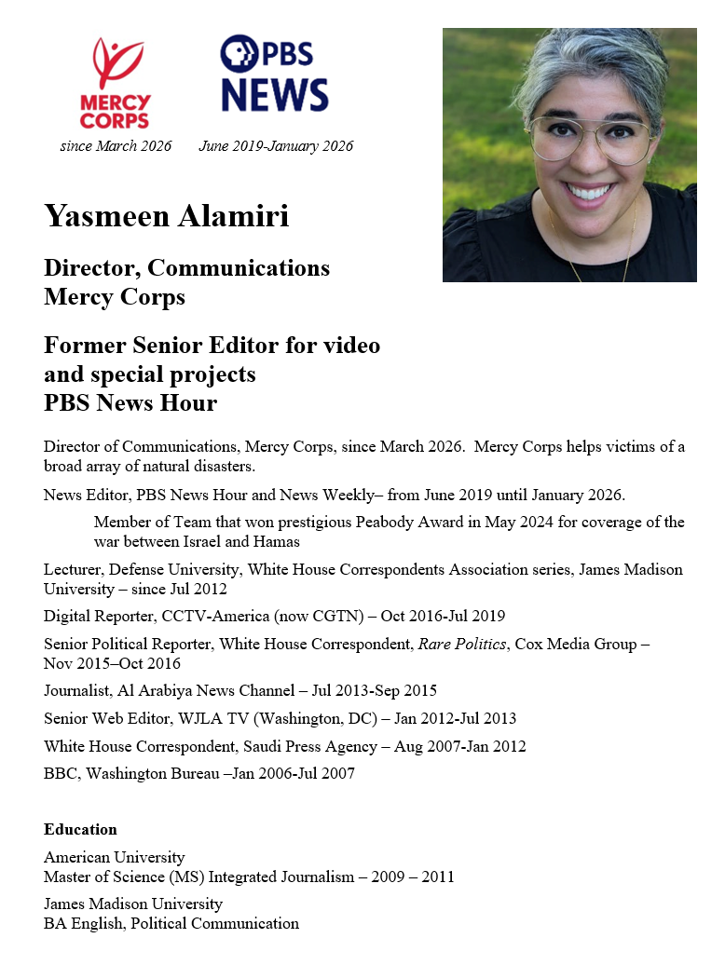
GUEST SPEAKER
Intro by Elyza

Slide 7
GUEST SPEAKER
Q & A
How well served are we by the traditional and new media?
Who can we trust? Why?
What advice do you have for us as consumers of info? As new arrivals to the professional workplace?

Slide 8
BREAK
(set up zoom)

Slide 9
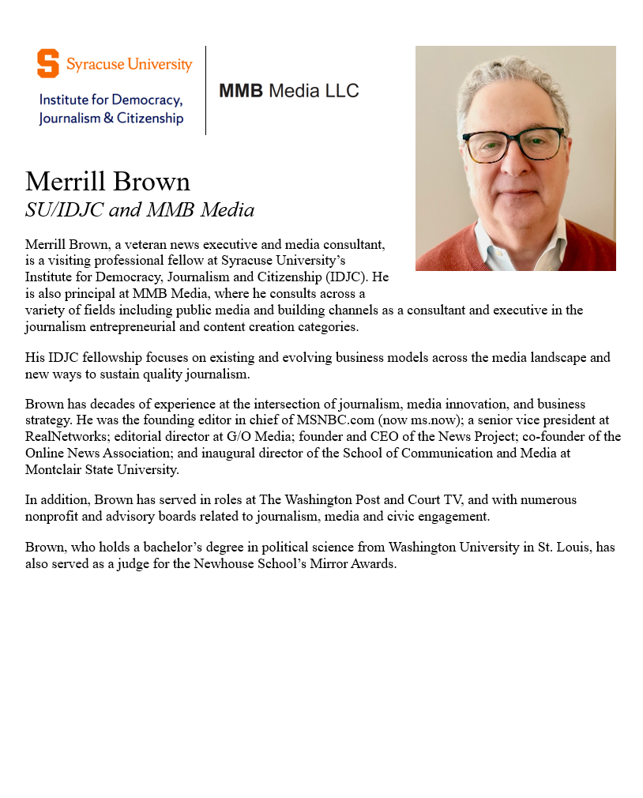
GUEST SPEAKER
Intro by Luciano

Slide 10
GUEST SPEAKER
Q & A
How well served are we by the traditional and new media?
Who can we trust? Why?
What advice do you have for us as consumers of info? As new arrivals to the professional workplace?

Slide 11
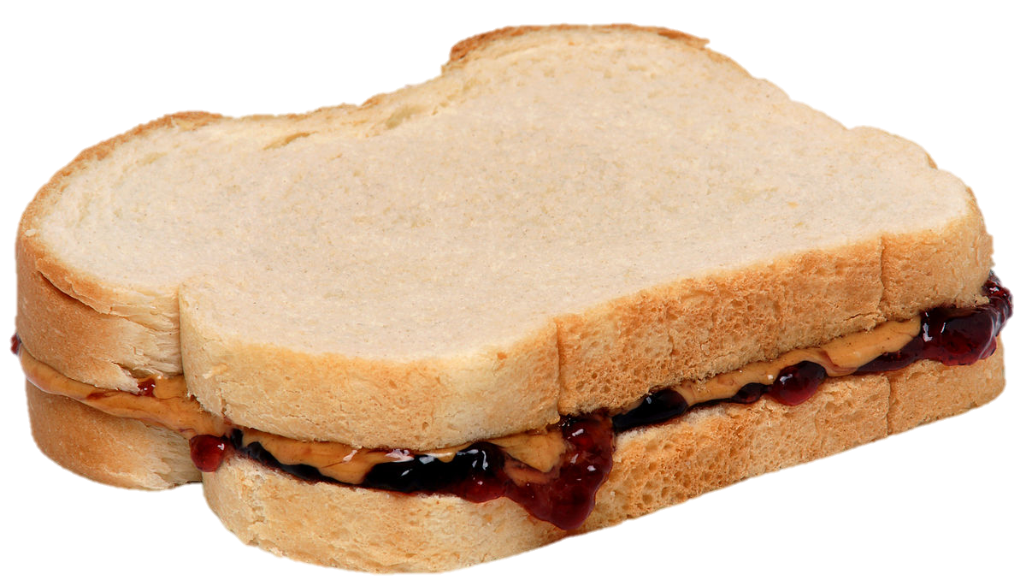
Video Introductions
Lunch
Happy to discuss 401 and 402 topics
Metro to Holocaust Museum – depart lounge at 1:40

Slide 12
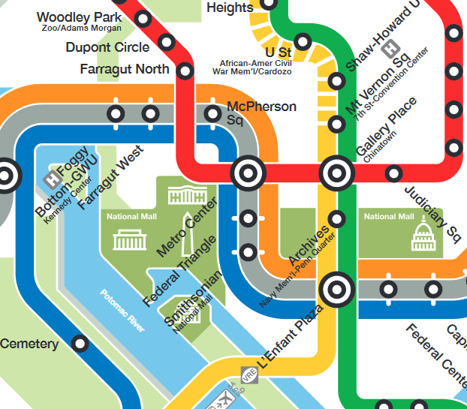



RED LINE (→Glenmont)
from Dupont Circle to Metro Center
then
ORANGE (→New Carrollton) or
BLUE (→ Largo) or SILVER (→ Largo)
from Metro Center to Smithsonian

Slide 13
TODAY’S AGENDA
9:00 | Skills Presentation: Media Diet, by Margaret Talev Ddirector of the Institute for Democracy, Journalism and Citizenship (IDJC)
10:00 | Guest Speaker: Ms. Yasmeen Alamiri Communications Director, Mercy Corps Former Senior Editor for video and special projects, PBS News Hour - Introduced by Elyza
11:30 | Guest Speaker: Mr. Merrill Brown Visting professional fellow (and media expert) Institute for Democracy, Journalism and Citizenship (IDJC) - Introduced by Luciano
12:40 | - Make intro video - Lunch and Metro to Holocaust Museum
2:15 | Holocaust Museum 100 Raoul Wallenberg Place, SW
~3:45 | Wrapup

Slide 14
Global Policy Seminar and NSC Simulation
IRP 401 - IRP 402
Week Two
04 September 2026
Prof. Fulton T. Armstrong

