Slide 1

Global Policy Seminar and NSC Simulation
IRP 401 - IRP 402

Slide 2
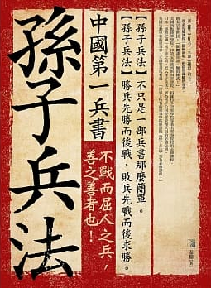
孙子
Sun Tzu
知己知彼，百战不殆。
Zhījǐzhībǐ, bǎizhànbúdài
The Art of War
Know yourself as you know your enemy, and you will win all battles.

Slide 3
WHO’S WHO IN AN EMBASSY?
CONSULATES
Consul General
Consul
Vice Consul
INTERNATIONAL ORGANIZATIONS
Permanent Representative
Deputy Permanent Representative
Ambassador
(Deputy Chief of Mission)
Minister
Minister-Counselor
Counselor
First Secretary
Second Secretary
Third Secretary
Attaché
Assistant Attaché
Examples of job titles
Political Officer
Economics Officer
Regional Security Officer
Administrative Officer
Public Affairs Officer
Defense Attache
MilGroup Member
FLEXIBILITY
Ambassador-at-Large
Envoy or Special Envoy

Slide 4

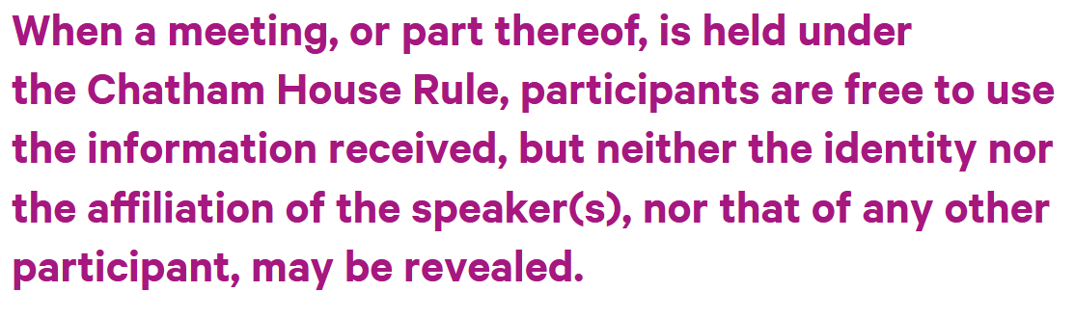
ETIQUETTE or PROTOCOL
Personal vs official views
Chatham House Rule
St. James’s Square
London

Slide 5
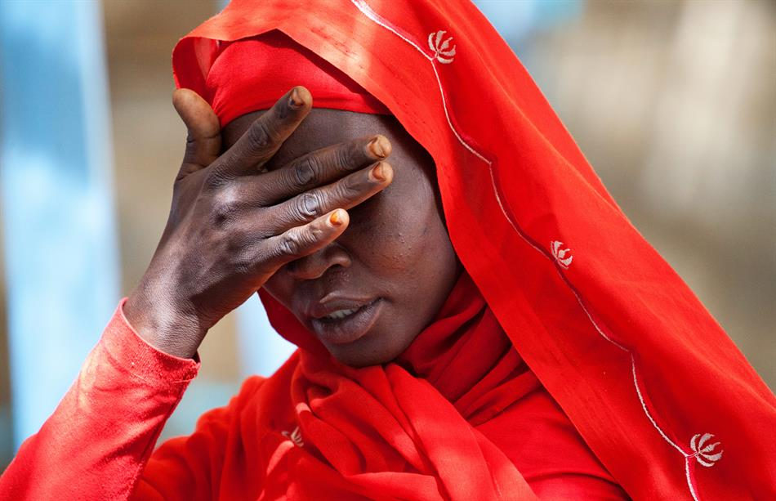
The crimes
The Court's founding treaty, called the Rome Statute, grants the ICC jurisdiction over four main crimes.
First, the crime of genocide is characterised by the specific intent to destroy in whole or in part a national, ethnic, racial or religious group by killing its members or by other means: causing serious bodily or mental harm to members of the group; deliberately inflicting on the group conditions of life calculated to bring about its physical destruction in whole or in part; imposing measures intended to prevent births within the group; or forcibly transferring children of the group to another group.

Slide 6
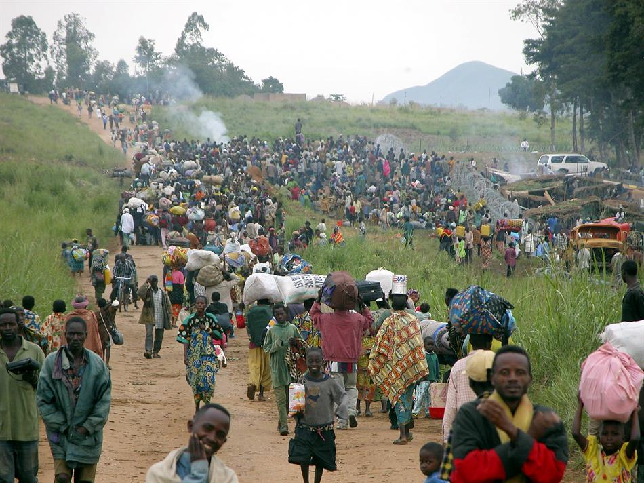
The crimes
The Court's founding treaty, called the Rome Statute, grants the ICC jurisdiction over four main crimes.
Second, the ICC can prosecute crimes against humanity, which are serious violations committed as part of a large-scale attack against any civilian population. The 15 forms of crimes against humanity listed in the Rome Statute include offences such as murder, rape, imprisonment, enforced disappearances, enslavement – particularly of women and children, sexual slavery, torture, apartheid and deportation.
Image

Slide 7
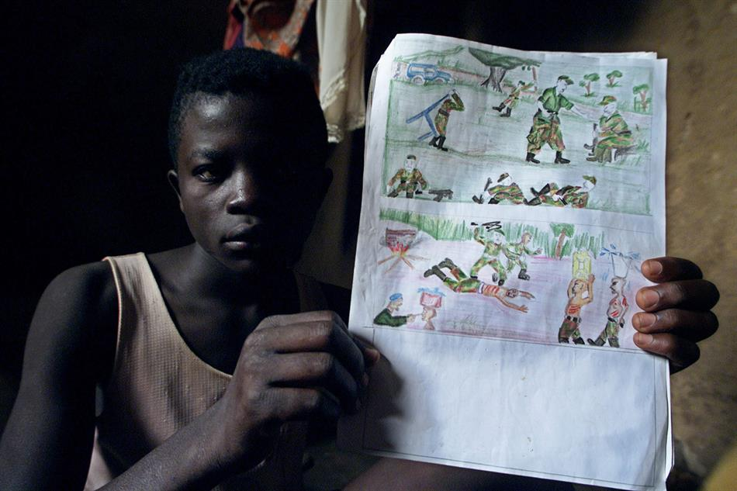
The crimes
The Court's founding treaty, called the Rome Statute, grants the ICC jurisdiction over four main crimes.
Third, war crimes which are grave breaches of the Geneva conventions in the context of armed conflict and include, for instance, the use of child soldiers; the killing or torture of persons such as civilians or prisoners of war; intentionally directing attacks against hospitals, historic monuments, or buildings dedicated to religion, education, art, science or charitable purposes.

Slide 8
The crimes
The Court's founding treaty, called the Rome Statute, grants the ICC jurisdiction over four main crimes.
The fourth crime falling within the ICC's jurisdiction is the crime of aggression. It is the use of armed force by a State against the sovereignty, integrity or independence of another State.
The definition of this crime was adopted through amending the Rome Statute at the first Review Conference of the Statute in Kampala, Uganda, in 2010.
On 15 December 2017, the Assembly of States Parties adopted by consensus a resolution on the activation of the jurisdiction of the Court over the crime of aggression as of 17 July 2018.

Slide 9
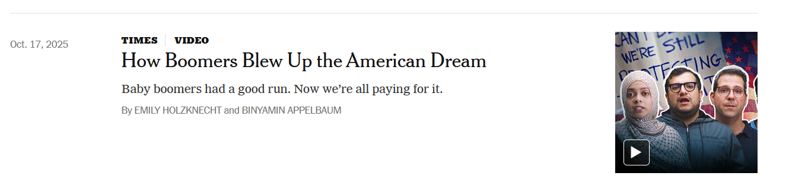
Discussion

Slide 10


Slide 11
What happened?
Were the Boomers fakes from the start?
If not, where’d they go wrong? Why?
Also, FWIW: Not all Boomers like what happened. Not
all abandoned principles.

