Slide 1

Protecting Yourself in a Digital World
- Securing your Devices and Information -
Fulton T Armstrong
Friday
09 October 2026

Slide 2
- Securing your Devices and Information -
The BLUF is NOT: It’s a dangerous world, so don’t go out and play.

Slide 3
- Securing your Devices and Information -
The BLUF is NOT: It’s a dangerous world, so don’t go out and play.
Identity
But rather: Go out, and … protect yourself.
Property/wealth
Reputation (public shaming)
Ward against theft of …
Privacy
Freedom from “behavioral marketing”
Peace of mind
You are more “valuable” to bad guys than you think you are.

Slide 4
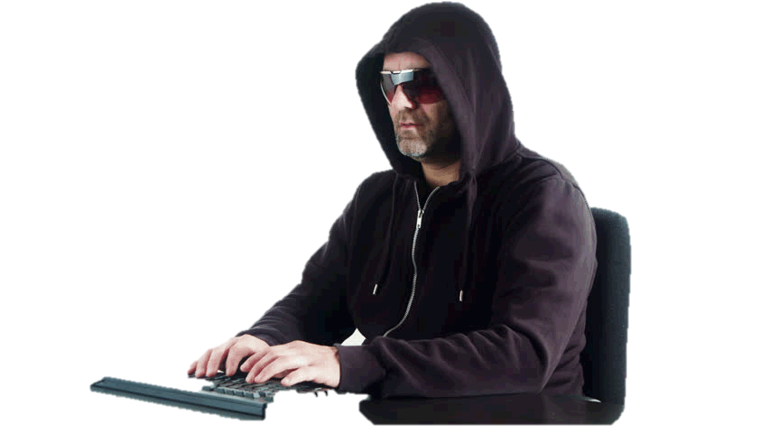

Who might target you?
hackers, blackmailers, extortionists, phishers, etc.
companies
governments and intel services
exes and stalkers
competitors
When and where?
browsing
texting
e-mailing
storing docs
and some simply monitor everything
Pegasus by

Slide 5
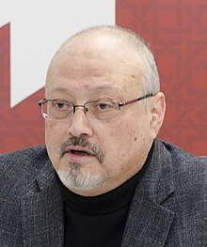
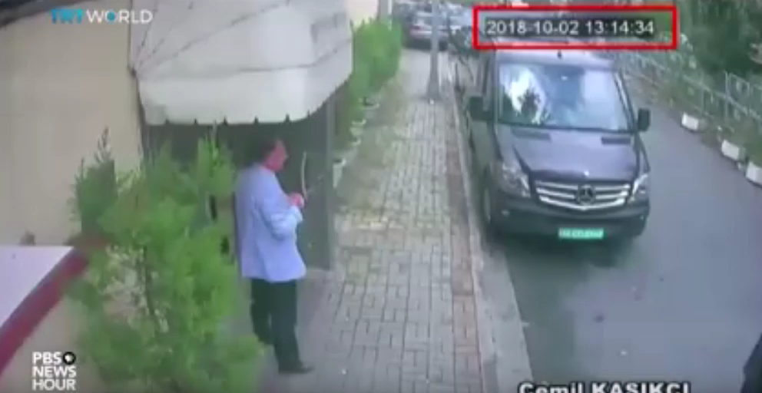
A Horrifying Example
Friend’s phone reportedly was taken over by Pegasus
Jamal Khashoggi
Oct ‘18

Slide 6

They already know a lot about you
through
browsing, especially searches
purchases
e-mail
social media
app user agreements
store “loyalty” cards
“free” subscriptions
car-trackers (LPRs), like Flock
to build your
PROFILE
and the
ALGORITHM
through which
they target you
Who you are.
What they want you to do.
Currently no comprehensive laws to protect us. Only some state laws/regulations, including some protecting minors.

Slide 7
EXAMPLE of harm: IDENTITY THEFT
Definition | Using your information to Make purchases Take over existing financial accounts Establish credit Engage in criminal activity
Impact | 17.6 m Americans compromised at least once annually (DOJ) Direct financial losses (avg $1,343) Costs to banks, vendors ($15.4 b) Emotional toll

Slide 8
So what can (should) we do?
If we can’t really shut it all out …
at least we can make it difficult by
GOING “BLACK”
BEING SMART
BEING DECEPTIVE

Slide 9
GOING “BLACK”
BEING SMART
BEING DECEPTIVE
Measures you can take with your phone, desktop/laptop, and on-line storage.

Slide 10
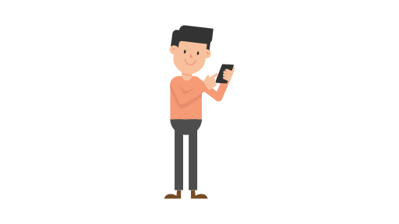
Our phones give away valuable info!
Location
Where we are
Where we’re going (if using map)
Where we shop
Who we visit
Where we linger in a store
People
Who we call and text
Who’s a contact
Data
Messages (depending on system)
Internet searches
Podcast and music preferences
E-mail info
Image used with permission Creative Commons

Slide 11
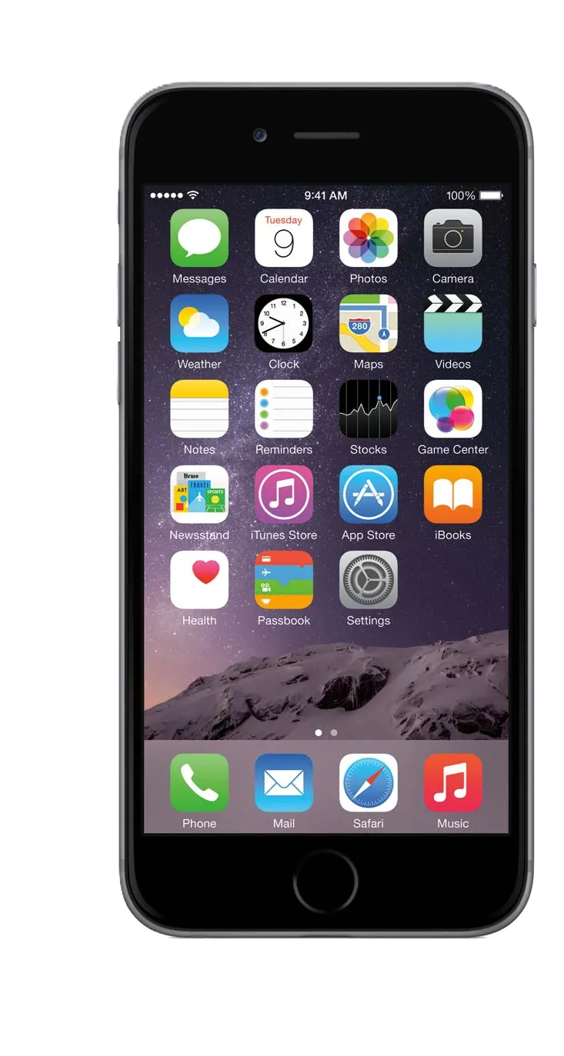
Don’t make your phone a 24-hr broadcast of your whereabouts and activities.
When you can, “go black” by going into airplane mode.
  Cell towers always know where you are.
  Private companies have the data, with few controls.
  Put it on your WiFi instead.
Unless you really need it, turn off the geo-location function.
  Remember also that pictures carry data.
Keep the OS up to date.

Slide 12
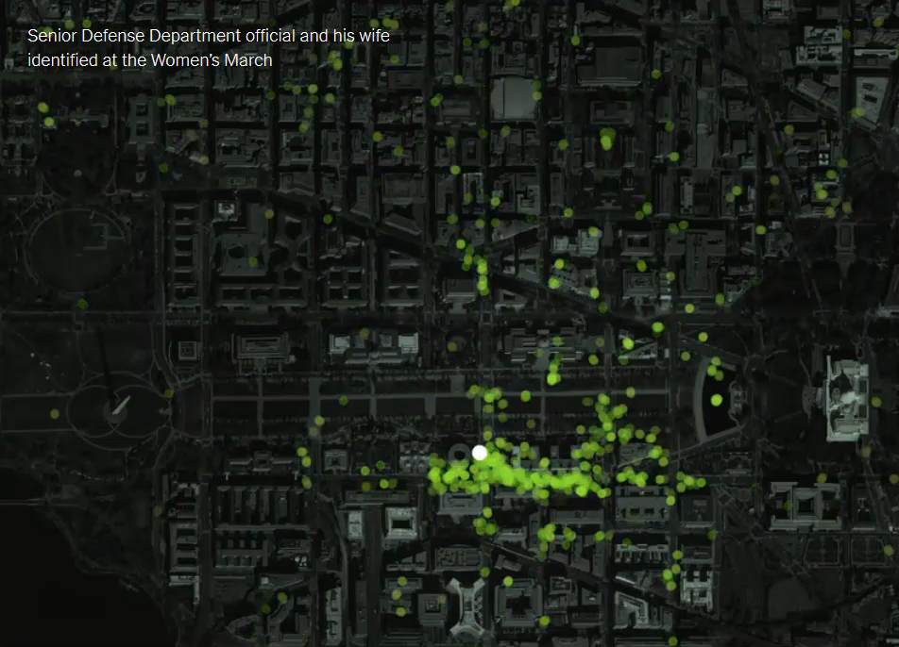
Scarier when they pull out one particular number
© New York Times Privacy Project
Notes:
Why they want your cell number.
They use your phone, nearby WIFI, and Bluetooth sensors

Slide 13
So what can (should) we do?
FOUR WAYS TO SAY THE SAME THING:
Be aware.
Be cautious.
Have guard up.
Don’t assume safety.
FIVE THINGS YOU ALREADY KNOW:
Don’t go to shifty, uncertain sites.
Don’t click or download stuff without knowing.
Don’t divulge more than you have to.
And (sorry) be especially careful with AI.
Worse than an open-book.
It’s all searchable, permanent.

Slide 14


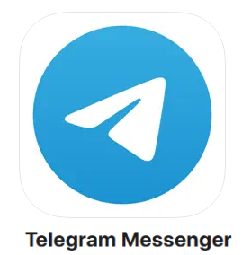
TEXTING
SMS (Short Message Service) is a postcard.
Consider one with end-to-end encryption.
  Allow data, photos, etc.
  Allow calls and video.

Slide 15
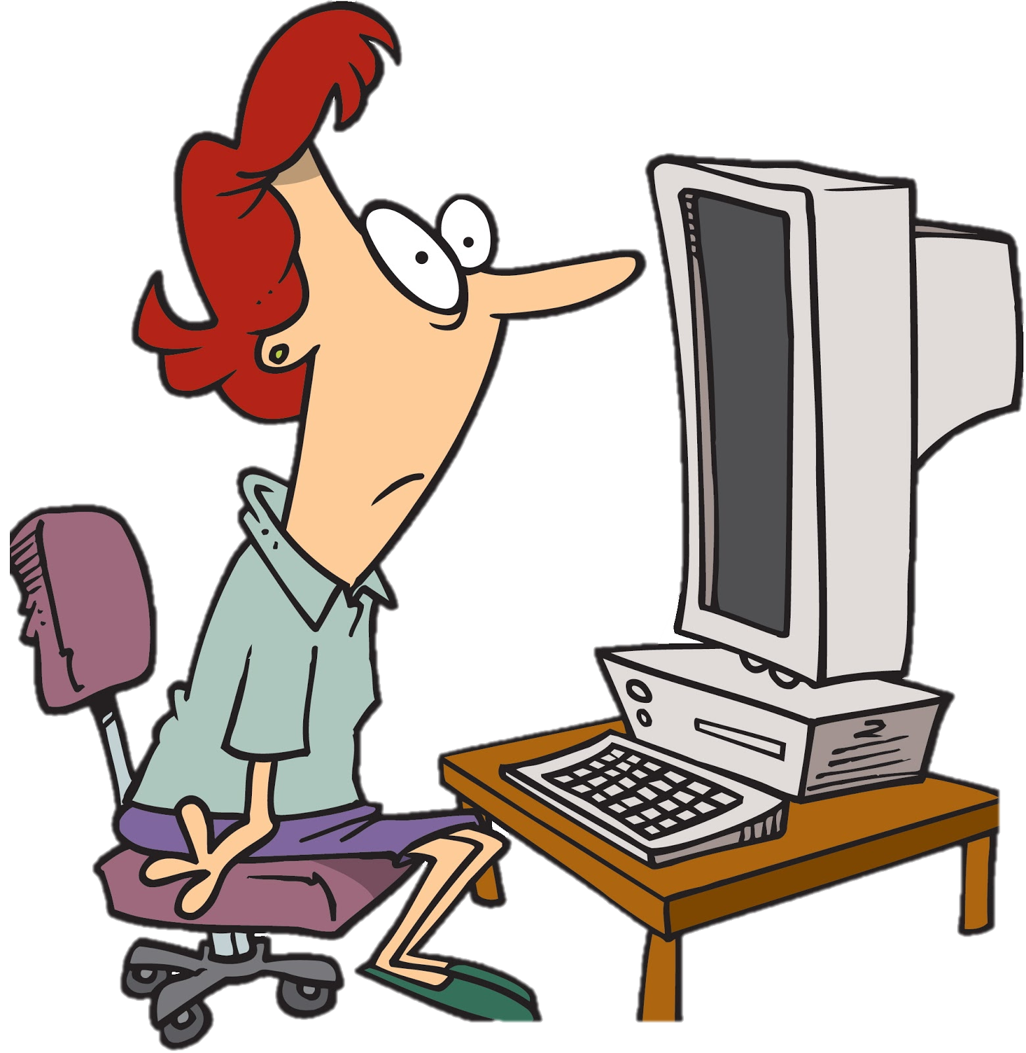
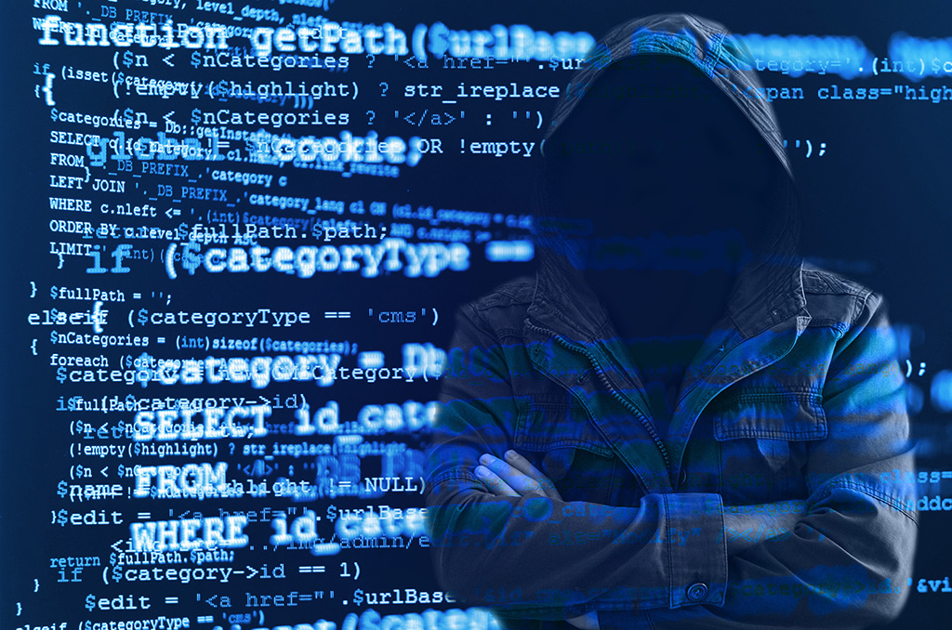


Our on-line behavior … gives away a lot!
likes/dislikes
purchases
info diet
searches
naughty sites
friends
travels
interests
medical issues
family issues
political views
religion
banks/financial
travels
PROFILE
djkjdadjkajkdjfjkj
jkjkjkjkjakdjfkjk
adajkjthiasjkjkjkjk
jdjkjdadjkajkdjfjkj
Images used with permission Creative Commons

Slide 16
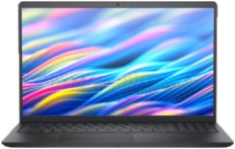


Laptop
or Desktop
DUH!
Six bits of advice from the experts:
1. Trust fingerprint-scanner or facial recognition, but choose a good password/PIN (or passphrase or two-factor authentication). And password manager.

Slide 17
Laptop
or Desktop
It’s free, man!
Six bits of advice from the experts:
2. Use the built-in full-disc encryption.
Windows Bitlocker
Mac FileVault
(With both, save the recovery key in safe place.)

Slide 18
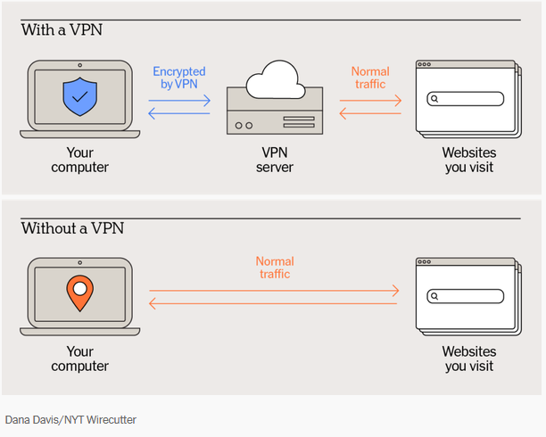
Laptop
or Desktop
I’m outta here!
Some are free!
Six bits of advice from the experts:
3. Use a VPN when on a WiFi system you can’t trust.

Slide 19


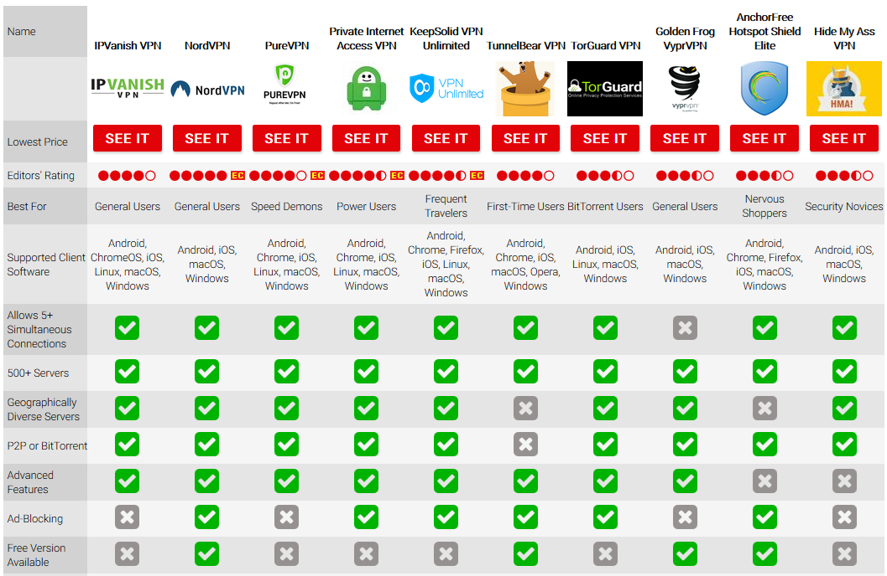

Laptop
or Desktop
NYT Wirecutter recommends
Six bits of advice from the experts:
3. Use a VPN when on a WiFi system you can’t trust.

Slide 20
Laptop
or Desktop
Six bits of advice from the experts:
4. Cover your camera. Turn off Siri, Gemini, Bixby or similar.

Slide 21
Laptop
or Desktop
Six bits of advice from the experts:
5. Know your apps.
Experts are often finding Chrome and Edge “extensions” that steal info.
“Bossware” can do the same.
Delete your cookies often.
Consider using a library computer for increased anonymity.

Slide 22
Laptop
or Desktop
Six bits of advice from the experts:
6. Back up your substantive, sensitive files on a thumbdrive or external drive.

Slide 23

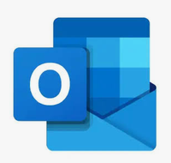



E-MAIL (phone or PC/Mac)
Browser-based e-mail
G-mail
Yahoo
Outlook
SUMail
security depends on which.
But for very sensitive communications, there are good (and free for lower-end service) encrypted e-mail servers:

Slide 24
E-MAIL (phone or PC/Mac)
Client or app e-mail is different.
Windows Mail or Apple Mail
Outlook
Thunderbird
eM Client
Mailbird
Can save mail on your hard drive, but encyrption requires add-ins that can get complicated.
FYI, three kinds of connections:
Post Office Protocol POP
Simple Mail Transfer Protocol SMTP
Internet Message Access Protocol IMAP

Slide 25
How can we save sensitive info securely?
You have a document, spreadsheet, photo/video that you need to protect …
… one easy thing is to attach it to a draft message in an encrypted on-line e-mail, like Proton.
But if you have a number of documents or a directory of them, consider …

Slide 26
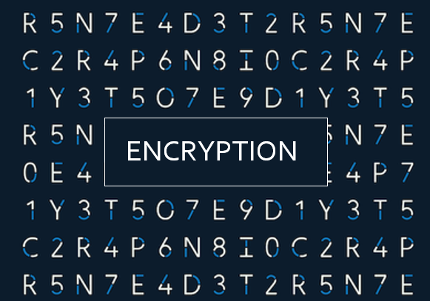

Slide 27
We read the privacy policies and available audits for all of these services, and we examined their apps and documentation for information about their underlying technology. After purchasing accounts from all of these companies, we evaluated the user experience on an Android phone, an iPhone, an Apple MacBook Pro laptop, and a Windows laptop. We used online DNS leak test tools (such as DNSLeakTest) to confirm that the VPN was not leaking DNS requests and that our visible IP address changed on every device. All of the VPNs we tested passed both tests on every platform.
Basic encryption takes plain text like this:

Slide 28
-----BEGIN PGP MESSAGE-----
Version: Encryption Desktop 10.3.0 (Build 9060)
Charset: utf-8
qANQR1DDDQQJAwLNtAknetvw+b/Sw7AB45QS3sUlBFVMuZaMOsJoTJW1h0TKAFsy
t64uIgxL338edNbwbAlFWZlpfPbFwpbn9ZtI7KDtKwx7aEwTBlDaiS1IsAfW7glF
BHwTZ9c+dR1WTy+Q/YVDwsjMdfsyoz8/c13BVQOIZOkdfSiBhEkuV+PAhwxD86lZ
6PmpJZAb0vxxC4iL3OqTdxjf9kuPag3QTqSkVfeko4E3iIrCpRBFYmoUdXZ1wTA2
eo1gX5ToXD7GUt7bECZCMuKvxWoVDK/uLyQIA2Kn7CYejad7x0XWrNhm5QC/EzBT
CKlKNc372T0y+kVzThecVv7m0OMMhI1JpedlTYdRAV7RrrbCAaoJVzRq0C+bH+Qo
L/ZZfUnX2YJeSZdRzIrFRXQ+fIsklXtjZMs9dxYK4Xt9hTHmJMF9mRGZgwlkjZS0
p66+bAmNQHgvDbf60YX+eG80AgenyoBU1XYA42c+o+gFV+WbFGKipq1tKRk+4543
II33iBgQhdZenYzTKqXQX7f2ZiEZyE3UYc32r3zvLNowyisPJDJ6dbCmY/9w0aEo
LtWjUs8ZWNw1phLjj7SxiUa6Tp9hbivxUfcpAJF22Yp68E/JiXTyV2lgmGy7pWIk
N11udz9qF8+AATDjmALXpLY7E/n1M5EMRL8M4PhMoqcb8VYzfUYdkXCgq8oIesSQ
f1MA+TG72KVEnyIfkD9/5heF7ExC4wwzrBGLV8YLnGjdh+ILcKSzAp/PWL3fH3gg
sVHetUUgsVvARQav+oEe02GlWQo9vz2UYT91nLa7NbLLrlJEY73rzqZ37/7ZRTfB
qhwxyLZlvC7/tFv94XsCn9pi+ZiqzpVpMUNRFbWsVCak178jsuy2+1zMmofanJS9
1E5cf5g/D1i/YHe53jwXbnBgGna3FMFUKZn+LAPqPz93M1GybRAqltKlBH2FSCNF
a3e5YhX155FIxI/RQ8ss4BuN0cDVE5JTU2PXLbUKl8cIDCZLoD8dGrz6Fgw3vEYk
BKReu1Oo9qiBcfahPlBLZOkcyjtMH2NKoFEu+rpI9tbGp9v9Fi0pfkxvnv3Ug2N5
D3s30V8jJemmEin/GNdz78MH9TAHk2b4tEZUW6v/kRvEKueLK94vDz1Cz6na/J5I
shbcxwLqbscNvBlUF87TCJhAawfA9P75GvKKNQgSBFZWLB54wdftK306gPJdc1c1
GaHmbEDDPRssCN+1wHR84cKFh2hgaZUUr4zbA8LAozVGkQGqIpR3+kuqx6DLsY+s
r6C6Q1GNPnVJDy3acqQTvOmi55IbajGsZ61MzHbp0tY9r67Vl4mPCvt1IX4K++RE
ZY2ly8vtkEDU6UY/70QbewXSYKGYwD74ORkLenAWZpHJC0e/ZK5ZvwvviEIGdbE/
zgILF8ps8vwbnPjEao0kLicHxq7Isz5t4tz5h/qpUVvaXliuZ+iKWZ7veM4Ay+zA
xnpOlJNtZvVVLCRej8QIrwsHw+563wtgUZhAqSm5J7CXMDKQ8MOwiyxPG+kBExGY
JIAUywRg7g==
=JKm8
-----END PGP MESSAGE-----
and makes this:
It looks like letters, but it’s based on numbers.

Slide 29
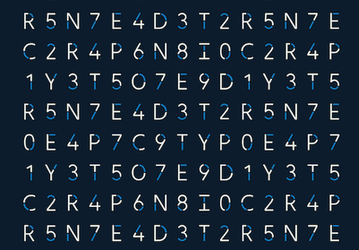
ENCRYPTION

Slide 30



creates a “virtual encrypted disk” within a file.
It looks like a file on your drive, but when you double-click on it and enter a password, it looks like a drive with however many files you want to put on it.
is an open-source e-mail encryption standard that a number of companies use to build add-ons and clients, most of which are free.
is the original consumer-friendly encryption software used for documents, to create virtual drives, and as an e-mail plug-in.
(legacy)

Slide 31
-----BEGIN PGP MESSAGE-----
Version: Encryption Desktop 10.3.0 (Build 9060)
Charset: utf-8
qANQR1DDDQQJAwLNtAknetvw+b/Sw7AB45QS3sUlBFVMuZaMOsJoTJW1h0TKAFsy
t64uIgxL338edNbwbAlFWZlpfPbFwpbn9ZtI7KDtKwx7aEwTBlDaiS1IsAfW7glF
BHwTZ9c+dR1WTy+Q/YVDwsjMdfsyoz8/c13BVQOIZOkdfSiBhEkuV+PAhwxD86lZ
6PmpJZAb0vxxC4iL3OqTdxjf9kuPag3QTqSkVfeko4E3iIrCpRBFYmoUdXZ1wTA2
eo1gX5ToXD7GUt7bECZCMuKvxWoVDK/uLyQIA2Kn7CYejad7x0XWrNhm5QC/EzBT
CKlKNc372T0y+kVzThecVv7m0OMMhI1JpedlTYdRAV7RrrbCAaoJVzRq0C+bH+Qo
L/ZZfUnX2YJeSZdRzIrFRXQ+fIsklXtjZMs9dxYK4Xt9hTHmJMF9mRGZgwlkjZS0
p66+bAmNQHgvDbf60YX+eG80AgenyoBU1XYA42c+o+gFV+WbFGKipq1tKRk+4543
II33iBgQhdZenYzTKqXQX7f2ZiEZyE3UYc32r3zvLNowyisPJDJ6dbCmY/9w0aEo
LtWjUs8ZWNw1phLjj7SxiUa6Tp9hbivxUfcpAJF22Yp68E/JiXTyV2lgmGy7pWIk
N11udz9qF8+AATDjmALXpLY7E/n1M5EMRL8M4PhMoqcb8VYzfUYdkXCgq8oIesSQ
f1MA+TG72KVEnyIfkD9/5heF7ExC4wwzrBGLV8YLnGjdh+ILcKSzAp/PWL3fH3gg
sVHetUUgsVvARQav+oEe02GlWQo9vz2UYT91nLa7NbLLrlJEY73rzqZ37/7ZRTfB
qhwxyLZlvC7/tFv94XsCn9pi+ZiqzpVpMUNRFbWsVCak178jsuy2+1zMmofanJS9
1E5cf5g/D1i/YHe53jwXbnBgGna3FMFUKZn+LAPqPz93M1GybRAqltKlBH2FSCNF
a3e5YhX155FIxI/RQ8ss4BuN0cDVE5JTU2PXLbUKl8cIDCZLoD8dGrz6Fgw3vEYk
BKReu1Oo9qiBcfahPlBLZOkcyjtMH2NKoFEu+rpI9tbGp9v9Fi0pfkxvnv3Ug2N5
D3s30V8jJemmEin/GNdz78MH9TAHk2b4tEZUW6v/kRvEKueLK94vDz1Cz6na/J5I
shbcxwLqbscNvBlUF87TCJhAawfA9P75GvKKNQgSBFZWLB54wdftK306gPJdc1c1
GaHmbEDDPRssCN+1wHR84cKFh2hgaZUUr4zbA8LAozVGkQGqIpR3+kuqx6DLsY+s
r6C6Q1GNPnVJDy3acqQTvOmi55IbajGsZ61MzHbp0tY9r67Vl4mPCvt1IX4K++RE
ZY2ly8vtkEDU6UY/70QbewXSYKGYwD74ORkLenAWZpHJC0e/ZK5ZvwvviEIGdbE/
zgILF8ps8vwbnPjEao0kLicHxq7Isz5t4tz5h/qpUVvaXliuZ+iKWZ7veM4Ay+zA
xnpOlJNtZvVVLCRej8QIrwsHw+563wtgUZhAqSm5J7CXMDKQ8MOwiyxPG+kBExGY
JIAUywRg7g==
=JKm8
-----END PGP MESSAGE-----
We read the privacy policies and available audits for all of these services, and we examined their apps and documentation for information about their underlying technology. After purchasing accounts from all of these companies, we evaluated the user experience on an Android phone, an iPhone, an Apple MacBook Pro laptop, and a Windows laptop. We used online DNS leak test tools (such as DNSLeakTest) to confirm that the VPN was not leaking DNS requests and that our visible IP address changed on every device. All of the VPNs we tested passed both tests on every platform.

Slide 32
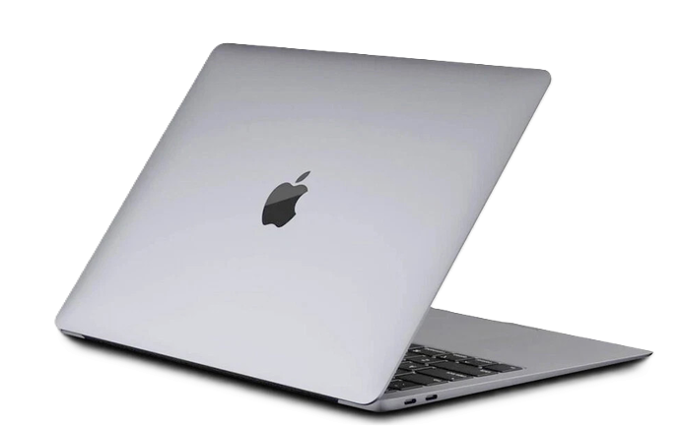
On a Mac
To Encrypt a Single Folder or File
Open Disk Utility.
File > New Image > Image from Folder.
Choose the folder you want to secure.
Pick 128-bit or 256-bit AES encryption from the encryption menu.
Type a strong password and click Save.

Slide 33
It takes a couple minutes to learn, but it works … and is fun.

Slide 34

Encryption the “old-fashioned way”
“One-time pad”
Book code or book cipher

Slide 35
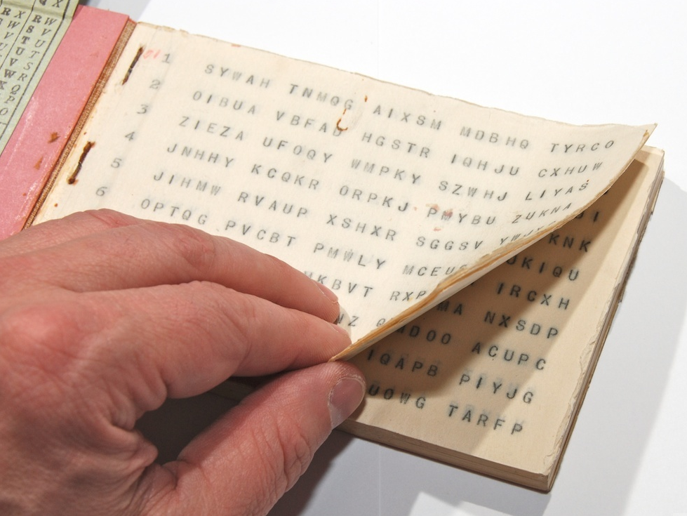
“One-time pad”
keys
A series of groups of letters
Two identical copies
Used agreed-upon day/time
Extremely secure (if pad is secure)
Notes:
NOTE FIVE GROUPS OF FIVE LETTERS – because A=0

Slide 36
“One-time pad”
keys
A series of groups of letters
Two identical copies
Used agreed-upon day/time
Extremely secure (if pad is secure)
AN EXAMPLE … Let’s say …
First key is SBMHR
Your requirement is: What is the enemy having for lunch?
Notes:
NOTE FIVE GROUPS OF FIVE LETTERS – because A=0

Slide 37
Key begins with: SBMHR
Message you want to send: PIZZA
Message: | P |  | I |  | Z |  | Z |  | A
Values: | 14 |  | 8 |  | 25 |  | 25 |  | 0
Key: | S |  | B |  | M |  | H |  | R
Values: | 17 |  | 1 |  | 12 |  | 7 |  | 16
Sum: | 5 |  | 9 |  | 11 |  | 6 |  | 16
Ciphertext: | F |  | J |  | L |  | G |  | R

Slide 38
MSG from HQS:
  What is the enemy going to eat for lunch?
Your encoded REPLY:
F J L G R
On subsequent mentions of PIZZA, you will not repeat
F J L G R, because you’ll use a different key from the OTP.

Slide 39
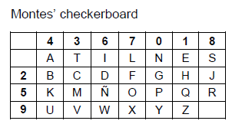

Variation for double-encryption : The Straddling Checkerboard
And then use a one-time pad … to subtract or add … to get “ciphertext”
“A” = 4, “T” = 3, and so on. The less frequent letters in the other rows are composed with the digit of the row, followed by digit of the column: “B” = 24, “P” = “50”

Slide 40
Key begins with: SBMHR
Message you want to send: PIZZA
Message: | P |  | I |  | Z |  | Z |  | A
Values: | 14 |  | 8 |  | 25 |  | 25 |  | 0
Key: | S |  | B |  | M |  | H |  | R
Values: | 17 |  | 1 |  | 12 |  | 7 |  | 16
Sum: | 5 |  | 9 |  | 11 |  | 6 |  | 16
Ciphertext: | F |  | J |  | L |  | G |  | R
Notes:
Once again!!!

Slide 41
“Book Code”
Two identical copies of a book
Commercially available; doesn’t look like a codebook
Flexible date/time
Caution: Vocabulary has to be appropriate to intelligence information

Slide 42
“Book Code”
page/line/word | 842914
paragraph/word | 1586

Slide 43
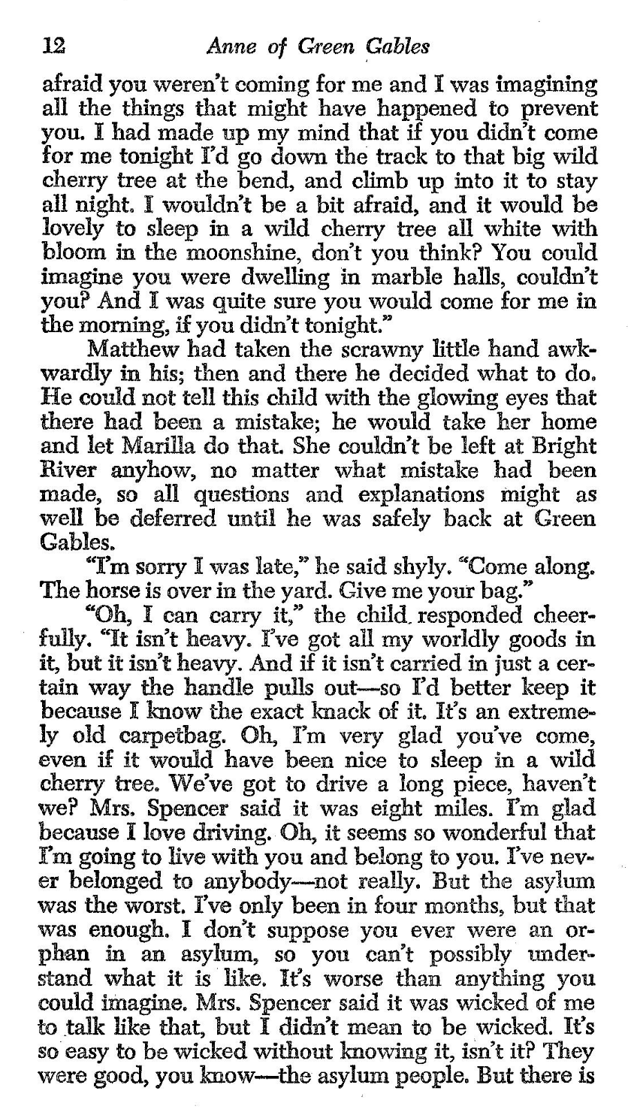
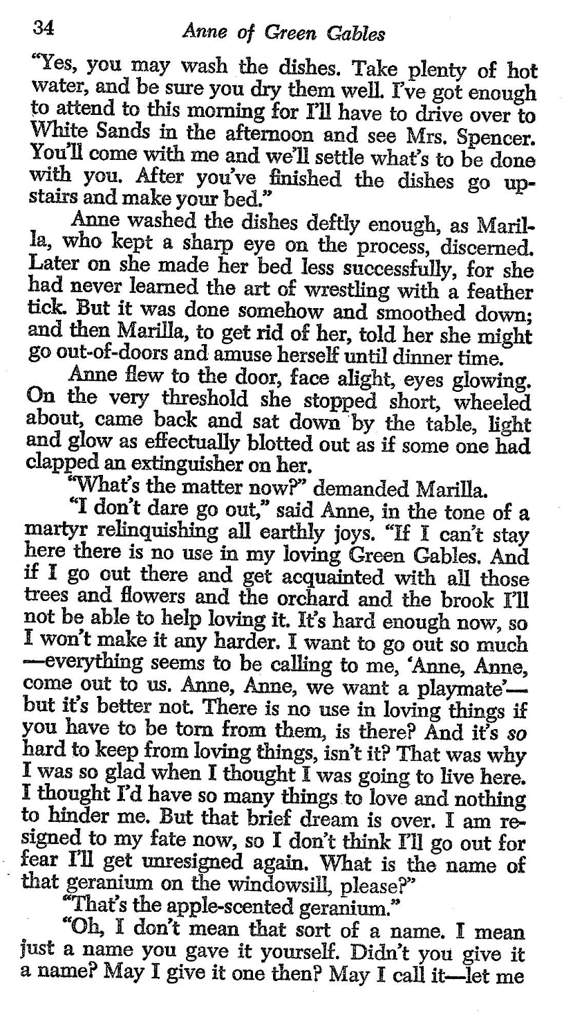
121003
343409
340102
I
LOVE
YOU

Slide 44
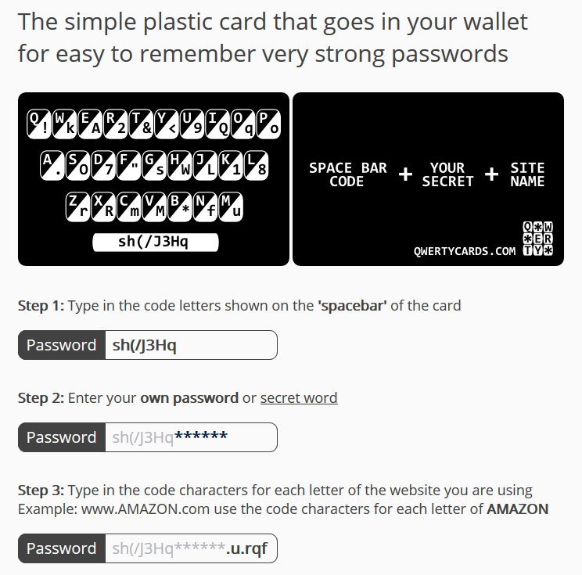
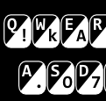
Encryption on a card
QWERTYCARD
White letters on black are original; black on white are code

Slide 45
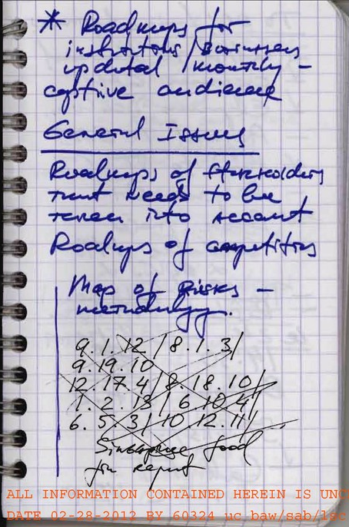
“MATRIX Code”
RUSSIA SLEEPER CASE
2010
Handwritten notes in graph paper notebook showing 27-digit password
Released by FBI in February 2012

Slide 46
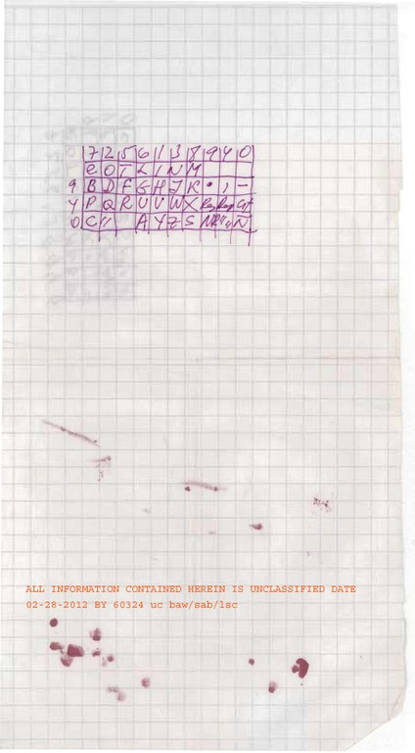
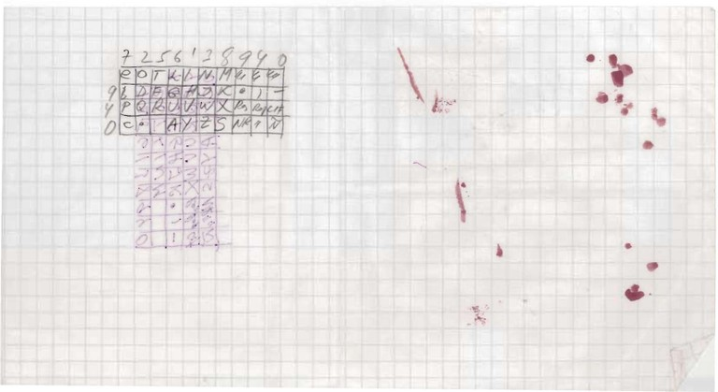
Handwritten checkerboard code on graph paper used by Juan Lazaro to encrypt messages to SVR Center
(Same code written on a different document, also by Juan Lazaro)

Slide 47
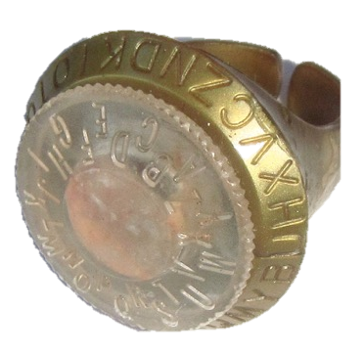
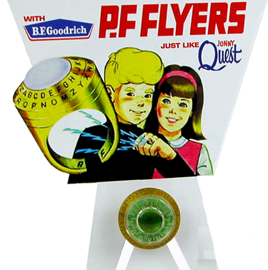
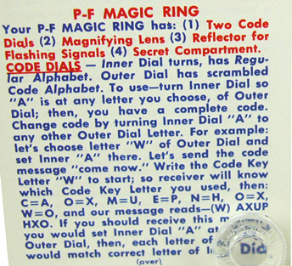
Encryption Machines
Ever had one?
PF FLYER Decoder Ring (1964)

Slide 48
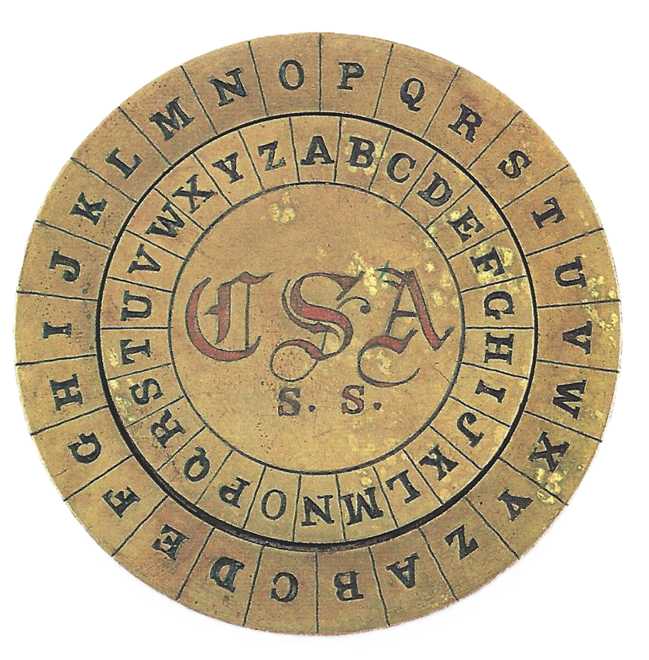
Signal Service
Confederate States of America
1862

Slide 49
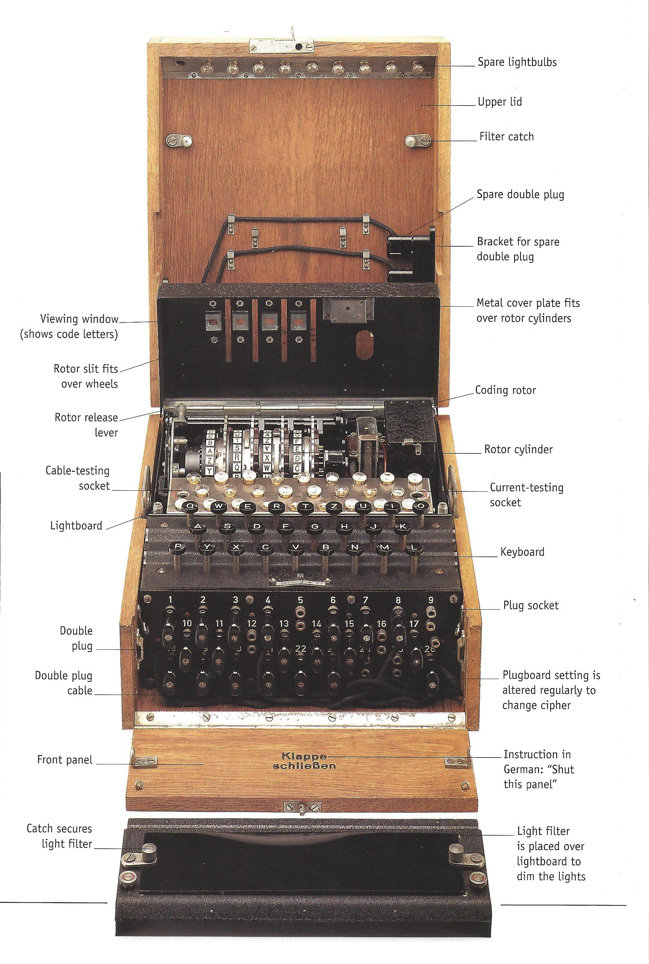
Encryption Machines
ENIGMA
German encryption device first invented in 1920s, central during WWII
Often –
One pressed keys
Another wrote enciphered letters as they lit up
Call codes via radio

Slide 50
I asked … what can (should) we do?
We can’t really shut it all out …
at least we can make it difficult by
GOING “BLACK” – radio silence, no locator, delete cookies
BEING SMART – don’t be open, use VPN, etc.
BEING DECEPTIVE – varying channels, encrypting files

Slide 51
Questions?
Comments?
Experiences?

Slide 52
Protecting Yourself in a Digital World
- Securing your Devices and Information -
Fulton T. Armstrong
Friday
09 October 2026

