Slide 1

Effective Analysis
- An Analytical Model for Making Information Actionable -
Fulton T. Armstrong
Friday
11 September 2026

Slide 2
What is analysis?
Lots of important processes are called analysis,
but what’s most important in most decisionmaking contexts?
GOING BEYOND what, who, when, where, how many
enables predictions
enables action
TO IDENTIFY the why and how

Slide 3
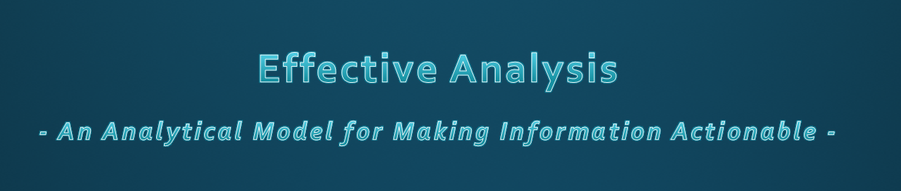
When decisionmakers face a problem, they need …
    Facts on the “symptoms” they have to react to
    Analysis on why/how it’s developing – to make a policy

Slide 4
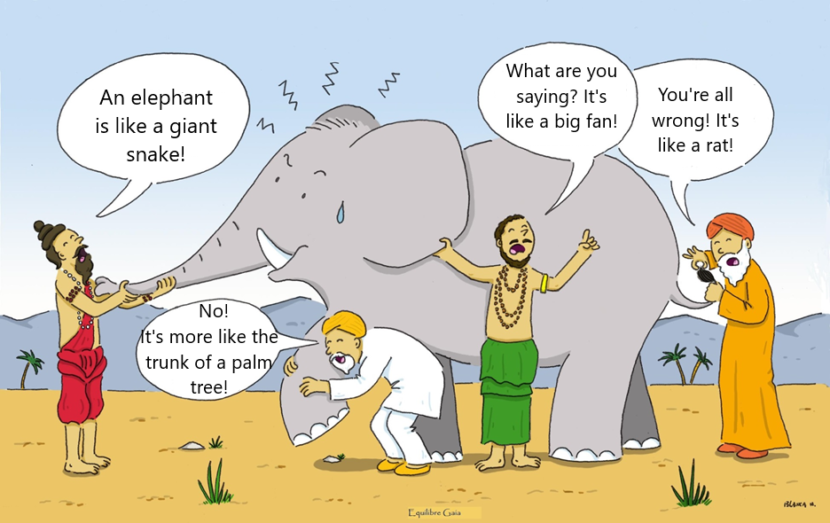
Indian Story: The Blind Men and the Elephant
Notes:
Somos como en la historia india … los ciegos que quieren entender qué es un elefante. Cada uno lo toca, pero nadie entiende qué es hasta que se unan sus observaciones.
Un analista de una agencia de inteligencia … o un académico … o un periodista … o un representante de un negocio … quizás tenga información interesante, pero no es inteligencia hasta que, como sociedad, se una lo que saben y opinan del fenómeno que están observando.

Slide 5
Indian Story: The Blind Men and the Elephant
First Purpose: Getting facts to say WHAT we perceive.
SECOND Purpose: Make sense of it -- what it means.
Are they developing good analysis?
Notes:
Somos como en la historia india … los ciegos que quieren entender qué es un elefante. Cada uno lo toca, pero nadie entiende qué es hasta que se unan sus observaciones.
Un analista de una agencia de inteligencia … o un académico … o un periodista … o un representante de un negocio … quizás tenga información interesante, pero no es inteligencia hasta que, como sociedad, se una lo que saben y opinan del fenómeno que están observando.

Slide 6
How do we do it?
Information – identify needs, validate, process

Slide 7
How do we do it?
Information – identify needs, validate, process
Hypothesis – initial answer, purged of biases

Slide 8
How do we do it?
Information – identify needs, validate, process
Hypothesis – initial answer, purged of biases
Testing – honest check of strength

Slide 9
How do we do it?
Information – identify needs, validate, process
Hypothesis – initial answer, purged of biases
Testing – honest check of strength
Ranking – assigning probabilities, alternatives

Slide 10
How do we do it?
Information – identify needs, validate, process
Hypothesis – initial answer, purged of biases
Testing – honest check of strength
Ranking – assigning probabilities, alternatives
Developing conclusions … and writing

Slide 11
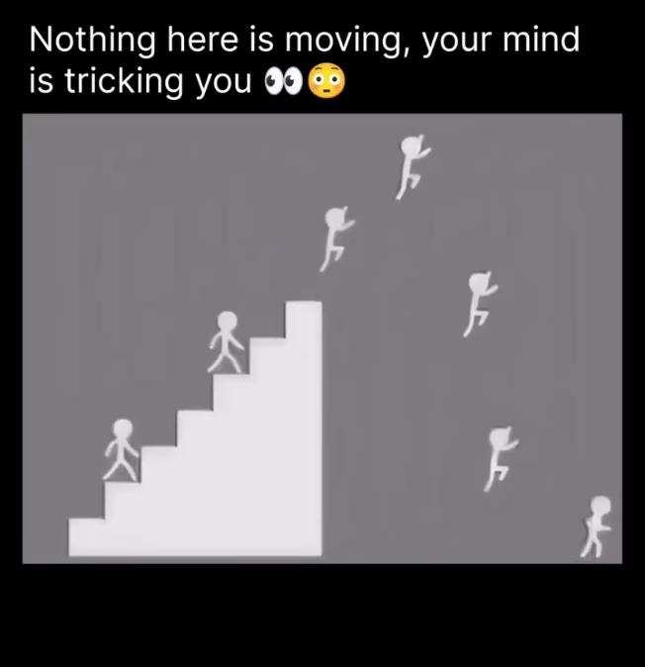
Checking info

Slide 12
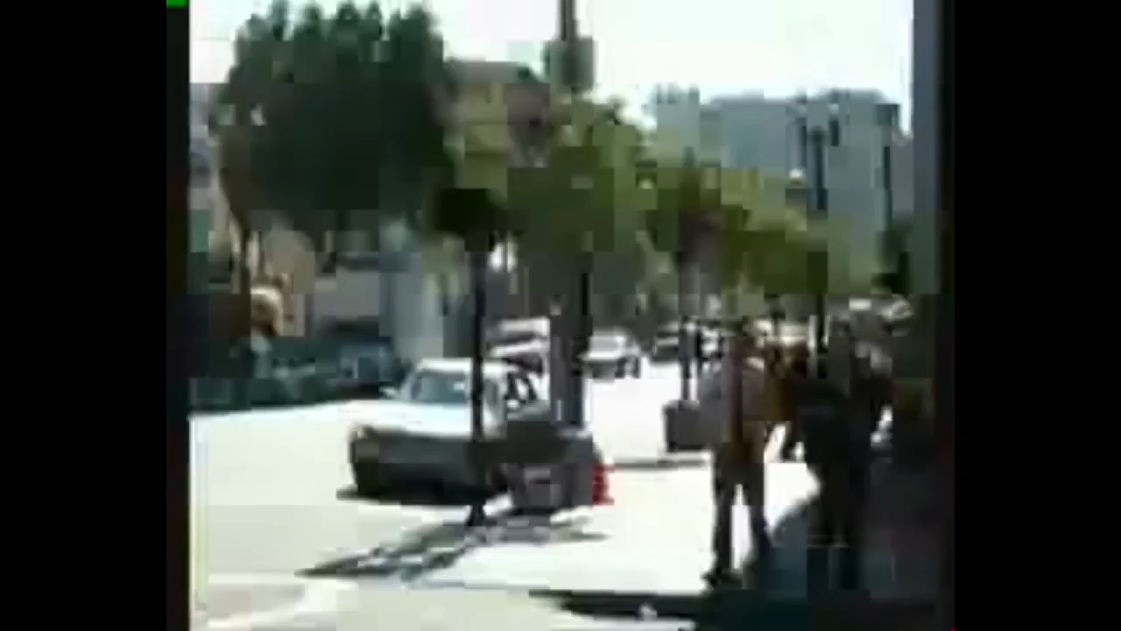
Checking bias
What happened?

Slide 13
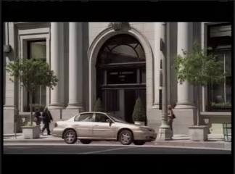

Slide 14
Being aware
How do we know what we “know”?
What’s REAL and what’s FAKE?
Do we know it?
Do we want it to be real/fake?
Do we cancel it because we haven’t seen it?
Do we think it’s probably real/fake?
(OK … as long as we can explain why)

Slide 15
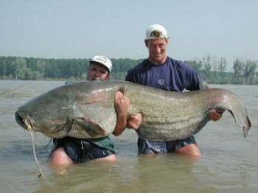
Is this catfish real or fake?
Real
Notes:
HOW DO YOU KNOW??

Slide 16
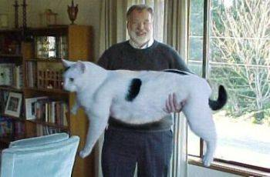
Is this house cat real or fake?
FAKE
Notes:
HOW DO YOU KNOW??

Slide 17
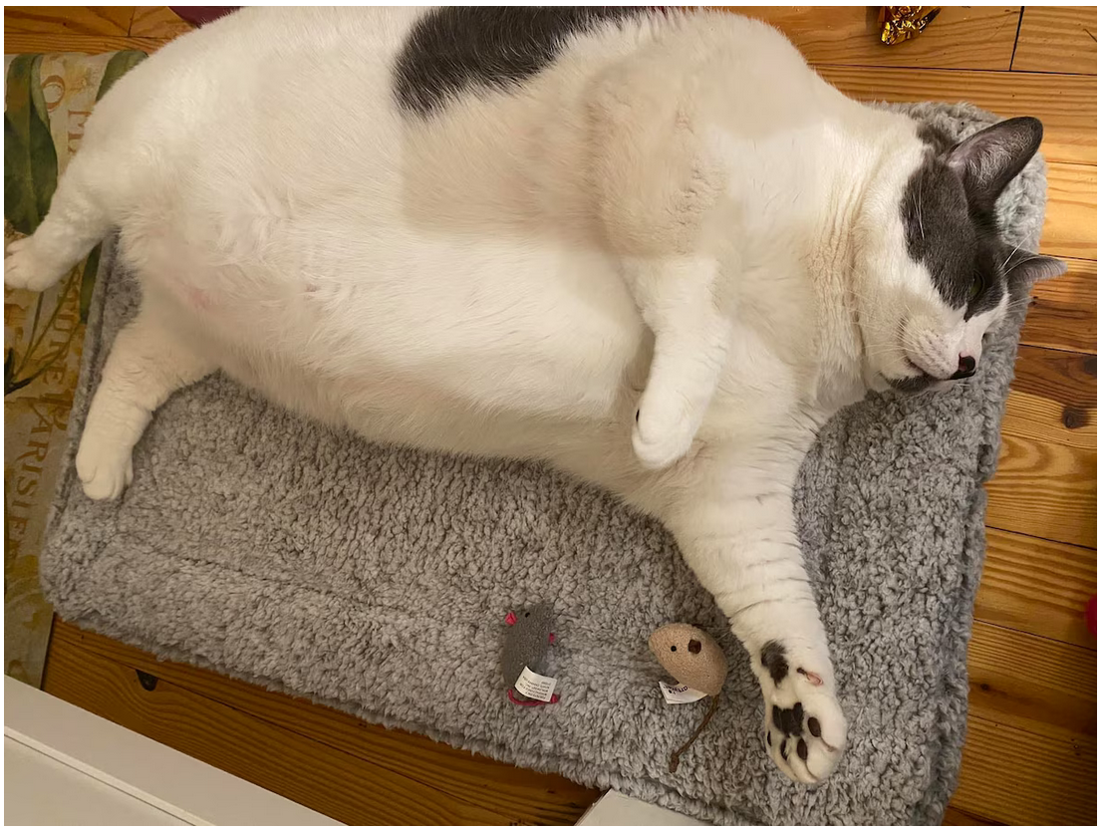
Real
Is this house cat real or fake?

Slide 18
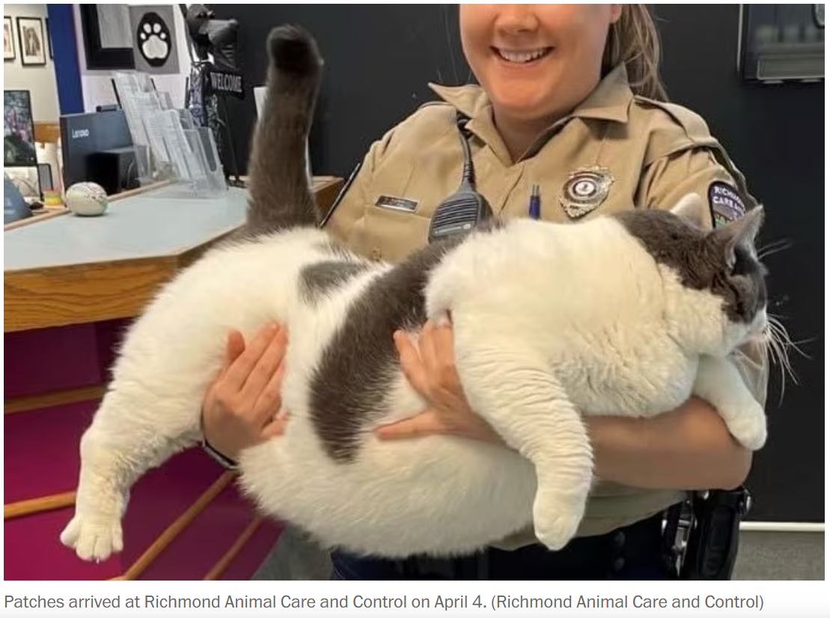
Washington Post 27 Apr 2023 (18kg/40lb)

Slide 19
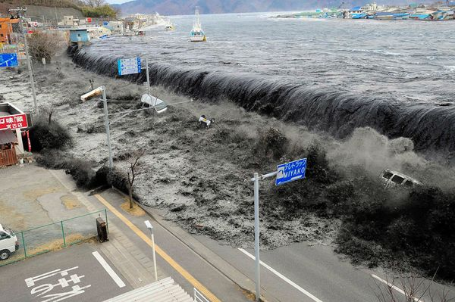
Is this tsunami in Miyako, Japan, real or fake?
Real
Notes:
HOW DO YOU KNOW??

Slide 20
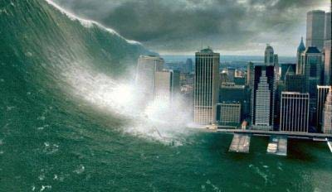
Is this tsunami in New York City real or fake?
FAKE
Notes:
HOW DO YOU KNOW??

Slide 21
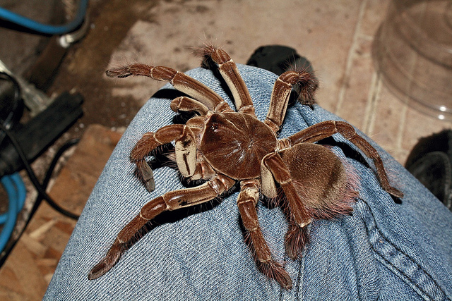
Is this goliath birdeater tarantula real or fake?
Real

Slide 22
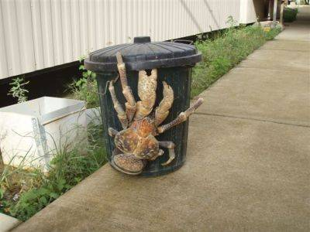
Is this coconut crab real or fake?
Real
Notes:
HOW DO YOU KNOW??

Slide 23
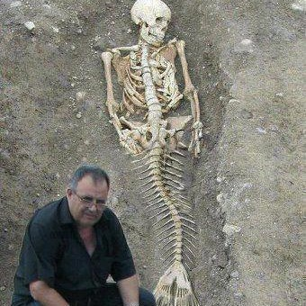
Is this mermaid skeleton found near the Black Sea real or fake?
FAKE
Notes:
HOW DO YOU KNOW??

Slide 24
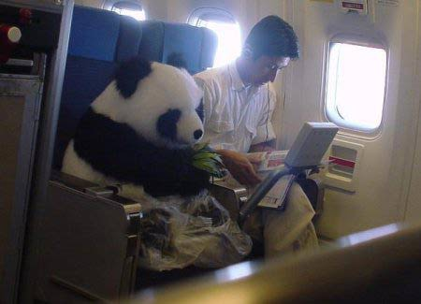
Is this flying panda real or fake?
FAKE
Notes:
HOW DO YOU KNOW??

Slide 25

Bark Air — $6,650 from New Jersey to Los Angeles
REAL
Notes:
HOW DO YOU KNOW??

Slide 26

Is this 9/11 tourist snapshot real or fake?
FAKE

Slide 27
How did you determine “real” or “fake”?
When you’re doing analysis, you have to be conscious of WHY you believe or disbelieve.

Slide 28
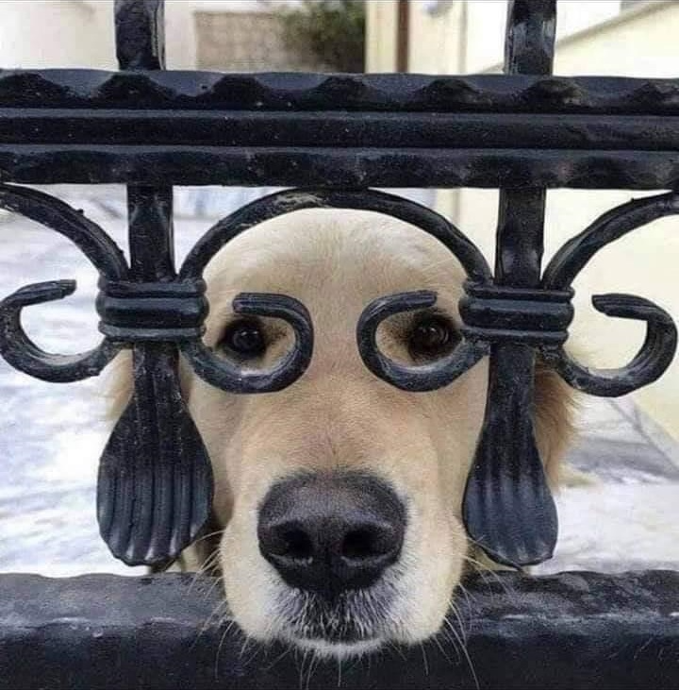
We have to see everything clearly – what it is, what it isn’t.
And from all angles.

Slide 29
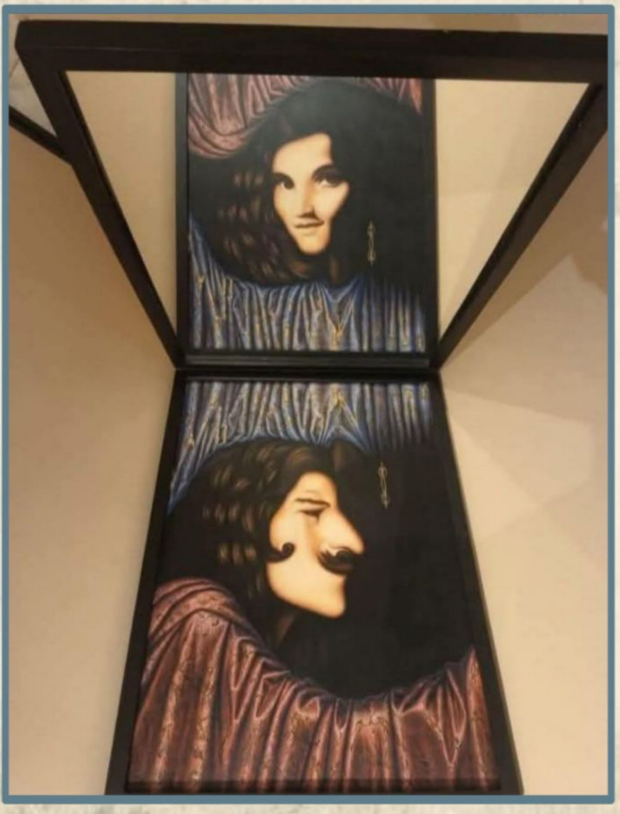

Slide 30


Slide 31
And, of course, the flood of fake videos.

Slide 32
So … what do decision-makers need?
B
L
U
F
ottom
ine
p
ront
Basic facts and your validation of them.
Who? What? When? Where? How many?
Drivers and trends.
Why? How? How behaving?
Scenarios, probabilities, and implications.
How urgent? Why should I care?

Slide 33
A Decisionmaking Model
Problem
Analysis
Options
Decision
Results
Essential to the entire process

Slide 34
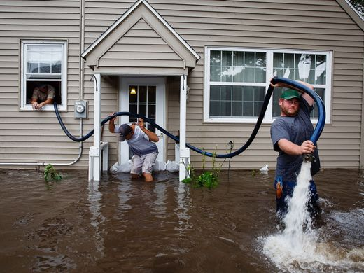
Sorting
“SYMPTOMS”
from
“PROBLEMS”

Slide 35
Sorting
“SYMPTOMS”
from
“PROBLEMS”
responses are
tactical, often obvious, political
responses are
strategic, expensive, slow
but DURABLE
based on “DRIVERS”

Slide 36

The Heartbeat of Analysis
(… and POLICY)
What’s driving events?
What scenarios are likely and less-likely?
To help decisionmaker determine:
How can I make a better scenario?
“DRIVERS”

Slide 37
What are drivers?
Interests
Borrowing from the “3-i framework” …
In our PERSONAL lives …
Ideas
Institutions
Interests | Ideas | Institutions
Work Food Love - Sex Family Home Transportation Entertainment Recreation Challenges | Education Religion or values Political thought Ideology Imposed expectations | Parents Boy/Girlfriend Husband/Wife Colleagues Friends Political party Employer
drivers

Slide 38
What are drivers?
Interests
In our NATIONAL lives …
Ideas
Institutions
Interests | Ideas | Institutions
Power/influence Needs Desires/ambitions Wealth Economic performance | Self-definition Nationalism History Concepts/logic Values Ideology | Leadership Abilities/constraints Economic structures Intermediation Inclusion Topography/geography Climate
drivers

Slide 39
DRIVERS aren’t static …
So we also look at their TRENDS.

Slide 40
What are the “trends” of the drivers?
stronger
The “trends” or “currents” are how the drivers are (or have been) behaving:
  More or less strong, important
  Moving toward or away from resolution
“worst outcome”
“best outcome”
worse
better
“mixed outcome”
“mixed outcome”
weaker

Slide 41
Building the Principal Scenario
driver and trend
Principal Scenario
driver and trend
driver and trend
driver and trend
driver and trend
driver and trend

Slide 42
EXAMPLE: Central American Migration
corruption
Principal scenario
violence
poverty
“Will continue to get worse”
weak government
climate change
“U.S. Green light”

Slide 43
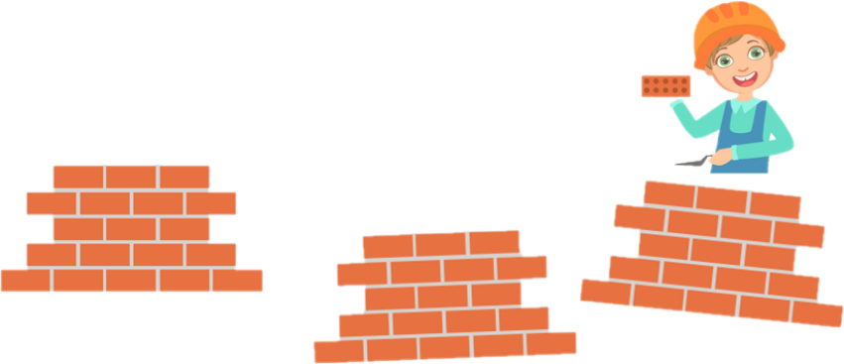
Build the ALTERNATIVE Scenario

Slide 44
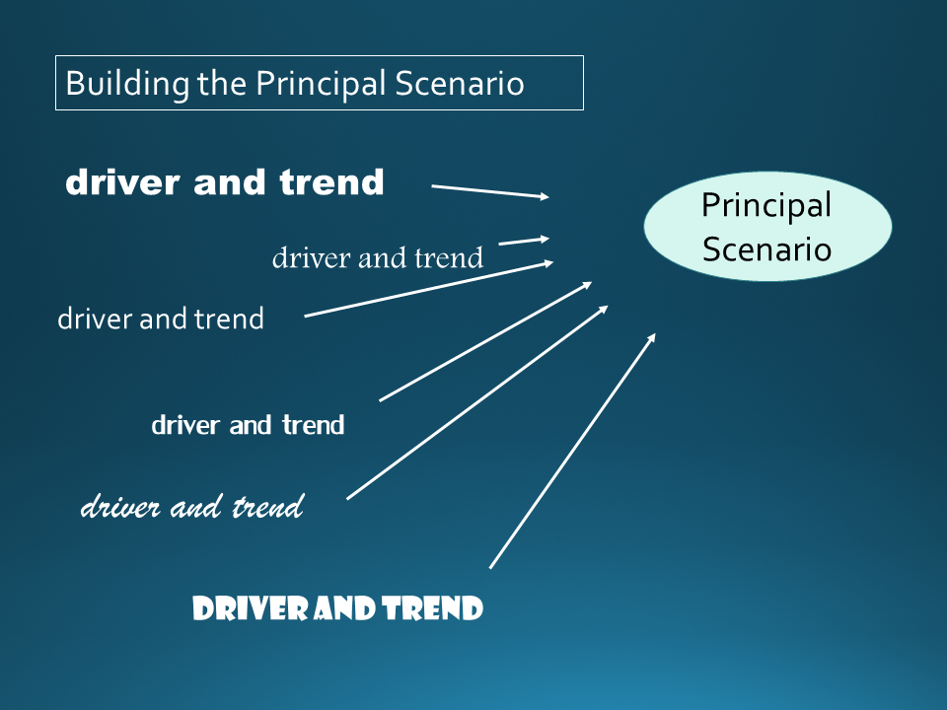
BUT … ASK YOURSELF:
What if the drivers behave differently?
What if I’m WRONG?

Slide 45
Building the ALTERNATIVE Scenario
driver and trend
In other words …
If the drivers evolve … gain or lose salience … then you get a different outcome.
driver and trend
driver and trend
driver and trend
Alternative Scenario
driver and trend
driver and trend

Slide 46
EXAMPLE: Central American Migration
corruption
violence
poverty
weak government
Alternative Scenario
climate change
U.S. “green light”
“Will decline”

Slide 47
EXAMPLE: Central American Migration
corruption
Or … MORE likely … MIXED
violence
poverty
weak government
Alternative Scenario
climate chnage
U.S. “green light”
“Will probably decline”

Slide 48
How do we state probability?
________
100
100%
90%
80%
70%
60%
50%
40%
30%
20%
10%
0%
________
87-99
________
63-87
FIRST, what would YOU say?
________
40-60
________
20-40
________
2-12
________
0

Slide 49
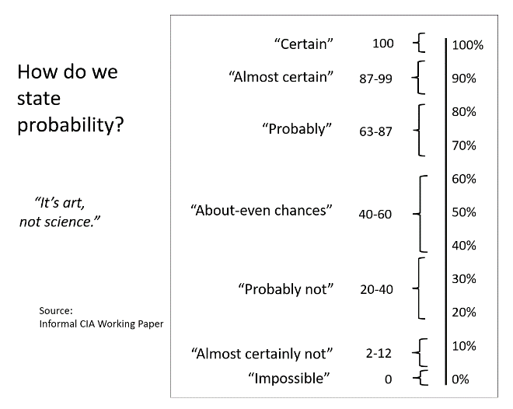
How do we state probability?
“Certain”
100
100%
90%
80%
70%
60%
50%
40%
30%
20%
10%
0%
“Almost certain”
87-99
“Probably”
63-87
NOW, what did CIA analysts say?
“About-even chances”
40-60
“Probably not”
20-40
“It’s art, not science.”
“Almost certainly not”
2-12
Source:
Informal CIA Working
Paper
“Impossible”
0

Slide 50
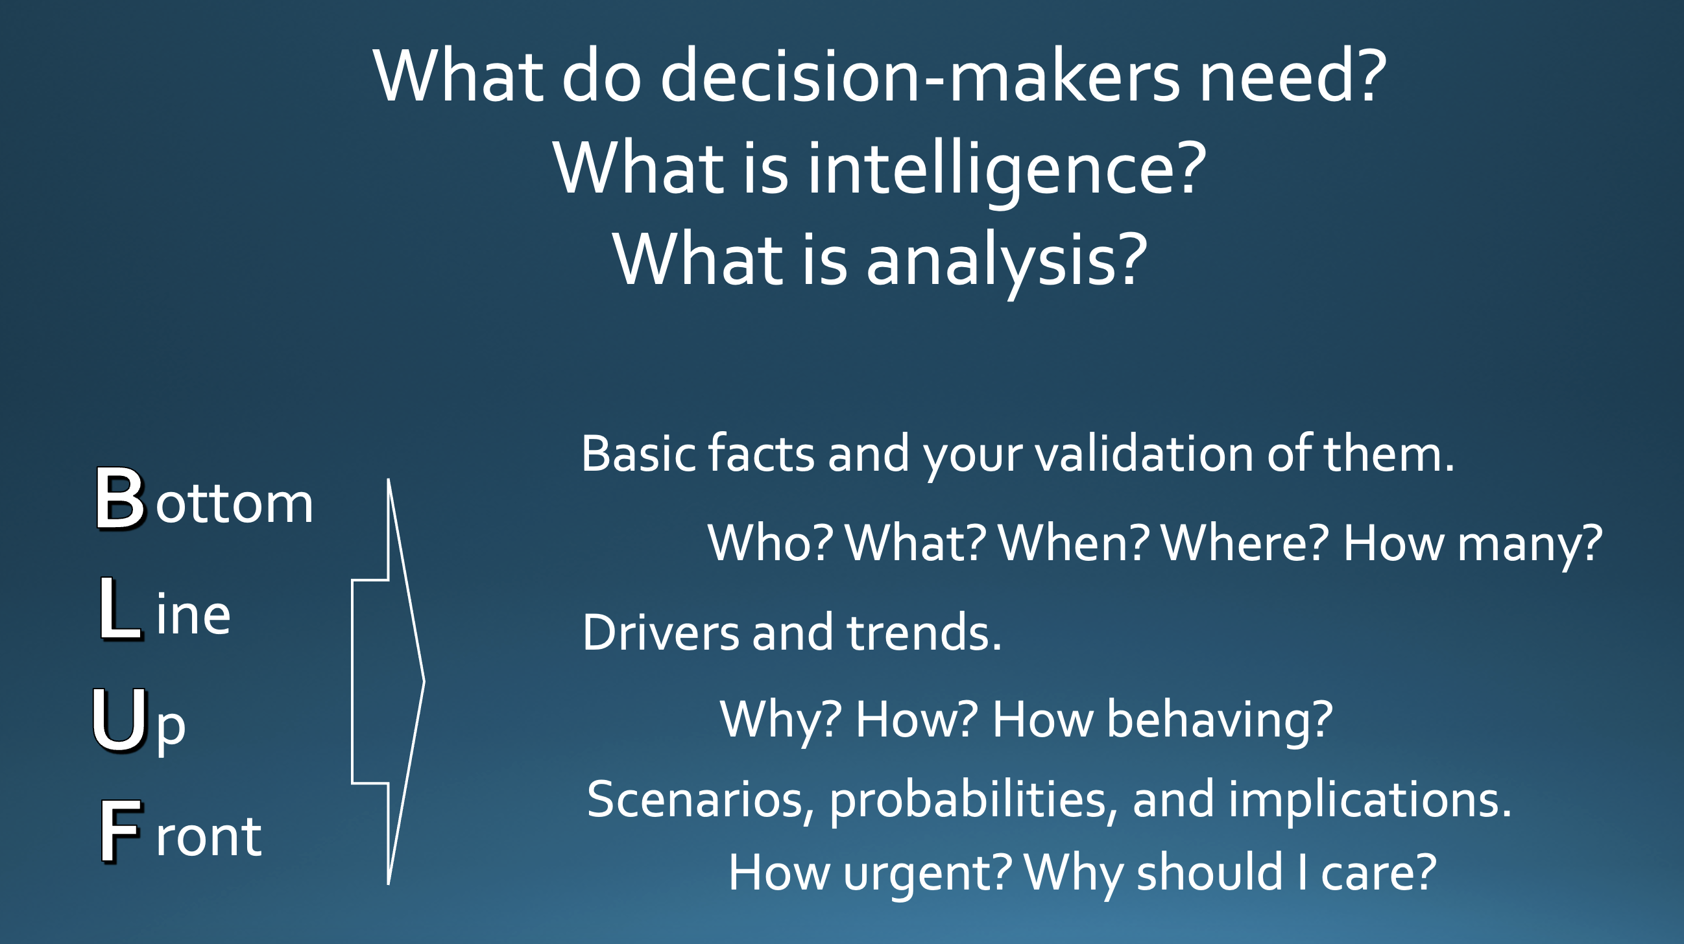
That’s it …

Slide 51
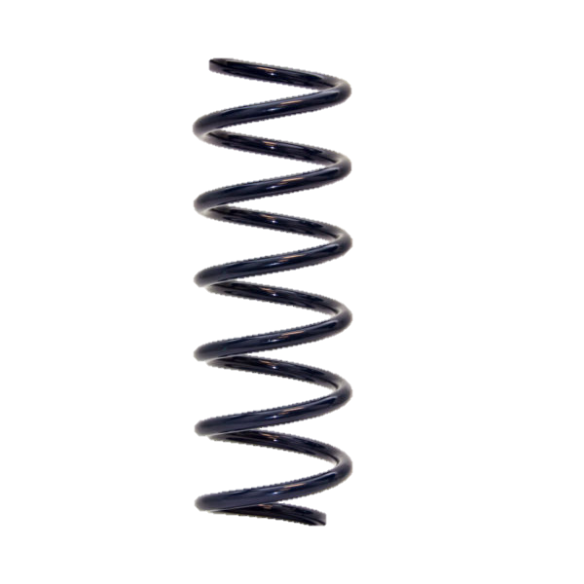
It’s not a linear process
, but spiral.
It’s also COMMON SENSE made CONSCIOUS.

Slide 52
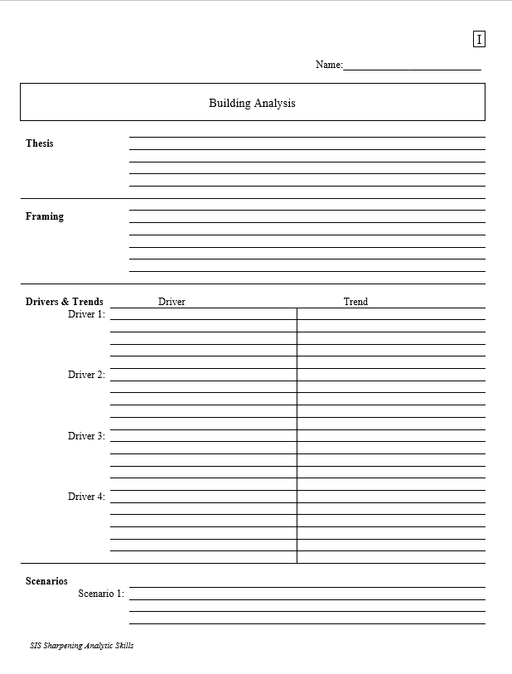
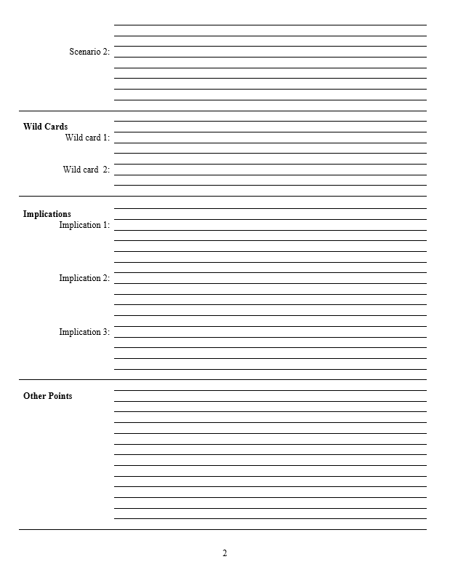
The Analytical Worksheet: One Proven, Effective Way to Build Analysis for Presentation
Other Points | Things that don’t fit in rigid structure
 | Give color, texture to analysis
 | Useful in building “narrative” when you write
 | Pet facts, thoughts that you like (and show you care)
Thesis sentence(s): Main conclusion.
            “Bottom Line Up Front.”
            Short, concise summary – including as many elements as needed to tell the whole story.
Framing: The information your decisionmaker needs to get into the story.
Basics
Not “research or encylopedia”

Slide 53
Armed with a worksheet like this, the writing is easy.

Slide 54
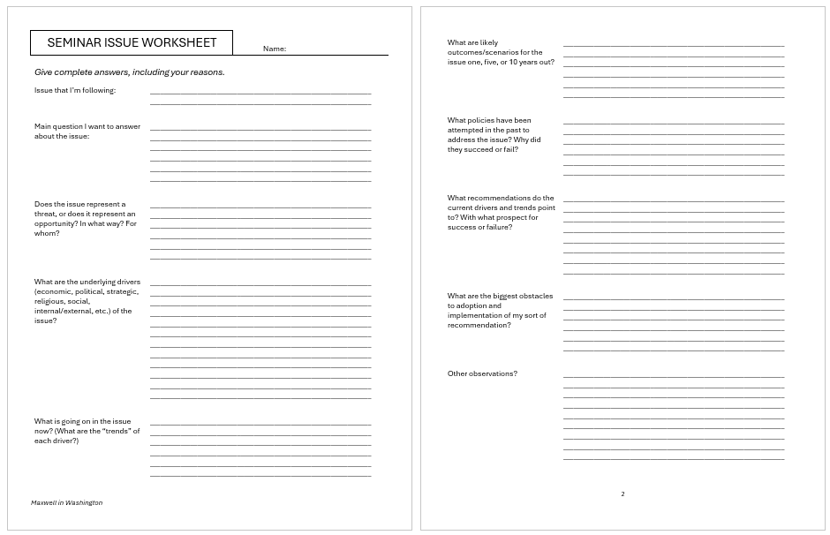
Even less intimidating …

Slide 55
My opinion: Good analysis (and writing it well) is now more important than ever.
YOU CAN DO IT.

Slide 56
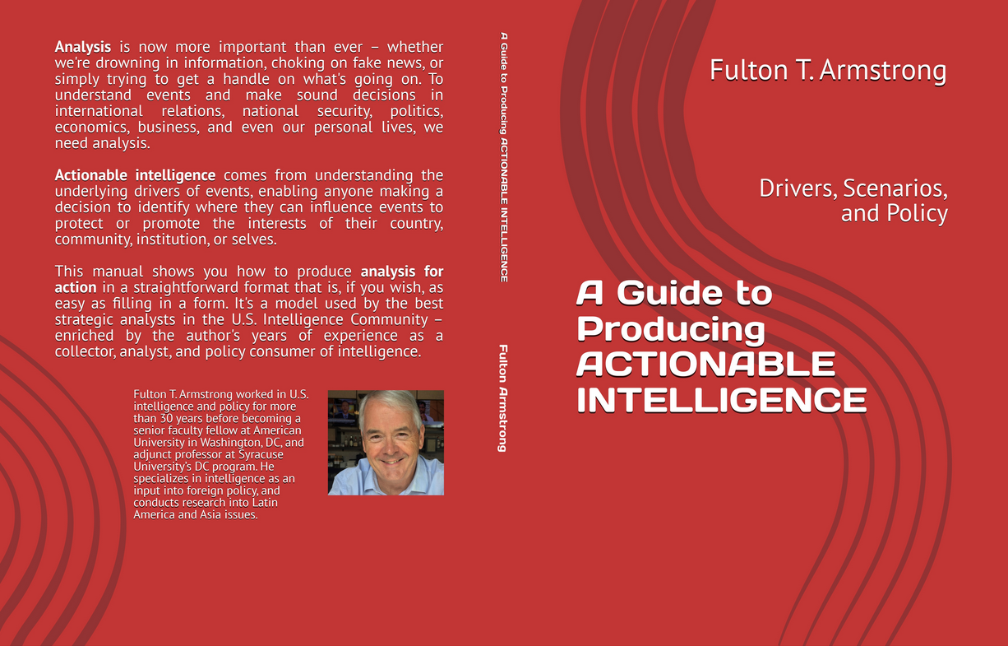

Slide 57
How do you do analysis of issues that you’re tracking?
Questions? Comments?

Slide 58
Effective Analysis
- An Analytical Model for Making Information Actionable -
Fulton T. Armstrong
Friday
11 September 2026

