Slide 1
Briefing and PowerPoint
Making it easy for your audience to get your message.
10 April 2026
Fulton T. Armstrong

Slide 2
Briefing and PowerPoint
What to say
Clear
Actionable
Interesting
How to support it
Efficient
Logical
Attractive

Slide 3
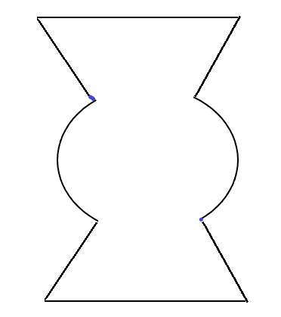
Scott Morgan’s MODEL
Problem
Vivid Examples
&
Evidence
Structure of
a good briefing
Solution
Next Steps
Morgan:
“If I buy your analysis, I’m much more likely to buy your recommendation.”

Slide 4
Scott Morgan’s MODEL
Problem
Vivid Examples
&
Evidence
Structure of
a good briefing
Solution
Next Steps
Morgan:
“If I buy your analysis, I’m much more likely to buy your recommendation.”

Slide 5
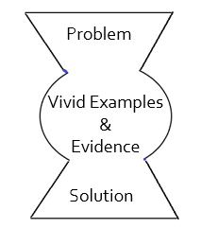
Washington Policy MODEL
Widely used structure
in Government:
  BLUF
  “Framing”
  Drivers/Trends
  Options
  Recommendation
Scott Morgan’s
Analysis
Arguments
Options &
Recommendation
Analysis points the way to options and recommendation.

Slide 6
Washington Policy MODEL
Widely used structure
in Government:
  BLUF
  “Framing”
  Drivers/Trends
  Options
  Recommendation
Bottom line up front; 15- to 20-second.
Minimal facts to launch the story.
Causes and evolution of the story.
Ways of changing causes and outcomes.
The way you think is best.

Slide 7
Washington Policy MODEL
Widely used structure:
  BLUF
  “Framing”
  Drivers/Trends
  Options
  Recommendation
Bottom line up front; 15- to 20-second.
Minimal facts to launch the story.
Causes and evolution of the story.
Ways of changing causes and outcomes.
The way you think is best.

Slide 8
Washington Policy MODEL
Bottom line up front; 15- to 20-second.
Minimal facts to launch the story.
Causes and evolution of the story.
Ways of changing causes and outcomes.
The way you think is best.
PREPARE YOUR BRIEFING
Plan your message.
Plan your time.

Slide 9
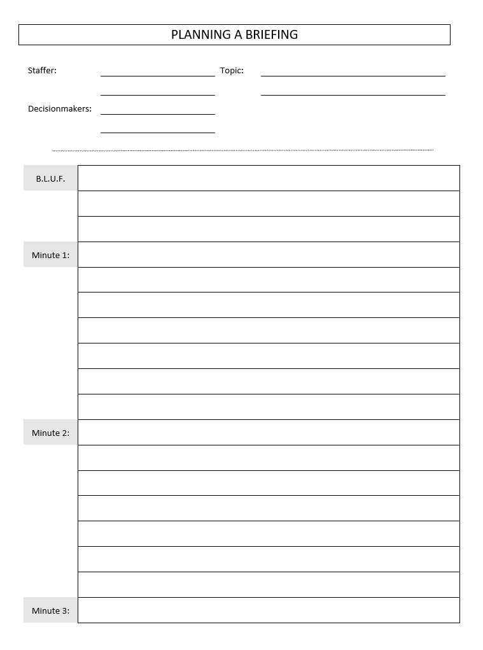

One way of doing it
BLUF …
Talking points …
Talking points …
Talking points …
Talking points …
This
becomes
Talking points …
your “script.”

Slide 10
One way of doing it
BLUF …
Talking points …
Talking points …
Talking points …
Talking points …
Talking points …

Slide 11
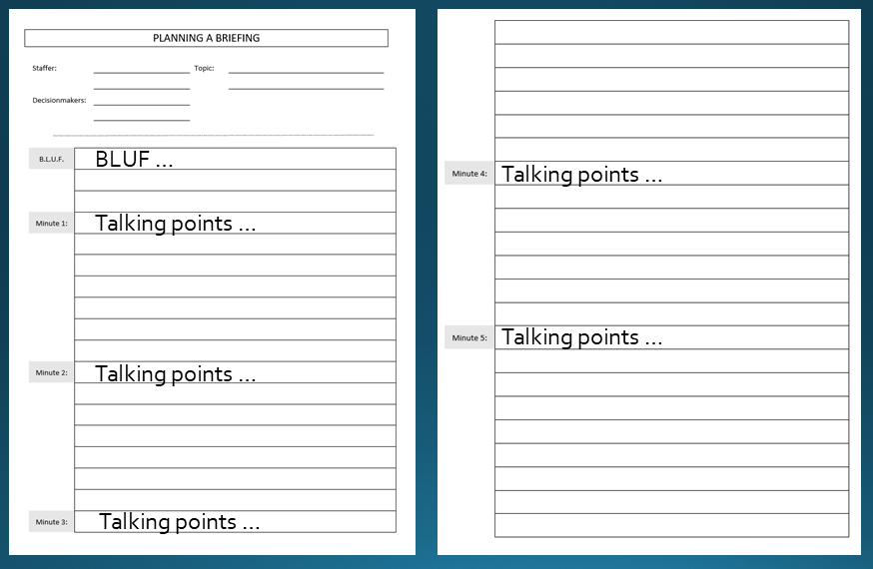

The Presentation
I’m brilliant!

Slide 12
I’m brilliant!
The Presentation

Slide 13

The Presentation

Slide 14

The Presentation
“It’s as easy as …”
A
ccuracy
B
revity
C
larity

Slide 15
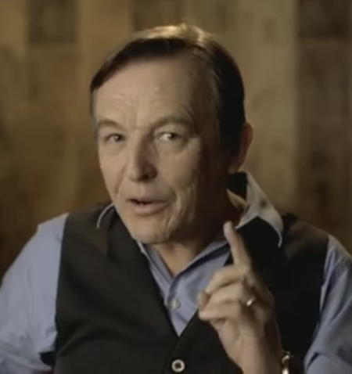

Chris Anderson´s FOUR GUIDELINES
Chris Anderson
Head of “TED”
Focus on one main idea.
Give a reason to care.
Build your idea with familiar concepts.
Make your idea worth sharing.
The “gift” of an idea.

Slide 16
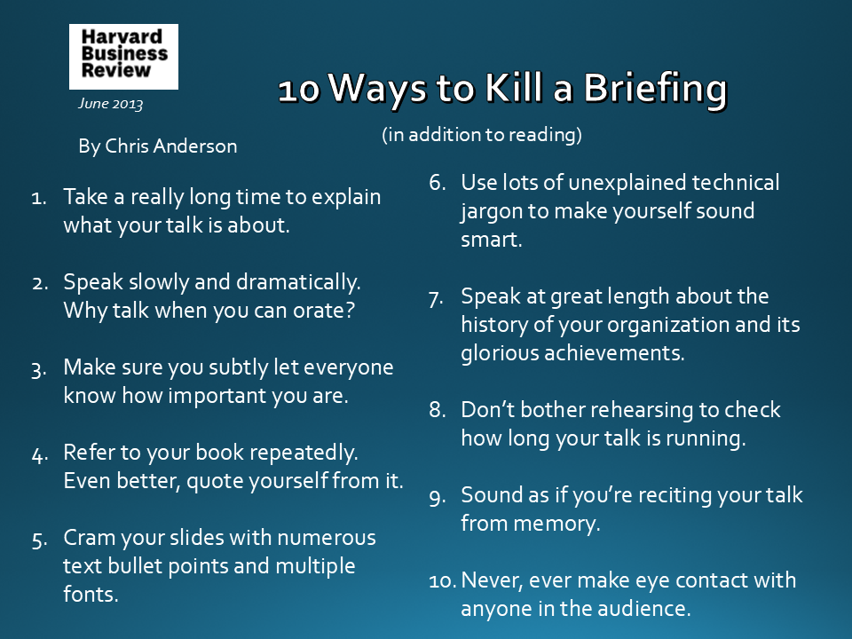
For your reading pleasure later …
Chris Anderson
Head of “TED”

Slide 17

10 Ways to Kill a Briefing
June 2013
By Chris Anderson
(in addition to reading)
Use lots of unexplained technical jargon to make yourself sound smart.
Speak at great length about the history of your organization and its glorious achievements.
Don’t bother rehearsing to check how long your talk is running.
Sound as if you’re reciting your talk from memory.
Never, ever make eye contact with anyone in the audience.
Take a really long time to explain what your talk is about.
Speak slowly and dramatically. Why talk when you can orate?
Make sure you subtly let everyone know how important you are.
Refer to your book repeatedly. Even better, quote yourself from it.
Cram your slides with numerous text bullet points and multiple fonts.

Slide 18


Leonardo DiCaprio
Jennifer Lawrence
Meryl Streep
How NOT to do a briefing!!

Slide 19
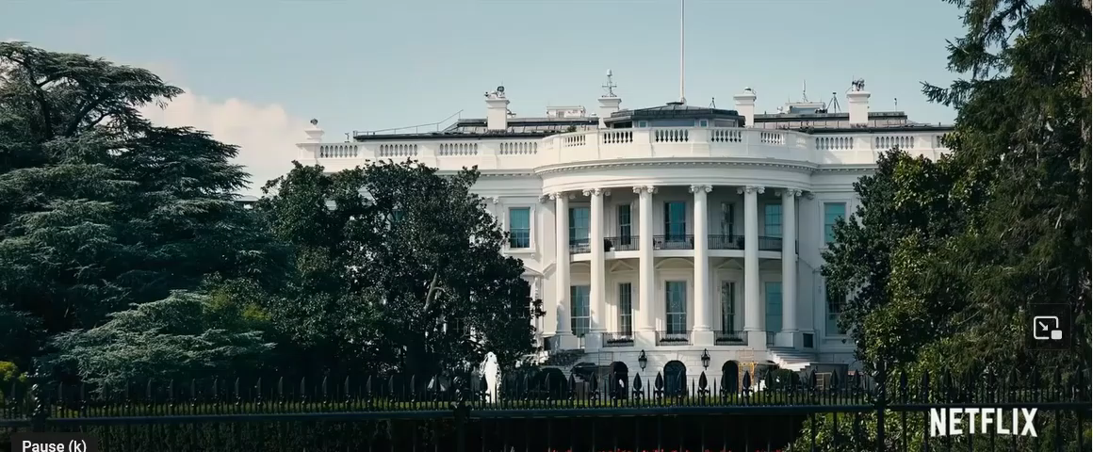

Slide 20
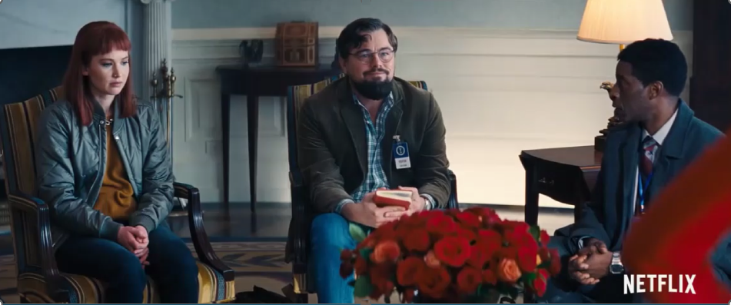
What went right ?? What went wrong ??

Slide 21
To “win” the room, we have to …
Understand our audience and their needs.
Have a plan, including a clear BLUF to launch.
Practice.
Anticipate questions and reactions, including pushback, manipulation.
Have the briefing down so cold … that we stay cool.
Breathe!

Slide 22



Slide 23
Facilitating, Not Obstructing, Your Message

Slide 24
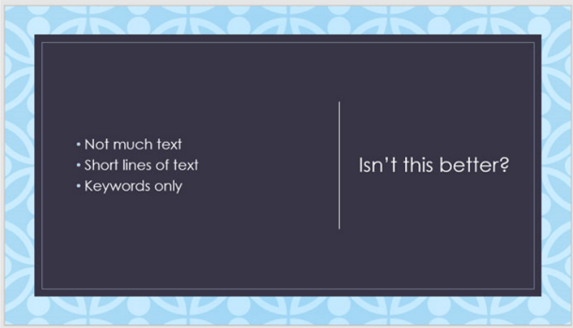
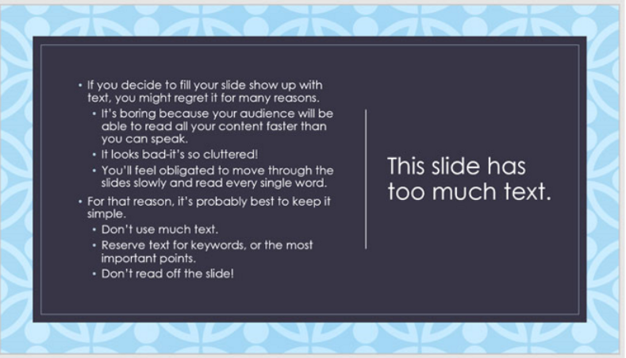
BRIEFING SLIDES
There are plenty of good guides “out there.” Here are some tips from them.
IN GENERAL
Don’t use too many words.
Some experts like the 5/5/5 rule.
5 words per line of text
5 lines of text per slide
5 text-heavy slides in a row

Slide 25
BRIEFING SLIDES
IN GENERAL
Don’t use too many words.
Some experts like the 5/5/5 rule.
Be respectful of your audience.
Hey, sweetie!

Slide 26

BRIEFING SLIDES
IN GENERAL
Don’t use too many words.
Some experts like the 5/5/5 rule.
Be respectful of your audience.
Choose readable colors and fonts.

Slide 27
BRIEFING SLIDES
IN GENERAL
Don’t use too many words.
Some experts like the 5/5/5 rule.
Be respectful of your audience.
Choose readable colors and fonts.
Use
animations
sparingly.

Slide 28
Other tips
FONT | Simple is good – Arial or Calibri or Aptos Big enough
TEXT | Bullets, phrases, short sentences
SIMPLE GRAMMAR | Can drop articles “Headline” style
ART and VIDEO | Graphics to show story
LAYOUT and ANIMATION | Reflect logic, flow
CORRECTNESS | Proof; czech speeling

Slide 29
Other tips
FONT | Simple is good – Arial or Calibri Big enough
TEXT | Bullets, phrases, short sentences
SIMPLE GRAMMAR | Can drop articles “Headline” style
ART and VIDEO | Graphics to show story
LAYOUT and ANIMATION | Reflect logic, flow
COLOR | High contrast
CORRECTNESS | Proof; check speeling

Slide 30
Technical issues
THE PPT FILE | Thumbdrive? E-mail ahead?
THE “CLICKER” | Mouse? Logitech Presentation?
LASER | Welcome?
AUDIO | Connected? Levels?
Also … | set up your PPT to your desire.
 | >>>>>>>>>>>

Slide 31
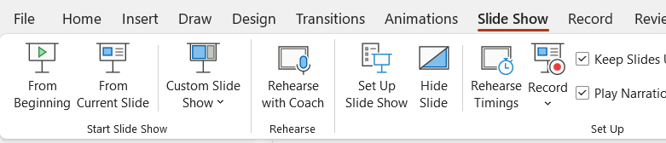
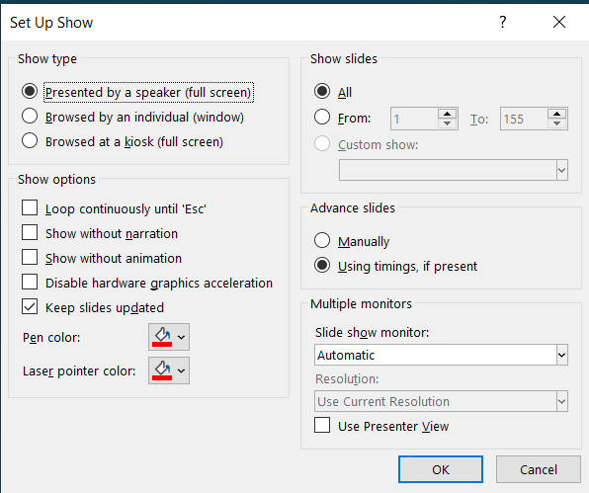

Slide 32
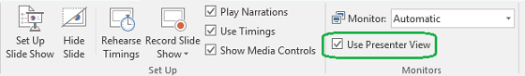
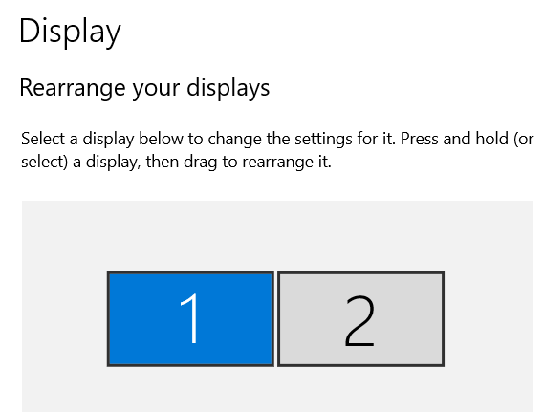
Presenter View
(if using two monitors)
See your notes
See upcoming slide
Make annotations
Zoom in
Windows setup

Slide 33
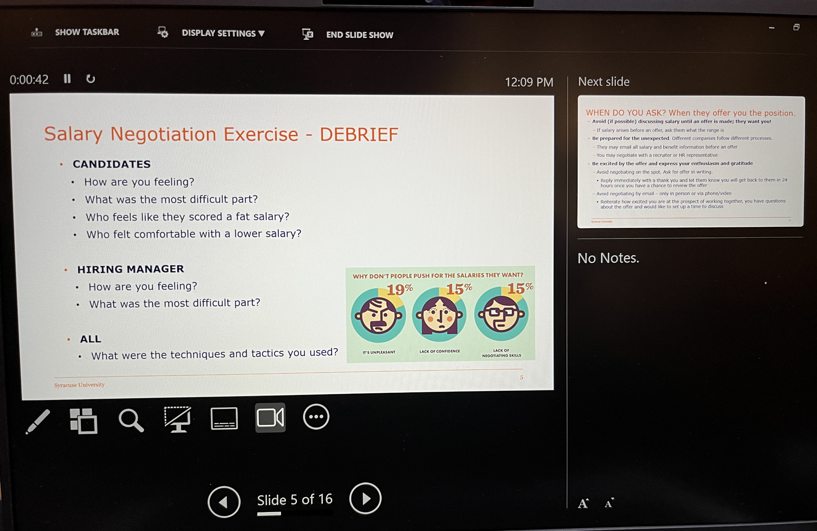
Presenter View
Audience
sees
You also
see

Slide 34
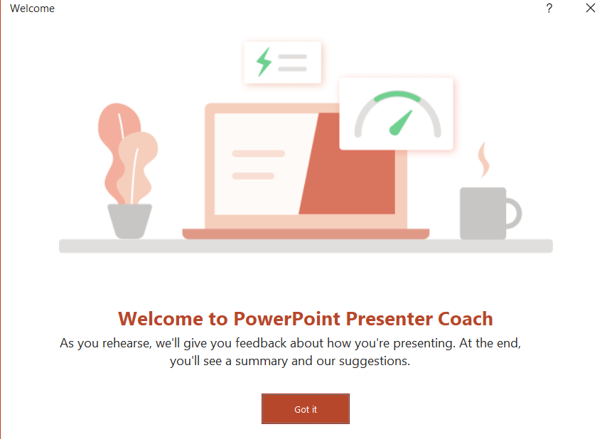
Evaluates
pacing
pitch
filler words
informal speech
euphemisms, and culturally sensitive terms.
Detects overly wordy or are simply reading.
Gives you statistics and suggestions for improvements.
Speaker Coach or Presenter Coach

Slide 35
Formatting
A quick tutorial …
Themes
and
Templates
Apply to new or existing decks.
Include
fonts
colors
backgrounds, etc.
Apply to new decks only.
Are themes with some boilerplate.
Are “types” of presentation (e.g., sales).

Slide 36
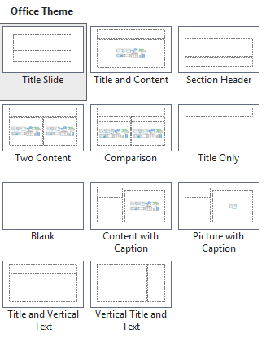
Formatting
Layouts
A quick tutorial …
Themes
and
Templates

Slide 37
Formatting
Most specific formatting same as other MS apps.
and
actions
Fonts, sizes, bold, italics, etc.
“Selecting”
CTRL-C V X Z and CTRL-F H

Slide 38
Formatting
Transitions
and
Animations

Slide 39
Formatting
Remember idea is to help viewer,
not overwhelm.
Transitions
and
Animations
From one slide to next.
50 different effects, with various sound and speed.
Applied to the second slide.
Within a particular slide.
Appear/disappear, emphasis, move/motion, dim.
Various timing and repetition.
Can do multiple on each element.

Slide 40

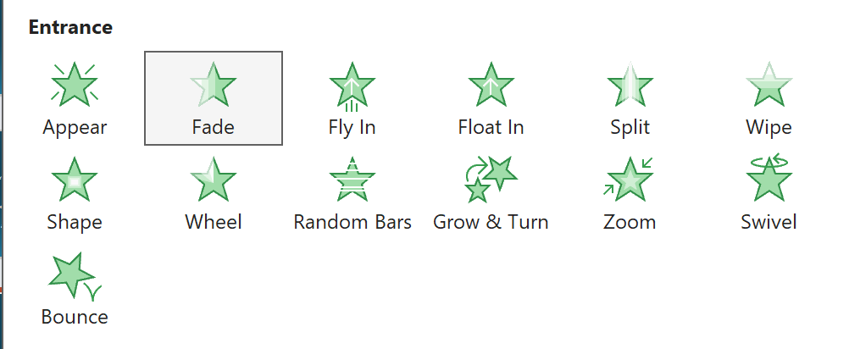
An example …
Make an ice cream cone appear.
You choose speed, etc.

Slide 41
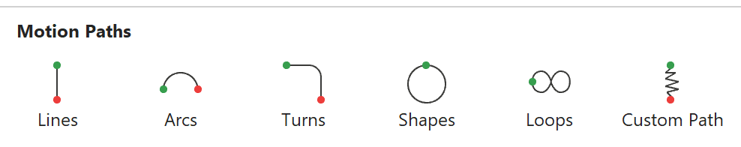
An example …
Make an ice cream cone appear.
You choose shape, direction, speed, etc.

Slide 42
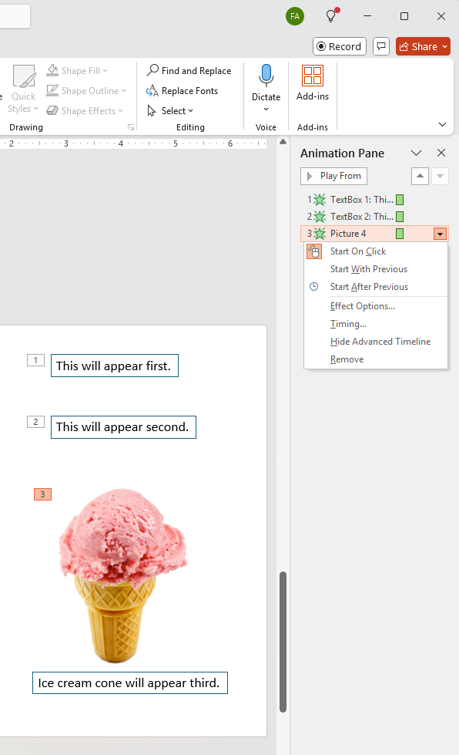
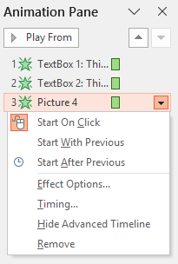


Slide 43
This will appear first.
This will appear second.
Ice cream cone will appear third.

Slide 44


Formatting
Idea
Design
Plan
Fund
Work
Distribute

Slide 45
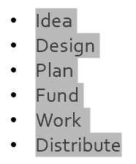
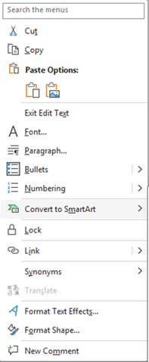

Highlight and
RIGHT click on list,
then LEFT click on
Convert to SmartArt,
and click to choose.

Slide 46
Idea
Design
Plan
Fund
Work
Distribute
Idea
Design
Plan
Fund
Work
Distribute
Idea
Design
Plan
Fund
Work
Distribute
Idea
Design
Plan
Fund
Work
Distribute

Slide 47
Clear analysis and clear recommendations
deserve
clear presentation.
Your reader or audience deserve it too.
GIVE THEM THE GIFT OF AN IDEA.

Slide 48
Briefing and PowerPoint
What to say
Clear
Actionable
Interesting
How to support it
Efficient
Logical
Attractive

Slide 49
Briefing and PowerPoint
Making it easy for your audience to get your message.
10 April 2026
Fulton T. Armstrong

