Slide 1
The Interview
Getting one. Acing one. Learning from one.
Samantha Clemence
Fulton T. Armstrong
27 March 2026

Slide 2
The Interview
Getting one.
Acing one.
Learning from one.
Finding opportunity
Networking
Applying
Preparing
Performing
Asking
Getting feedback
Analyzing results
Fixing for the future

Slide 3
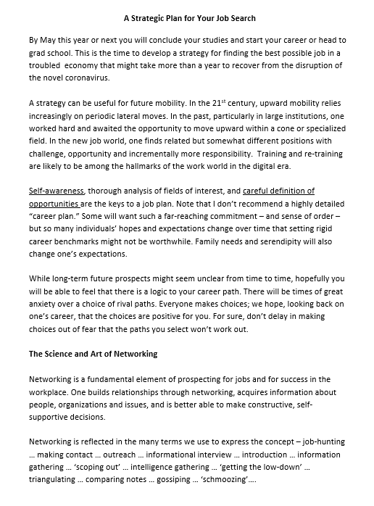
On-line Handouts
A Strategic Plan for Your Job Search

Slide 4
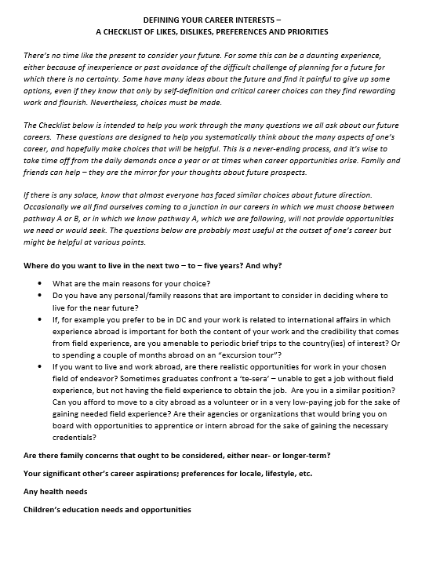
On-line Handouts
Defining your Career Interests –
A Checklist of Likes, Dislikes,
Preferences and Priorities

Slide 5
The Interview

Slide 6
Know yourself, needs, desires
Inventory skills
Consider other factors
Listen to your heart
Getting one.
Finding opportunity
Networking
Applying
Social media
“Build your brand”
Track the business
Look for names
Submit application
Build strong, readable, grounded, plain-English CV
Be honest to them, yourself
Begin the visualize
Per our previous discussion
Attend events
E-mail people
Find connections
“Enthusiasm needs to be grounded in reality.”
-Lorne Epstein

Slide 7
Know them, their business, their market
Research to know and show eagerness
Acing one.
Preparing
Performing
Asking
“Murder board” yourself
Prepare BLUF comments, answers
Anticipate tough questions
Heed the usual advice
Appearance with message
Take deep breath
Listen to the question, look for hints
Tune your language to interviewer
Read and use posture, body language
Be brief, but look for green light
Be honest
You interview them
Responsibilities, expectations
Special requirements (e.g., clearances)
Salary, benefits
Work environment, flex-issues, location
Org’s substantive views

Slide 8
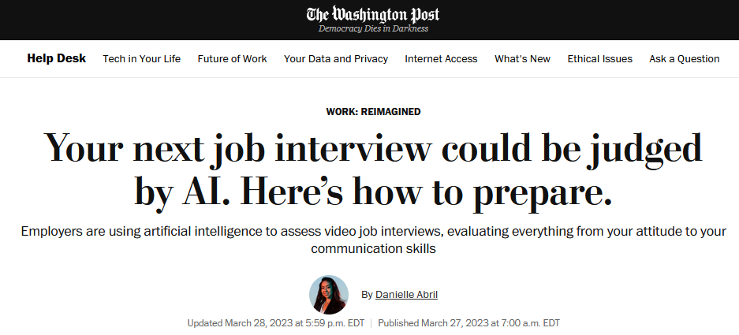
A glimpse of the future … with some advice that fits today

Slide 9
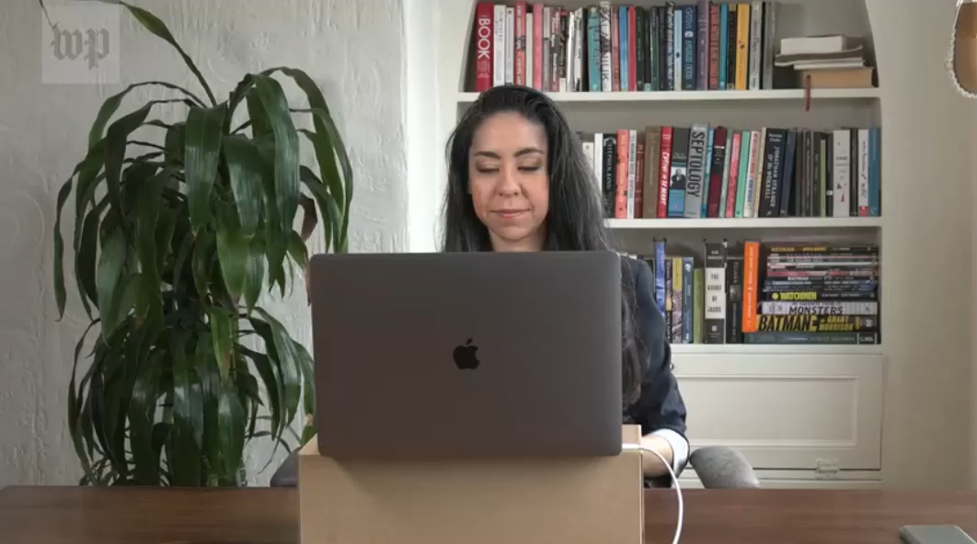
A glimpse of the future … with some advice that fits today
with Marcie Kirk Holland
Executive Director
Internship and Career Center
UC Davis

Slide 10
“Show, don’t tell” The “behavioral” interview
Don’t just tell them you’re a problem-solver; give them examples.
Use “I” (not we). This conversation is about you.
Create a narrative.
Anecdotes let you be confident without being too cocky.
Anecdotes keep you from droning on; they keep you on point.
Anecdotes keep you honest; they’re verifiable.
Be alert for – but don’t overreact to – off-limits questions.

Slide 11
Favorite (but sometimes problematic) Questions
Suggested Responses
“Tell me about yourself.” | See it as an ice-breaker, not a psychological exam Don’t ramble Don’t jump around Breathe
“Where do you see yourself in five years?” | Be flexible, knowing that average person changes jobs every four years Tell anecdote underscoring adaptability, curiosity as life-long learner
New York Times, 13 March 2020

Slide 12
Favorite (but sometimes problematic) Questions
Suggested Responses
“What is your greatest weakness?” or variation “Tell me about a time you failed.” | Be careful not to cast a strength as a weakness (e.g., “I work too hard”; “I’m too conscientious”); sounds insincere Identify a small weakness and explain how you’re addressing it Alternative: point out flaw unrelated to specific position or from outside work
New York Times, 13 March 2020

Slide 13
Favorite (but sometimes problematic) Questions
Suggested Responses
“Do you have any questions for me.” | GREAT opportunity to turn interview into dialogue
Show you care – that you’ve done your research on organization, job, people.
Learn about the organization.
Learn about the predecessor – e.g., why they left position.
Ask to see the workspace
Ask to meet future colleagues
Ask timeline for hiring decision

Slide 14
Another Suggestion
An appropriate thank-you note is good
  Adhere to interview protocol
  Include answer to any pending issue
  Look forward to hearing back

Slide 15
Learning from one.
If hired, can wait to ask
Getting feedback
Analyzing results
Fixing for the future
If not hired, find appropriate way to ask for freedback
Don’t dispute, argue; be positive
Get over pain a.s.a.p.
Express willingness to re-engage
Be honest with self but not too aggressively*
If there was a flaw, figure out where; ask mentor, friend
Develop a plan to remedy – e.g., rewrite, rethink, retrain
* A lot of times – perhaps majority of times – there are legitimate reasons other than your qualifications or fit. In those cases, understand it’s reality.

Slide 16
On-line Handouts
Defining your Career Interests –
A Checklist of Likes, Dislikes,
Preferences and Priorities
A Strategic Plan for Your Job Search
On BlackBoard
(along with a PDF of this presentation)

Slide 17
The resume gets your foot in the door.
The interview gets you in the door.
The resume shows your skills and experience.
The interview shows you’ll be a “good fit.”
  Stay focused
  Stay in “learning mode”
  Stay honest

Slide 18
Questions? Comments? Experiences to share?

Slide 19
The Interview
Getting one. Acing one. Learning from one.
Samantha Clemence
Fulton T. Armstrong
27 March 2026

