Slide 1

The Washington Memo
- Writing for Policymakers who Need to Make Decisions -
Fulton T. Armstrong
27 February 2026

Slide 2
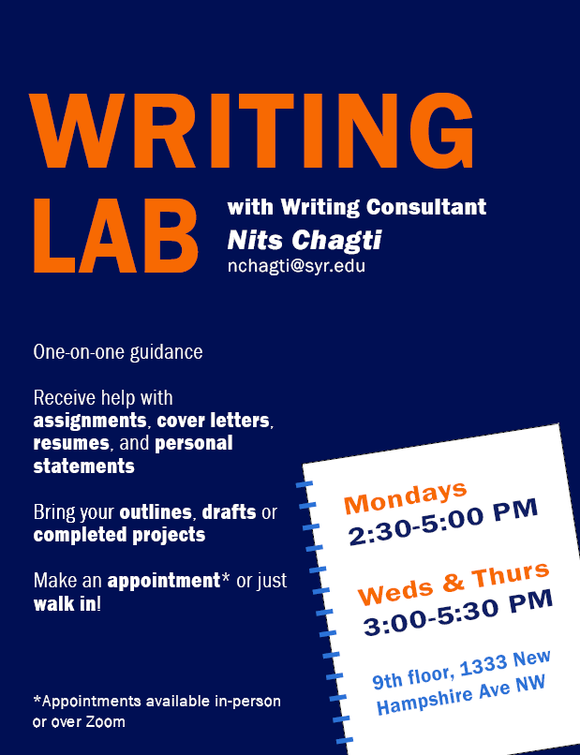

Writing Lab

Slide 3
Writing Lab

Slide 4
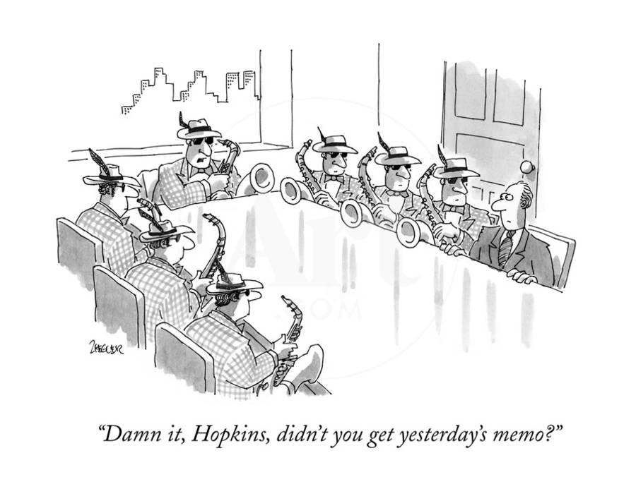
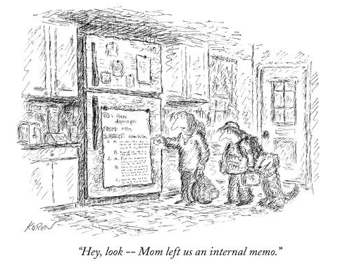
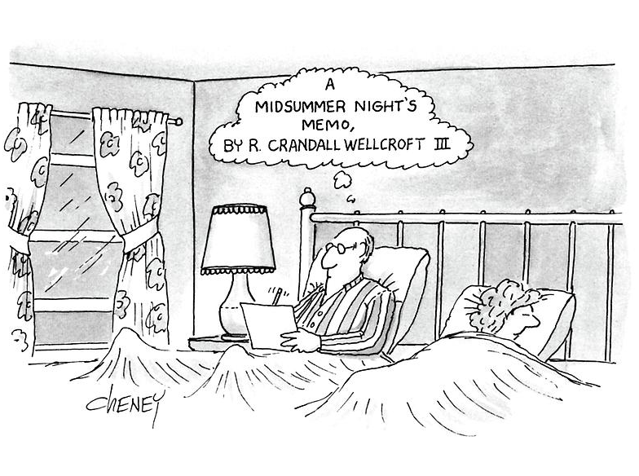
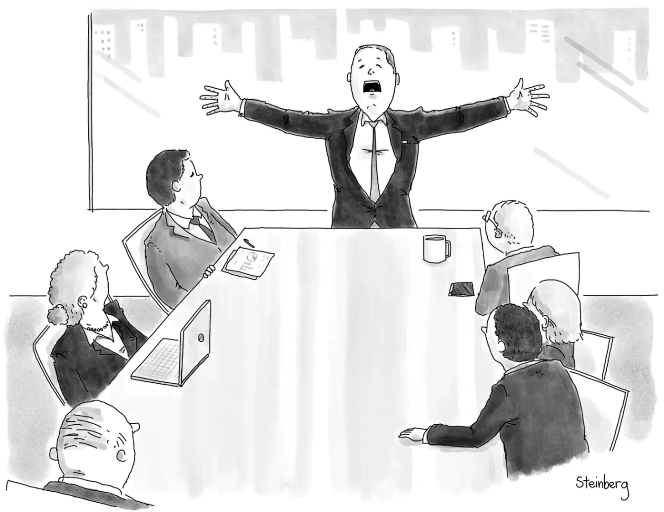
© New Yorker

Slide 5
In Washington Speak, they basically boil down to …
The information memo
The decision (or options) memo
The guidance memo
The Memorandum of Conversation
The intelligence (or research) memo
Summary of Conclusions
Talking points
Scenarios
Implementation

Slide 6
Are all memos alike – with same structure, style, etc?
NO.
Approach to options
Language & terms
Values & objectives
(& politics?)
Different purposes (per above)
Different agencies
Different clearance/coordination
Different audience/dissemination
BUT ... all have IMPORTANT things in common ………..

Slide 7
All good memos are …
Brief | They don’t waste readers’ time.
Concise | They’re not sloppy, long-winded.
MAKE IT EASY FOR YOUR READER TO GET WHAT THEY NEED TO KNOW.
Clear, precise | They don’t make reader sort through ambiguity.
JOB ONE:
Relevant | They don’t burden reader with clutter.
Objective | They don’t get bogged down in values, norms.
Readable | They’re not obtuse, ornate, distracting.

Slide 8
REFRESH
What are the differences between academic writing and memo-writing?
“Washington Memo”
Purpose(s)
“Action”; empower reader by educating.
Scope
Background
Relevance
Only what reader needs to know to decide.
Only what’s relevant.
Examples to show point, not encyclopedia.
Style
Language
Length
Voice
Concise, direct, active.
“As brief as possible” (usually two pages).
Objective, not ornate.
Structure

Slide 9
Standard Info Memo
Standard Decision Memo
Subject: | Clear, crisp
Thesis: | BLUF, analytical
Framing: | What, when, who, where
Dynamics: | Why, how
Outcomes: | Likely, less likely (and why)
Implications: | Why matter?

Slide 10
Standard Info Memo
Standard Decision Memo
Subject: | Clear, crisp
Subject: | Clear, crisp
Thesis: | BLUF, analytical
Thesis: | BLUF, analytical
Framing: | What, when, who, where
Framing: | What, when, who, where
Dynamics: | Why, how
Dynamics: | Why, how
OPTIONS: | Stated, assessed; interagency views
Outcomes: | Likely, less likely (and why)
Outcomes: | Likely, less likely (and why)
Implications: | Why matter?
Implications: | Why matter?
RECOMMENDATION

Slide 11
Standard Info Memo
Standard Decision Memo
Subject: | Clear, crisp
Subject: | Clear, crisp
Thesis: | BLUF, analytical
Thesis: | BLUF, analytical
Framing: | What, when, who, where
Framing: | What, when, who, where
Dynamics: | Why, how
Dynamics: | Why, how
OPTIONS | Stated, assessed; interagency views
Outcomes: | Likely, less likely (and why)
Outcomes: | Likely, less likely (and why)
Implications: | Why matter?
Implications: | Why matter?
RECOMMENDATION

Slide 12
So how do we write one?

Slide 13
Four Steps:
Know who you’re writing for.
Know what they need.
Know, realistically, what they can do.
Build the answer.
Hypothesis → research; research → hypothesis.
Drivers and outcomes.
Formulate the question.
Scope, depth.
Vocabulary
Write the answer.

Slide 14
Writing as “building”
Some people on some occasions can just write,
and sometimes it will be acceptable.
But most of us will do better by BUILDING our memo.
structure
→ words
→ sentences
→ paragraphs
→ sections
→ paper

Slide 15
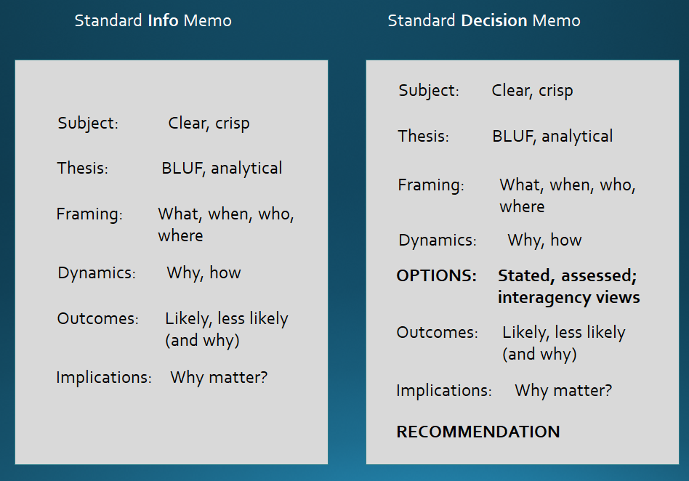
Structure

Slide 16
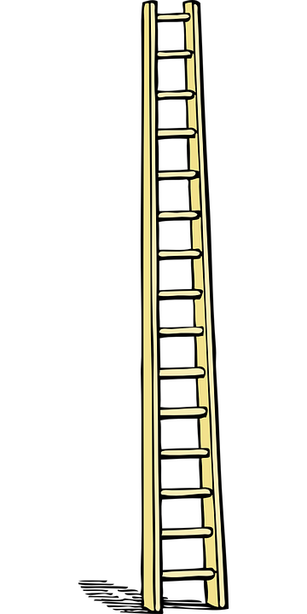
Abstractions
  office necessities
  sustenance
  protection from the elements
Words
Abstract things
  stationery
  food
  wardrobe
“Ladder of Abstraction”
Specific-general words
  writing utensil
  fruit
  clothing
Concrete things
  pen
  grapes
  socks
Notes:
“Motivation”

Slide 17
Grammar
and
Logic
grammar
Phrases
Clauses
logic, reason
Sentences
Paragraphs
Structure
Paper or Memo

Slide 18
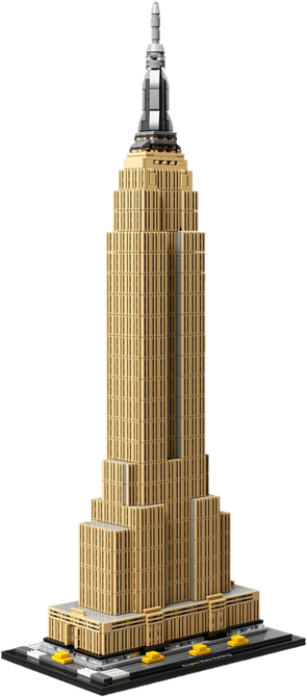
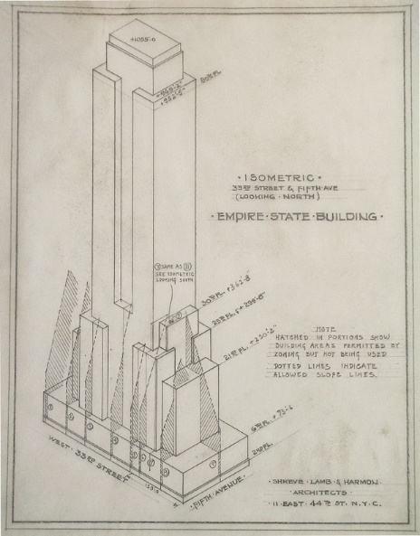
Build
blueprint
Hypothesis/Thesis
Evidence
and
words
paragraphs
sentences

Slide 19
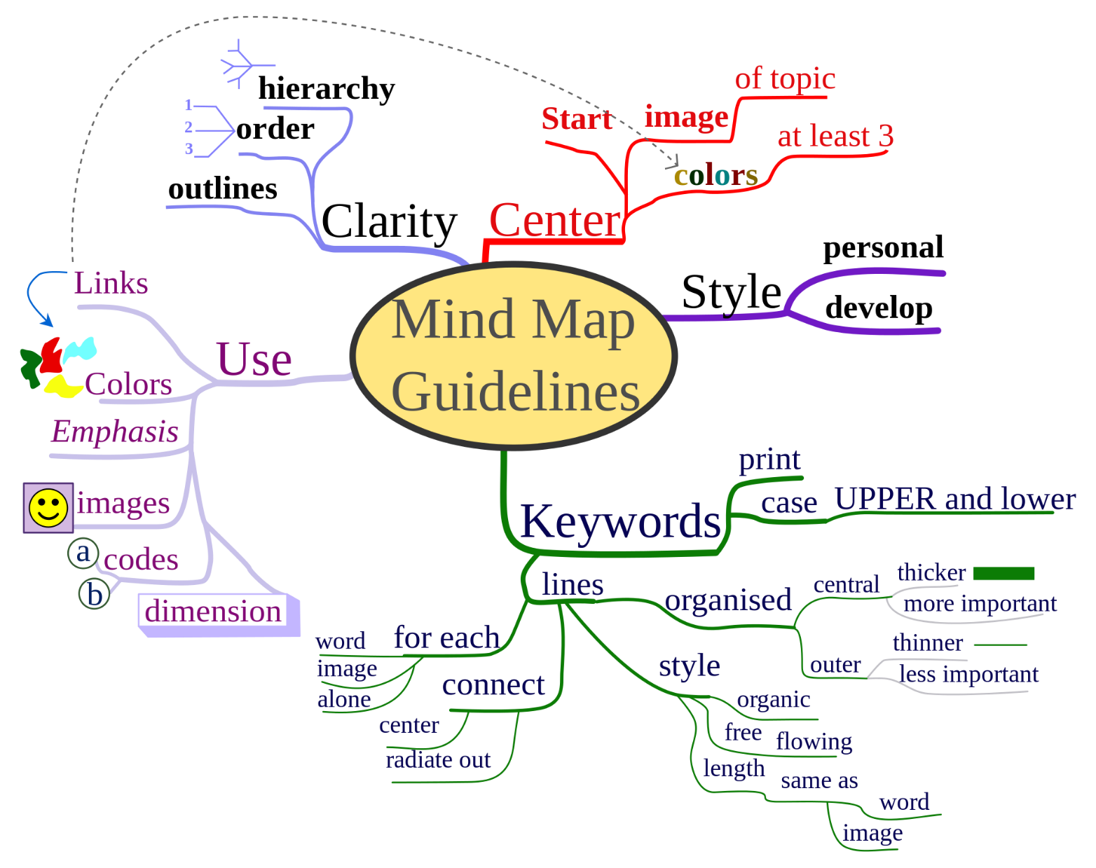
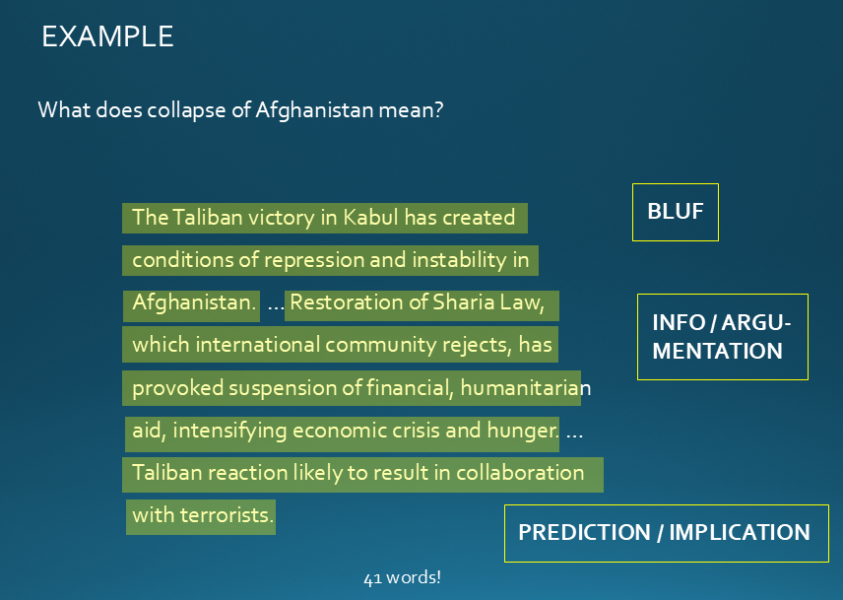
Tips and Tricks
Write a “snowflake.”
Do an analytical worksheet.
Have a friend interview you (and record it and transcribe it).
Draw a “mind map.”
Don’t fall in love with your words.
Keep moving as you draft; don’t seek perfection.

Slide 20




Self-edit!!!!
REMEMBER …
The first draft of everything we write
is – almost universally – loaded with sh_t.
The difference between good and bad writing is that we edit the sh_t out it.
BRILLIANT!

Slide 21

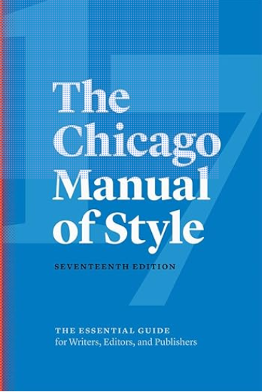
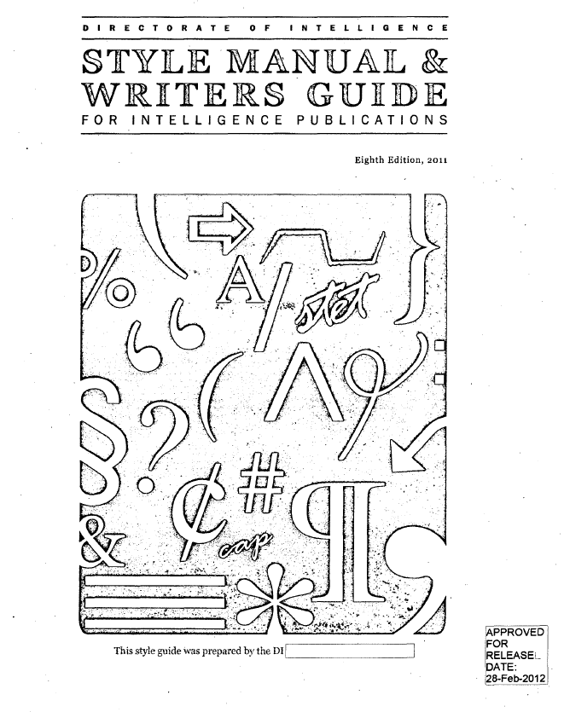
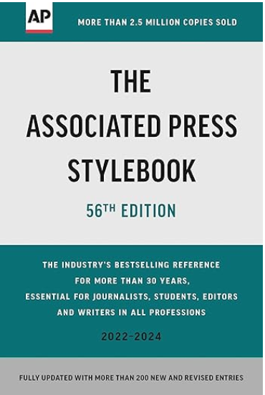
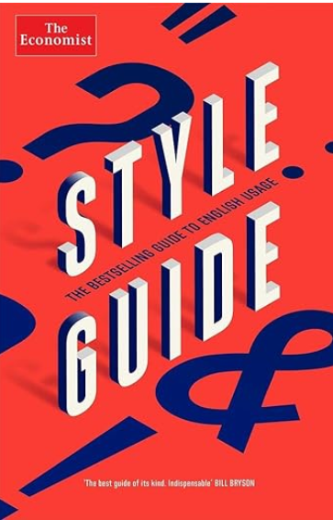
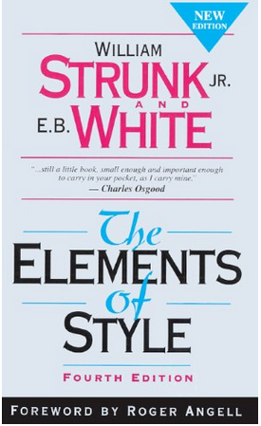
And …
Get a dictionary
… and style manual

Slide 22


Identify what’s needed.
It’s not a linear process
, but spiral.
Think and take on info.
Words → sentences → paragraphs.
Build, refine, and adjust.
Edit, edit, edit.
Be happy.

Slide 23
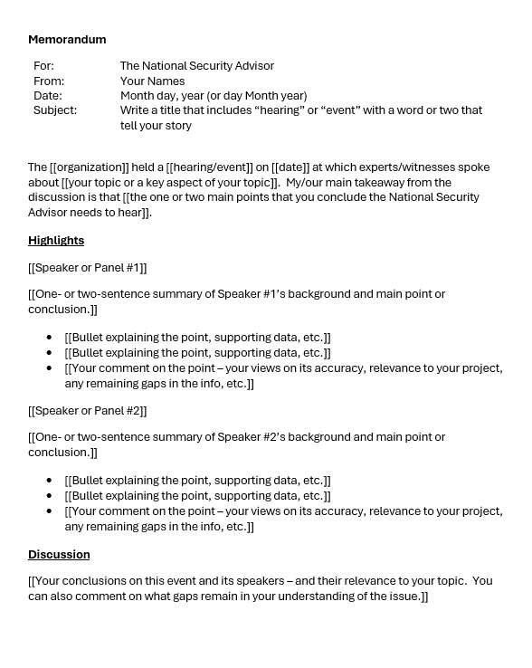
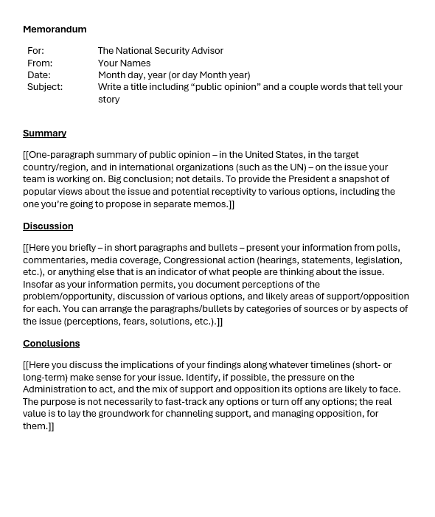
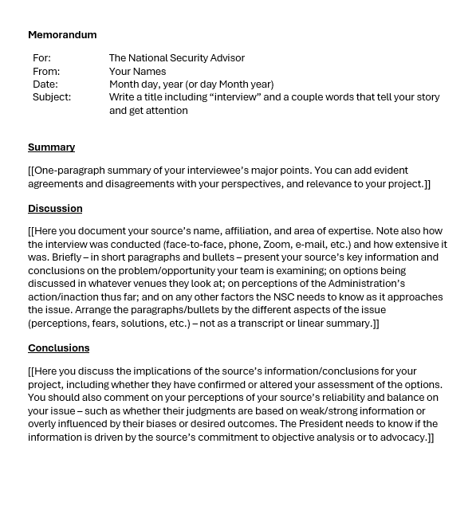
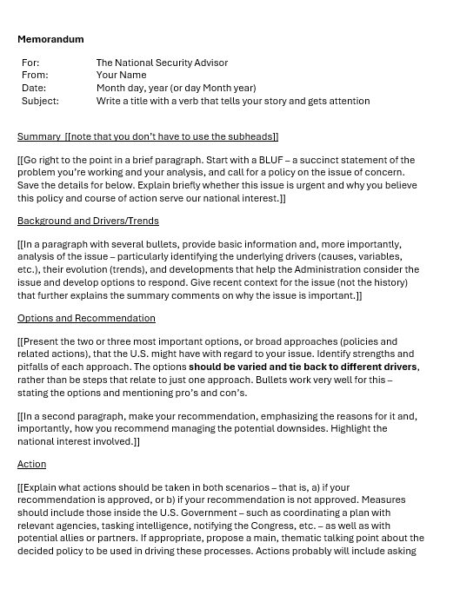
The Templates
402
401

Slide 24
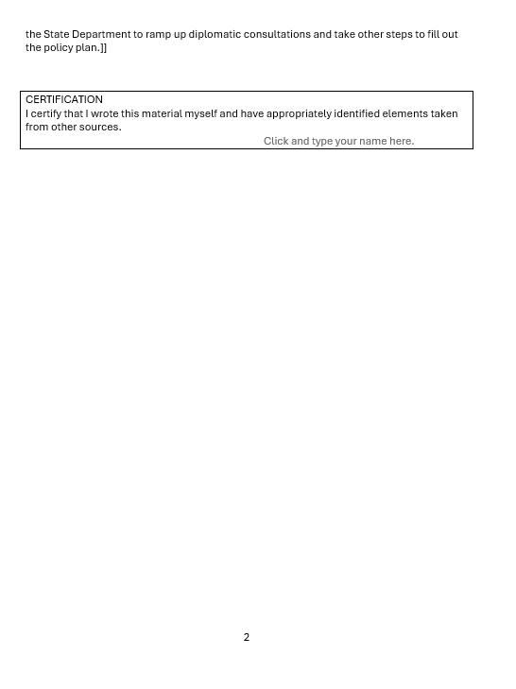
The Templates

Slide 27
QUESTIONS or COMMENTS?

Slide 28
PROJECT UPDATES

Slide 29
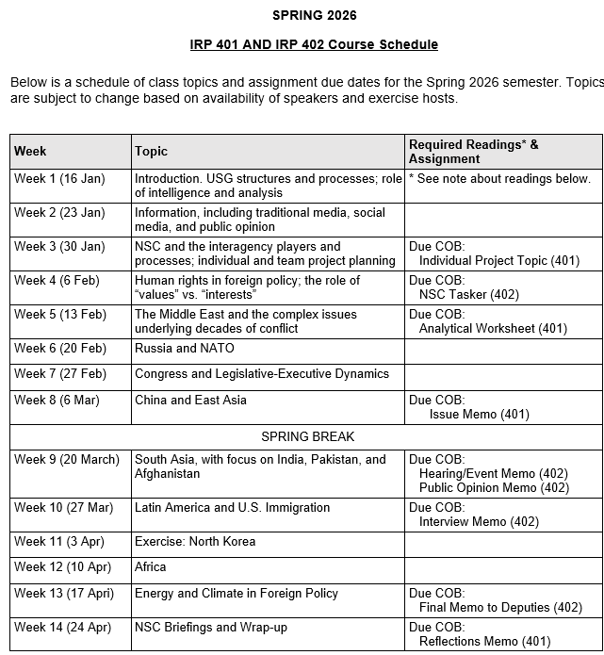
✓
✓
✓
✓
401
✓
✓
✓
✓
✓
✓
✓
✓
402
✓
✓
✓
✓
✓
✓
✓
✓
✓
✓
✓
✓
✓
✓
✓
✓
✓
✓
✓
✓
✓
✓
✓
✓

Slide 30
PROJECT PLANNING
Emmett | Countering “CRINK” Alignment | Danger of one-dimensional energy sector
John | Innovation and Environmental Capacity
Miles | Capitalism and Environment Protection | Climate change and refugees/sovereignty
Kennedy | Taiwan Prosperity and U.S. Interests
Eli | Prediction Markets | Iran-US relations
Michael | Foreign Manipulation of U.S. Elections
Diego | Russian Invasion of Ukraine | Globalization and environmental impact
Molisa | U.S.-China Competition in Critical Technologies
Kaiwen | U.S.-China Economic and Trade Competition | China’s Influence in Africa
Yvette | Rwanda-DRC Conflict and Resolution
Bijan | Housing Shortage and its Implications | Humanitarian Crisis in Gaza
Megha | Restrictive U.S. Immigration and Visa Policies
Filippo | Transatlantic Relations | North Korea illegal ops to support goals
David | ???? | ??????

Slide 31
DISCUSSION
Comfortable?
  Topics
  How partnership will work
The purposes
  Substance, process, skills
The elements
401
  Analysis
  “Memo #2”
402
  Proposal
  Hearing/event
  Public opinion
  Interviews
  DC memo
  Briefing

Slide 32

Don’t forget … there’s always help.

Slide 33
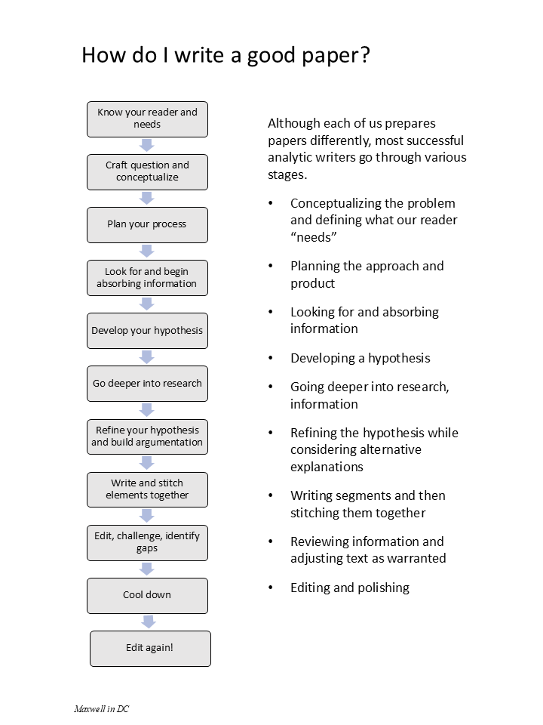
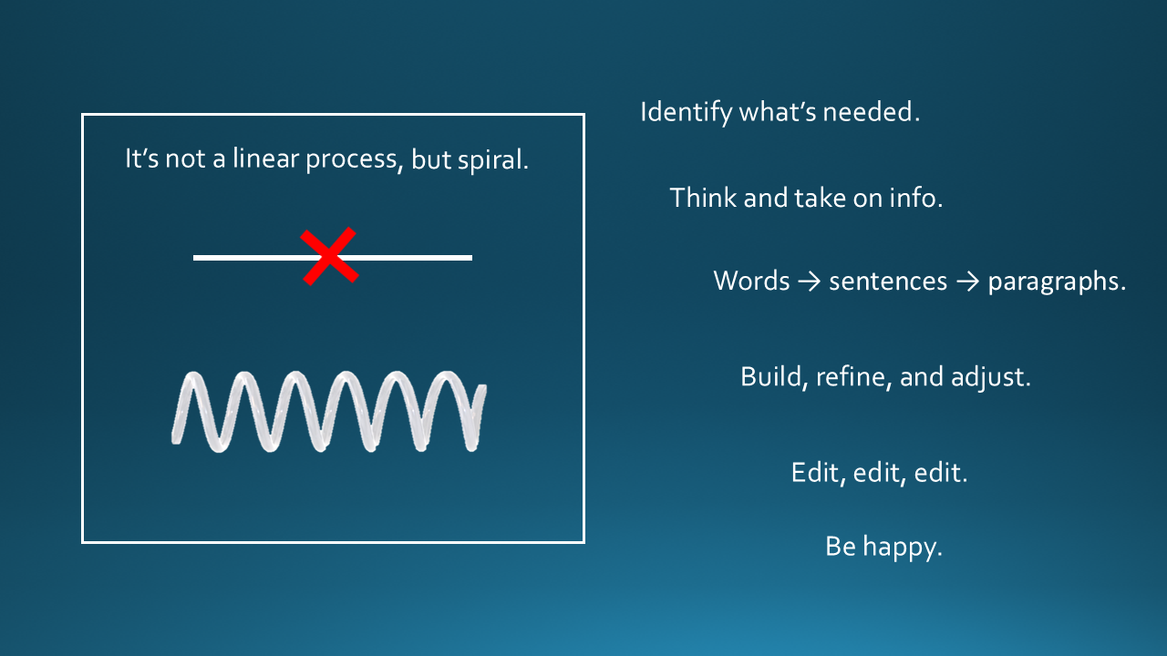
With practice, is there
any part of this you can’t do?

Slide 34
The Washington Memo
- Writing for Policymakers who Need to Make Decisions -
Fulton T. Armstrong
27 February 2026

