Slide 1

Advanced Word Processing
- Formatting, Tips, and Tricks -
Fulton T. Armstrong Friday 30 January 2026

Slide 2
Huh?
Why do I need to learn more about word processing?
Most of us write within institutions, and institutions have formats and styles.
Word processing software makes things easier.

Slide 3
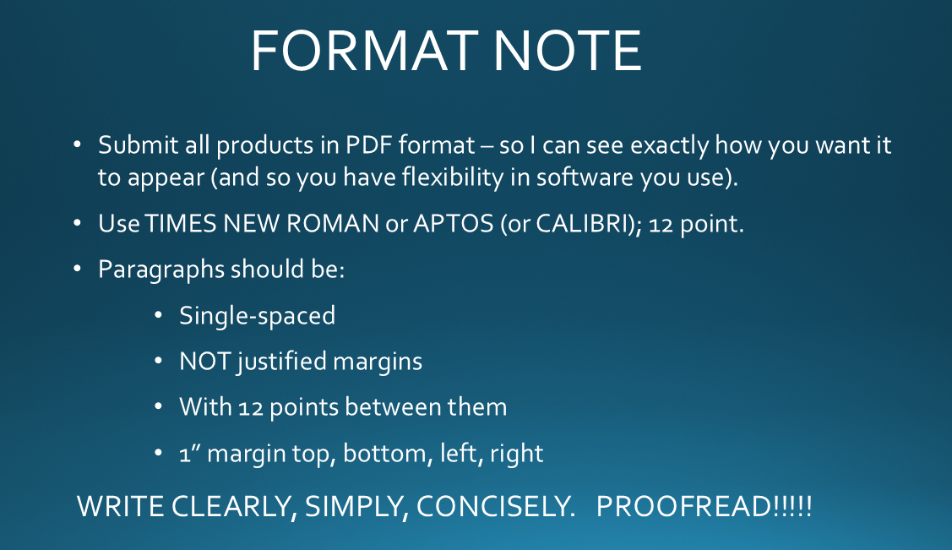
Example: Our styles

Slide 4
We’ll discuss …
the page
the word
the paragraph
the document
the editor
margins
page numbers
font
size
justification
line spacing
paragraph spacing
styles
page breaks
section breaks
track changes
spelling and grammar
A tool for managing a paper.
A tool for encrypting sensitive information.

Slide 5
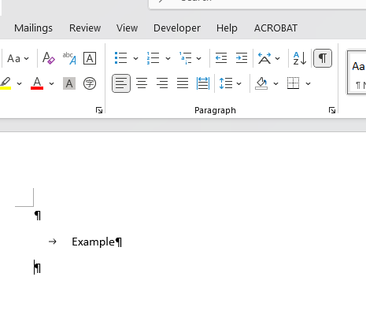
[[ Will set “show/hide” option to “show.” ]]
Googledocs:
View: Show non-printing characters

Slide 6
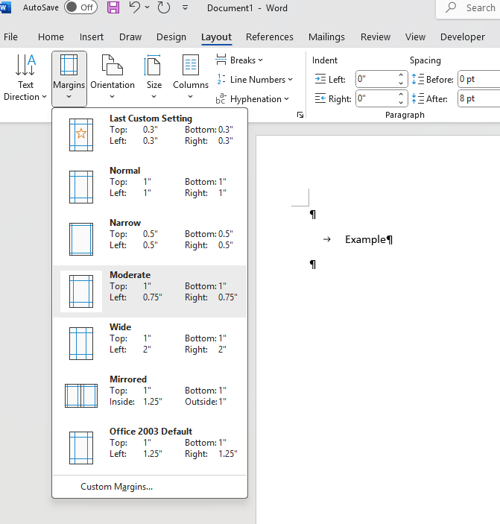
The PAGE
Margins

Slide 7
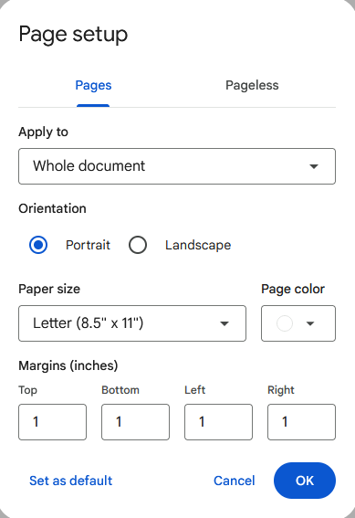
The PAGE
Googledocs
File >
Margins

Slide 8
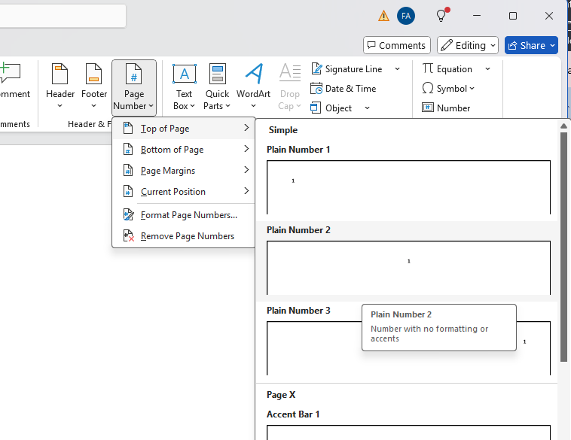
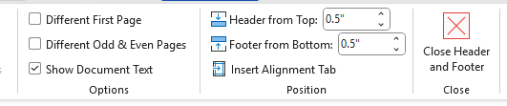
The PAGE
Page numbers

Slide 9
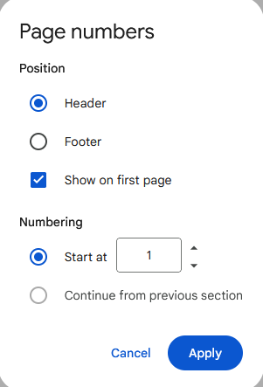
The PAGE
Googledocs
Format >
Page numbers

Slide 10
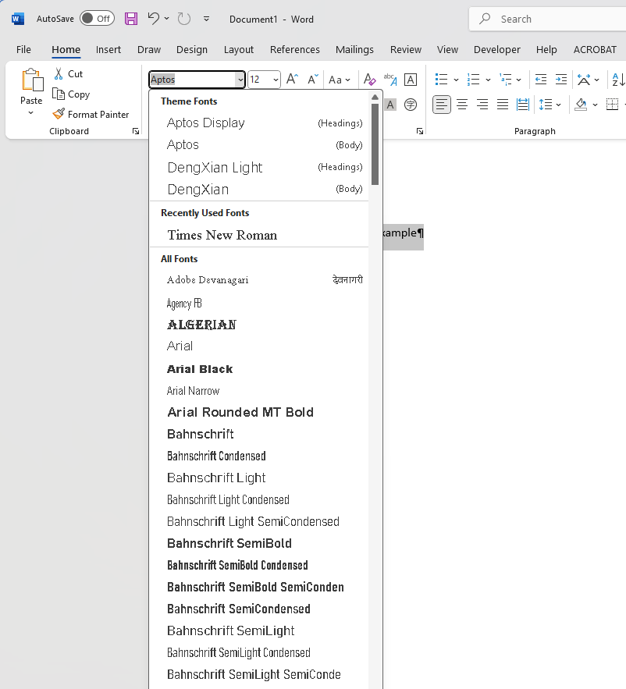
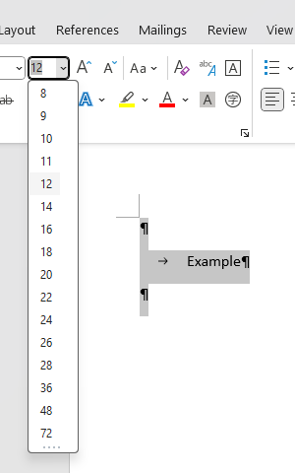
The WORD
font
size

Slide 11
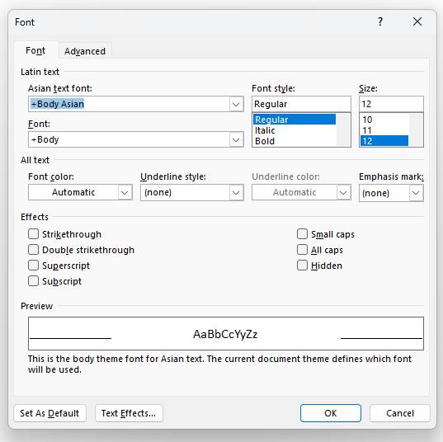
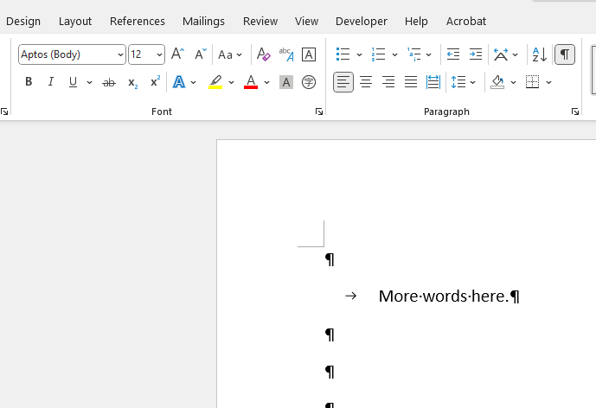
The WORD
font
size

Slide 12

The WORD
Googledocs
font
size
(drop-down list)

Slide 13
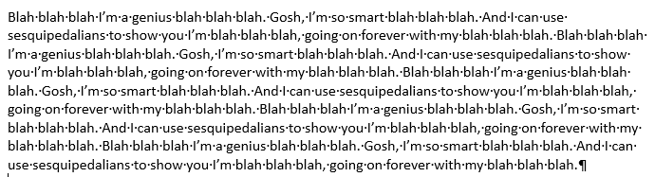
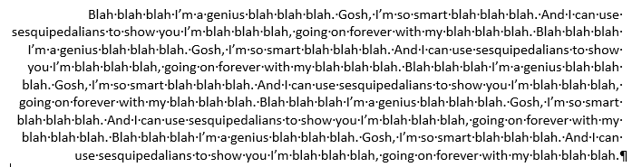
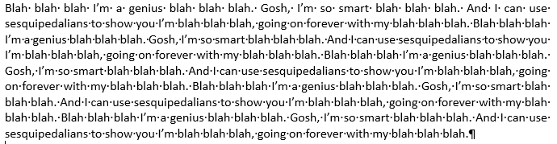
The PARAGRAPH
justification
Left
Right
Justified
Ugh

Slide 14
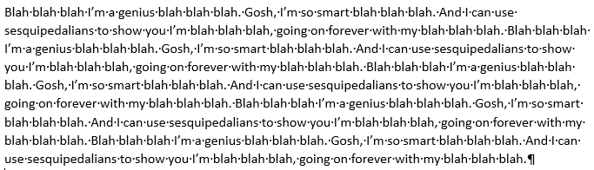
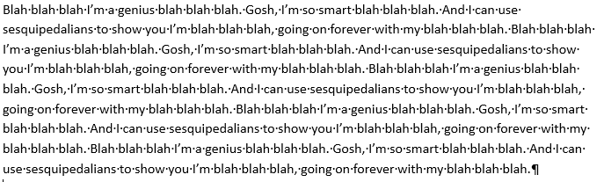
The PARAGRAPH
1.0
line spacing
1.08
1.16

Slide 15
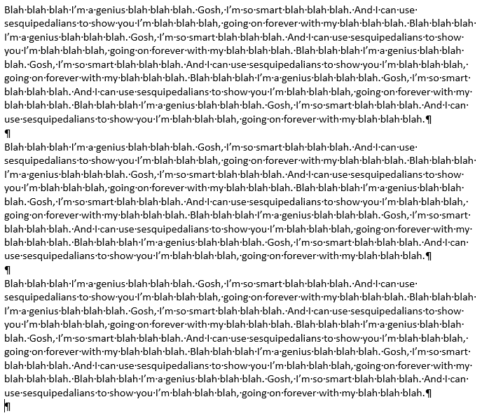
The PARAGRAPH
paragraph spacing

Slide 16
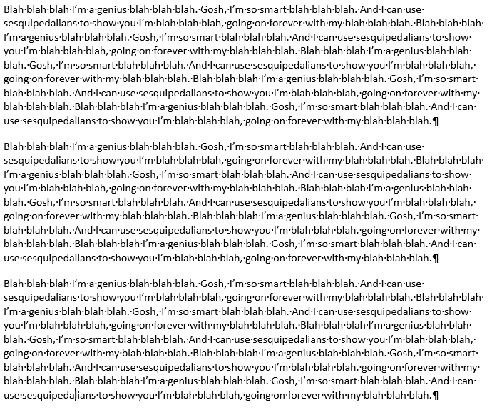
The PARAGRAPH
paragraph spacing

Slide 17
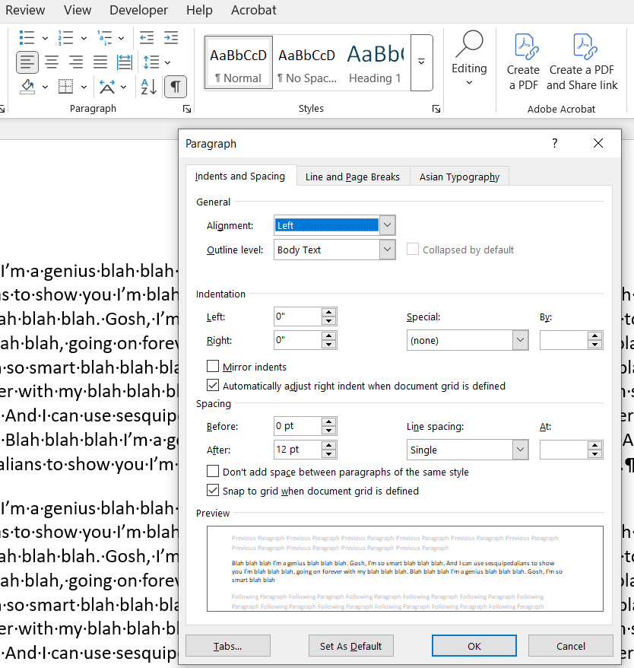
The PARAGRAPH
paragraph spacing

Slide 18
The PARAGRAPH
paragraph spacing
Why care about whether you make 12sp with formatting or with two returns?
Elegance
And … pagination

Slide 19
We don’t want “widows” and “orphans” stuck between our pages.
Single lines dangle at either the beginning or end of a block of text.
To keep from separating them,
we don’t use returns between paragraphs, and
we use “Widow/Orphan control”

Slide 20
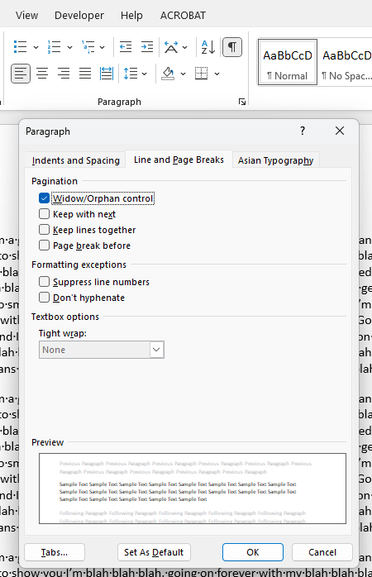

Slide 21
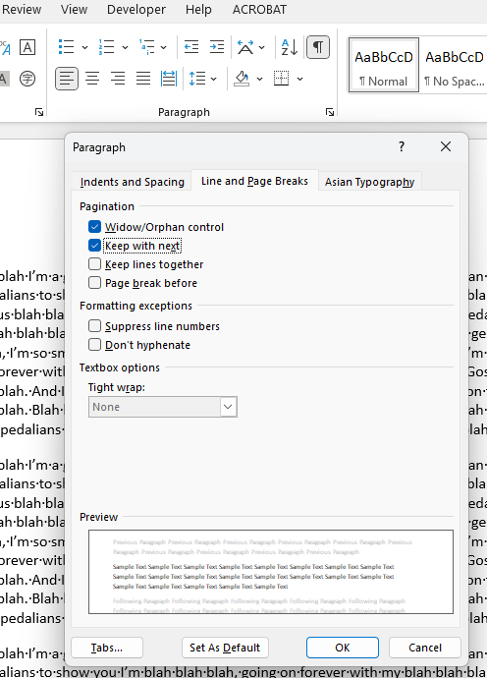
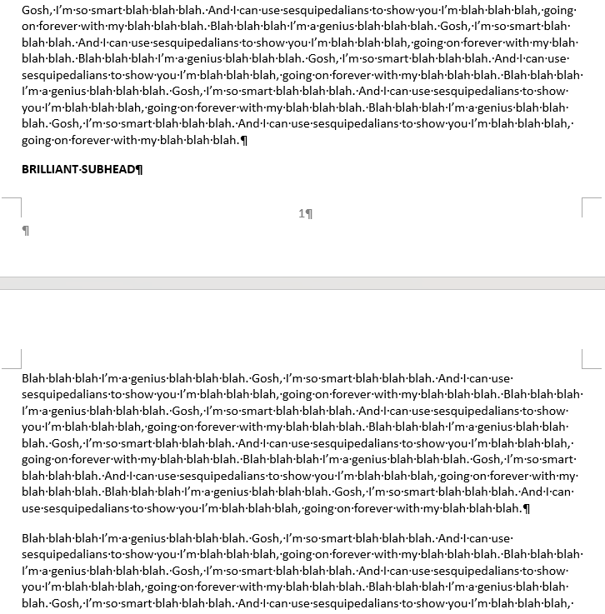
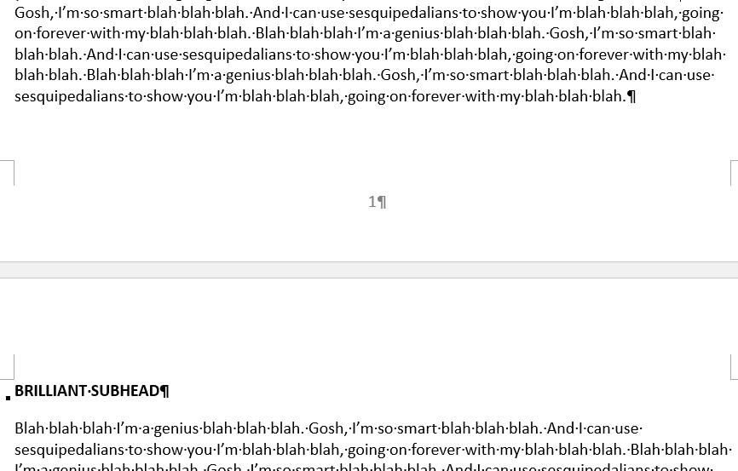
And we use “Keep with next” to avoid this problem:
Googledocs
under Format > Line & Paragraph Spacing uses …
Keep with next
Keep lines together
Prevent single lines
Add page break before

Slide 22
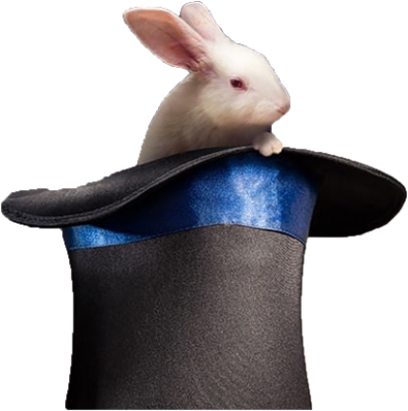
Now … a little
MAGIC !!!
Styles

Slide 23

Making and Using STYLES
fonts
and/or
paragraphs

Slide 24
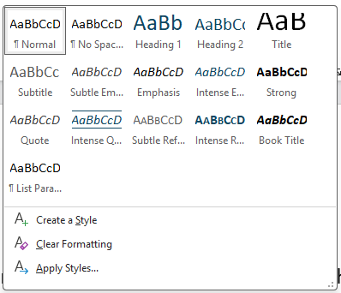
Making and Using STYLES
Already in this document, for you to use or change
Or you create your own

Slide 25
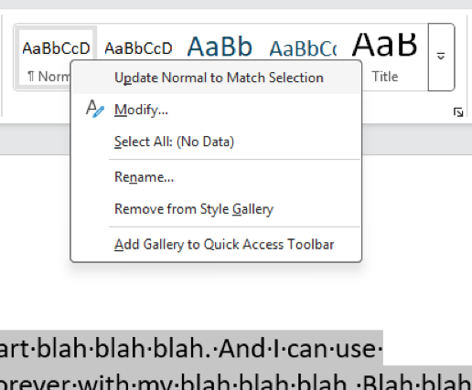
Making and Using STYLES
Very cool thing to do:
Make paragraph (font, spacing, etc.) as you want it.
Highlight it.
Either
right-click on an existing style
click on “Update xxxx to Match Selection”
And then … all paragraphs with that style are updated with your desired format.

Slide 26
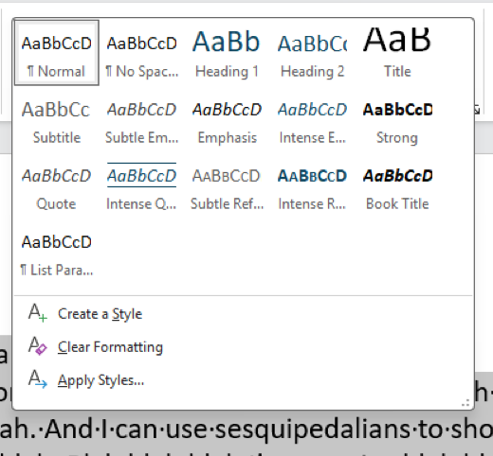
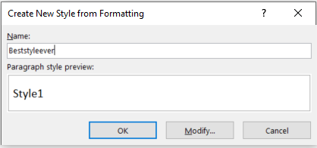
Making and Using STYLES
Very cool thing to do:
Make paragraph (font, spacing, etc.) as you want it.
Highlight it.
Or
make a new style.
give it a name
click ok or modify it
to use it, click into a paragraph, and click on the style
OK?

Slide 27
Making and Using STYLES
KEY THING:
The styles update the format (font and para) of every paragraph that you give that style (by clicking on it).
Example: You have a style called “subhead” that you want to change to a bigger font. Change the style, and it changes everywhere.

Slide 28
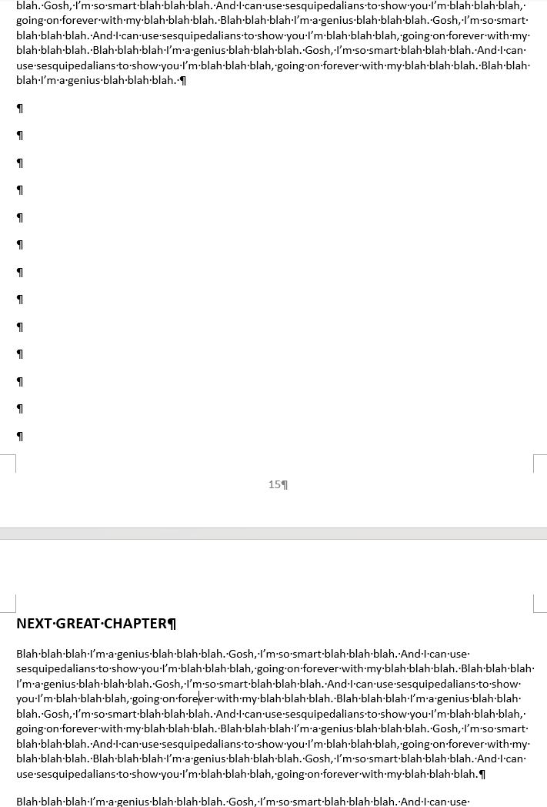
The DOCUMENT
Have you ever done this to force a new page?
page breaks

Slide 29
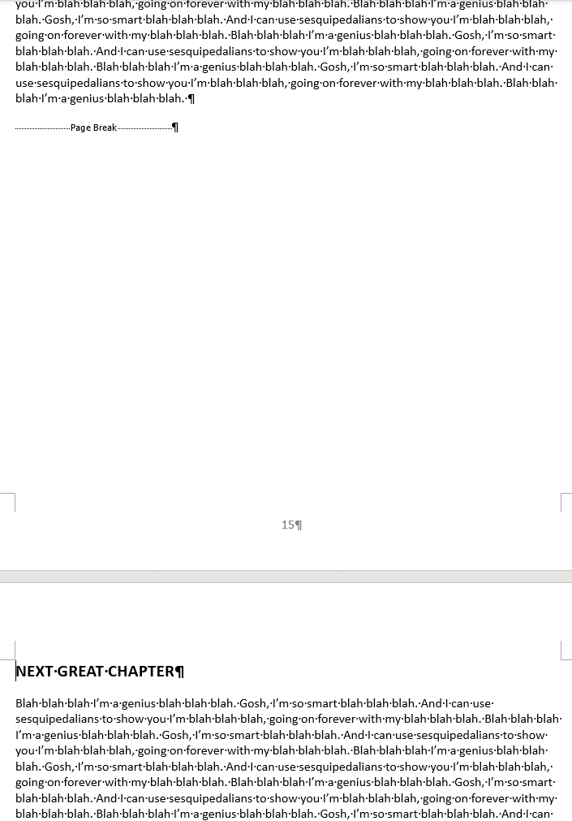
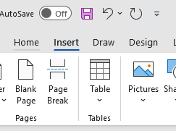
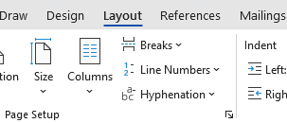
The DOCUMENT
Insert a “page break” instead.

Slide 30
The DOCUMENT
Like “page breaks” but much more powerful.
Can make major changes in layout, including portrait/landscape, reset page numbers, margins, and more.
But can also continue elements that you don’t want to change.
section breaks

Slide 31
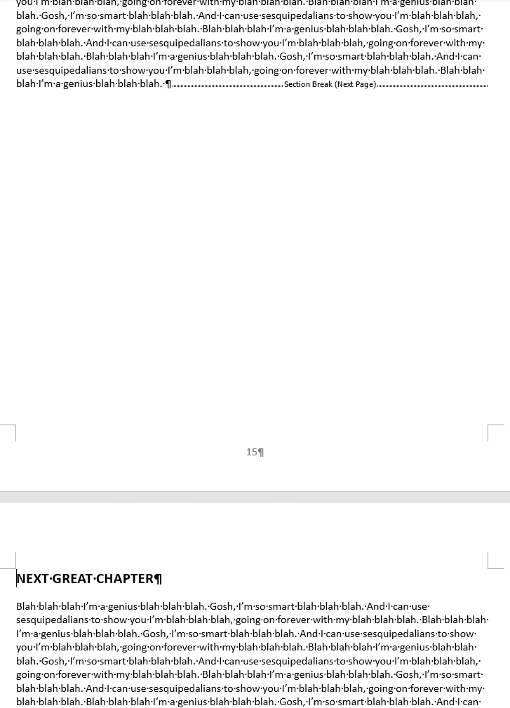
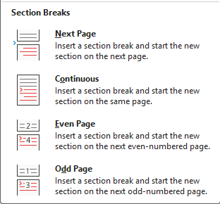
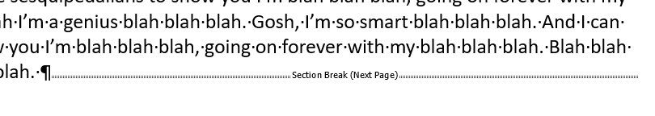

The DOCUMENT

Slide 32

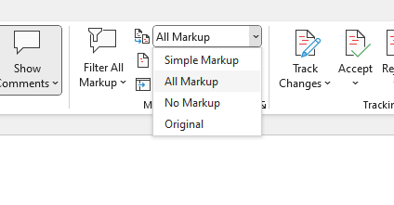
The EDITOR
track changes
→

Slide 33
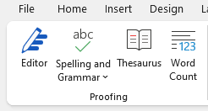
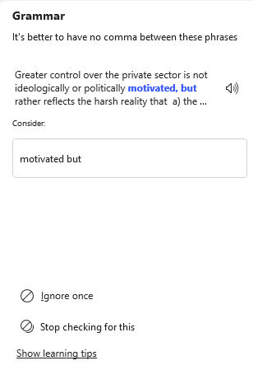
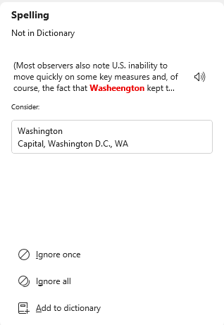
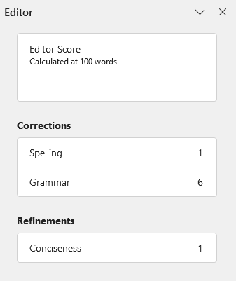
The EDITOR
spelling and grammar

Slide 34
The ORGANIZER
How best to manage our information and organize our paper?
(And not index cards)

Slide 35

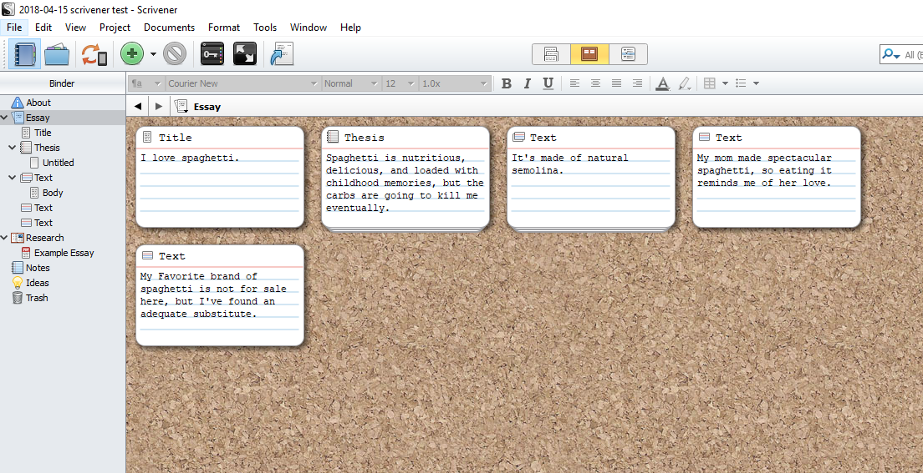
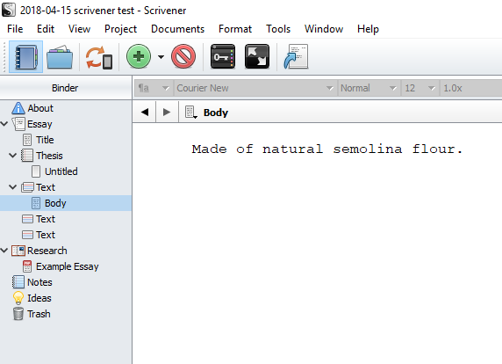
Scrivener software – to draft and organize

Slide 36
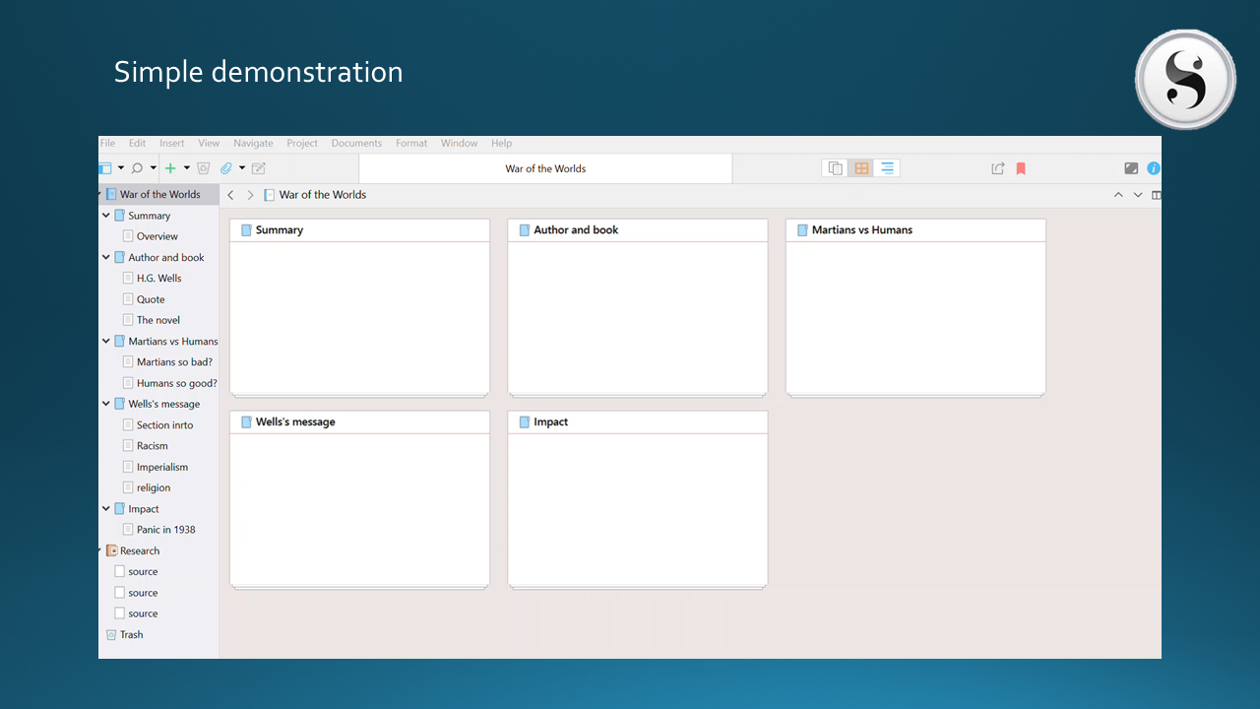
The elements that I’ve already developed.

Slide 37
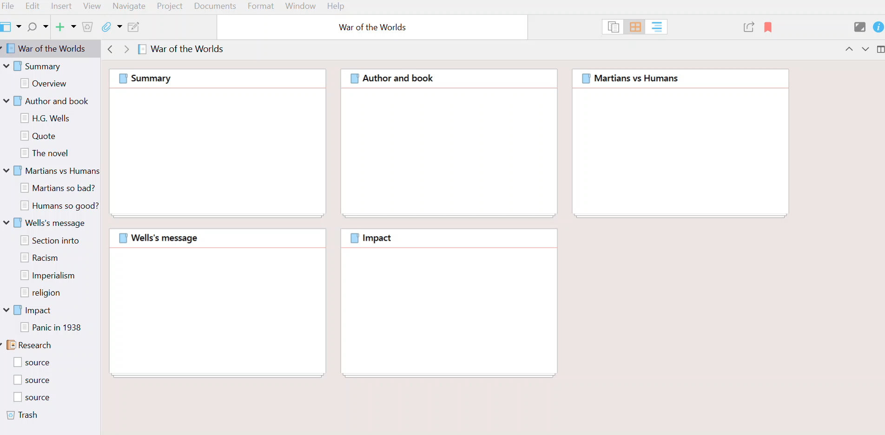
Simple demonstration

Slide 38
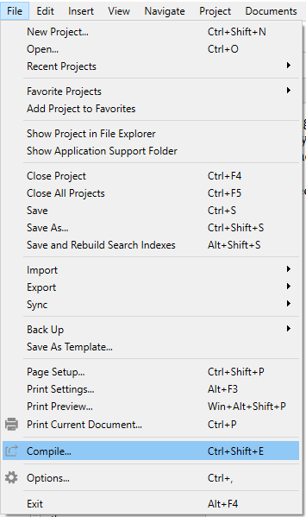
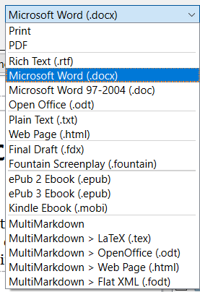
And when you’re ready …

Slide 39




The PROTECTOR
Several ways to use
Within a “point-to-point” e-mail or text system
Proton and others
WhatsApp, Signal, Telegram, and others
Within an open system, but …
Encrypted and embedded in your message
As an encrypted attachment
Or with a key word encoded
Encryption
EXAMPLES

Slide 40



creates a “virtual encrypted disk” within a file. It looks like a file on your drive, but when you double-click on it and enter a password, it looks like a drive with however many files you want to put on it.
is an open-source e-mail encryption standard that a number of companies use to build add-ons and clients, most of which are free.
is the original consumer-friendly encryption software used for documents, to create virtual drives, and as an e-mail plug-in.
(legacy)

Slide 41
At a minimum …
Put a good password/PIN on your device.
Use the “full-disk” encryption if available
BitLocker (Windows)
FileVault (Mac)

Slide 42

Encryption the “old-fashioned way”
“One-time pad”
Book code or book cipher

Slide 43
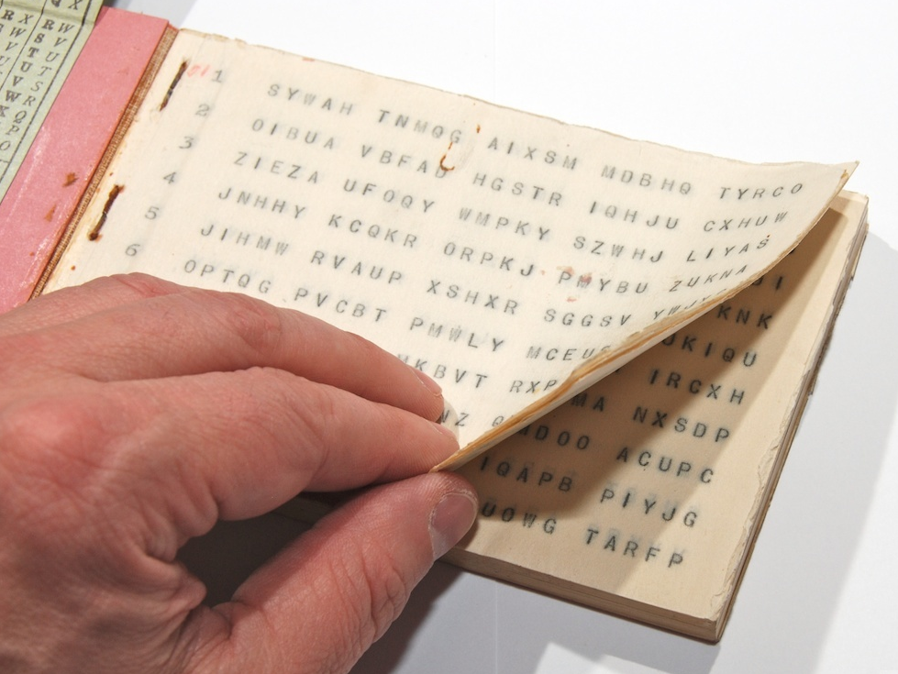
“One-time pad”
keys
A series of groups of letters
Two identical copies
Used agreed-upon day/time
Extremely secure (if pad is secure)
Notes:
NOTE FIVE GROUPS OF FIVE LETTERS – because A=0

Slide 44
“One-time pad”
keys
A series of groups of letters
Two identical copies
Used agreed-upon day/time
Extremely secure (if pad is secure)
AN EXAMPLE … Let’s say …
First key is SBMHR
Your requirement is: What is the enemy having for lunch?
Notes:
NOTE FIVE GROUPS OF FIVE LETTERS – because A=0

Slide 45
Key begins with: SBMHR
Message you want to send: PIZZA
Message: | P |  | I |  | Z |  | Z |  | A
Values: | 14 |  | 8 |  | 25 |  | 25 |  | 0
Key: | S |  | B |  | M |  | H |  | R
Values: | 17 |  | 1 |  | 12 |  | 7 |  | 16
Sum: | 5 |  | 9 |  | 11 |  | 6 |  | 16
Ciphertext: | F |  | J |  | L |  | G |  | R

Slide 46
Key begins with: SBMHR
Message you want to send: PIZZA
Message: | P |  | I |  | Z |  | Z |  | A
Values: | 14 |  | 8 |  | 25 |  | 25 |  | 0
Key: | S |  | B |  | M |  | H |  | R
Values: | 17 |  | 1 |  | 12 |  | 7 |  | 16
Sum: | 5 |  | 9 |  | 11 |  | 6 |  | 16
Ciphertext: | F |  | J |  | L |  | G |  | R
Notes:
Once again!!!

Slide 47
MSG from HQS:
What is the enemy going to eat for lunch?
Your encoded REPLY:
F J L G R
On subsequent mentions of PIZZA, you will not repeat F J L G R, because you’ll use a different key from the OTP.

Slide 48
“Book Code”
Two identical copies of a book
Commercially available; doesn’t look like a codebook
Flexible date/time
Caution: Vocabulary has to be appropriate to intelligence information

Slide 49
“Book Code”
page/line/word | 842914
paragraph/word | 1586

Slide 50
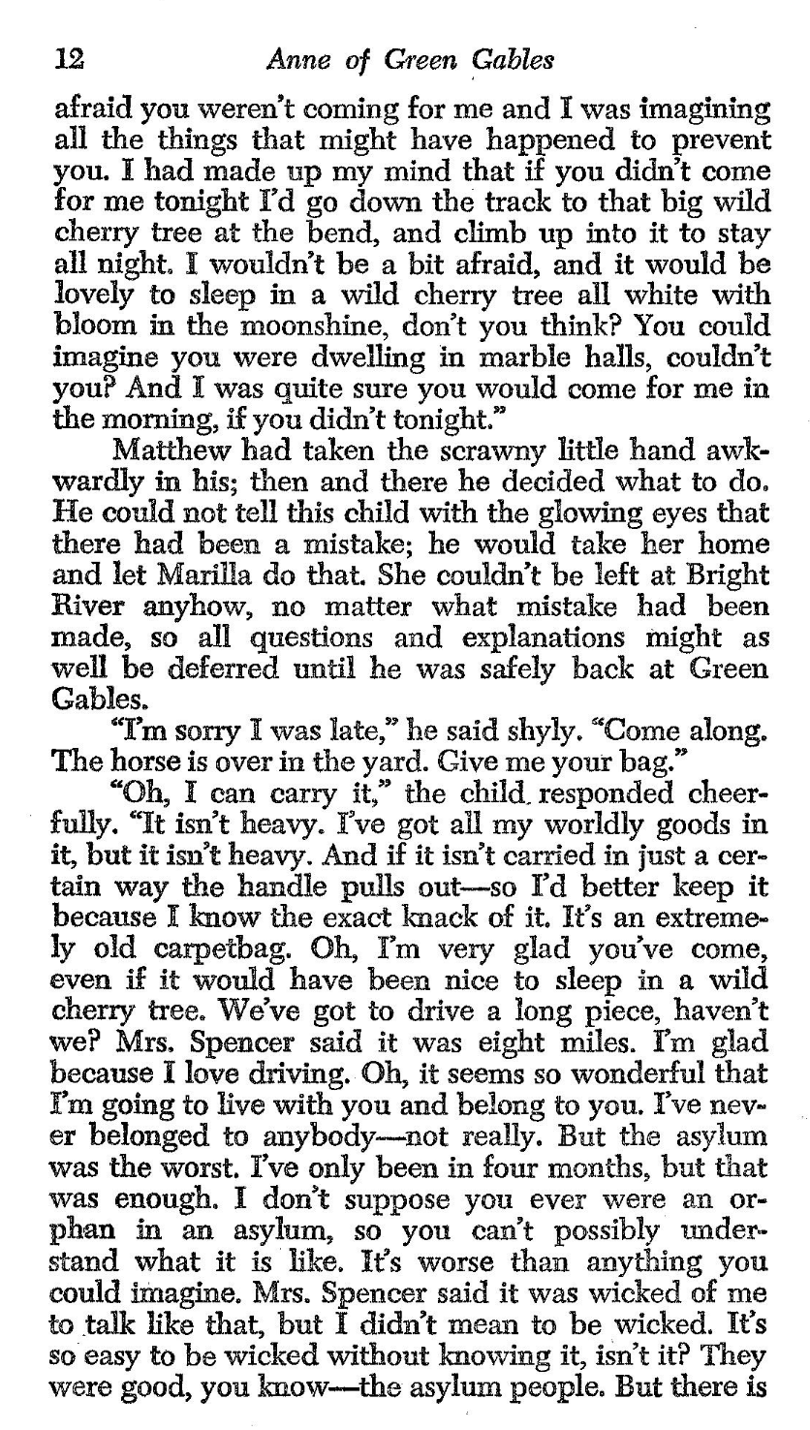
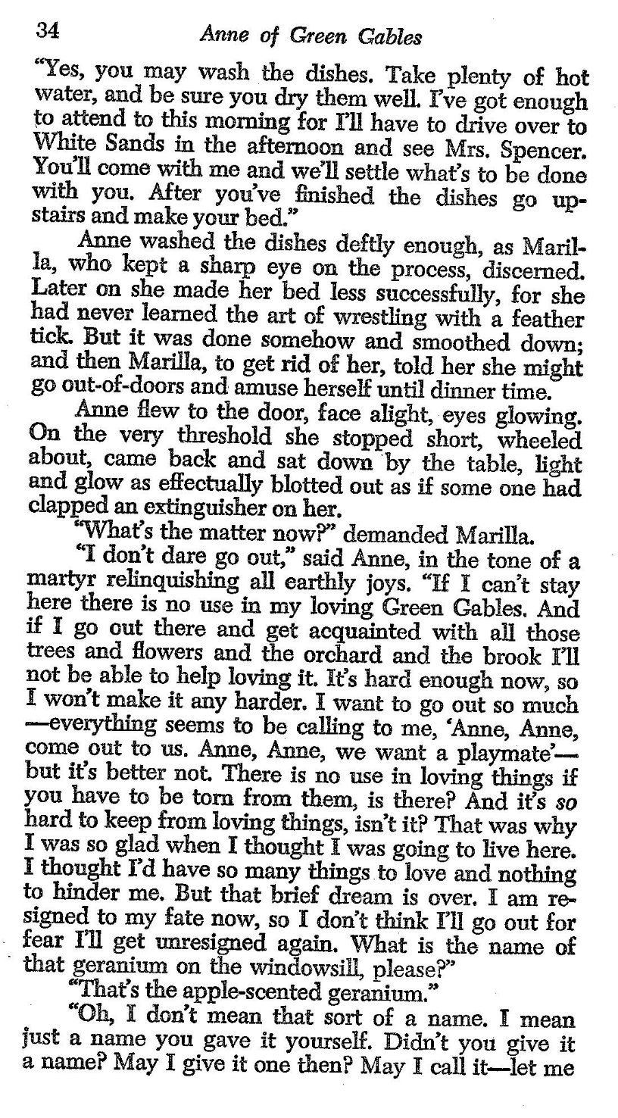
121003
343409
340102
I
LOVE
YOU

Slide 51
We’ve discussed …
the page
the word
the paragraph
the document
the editor
QUESTIONS?
TIPS TO SHARE?
A tool for managing a paper.
A tool for encrypting sensitive information.

Slide 52
Advanced Word Processing
- Formatting, Tips, and Tricks -
Fulton T. Armstrong Friday 30 January 2026

