Slide 1

Effective Analysis
- An Analytical Model for Making Information Actionable -
Fulton T. Armstrong
Friday
16 January 2026

Slide 2
What is analysis?
What is it about someone that makes you think, “That person is intelligent”?

Slide 3
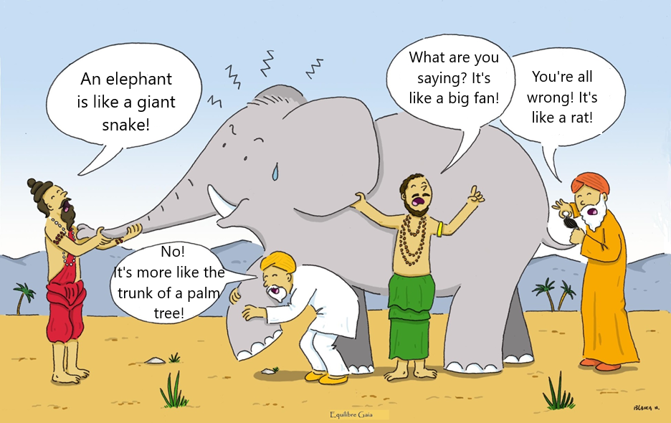
Indian Story: The Blind Men and the Elephant
Notes:
Somos como en la historia india … los ciegos que quieren entender qué es un elefante. Cada uno lo toca, pero nadie entiende qué es hasta que se unan sus observaciones.
Un analista de una agencia de inteligencia … o un académico … o un periodista … o un representante de un negocio … quizás tenga información interesante, pero no es inteligencia hasta que, como sociedad, se una lo que saben y opinan del fenómeno que están observando.

Slide 4
MECHANIC
DOCTOR
What is analysis?
SHRINK
CAREER
COUNSELOR
What would you think of a _______
Telling our readers or audiences …
What we know about what’s happening
Who, what, when, where, how many
But more importantly …
WHY it’s happening
HOW it’s happening
And WHAT WILL happen
and WHY we should care
who told you this?
but not this?
and gave you no ACTIONABLE analysis?

Slide 5
Why do we (or others) make mistakes?
Bad or inadequate information?
Inability to understand the meaning and consequences?
Unable or unwilling to take on new info?
Conflict of interest?
Too much pressure surrounding info or interpretation?
Unable to articulate info and/or analysis?
Sloppy presentation, with unclear bottom line?
Inability to get access to deliver message?
How can we improve?

Slide 6
My Main Bias:
Good information and good analysis are at the heart of ALL good policy.
And bad information and bad analysis are at the heart of ALL bad policy.
A SECOND bias:
There’s rarely a *single* right answer.

Slide 7
The Role of Intelligence: The Blind Men and the Elephant
First Purpose: Getting facts to say WHAT we perceive.
SECOND Purpose: Make sense of it -- what it means.
Notes:
Somos como en la historia india … los ciegos que quieren entender qué es un elefante. Cada uno lo toca, pero nadie entiende qué es hasta que se unan sus observaciones.
Un analista de una agencia de inteligencia … o un académico … o un periodista … o un representante de un negocio … quizás tenga información interesante, pero no es inteligencia hasta que, como sociedad, se una lo que saben y opinan del fenómeno que están observando.

Slide 8
The Role of Intelligence: The Blind Men and the Elephant
Are they developing good analysis?
Notes:
Somos como en la historia india … los ciegos que quieren entender qué es un elefante. Cada uno lo toca, pero nadie entiende qué es hasta que se unan sus observaciones.
Un analista de una agencia de inteligencia … o un académico … o un periodista … o un representante de un negocio … quizás tenga información interesante, pero no es inteligencia hasta que, como sociedad, se una lo que saben y opinan del fenómeno que están observando.

Slide 9
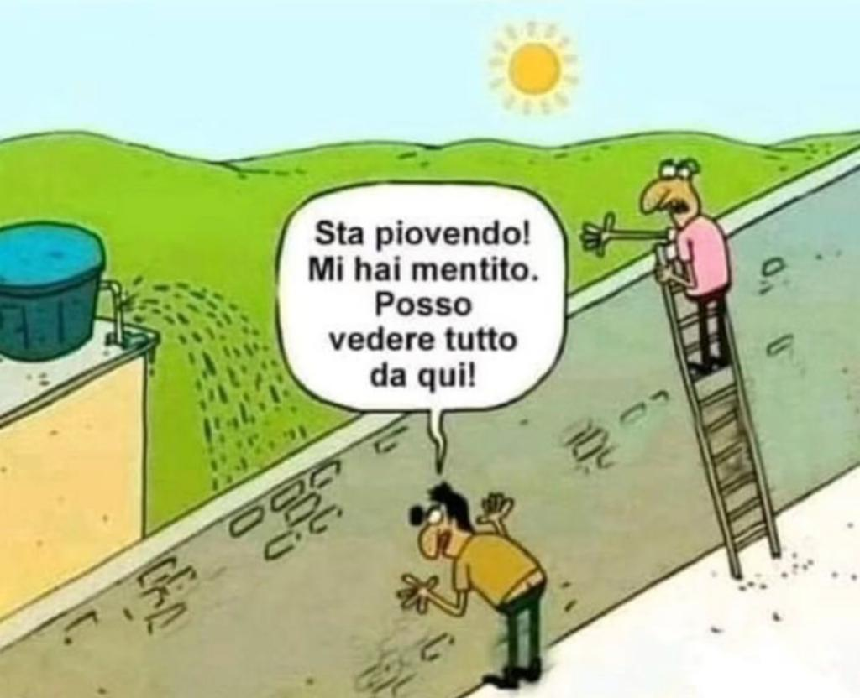
Italian version: Two men and a wall
It's raining!!! You lied! I can see everything from
here!!!
Both are “right” … and
Both are wrong.
Does this help?
Notes:
Somos como en la historia india … los ciegos que quieren entender qué es un elefante. Cada uno lo toca, pero nadie entiende qué es hasta que se unan sus observaciones.
Un analista de una agencia de inteligencia … o un académico … o un periodista … o un representante de un negocio … quizás tenga información interesante, pero no es inteligencia hasta que, como sociedad, se una lo que saben y opinan del fenómeno que están observando.

Slide 10
More important than ever.

Slide 11
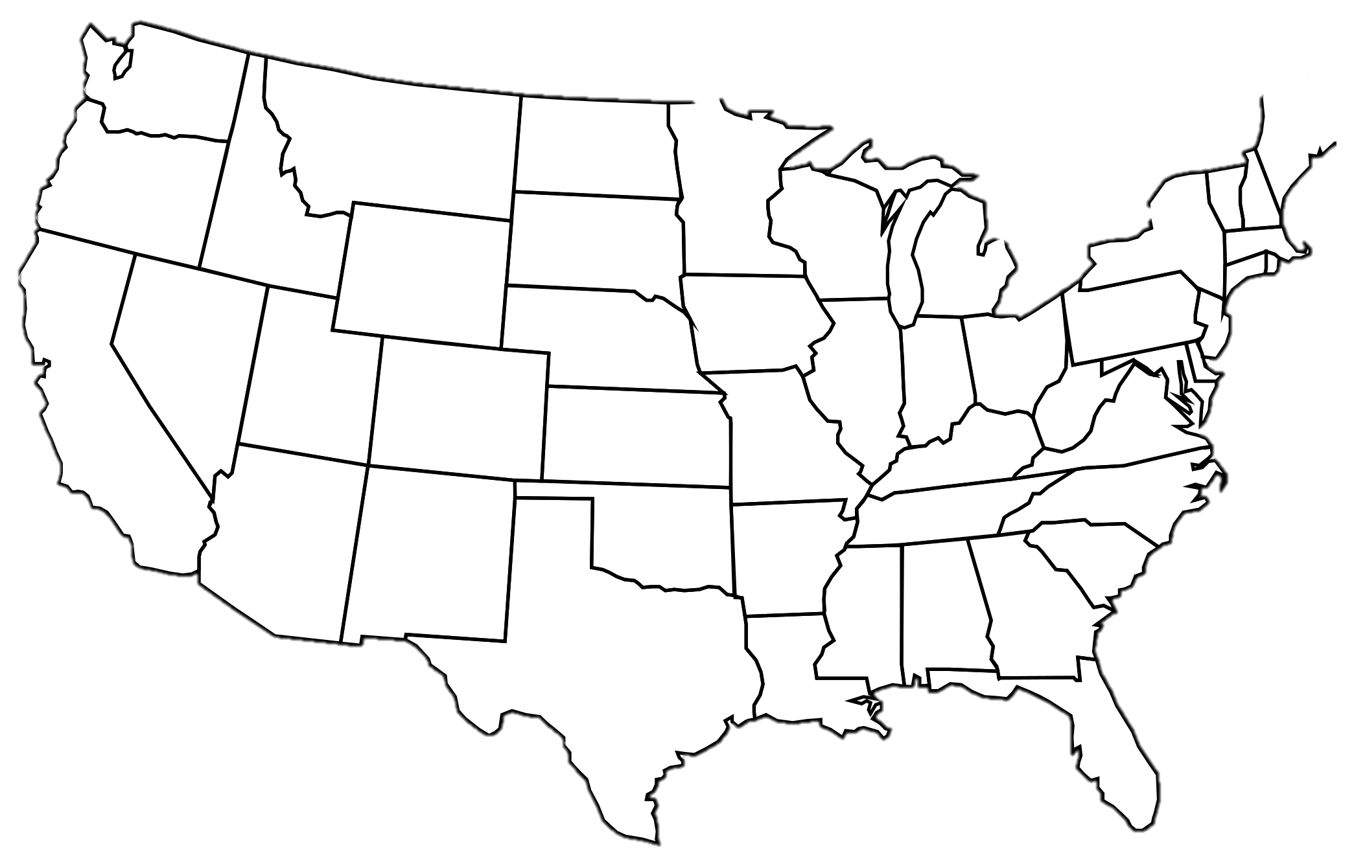

Simultaneous Crises
Distrust
Violence and Crime
Three Branches:
Executive
Legislative
Judicial
Uncertainty
Economy
Culture wars
Fake news
Traditional media
Politicization of religion
Institutions
Scientists
Journalists
Academics
Clergy
Race issues
Inequality
Environmental challenges

Slide 12
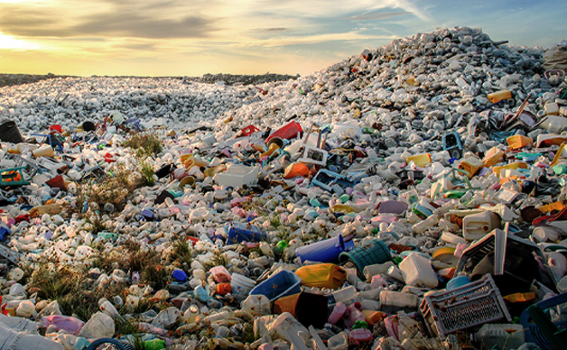
GARBAGE
FAKE NEWS
CHALLENGE | LEADERSHIP
CONSPIRACY THEORIES
CHALLENGE | FOLLOWERS
DISINFORMATION
CHALLENGE | INTELLIGENCE Information Analysis Communication
MANIPULATION
“ANTI-INTELLIGENCE”

Slide 13
Fulton T. Armstrong
A spontaneous career in information, analysis, policy and politics
Forty years of analysis
Linguistics and study in Spain
journalism in Taiwan
U.S. House of Representatives
CIA
State Department
National Security Council
National Intelligence Council
U.S. Military – Intelligence Advisor
U.S. Senate
SU … AU … and others

Slide 14
What do decision-makers need?
What is intelligence?
What is analysis?
Once we have a defined analytical question …
Once we have some basic information …
What is our FIRST analytic contribution on an issue?
And how do we do it?

Slide 15
Evaluate the reliability of the “facts”
Let’s play a game…
What do we see and believe in the following video and pictures?

Slide 16
A bystander takes a video of something they saw.
Posts it in social media,
as an example of “police incompetence.”
What is happening?
How do we know?

Slide 17
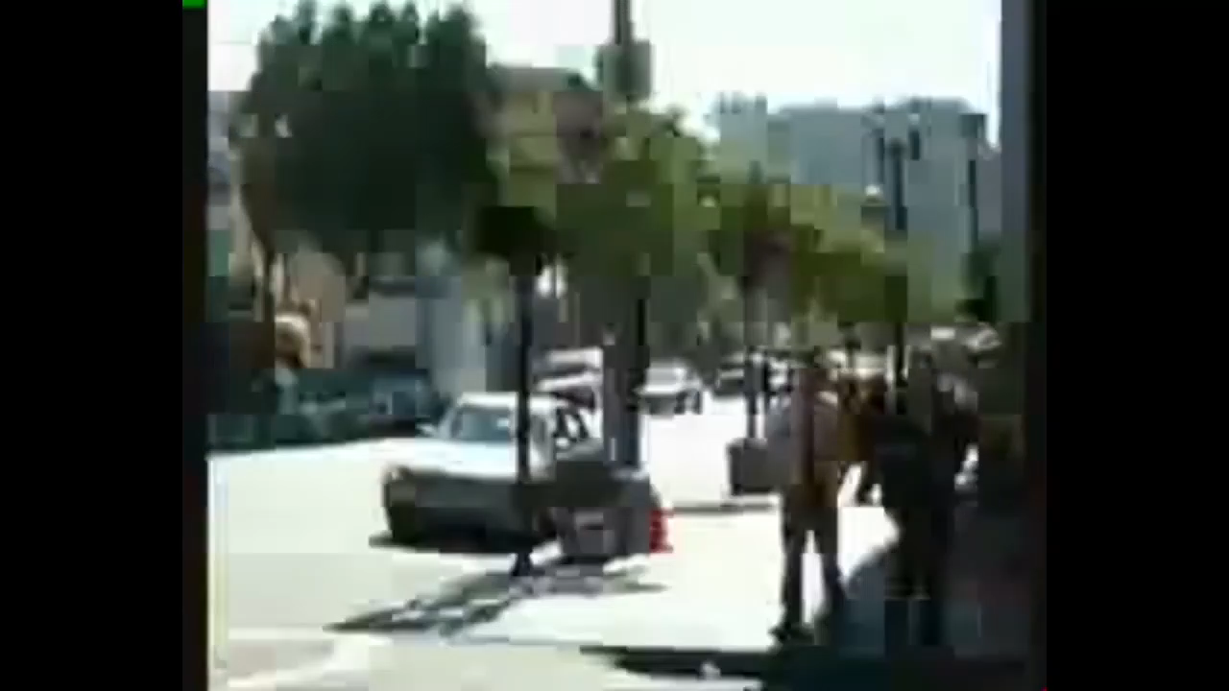
What happened?

Slide 18
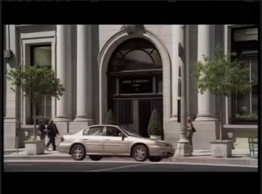

Slide 19
How do we know what we “know”?
What’s REAL and what’s FAKE?
Exercise #2: Real or Fake?

Slide 20
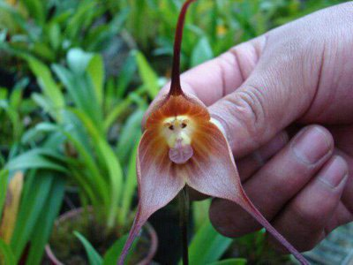
Is this orchid blossom real or fake?
Real
Notes:
HOW DO YOU KNOW??

Slide 21
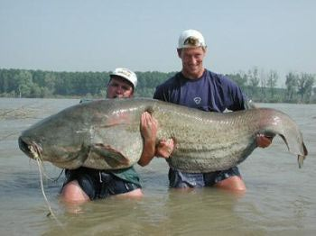
Is this catfish real or fake?
Real
Notes:
HOW DO YOU KNOW??

Slide 22
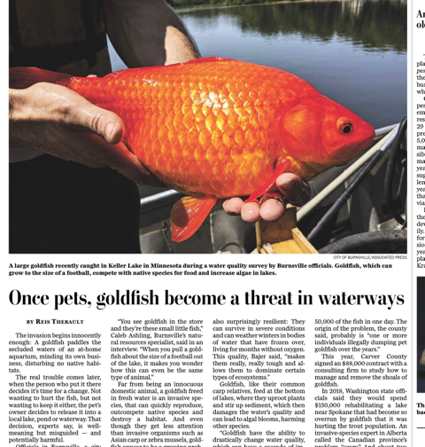
Is this goldfish real or fake?
Real

Slide 23
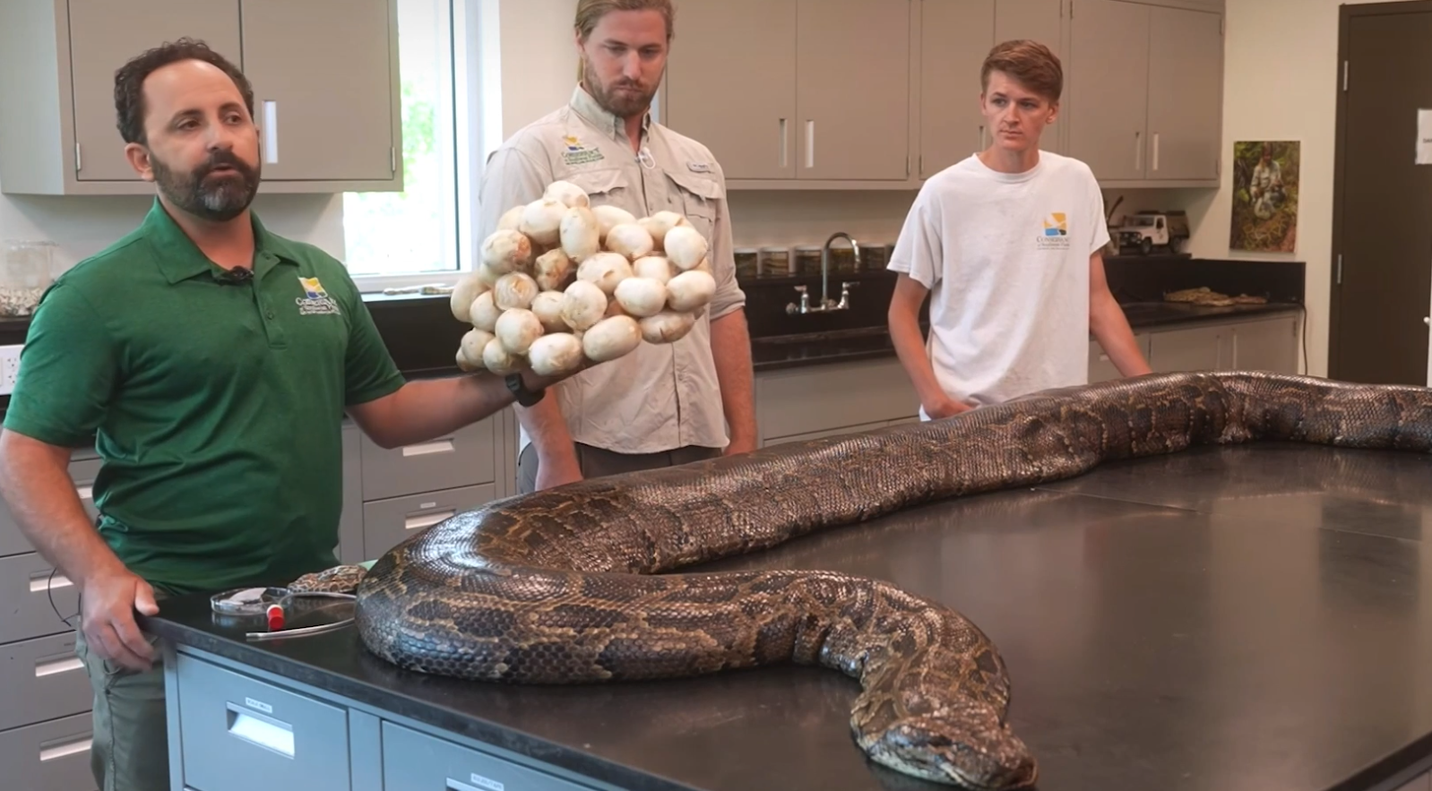
Is this Burmese Python (98kg and 5.5m) found in Florida real or fake?
Real
Notes:
HOW DO YOU KNOW??

Slide 24
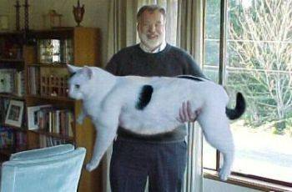
Is this house cat real or fake?
FAKE
Notes:
HOW DO YOU KNOW??

Slide 25
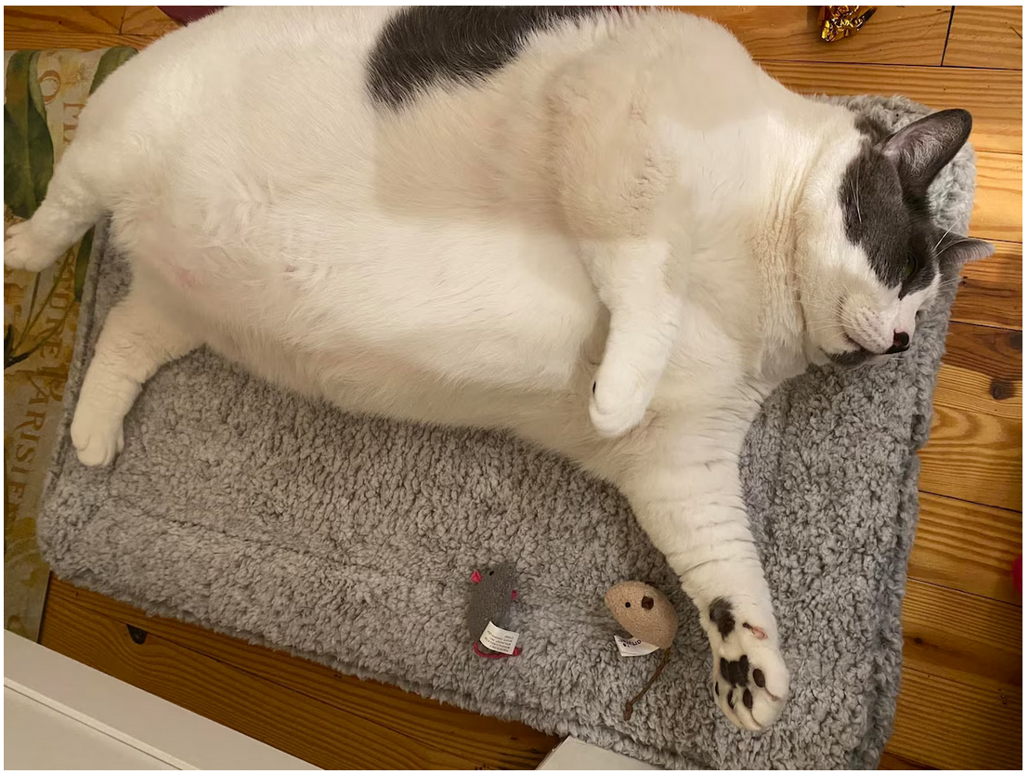
Real
Is this house cat real or fake?

Slide 26
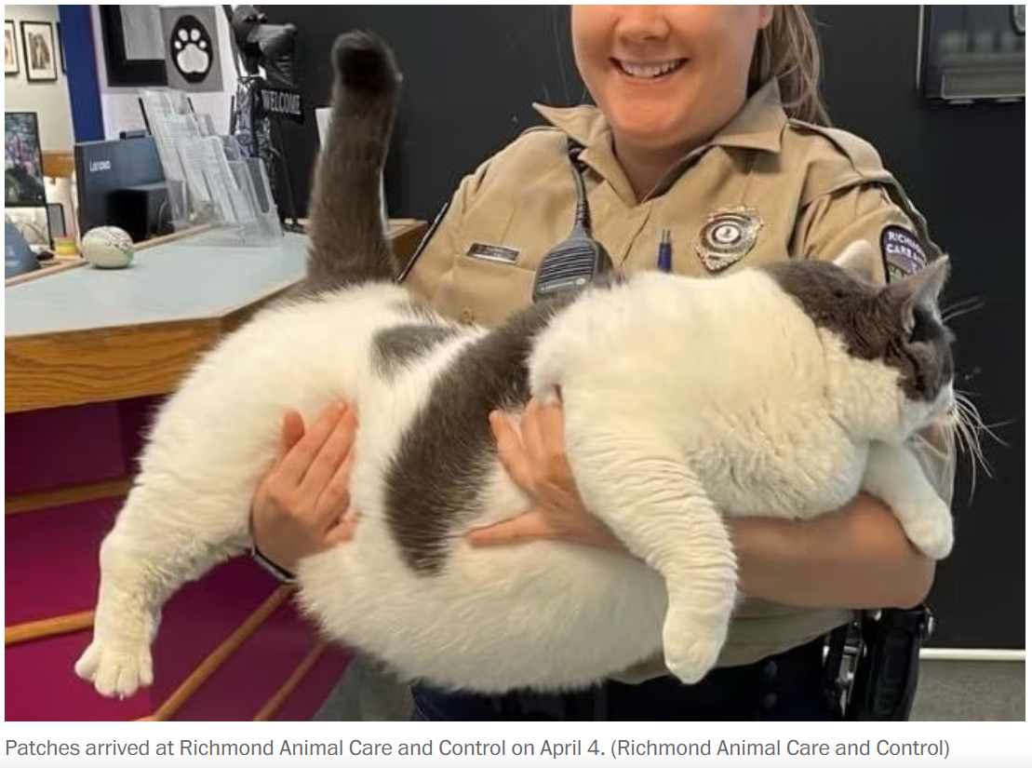
Washington Post 27 Apr 2023 (18kg)

Slide 27
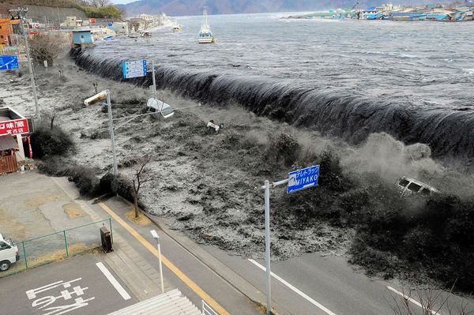
Is this tsunami in Miyako, Japan, real or fake?
Real
Notes:
HOW DO YOU KNOW??

Slide 28
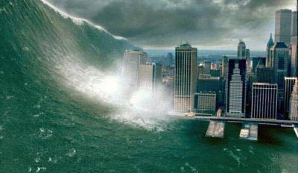
Is this tsunami in New York City real or fake?
FAKE
Notes:
HOW DO YOU KNOW??

Slide 29
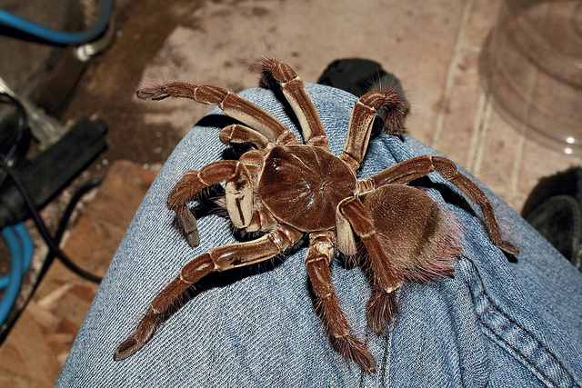
Is this goliath birdeater tarantula real or fake?
Real

Slide 30
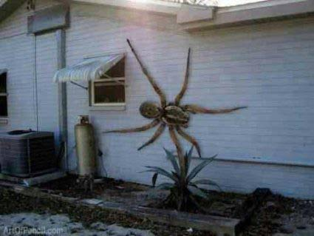
Is this wall spider in a beach town real or fake?
FAKE
Notes:
HOW DO YOU KNOW??

Slide 31
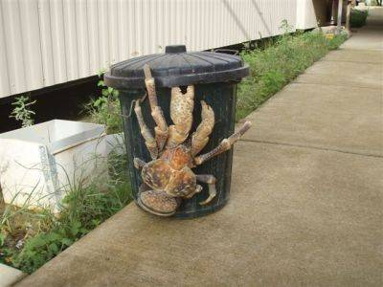
Is this coconut crab real or fake?
Real
Notes:
HOW DO YOU KNOW??

Slide 32
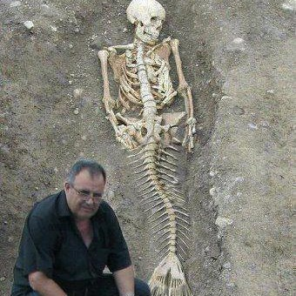
Is this mermaid skeleton found near the Black Sea real or fake?
FAKE
Notes:
HOW DO YOU KNOW??

Slide 33
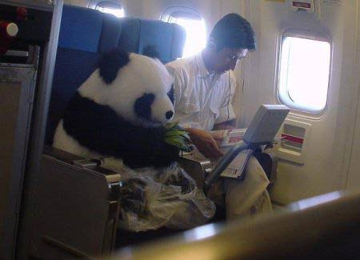
Is this flying panda real or fake?
FAKE
Notes:
HOW DO YOU KNOW??

Slide 34

Bark Air — $6,650 from New Jersey to Los Angeles
REAL
Notes:
HOW DO YOU KNOW??

Slide 35
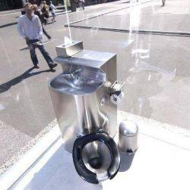
Is this public toilet with one-way glass walls
real or fake?
Real
Notes:
HOW DO YOU KNOW??

Slide 36
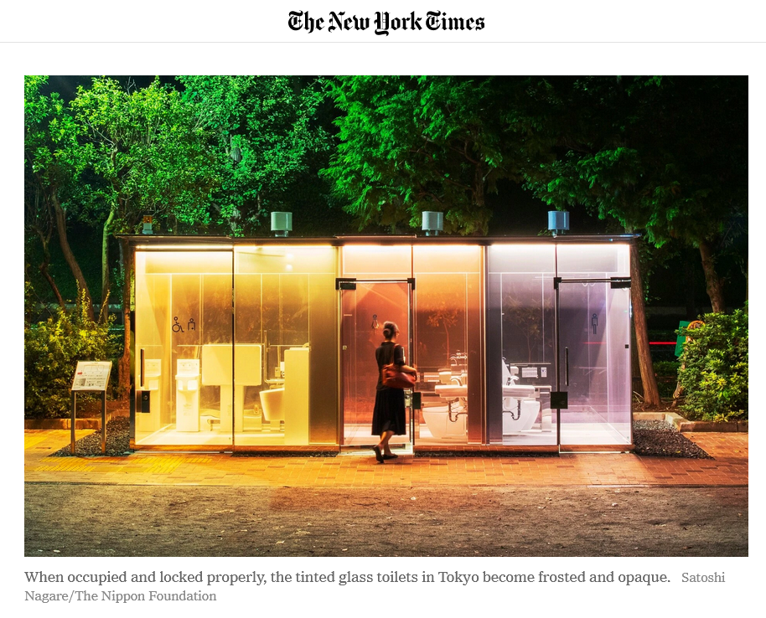
19 August 2020

Slide 37
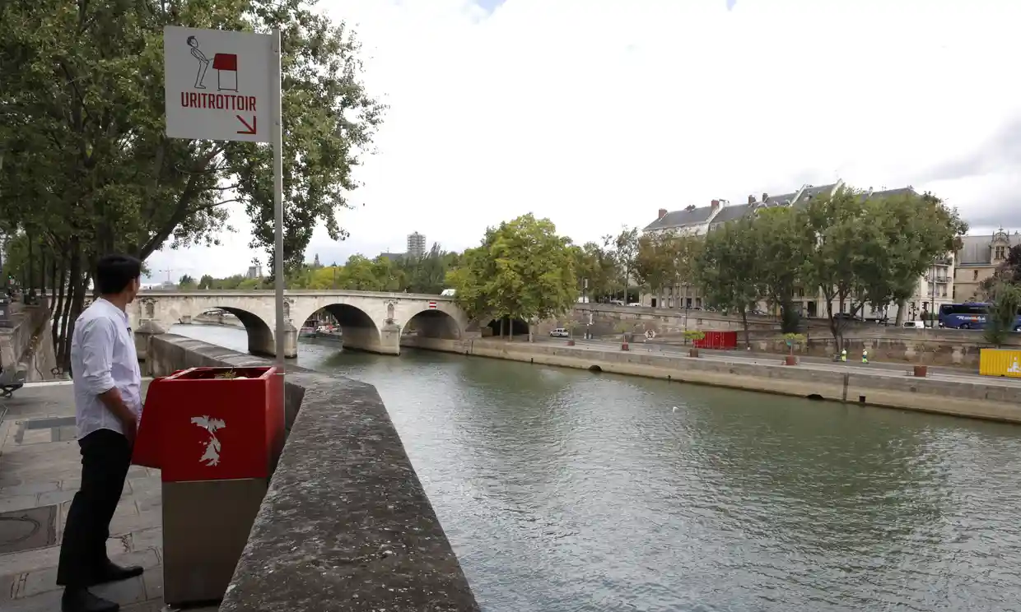
Real
Is this man in Paris using a (legal) public urinal?

Slide 38
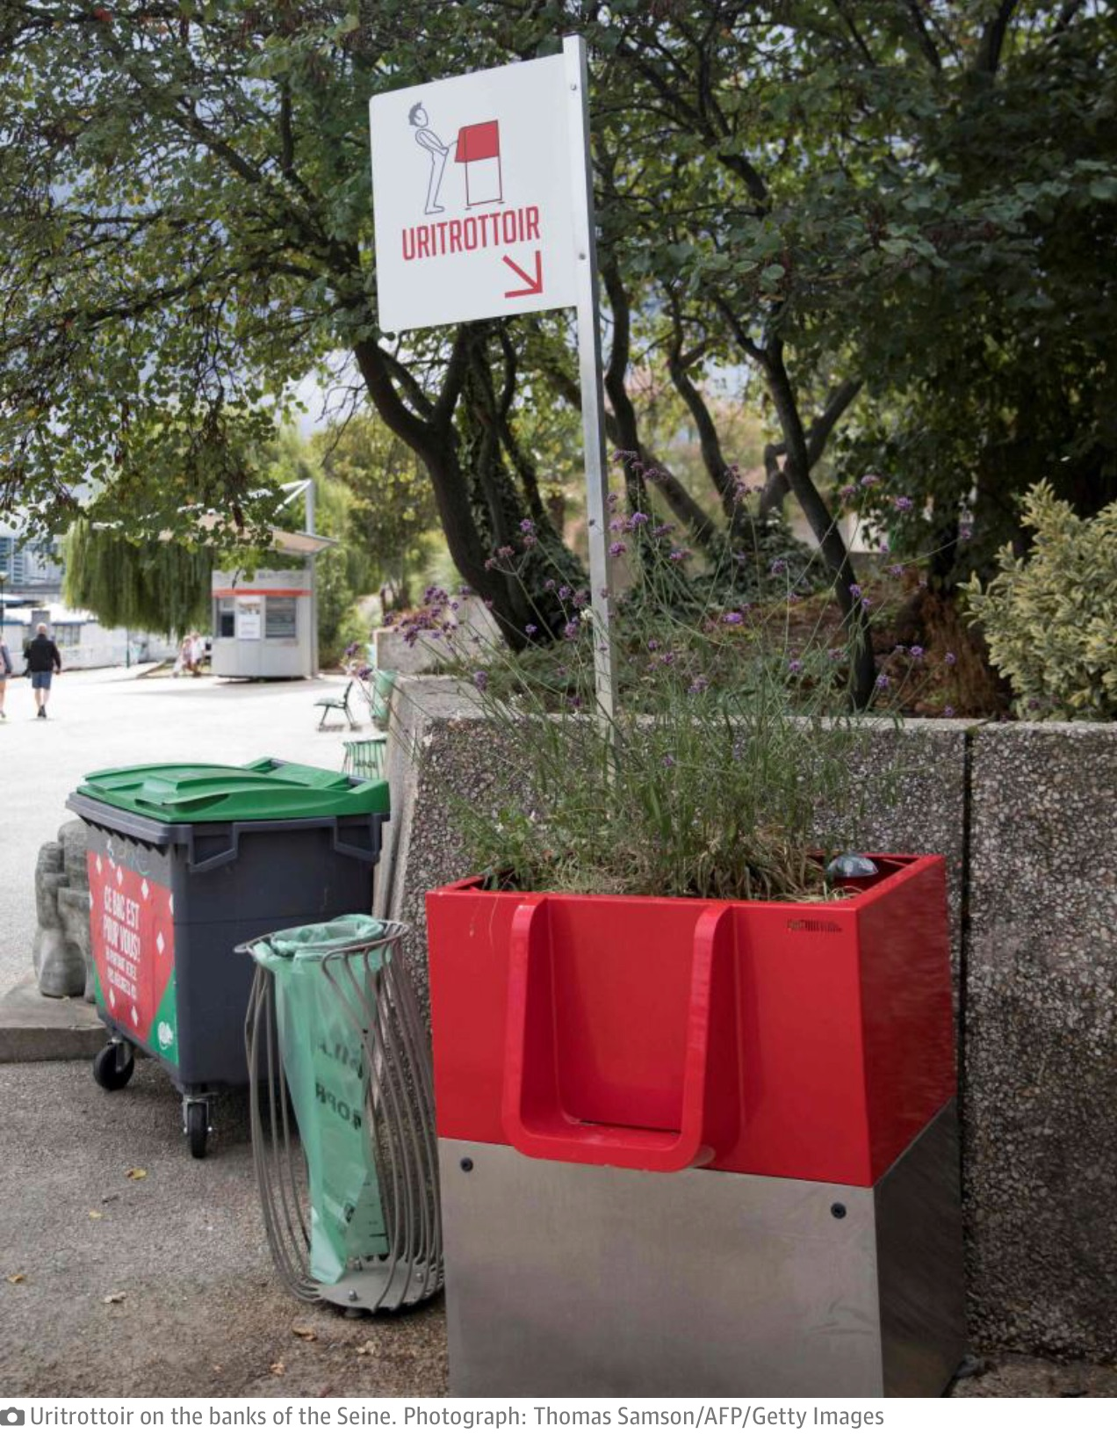
Real
Notes:
HOW DO YOU KNOW??

Slide 39
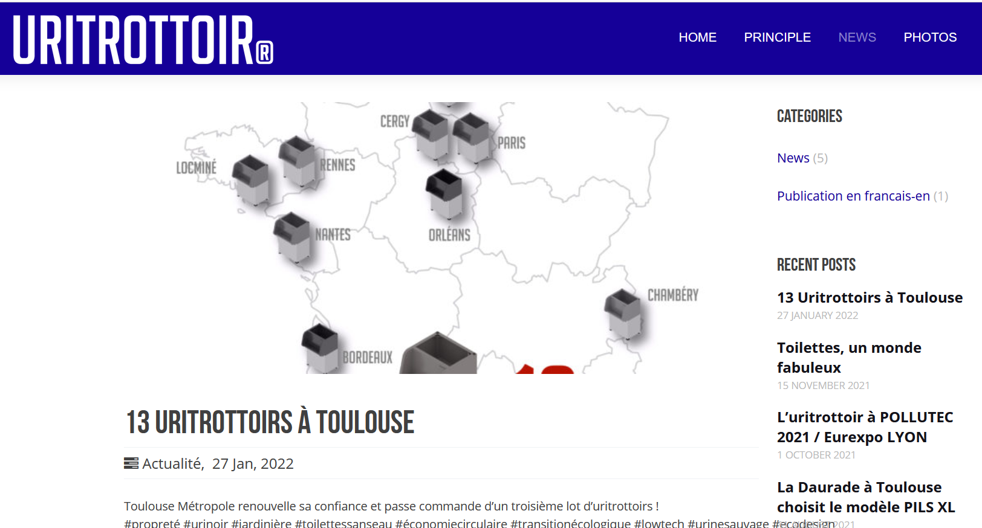
https://uritrottoir.com/

Slide 40
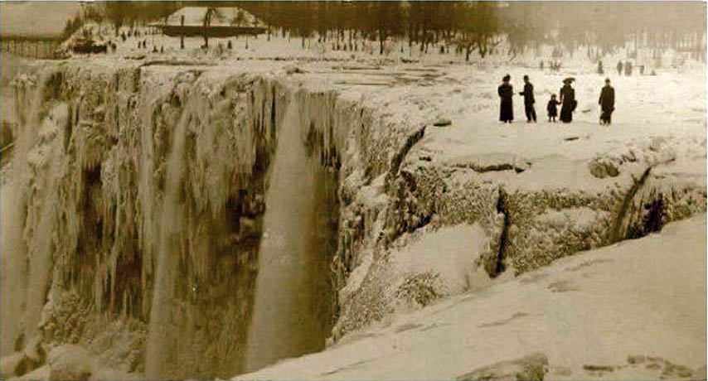
Is this frozen Niagara Falls (in the early 1900s) real or fake?
Real

Slide 41
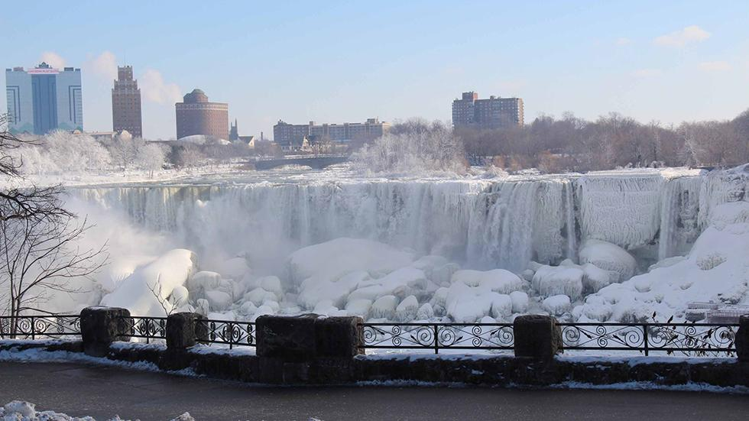
Niagara Falls - Jan. 9, 2014

Slide 42
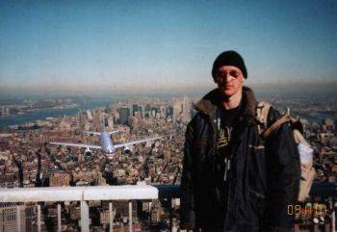
Is this 9/11 tourist snapshot real or fake?
FAKE

Slide 43
How did you determine “real” or “fake”?
Because you really know something as fact?
Because you can tell that a photo has been Photoshopped?
By some sort of logic?
Because you know of precedents or parallels?
An analyst is conscious of all this.
How did you process your information?
Did wishes or biases or fears influence you?

Slide 44
Be careful … what you see
may belie
what you think.

Slide 45
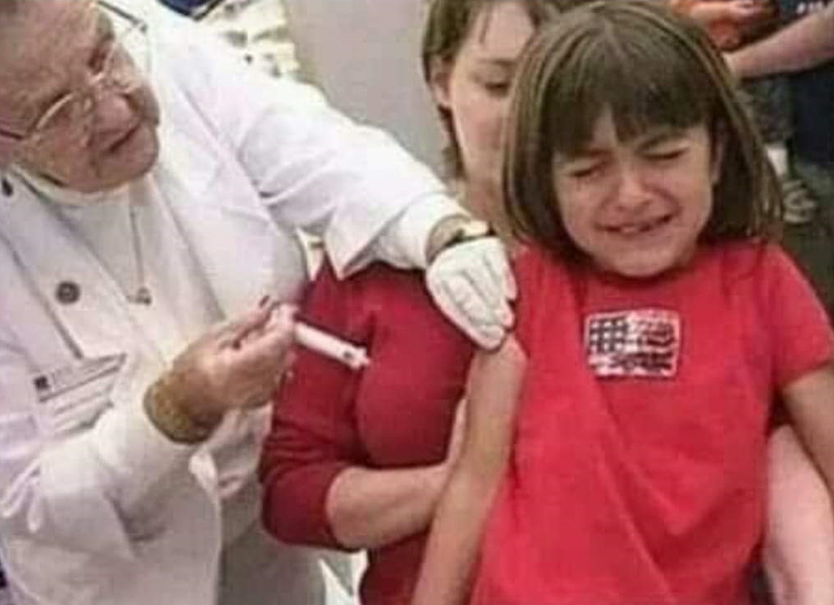
What do you see in this picture?

Slide 46
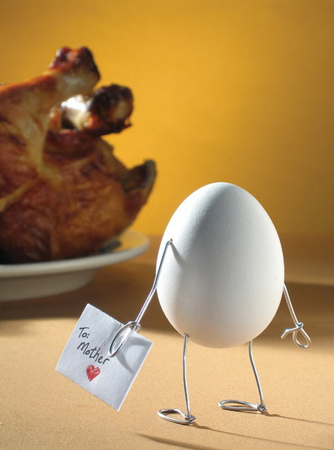
And … an analyst sees a story in everything.
¡¡ Mami !!
¡Be careful!

Slide 47
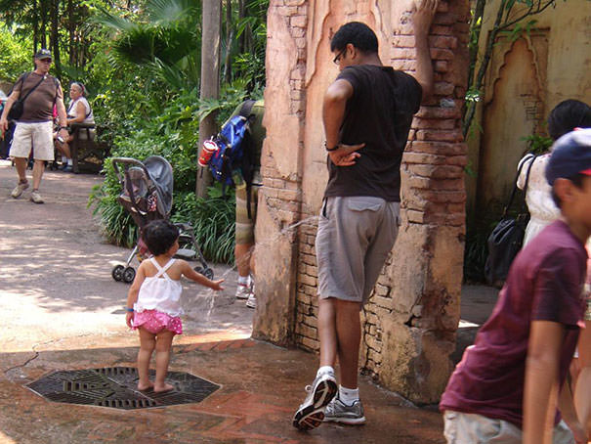
And … an analyst sees a story in everything.
¡Be careful!

Slide 48
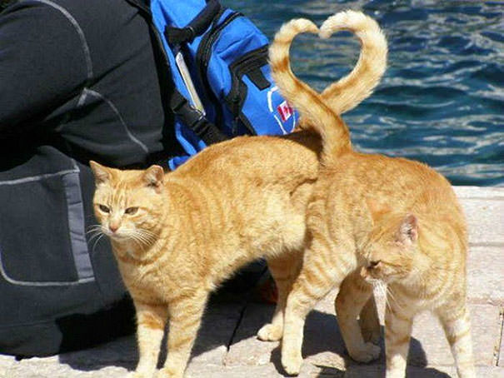
And … an analyst sees a story in everything.
¡CUIDADO!

Slide 49
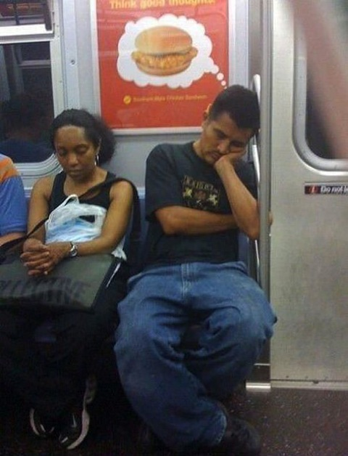
And … an analyst sees a story in everything.
¡CUIDADO!

Slide 50
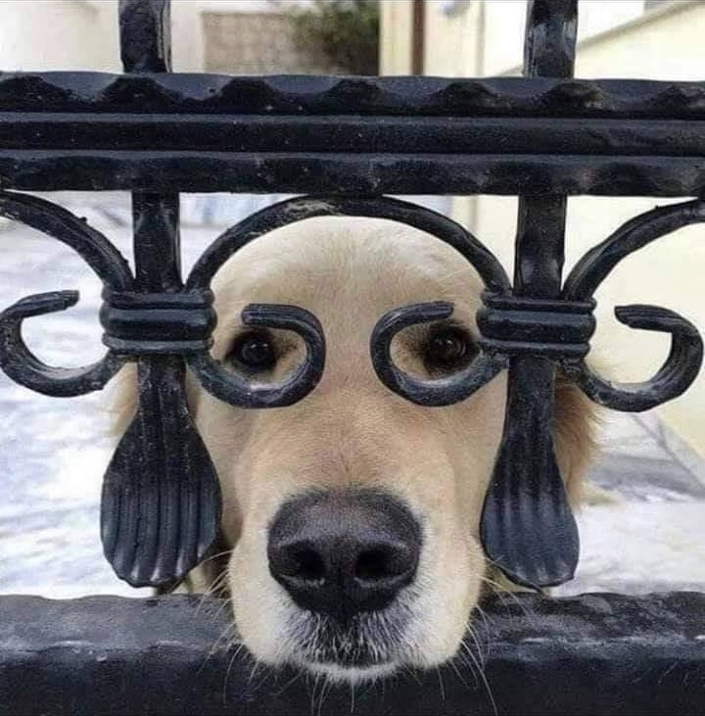
We have to see everything clearly – what it is, what it isn’t.
And from all angles.

Slide 51
And from all angles.

Slide 52
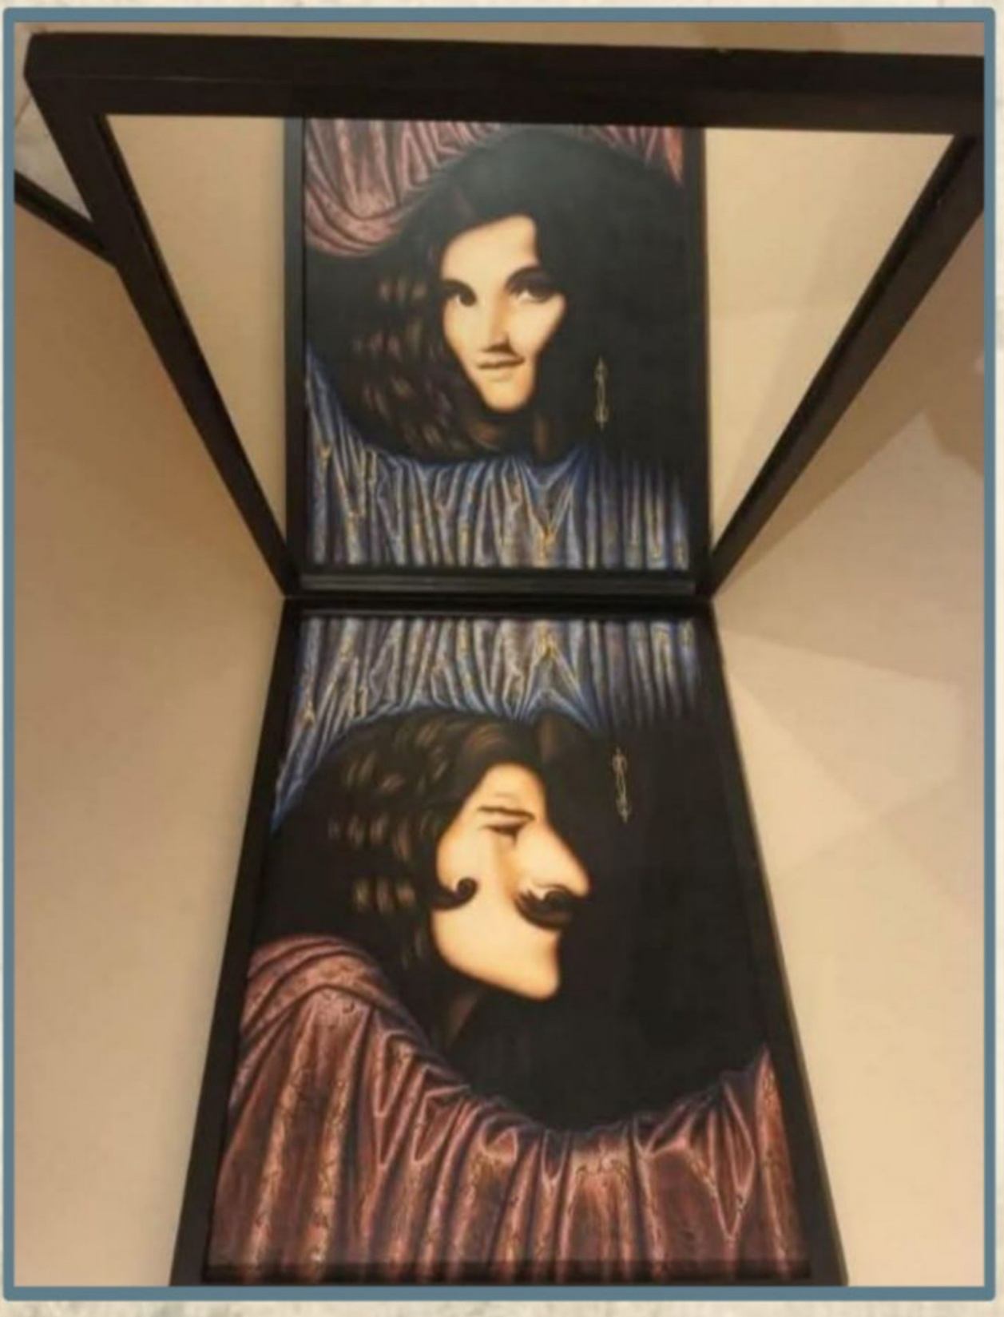

Slide 53
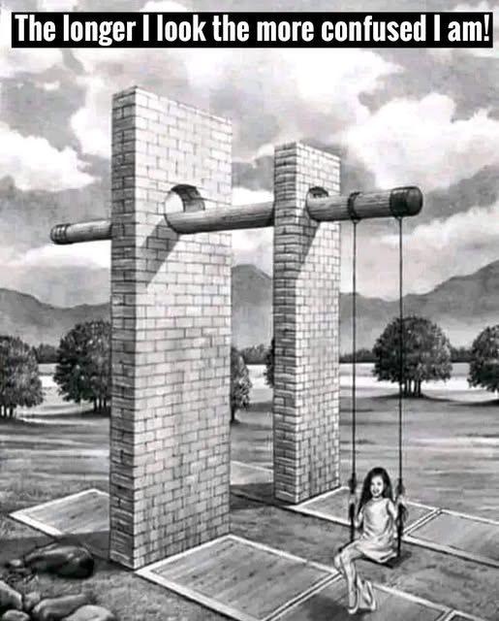

Slide 54
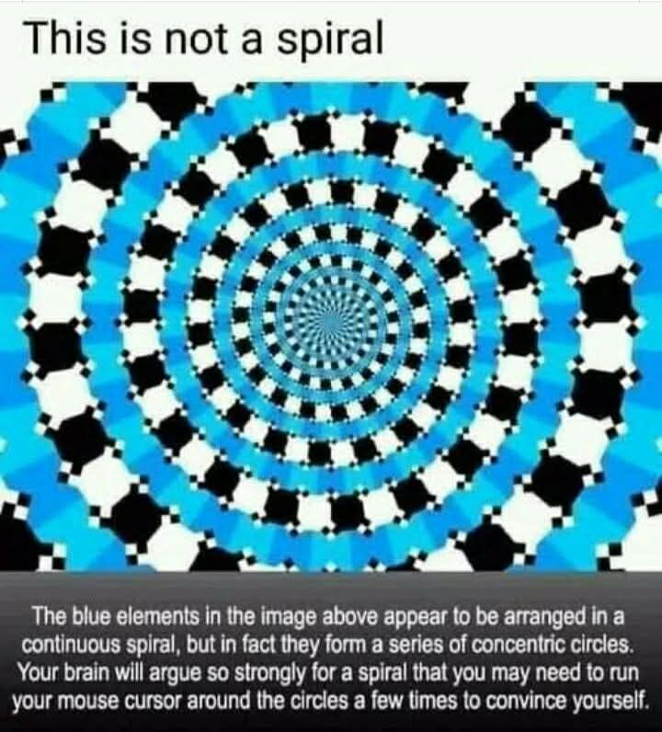

Slide 55
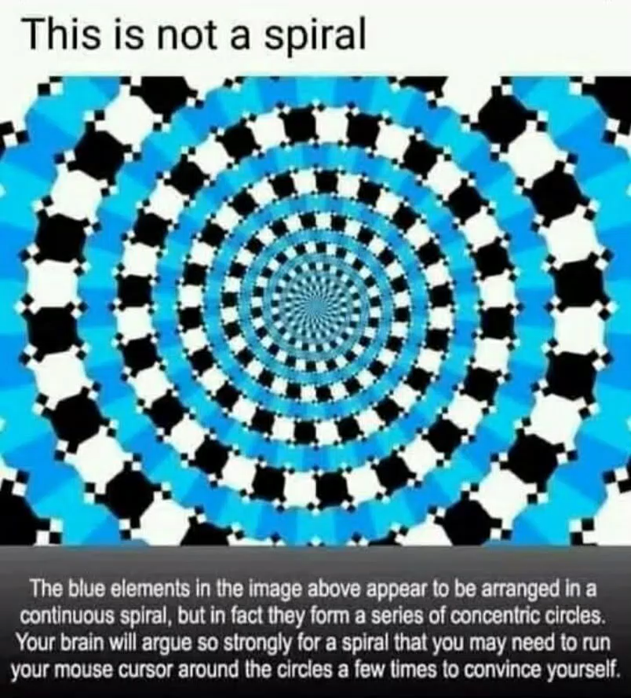

Slide 56
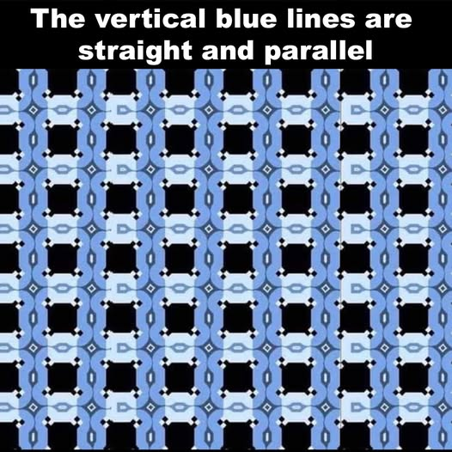

Slide 57
It’s especially difficult with multimedia
Can you trust it?

Slide 58
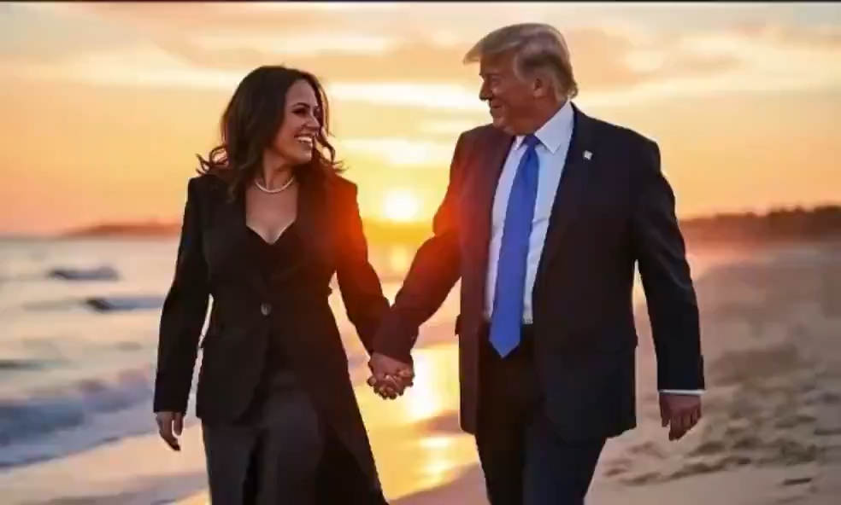

Slide 59
More important than ever.

Slide 60
Fulton T. Armstrong
A spontaneous career in information, analysis, policy and politics
Forty years of analysis
Linguistics and study in Spain
journalism in Taiwan
U.S. House of Representatives
CIA
State Department
National Security Council
National Intelligence Council
U.S. Military – Intelligence Advisor
U.S. Senate
SU … AU … and others

Slide 61
What do decision-makers need?
What is intelligence?
What is analysis?
Keep in mind as we proceed.

Slide 62
What do decision-makers need?
What is intelligence?
What is analysis?
B
L
U
F
ottom
ine
p
ront
Basic facts and your validation of them.
Who? What? When? Where? How many?
Drivers and trends.
Why? How? How behaving?
Scenarios, probabilities, and implications.
How urgent? Why should I care?

Slide 63
Two valuable contributions to decision-making:
You can use in any estimative analysis.
How we got here … where we’re going.
You show what can be done (without being prescriptive).
Protects you, your tradecraft, your credibility.
Plus … it’s based on common sense … and it’s easier and more fun than academic stuff.

Slide 64


A simple example: The Snowflake

Slide 65
THREE MAIN ELEMENTS
What’s happening?
Why or how is it happening?
What’s going to happen?
or
Why does it matter?
SNOWFLAKE
In 40 words,
    A thesis or conclusion (“BLUF”).
    An argument or explanation.
    Something about future or implications.
EXAMPLE

Slide 66
WRITE
EXAMPLE: What does collapse of Afghanistan mean?
    The Taliban victory in Kabul has created conditions of repression and instability in Afghanistan. … Restoration of Sharia Law, which international community rejects, will provoke suspension of financial, humanitarian aid, intensifying economic crisis and hunger. … Taliban reaction may result in collaboration with terrorists.
MAIN MESSAGE
INFORMA-
TION &
ARGUMENTATION
IMPLICATION
41 words!

Slide 67
EXAMPLE
What does collapse of Afghanistan mean (circa September 2021)?
    The Taliban victory in Kabul has created conditions of repression and instability in Afghanistan. … Restoration of Sharia Law, which international community rejects, will provoke suspension of financial, humanitarian aid, intensifying economic crisis and hunger. … Taliban reaction likely to result in collaboration with terrorists.
BLUF
INFO / ARGU-
MENTATION
PREDICTION / IMPLICATION
41 words!

Slide 68
WRITE
EXAMPLE: What does collapse of Afghanistan mean?
    The Taliban victory in Kabul has created conditions of repression and instability in Afghanistan. … Restoration of Sharia Law, which international community rejects, will provoke suspension of financial, humanitarian aid, intensifying economic crisis and hunger. … Taliban reaction may result in collaboration with terrorists.
41 words!

Slide 69
Could you write one if asked?
THREE MAIN ELEMENTS
What’s happening?
Why or how is it happening?
What’s going to happen?
or
Why does it matter?
Tip #1:
Write a snowflake before you start writing your paper

Slide 70

Why invest time in a 40-word product?
“If you can’t explain it simply,
you don’t understand it well enough.”
- Albert Einstein
“If you can’t say it in 30 seconds, it’s not ready for prime time.”
Purpose
Structure / Roadmap
Early thesis
It later becomes your “elevator briefing”

Slide 72
Tip #2: Know what your decision-maker needs
What’s at stake?
What pressures do they face?
What have they tried?
What’s being demanded of them?
What and who do they have to work with?

Slide 73
A Decisionmaking Model
Problem
Analysis
Options
Decision
Results
Essential to the entire process

Slide 74
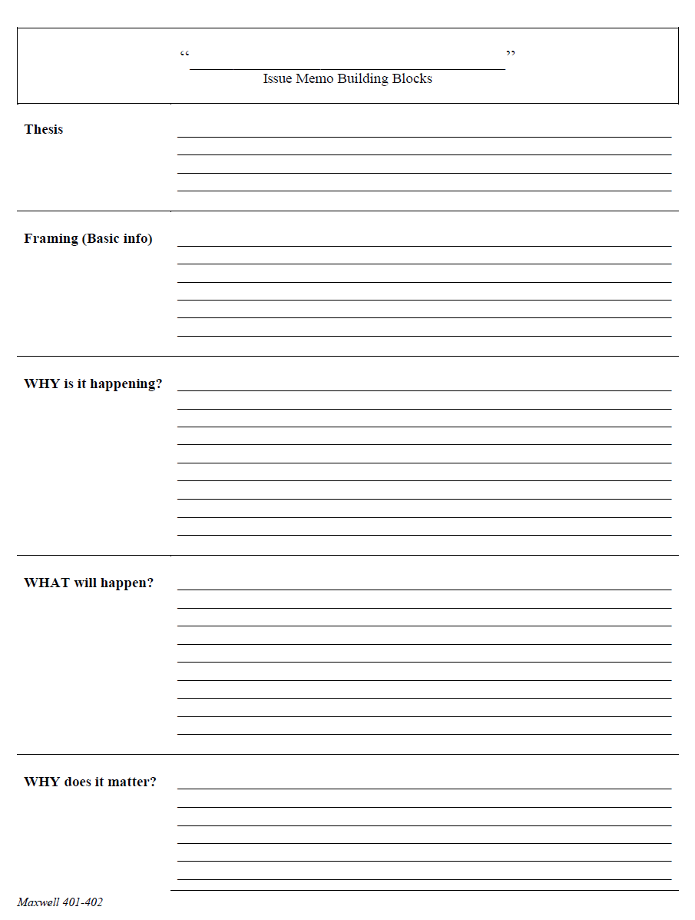
Tip #3: Identify the key elements of the story
WHAT is going on
WHY it is going on,
WHERE it is going, and
WHY we should care

Slide 75
Then home in on the MOST important element.

Slide 76
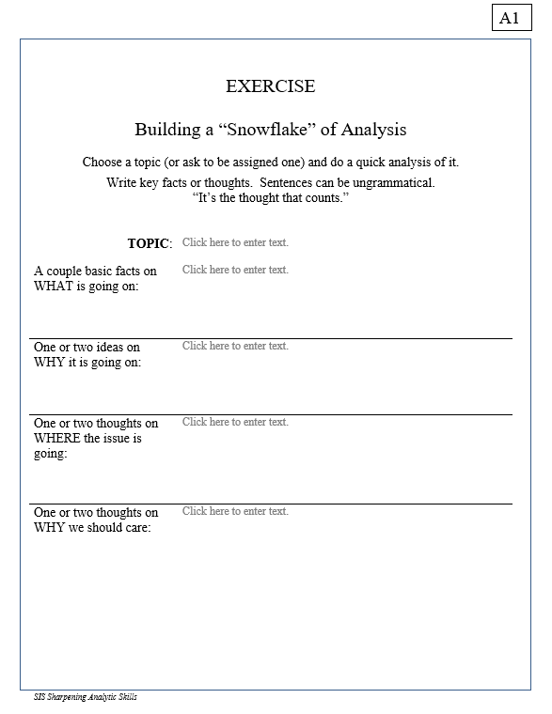

WHAT is going on
WHY it is going on,
WHERE it is going, and
WHY we should care
10 minutes
HANDOUT A1

Slide 77
INFORMATION
  Compilation
  Research / collection
  Evaluation / validation
  Contextualization
ANALYSIS OF DRIVERS
  Identification
  Hierarchization
  Evolution
  Interrelation / dynamics
SCENARIO & IMPLICATIONS
  Most probable & impact
  Less probable & impact
  “Wild cards” & impact
Analysis
When decisionmakers ask for analysis, what do they want and need?

Slide 78
INFORMATION
  Compilation
  Research / collection
  Evaluation / validation
  Contextualization
ANALYSIS OF DRIVERS
  Identification
  Hierarchization
  Evolution
  Interrelation / dynamics
SCENARIO & IMPLICATIONS
  Most probable & impact
  Less probable & impact
  “Wild cards” & impact
Analysis

Slide 79

The Heartbeat of Analysis
(… and POLICY)
What’s driving events?
What scenarios are likely and less-likely?
To help decisionmaker determine:
How can I make a better scenario?
“DRIVERS”

Slide 80
The Heartbeat of Analysis
(… and POLICY)
“DRIVERS”

Slide 81
Tip #4: Good policy decisions focus on changing drivers
React to symptoms
DRIVERS
situations/ scenarios
Make policies,
programs,
operations that alter scenarios
So … identify the drivers for your decisionmaker!

Slide 82
What are drivers?
Interests
Borrowing from the “3-i framework” …
In our PERSONAL lives …
Ideas
Institutions
Interests | Ideas | Institutions
Work Food Love - Sex Family Home Transportation Entertainment Recreation Challenges | Education Religion or values Political thought Ideology Imposed expectations | Parents Boy/Girlfriend Husband/Wife Colleagues Friends Political party Employer
drivers
HANDOUT G

Slide 83
What are drivers?
Interests
In our PERSONAL lives …
Ideas
Institutions
Interests | Ideas | Institutions
Work Food Love - Sex Family Home Transportation Entertainment Recreation Challenges | Education Religion or values Political thought Ideology Imposed expectations | Parents Boy/Girlfriend Husband/Wife Colleagues Friends Political party Employer
drivers

Slide 84
What are drivers?
Interests
In our NATIONAL lives …
Ideas
Institutions
Interests | Ideas | Institutions
Power/influence Needs Desires/ambitions Wealth Economic performance | Self-definition Nationalism History Concepts/logic Values Ideology | Leadership Abilities/constraints Economic structures Intermediation Inclusion Topography/geography Climate
drivers

Slide 85
What are drivers?
Interests
In our NATIONAL lives …
Ideas
Institutions
Interests | Ideas | Institutions
Power/influence Needs Desires/ambitions Wealth Economic performance | Self-definition Nationalism History Concepts/logic Values Ideology | Leadership Abilities/constraints Economic structures Intermediation Inclusion Topography/geography Climate
drivers

Slide 86
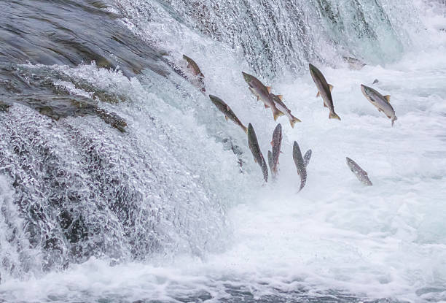
Another way of looking at drivers - I
“sub-drivers”
or
“super-drivers”
What creates the drivers that we see in action?
How far “upstream” do we chase the drivers?
What’s driving/causing/influencing the situation you’re analyzing?
    What’s driving/causing/influencing that driver?
      And what’s driving/causing/influencing THAT driver??
          Etc., etc., etc.

Slide 87
Q: How far “upstream” do I want to go?
  A: To the highest point that has greatest relevant meaning for your decisionmaker.

Slide 88
Another way of looking at drivers - II
“FUEL”
“FRICTION”
Effort/energy
Resources
Technology, etc.
to PUSH a solution.
Obstacles
Resistence
Limitations, etc.
that OBSTRUCT a solution.
“Forward” drivers
“Status Quo” or “Backward” drivers
Examples

Slide 89
What are drivers?
React to symptoms
“sub-drivers”
or
“super-drivers”
DRIVERS
scenarios
Make policies,
programs,
operations that alter scenarios
What creates the drivers that we see in action?

Slide 90
Another way of looking at DRIVERS …
How far “upstream” do we chase the drivers?
What’s driving/causing/influencing the situation you’re analyzing?
What’s driving/causing/influencing that driver?
And what’s driving/causing/influencing THAT driver??
Etc., etc., etc.
Q: The deeper the question, the more accurate your analysis?
A: Depends on the issue, but generally yes. And more strategic.

Slide 91
When you go to a doctor, do you want …
    Treatment of symptoms?
    Diagnosis of what’s wrong?
    Analysis of the causes?
Or to a mechanic? Or to a psychologist? Or to a career advisor?
The real value is in understanding the
DRIVERS
of each issue.

Slide 92
EXAMPLE: CENTRAL AMERICAN MIGRATION
Policymaker is thinking: | What can I do about Central American migration?
Analyst is thinking: | What are the drivers of Central American migration?
PULL
PUSH
focus of most U.S. policy
in the region

Slide 93
EXAMPLE: CENTRAL AMERICAN MIGRATION
Q: Why are the “push factors” of migration from the “Northern Triangle”
of Central America so strong?
Q: WHY?
Q: WHY?
Q: WHY?
A: Poverty
A: Drug cartels
A: Poor education system
Q: WHY?
Q: WHY?
A: Geography
Q: WHY?
A: Cultural attributes
A: Low cooperation
Q: WHY?
Q: WHY?
Q: WHY?
A: Weak institutions
A: Aloof elites
A: Corruption
Q: WHY?
Q: WHY?
Q: WHY?
A: U.S. guns
A: Gang deportees
A: Climate change
What is DRIVING events? How should we weight the drivers?

Slide 94
EXAMPLE: CENTRAL AMERICAN MIGRATION
Q: Why are the “push factors” of migration from the “Northern Triangle”
of Central America so strong?
Q: WHY?
Q: WHY?
Q: WHY?
A: Poverty
A: Drug cartels
A: Poor education system
Q: WHY?
Q: WHY?
A: Geography
Q: WHY?
A: Cultural attributes
A: Low cooperation
Q: WHY?
Q: WHY?
Q: WHY?
A: Weak institutions
A: Aloof elites
A: Corruption
Q: WHY?
Q: WHY?
Q: WHY?
A: U.S. guns
A: Gang deportees
A: Climate change
EACH DRIVER PRESENTS A **POSSIBLE** PLACE WHERE POLICY CAN PLAY

Slide 95
So those are DRIVERS.
Questions? Comments? Experiences?
Next … TRENDS

Slide 96
What are the “trends” of the drivers?
stronger
The “trends” or “currents” are how the drivers are (or have been) behaving:
  More or less strong, important
  Moving toward or away from resolution
“worst outcome”
“best outcome”
worse
better
“mixed outcome”
“mixed outcome”
weaker

Slide 97
EXAMPLE: CENTRAL AMERICAN MIGRATION
ANALYTICAL QUESTION: What TRENDS are the “push factors” of migration from the “Northern Triangle” of Central America experiencing?
Q: TREND?
Q: TREND?
Q: TREND?
A: Poverty
A: Drug cartels
A: Poor education system
Q: TREND?
Q: TREND?
A: Geography
Q: TREND?
A: Cultural attributes
A: Low cooperation
Q: TREND?
Q: TREND?
Q: TREND?
A: Weak institutions
A: Aloof elites
A: Corruption
Q: TREND?
Q: TREND?
Q: TREND?
A: U.S. guns
A: Gang deportees
A: Climate change
How is each driver “behaving”? How should we weight the drivers?

Slide 98
EXAMPLE: CENTRAL AMERICAN MIGRATION
ANALYTICAL QUESTION: How MIGHT THE DRIVERS CHANGE to reduce the “push factors” of migration from the “Northern Triangle” of Central America?
Q: CAN CHANGE?
Q: CAN CHANGE?
Q: CAN CHANGE?
A: Poverty
A: Drug cartels
A: Poor education system
Q: CAN CHANGE?
Q: CAN CHANGE?
Q: CAN CHANGE?
A: Geography
A: Low cooperation
A: Cultural attributes
Q: CAN CHANGE?
Q: CAN CHANGE?
Q: CAN CHANGE?
A: Weak institutions
A: Aloof elites
A: Corruption
Q: CAN CHANGE?
Q: CAN CHANGE?
Q: CAN CHANGE?
A: U.S. guns
A: Gang deportees
A: Climate change
Each driver presents a *possible* place where policy can play.

Slide 99
EXAMPLE: CENTRAL AMERICAN MIGRATION
YOUR QUESTION: How MIGHT THE DRIVERS CHANGE to reduce the “push factors” of migration from the “Northern Triangle” of Central America?
Q: CAN BE CHANGED?
Q: CAN BE CHANGED?
Q: CAN BE CHANGED?
A: Poverty
A: Drug cartels
A: Poor education system
Q: CAN BE CHANGED?
Q: CAN BE CHANGED?
Q: CAN BE CHANGED?
A: Geography
A: Low cooperation
A: Cultural attributes
Q: CAN BE CHANGED?
Q: CAN BE CHANGED?
Q: CAN BE CHANGED?
A: Weak institutions
A: Aloof elites
A: Corruption
Q: CAN BE CHANGED?
Q: CAN BE CHANGED?
Q: CAN BE CHANGED?
A: U.S. guns
A: Gang deportees
A: Climate change
CAN THESE DRIVERS BE CHANGED?

Slide 100
Make sense?
Do you see this in issues you work?
Next … SCENARIOS

Slide 101
Build the Principal Scenario
What’s going to happen in short, medium, and long term?
Why?
What drivers will produce this scenario?
How much confidence do we have in this scenario?
What level of probability do we give this scenario?

Slide 102
Build the Principal Scenario
Steps:
Where are the drivers and trends (already identified) taking the issue in my defined timeframe?
Which drivers are predominant if not determinant?
What will the issue look like after I take all of this into account?
What probability to assign to this scenario? What words should I use?

Slide 103
Building the Principal Scenario
driver and trend
Principal Scenario
driver and trend
driver and trend
driver and trend
driver and trend
driver and trend

Slide 104
EXAMPLE: Central American Migration
corruption
Principal scenario
violence
poverty
“Will continue to get worse”
weak government
climate change
“U.S. Green light”

Slide 105
And we give it a probability.
But then

Slide 106
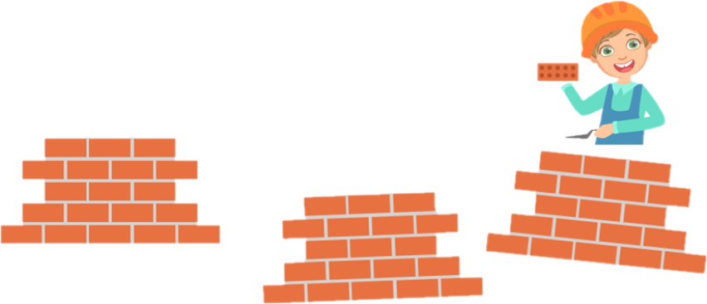
Build the ALTERNATIVE Scenario

Slide 107
Building the ALTERNATIVE Scenario
What is it, and why does it matter?
How do we build it?
How do we give it a probability?
How do we present it?

Slide 108
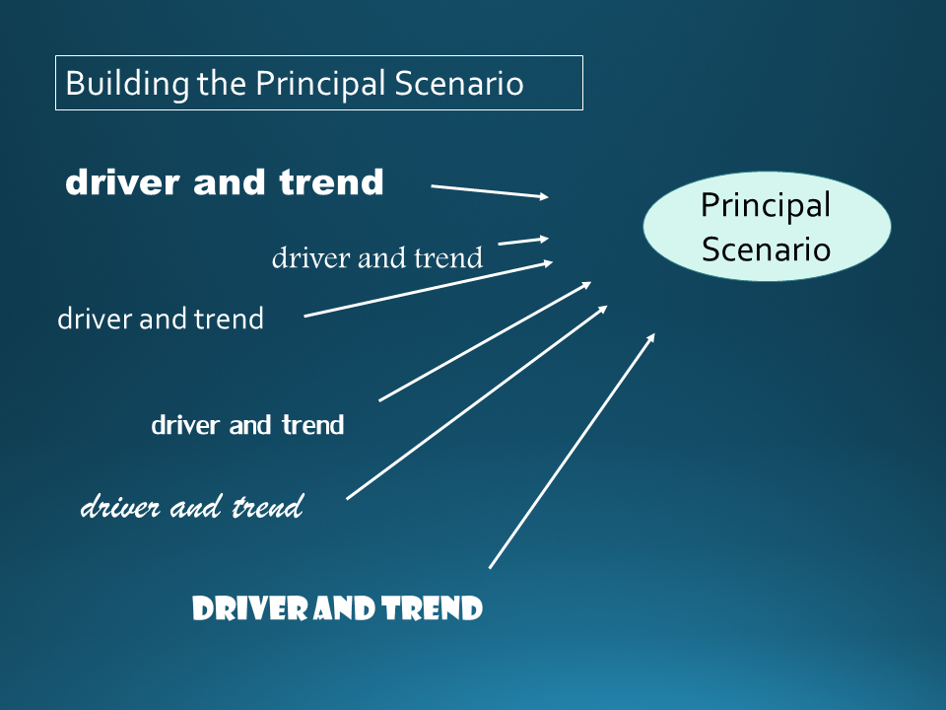
BUT … ASK YOURSELF:
What if the drivers behave differently?
What if I’m WRONG?

Slide 109
Building the ALTERNATIVE Scenario
driver and trend
driver and trend
driver and trend
driver and trend
Alternative Scenario
driver and trend
driver and trend

Slide 110
Building the ALTERNATIVE Scenario
driver and trend
In other words …
If the drivers evolve … gain or lose salience … then you get a different outcome.
driver and trend
driver and trend
driver and trend
Alternative Scenario
driver and trend
driver and trend

Slide 111
EXAMPLE: Central American Migration
corruption
Principal scenario
violence
poverty
“Will continue to get worse”
weak government
climate change
“U.S. Green light”

Slide 112
EXAMPLE: Central American Migration
corruption
Principal scenario
violence
poverty
“Will continue to get worse”
weak government
climate change
“U.S. Green light”

Slide 113
EXAMPLE: Central American Migration
corruption
violence
poverty
weak government
Alternative Scenario
climate change
U.S. “green light”
“Will decline”

Slide 114
EXAMPLE: Central American Migration
corruption
Or … MORE likely … MIXED
violence
poverty
weak government
Alternative Scenario
climate chnage
U.S. “green light”
“Will probably decline”

Slide 115
WHY do an alternative scenario (or two)?
Helps test your drivers.
Raises sophistication, confidence in judgments.
Helps test your main scenario.
Results in better product for decisionmaker?
Prepares them and educates them.

Slide 116
WHY do an alternative scenario (or two)?
Helps them track and understand INDICATORS
Helps test your drivers.
Raises sophistication, confidence in judgments.
Helps test your main scenario.
Results in better product for decisionmaker?
Prepares them and educates them.

Slide 117
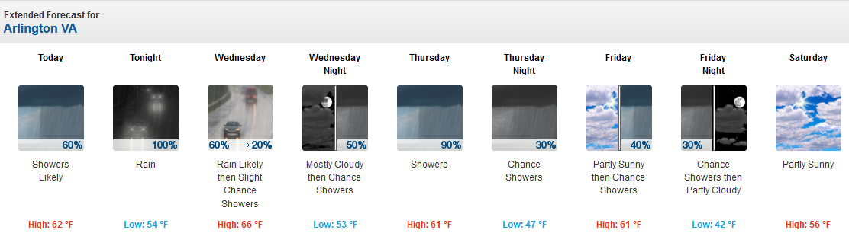
How do we state probability?
Who are (supposedly) the best estimators of probability?

Slide 118
How do we state probability?
________
100
100%
90%
80%
70%
60%
50%
40%
30%
20%
10%
0%
________
87-99
________
63-87
FIRST, what would YOU say?
________
40-60
________
20-40
________
2-12
________
0

Slide 119
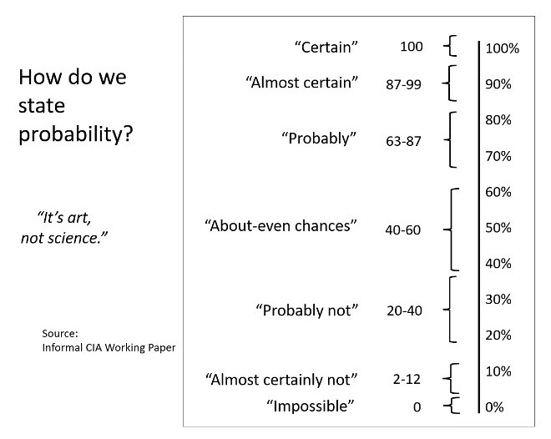
How do we state probability?
“Certain”
100
100%
90%
80%
70%
60%
50%
40%
30%
20%
10%
0%
“Almost certain”
87-99
“Probably”
63-87
NOW, what did CIA analysts say?
“About-even chances”
40-60
“Probably not”
20-40
“It’s art, not science.”
“Almost certainly not”
2-12
Source:
Informal CIA Working
Paper
“Impossible”
0

Slide 120
How do we state probability?
“Certain”
100
100%
90%
80%
70%
60%
50%
40%
30%
20%
10%
0%
“Almost certain”
87-99
“Probably”
63-87
NOW, what did CIA analysts say?
“About-even chances”
40-60
“Probably not”
20-40
“It’s art, not science.”
“Almost certainly not”
2-12
Source:
Informal CIA Working
Paper
HANDOUT H
“Impossible”
0

Slide 121
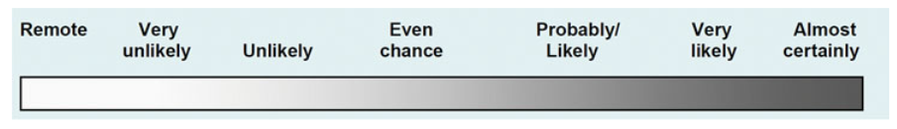
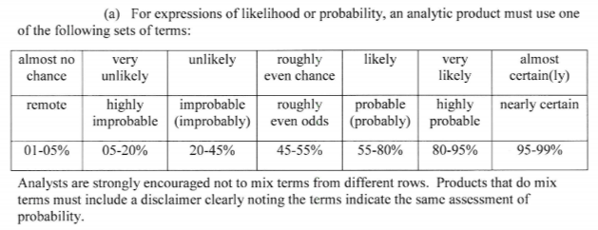
Words of Estimative Probability
Source: 2007 National Intelligence Estimate, Iran: Nuclear Intentions and Capabilities, and other products)
Source: 2015 Intelligence Community Directive 203 on ANALYTIC STANDARDS

Slide 122

Also from ICD 203:
Example of a no-no:
We are highly confident that the President will probably veto the legislation.
Or …
The meteorologist is pretty confident that there’s a 30 percent chance of rain.

Slide 123
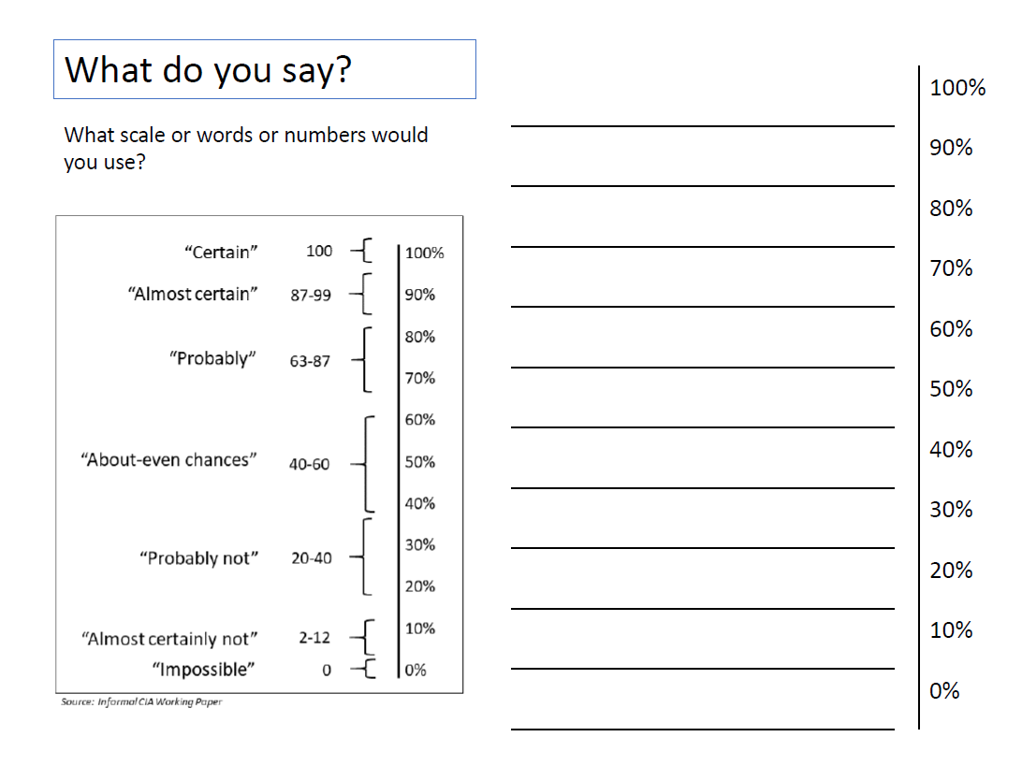
How do YOU state probability?
Handout L

Slide 124
Next … wild cards!

Slide 125

“Wildcards”
Extremely low probability; impossible
to predict …
but …
Changes our analysis drastically
Something that, in our list of assumptions, we calculate as beyond our analysis
HINT - HINT

Slide 126
“Wildcards”
EXAMPLES
Leader’s death by natural cause
Assassination without any indications
Natural disasters, epidemics, etc.
Factors that we can’t analyze.

Slide 127
“Wildcards”
What are some wildcards that would turn analysis of some current events on its head?
Israel-Gaza
Russia-Ukraine
China-U.S. tensions
North Korea’s push for a nuclear weapon
Global warming
Liberal democracy in Western Europe
AI and cyber-security
(Other topics you follow)

Slide 128
Next … last but not least … implications!

Slide 129
Analyzing Implications
What importance do the current situation and the scenarios have for the decisionmaker?
    Why should they pay attention?
    How can events affect their interests?
Assumes, of course, knowledge of decisionmaker and interests.

Slide 130


Analyzing Implications
Warning analysis
vs
Opportunity analysis
(implicit or explicit)

Slide 131
Analyzing Implications
SCENARIO: War
EXAMPLES
humanitarian crisis
uncontrolled migration
disorder
SCENARIO: Inconclusive elections
political tensions
indecision
harm to institutions
SCENARIO: Economic decline
unemployment
popular suffering
tensions
weak institutions

Slide 132
Analyzing Implications
SCENARIO: Global warming
EXAMPLES
reduced ag production
water shortages
threat to coastal cities
SCENARIO: Manipulation of social media
threaten legitimacy
undermine institutions
youth disorientation
SCENARIO: New patents (5G)
monopolies
insecurity, doubt
international tensions

Slide 133

Implications?
What are the implications for the United States, Western Europe, the world?

Slide 134
Implications?
What are some IMPLICATIONS of the different scenarios of some current events?
Syria
Israel-Gaza
Russia-Ukraine
China-U.S. tensions
North Korea’s push for a nuclear weapon
Global warming
Liberal democracy in Western Europe
AI and cyber-security
(Other topics you follow)

Slide 135

That’s it …

Slide 136
So … how do I do it?
A QUICK overview

Slide 137
What do decision-makers need?
What is intelligence?
What is analysis?
B
L
U
F
ottom
ine
p
ront
Basic facts and your validation of them.
Who? What? When? Where? How many?
Drivers and trends.
Why? How? How behaving?
Scenarios, probabilities, and implications.
How urgent? Why should I care?

Slide 139
EXAMPLE closer to home
Q: Why did Trump win the election in 2016?
A: Because people wanted change.
Q: Why did people want change?
A: Because they were unhappy.
Q: Why were they unhappy?
A: Because they felt left behind.
Q: Why did they feel left behind?
A: Because they were left behind.
Q: Why were they left behind?
A: Because the U.S. economy changed.
Q: Why did the U.S. economy change?
etc., etc., etc.
Q: The deeper the question, the more accurate your analysis?
A: Depends on the issue, but generally yes. And more strategic.

Slide 140
EXAMPLE in the UK
Q: Why did the UK vote for BREXIT?
A: Because people wanted change.
Q: Why did people want change?
A: Because they were unhappy.
Q: Why were they unhappy?
A: Because they felt left behind.*
Q: Why did they feel left behind?
A: Because they were left behind.
Q: Why were they left behind?
A: Because the economy (or the world) changed.
Q: Why did the economy (or the world) change?
etc., etc., etc.
WE CAN DO THE SAME THING WITH OTHER STRATEGIC ISSUES:
Migration problems
Economic challenges
WMD developments
Etc, etc.
* In addition to other factors

Slide 141
How do you do it?
After get the TASKING and do some INITIAL RESEARCH …
    Assess your client’s needs
    Formulate hypotheses
    Continue research; build arguments; collate evidence
    Validate information; remain conscious of gaps
    Check assumptions; check logic; check words
    Adjust hypotheses
    Assess probabilities
    Think about wildcards
    Test, test, test
    Edit, edit, edit your thesis

Slide 142

HANDOUT B
in yesterday’s packet

Slide 143

How do you do it?
After get the TASKING and do some INITIAL RESEARCH …
    Assess your client’s needs
    Formulate hypotheses
    Continue research; build arguments; collate evidence
    Validate information; remain conscious of gaps
    Check assumptions; check logic; check words
    Adjust hypotheses
    Assess probabilities
    Think about wildcards
    Test, test, test
    Edit, edit, edit your thesis

Slide 144

Writing a paper
Envision and conceptualize
Plan time, efforts
Get basic info
Hypothesize
Get more info, adjust hypothesis
Write and cut-and-paste
Edit, strengthen
Coooooooooool down
Edit, edit, edit

Slide 145
Writing a paper
Envision and conceptualize
Plan time, efforts
Get basic info
Hypothesize
Get more info, adjust hypothesis
Write and cut-and-paste
Edit, strengthen
Coooooooooool down
Edit, edit, edit

Slide 146
Writing a paper
Envision and conceptualize
Plan time, efforts
Get basic info
Hypothesize
Get more info, adjust hypothesis
Write and cut-and-paste
Edit, strengthen
Coooooooooool down
Edit, edit, edit

Slide 147
Writing a paper
Envision and conceptualize
Plan time, efforts
Get basic info
Hypothesize
Get more info, adjust hypothesis
Write and cut-and-paste
Edit, strengthen
Coooooooooool down
Edit, edit, edit

Slide 148
Writing a paper
Envision and conceptualize
Plan time, efforts
Get basic info
Hypothesize
Get more info, adjust hypothesis
Write and cut-and-paste
Edit, strengthen
Coooooooooool down
Edit, edit, edit

Slide 149
Writing a paper
Envision and conceptualize
Plan time, efforts
Get basic info
Hypothesize
Get more info, adjust hypothesis
Write and cut-and-paste
Edit, strengthen
Coooooooooool down
Edit, edit, edit

Slide 150
Writing a paper
Envision and conceptualize
Plan time, efforts
Get basic info
Hypothesize
Get more info, adjust hypothesis
Write and cut-and-paste
Edit, strengthen
Coooooooooool down
Edit, edit, edit

Slide 151
Writing a paper
Envision and conceptualize
Plan time, efforts
Get basic info
Hypothesize
Get more info, adjust hypothesis
Write and cut-and-paste
Edit, strengthen
Coooooooooool down
Edit, edit, edit

Slide 152
Writing a paper
Envision and conceptualize
Plan time, efforts
Get basic info
Hypothesize
Get more info, adjust hypothesis
Write and cut-and-paste
Edit, strengthen
Coooooooooool down
Edit, edit, edit

Slide 153


It’s not a linear process
, but spiral.
It’s also COMMON SENSE made CONSCIOUS.

Slide 154


The Analytical Worksheet: One Proven, Effective Way to Build Analysis for Presentation

Slide 155


An example: Central American Migration

Slide 156


With a thesis sentence at the top, here’s the whole model.
Other Points | Things that don’t fit in rigid structure
 | Give color, texture to analysis
 | Useful in building “narrative” when you write
 | Pet facts, thoughts that you like (and show you care)
Thesis sentence(s): Main conclusion.
            “Bottom Line Up Front.”
            Short, concise summary – including as many elements as needed to tell the whole story.
Framing: The information your decisionmaker needs to get into the story.
Basics
Not “research or encylopedia”

Slide 157
Armed with a worksheet like this, the writing is easy.

Slide 158
Tradecraft Model
HANDOUT E
Problem or Question
Information
Analysis of Drivers
Scenarios
Implications
Hypothesis
Definition of problem or question
In neutral terms; without loaded messages, connotations
In view of the broader interests of the entity
Integrity of information
Compilation Research/collection | Evaluation/validation Contextualization
Exploration of possible explanation(s)
Identify possible flaws, gaps in information Launch the “scientific” process of testing/invalidating possibilities
Analysis of drivers
Identification Hierarchization | Evolution Dynamic interrelationships
Conclusions with three (or more) elements
Most probable (drivers as they are) Less probable (drivers changing) | “Wildcards” or other result from brainstorming
Discussion of consequences for the entity
Short and long term | Interests

Slide 159

HANDOUT F

Slide 160

IF YOU WANT SOME THEORY

Slide 161



Slide 162
Heuer emphasizes
Both the value and the dangers of mental models, or mind-sets.
The strong influence of experience, education, cultural values, and institutional norms on what people perceive, how readily they perceive it, and how they process it.
Mirror-imaging as an example of an unavoidable cognitive trap. No matter how much expertise an analyst applies to interpreting the value systems of foreign entities, when the hard evidence runs out the tendency to project the analyst’s own mind-set takes over.
“More and better information” is often NOT the remedy for unsatisfactory analytic performance. Analysts continuously challenge and revise their mental models.

Slide 163



Heuer’s Checklist for Analysts
Six key steps in the analytical process:
Defining the problem
Generating hypotheses
Collecting information
Evaluating hypotheses, selecting the most likely
Monitoring of new information
Exposing oneself to Alternative Mind-Sets
The realities of bureaucratic life produce strong pressures for conformity – which must be resisted in order to do good analysis.

Slide 164
Heuer’s Checklist for Analysts
Six key steps in the analytical process:
Defining the problem
Generating hypotheses
Collecting information
Evaluating hypotheses, selecting the most likely
Monitoring of new information
Exposing oneself to Alternative Mind-Sets
The realities of bureaucratic life produce strong pressures for conformity – which must be resisted in order to do good analysis.

Slide 165
Enemy Number One: COGNITIVE BIAS
Definition:
Unconscious errors that arise from problems related to memory, attention, thinking processes, and purpose.
Kinds:
Thinking errors
Confirmation bias
Hindsight bias
Conflict-of-interest bias
Value/Normative bias
False-consensus bias
Institutional bias
Garbage-in bias
Etc., etc., etc.
Process errors
Straight-lining
Lack of control of question or words
Which is the worst for you?

Slide 166



BETTER ANALYSIS
Can you ever have analysis totally free of bias?

Slide 167





Slide 168

The “Other” CIA Manual

Slide 169
As I said up top …
My opinion: Good analysis (and writing it well) is now more important than ever.
YOU CAN DO IT.

Slide 170


Slide 171
I will post these slides – and handouts – in BB.
Copy in Nayyera’s and Samantha’s office
Questions? Comments?

Slide 172
How do you do analysis of issues that you’re tracking?
Questions? Comments?

Slide 173
Effective Analysis
- An Analytical Model for Making Information Actionable -
Fulton T. Armstrong
Friday
16 January 2026

