Slide 1
Professional Skills: Are You Listening?
Samantha Clemence
Fulton Armstrong
31 October 2025

Slide 2
Are You Listening?
Consider …
How much does good communication depend on good listening?
How much “bandwidth” does listening take?
Why do we not listen better?
(Answers later)

Slide 3
Are You Listening?
Up to 80% of your waking hours are spent in some form of
communication
45% of that time is spent listening
  The rest: 9% writing, 16% reading, 30% speaking
We are poor and inefficient listeners
  Studies show most people remember less than 50% of what they hear in a conversation!

Slide 4
Why Should We Listen?
Obtain information | get competence and knowledge; improve retention
Understand | broaden your perspective and reduce misunderstandings
Learn | create new ways to approach issues; help detect and solve problems
Connect | build relationships; gain trust, support and confidence of others; defuse emotional situations
→→ Good leaders listen! ←←
(The higher you go in a hierarchy,
the more you listen.)

Slide 5
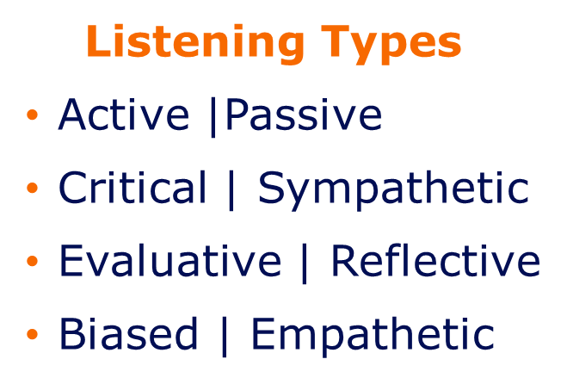
I Said, Are You Listening?
Are you a good listener?
Pay attention to your listening habits:
  Do you talk more than the people
  around you?
  Do you find yourself interrupting others
  to get your point across?
  Do you often forget things people tell you?
  Are you multitasking? On your phone?

Slide 6
Conscious Listening Skills: The Basics
Give your full attention to the speaker and make a conscious effort to hear the whole message being communicated
Put aside distracting thoughts and things
“Listen” to the speaker’s body language

Slide 7
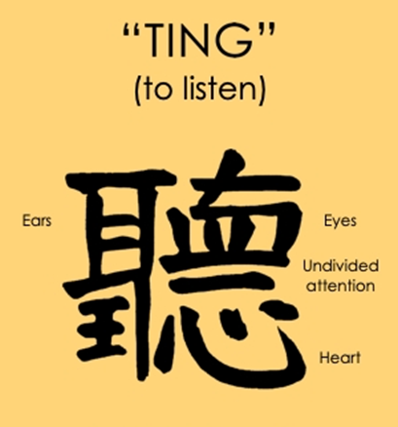
Conscious Listening:
SHOW you are listening
Be aware of how your body language and gestures can convey your attention
Keep a pleasant facial expression; smile (without being weird)
Keep your body language open and inviting; use small gestures like nodding
Signal to the speaker continue, slow down, “got it.”
Take short notes, if appropriate
It’s your “meta message.”

Slide 8


Conscious Listening: Suspend Bias
Defer Judgment
Don’t Interrupt
Remember:
Listening does not mean agreeing.
Check your biases and listen with an open mind
Allow the speaker to finish each point before asking questions
Don’t interrupt with counter arguments
Don’t mentally prepare a rebuttal
It says:
I'm more important than you are
What I have to say is more interesting
I don't care what you think
I don't have time for your opinion
  Remember that we all think and speak at different rates.

Slide 9
Conscious Listening: Repeat and Respect
Provide Feedback
Respond Appropriately
Providing feedback and asking questions can help clarify:
Summarize or paraphrase: “What I’m hearing is…” “If I understand correctly…”
Ask questions to clarify points “What do you mean when you say…”
I appreciate the time you’ve taken to speak to me / share your perspective
It is important to be respectful. You gain NOTHING from attacking or offending a speaker, even unintentionally
Be open and honest in your response
Assert your opinions respectfully
Treat the other person in a way you would want to be treated

Slide 10
Keeping Communication on Track
  If you feel the speaker is embracing disinformation or misinformation, or
  If a situation becomes tense or emotional
  Clarify – again – what you think you’ve heard, using their language
  Use inoffensive phrases such as “Sorry, what I hear you saying is…” or “For me, the word ___ means ___”
  Mentally try to identify the reason for the discrepancy:
  factual? context? analytical? values? experience?
  Speak constructively, analytically, and non-judgmentally

Slide 11

Keeping Communication on Track
If you’re the speaker, and someone is interrupting you
  Don’t get emotional
  Take a deep breath, relax your shoulders, and focus on being effective vs being right
  Techniques
    Hand facing up, palm open
    “Let me finish”
    Pause
    Look away (disengage until they stop talking)
    Walk away – last resort

Slide 12
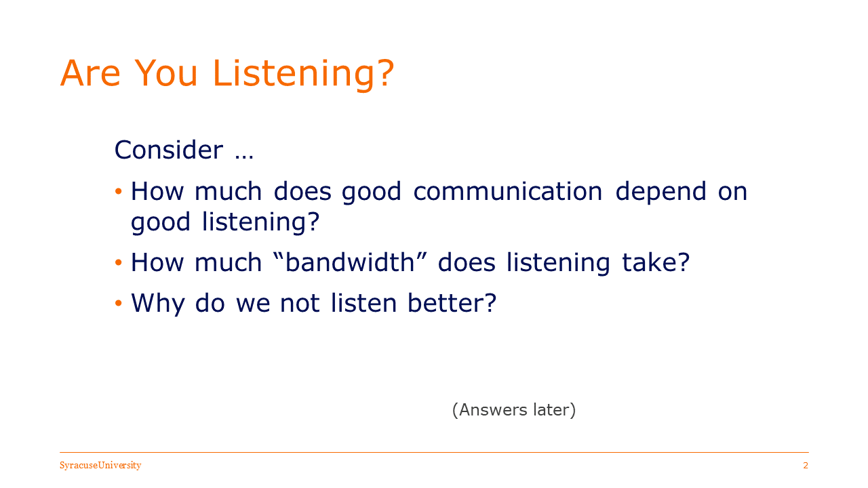
The Answers (for you)?
100 percent
100 percent
Multiple reasons:
  Don’t understand
  Afraid/unwilling to change
  Afraid/unwilling to “lose”
  Afraid/unwilling to acknowledge other views and values
  Others …

Slide 13
The Answers (for you)?
100 percent
100 percent
Multiple reasons:
  Don’t understand
  Afraid/unwilling to change
  Afraid/unwilling to “lose”
  Afraid/unwilling to acknowledge other views and values
To listen well … is a conscious decision.

Slide 14
The goal is to hear and understand each other.
Hearing and understanding are not necessarily agreeing.
Strive for effective professionalism.
Questions and Discussion

Slide 15
Professional Skills: Are You Listening?
Samantha Clemence
Fulton Armstrong
31 October 2025

