Slide 1

Artificial Intelligence
-Using AI Responsibly -
Nayyera Haq
Fulton Armstrong
19 September 2025

Slide 2
What is Artificial Intelligence?
What are its benefits … and risks?

Slide 3
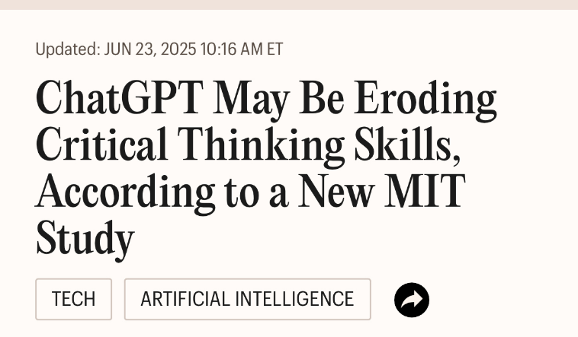
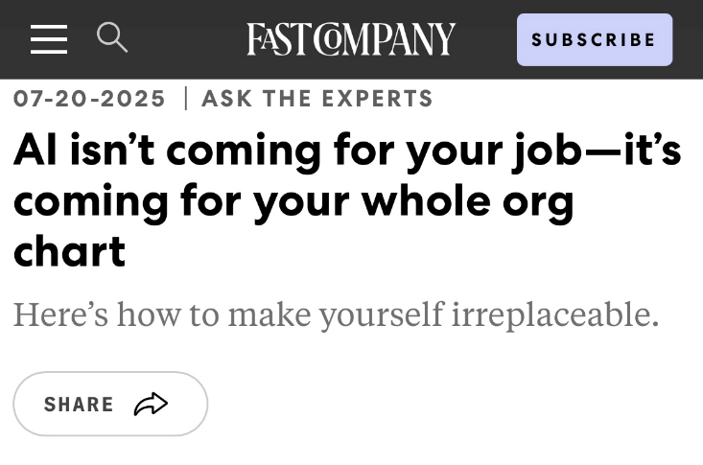
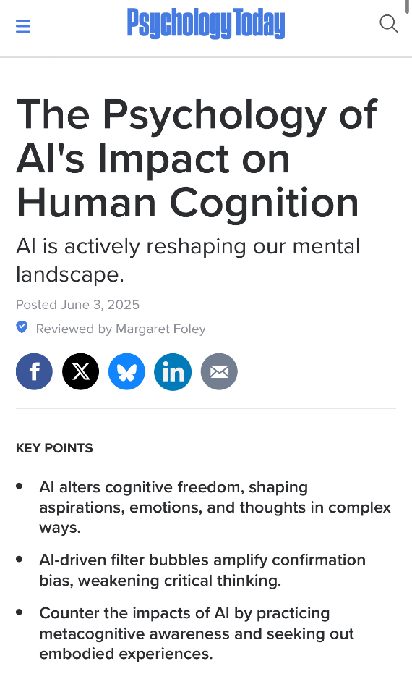
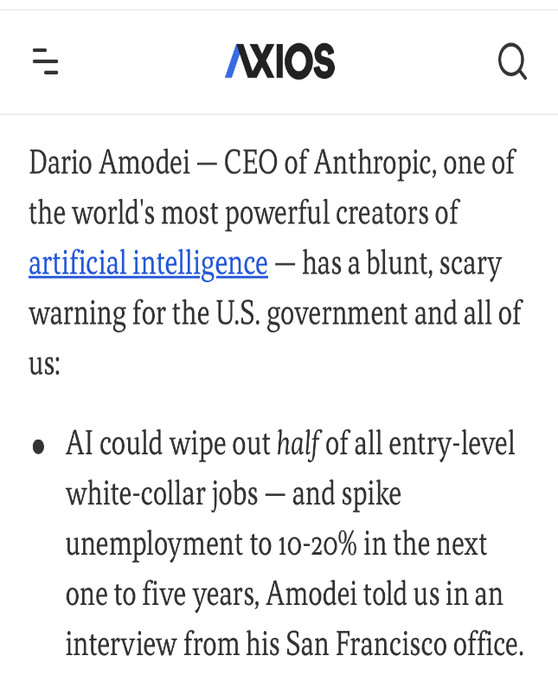

Slide 4
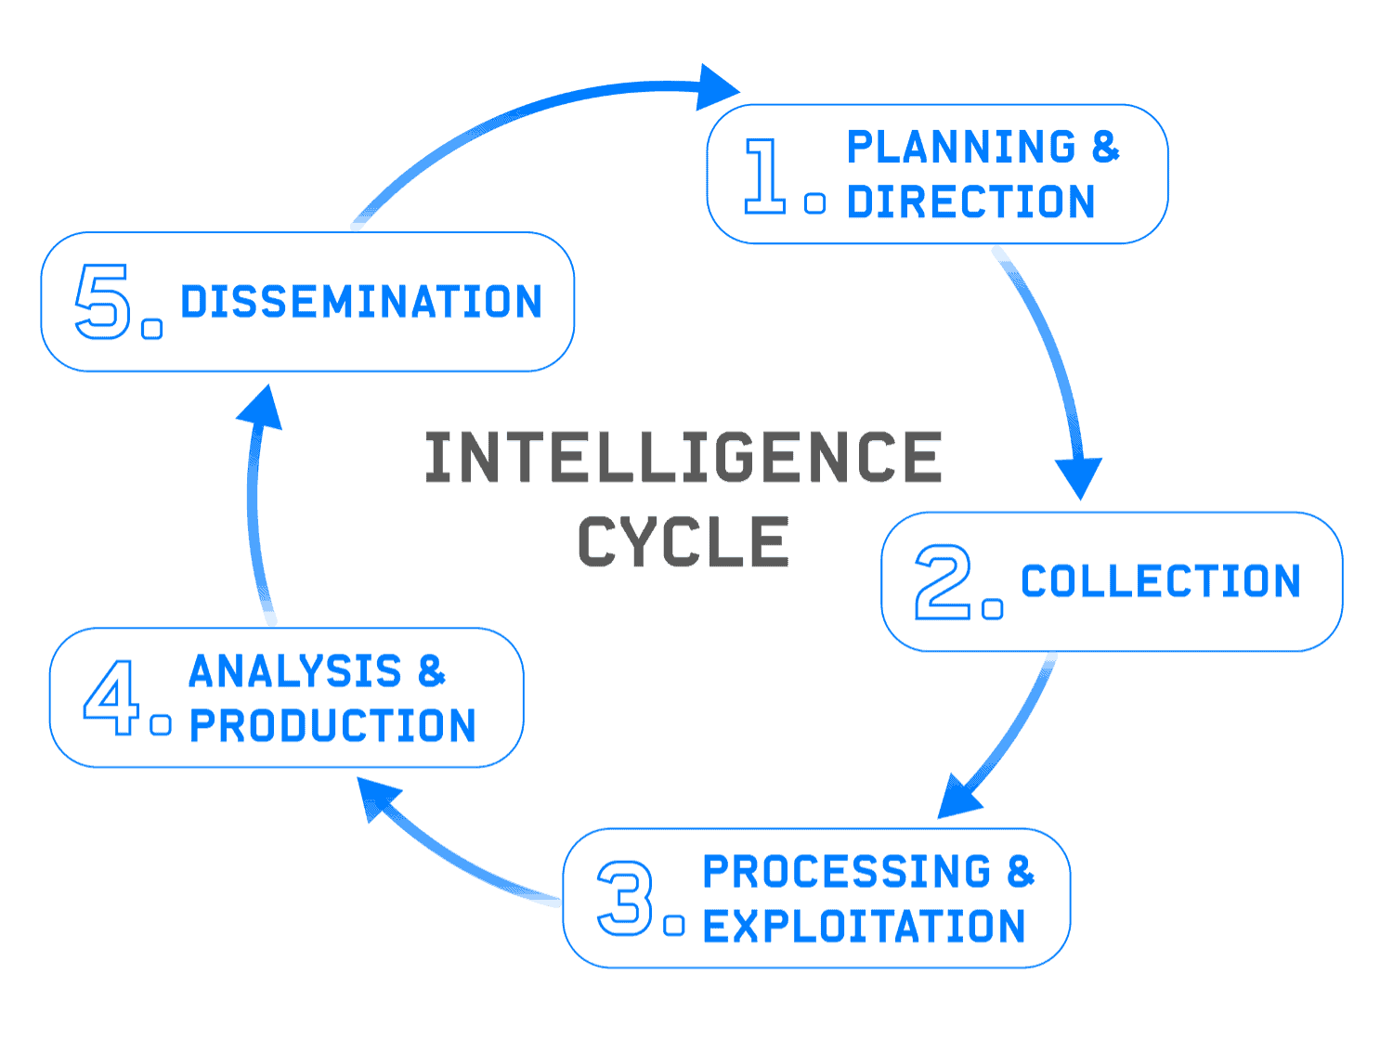
Enabling devices, such as computers, to carry out tasks and processes that would usually demand human-level intelligence.
The processes include reading, understanding and responding to language, analyzing data, and problem solving.
The difference from previous machines?
By design, AI models learn and improve
their processes.

Slide 5
How does AI work?

Slide 6
AI functionality is based on:
- algorithms, mathematical models
- data, vast amounts of information
Massive amounts of data have to be collected, aka the internet, to train AI models to notice patterns and trends.
AI Neural Networks: multiple algorithms plus layers of interconnected nodes imitate the neurons of the brain. Each node can receive and transmit data to those around it, giving AI “generative” abilities.

Slide 7
If AI models pull from existing data sets...
...can it be unbiased?
...can it create new information?
...can it assess accuracy?

Slide 8
Types of AI
Smart assistants: Siri and Alexa
Translation: real-time language translation
Image Recognition: camera scans
Generative AI: tools to create content based on use prompts, aka create “new” data similar to data trained on
    ChatGPT, DALL-E

Slide 9
What it does
Well
Collecting, aggregating existing info.
“Generating” info that sounds, looks new.
Writes several styles.
Graphics, etc.
Not well
High-end thinking.
Work in nuances.
Work in values.
Source validation.
Strong allure:
Easy, fast, sounds good.
(Perhaps because “sycophantic”?)

Slide 10
Protect yourself from it
  Errors
  Manipulation
  Make us stupid

Slide 11
Errors
Well-known anecdotes
Put glue on pizza
Obama was a Muslim born in Kenya
Drink urine to pass a kidney stone
Law firms submit false citations to court

Slide 12
Manipulation
What influences what a search tool or AI gives you?
1.
Profiles
Hundreds or thousands of bits of info “they” have collected on you.
  Address
  Income, credit
  Interests
  Purchases
  Memberships
  What you read
  Language
  Videos
  People you communicate with
  Political views
  Sexual orientation
  Recreation, hobbies
… plus hundreds more

Slide 13
Manipulation
What influences what a search tool or AI gives you?
2.
Algorithms
Strictly speaking, set of criteria through which results are filtered and prioritized
Much is “behavioral personalization,” part of your profile.
Visits to sites; links to sites; “backlinks”
Searches
Much is PAID BY INTERESTS
Companies, parties, governments that want to influence you.
Google sells its “analytics” to clients.
Clients pay for targeting of people with particular profiles or behavioral personalization.
Enables “behavioral targeting” based on “training data” and assigned values.

Slide 14
Manipulation
Bottom line:
  Not everything is being spoon-fed by interested parties, but you must be on guard.
  The search tools are flawed, but they are more transparent than the AI tools.
  The algorithms and clients are not transparent, and they are much more opaque in AI.

Slide 15

Make us Stupid
Serious research increasingly shows that these tools dumb us down.
Among the good studies:
MIT Media Lab
“Neural and behavioral deficits” when use LLM tools to do your thinking and writing.
Not an entirely new or surprising. Don’t remember phone numbers because of iPhone. Don’t remember way to places because of GPS.

Slide 16
How to Protect Ourselves
Be smart.
  Never take off your critical-thinking hat.
  Always control the question and words.
  Don’t become too dependent on tech.
Online, manage your profile and watch the algorithms.
  Create different personas for searches.
  Use different machines* and use VPN.
  Delete browser cookies and history.
  Protect your privacy.
* Device fingerprints – based on hardware, software, and IP are extremely precise.

Slide 17
device fingerprint
NOT USE
• Software attributes:
Operating system (OS) type and version
Browser type and version
Installed fonts and plugins
Time zone and language settings
User agent string
IP address
• Hardware attributes:
Screen resolution and size
CPU model and architecture
GPU model and drivers (often through techniques like Canvas and WebGL fingerprinting)
Battery information
Device model (for mobile devices)
Connected media devices (e.g., audio and video cards)
Hardware ID (in some cases)
• Other characteristics:
Network type
Geolocation data
VPN and browser information
Flash data

Slide 18
NOT USE
While completely avoiding device fingerprinting is difficult, you can take steps to reduce its effectiveness:
Use privacy-focused browsers: Browsers like Tor, Brave, and Mozilla Firefox offer enhanced privacy features and resistance to fingerprinting.
Install anti-fingerprinting extensions: Extensions like uBlock Origin, Privacy Badger, and CanvasBlocker can block or mitigate fingerprinting techniques.
Adjust browser settings: Modify settings to minimize data sharing, such as disabling unnecessary plugins, JavaScript (with caution as it can break some websites), or opting out of third-party cookies.
Use a VPN: A VPN can mask your IP address, a component of your digital fingerprint, but won't prevent fingerprinting entirely.
Disable WebGL and canvas: This can reduce exposure to canvas fingerprinting.
Regularly clear browser data: While not foolproof, it can minimize some tracking methods.

Slide 19
Responsible Use: Better Google
Narrowing research—one author, multiple topics
  reference noted writer and specific time period in the prompt and ask to pull out key works for you to read
Reference selection—one topic, multiple papers
  reference multiple research papers, or a massive document, in the prompt and ask to pull out mentions of a specific topic.

Slide 20
ChatGPT Prompts for Academic Writing
Dr Amina Yunis Explainer (start 1:00)
https://www.youtube.com/watch?v=NqQl8jAy5f8

Slide 21
Artificial Intelligence
-Using AI Responsibly -
Nayyera Haq
Fulton Armstrong
19 September 2025

