Slide 1
Real or Fake? Determining the truth of something is among the analyst’s primary tasks.

Slide 2
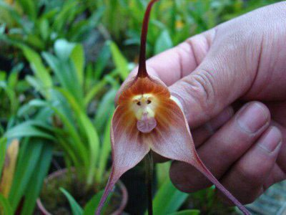
Is this orchid blossom real or fake?
Real

Slide 3
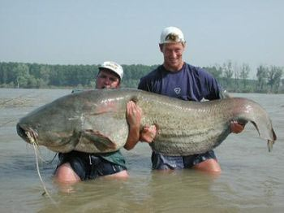
Is this catfish real or fake?
Real

Slide 4
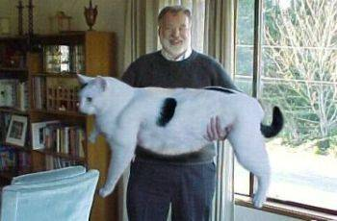
Is this house cat real or fake?
Fake

Slide 5
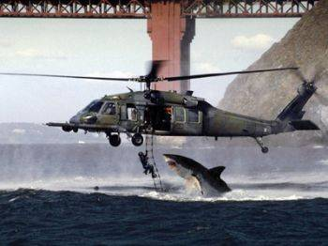
Is this shark attack real or fake?
Fake

Slide 6
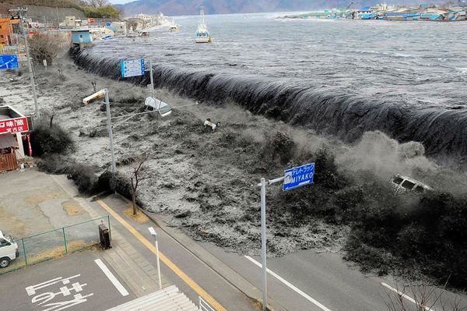
Is this tsunami in Miyako, Japan, real or fake?
Real

Slide 7
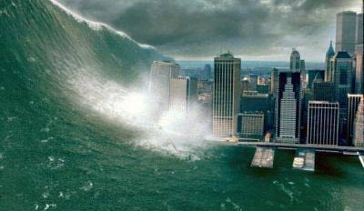
Is this tsunami in New York City real or fake?
Fake

Slide 8
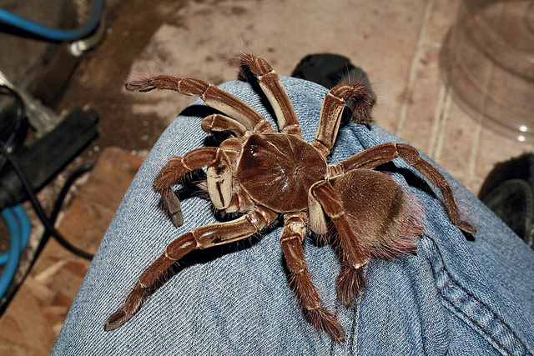
Is this goliath birdeater tarantula real or fake?
Real

Slide 9
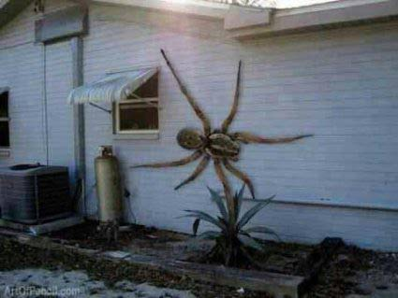
Is this wall spider real or fake?
Fake

Slide 10
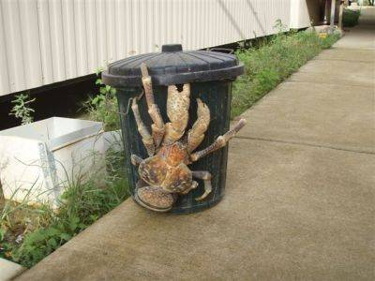
Is this coconut crab real or fake?
Real

Slide 11
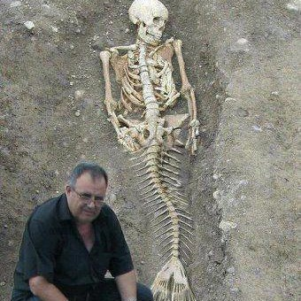
Is this mermaid skeleton found near the Black Sea real or fake?
Fake

Slide 12
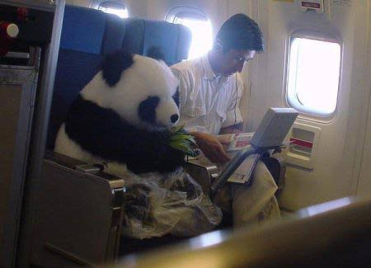
Is this flying panda real or fake?
Fake

Slide 13
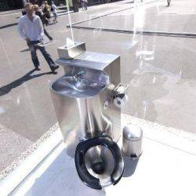
Is this public toilet with one-way glass walls real or fake?
Real

Slide 14
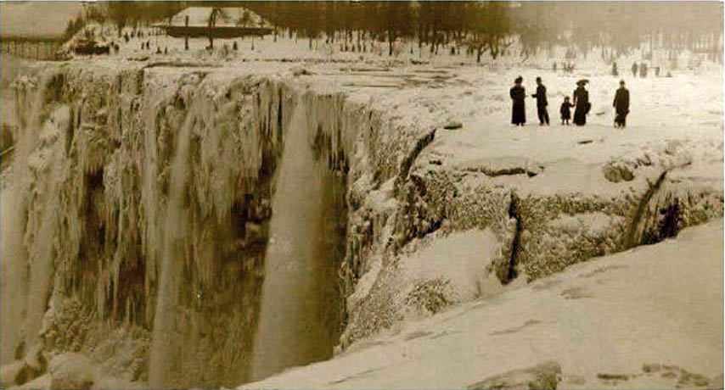
Is this frozen Niagara Falls (in the early 1900s) real or fake?
Real

Slide 15
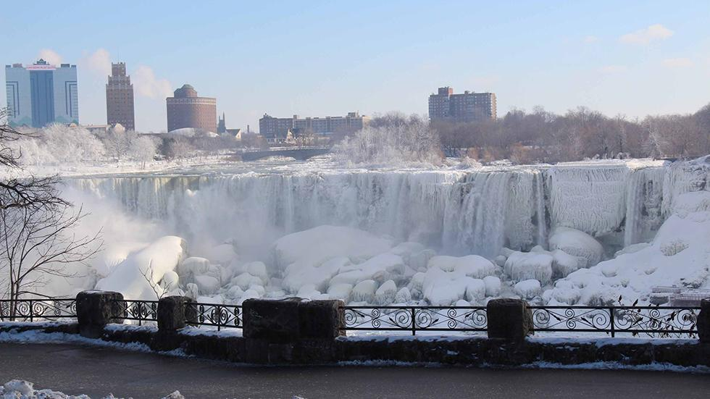
Niagara Falls - Jan. 9, 2014

Slide 16

Is this set of twins – one white and one black – real or fake?
Real

Slide 17
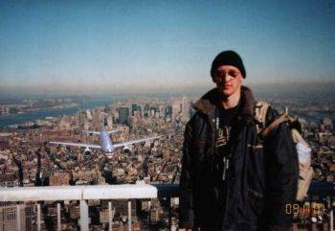
Is this 9/11 tourist snapshot real or fake?
Fake

Slide 18
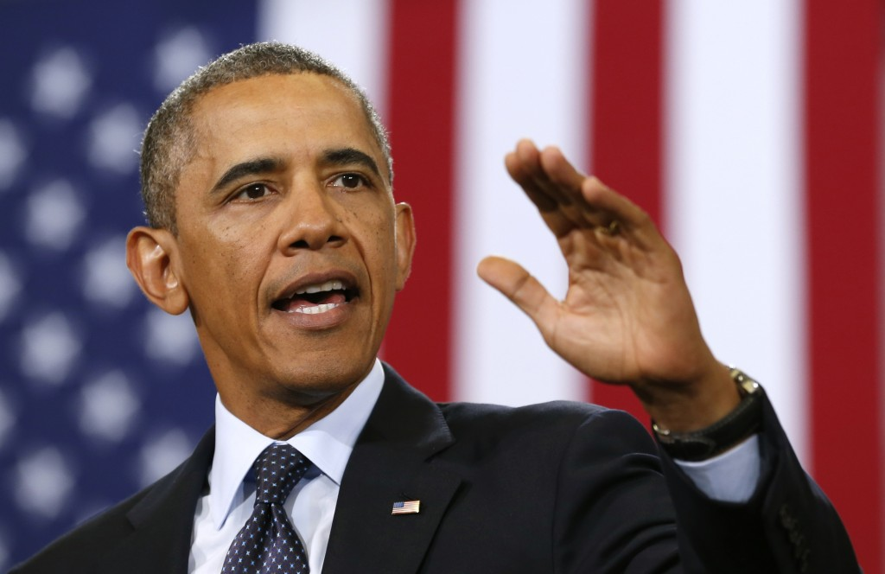
Is this man the constitutional president of the United States of America?
Real

