Slide 1
Do you trust your information?
Life is an illusion … or at least … it’s full of them …
AND our mind often fills in the gaps … incorrectly.

Slide 2
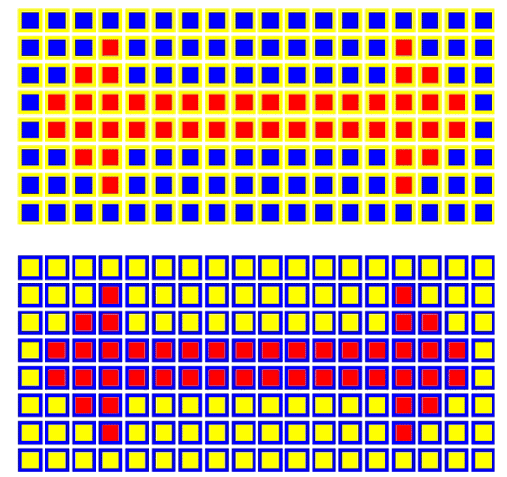
Are the arrows the same color red?

Slide 3

brainbashers.com

Slide 4
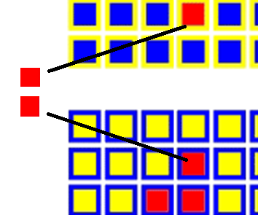

Slide 5
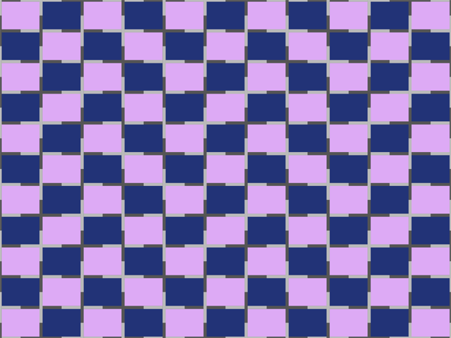
Are the lines straight?

Slide 6
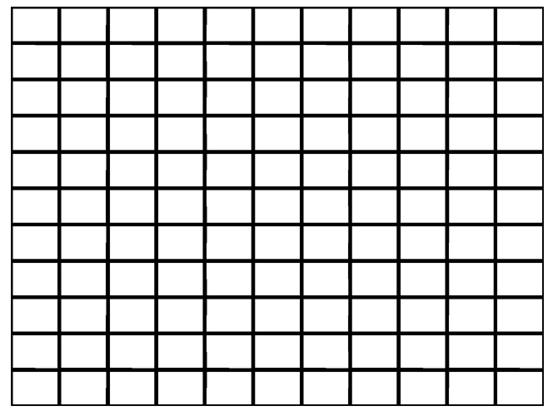
brainbashers.com

Slide 7


What’s this?
brainbashers.com

Slide 8

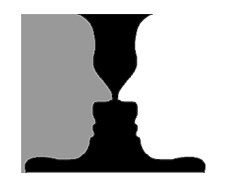
What’s this?

Slide 9
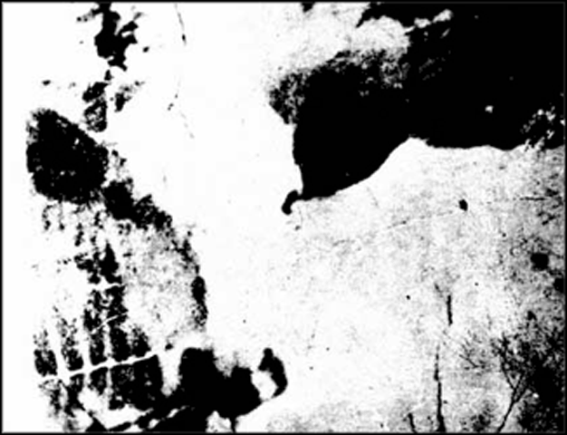
What’s this?

Slide 10
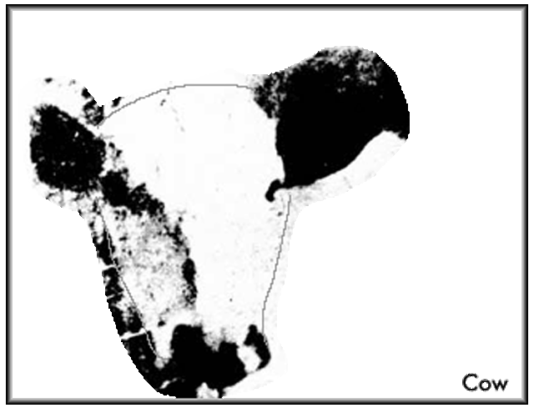

Slide 11


What’s this?

Slide 12
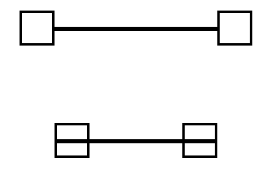
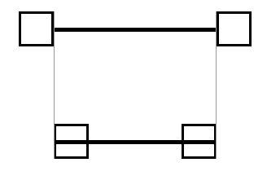
Are the two lines the same length?
Yes

Slide 13
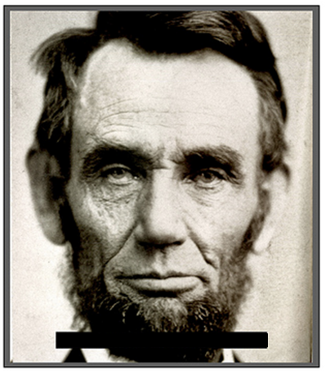
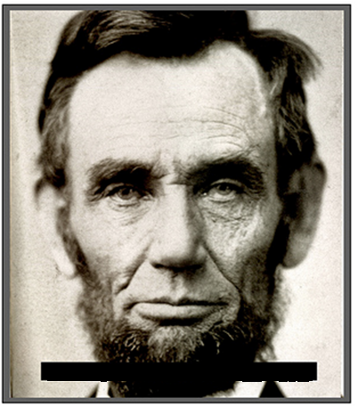
Which man is more trustworthy?

Slide 14
Which man is more trustworthy?

Slide 15
Which man is more trustworthy?

Slide 16
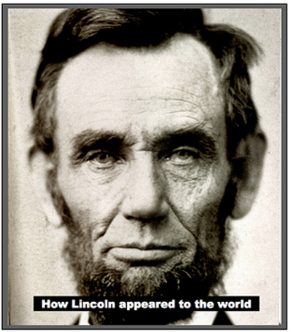
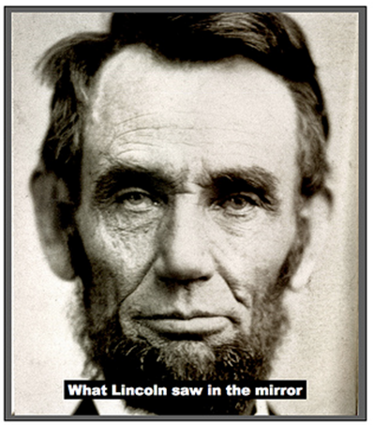
Which man is more trustworthy?

Slide 17
Be careful … what you see may belie what you think.

Slide 18
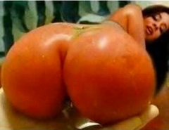
What is this?
A tomato!

Slide 19
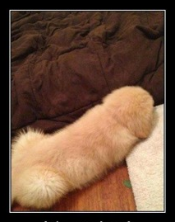
What is this?
A dog!!

Slide 20
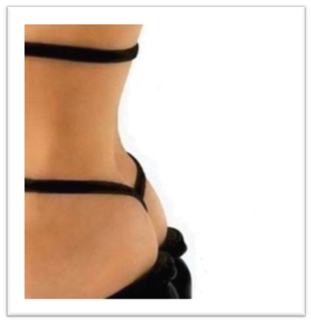
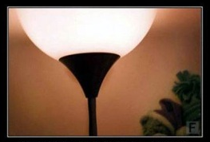
What are these?
It’s a lamp!
A pair of shoes!

Slide 21
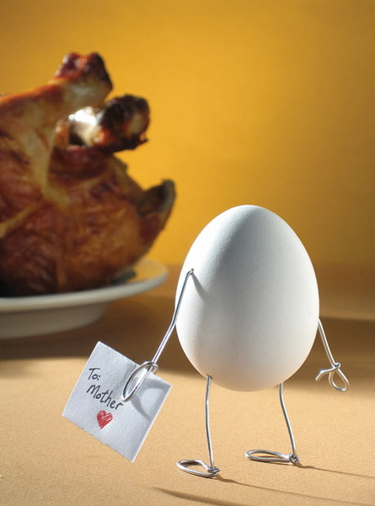
And … finally … an analyst sees a story in everything.

