Slide 1

Producto de Inteligencia
Delivering Quality Analysis to Decisionmakers
11-12 November 2016
Guanajuato
Fulton Armstrong

Slide 2

What is analysis?
To warm up our analytical skills,
let’s take a little quiz.

Slide 3
How did you determine “real” or “fake”?
By what you really know?
By your ability to spot Photoshop pictures?
By logic?
By precedent?
Do you trust your eyes??
How do you process information??

Slide 4
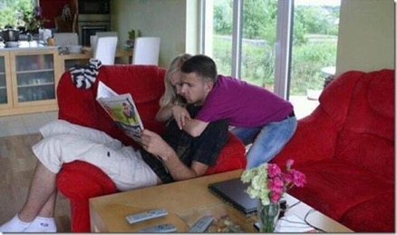
Left brain … or right brain?

Slide 5
If you see the woman sitting and man with his arms around her neck, then you are “left brain.”
You’re supposed to be good at doing math, breaking down problems, and doing analysis

Slide 6
If you see the man sitting and woman with her arms around his neck, then you are “right brain.”
You’re supposed to be intensely curious, creative, and see the “big picture.”

Slide 7
What is analysis?
How good an observer are you?

Slide 8
What is analysis?
Analysis is …
  Challenging
  Fun
  Important

Slide 9
“Who am I? And what am I doing here?”
A spontaneous career producing and consuming information:
    Linguistics
    Journalism
    U.S. House of Representatives
    CIA
    White House – National Security Council (NSC)
    National Intelligence Council (NIC)
    U.S. Military – Intelligence Advisor
    U.S. Senate
    The American University
    New York; Washington, DC;
    Barcelona; Madrid;
    Taipei; Havana; Brussels; San José

Slide 10


http://www.american.edu/clals/
http://aulablog.net/

Slide 11
First Briefing
“Who are you?”
>>>>>>>>>>>>>>>

Slide 12
Presentación de análisis
A
Nombre: ___________________
Preparación:
¿Quién eres? Notas para auto-presentación oral de 30 segundos.
_______________________________________________________________________________
_______________________________________________________________________________
_______________________________________________________________________________
_______________________________________________________________________________
_______________________________________________________________________________
_______________________________________________________________________________
_______________________________________________________________________________
¿Qué decisión hiciste recientemente? ¿Cómo la hiciste?
_______________________________________________________________________________
_______________________________________________________________________________
_______________________________________________________________________________
_______________________________________________________________________________
_______________________________________________________________________________
_______________________________________________________________________________
_______________________________________________________________________________

Slide 13
Presentación de análisis
A
Nombre: ___________________
Preparación:
¿Quién eres? Notas para auto-presentación oral de 30 segundos.
_______________________________________________________________________________
_______________________________________________________________________________
_______________________________________________________________________________
_______________________________________________________________________________
_______________________________________________________________________________
_______________________________________________________________________________
_______________________________________________________________________________
¿Qué decisión hiciste recientemente? ¿Cómo la hiciste?
_______________________________________________________________________________
_______________________________________________________________________________
_______________________________________________________________________________
_______________________________________________________________________________
_______________________________________________________________________________
_______________________________________________________________________________
_______________________________________________________________________________
TAKE FIVE MINUTES TO PREPARE
10-min
clock

Slide 14
First Briefing
“Who are you?”
Tell me (and us) in 30 seconds, please
30 seconds

Slide 15
“And what are we doing here?”
Build on what you already know and what you do in your current jobs
Discuss what policymakers (in broad definition) want and need – and the difference between the two
Examine the differences between the culture and psychology of policymakers and us
Discuss the importance of analytical tradecraft
Discuss the importance of briefing skills
PRACTICE ALL OF THE ABOVE SKILLS

Slide 16
Our Agenda
FRIDAY
What does the policymaker want and need?
How do we (and policymakers) make decisions?
What do we need to make decisions?
In what ways are “we” and “they” different?
What is the role of analysis in policymaking?
What makes good analysis good? (Examples.)
What is analytical tradecraft, and what does it do for me?

Slide 17
Our Agenda
FRIDAY
How can I present my information and analysis in the most effective way possible?
What makes for a good briefing?

Slide 18
Our Agenda
SATURDAY
Practice briefing a policymaker
Practice answering questions; building rapport
Discuss how to evaluate your analysis and briefing

Slide 19
Terminology
Policy/policymaker, politics/politician
Intelligence, information, facts
Opinion, analysis, judgment
Logic, precedent, models
Event, driver, trend, scenario
Assumption, variable, alternative

Slide 20
Ground Rules
This is a workshop.
  participation
  creativity, not staying within “the lines”
  build and adapt models together
  respect for all views in and outside class

Slide 21
What does the policymaker want and need?
Three approaches:
How do you (or anyone) make a decision? What do you need to do it?
What’s the difference between “them” (policymakers) and “us” (analysts)?
What’s the difference between what they want and what they need?

Slide 22
What does the policymaker want and need?
Three approaches:
How do you (or anyone) make a decision? What do you need to do it?
What’s the difference between “them” (policymakers) and “us” (analysts)?
What’s the difference between what they want and what they need?

Slide 23
How do you make decisions?
What’s a decision you made recently?
    a job-related move
    a boyfriend/girlfriend
    a purchase
    a new apartment
How did you make it?
    research
    discuss with friend or professional
    fortune-teller
    toss a coin

Slide 24
Presentación de análisis
A
Nombre: ___________________
Preparación:
¿Quién eres? Notas para auto-presentación oral de 30 segundos.
_______________________________________________________________________________
_______________________________________________________________________________
_______________________________________________________________________________
_______________________________________________________________________________
_______________________________________________________________________________
_______________________________________________________________________________
_______________________________________________________________________________
¿Qué decisión hiciste recientemente? ¿Cómo la hiciste?
_______________________________________________________________________________
_______________________________________________________________________________
_______________________________________________________________________________
_______________________________________________________________________________
_______________________________________________________________________________
_______________________________________________________________________________
_______________________________________________________________________________

Slide 25
How do you make decisions?
How do you control your impulses?
    wishful thinking
    biases
    image
How do you (or will you) know it was the right decision?
    test results
    profits
    other indicators
How would you describe your analytical method?

Slide 26
Presentación de análisis
A
Nombre: ___________________
Preparación:
¿Quién eres? Notas para auto-presentación oral de 30 segundos.
_______________________________________________________________________________
_______________________________________________________________________________
_______________________________________________________________________________
_______________________________________________________________________________
_______________________________________________________________________________
_______________________________________________________________________________
_______________________________________________________________________________
¿Qué decisión hiciste recientemente? ¿Cómo la hiciste?
_______________________________________________________________________________
_______________________________________________________________________________
_______________________________________________________________________________
_______________________________________________________________________________
_______________________________________________________________________________
_______________________________________________________________________________
_______________________________________________________________________________
TAKE FIVE MINUTES TO PREPARE
10-min
clock

Slide 27
So what do we need to make GOOD decisions?
A clear understanding of
your needs and desires
the causes or drivers of your needs
the trends of the causes of your needs
the likely outcomes and alternative outcomes of those trends
the implications of addressing (or not) the needs
And a clear, conscious effort to
think through alternative analysis
control biases
be transparent

Slide 28
So what do we need to make GOOD decisions?
Example: My old car is becoming unreliable
Problem | Unreliable transportation
My needs/desires | Reliable transportation; nice style
Causes or drivers affecting needs | Job, shopping location; car age or other condition
Trends of those causes/drivers | More repairs; more expensive; salary
Likely outcomes | Probably less reliable, less safe
Alternative analyses? | Company provide car?
Implications | Keep/lose job; could have accident; big pay raise
Biases? | Want to drive in style
Conclusions? | ???

Slide 29
So what do we need to make GOOD decisions?
In this example, what do I do?
Look at the causes (drivers)
Look at what’s happening (trends)
Look at what is likely to happen (outlooks)
Look at what could happen (alternative scenarios) and at “low probability, high impact” events (wildcards)
Think about options
Think about implications

Slide 30
So what do policymakers need to make GOOD decisions?
GOOD QUALITY INFORMATION
timely, objective, independent, without agenda
transparent, honest (what’s known, thought, speculated)
USEFUL AND RELEVANT
  focusing on drivers (differentiating causes/results, symptoms/illnesses)
  identifying trends
  producing realistic scenarios (with realistic probabilities) as well as alternatives and wildcards.
confidential
This is our model.

Slide 31
What does the policymaker want and need?
Three approaches:
How do you (or anyone) make a decision? What do you need to do it?
What’s the difference between “them” (policymakers) and “us” (analysts)?
What’s the difference between what they want and what they need?

Slide 32
Differences between “them” and “us”
(policymakers and analysts)
Same role in government, company, and society?
Same objectives? Same timelines for results?
Same definitions of interests?
Same skills and experience? Same expertise on issues?
Same accountability?
Same information?
Same work environment? Same office support?
Same personality?

Slide 33
Differences between “them” and “us”
(policymakers and analysts)
Do you think that …
  We’re on the same team, with most objectives in common?
  Different emphasis on objectives can usually be explained?
  Differences are resolved differently in public and private sector?
  In the end, the policymaker/decisionmaker is the boss and is ultimately more accountable than the analyst?
  Respect is essential, and should be strong institutional ethic?

Slide 34
What does the policymaker want and need?
Three approaches:
How do you (or anyone) make a decision? What do you need to do it?
What’s the difference between “them” (policymakers) and “us” (analysts)?
What’s the difference between what they want and what they need?

Slide 35
Difference between what the policymaker wants
and needs?
Why and when would the difference be significant?
What factors cause this?
What are some examples?

Slide 36
Difference between what the policymaker wants
and needs?
In your example, how did you control your impulses?
    wishful thinking
    biases
When you’re briefing a decisionmaker, how do you control his/her impulses?
    clear tradecraft, including
    - drivers showing his/her possible influence
    - scenarios with meaningful probabilities*
*including, indirectly, good/bad prospects for scenarios premised upon his/her policies

Slide 37
In its simplest form … good analysis:
Provides an accurate snapshot of what we know and what we think about a current situation
    who, what, when, where, how, why
    what’s driving it – the “drivers”
Identifies the trends
    what’s happening with each key driver
Identifies potential outcomes, with some estimation of probability
These amount to the key judgments.
Good analysis educates … is transparent … policy-relevant … dynamic.

Slide 38
In its simplest form … good analysis …
Educates and Equips
Transparent, honest, neutral
Identifies drivers
Identifies trends and probable outcomes
Considers range of interests
Builds on policymaker’s expertise
Informed by policy
Identifies threats and opportunities
Good analysis is dynamic.

Slide 39
Success is …
We succeed as analysts when our information and analysis enable policymakers to adopt policies that
meet their short- and mid-term political needs, and
serve the country’s (or company’s) short-, mid-, and long-term security, economic and social needs.

Slide 40
Failure is …
We fail as analysts when our information and analysis leads policymakers to adopt policies that
might or might not meet their short- and mid-term political needs,
don’t warn meaningfully of challenges,
don’t identify opportunities to move interests, and
do not serve the country’s short-, medium- or long-term security, economic and social needs.

Slide 41


is all too common.
Take a break

Slide 42
Our Briefing Exercise (Tomorrow)
PURPOSES |  | Deepen understanding of policymaker needs Improve analytical tradecraft Practice oral briefing skills
STEPS
Now: |  | Choose a partner and sit with him/her Choose a topic to analyze and brief Analyze your decisionmaker’s needs (Handout B) Fill out your decisionmaker survey (Handout C)
Later: |  | Prepare your briefing
Tomorrow: |  | As analysts, give oral briefing; Q&A As policymakers, receive briefing; Q&A Change roles Discuss strengths/weaknesses of process

Slide 43
Our Briefing Exercise (Tomorrow)
PURPOSES |  | Deepen understanding of policymaker needs Improve analytical tradecraft Practice oral briefing skills
STEPS
Now: |  | Choose a partner and sit with him/her Choose a topic to analyze and brief Analyze your decisionmaker’s needs (Handout B) Fill out your decisionmaker survey (Handout C)
Later: |  | Prepare your briefing
Tomorrow: |  | As analysts, give oral briefing; Q&A As policymakers, receive briefing; Q&A Change roles Discuss strengths/weaknesses of process

Slide 44
Our Briefing Exercise (Tomorrow)
PURPOSES |  | Deepen understanding of policymaker needs Improve analytical tradecraft Practice oral briefing skills
STEPS
Now: |  | Choose a partner and sit with him/her Choose a topic to analyze and brief Analyze your decisionmaker’s needs (Handout B) Fill out your decisionmaker survey (Handout C)
Later: |  | Prepare your briefing
Tomorrow: |  | As analysts, give oral briefing; Q&A As policymakers, receive briefing; Q&A Change roles Discuss strengths/weaknesses of process

Slide 45
Our Briefing Exercise (Tomorrow)
PURPOSES |  | Deepen understanding of policymaker needs Improve analytical tradecraft Practice oral briefing skills
STEPS
Now: |  | Choose a partner and sit with him/her Choose a topic to analyze and brief Analyze your decisionmaker’s needs (Handout B) Fill out your decisionmaker survey (Handout C)
Later: |  | Prepare your briefing
Tomorrow: |  | As analysts, give oral briefing; Q&A As policymakers, receive briefing; Q&A Change roles Discuss strengths/weaknesses of process

Slide 46
Our Briefing Exercise (Tomorrow)
PURPOSES |  | Deepen understanding of policymaker needs Improve analytical tradecraft Practice oral briefing skills
STEPS
Now: |  | Choose a partner and sit with him/her Choose a topic to analyze and brief Analyze your decisionmaker’s needs (Handout B) Fill out your decisionmaker survey (Handout C)
Later: |  | Prepare your briefing
Tomorrow: |  | As analysts, give oral briefing; Q&A As policymakers, receive briefing; Q&A Change roles Discuss strengths/weaknesses of process

Slide 47


Our Briefing Exercise (Tomorrow)
Small-team exercise
Team A
Team B
Team A plays analyst/briefer; Team B plays policymaker
Team B plays analyst/briefer; Team A plays policymaker

Slide 48
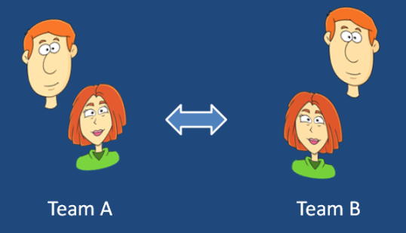

BRIEFING
TEMAS y EQUIPOS
CLICK HERE TO OPEN LIST
Con cada tema …
Equipo A juega papel de analista/briefer sobre su tema, mientras Equipo B juega papel de su decisor.
Equipo B juega papel de analista/briefer sobre su tema, mientras Equipo A juega papel de su decisor.
Tema Equipo A | Equipo A | Equipo B | Tema Equipo B
Elecciones EEUU | Juan Emma | Nancy Carlos | Acuerdo de paz en Colombia

Slide 49
Presentación de análisis
¿Qué es lo que tu decisor necesita saber?
El tema | ¿A qué asunto quiero yo llamar la atención de los decisores?
Información/análisis | ¿Qué pasa, y por qué? ¿Cuáles son los impulsores, las tendencias actuales, los escenarios, los variables?
Los intereses | ¿Por qué es este tema importante para los decisores? ¿Cómo aumenta (o disminuye) la ventaja del país/empresa? ¿Cuáles son las probabilidades de los escenarios beneficiosos, y de los escenarios dañinos?
Las opciones | ¿Qué puede hacer el decisor para influir la situación y prepararse para las consecuencias?
La inteligencia | ¿Qué información tenemos ahora, y qué información tenemos que recoger o desarrollar, para ayudar al decisor entender la situación, tener alguna influencia sobre ella, y por lo menos reaccionar a ella?

Slide 50
Presentación de análisis
B
Equipo: ________ y ___________
¿Qué es lo que tu decisor necesita saber?
El tema
Información/análisis
Los intereses
Las opciones
La inteligencia

Slide 51

Presentación de análisis
30 mins
¿Qué es lo que tu decisor necesita saber?
El tema | ¿A qué asunto quiero yo llamar la atención de los policymakers?
Información/análisis | ¿Qué pasa, y por qué? ¿Cuáles son los impulsores, las tendencias actuales, los escenarios, los variables?
Los intereses | ¿Por qué es este tema importante para los decisores? ¿Cómo aumenta (o disminuye) la ventaja del país/empresa? ¿Cuáles son las probabilidades de los escenarios beneficiosos, y de los escenarios dañinos?
Las opciones | ¿Qué puede hacer el decisor para influir la situación y prepararse para las consecuencias?
La inteligencia | ¿Qué información tenemos ahora, y qué información tenemos que recoger o desarrollar, para ayudar al decisor entender la situación, tener alguna influencia sobre ella, y por lo menos reaccionar a ella?

Slide 52
What is Analytical Tradecraft?
How does good tradecraft help us serve the policymaker?
How does it help us as analysts protect our own equities?
How does it make our lives easier and more fun?

Slide 53
What is Analytical Tradecraft?
How does good tradecraft help us serve the policymaker? How does it help us as analysts protect our own equities? How does it make our lives as analysts easier and more fun?
1. It is the CONSCIOUS and DELIBERATE process of evaluating and transforming raw data into descriptions, explanations, and conclusions for intelligence consumers –
free from bias (ours or policymaker’s)
free from manipulation (the reporting agency’s, source’s or sub-source’s)
free from intellectual limitations (linear thinking)
2. Tradecraft is what enables us to look the policymaker in the eye and say:
We have examined the information and evidence we have, and we believe that ___ is occurring; it is being driven by ____; it appears likely to ___; and it has ___ implications. We also believe that, although less likely, the situation could evolve in ___ manner if ___ occurs, which would have ___ implications.
3. Tradecraft is also structured humility – the willingness to concede that
any issue worth analysis is difficult
our information rarely (or never) is good enough
our speculation is “informed” by our expertise, but we don’t know as much as we think
if our “probable” scenario doesn’t materialize, we also offer alternative scenarios

Slide 54
What is Analytical Tradecraft?
Tradecraft
It is the CONSCIOUS and DELIBERATE process of evaluating and transforming raw data into descriptions, explanations, and conclusions for intelligence consumers –
free from bias (ours or policymaker’s)
free from manipulation (the reporting agency’s, source’s or sub-source’s)
free from intellectual limitations (linear thinking)

Slide 55
What is Analytical Tradecraft?
Tradecraft
Tradecraft is what enables us to look the policymaker in the eye and say:
We have examined the information and evidence we have, and we believe that ___ is occurring; it is being driven by ____; it appears likely to ___; and it has ___ implications. We also believe that, although less likely, the situation could evolve in ___ manner if ___ occurs, which would have ___ implications.

Slide 56
What is Analytical Tradecraft?
Tradecraft
Tradecraft is also structured humility – the willingness to concede that
any issue worth analysis is difficult
our information rarely (or never) is good enough
our speculation is “informed” by our expertise, but we don’t know as much as we think
if our “probable” scenario doesn’t materialize, we also offer alternative scenarios

Slide 57
What is Analytical Tradecraft?
Tradecraft
Can you believe what you see even with your own eyes?

Slide 58
What is Analytical Tradecraft?
Tradecraft
The CONSCIOUS process of …
  checking ASSUMPTIONS (suposiciones) and BIASES (preferencias)and channeling them into HYPOTHESES that you rigorously test
  knowing FACTS and testing them
  admitting information GAPS and exploring different possibilities of missing pieces
  studying DRIVERS and TRENDS of a situation
  looking at probabilities of various SCENARIOS
  examining IMPLICATIONS
  going back to CHECK and CHECK and CHECK

Slide 59
Who is the analyst?
Tradecraft
The analyst’s personality usually includes …
  intense curiosity
  skepticism of sources/information
  idealism (“truth shall set you free”)
  not cynicism or nihilism
He/she sometimes appears conflicted over …
  relationship with team
  ability to come to closure
  arrogance vs. humility (!!!!)

Slide 60
What is the process? (1)
Tradecraft
Assumption - a proposition whose truth is established or otherwise accepted that we make CONSCIOUS as we enter the analytical process, usually in the formation of our hypothesis and first round of questions.
Hypothesis - a tentative assertion linking two or more phenomena, subject to testing and proof.
Usually states a relationship between two or more things
Is stated affirmatively
Can be tested with empirical evidence
The theory/underlying logic of the relationship makes sense
Courtesy Bill Ortman

Slide 61
What is the process? (2)
Tradecraft
Main Elements
  Drivers – factors influencing events
  Trends – flows of events
  Outcomes – where events will be at a certain point in time
  Implications – what the events, drivers, trends and outcomes mean
Judgment – a statement that goes beyond available information to reach a conclusion on the basis of probabilities – an analytic leap from the known to the uncertain – and an honest assessment of our information.
Courtesy Bill Ortman

Slide 62
Examples
Tradecraft
Tradecraft |  | Issues
What are the |  | Terrorism?
assumptions |  | Change in Cuba?
hypotheses |  | Civil war in Syria?
key elements |  | Nuclear programs in Iran?
drivers |  | Migration_
trends |  | Narcotics trade in Europe?
outcomes |  | ISIS expansion in ME?
key judgments
implications

Slide 63
EXAMPLE
How well did U.S. intelligence agencies analyze the Tlatelolco Massacre?
BACKGROUND
2 October 1968
La Plaza de las Tres Culturas, Tlatelolco, DF
Students and others challenge government of President Gustavo Díaz Ordaz Bolaños
Culmination of months of protests, confrontation, and tensions
Hundreds dead; many more injured
Olympic Games two weeks later
Documents declassified / published in 2003
by National Security Archives
www.nsarchive.gwu.edu

Slide 64
EXAMPLE
How well did U.S. intelligence agencies analyze the Tlatelolco Massacre?
QUESTIONS
Did U.S. intelligence …
  understand the underlying dynamics?
  have good, objective sources?
  analyze information effectively?
  get information and analysis to policymakers in effective formats?
Did U.S. intelligence …
  use good analytical tradecraft?

Slide 65
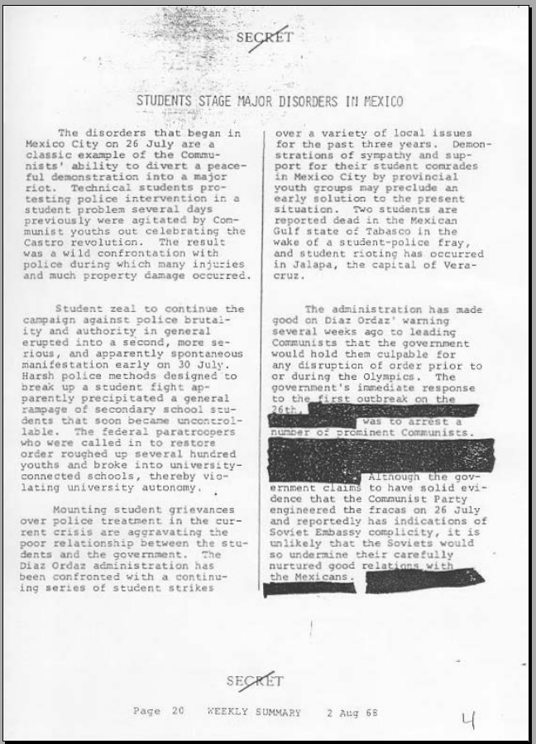
CIA WEEKLY REVIEW
2 August 1968
Assessing 26 July protest and government’s reaction
Some sloppy analysis on drivers
Some contradictions between lead and conclusion
doc 3

Slide 66
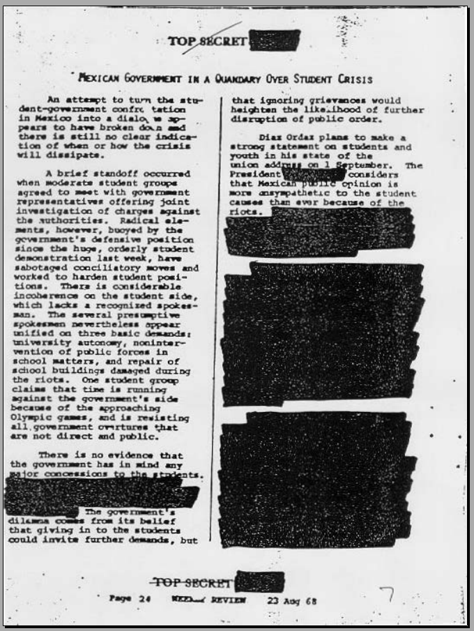
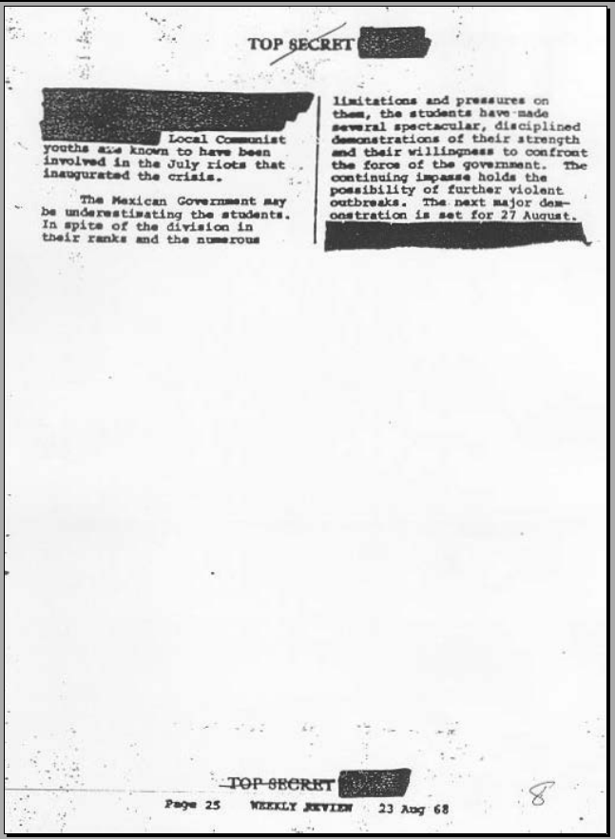
CIA WEEKLY REVIEW
23 August 1968
Warns that dialogue not working
Reports on student, government positions
“Possibility” of more violence
doc 5

Slide 67
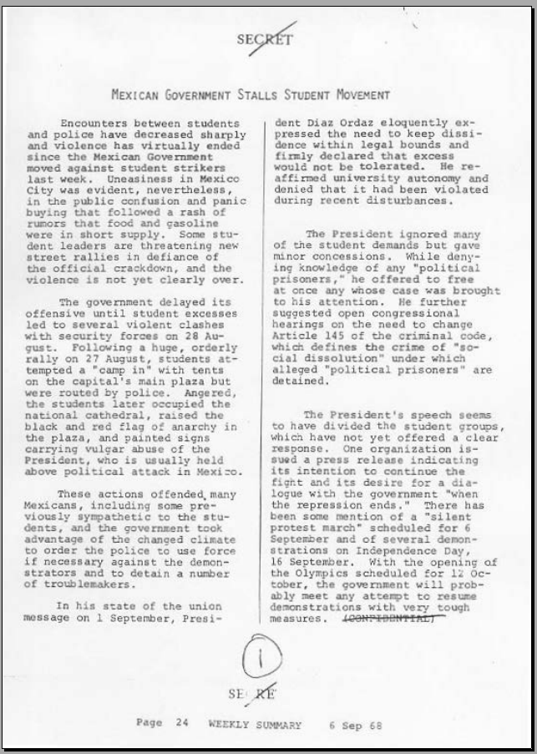
CIA WEEKLY SUMMARY
6 September 1968
Summary of developments
Updates popular attitudes since violence on 28 August
Editorializes on Díaz Ordaz speech and impact
Quality sourcing?
Identifies trigger (Olympics) and predicts government response to demonstrations
doc 8

Slide 68
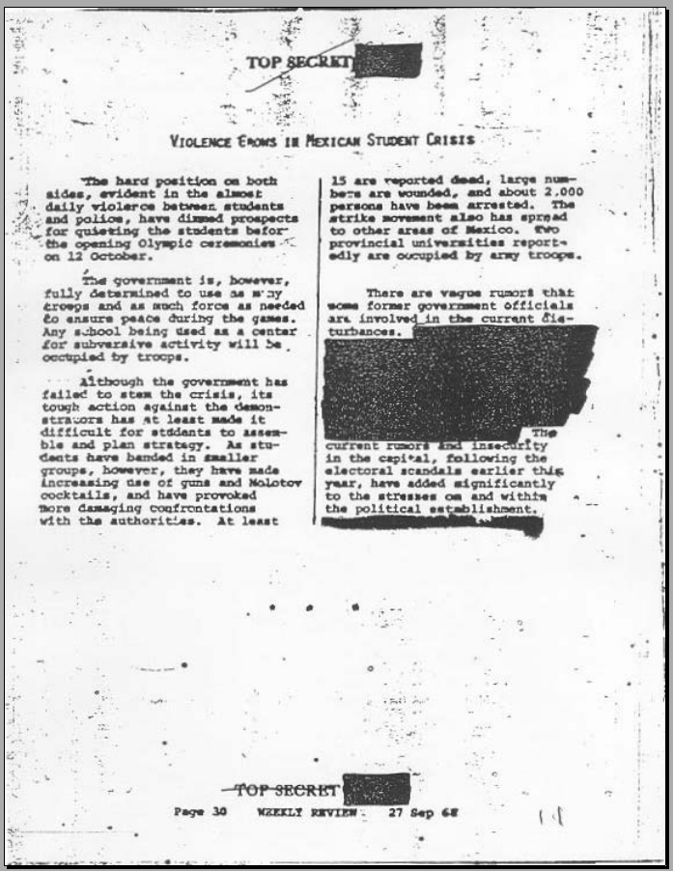
CIA WEEKLY SUMMARY
27 September 1968
Basic warning about growing violence
States government’s resolve (although with weak sourcing)
Transparency of info (“vague rumors”)
Notes growing stresses, suggesting trouble ahead
doc 18

Slide 69
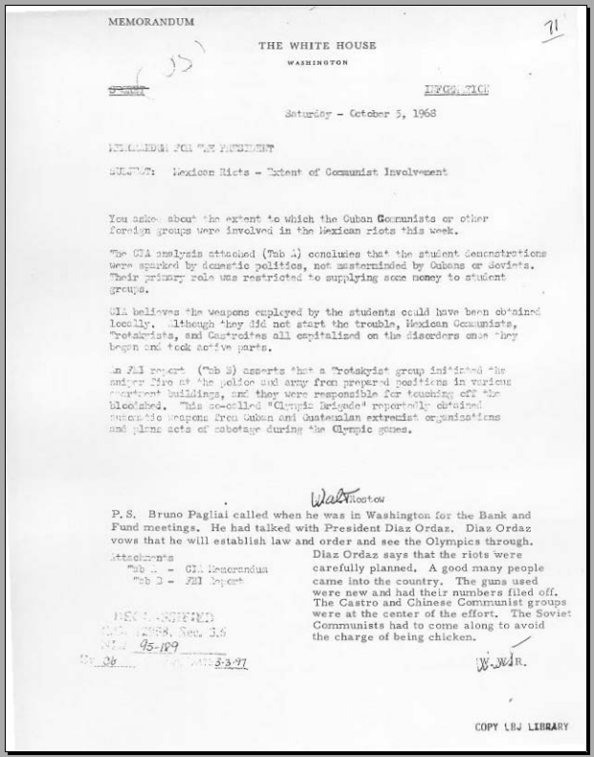
WHITE HOUSE MEMO
with CIA Assessment
5 October 1968
Example of how good analysis can be trumped by back-channel info
      Untested
      Unevaluated
doc 18

Slide 70
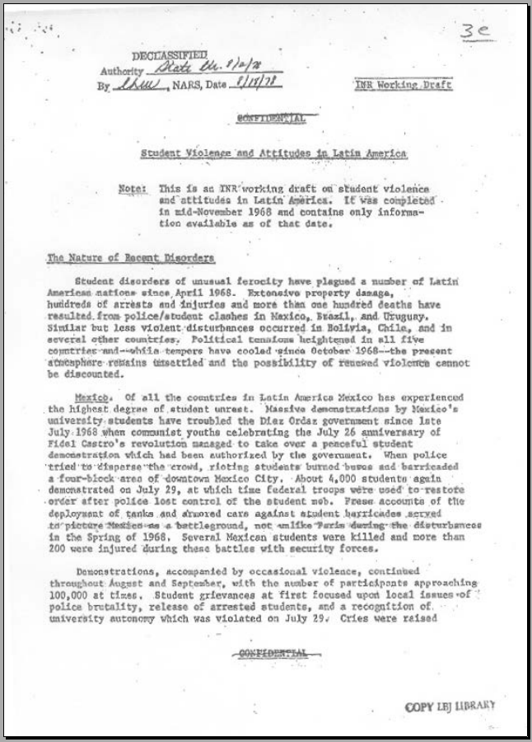
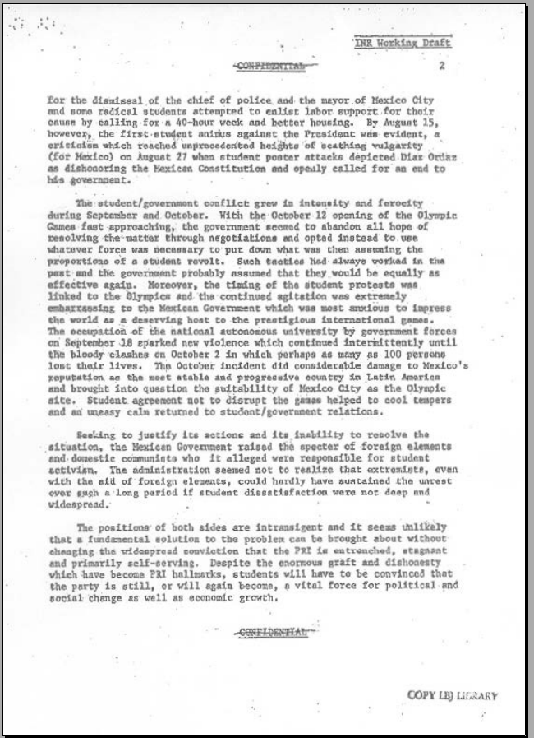
INR WORKING DRAFT
15 November 1968
Summary of protests – with reflections on implications for future
Analyzes underlying drivers and pressure from Olympics
Explains government allegations of external support
States how government could turn things around
doc 26

Slide 71
Other issues …
Politicization - politización
Our value-added
Our customers
Maintaining our morale

Slide 72
Politicization
What is it, and why is it bad?
Why and how does it happen?
What forms does it take?
What is the role of feedback?

Slide 73
Politicization
How about “reverse” politicization – when we do it?
What is it, and why is it bad?
Why and how does it happen?
What forms does it take?

Slide 74
Politicization
How do we prevent either variety of politicization?
  Good tradecraft and transparency
      Be honest about reporting
      Set aside institutional preferences
      Don’t be influenced by access
  Stay up on policy and political developments
  Think like a policymaker
  Remember how “national interests” are determined
  Respect people’s views. Respect processes.
  Respect institutional roles. Respect democracy

Slide 75
Our value-added
What’s our unique contribution?
  Clandestine or special info?
  Subject expertise?
  Timeliness?
  Tradecraft?
  Lack of agenda?
  Warning or opportunity analysis?
Are we basically an internal news outlet competing with external news outlets?

Slide 76
Our customers
Who are our customers?
  Executive branch only?
  Our operational colleagues?
  Private-sector contacts?
  Press (via backgrounders)?
  “The people” (e.g., white papers)

Slide 77
Our Morale
How do we analysts keep up our morale?
Our work can be fun but is often difficult.
We don’t get the same “ego candy” as many of our operational colleagues and policymakers.
So …
  How do we remain motivated?
  How do we charge our batteries?
  How do we feel good about ourselves?
  How do I know if I’m doing a good job?

Slide 78
Consolidate
We have discussed …
  The policymaker’s needs and wants – his/her “world”
  The tradecraft and skills that enable us to meet those needs without the pitfalls of politicization – to be relevant but not prescriptive
  The attitude and knowledge that can enhance our performance and professionalism

Slide 79
And now … how to brief your analysis
What is the value of briefing skills?
What makes a good briefing?
How can I prepare for a briefing?
How do I handle challenges during the briefing (short time, new or difficult questions, etc.)?
How do I evaluate the effectiveness of my briefing?

Slide 80
Why are briefing skills so important?
Write clearly and concisely
Speak clearly and concisely
Think clearly and concisely

Slide 81
What’s the purpose of a
good briefing?
In business …
To convince someone of something.
To make the “sale”
For us …
To sharpen our own thinking
To help policymakers
To save everyone time
“To do our job”

Slide 82
First Briefing
Your first exercise – self-introduction:
You wrote notes for a 30-second briefing that tells us who you are.
WHY IS THIS A PARTICULARLY IMPORTANT SKILL?????

Slide 83
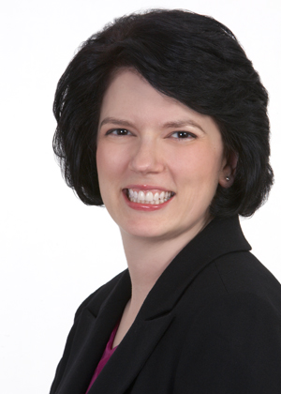

First Briefing
How to introduce ourselves
in 10 seconds
Identify your purpose; prepare; practice
Use your voice, eyes, posture to project energy and competence
Speak in complete sentences, with complete thoughts
Speak naturally, and avoid slang
Emphasize the positive without being arrogant
Gilda Bonanno

Slide 84
How often do you brief now?
How often do you do oral briefings?
How long are your briefings?
Who are your customers? How many at a time?
How many other briefers or supervisors participate?
How often do you get questions?
What problems/challenges do you encounter?

Slide 85
Our Objectives
Build on what you already know about briefing and what you do in your current jobs
Discuss styles – our own, our institution’s, and our customers’
Agree on what policymakers want and need – and the difference between the two
Discuss how to say more with fewer words
Identify ways to improve

Slide 86
What are the advantages of doing an oral briefing?
Exposure to policymaker’s logic, thoughts, processes, values
Flexibility
Q&A allows depth, confirmation that message was received
Greater confidentiality
Greater relevance, credibility (by virtue of access)

Slide 87
What are the characteristics of a good briefing?
Brief, brief, brief, brief, brief, brief
Appropriate to policymaker’s culture (while protecting ours)
Transparent regarding limits of information
Uses good tradecraft
Shifts according to policymaker’s needs

Slide 88
Why is a briefing BRIEF?
Everyone is busy.
Human mind likes brevity.
Better comprehension and retention.
Forces us to be disciplined in information,
analysis, thought.

Slide 89
The importance of brevity
It is my ambition to say in ten sentences what others say in a whole book.
Friedrich Nietzsche (1844-1900)
I would have written a shorter letter, but I did not have the time.
Blaise Pascal (1623-1662)
The most valuable of all talents is that of never using two words when one will do.
Thomas Jefferson (1743-1826)

Slide 90
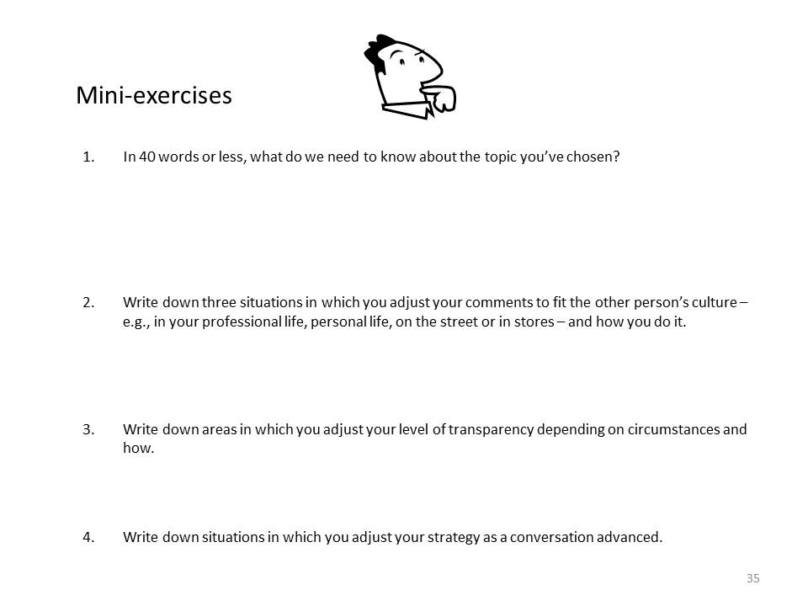
On your handout labeled “Mini-exercises,” write down – in 40 words or less – what we need to know about a topic you like:
las relaciones México-EEUU
la integridad de FIFA
el terrorismo global
el futuro de Centroamérica
la comida mexicana
el mejor destino turístico del mundo
… u otro tema que te interesa

Slide 91
Presentación de análisis
Nombre: ___________________
C
Mini-ejercicios
1. | En 40 palabras o menos, dinos qué necesitamos saber sobre el tema que has escogido.
2. | Explica cómo cambiarías esa presentación en situaciones diferentes – como el contexto profesional, vida personal, o conversación con personas de cultura ajena.
3. | ¿Cómo ajustarías el nivel de transparencia en tus comentarios según tus interlocutores?
4. | Mientras avanza la conversación, ¿cómo ajustarás el contenido y estilo de tus comentarios?

Slide 92
Now tell us … your 40 words
    What facts did you write?
    What analysis did you write?
    What vocabulary and tone did you use?
    What was your scope?
What audience did you envision – and how would you change it for a different audience?

Slide 93
Why does a briefing have to be APPROPRIATE TO CULTURE?
Appropriate to policymaker’s culture (while protecting ours)
Professional language – e.g., not slang
Precise language – e.g., on probability
Understand his/her needs, including level of detail
Respect his/her prerogatives

Slide 94
On your handout, write down other areas in which you adjust your comments to fit the other person’s culture.
in your professional life?
in your personal life?
on the street or in stores?
AND how do you do it?

Slide 95
Presentación de análisis
Nombre: ___________________
C
Mini-ejercicios
1. | En 40 palabras o menos, dinos qué necesitamos saber sobre el tema que has escogido.
2. | Explica cómo cambiarías esa presentación en situaciones diferentes – como el contexto profesional, vida personal, o conversación con personas de cultura ajena.
3. | ¿Cómo ajustarías el nivel de transparencia en tus comentarios según tus interlocutores?
4. | Mientras avanza la conversación, ¿cómo ajustarás el contenido y estilo de tus comentarios?

Slide 96
Why does a briefing have to be TRANSPARENT?
Transparent regarding limits of information
Appropriate level of honesty
Make logic clear
Don’t exaggerate the quality of data or judgments
Don’t exaggerate your confidence

Slide 97
On your handout, write down areas in which you adjust your level of transparency depending on circumstances.
in your personal life?
in a religious context?
in a judicial context?
in a commercial context?
AND how do you do it?

Slide 98
Presentación de análisis
Nombre: ___________________
C
Mini-ejercicios
1. | En 40 palabras o menos, dinos qué necesitamos saber sobre el tema que has escogido.
2. | Explica cómo cambiarías esa presentación en situaciones diferentes – como el contexto profesional, vida personal, o conversación con personas de cultura ajena.
3. | ¿Cómo ajustarías el nivel de transparencia en tus comentarios según tus interlocutores?
4. | Mientras avanza la conversación, ¿cómo ajustarás el contenido y estilo de tus comentarios?

Slide 99
Why does a briefing have to use GOOD TRADECRAFT?
Uses good tradecraft
Combination of …
transparency (on info, logic, etc.)
agreed-upon logic and models
careful selection of words
examination of alternative interpretations
knowledge of implications
neutrality/objectivity/value-free

Slide 100
Why does a briefing have to ADAPT AS NEEDED?
Adapts according to policymaker’s needs
Aware of policy options and their evolution
Aware of policy actions already taken
Respond to questions
Adjust to customer’s style

Slide 101
On your handout, write down situations in which you adjust your strategy as a conversation advances.
in your personal life?
in a professional situation?
in a business context?
AND how do you do it?

Slide 102
Presentación de análisis
Nombre: ___________________
C
Mini-ejercicios
1. | En 40 palabras o menos, dinos qué necesitamos saber sobre el tema que has escogido.
2. | Explica cómo cambiarías esa presentación en situaciones diferentes – como el contexto profesional, vida personal, o conversación con personas de cultura ajena.
3. | ¿Cómo ajustarías el nivel de transparencia en tus comentarios según tus interlocutores?
4. | Mientras avanza la conversación, ¿cómo ajustarás el contenido y estilo de tus comentarios?

Slide 103
Summary
A good briefing is brief, focused, based on the policymaker’s needs, flexible, transparent, and analytically solid.
You want to have the persuasive force of a business presentation but without the manipulation and personal incentive.
IN ADDITION

Slide 104
A good INTELLIGENCE briefing ….
NEVER …
NEVER …
Never …
NEVER …
NEVER …
NEVER …
NEVER …
NEVER …
Never … never … crosses the line into policy!

Slide 105

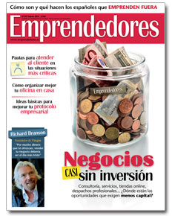
Video
José Hermida
Asesor
Revista Emprendedores

Slide 106
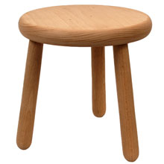
How to build a briefing
time
Style
How you
say it
Message
What you say
Audience
Who you’re
talking to

Slide 107
Time
Increase Attention and Retention
You have NINE seconds to engage your listener.
We all have a “learning curve” and “forgetting curve.”
Always steeper … and is surely getting worse with distractions.
Most people forget … 40 percent by the end of the presentation
60 percent by the end of the day
90-100 percent by the end of the week

Slide 108
Time
Attention and Retention
To increase attention and retention, presentations must be
    Simple, focused
    Attractive (and maybe a little entertaining)
    Relevant
We achieve that by …
    Knowing our audience, their situation, and their needs
    Making an “emotional” connection (showing that you care)
    Making our message clear

Slide 109
Audience
Know who you’re talking to
KNOW THE AUDIENCE
Know who they are
Know what they need and want (from the issue and from you)
Know and understand what’s at play in this issue for them
Know how much do they know … and want and need to know
Know that they are BUSY – busier than you are!
Aristóteles: El tonto trata de persuadirme con sus argumentos, y el sabio con los míos.

Slide 110
Audience
Know who you’re talking to
MAKE AN “EMOTIONAL” CONNECTION
Care about your issue, and show it
Care about your customer, and show it
Show your respect for the policymaker by respecting his/her time and perspective, not by being obsequious

Slide 111

Message
Know what you say
MAKE YOUR MESSAGE CLEAR
k.i.s.s.
Decide what your main message is
Know which information is necessary for that message
Know which information is MOST important
Drop the information that is not important
The very first question you must ask yourself:
“What is the purpose of my briefing?”
Your intention should be so clear that you can state it in one sentence.

Slide 112
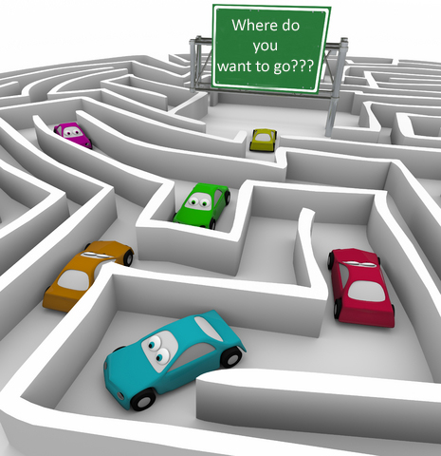
Message
Know what you say
“If you don’t know where you’re going, your probably not going to get there.”

Slide 113
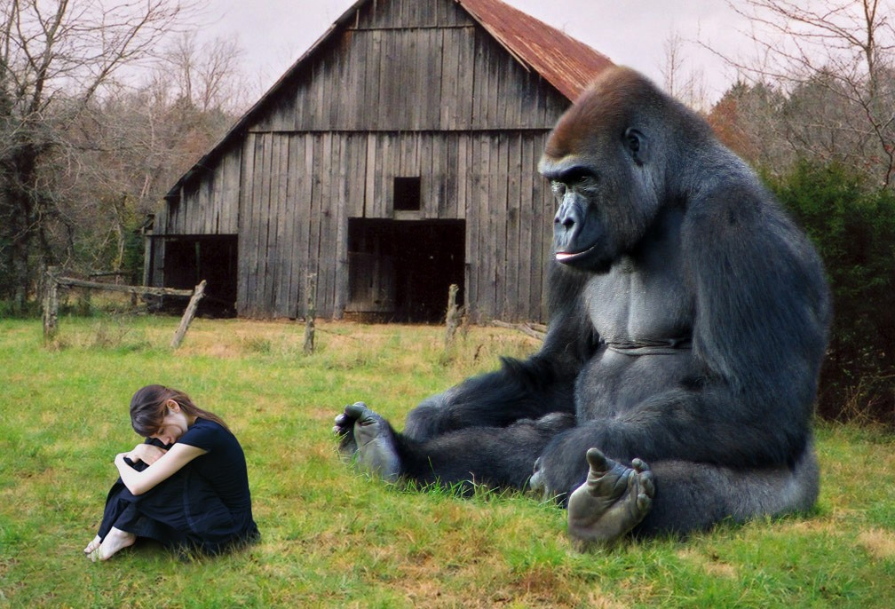
Message
Know what you say
MAKE YOUR MESSAGE CLEAR
Two very important points:
As always, showing your message is more effective than telling your message.
A few policymakers will respect your command of details, but NO policymaker wants to hear them.
Edit out anything that doesn’t support your main message.
SHOW. DON’T JUST TELL.

Slide 114
Style
Know how you say it
USE THE RIGHT VOICE
Use a voice – including vocabulary – appropriate for the
circumstances and institutions.
Speak clearly but not as if talking to moron.
Sound like you care – neutral but not aloof.
Project confidence without arrogance – use the right intonation.
Avoid slang and jargon (yours or the policymaker’s).
Be careful with euphemisms.
Be careful with humor.

Slide 115
Style
Know how you say it
WATCH BODY LANGUAGE AND PACE
Sit up straight but natural.
Look at the policymaker – in the eye – but don’t be weird.
Use hands and body as part of message, but don’t fidget.
Be swift, but don’t race. Be agile.
Welcome (or at least pause for) interruptions.
IMAGINE someone you know and like on the other side of the table.

Slide 116
Style
Know how you say it
VERY IMPORTANT:
Be natural. Be yourself.
Remember you are there as an expert talking to a generalist.
Look for signals on receptivity, preferences.
Adapt as needed.
Have fun.
Breathe!!!!

Slide 117
NEXT …….
How to build a traditional briefing … by modules.

Slide 118
HOW TO BUILD A BRIEFING
The seven traditional modules
evidence
headline
context
points
proofs
indicators
summary
“action”

Slide 119
HOW TO BUILD A BRIEFING
Module #1
headline
- your most important point
- ready for delivery at any time
- memorable
Module #2
context
- background information
- bare essential for understanding
- not history for history sake

Slide 120
HOW TO BUILD A BRIEFING
Module #3
points
- “sub-headlines”
- major supporting conclusions
Module #4
proofs
- three major kinds:
1. facts
2. analogies
3. anecdotes
- support conclusions
- indicate the quality/strength of information

Slide 121
HOW TO BUILD A BRIEFING
Module #5
indicators
- these “signposts” in business are lock-in phrases
- in analysis, they’re events that validate conclusions
Module #6
summary
very briefly sum up your key judgment
in analysis, this can be future scenario(s)
Module #7
“action”
in business, it’s the big pitch
in analysis, it’s a statement of the implications of events for the policymaker

Slide 122
HOW TO BUILD A BRIEFING
The seven traditional modules
The five analytical modules
Briefing
format
Analytical
elements
headline
key judgments
juicios principales
context
drivers
impulsores
points
proofs
trends
corrientes/ tendencias
indicators
outcomes
escenarios
summary
“action”
implications
implicaciones

Slide 123
HOW TO BUILD A BRIEFING
The five analytical modules
juicios principales
impulsores
corrientes/tendencias
escenarios
implicaciones

Slide 124
AN EXAMPLE: Cuba
Cuba has begun a transition to a new political-economic system
juicios principales
Cuba is making changes in its economy and, ultimately, its political system.
Biological reality
Economic necessity.
Popular expectations.
Regional change.
National pride.
U.S. normalization
impulsores
corrientes / tendencias
Castro brothers are still alive and, even though their rhetoric suggested “die with boots on,” they’re allowing change.
New laws on taxation, property -- stimulating growth.
Laying off state workers, creating new job categories.
Allowing greater debate, even if dissidents still face arrest. “Dentro del partido.”

Slide 125
escenarios
More likely: Stable, evolutionary change -
  Continued growth in non-government sectors, better diet, etc.
  Some relaxation of state media.
  Some greater confidence in future.
  Rather than cling to a failed political-economic model, Cubans are developing their own eclectic model.
Alternative: Continued deterioration if not breakdown
  New policies fail to produce results.
  Popular impatience mounts, etc.
implicaciones
The implications are potentially big … new opportunities … new relationship … new regional role for Cuba … etc., etc.

Slide 126

Enough for one day?
See you tomorrow.

Slide 127
DAY TWO

Slide 128
Producto de Inteligencia
Delivering Quality Analysis to Decisionmakers
11-12 November 2016
Guanajuato
Fulton Armstrong

Slide 129
Our Briefing Exercise
Small-team exercise
Team A
Team B
Team A plays analyst/briefer; Team B plays policymaker
Team B plays analyst/briefer; Team A plays policymaker

Slide 130
Our Briefing Exercise (Tomorrow)
PURPOSES |  | Deepen understanding of policymaker needs Improve analytical tradecraft Practice oral briefing skills
STEPS
Earlier: |  | Choose a partner and sit with him/her Choose a topic to analyze and brief Analyze your decisionmaker’s needs (Handout B) Fill out your decisionmaker survey (Handout C)
NOW: |  | Prepare your briefing
Tomorrow: |  | As analysts, give oral briefing; Q&A As policymakers, receive briefing; Q&A Change roles Discuss strengths/weaknesses of process

Slide 131
Presentación de análisis
B
Equipo: ________ y ___________
¿Qué es lo que tu decisor necesita saber?
El tema
Información/análisis
Los intereses
Las opciones
La inteligencia
HABIENDO ANALIZADO LAS NECESIDADES ANALÍTICAS DE SU DECISOR EN ESTE PAPEL (HANDOUT “C”), PREPAREN UN BRIEFING QUE LAS SATISFAGA

Slide 132
Intelligence Briefing
Tema: _______________________ Nombres: ______________
D
Elementos
analíticos
juicios principales
Su briefing tiene que incluir todos los elementos analíticos básicos
impulsores
corrientes/ tendencias
escenarios
implicaciones
30 mins

Slide 133
Our Briefing Exercise
Small-team exercise
Team A
Team B
15 mins
Equipo A juega papel de analista/briefer sobre su tema, mientras Equipo B juega papel de su decisor.

Slide 134
Our Briefing Exercise
Small-team exercise
Team A
Team B
Equipo B juega papel de analista/briefer sobre su tema, mientras Equipo A juega papel de su decisor.
15 mins

Slide 135
Intelligence Briefing
Tema: _____________________________________
Decisores: _________________________________
Analistas/briefers: ___________________________
E
Notas
de
evaloración
¿Cómo salió el briefing? ¿Incluyeron todos los elementos analíticos básicos?
juicios principales
¿Entendieron bien los briefers las necesidades de los decisores? ¿Las satisficieron?
impulsores
corrientes/ tendencias
¿Se mantuvieron desinteresados los analistas, o se metieron con recomendaciones?
escenarios
implicaciones
¿Había algo que los analistas podrían haber hecho mejor?
10 mins

Slide 136
Intelligence Briefing
.
Evaluation
Did briefers show they knew (and cared about) the POLICYMAKERS’ NEEDS?
Was each briefer’s KEY JUDGMENT(S) clear?
How well did they state the DRIVERS?
Did they provide a clear statement of the TRENDS surrounding the drivers?
Did they give the policymaker a clear vision of the MORE LIKELY SCENARIO and possible ALTERNATIVE SCENARIO (linked back to the drivers)?
Did the offer analysis of the IMPLICATIONS of the scenarios?
Were they prepared for Q&A?

Slide 137
Intelligence Briefing
Tema: _____________________________________
Decisores: _________________________________
Analistas/briefers: ___________________________
E
Notas
de
evaloración
¿Cómo salió el briefing? ¿Incluyeron todos los elementos analíticos básicos?
juicios principales
¿Entendieron bien los briefers las necesidades de los decisores? ¿Las satisficieron?
impulsores
corrientes/ tendencias
¿Se mantuvieron desinteresados los analistas, o se metieron con recomendaciones?
escenarios
implicaciones
¿Había algo que los analistas podrían haber hecho mejor?

Slide 138
Intelligence Briefing
Application
How easily can you adapt this sort of approach to your current and future work? What will you do differently? Why?

Slide 139
Challenges
Why is briefing difficult?
Substance: Any topic worth briefing is going to be a difficult topic.
Process: We have to maintain our integrity and expertise while stepping into policymaker’s shoes and broader view.
Environment: When briefing, we go onto policymaker’s turf – and rules.
Uncertainty: We don’t know the reactions and questions we will face.
Nerves: Our bodies react to stress, making it harder for us to be agile.
Why else??????

Slide 140

Challenges
How can we overcome each?
Substance:
Process:
Uncertainty:
Nerves:

Slide 141
Today’s exercise
Review
How well did the analytical model work? Which briefing preparation helped most? What could we do better? How can you apply these models and techniques to your work?

Slide 142
Today’s exercise
Practice when you want …
In 60 seconds, tell us …
why we should believe you were a beautiful baby
why polygamy is OK for men? for women? for both?
how to tie a tie
how to fry an egg
how to parallel park a car
the differences between Mexicans and other Latin Americans

Slide 143
Questions?
Comments?
Feedback?
Thank you!
Fulton Armstrong
farmstro@american.edu

Slide 144
Producto de Inteligencia
Delivering Quality Analysis to Decisionmakers
11-12 November 2016
Guanajuato
Fulton Armstrong

