Slide 1

Producto de Inteligencia
Delivering Quality Analysis to Decisionmakers
11-12 November 2016
Guanajuato
Fulton T. Armstrong
American University
Washington, DC

Slide 2
Presentación de análisis
A
Nombre: ___________________
Preparación:
¿Quién eres? Notas para auto-presentación oral de 30 segundos.
_______________________________________________________________________________
_______________________________________________________________________________
_______________________________________________________________________________
_______________________________________________________________________________
_______________________________________________________________________________
_______________________________________________________________________________
_______________________________________________________________________________
¿Qué decisión hiciste recientemente? ¿Cómo la hiciste?
_______________________________________________________________________________
_______________________________________________________________________________
_______________________________________________________________________________
_______________________________________________________________________________
_______________________________________________________________________________
_______________________________________________________________________________
_______________________________________________________________________________

Slide 3
Our Agenda
FRIDAY
What does the policymaker want and need?
How do we (and policymakers) make decisions?
What do we need to make decisions?
In what ways are “we” and “they” different?
What is the role of analysis in policymaking?
What makes good analysis good? (Examples.)
What is analytical tradecraft, and what does it do for me?
How can I present my information and analysis in the most effective way possible?
What makes for a good briefing?
SATURDAY
Practice briefing a policymaker
Practice answering questions; building rapport
Discuss how to evaluate your analysis and briefing

Slide 4
So what do policymakers need to make GOOD decisions?
GOOD QUALITY INFORMATION
timely, objective, independent, without agenda
transparent, honest (what’s known, thought, speculated)
USEFUL AND RELEVANT
  focusing on drivers (differentiating causes/results, symptoms/illnesses)
  identifying trends
  producing realistic scenarios (with realistic probabilities) as well as alternatives and wildcards.
confidential
This is our model.

Slide 5
Differences between “them” and “us”
(policymakers and analysts)
Do you think that we have the …
Same role in government, company, and society?
Same objectives? Same timelines for results?
Same definitions of interests?
Same skills and experience? Same expertise on issues?
Same accountability?
Same information?
Same work environment? Same office support?
Same personality?
Do you think that …
  We’re on the same team, with most objectives in common?
  Different emphasis on objectives can usually be explained?
  Differences are resolved differently in public and private sector?
  In the end, the policymaker/ decisionmaker is the boss and is ultimately more accountable than the analyst?
  Respect is essential, and should be strong institutional ethic?

Slide 6
In its simplest form … good analysis:
Provides an accurate snapshot of what we know and what we think about a current situation
    who, what, when, where, how, why
    what’s driving it – the “drivers”
Identifies the trends
    what’s happening with each key driver
Identifies potential outcomes, with some estimation of probability
These amount to the key judgments.
Good analysis educates … is transparent … policy-relevant … dynamic.

Slide 7
Success is …
We succeed as analysts when our information and analysis enable policymakers to adopt policies that
meet their short- and mid-term political needs, and
serve the country’s (or company’s) short-, mid-, and long-term security, economic and social needs.
Failure is …
We fail as analysts when our information and analysis leads policymakers to adopt policies that
might or might not meet their short- and mid-term political needs,
don’t warn meaningfully of challenges,
don’t identify opportunities to move interests, and
do not serve the country’s short-, medium- or long-term security, economic and social needs.

Slide 8
Presentación de análisis
¿Qué es lo que tu decisor necesita saber?
El tema | ¿A qué asunto quiero yo llamar la atención de los decisores?
Información/análisis | ¿Qué pasa, y por qué? ¿Cuáles son los impulsores, las tendencias actuales, los escenarios, los variables?
Los intereses | ¿Por qué es este tema importante para los decisores? ¿Cómo aumenta (o disminuye) la ventaja del país/empresa? ¿Cuáles son las probabilidades de los escenarios beneficiosos, y de los escenarios dañinos?
Las opciones | ¿Qué puede hacer el decisor para influir la situación y prepararse para las consecuencias?
La inteligencia | ¿Qué información tenemos ahora, y qué información tenemos que recoger o desarrollar, para ayudar al decisor entender la situación, tener alguna influencia sobre ella, y por lo menos reaccionar a ella?

Slide 9
Presentación de análisis
B
Equipo: ________ y ___________
¿Qué es lo que tu decisor necesita saber?
El tema
Información/análisis
Los intereses
Las opciones
La inteligencia

Slide 10
What is Analytical Tradecraft?
How does good tradecraft help us serve the policymaker? How does it help us as analysts protect our own equities? How does it make our lives as analysts easier and more fun?
1. It is the CONSCIOUS and DELIBERATE process of evaluating and transforming raw data into descriptions, explanations, and conclusions for intelligence consumers –
free from bias (ours or policymaker’s)
free from manipulation (the reporting agency’s, source’s or sub-source’s)
free from intellectual limitations (linear thinking)
2. Tradecraft is what enables us to look the policymaker in the eye and say:
We have examined the information and evidence we have, and we believe that ___ is occurring; it is being driven by ____; it appears likely to ___; and it has ___ implications. We also believe that, although less likely, the situation could evolve in ___ manner if ___ occurs, which would have ___ implications.
3. Tradecraft is also structured humility – the willingness to concede that
any issue worth analysis is difficult
our information rarely (or never) is good enough
our speculation is “informed” by our expertise, but we don’t know as much as we think
if our “probable” scenario doesn’t materialize, we also offer alternative scenarios

Slide 11
What is the process?
Assumption - a proposition whose truth is established or otherwise accepted that we make CONSCIOUS as we enter the analytical process, usually in the formation of our hypothesis and first round of questions.
Hypothesis - a tentative assertion linking two or more phenomena, subject to testing and proof.
  Usually states a relationship between two or more things
  Is stated affirmatively
  Can be tested with empirical evidence
  The theory/underlying logic of the relationship makes sense
Main Elements
  Drivers – factors influencing events
  Trends – flows of events
  Outcomes – where events will be at a certain point in time
  Implications – what the events, drivers, trends and outcomes mean
Judgment – a statement that goes beyond available information to reach a conclusion on the basis of probabilities – an analytic leap from the known to the uncertain – and an honest assessment of our information.
Courtesy Bill Ortman

Slide 12
Avoid Politicization Focus on Value-Added
How do we prevent either variety of politicization?
Good tradecraft and transparency
Be honest about reporting
Set aside institutional preferences
Don’t be influenced by access
Stay up on policy and political developments
Think like a policymaker
Remember how “national interests” are determined
Respect people’s views. Respect processes. Respect institutional roles. Respect democracy
What’s our unique contribution?
  Clandestine or special info?
  Subject expertise?
  Timeliness?
  Tradecraft?
  Lack of agenda?
  Warning or opportunity analysis?
Identify your value-added – and build on it!

Slide 13
A good briefing …
Time
Increase Attention & Retention
… is brief, focused, based on the policymaker’s needs, flexible, transparent, and analytically solid.
You want to have the persuasive force of a business presentation but without the manipulation and personal incentive.
And a good INTELLIGENCE briefing … never … never … never … never … crosses the line into policy!
… and is conscious of these factors:
Audience
Know who you’re talking to
Message
Know what you say
Style
Know how you say it

Slide 14
Presentación de análisis
Nombre: ___________________
C
Mini-ejercicios
1. | En 40 palabras o menos, dinos qué necesitamos saber sobre el tema que has escogido.
2. | Explica cómo cambiarías tu presentación en situaciones diferentes – como el contexto profesional, vida personal, o conversación con personas de cultura ajena.
3. | ¿Cómo ajustarías el nivel de transparencia en tus comentarios según tus interlocutores?
4. | Mientras avanza la conversación, ¿cómo ajustarás el contenido y estilo de tus comentarios?

Slide 15
A good briefing …
Adapts to policymaker’s needs
Aware of policy options and their evolution
Aware of policy actions already taken
Respond to questions
Adjust to customer’s style
Is appropriate to policymaker’s culture (while protecting ours)
Professional language – e.g., not slang
Precise language – e.g., on probability
Understand his/her needs, including level of detail
Respect his/her prerogatives
Uses good tradecraft, with combination of
Transparency (on info, logic, etc.)
Agreed-upon logic and models
Careful selection of words
Examination of alternative interpretations
Knowledge of implications
Neutrality/objectivity/value-free
Is transparent
Appropriate level of honesty
Make logic clear
Don’t exaggerate the quality of data or judgments
Don’t exaggerate your confidence
You want to have the persuasive force of a business presentation but without the manipulation and personal incentive.

Slide 16
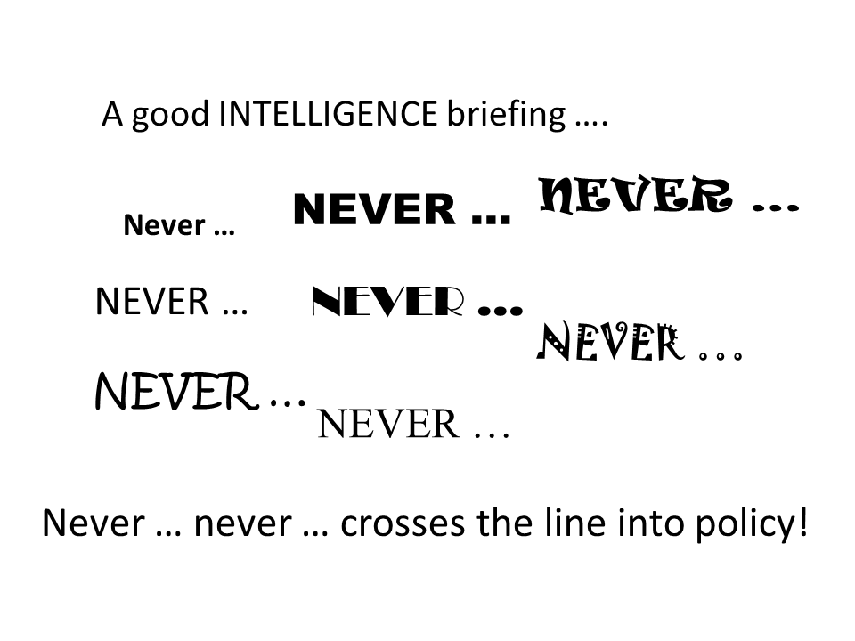
Guidelines:
Don’t waste time (but don’t speak too fast)
Know your audience
Make an “emotional” connection
KISS, KISS, KISS
Know where you want to go … and go there
Show; don’t just tell
Use the right voice, body language, and eye contact; be natural

Slide 17
HOW TO BUILD A BRIEFING
The seven traditional modules
The five analytical modules
Briefing
format
Analytical
elements
headline
key judgments
juicios principales
context
drivers
impulsores
points
proofs
trends
corrientes/ tendencias
indicators
outcomes
escenarios
summary
“action”
implications
implicaciones

Slide 18
SAMPLE BRIEFING: Cuba
juicios principales
Cuba is making changes in its economy and, ultimately, its political system.
escenarios
More likely: Stable, evolutionary change -
  Continued growth in non-government sectors, better diet, etc.
  Some relaxation of state media.
  Some greater confidence in future.
  Rather than cling to a failed political-economic model, Cubans are developing their own eclectic model.
Alternative: Continued deterioration if not breakdown
  New policies fail to produce results.
  Popular impatience mounts, etc.
impulsores
Biological reality
Economic necessity.
Popular expectations.
Regional change.
National pride.
U.S. normalization
corrientes / tendencias
Castro brothers are still alive and, even though their rhetoric suggested “die with boots on,” they’re allowing change.
New laws on taxation, property -- stimulating growth.
Laying off state workers, creating new job categories.
implicaciones
The implications are potentially big … new opportunities … new relationship … new regional role for Cuba … etc., etc.
Allowing greater debate, even if dissidents still face arrest. “Dentro del partido.”

Slide 19
Intelligence Briefing
Tema: _______________________ Nombres: ______________
D
Elementos
analíticos
juicios principales
impulsores
corrientes/ tendencias
escenarios
implicaciones

Slide 20
Intelligence Briefing
Tema: _____________________________________
Decisores: _________________________________
Analistas/briefers: ___________________________
E
Notas
de
evaloración
¿Cómo salió el briefing? ¿Incluyeron todos los elementos analíticos básicos?
juicios principales
¿Entendieron bien los briefers las necesidades de los decisores? ¿Las satisficieron?
impulsores
corrientes/ tendencias
¿Se mantuvieron desinteresados los analistas, o se metieron con recomendaciones?
escenarios
implicaciones
¿Había algo que los analistas podrían haber hecho mejor?

