Slide 1
U.S. Border Wall Faces Immigration Crisis: Immigration System Overloaded
Huiwen Ding

Slide 2
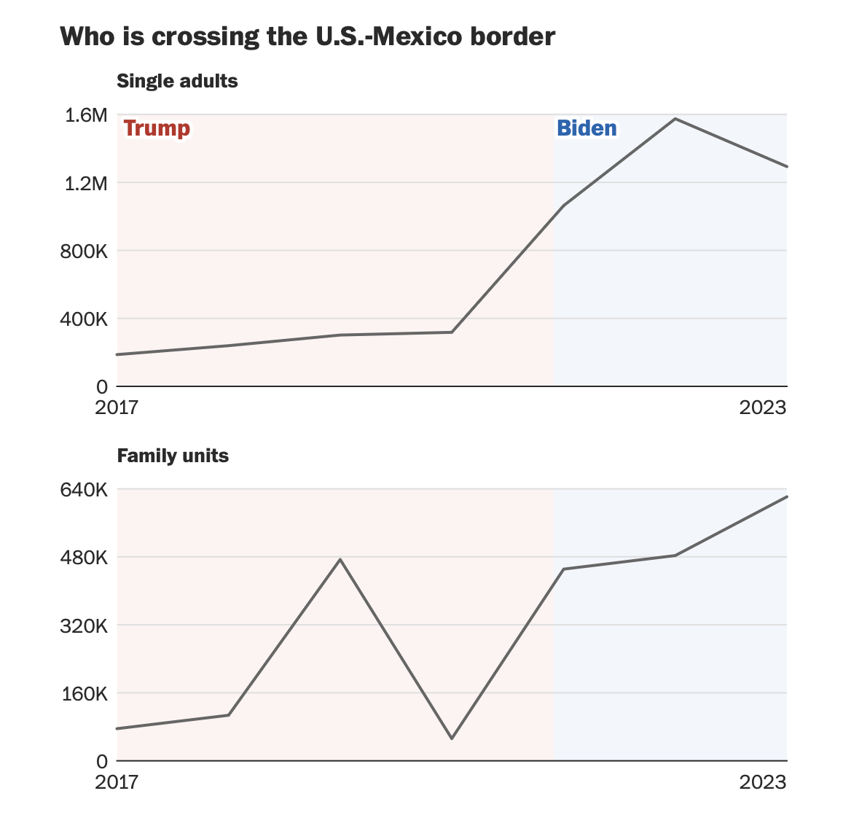
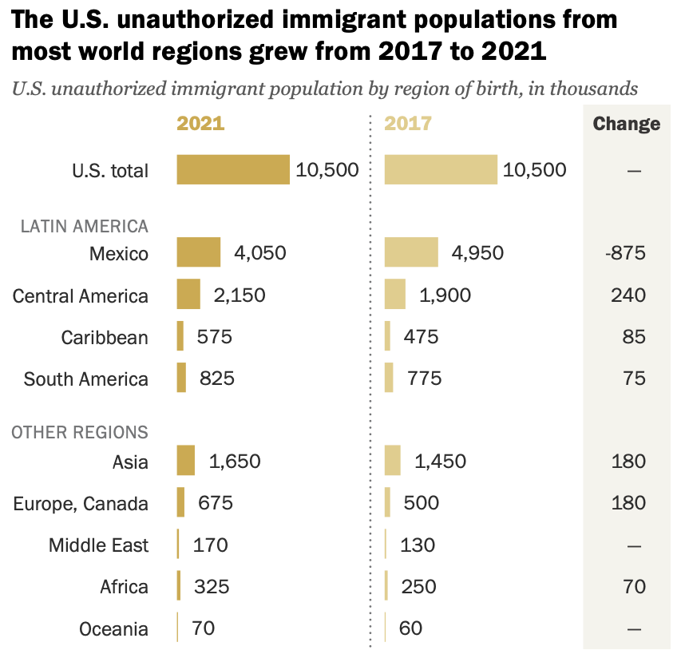
Problem facing by Border Wall：
Immigrants are being injured more frequently after defensive weapons were added to the border wall. (2023-455，2022-311）
Increasing funding to build a border wall will not help solve the immigration crisis, meanwhile, increase the financial burden of local government. (15 Billion dollar on 454 mile)
Asia and C-3 countries have gradually become the new main force of immigrants. Adding more pressure to the immigration system.
Underlying Causes: Immigration Crisis Caused by Global Economic Downturn
Regime change, Religious persecution
Debt

Slide 3
Desired effect: Reduce casualties caused by undocumented immigrants crossing the border wall
Reduce the impact of undocumented immigrants on social security （NY high school）
Solution 1: Reform existing immigration system completely, develop a framework of strict conditions and use scoring system that allows for quick screening.
( Singapore Employment Pass）
Pro：Long-term efficiency
Reducing misjudgments
Con：System changes may lead to a short-term decrease in USCIS productivity
（Small-scale reform EB2-EB3 channel first）
Ms. JAYAPAL
Solution 2: The immigration application channel remains unchanged, but the organizational structure of the reviewers will be reformed. Add new Emergency Coordination Citizenship and Immigration Services Team in USCIS.
Pro: The required personnel team can be quickly assembled
and put to work
Con: Can only solve the short-term inefficiency of the
immigration system
（More time to formulate new immigration regulations）
Carlos Denton

Slide 4
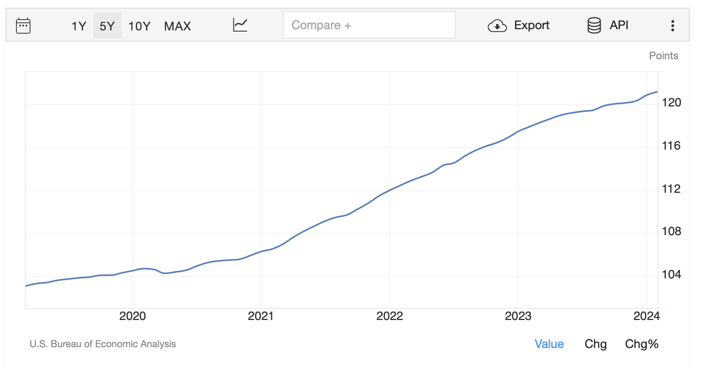
Recommendation：Solution 2
Solution 2: The immigration application channel remains unchanged, but the organizational structure of the reviewers will be reformed. Add new Emergency Coordination Citizenship and Immigration Services Team in USCIS.
Why？
UN Trade and Development (UNCTAD) forecasts global economic growth to 2.6% in 2024
The U.S. economic downturn is slowing down, and the global economy is slowly recovering

