Slide 1
Dealing with the Houthis: Promoting Democracy and Freedom of Navigation
By: Noah Quinn & Gavin Roca

Slide 2
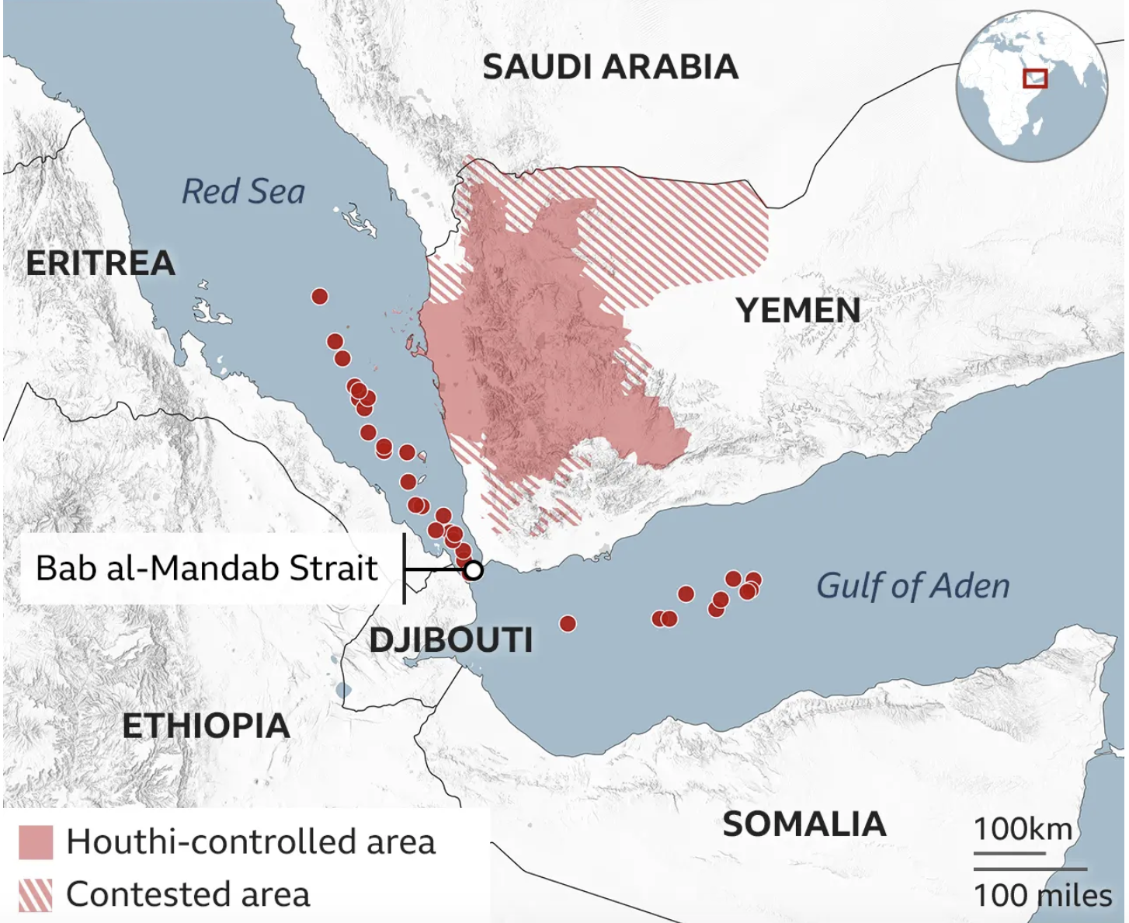
Problem & Status
Houthis expand control and power
Controls the capital and 70% of population
Severe Famine and Economic issues
17.4 Million in need of food assistance
Houthis pose massive threats to human rights
Freedom of Navigation being prohibited
One of eight maritime chokepoints

Slide 3
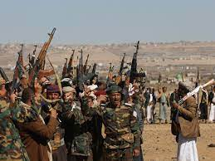
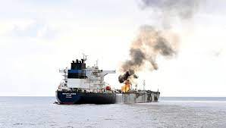
Key Analysis
Houthis are fundamentally opposed to peace
Instability in key region & key ally
Inflation & costs on the rise due to insecurity
Iran plays a key role in fueling Houthis power
Inaction on the Houthis
10 years in power after Houthi takeover
Yemen support for United States is minimal
Houthi missile strikes cause global fear

Slide 4
Recommendation, Pros and Cons
Naval defenses around the south coast of Yemen
Defends cargo ships and creates a presence on the coast of Yemen
Eventually we will have countries take over presence of U.S. ships
Aid will be able to get through
Giving aid to Yemen eventually leads to the Houthi gov’t being overthrown
Con’s:
Money
Risking Navy ships
Not a permanent solution
Pro’s:
Will be able to effectively defend cargo ships
Lowering inflation and travel times for ships
Restores order in the Bab al-Mandab strait
Not a permanent solution

