Slide 1
COUNTERING China’s rising influence over microchips to promote fair and resilient competition: Revitalizing our national production and independence.
Nicolas SCHIRMANN
Akosua ADDO

Slide 2
China is becoming the dominant leader in the semiconductor industry
Growing U.S dependency on foreign microchips, which threatens its national security, resilience, and economic prosperity
DRIVERS
INCREASING IMPORTANCE IN STRATEGIC TECHNOLOGIES
China uses various tactics such as intellectual property theft, forcing technology transfers, offering subsidies, and mobilizing state-owned enterprises
MAIN PRIORITY: revitalize our national production and independence through increased domestic investment and innovation incentives.

Slide 3
strengthen domestic semiconductor manufacturing capabilities through increased investment and innovation incentives
enhance international collaboration and alliances with key partners
implementing robust intellectual property protections and export controls
OPTIONS
U.S public support + boost national workforce and R&D
Inconsistant support from Congress + economic feasibility
Foster innovation cooperation + reinforce talent exchanges
Opposing international strategies + rising populist parties
Encourage key innovation from national firms
China circumvents export controls + difficult to harmonize U.S. restrictions +adverse impacts on consumer prices and domestic industries

Slide 4
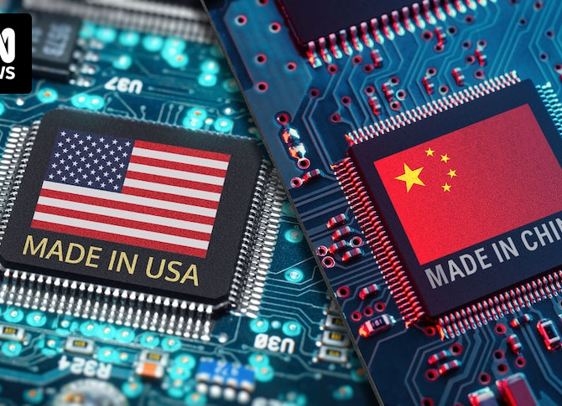
RECOMMENDATION
Continue incentivizing foreign leading companies to invest their most advanced technology capabilities in the U.S
Permit the co-production of sensitive technologies, promoting larger industrial cooperation and STEM talent exchanges with key partners
Implement a clear reinforcement of our legal intellectual property framework

