Slide 1
Implications of Climate Change on Insurgent Activity
Meghan Harris and Bryce Lander

Slide 2
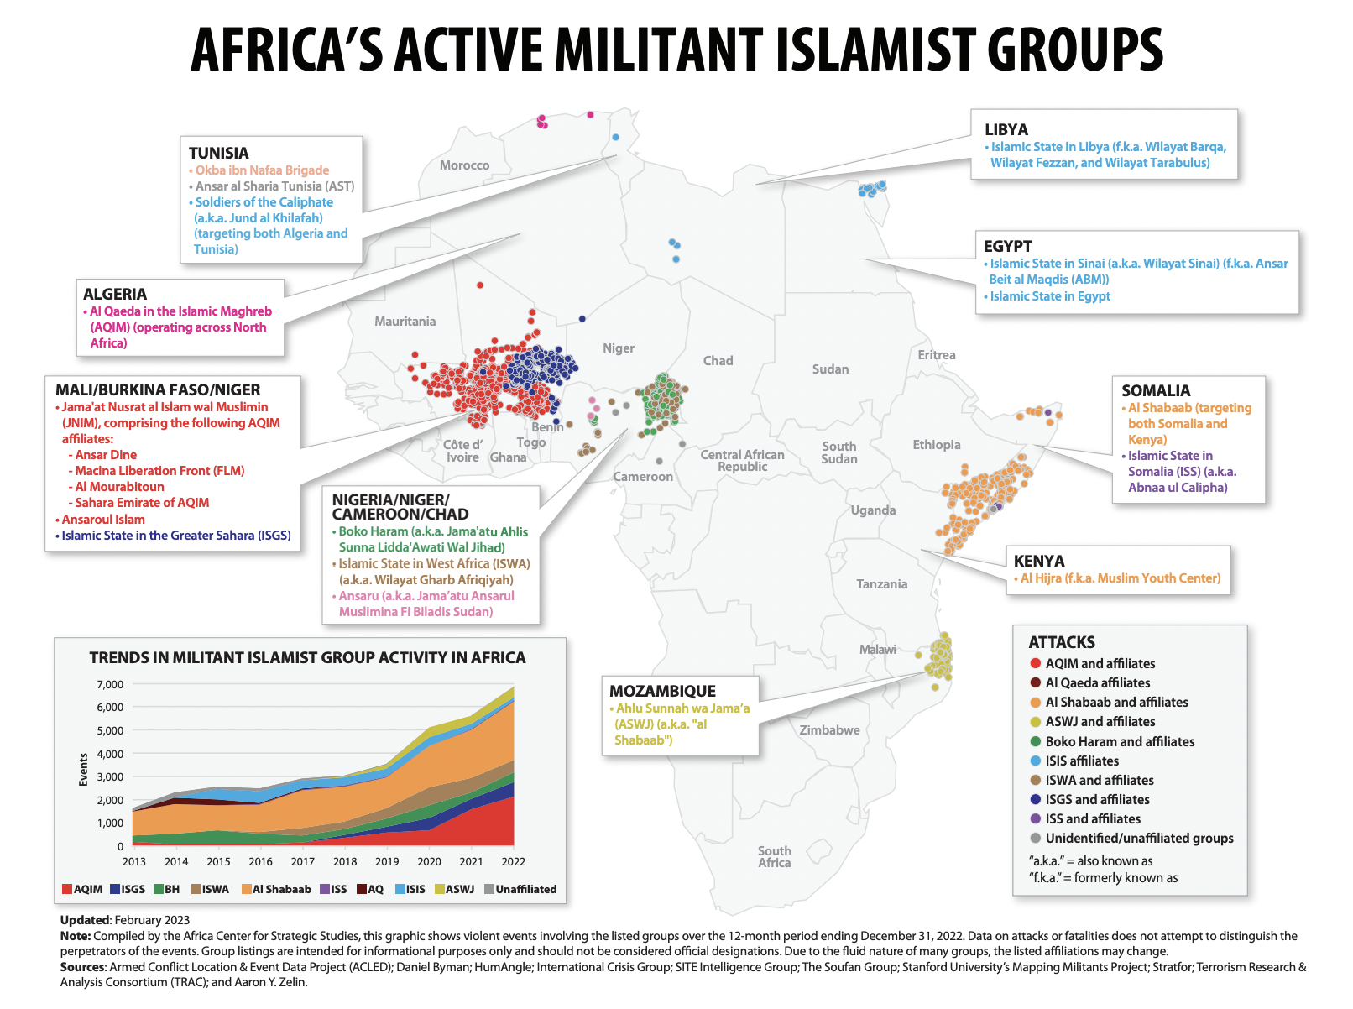
Key Judgements
BLUF: Social instability, lack of aid in remote locations, and limited food and water caused by climate change has allowed insurgent groups to grow influence in North Africa.
Environmental challenges, such as floods, droughts, rising sea levels and limited food and water, has driven the region into instability and has had major impacts on industries such as agriculture; a key driver of North African economies.
Limited aid has been crucial to the success of insurgent groups in the region who are becoming sole providers of critical resources in remote communities.
Insurgent groups have utilized becoming a sole provider as a means to generate support toward their ideologies and to recruit new members.

Slide 3
Options for Consideration
Security
Humanitarian
Social
Provide robust weapons, strategic, and tactical training for favorable regimes to counteract extremist operations.
Provide humanitarian aid to nations heavily impacted by climate change, including further commitment to the Africa Climate Summit for Green Infrastructure.
Consider establishing national reconciliation programs to mend ethnic and cultural differences within nations.
Pros: greater likelihood of limiting the spread of insurgency, continue the U.S. longstanding CT campaign
Cons: may be difficult to negotiate with local governments, could exacerbate existing conflict
Pros: assist bridging ethnic and cultural divides that drive insurgent activity, use of soft power to combat the issue
Cons: Anti-western sentiment can make it difficult to implement educational campaigns
Pros: continued commitment to combat climate change and strengthen African partnerships
Cons: risk of corrupt leadership misusing funds

Slide 4
Recommendation
We recommend the adoption of options two and three that address humanitarian aid and social support:
Interagency collaboration: State department, Intelligence Community, USAID, AFRICOM, UN, NGOs
Continued commitment to strengthen African partnerships and promoting existing aid packages
Immediate action must be taken to limit the spread of extremism and combat worsening climate conditions

