Slide 1
Global Policy Seminar and NSC Simulation
IRP 401 - IRP 402
Week Fourteen 26 April 2024
Prof. Fulton T. Armstrong

Slide 2
Week 1 (19 Jan)
Week 2 (26 Jan)
Week 3 (2 Feb)
Week 4 (9 Feb)
Week 5 (16 Feb)
Week 6 (23 Feb)
Week 7 (1 Mar)
Week 8 (8 Mar)
BREAK
Week 9 (22 Mar)
Week 10 (29 Mar)
Week 11 (5 Apr)
Week 12 (12 Apr)
Week 13 (19 Apr)
Week 14 (26 Apr)
SPRING 2024

Slide 3
Looking back …
Substance and Process
Diplomats and spies and DOD
Academics and think-tankers
Journalists
Hill types
Museums
Readings
Lessons from Internships
Defining issues: Israel-Palestine
Ukraine-Russia
China
But also …
North Korea
South Asia
Latin America
Africa
Environment and Migration
How to prepare “actionable” products
Research (various inputs) →→ Analysis →→ Recommendation
(In clear, concise, transparent style.)
DRIVERS!!!!

Slide 4
Professional Development Series
Job Search and Networking
Overcoming “Impostor Syndrome”
Acing the Interview
Professional Listening Skills
Salary/Benefits Negotiations

Slide 5
Next steps …
Reflections Memo (tonight, tomorrow or Sunday)
Journal
Not just “for the grade”

Slide 6
Links to some photos in Class Prep section of Blackboard.

Slide 7
WHEN YOU CAN: COURSE EVALUATION
(401 only)

Slide 8
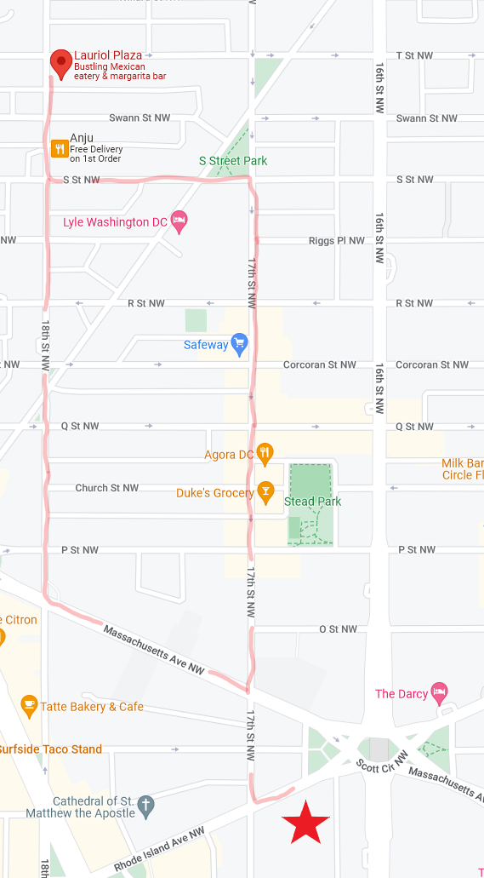
2:00 TODAY
Lauriol Plaza
1835 18th St NW

Slide 9
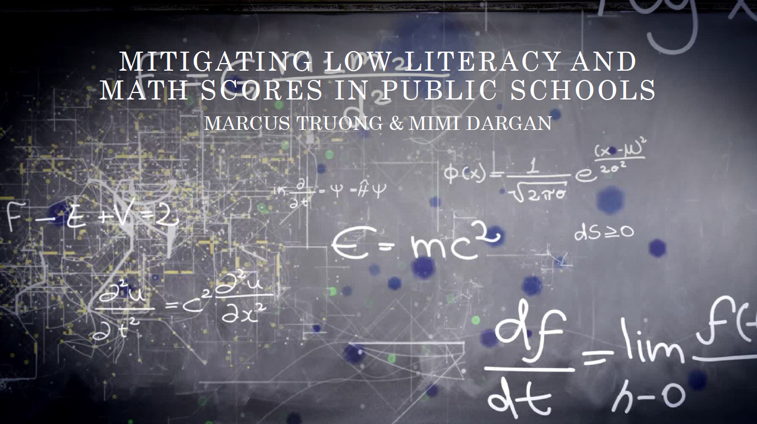
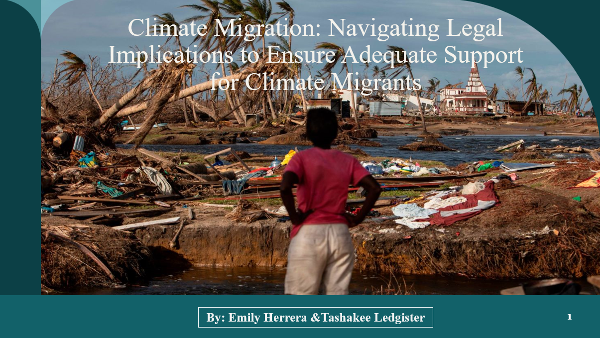
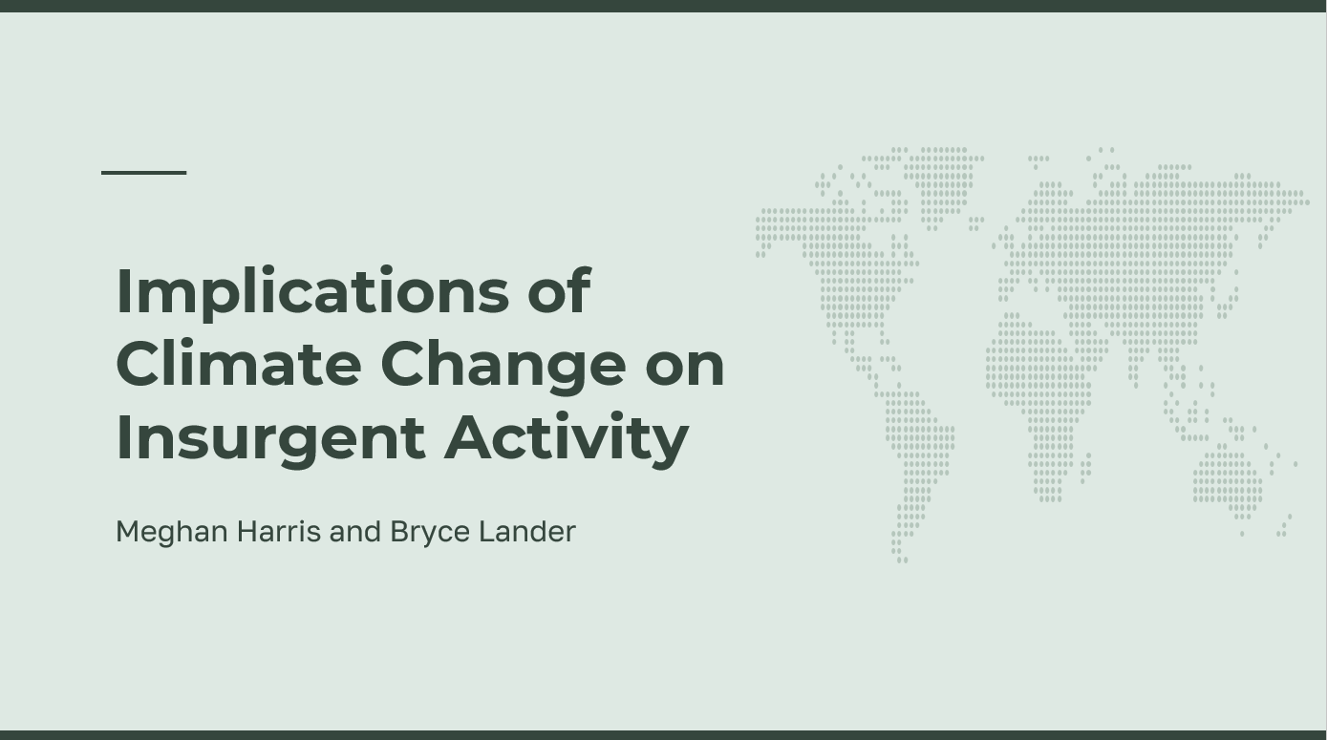
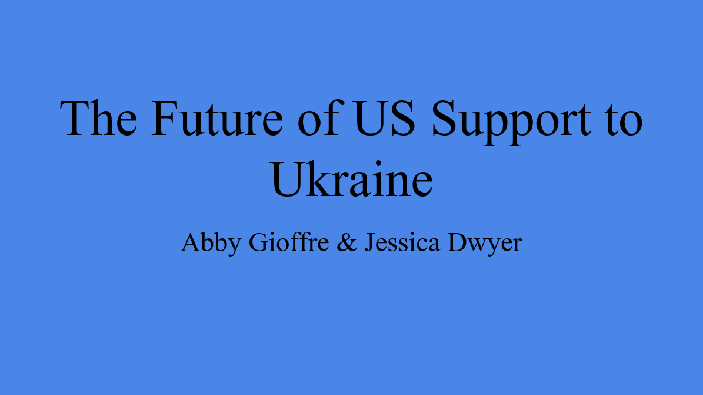
NSC DEPUTIES COMMITTEE MEETING
NSC staff
Deputies
Reese, Emma | Conflict in Sudan | Meghan, Abby
Meghan, Bryce | Impact of climate change on insurgency | Matthew, Emily
Akosua, Nicolas | Ensuring microchip competition and supply | Jessica, Marcus
Abby, Jessica | U.S. support to Ukraine defense against Russia | Ding, Gavin
Emily, Tashakee | How to deal with climate migrants/refugees | Reese, Gavin
Vaughn, Matt | Israel-Palestine: Two-state solution possible? | Bryce, Noah
Gavin, Noah | U.S. policy toward Yemen and the Houthis | Nicolas, Vaughn
Marcus, Mimi | Low Reading, Math Scores in U.S. Public Schools | Emma, Akosua
Ding | U.S. border-state challenges from immigration | Mimi, Tashakee

Slide 10
NSC DEPUTIES COMMITTEE MEETING
NSC staff
Deputies
Reese, Emma | Conflict in Sudan | Meghan, Abby
Meghan, Bryce | Impact of climate change on insurgency | Matthew, Emily
Akosua, Nicolas | Ensuring microchip competition and supply | Jessica, Marcus
Abby, Jessica | U.S. support to Ukraine defense against Russia | Ding, Gavin
Emily, Tashakee | How to deal with climate migrants/refugees | Reese, Gavin
Vaughn, Matt | Israel-Palestine: Two-state solution possible? | Bryce, Noah
Gavin, Noah | U.S. policy toward Yemen and the Houthis | Nicolas, Vaughn
Marcus, Mimi | Low Reading, Math Scores in U.S. Public Schools | Emma, Akosua
Ding | U.S. border-state challenges from immigration | Mimi, Tashakee

Slide 11
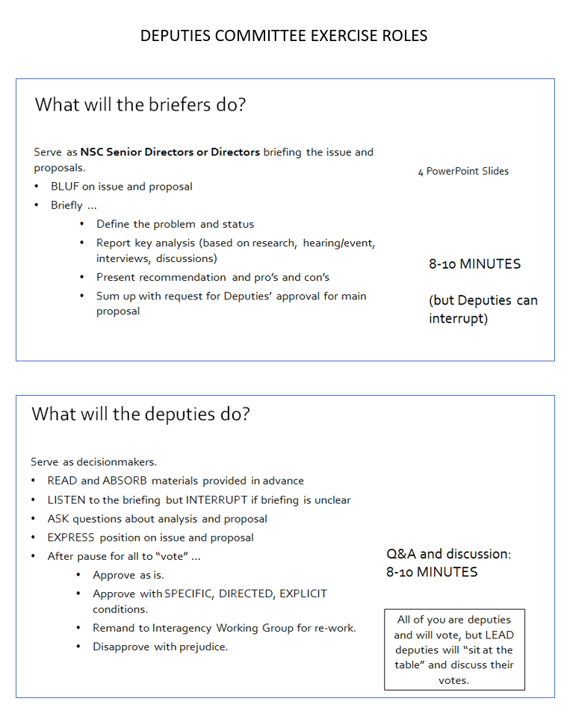
NSC DEPUTIES SIMULATION
TWO ROLES
NSC Directors or Senior Directors briefing the issue and proposals.
“The Deputies” receiving the briefing, asking the questions, and making the decisions.

Slide 12
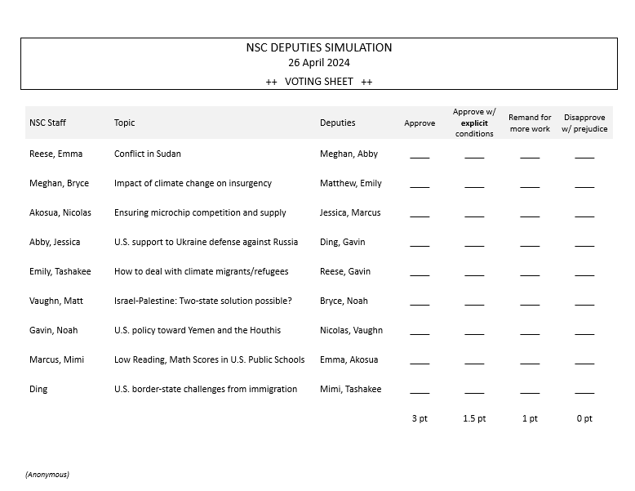
Deputies MUST give EXPLICIT guidance
YOUR VOTES WILL BE BASED ON
Are you convinced?
Do you support the recommendation?
Are you prepared to put your personal credibility and your agency/department’s resources on the line for the recommendation?
Just a ✓mark

Slide 13
VOTE FOR YOUR OWN PRESENTATION
Just a ✓mark

Slide 14
YOUR VOTES WILL BE BASED ON
Are you convinced?
Do you support the recommendation?
Are you prepared to put your personal credibility and your agency/department’s resources on the line for the recommendation?
Just a ✓mark

Slide 15
ALL CLEAR??
Let’s start.

Slide 16
WRAPUP

Slide 17
Next steps …
Reflections Memo (tonight, tomorrow or Sunday)
Journal
Not just “for the grade”
Student survey.

Slide 18
“QUESTIONS? SUGGESTIONS? CONCERNS?”
It’s been fun!

Slide 19
2:00 NEXT FRIDAY
Lauriol Plaza
1835 18th St NW

Slide 20
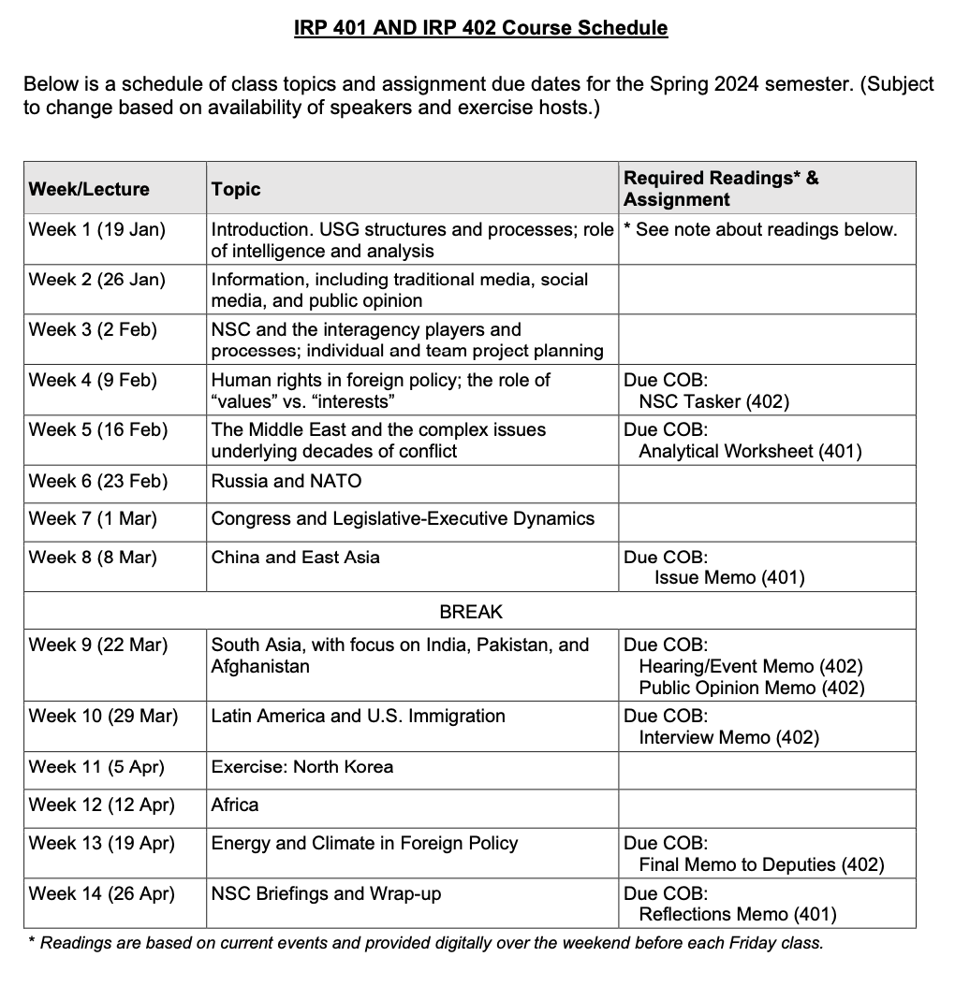
✓
401
402
✓
✓
✓
✓
QUESTIONS?
✓
✓

Slide 21
Project Planning
Akosua | U.S.-Russia: How constrain Putin? | Ensuring microchip competition and supply
Nicolas | U.S.-North Korea: How constrain Kim?
Marcus | U.S.-Vietnam tech/innovation ties | U.S. education deficits
Mimi | Youth homelessness
Vaughn | Central America migration | Israel-Palestine: Two-state solution possible?
Matt | Crisis in Haiti
Gavin | Impact of COVID on mental health | U.S. policy toward Yemen and the Houthis
Noah | Reducing reliance on China trade
Meghan | Russia/Wagner influence in Africa | Impact of climate change on insurgency
Bryce | Improving gun control background checks
Emily | Russia WMD in wake of Ukraine war | How to deal with climate migrants/refugees
Tashakee | Negative impact of cobalt mining in DRC
Reese | South America climate migration | “War time policy”
Emma | U.S.-Mexico border deaths
Ding | Calming tensions on Korean peninsula | U.S. border-state challenges from immigration
Abby | Human trafficking | U.S. support to Ukraine defense against Russia
Jessica | Stopping the flow of fentanyl into U.S.

Slide 22
Global Policy Seminar and NSC Simulation
IRP 401 - IRP 402
Week Fourteen 26 April 2024
Prof. Fulton T. Armstrong

Slide 23
