Slide 1
Global Policy Seminar and NSC Simulation
IRP 401 - IRP 402
Week Ten 29 March 2024
Prof. Fulton T. Armstrong

Slide 2
Week 1 (19 Jan)
Week 2 (26 Jan)
Week 3 (2 Feb)
Week 4 (9 Feb)
Week 5 (16 Feb)
Week 6 (23 Feb)
Week 7 (1 Mar)
Week 8 (8 Mar)
BREAK
Week 9 (22 Mar)
Week 10 (29 Mar)
Week 11 (5 Apr)
Week 12 (12 Apr)
Week 13 (19 Apr)
Week 14 (26 Apr)
SPRING 2024

Slide 3
TODAY’S AGENDA
9:00 | Class Discussion - Readings - Internship conversations: Abby, Jessica, Nicolas
10:00 | Vicki Gass Executive Director Latin America Working Group (LAWG) - Introduced by Vaughn
11:30 | David Brooks Senior Correspondent La Jornada (Mexico) - Introduced by Emily
12:45 | Lunch and transportation to Georgetown University
2:30 | Dr. Angelo Rivero Santos Professor, Walsh School of Foreign Service Georgetown University - Introduced by Noah

Slide 4
TODAY’S AGENDA
9:00 | Class Discussion - Readings - Internship conversations: Abby, Jessica, Nicolas
10:00 | Vicki Gass Executive Director Latin America Working Group (LAWG) - Introduced by Vaughn
11:30 | David Brooks Senior Correspondent La Jornada (Mexico) - Introduced by Emily
12:45 | Lunch and transportation to Georgetown University
2:30 | Dr. Angelo Rivero Santos Professor, Walsh School of Foreign Service Georgetown University - Introduced by Noah

Slide 5
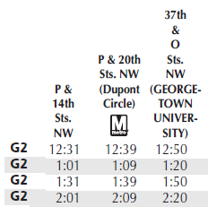
G2 Metrobus
~12:31
~1:01
~1:31
~2:01
16th & P
37th & O
20th & P
18th & P

Slide 6
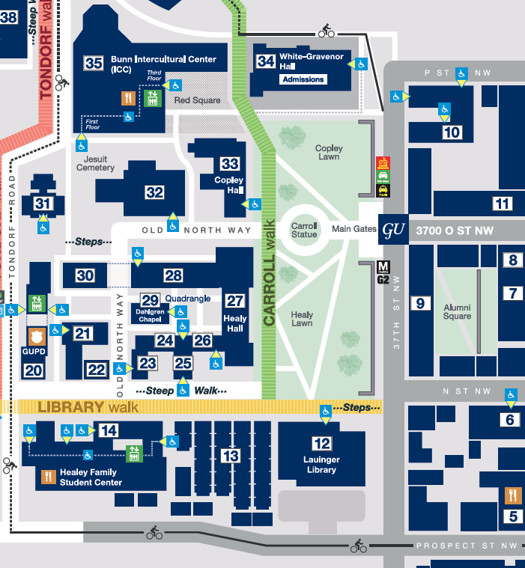
ICC
“Red Square”

Slide 7
Next Week
Six-Party Talks Exercise
LinkedIn
More INTERNSHIP discussions Three volunteers?

Slide 8
NEXT WEEK
 | Republic of Korea (South Korea) | Democratic People’s Republic of Korea (North Korea) | USA | People’s Republic of China | Japan | Russia
Team 1
Team 2
Team 3

Slide 9
READINGS
What are the big “threats” to U.S. interests in Latin America?
Immigration
What are the drivers?
in sending countries?
in transit countries?
on the border?
in the United States?
What can the USG do?
Venezuela Cuba Nicaragua
What are the drivers?
historical?
current?
What can the USG do?
Chinese influence
What are the drivers?
historical?
current?
What can the USG do?
Other?

Slide 10
Internship conversations
2-3 minutes each --
Abby
Jessica
Nicolas
INFORMAL DISCUSSION
Organization name and business
In-person, virtual, hybrid
My tasks and responsibilities
Communications and team dynamics
Fun things and challenges

Slide 13
Encryption
Securely sending information
“One-time pad”
Book code or book cipher
Encryption machines
Computer encryption

Slide 14
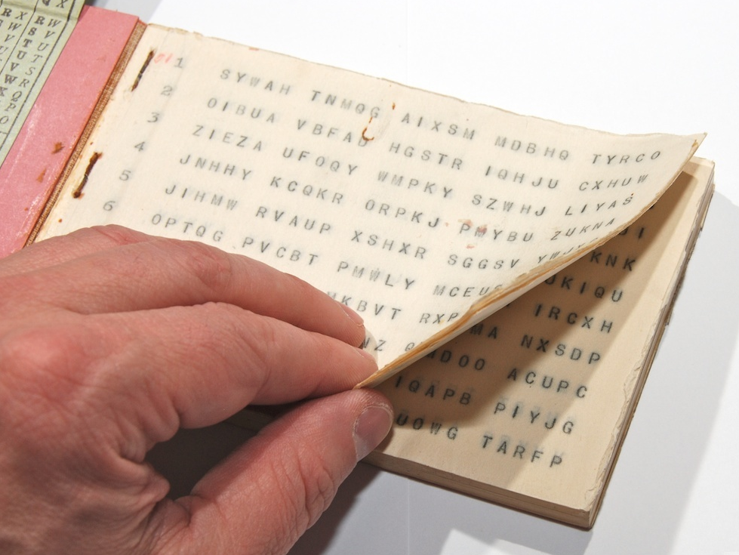
“One-time pad”
keys
A series of groups of letters
Two identical copies
Used agreed-upon day/time
Extremely secure (if pad is secure)
Notes:
NOTE FIVE GROUPS OF FIVE LETTERS – because A=0

Slide 15
“One-time pad”
keys
A series of groups of letters
Two identical copies
Used agreed-upon day/time
Extremely secure (if pad is secure)
AN EXAMPLE … Let’s say …
First key is SBMHR
Your requirement is: What is the enemy having for lunch?
Notes:
NOTE FIVE GROUPS OF FIVE LETTERS – because A=0

Slide 16
Key begins with: SBMHR
Message you want to send: PIZZA
Message: | P |  | I |  | Z |  | Z |  | A
Values: | 14 |  | 8 |  | 25 |  | 25 |  | 0
Key: | S |  | B |  | M |  | H |  | R
Values: | 17 |  | 1 |  | 12 |  | 7 |  | 16
Sum: | 5 |  | 9 |  | 11 |  | 6 |  | 16
Ciphertext: | F |  | J |  | L |  | G |  | R

Slide 17
Key begins with: SBMHR
Message you want to send: PIZZA
Message: | P |  | I |  | Z |  | Z |  | A
Values: | 14 |  | 8 |  | 25 |  | 25 |  | 0
Key: | S |  | B |  | M |  | H |  | R
Values: | 17 |  | 1 |  | 12 |  | 7 |  | 16
Sum: | 5 |  | 9 |  | 11 |  | 6 |  | 16
Ciphertext: | F |  | J |  | L |  | G |  | R
Notes:
Once again!!!

Slide 18
MSG from HQS:
What is the enemy going to eat for lunch?
Your encoded REPLY:
F J L G R
On subsequent mentions of PIZZA, you will not repeat F J L G R, because you’ll use a different key from the OTP.

Slide 19
“Book Code”
Two identical copies of a book
Commercially available; doesn’t look like a codebook
Flexible date/time
Caution: Vocabulary has to be appropriate to intelligence information

Slide 20
“Book Code”
page/line/word | 842914
paragraph/word | 1586

Slide 21
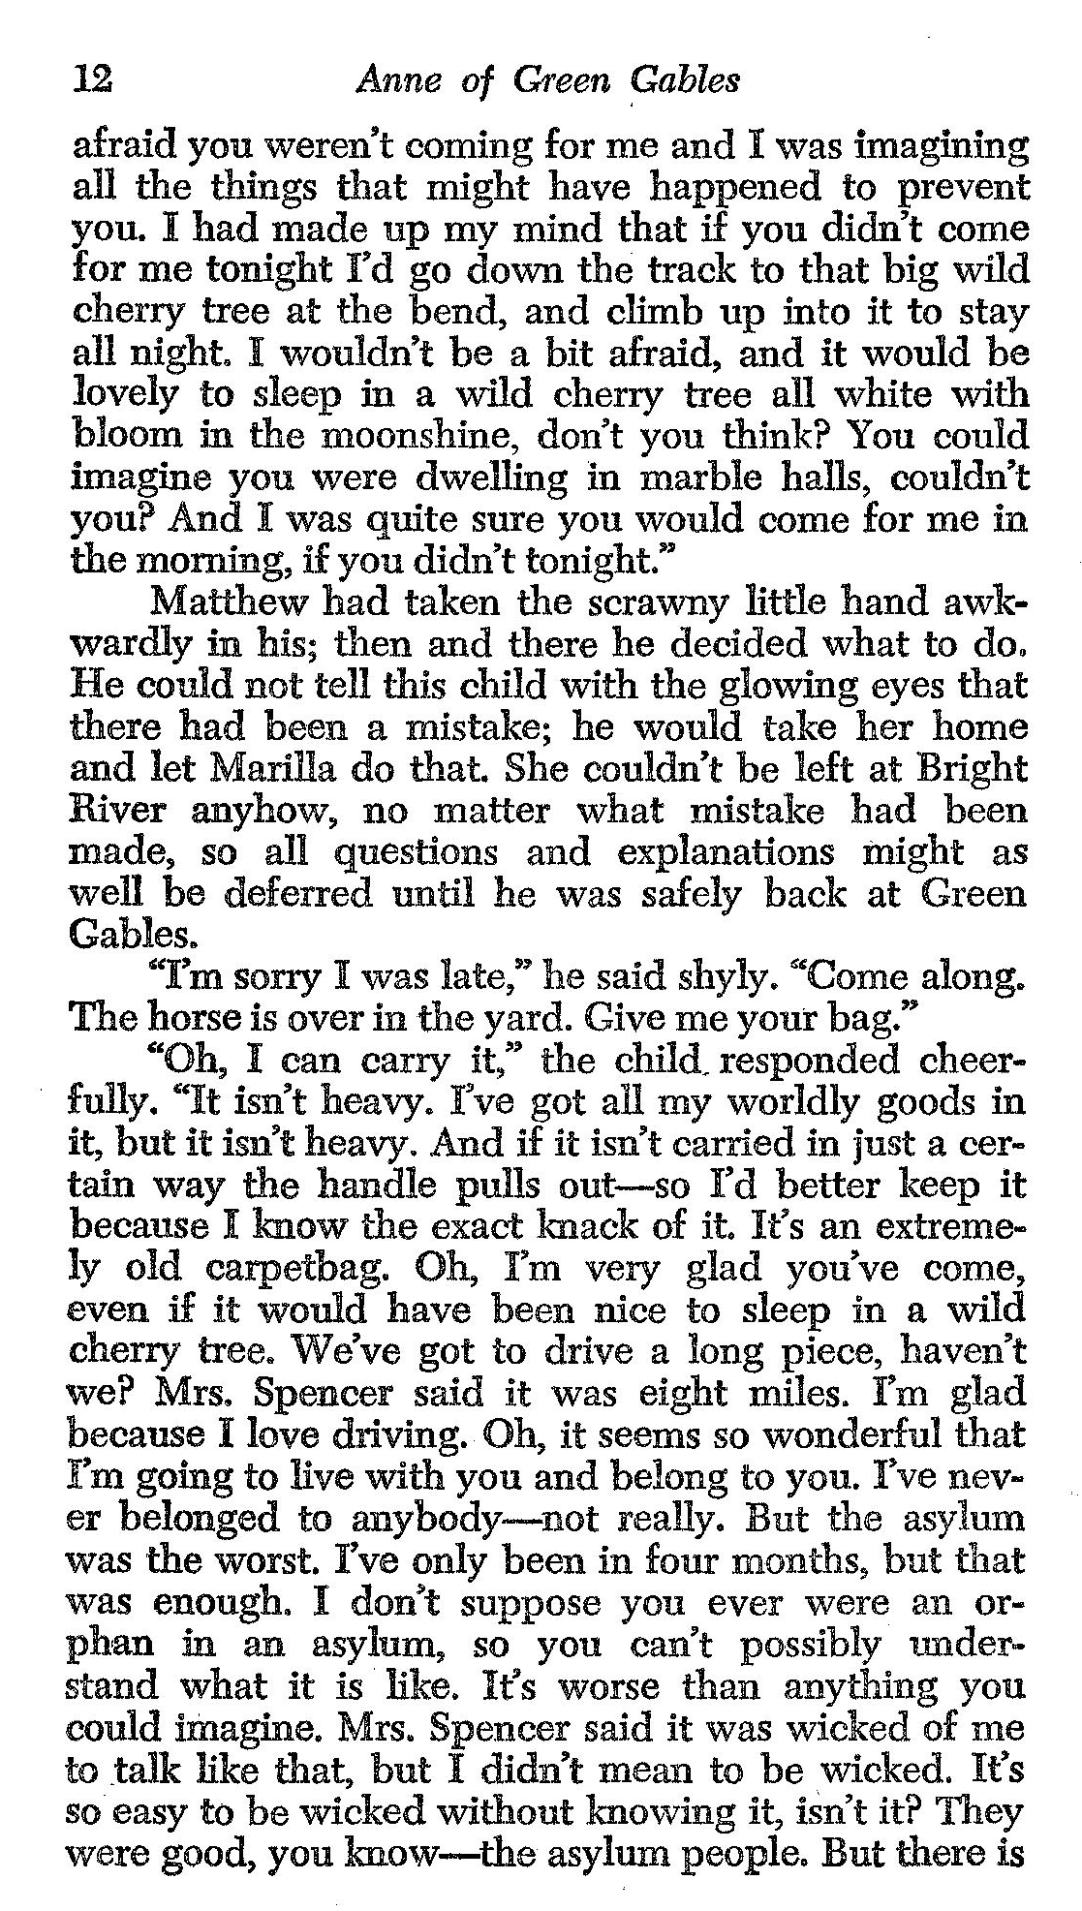
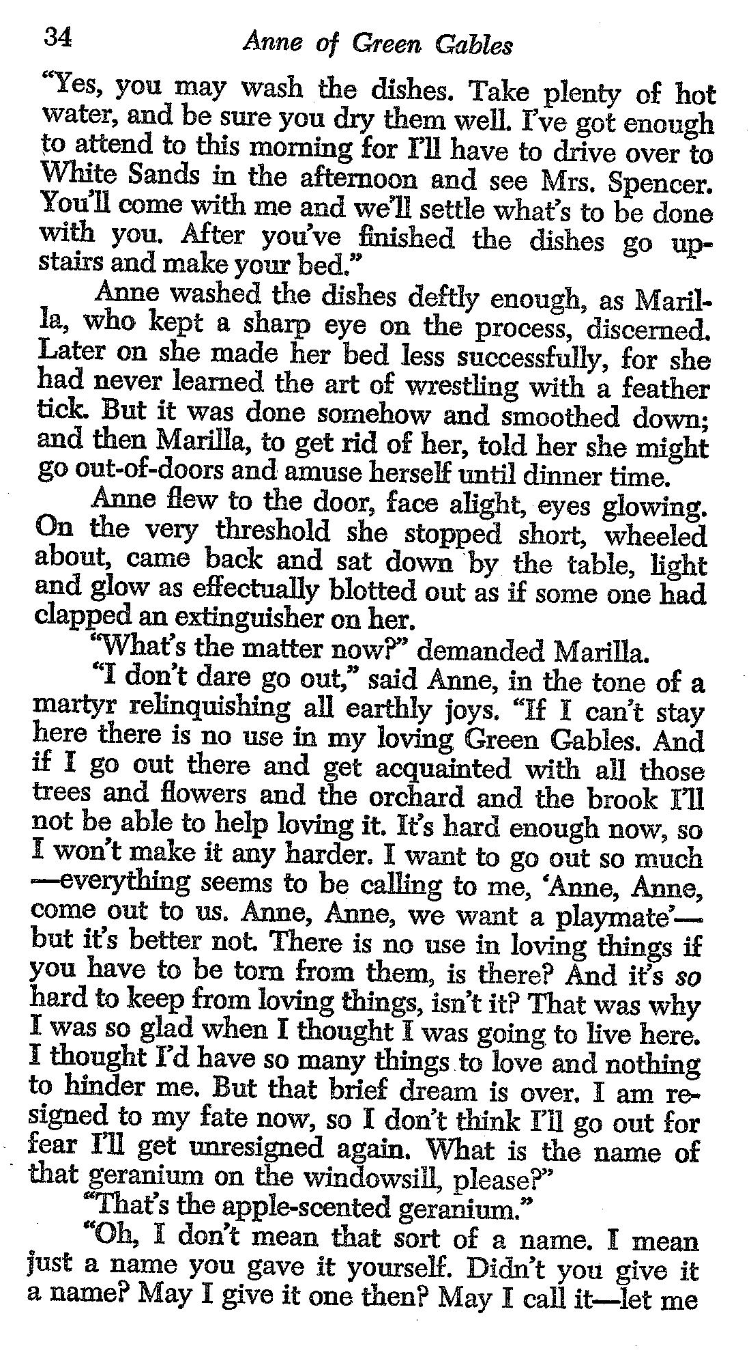
121003
343409
340102
I
LOVE
YOU

Slide 22
Questions? Comments?

Slide 23
GUEST SPEAKER
Vicki Gass
Executive Director, Latin America Working Group
- introduced by Vaughn

Slide 24
break

Slide 25
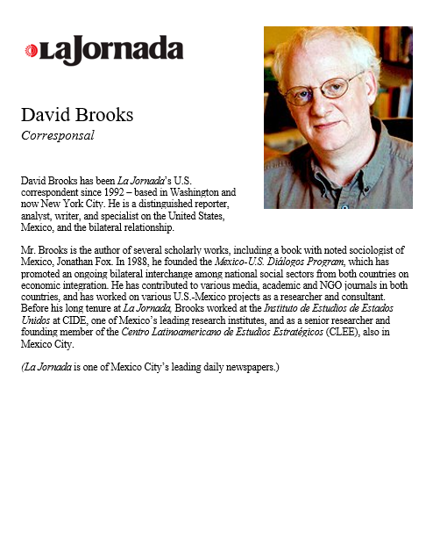
GUEST SPEAKER
David Brooks
Bureau Chief and Senior Correspondent, La Jornada de México
- introduced by Emily

Slide 26
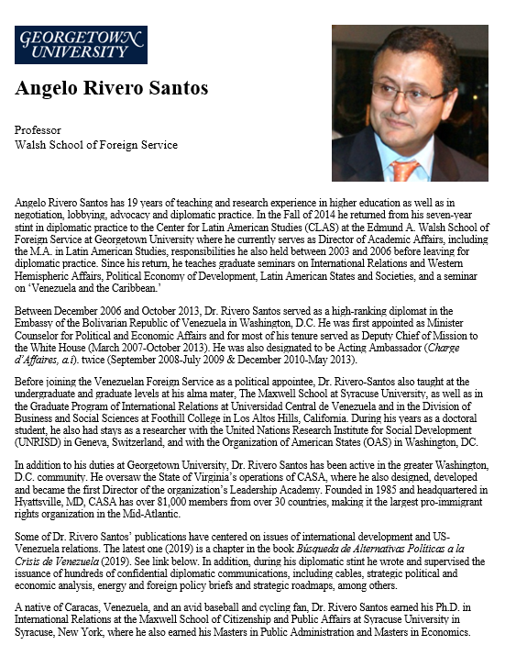
GUEST SPEAKER
Angelo Rivero Santos
Professor, Georgetown University
- introduced by Noah

Slide 27
G2 Metrobus
~12:31
~1:01
~1:31
~2:01
16th & P
37th & O
20th & P
18th & P

Slide 28
ICC
“Red Square”

Slide 29
LUNCH

Slide 30
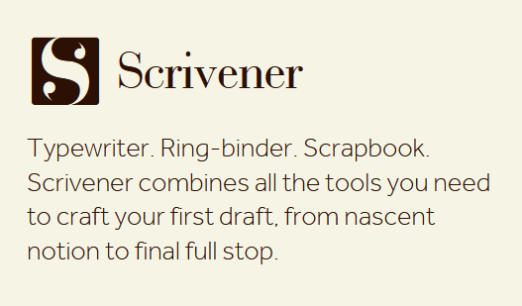

Slide 33
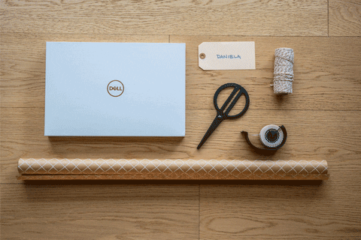
WRAPUP

Slide 34
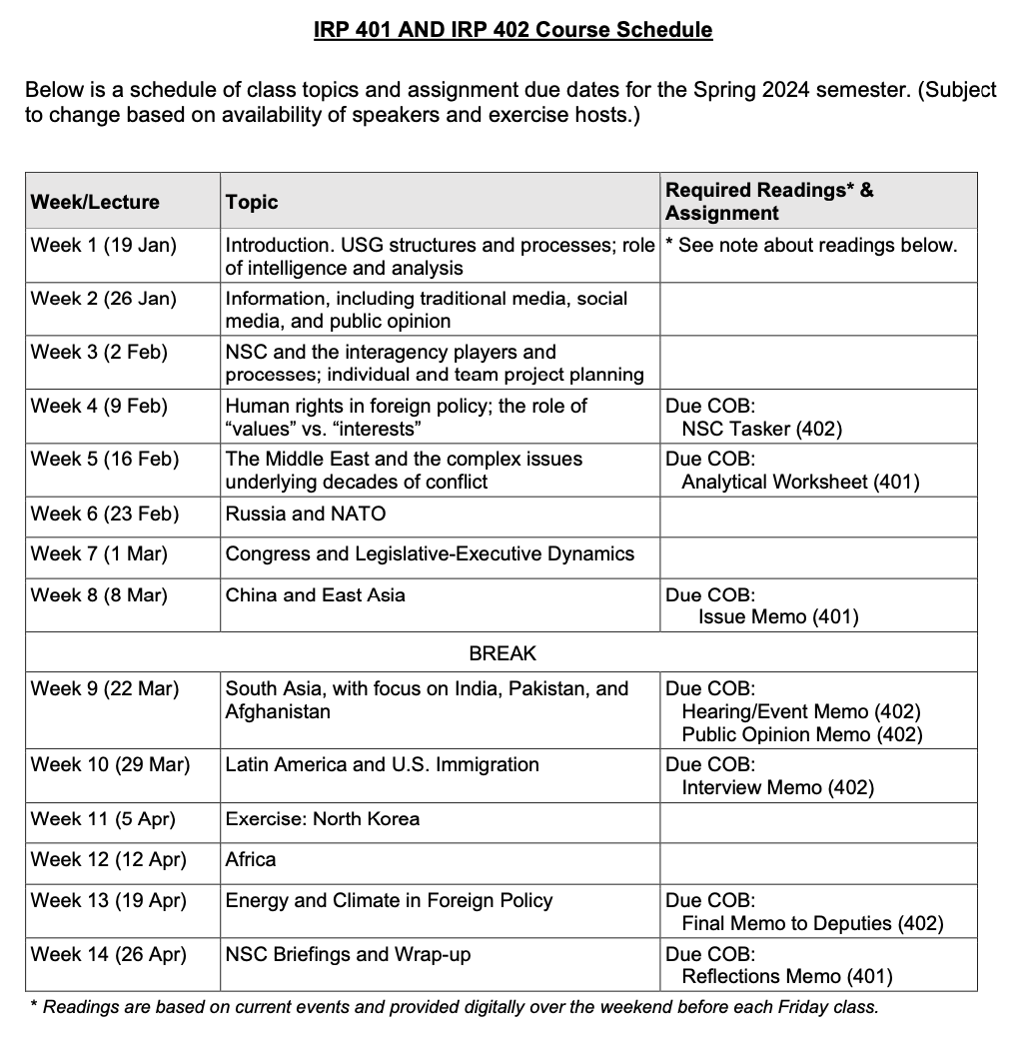
✓
401
402
✓
✓
✓
✓
QUESTIONS?
✓
✓

Slide 35
Project Planning
Akosua | U.S.-Russia: How constrain Putin? | Ensuring microchip competition and supply
Nicolas | U.S.-North Korea: How constrain Kim?
Marcus | U.S.-Vietnam tech/innovation ties | U.S. education deficits
Mimi | Youth homelessness
Vaughn | Central America migration | Israel-Palestine: Two-state solution possible?
Matt | Crisis in Haiti
Gavin | Impact of COVID on mental health | U.S. policy toward Yemen and the Houthis
Noah | Reducing reliance on China trade
Meghan | Russia/Wagner influence in Africa | Impact of climate change on insurgency
Bryce | Improving gun control background checks
Emily | Russia WMD in wake of Ukraine war | How to deal with climate migrants/refugees
Tashakee | Negative impact of cobalt mining in DRC
Reese | South America climate migration | “War time policy”
Emma | U.S.-Mexico border deaths
Ding | Calming tensions on Korean peninsula | U.S. border-state challenges from immigration
Abby | Human trafficking | U.S. support to Ukraine defense against Russia
Jessica | Stopping the flow of fentanyl into U.S.

Slide 36
(I ask again …)
Are you running into any difficulties?
- Finding information
- Doing analysis
- Developing 0ptions
- Formulating a recommendation
Do you remember the elements of a memo?
Are the templates working for you?

Slide 37
REMINDER
In ANY meeting … if guest/speaker is repeating self, consider …
Using body language to signal “message received”
Depending on your style, interrupting gently with a brief …
“thanks” or “I understand” or “I see”
paraphrasing
segue to colleague’s question/point
ask if you can ask followup
UNDERSTAND this: some people feel obligated to fill the time.

Slide 38
Next Week
Latin America
Migration
More INTERNSHIP discussions Three volunteers?
Anything else?

Slide 39
Global Policy Seminar and NSC Simulation
IRP 401 - IRP 402
Week Ten 29 March 2024
Prof. Fulton T. Armstrong

