Slide 1
Global Policy Seminar and NSC Simulation
IRP 401 - IRP 402
Week Nine 22 March 2024
Prof. Fulton T. Armstrong

Slide 2
Week 1 (19 Jan)
Week 2 (26 Jan)
Week 3 (2 Feb)
Week 4 (9 Feb)
Week 5 (16 Feb)
Week 6 (23 Feb)
Week 7 (1 Mar)
Week 8 (8 Mar)
BREAK
Week 9 (22 Mar)
Week 10 (29 Mar)
Week 11 (5 Apr)
Week 12 (12 Apr)
Week 13 (19 Apr)
Week 14 (26 Apr)
SPRING 2024

Slide 3
TODAY’S AGENDA
9:00 | Class Discussion - Readings - Internship conversations: Bryce, Vaughn, Matthew
10:00 | Jeff WU Director, Political Division Taipei Economic and Cultural Representative Office (TECRO) - Introduced by Emma
11:30 | Mr. Haroon Hakimi Former Deputy Minister for Information, Culture, Youth, and Tourism Kabul, Afghanistan - Introduced by Mimi
12:40 | Lunch
2:00 | Former Senior Diplomat of Pakistan Current Adjunct Professor, Georgetown University - Introduced by Marcus
3:15 | Wrap-up

Slide 4
TODAY’S AGENDA
9:00 | Class Discussion - Readings - Internship conversations: Bryce, Vaughn, Matthew
10:00 | Jeff WU Director, Political Division Taipei Economic and Cultural Representative Office (TECRO) - Introduced by Emma
11:30 | Mr. Haroon Hakimi Former Deputy Minister for Information, Culture, Youth, and Tourism Kabul, Afghanistan - Introduced by Mimi
12:40 | Lunch
2:00 | Former Senior Diplomat of Pakistan Current Adjunct Professor, Georgetown University - Introduced by Marcus
3:15 | Wrap-up

Slide 5
9:00 | Class Discussion Readings Project Updates Internship Discussions: Bryce, Vaughn, Matthew
10:00 | Jeff WU Director,Political Division Taipei Economic and Cultural Representative Office (TECRO) Bio attached Introduced by Emma
11:30 | Mr. Haroon Hakimi Former Deputy Minister for Information, Culture, Youth, and Tourism Kabul, Afghanistan Bio attached Introduced by Mimi
12:45 | Lunch
2:00 | Amb. Touqir Hussain Former Senior Diplomat of Pakistan and Current Adjunct Professor, Georgetown University Bio attached Introduced by Marcus
3:15 | Wrap-up

Slide 6
Washington dialect (0r general advice)
If you ask your “boss” for advice …
if you don’t say thank you …
understand that your message is that the help was not helpful.

Slide 7
Also … in general professional context … consider this advice:
KNOW WHAT YOU’RE BEING HEARD TO SAY,
NOT JUST WHAT YOU’RE SAYING.

Slide 8
Remember that words matter for clear analysis and policy
So your intended meaning is clear.
denotation
connotation
“direct specific meaning as distinct from additional suggestion”
“the conveying or suggesting a meaning by a word along with or apart from the thing it explicitly names or describes”

Slide 9
Remember that words matter for clear analysis and policy
So your intended meaning is clear.
My experience:
If you want a successful communication, you should know the other side’s codes and a) use them, or b) clarify yours and seek agreement to use them.
Sort of like code-switching, but with pure purpose of ensuring effective communication.

Slide 10
One more quote … since we’re doing China stuff … and you’re (perhaps) appreciating the challenges of some policies.

Slide 11
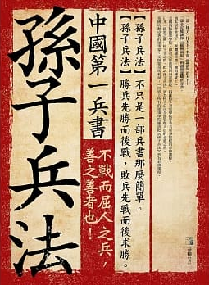
孙子
Sun Tzu
知己知彼，百战不殆。
Zhījǐzhībǐ, bǎizhànbúdài
The Art of War
Know yourself as you know your enemy, and you will win all battles.

Slide 12
Several examples:
Israel-Hamas War | Israel-Gaza War | Israel-Palestine War
Hamas | Gazan | Palestinian
Israeli | Jew | Zionist
Illegal immigrant | Undocumented immigrant | Immigrant
Contra | Freedom Fighter | Moral Equivalent of Founders
Communist | Socialist | Social-Democrat
[Nationality] | [Origin]-American | American

Slide 13
“Memo #2”
Some quick observations …
As said before, life is easier if you follow directions.
Heed feedback from other products (or tell your supervisor to stop giving feedback).
Use standard dates, use cardinal numbers (not ordinals), etc.
The link between good drivers and good options (and recommendations) is real.
Mixing real words with “can, could, may, might,” etc. undermines your message.
Self-edit and read aloud – or at least re-read to make sure head matches tail.
A person’s or country’s name shouldn’t change over the time it takes you to write a paper.
Proofread.
If you’re writing for the National Security Advisor, you’re working for the President and the Administration.
You don’t want your work, or parts of it, to smell like ChatGPTfish.

Slide 14
Taiwan
“The Taiwan Miracle”
“The Taiwan Problem”
“The Taiwan Question”
“The Taiwan Issue”

Slide 15
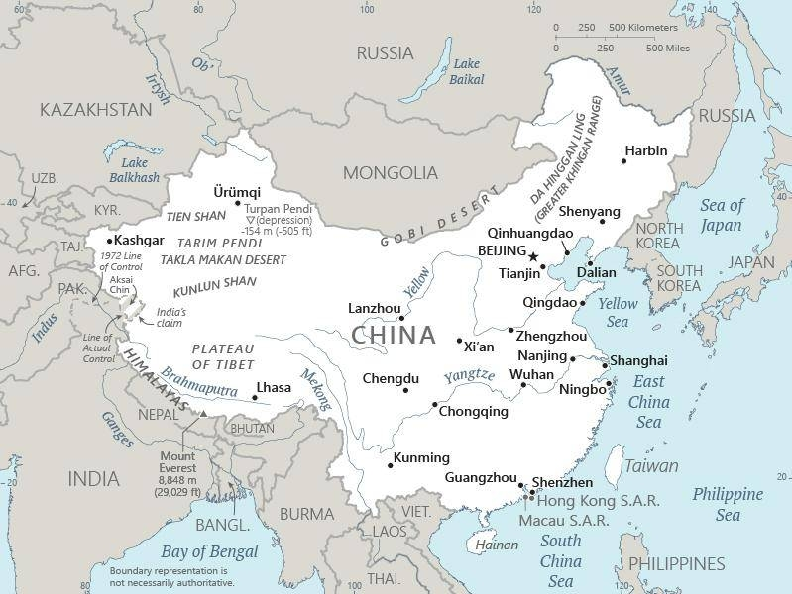

Slide 16
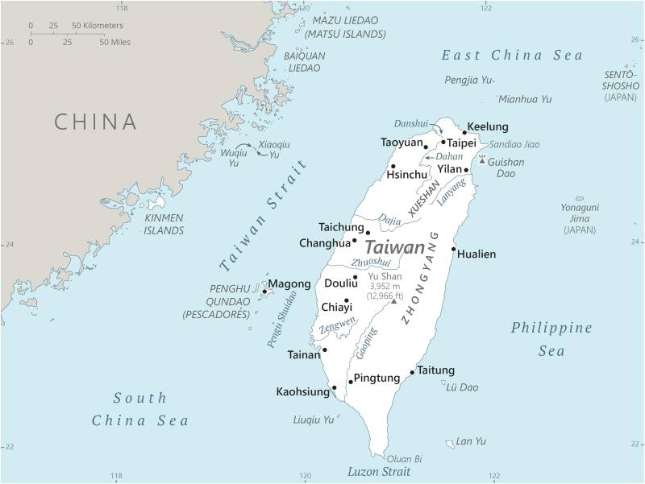
A little smaller than Maryland
250 miles long
100 miles from mainland
Population: 24 million
95-97 % ethnic Han
Languages: Taiwanese/Hokkienese
Chinese
Hakka

Slide 17
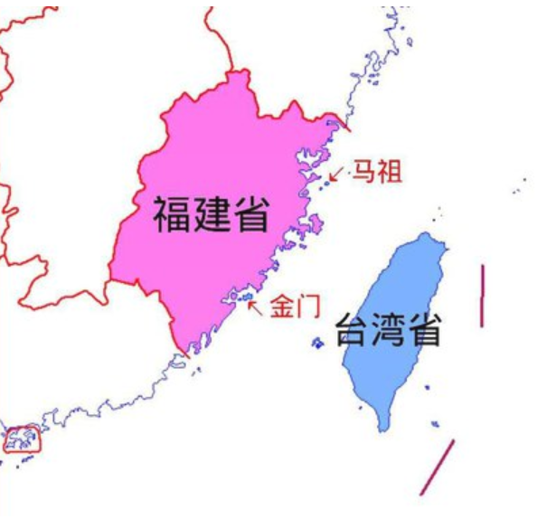
福州
廈門
Jinmen-Xiamen = 2 mi.
Mazu-Fuzhou = 10 mi.

Slide 18
P.R.C. and R.O.C.
What have been the main perspectives on Taiwan’s relationship with China?
How have those perspectives evolved since U.S.-China normalization (1979)?
What have been the drivers of that evolution?
What steps can China, Taiwan, the United States, and others take to avoid conflict?
What will happen, and why?

Slide 19
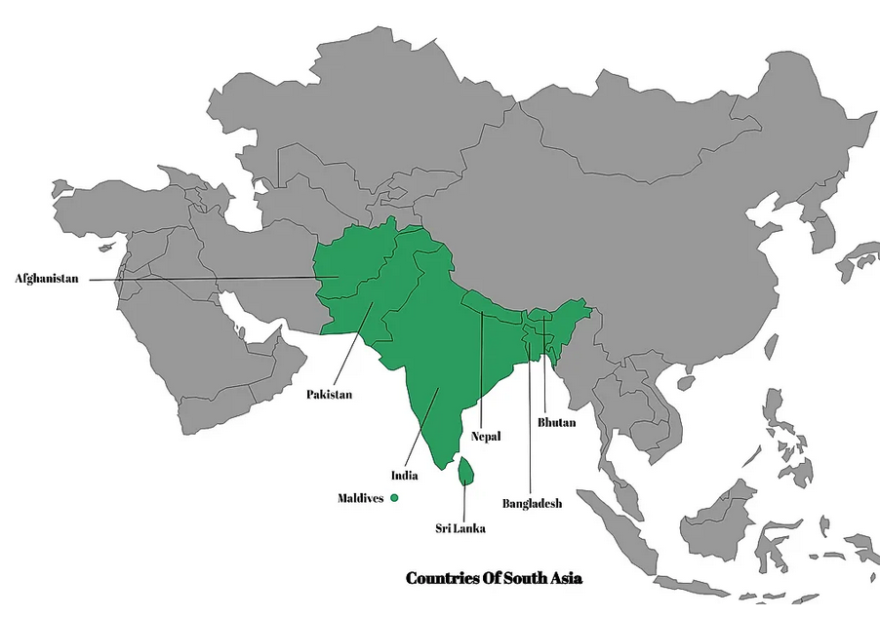
TURKMENISTAN
UZBEKISTAN
KYRGYZSTAN
TURKMENISTAN
SOUTH ASIA
1.
IRAN
2.
4.
5.
3.
8.
6.
7.

Slide 20
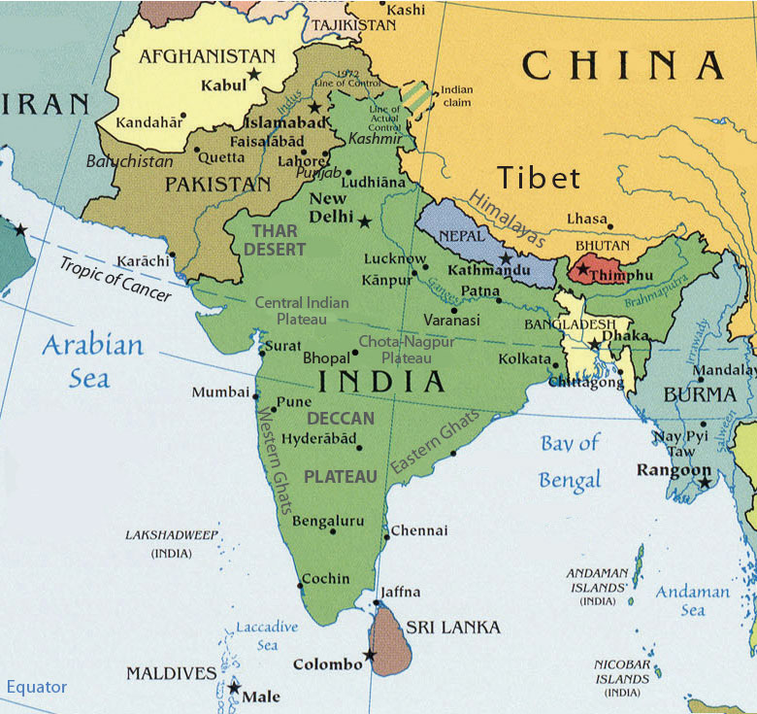

Slide 21
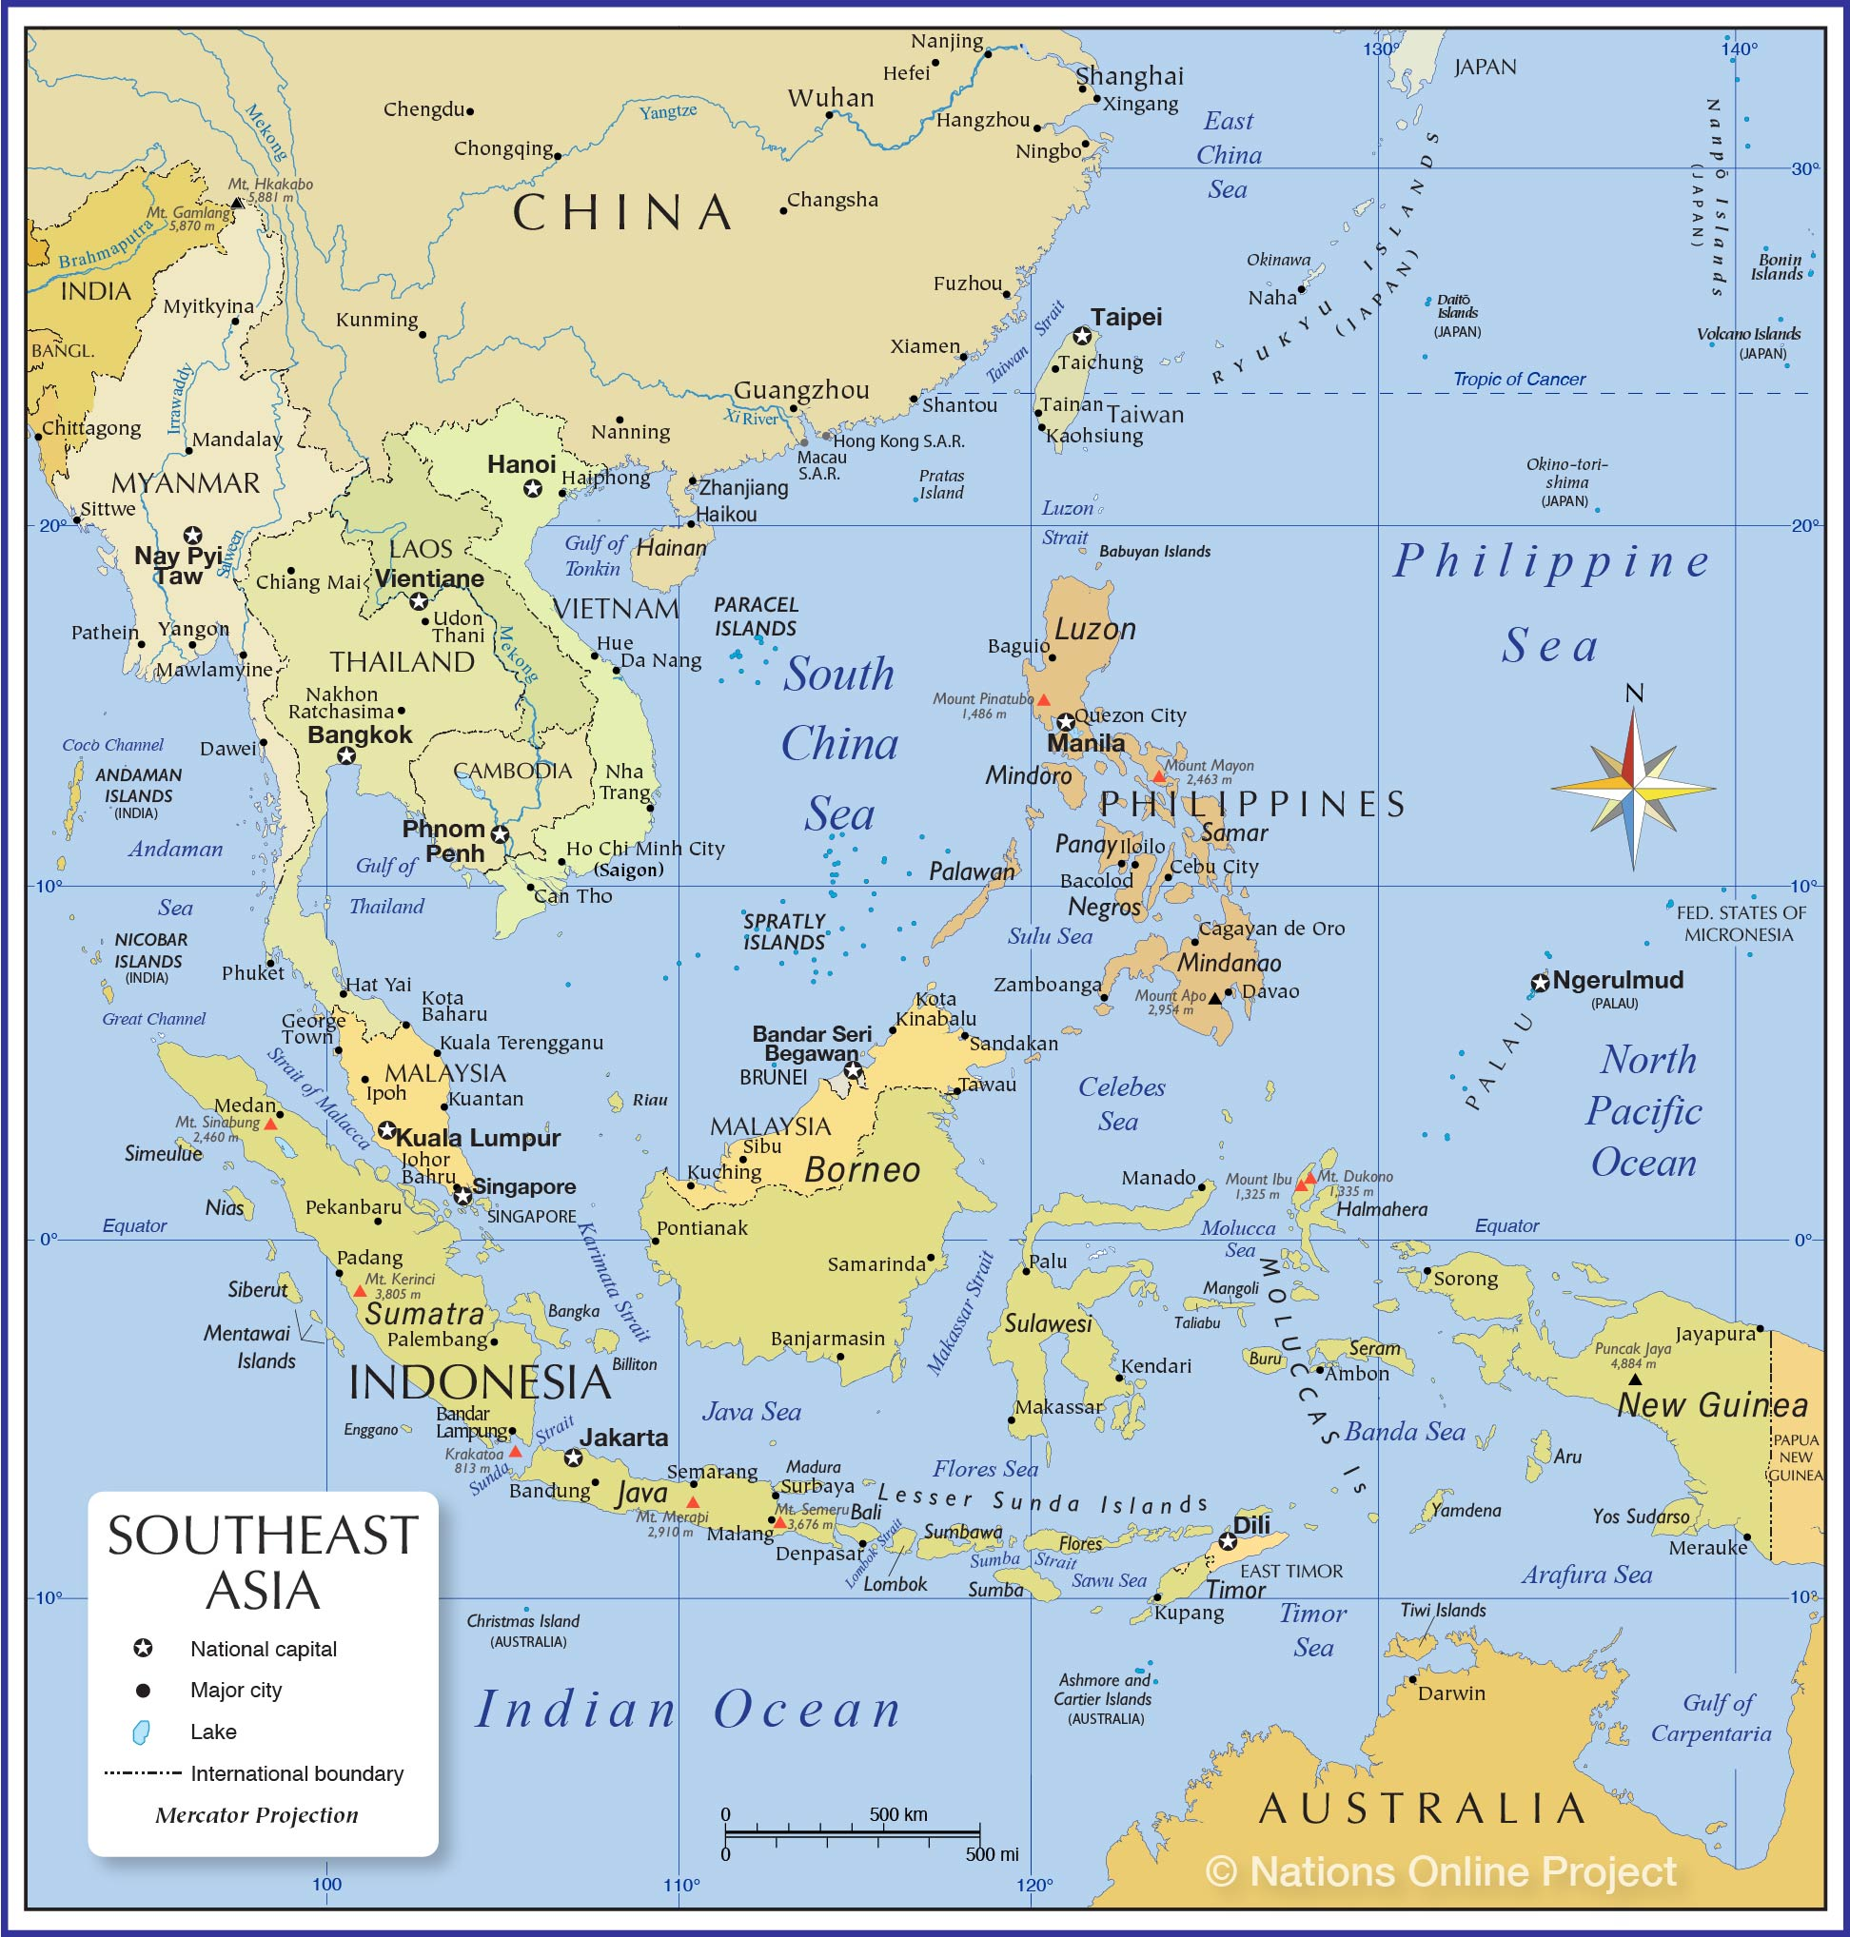

Slide 22
Afghanistan – What are the main issues?
Pakistan – What are the main issues?

Slide 23
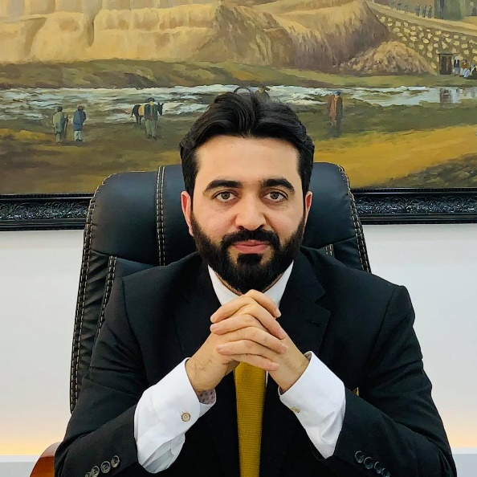
DISCUSSION
Fourteen Lessons from Afghanistan for Future U.S. Nation Building
CLEARLY DEFINE GOALS, HAVE A STRATEGY, AND STICK TO THEM
CHOOSE ALLIES AND PARTNERS CAREFULLY AND UNDERSTAND THEIR INTENTIONS
UNDERSTAND NEIGHBORS, THEIR RELATIONS, AND THE NEIGHBORHOOD
RECONCILE WITH FORMER ENEMIES AND ACCOMMODATE THEM TO MINIMIZE FUTURE THREATS
INCLUSIVENESS CREATES A STABLE AND EFFECTIVE GOVERNMENT
PRIORITIZING SECURITY INSTITUTIONS HELPS THE PROCESS AND LESSENS THE BURDEN ON U.S. FORCES
A FUNCTIONAL GOVERNMENT IS BETTER THAN A REPRESENTATIVE GOVERNMENT THAT FAILS TO FUNCTION
DIVIDE NATION BUILDING RESPONSIBILITIES CAREFULLY, PUSH FOR WIDESPREAD COORDINATION, AND MONITOR AND EVALUATE PROGRESS PROPERLY
Haroon HAKIMI

Slide 24
DISCUSSION
Fourteen Lessons from Afghanistan for Future U.S. Nation Building
BE PREPARED TO PREVENT CORRUPTION, FIGHT IT AS AN INNER ENEMY IF AND WHEN IT APPEARS
ESTABLISHING AND ENFORCING THE RULE OF LAW MUST BE A PRIORITY WITHOUT COMPROMISE
PROMOTE LONG-TERM ECONOMIC SELF-SUFFICIENCY AND SUSTAINABILITY TO AVOID AID DEPENDENCY
FIX THE PROPERTY REGIME TO REDUCE CONFLICTS AND PROTECT THE RIGHT TO OWNERSHIP
SUPPORT NATIONALISM AND THE NATIONAL IDENTITY THAT IS FUNDAMENTAL FOR DEMOCRACY
CONSISTENCY THROUGHOUT THE NATION BUILDING PROCESS HELPS TO ACHIEVING THE DESIRED GOALS
Haroon HAKIMI

Slide 25
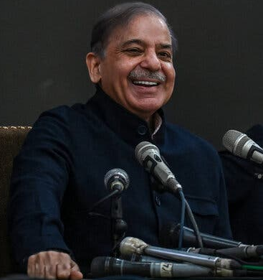
DISCUSSION
Brother of former PM Nawaz Sharif.
Family linked to corruption charges.
Prime Minister Shehbaz Sharif
Pakistan Muslim League-Nawaz Party

Slide 26
DISCUSSION
Elections on February 8 inconclusive.
Parliament voted him second term, after weeks of upheaval and agreement for limited power-sharing.
Beat Omar Ayub – protégé of former PM Imran Khan.
Preferred by military, which has been accused of tampering.
Fortune tied to Army Chief General Asim Munir.
Challenges ahead:
Economy
Civil-military relations
Relations with India and Afghanistan
Prime Minister Shehbaz Sharif

Slide 27
Internship conversations
2-3 minutes each --
Bryce
Vaughn
Matthew
INFORMAL DISCUSSION
Organization name and business
In-person, virtual, hybrid
My tasks and responsibilities
Communications and team dynamics
Fun things and challenges

Slide 28
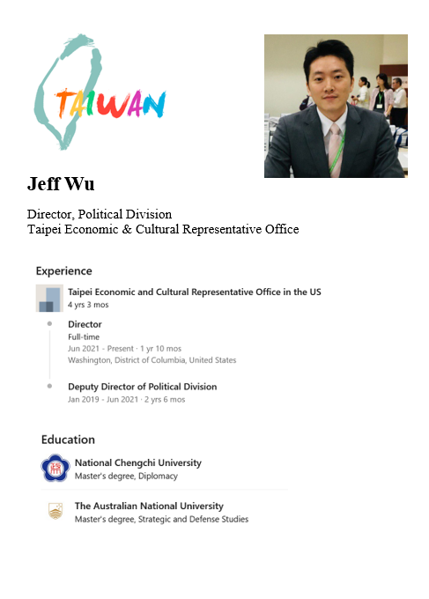
GUEST SPEAKER
Jeff WU
Director,Political Division Taipei Economic and Cultural Representative Office (TECRO)
- Introduced by Emma

Slide 29
BREAK

Slide 30
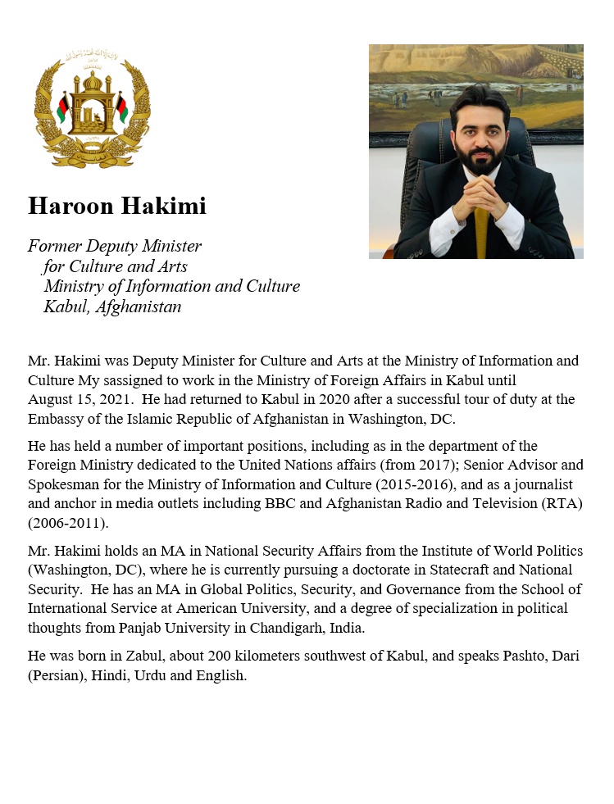
GUEST SPEAKER
Mr. Haroon Hakimi
Former Vice Minister Foreign and Information Ministry of Afghanistan, Kabul
- Introduced by Mimi

Slide 31
LUNCH

Slide 32
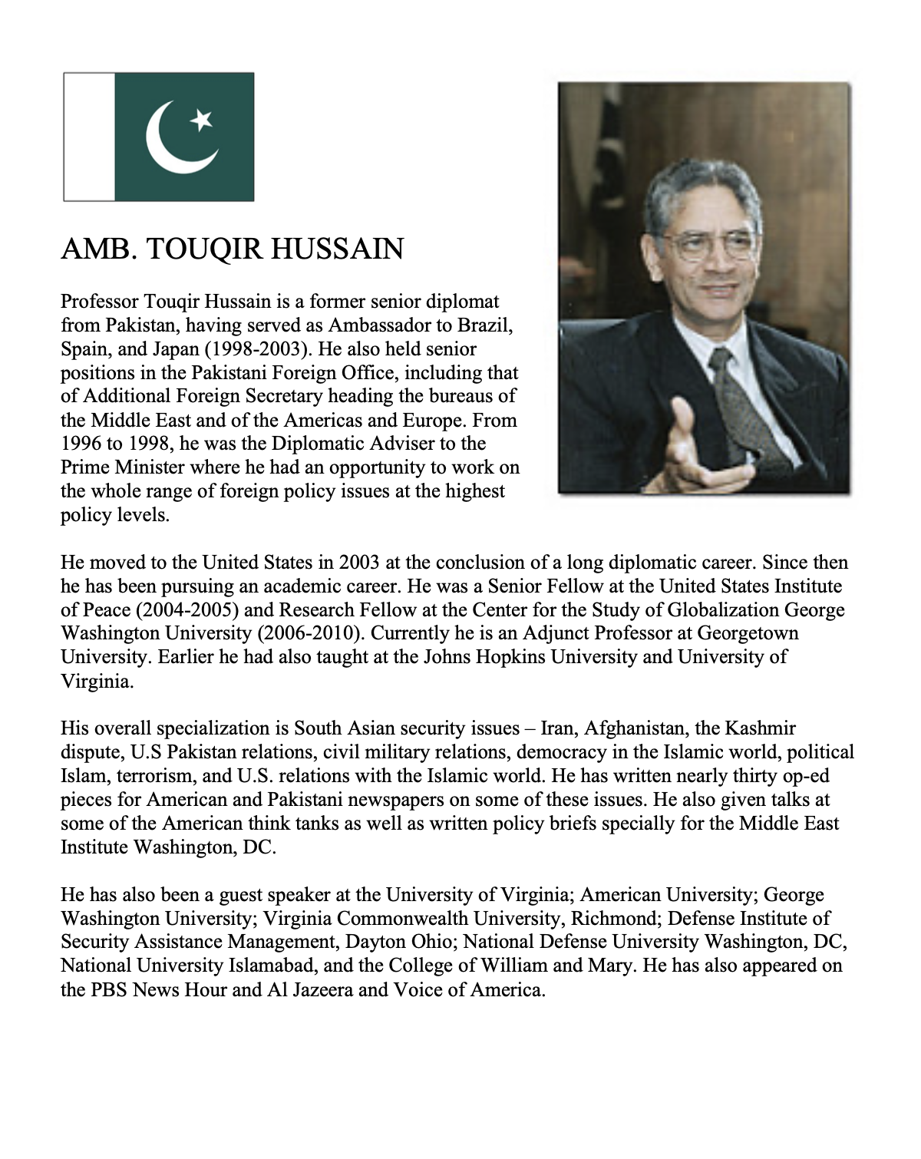
GUEST SPEAKER
Amb. Touqir Hussain
Former Senior Diplomat of Pakistan
Current Adjunct Professor, Georgetown University
- Introduced by Marcus

Slide 33
WRAPUP

Slide 34
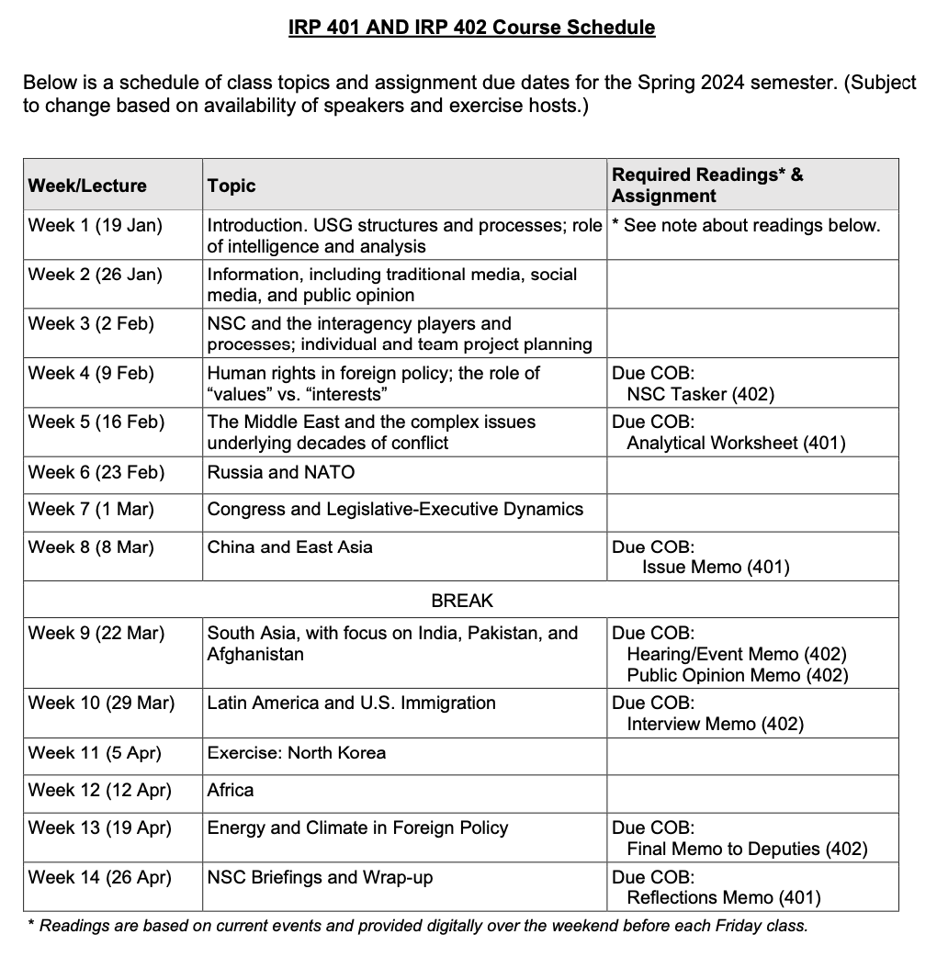
✓
401
402
✓
✓
✓
✓
QUESTIONS?
✓
✓

Slide 35
Project Planning
Akosua | U.S.-Russia: How constrain Putin? | Ensuring microchip competition and supply
Nicolas | U.S.-North Korea: How constrain Kim?
Marcus | U.S.-Vietnam tech/innovation ties | U.S. education deficits
Mimi | Youth homelessness
Vaughn | Central America migration | Israel-Palestine: Two-state solution possible?
Matt | Crisis in Haiti
Gavin | Impact of COVID on mental health | U.S. policy toward Yemen and the Houthis
Noah | Reducing reliance on China trade
Meghan | Russia/Wagner influence in Africa | Impact of climate change on insurgency
Bryce | Improving gun control background checks
Emily | Russia WMD in wake of Ukraine war | How to deal with climate migrants/refugees
Tashakee | Negative impact of cobalt mining in DRC
Reese | South America climate migration | “War time policy”
Emma | U.S.-Mexico border deaths
Ding | Calming tensions on Korean peninsula | U.S. border-state challenges from immigration
Abby | Human trafficking | U.S. support to Ukraine defense against Russia
Jessica | Stopping the flow of fentanyl into U.S.

Slide 36
(I ask again …)
Are you running into any difficulties?
- Finding information
- Doing analysis
- Developing 0ptions
- Formulating a recommendation
Do you remember the elements of a memo?
Are the templates working for you?

Slide 38
Encryption
Securely sending information
“One-time pad”
Book code or book cipher
Encryption machines
Computer encryption

Slide 39
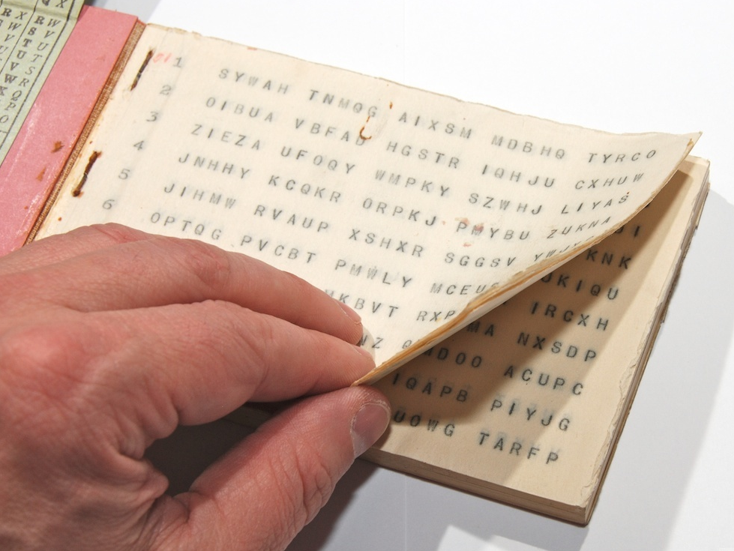
“One-time pad”
keys
A series of groups of letters
Two identical copies
Used agreed-upon day/time
Extremely secure (if pad is secure)
Notes:
NOTE FIVE GROUPS OF FIVE LETTERS – because A=0

Slide 40
“One-time pad”
keys
A series of groups of letters
Two identical copies
Used agreed-upon day/time
Extremely secure (if pad is secure)
AN EXAMPLE … Let’s say …
First key is SBMHR
Your requirement is: What is the enemy having for lunch?
Notes:
NOTE FIVE GROUPS OF FIVE LETTERS – because A=0

Slide 41
Key begins with: SBMHR
Message you want to send: PIZZA
Message: | P |  | I |  | Z |  | Z |  | A
Values: | 14 |  | 8 |  | 25 |  | 25 |  | 0
Key: | S |  | B |  | M |  | H |  | R
Values: | 17 |  | 1 |  | 12 |  | 7 |  | 16
Sum: | 5 |  | 9 |  | 11 |  | 6 |  | 16
Ciphertext: | F |  | J |  | L |  | G |  | R

Slide 42
Key begins with: SBMHR
Message you want to send: PIZZA
Message: | P |  | I |  | Z |  | Z |  | A
Values: | 14 |  | 8 |  | 25 |  | 25 |  | 0
Key: | S |  | B |  | M |  | H |  | R
Values: | 17 |  | 1 |  | 12 |  | 7 |  | 16
Sum: | 5 |  | 9 |  | 11 |  | 6 |  | 16
Ciphertext: | F |  | J |  | L |  | G |  | R
Notes:
Once again!!!

Slide 43
MSG from HQS:
What is the enemy going to eat for lunch?
Your encoded REPLY:
F J L G R
On subsequent mentions of PIZZA, you will not repeat F J L G R, because you’ll use a different key from the OTP.

Slide 44
“Book Code”
Two identical copies of a book
Commercially available; doesn’t look like a codebook
Flexible date/time
Caution: Vocabulary has to be appropriate to intelligence information

Slide 45
“Book Code”
page/line/word | 842914
paragraph/word | 1586

Slide 46
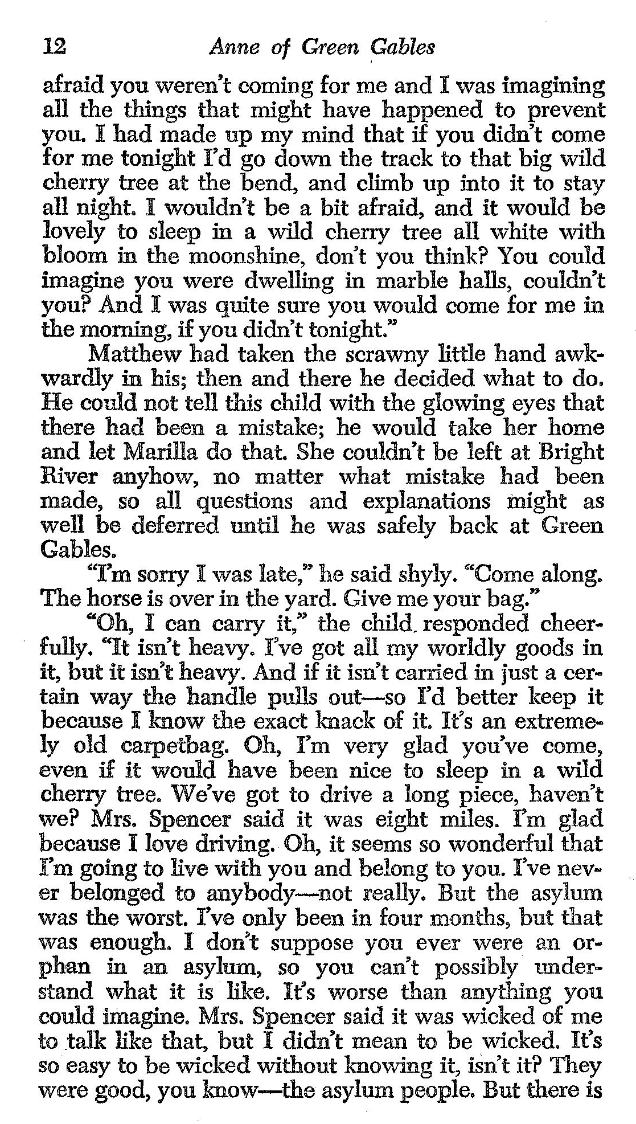
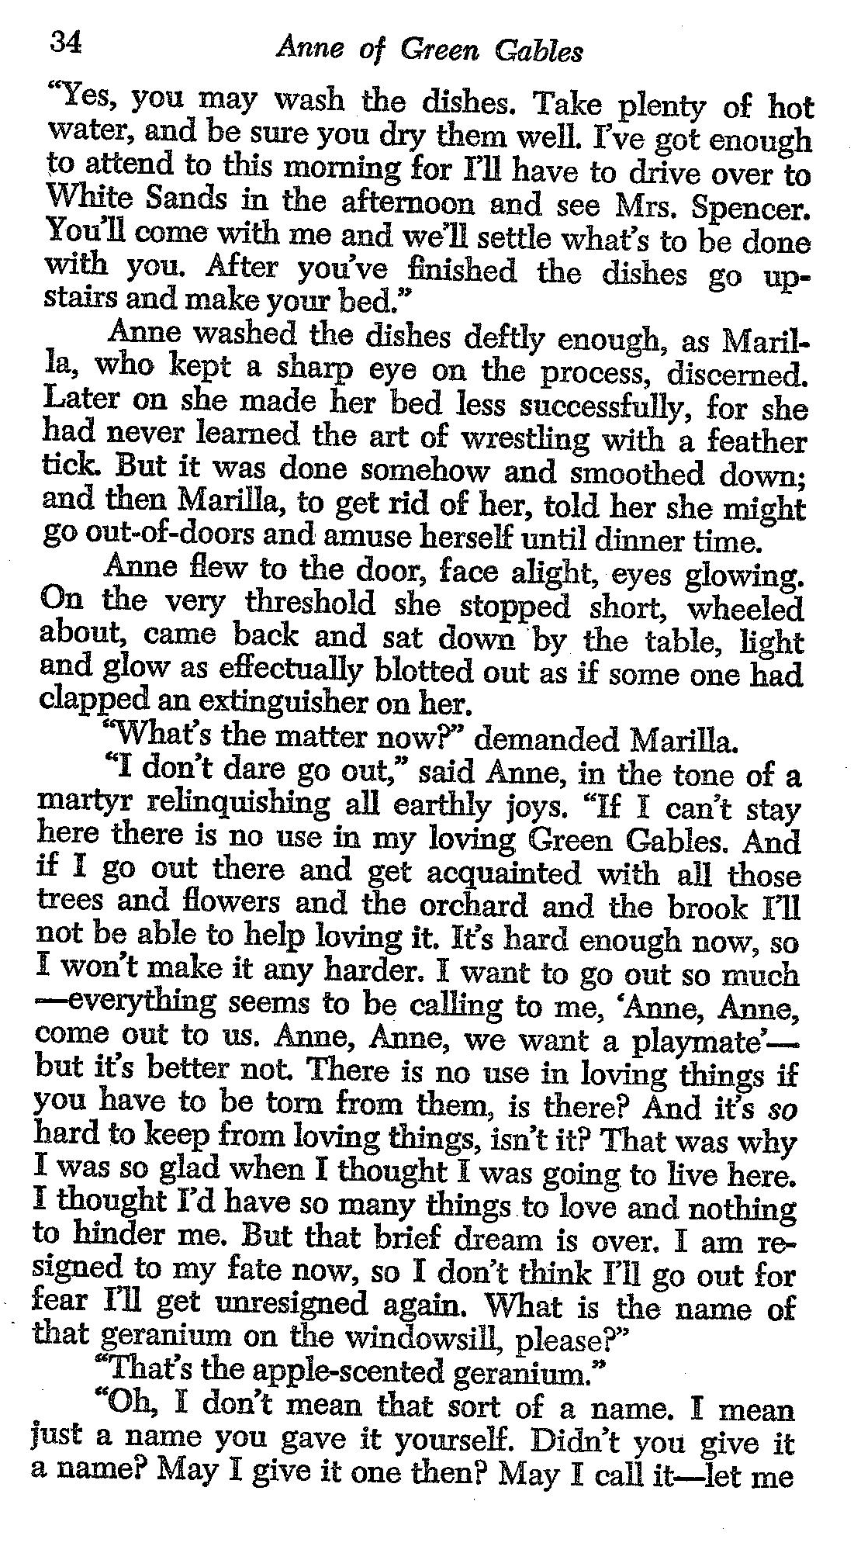
121003
343409
340102
I
LOVE
YOU

Slide 47
REMINDER
In ANY meeting … if guest/speaker is repeating self, consider …
Using body language to signal “message received”
Depending on your style, interrupting gently with a brief …
“thanks” or “I understand” or “I see”
paraphrasing
segue to colleague’s question/point
ask if you can ask followup
UNDERSTAND this: some people feel obligated to fill the time.

Slide 48
Next Week
Latin America
Migration
More INTERNSHIP discussions Three volunteers?
Anything else?

Slide 49
Global Policy Seminar and NSC Simulation
IRP 401 - IRP 402
Week Nine 22 March 2024
Prof. Fulton T. Armstrong

