Slide 1
Global Policy Seminar and NSC Simulation
IRP 401 - IRP 402
Week Five 16 February 2024
Prof. Fulton T. Armstrong

Slide 2
Week 1 (19 Jan)
Week 2 (26 Jan)
Week 3 (2 Feb)
Week 4 (9 Feb)
Week 5 (16 Feb)
Week 6 (23 Feb)
Week 7 (1 Mar)
Week 8 (8 Mar)
BREAK
Week 9 (22 Mar)
Week 10 (29 Mar)
Week 11 (5 Apr)
Week 12 (12 Apr)
Week 13 (19 Apr)
Week 14 (26 Apr)
SPRING 2024

Slide 3
Washington dialect
“Write it down.”
Write your JOURNALS

Slide 4
TODAY’S AGENDA
9:00 | Class Discussion - Readings - Preparation for Israel-Gaza discussions (Vaughn, Matthew, Bryce) - Preparation for Ukraine-Russia discussions (Jessica, Abby)
10:00 | Professional Development - Networking and the Elevator Pitch - The Interview: Getting One; Acing One; Learning from One
11:30 | Nadav Zysblat Minister-Counselor for Political Affairs, Embassy of Israel - introduced by Matthew
12:40 | Lunch
1:50 | Ubers depart CSIS
2:30 | Denys Sienik Deputy Chief of Mission, Embassy of Ukraine

Slide 5
TODAY’S AGENDA
9:00 | Class Discussion - Readings - Preparation for Israel-Gaza discussions (Vaughn, Matthew, Bryce) - Preparation for Ukraine-Russia discussions (Jessica, Abby)
10:00 | Professional Development - Networking and the Elevator Pitch - The Interview: Getting One; Acing One; Learning from One
11:30 | Nadav Zysblat Minister-Counselor for Political Affairs, Embassy of Israel - introduced by Matthew
12:40 | Lunch
1:50 | Ubers depart CSIS
2:30 | Denys Sienik Deputy Chief of Mission, Embassy of Ukraine

Slide 6
WHO’S WHO IN AN EMBASSY?
CONSULATES
Consul General
Consul
Vice consul
INTERNATIONAL ORGANIZATIONS
Permanent Representative
Deputy Permanent Representative
Ambassador
(Deputy Chief of Mission)
Minister
Minister-counselor
Counselor
First secretary
Second secretary
Third secretary
Attaché
Assistant attaché
Denys Sienik – Deputy Chief of Mission
TAO Song – Counselor for Political Affairs
Nadav Zysblat - Minister-Counselor for Political Affairs
Examples of job titles
Political Officer
Economics Officer
Regional Security Officer
Administrative Officer
Public Affairs Officer
Defense Attache
MilGroup Member
FLEXIBILITY
Ambassador-at-Large
Envoy or Special Envoy

Slide 7
ETIQUETTE or PROTOCOL
Professional respect
Smart, analytical questions
Non-combative tone
Depending on your style, perhaps preface question
What is your perspective on …?
What should we make of reports that …?
What do we need to know to understand …
Neutral vocabulary

Slide 8
ETIQUETTE or PROTOCOL
In ANY meeting … if guest/speaker is repeating self, consider …
Using body language to signal “message received”
Depending on your style, interrupting gently with a brief …
“thanks” or “I understand” or “I see”
paraphrasing
segue to colleague’s question/point
ask if you can ask followup
UNDERSTAND this: some people feel obligated to fill the time.

Slide 9
ETIQUETTE or PROTOCOL
Personal vs official views
Chatham House Rule
St. James’s Square London

Slide 10
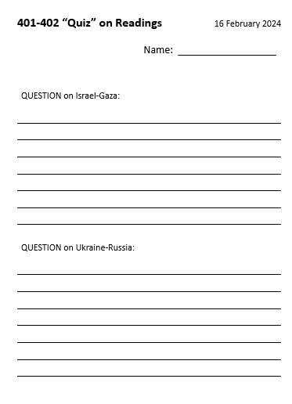
READINGS
Quiz (of sorts)

Slide 11
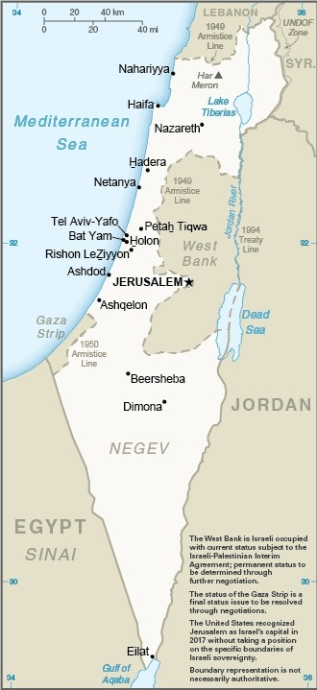
MEETING PREPS
Israel -Gaza
What do we need to know?
How can we approach the issue?
Vaughn, Bryce, Matthew

Slide 12
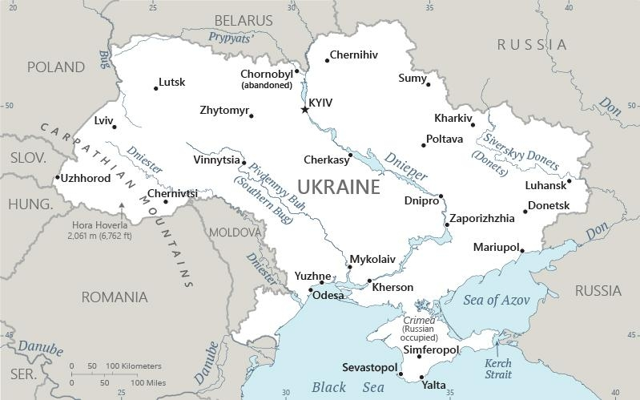
MEETING PREPS
Ukraine-Russia
What do we need to know?
How can we approach the issue?
Addy, Jessica

Slide 13
Comments?

Slide 14
The Maxwell in DC Professional Development Series

Slide 15
Comments?

Slide 16
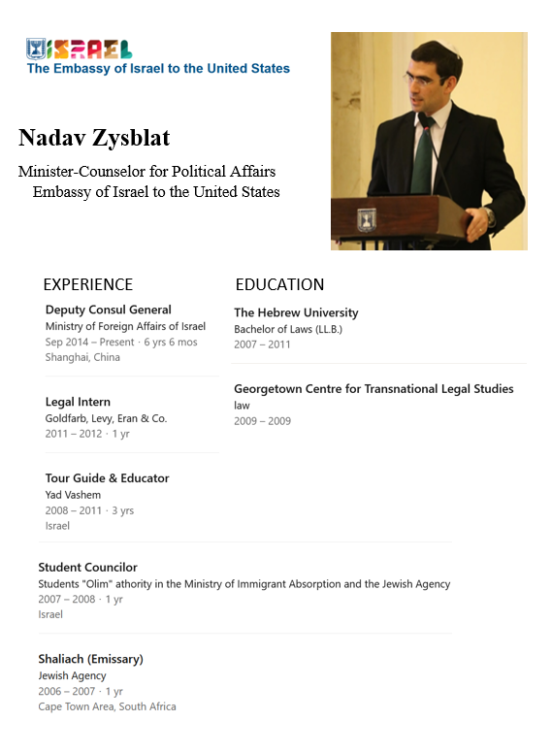
Nadav Zysblat
Minister-Counselor for Political Affairs
Embassy of Israel
Introduced by Matthew

Slide 17
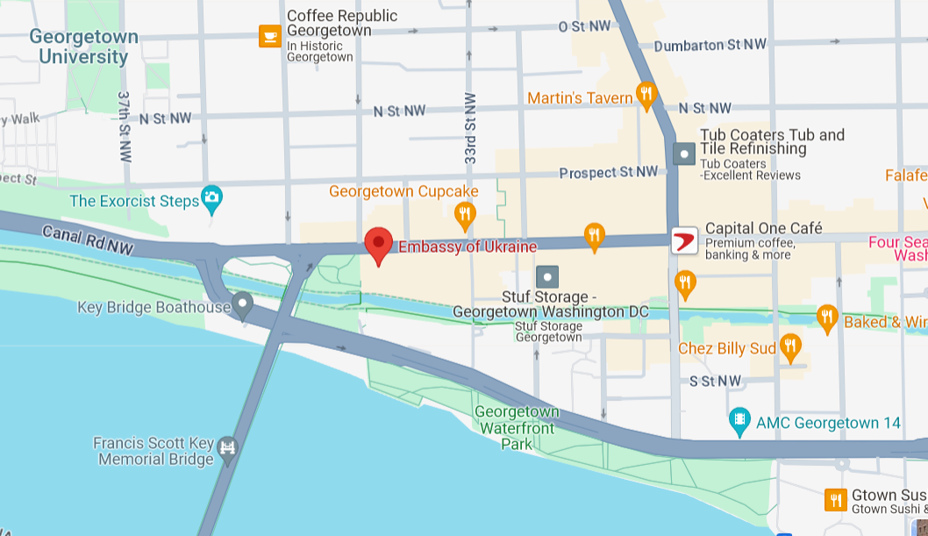
Lunch
Ubers depart at 1:50 sharp
Embassy of Ukraine
3350 M St NW

Slide 18
Project Planning
Akosua | U.S.-Russian: How constrain Putin? | Ensuring microchip competition and supply
Nicolas | U.S.-North Korea: How constrain Kim?
Marcus | Tech/innovation ties with Vietnam | Education deficits in St. Paul, Minnesota
Mimi | Youth homelessness
Vaughn | Central America migration | Israel-Palestine: Two-state solution possible?
Matt | Crisis in Haiti
Gavin | Impact of COVID on mental health | U.S. policy toward Yemen and the Houthis
Noah | Reducing reliance on China trade
Meghan | Russia/Wagner influence in Africa | Impact of climate change on insurgency
Bryce | Improving gun control background checks
Emily | Russia-Ukraine (prospects? What next?) | How to deal with climate migrants/refugees
Tashakee | Executive promotion abortion legislation T
Reese | Central America climate migration | “War time policy”
Emma | U.S.-Mexico deaths
Ding | U.S.-North Korea: Stopping Kim nuclear | U.S.Border-state challenges on immigration
Abby | Human trafficking | U.S. support to Ukraine defense against Russia
Jessica | Stopping the flow of fentanyl into U.S.

Slide 19
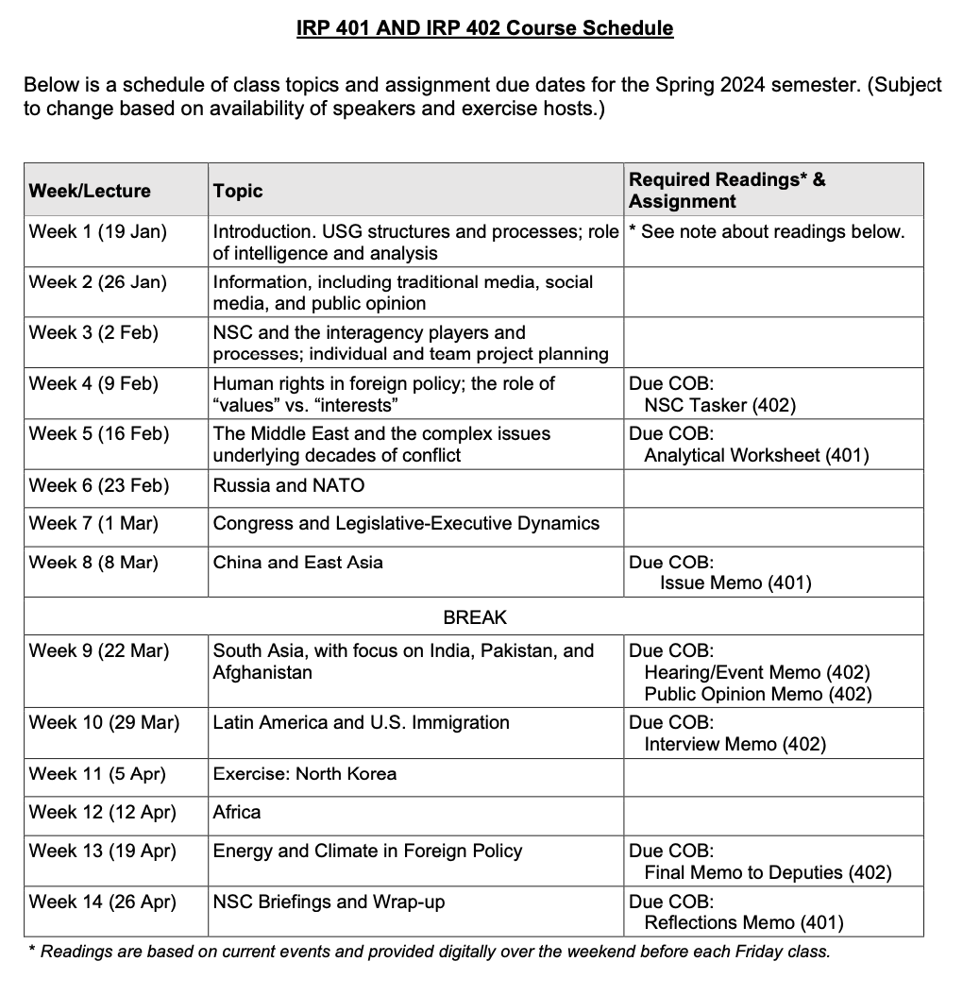
✓
401
402
✓
✓
✓
✓
QUESTIONS?
✓
✓

Slide 20
Global Policy Seminar and NSC Simulation
IRP 401 - IRP 402
Week Five 16 February 2024
Prof. Fulton T. Armstrong

