Slide 1
Global Policy Seminar and NSC Simulation
IRP 401 - IRP 402
Week Four 9 February 2024
Prof. Fulton T. Armstrong

Slide 2
Week 1 (19 Jan)
Week 2 (26 Jan)
Week 3 (2 Feb)
Week 4 (9 Feb)
Week 5 (16 Feb)
Week 6 (23 Feb)
Week 7 (1 Mar)
Week 8 (8 Mar)
BREAK
Week 9 (22 Mar)
Week 10 (29 Mar)
Week 11 (5 Apr)
Week 12 (12 Apr)
Week 13 (19 Apr)
Week 14 (26 Apr)
SPRING 2024

Slide 3
Washington dialect
“let me know”

Slide 4
TODAY’S AGENDA
9:00 | Discussion Impressions and Readings Building your projects
10:00 | Sarah Morris - Media Literacy Training The Carter Center and Emory University
11:30 | Nicole Widdersheim Human Rights Watch - Introduced by Reese
12:45 | Lunch and Metro to Holocaust Museum
2:00 | Enter Holocaust Museum

Slide 5
TODAY’S AGENDA
9:00 | Discussion Impressions and Readings Building your projects
10:00 | Sarah Morris - Media Literacy Training The Carter Center and Emory University
11:30 | Nicole Widdersheim Human Rights Watch - Introduced by Reese
12:45 | Lunch and Metro to Holocaust Museum
2:00 | Enter Holocaust Museum

Slide 6
Human Rights and Foreign Policy “Values vs Interests”

Slide 7
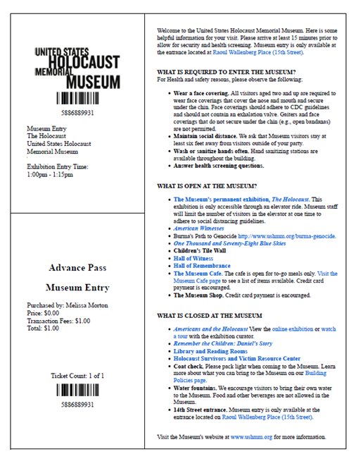
TICKETS
2:00pm
RECOMMEND
1.5 - 2 hours

Slide 8
Questions (among many others):
How predictable was this tragedy?
Were the signs clear enough?
Would we see the signs if they emerged today?
Do you see similar situations emerging?
What should the U.S. do? How should the U.S. prioritize?

Slide 9
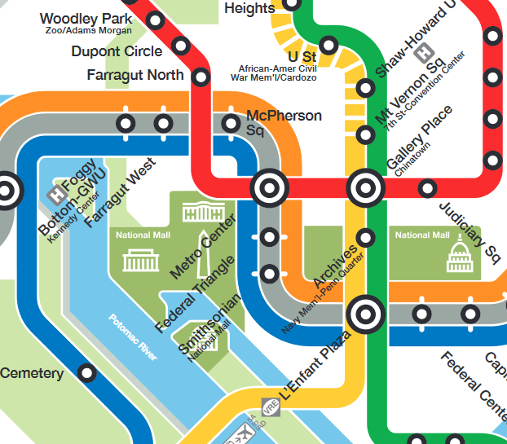

Slide 10
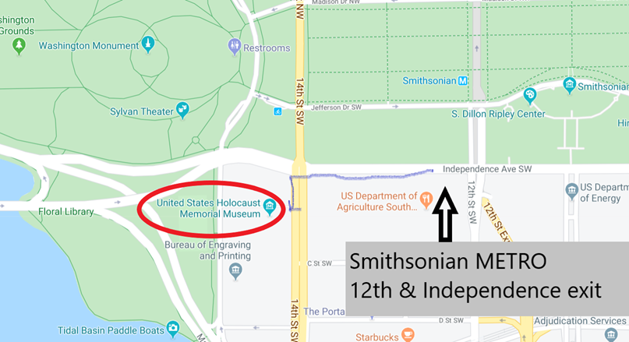
HOLOCAUST MUSEM

Slide 11
DISCUSSION
Project planning
Topics for individual (401) and partnered (402) projects?
Clear on criteria?
Clear on products and feasibility?

Slide 12
DISCUSSION
Interest
Expertise
Relevance
Project planning
Relevance
Information
Time
How to choose them?
How to frame them?
How to build them?
How to make them actionable?
Assess info and gaps
Develop hypothesis
Develop arguments
Develop options
Stay loyal to analysis
Write clearly, efficiently

Slide 13
Project Planning
Akosua | U.S.-Russian: How constrain Putin? | Ensuring microchip competition and supply
Nicolas | U.S.-North Korea: How constrain Kim?
Marcus | Tech/innovation ties with Vietnam | Education deficits in St. Paul, Minnesota
Mimi | Soft power through music (T)
Vaughn | Central America migration | Israel-Palestine: Two-state solution possible?
Matt | Crisis in Haiti
Gavin | Impact of COVID on mental health | U.S. policy toward Yemen and the Houthis
Noah | Reducing reliance on China trade
Meghan | Russia/Wagner influence in Africa | Impact of climate change on insurgency
Bryce | Improving gun control background checks
Emily | Russia-Ukraine (prospects? What next?) | How to deal with climate migrants/refugees
Tashakee | Executive promotion of abortion legislation
Reese | Central America climate migration | “War time policy”
Emma | U.S.-Mexico deaths
Ding | U.S: How to react to BREXIT (T) | Border-state challenges on immigration (T)
Abby | Human trafficking | U.S. support to Ukraine defense against Russia
Jessica | Stopping the flow of fentanyl into U.S.

Slide 14
SEMINAR PROJECT
“Issue focus worksheet”

Slide 15
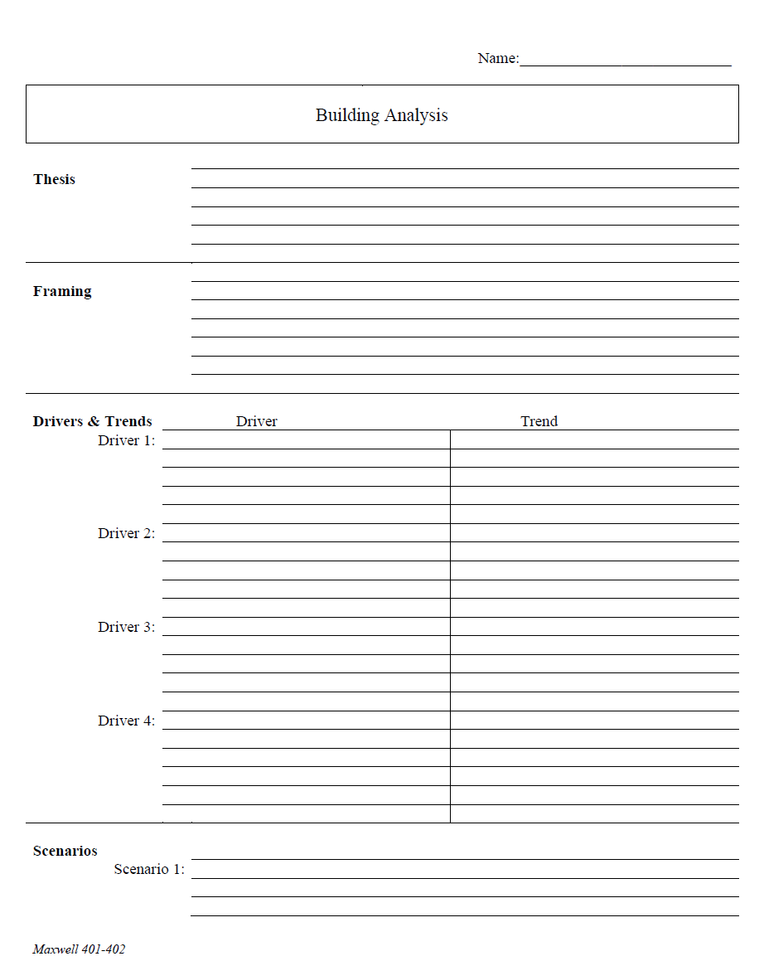
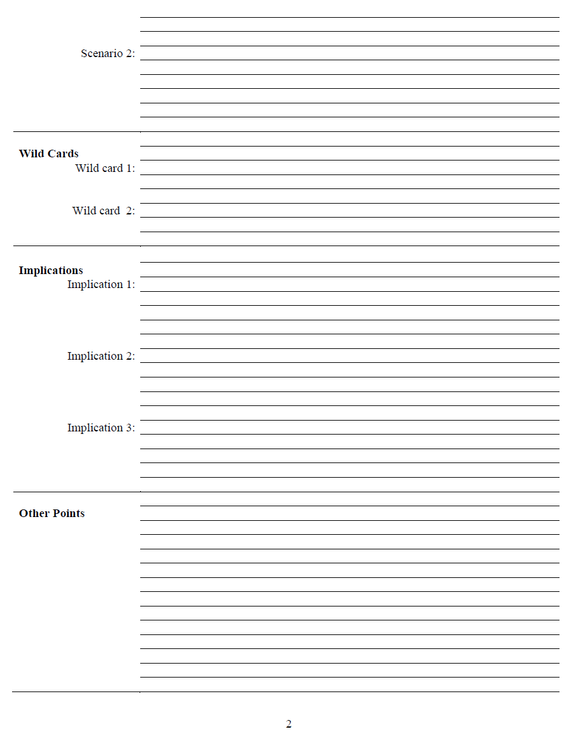
What is an analytical worksheet?
Purpose
Forms
ONE KIND

Slide 16
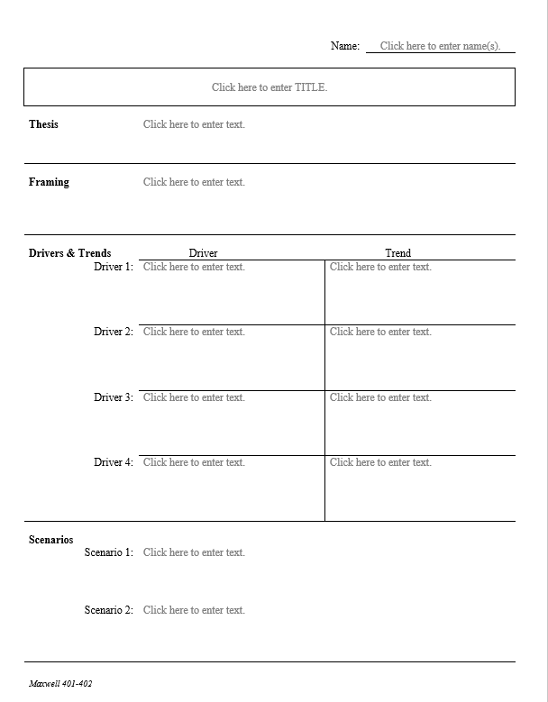
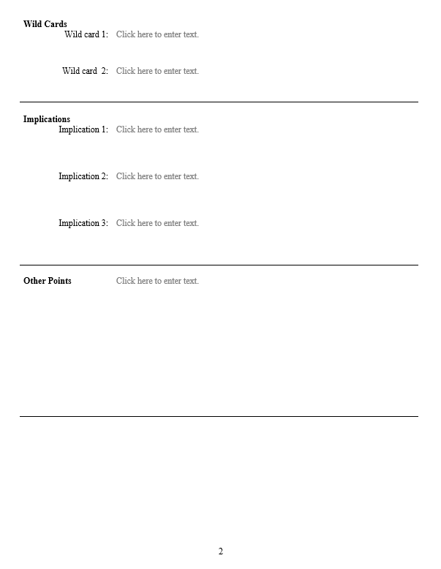
Analytical Worksheet

Slide 17
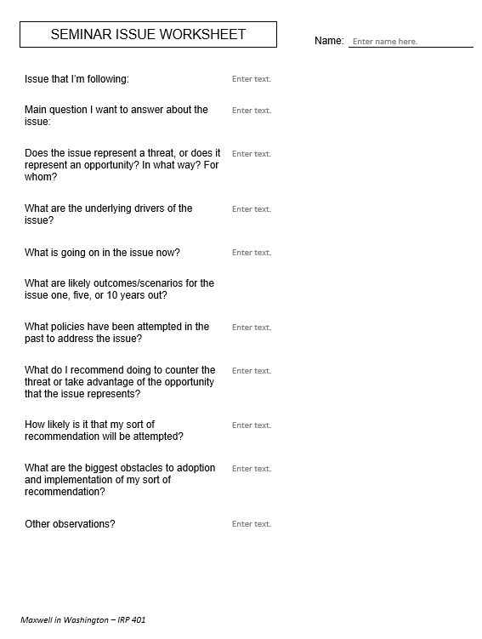
Issue that I’m following:
Main question I want to answer about the issue:
Does the issue represent a threat, or does it represent an opportunity? In what way? For whom?
What are the underlying drivers of the issue?
What is going on in the issue now?
What are likely outcomes/scenarios for the issue one, five, or 10 years out?
What policies have been attempted in the past to address the issue?
What do I recommend doing to counter the threat or take advantage of the opportunity that the issue represents?
How likely is it that my sort of recommendation will be attempted?
What are the biggest obstacles to adoption and implementation of my sort of recommendation?
Other observations?
for 401
drivers!!

Slide 18
The Heartbeat of Analysis (and Policy)
“DRIVERS”
The forces, needs, desires, and other factors that make things happen and influence outcomes.

Slide 19
What are drivers?
Interests
Borrowing from the “3-i framework” …
Ideas
Institutions
In our PERSONAL lives …
Interests | Ideas | Institutions
Work Food Love - Sex Family Home Transportation Entertainment Recreation Challenges | Education Religion or values Political thought Ideology Imposed expectations | Parents Boy/Girlfriend Husband/Wife Colleagues Friends Political party Employer
drivers

Slide 20
What are drivers?
Interests
Borrowing from the “3-i framework” …
Ideas
Institutions
In our PERSONAL lives …
Interests | Ideas | Institutions
Work Food Love - Sex Family Home Transportation Entertainment Recreation Challenges | Education Religion or values Political thought Ideology Imposed expectations | Parents Boy/Girlfriend Husband/Wife Colleagues Friends Political party Employer
drivers

Slide 21
What are drivers?
Interests
Borrowing from the “3-i framework” …
Ideas
Institutions
In our NATIONAL lives …
Interests | Ideas | Institutions
Power/influence Needs Desires/ambitions Wealth Economic performance | Self-definition Nationalism History Concepts/logic Values Ideology | Leadership Abilities/constraints Economic structures Intermediation Inclusion Topography/geography Climate
drivers

Slide 22
What are drivers?
Interests
Borrowing from the “3-i framework” …
Ideas
Institutions
In our NATIONAL lives …
Interests | Ideas | Institutions
Power/influence Needs Desires/ambitions Wealth Economic performance | Self-definition Nationalism History Concepts/logic Values Ideology | Leadership Abilities/constraints Economic structures Intermediation Inclusion Topography/geography Climate
drivers

Slide 23
What are drivers?
“FUEL”
“FRICTION”
Effort/energy
Resources
Technology, etc.
to PUSH a solution.
Obstacles
Resistence
Limitations, etc.
that OBSTRUCT a solution.
“Forward” drivers
“Status Quo” or “Backward” drivers
Organizational psychologist Loran Nordgren: Focus on the “invisible” obstacles
Examples

Slide 24
DISCUSSION: Examples of Drivers
What are the drivers of …
political division within the United States?
expansion of AI?
the COVID pandemic?
rising cost of higher education?
the recent surge in inflation?

Slide 25
Project Planning
WHAT ARE YOUR DRIVERS?
Akosua | U.S.-Russian: How constrain Putin? | Ensuring microchip competition and supply
Nicolas | U.S.-North Korea: How constrain Kim?
Marcus | Tech/innovation ties with Vietnam | Education deficits in St. Paul, Minnesota
Mimi | Soft power through music (T)
Vaughn | Central America migration | Israel-Palestine: Two-state solution possible?
Matt | Crisis in Haiti
Gavin | Impact of COVID on mental health | U.S. policy toward Yemen and the Houthis
Noah | Reducing reliance on China trade
Meghan | Russia/Wagner influence in Africa | Impact of climate change on insurgency
Bryce | Improving gun control background checks
Emily | Russia-Ukraine (prospects? What next?) | How to deal with climate migrants/refugees
Tashakee | Executive promotion of abortion legislation
Reese | Central America climate migration | “War time policy”
Emma | U.S.-Mexico deaths
Ding | U.S: How to react to BREXIT (T) | Border-state challenges on immigration (T)
Abby | Human trafficking | U.S. support to Ukraine defense against Russia
Jessica | Stopping the flow of fentanyl into U.S.

Slide 26
Do you know what you’re doing in your projects (401 and 402) now?

Slide 27
QUICK BREAK

Slide 28
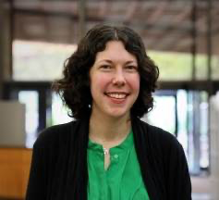
Sarah Morris
Head of instruction and engagement at the Emory University Libraries.
Focused on media literacy education and misinformation for the past decade.
Partnering with The Carter Center to develop media literacy education resources.

Slide 29
QUICK BREAK

Slide 30
GUEST SPEAKER

Slide 31
Enter at 2:00pm

Slide 33
HOLOCAUST MUSEM

Slide 34
WRAPUP

Slide 35
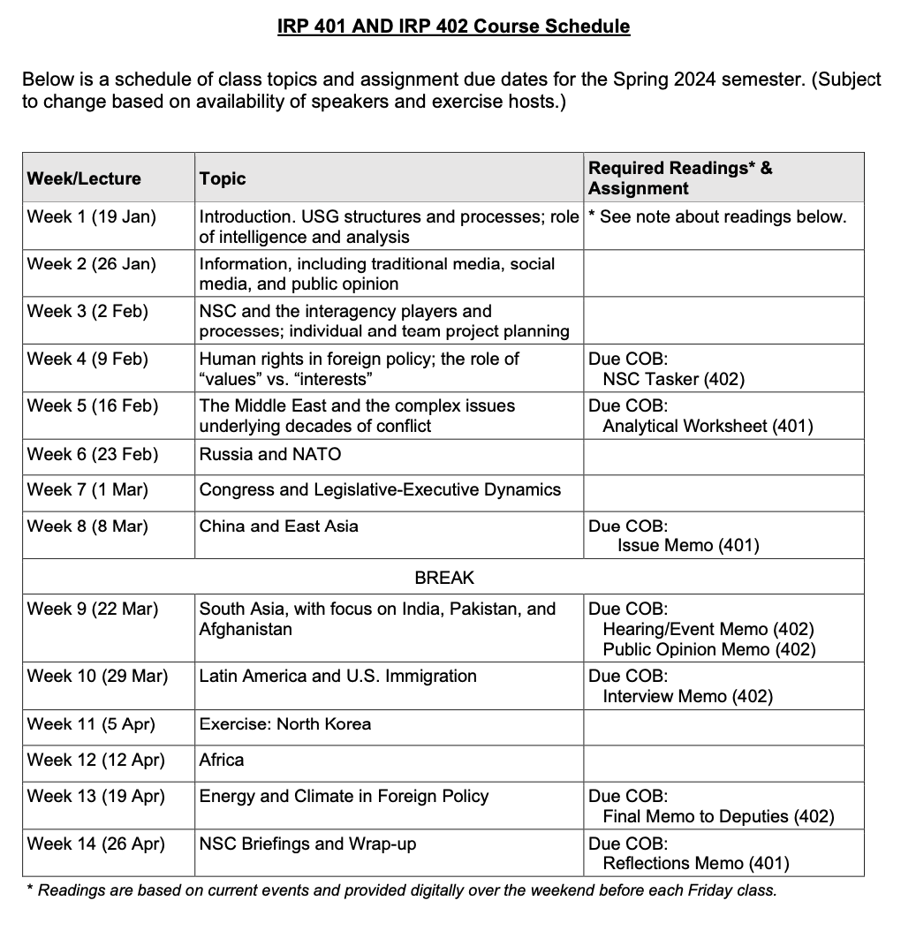
✓
401
402
✓
✓
✓
✓
QUESTIONS?
✓
✓

Slide 36
NEXT WEEK …
Israel
Ukraine
(and more)

Slide 37
Global Policy Seminar and NSC Simulation
IRP 401 - IRP 402
Week Four 9 February 2024
Prof. Fulton T. Armstrong

